Slide 2


delivery food
Encomendas online

Slide 3


Slide 4
delivery food
Encomendas online

Slide 5





Slide 6
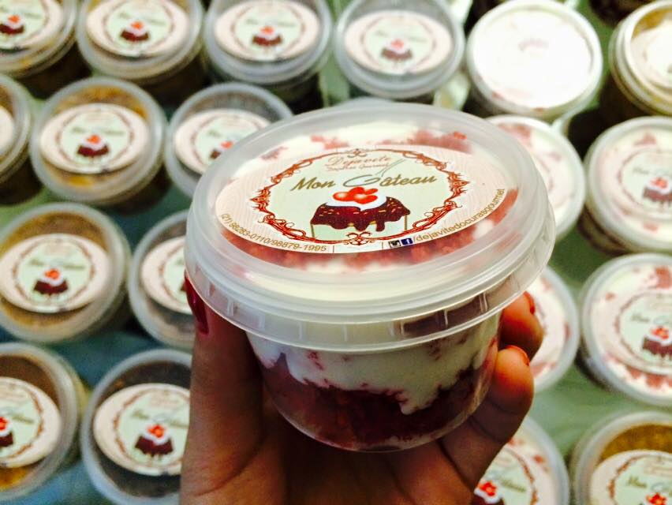
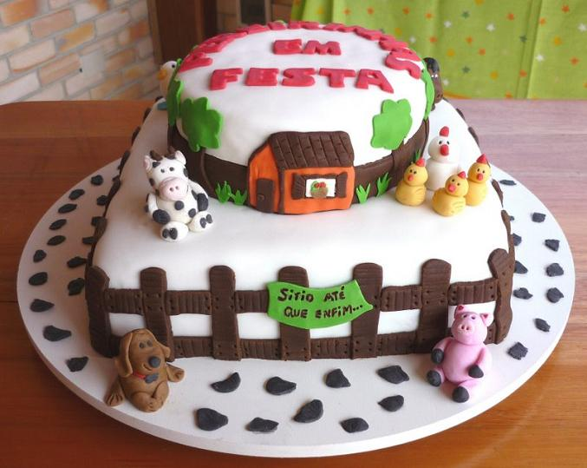



Slide 7


Slide 8


