Slide 1


NoSQL Databases: MongoDB vs Cassandra
Wubin Ouyang(M.eng)
System and computer engineering
Carleton University
a@benouyang.com

Slide 2
NoSQL Databases: MongoDB vs Cassandra
Thanks to Veronika Abramova and Jorge Bernardino.
NoSQL
ACID and BASE
MongoDB and Cassandra
Comparison by a benchmark

Slide 3
Outline of this presentation
SQL vs NoSQL
Schema, CAP theorem, ACID vs BASE
MongoDB and its demo
Data model, Operations, Map-reduce
Cassandra
Features, Data model
Brief of comparison in referenced paper
    Aspects, Conclusion

Slide 4
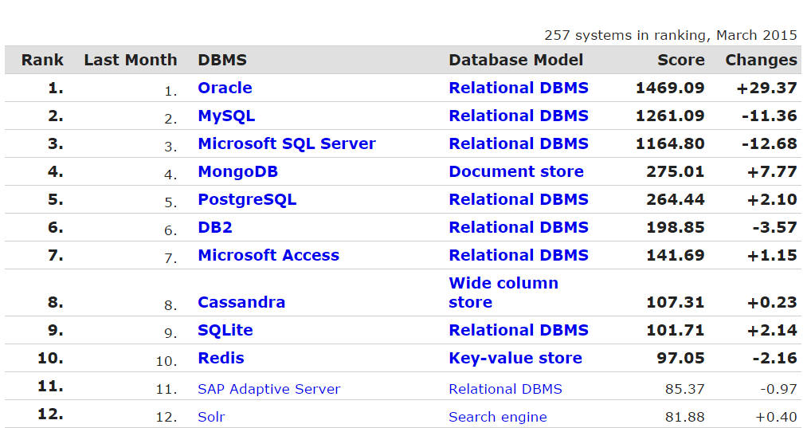
Database Market Share

Slide 5
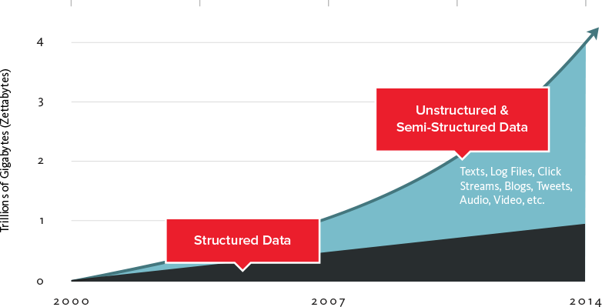
Big data and NoSQL
Big data
Increasing use and data quantity
Google, Facebook, other companies.
  No schema and distributed

Slide 6
Schema-less Model
Suppose that you have a large amount of unstructured data.
Suppose that you have every detail of every person, and you need to store these details.
Person
Student
Teacher
Writer

Slide 7
Join or denormalizaions in Relational DBMS
Split the table and make Join
You have to add a relation if a new model emerges.(e.g. A doctor moves to this town)
Join is expensive in some cases
De-normalization
1. Redundancy and some columns are meaningless for some tuple
2. You should change the data model of this relation when you need add a new column

Slide 8
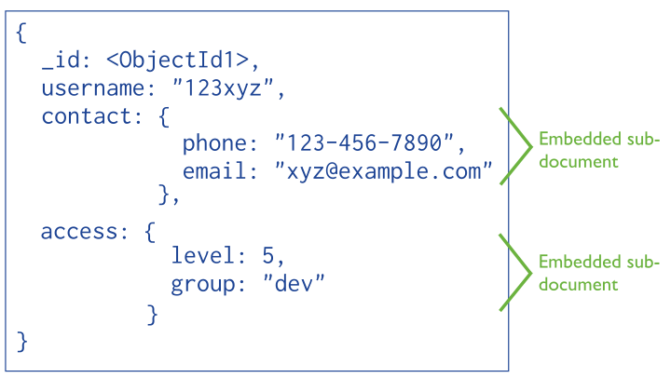
Data in NoSQL(MongoDB)

Slide 9
Data in NoSQL(Con’t)
{'weather': [{'description': 'scattered clouds', 'main': 'Clouds', 'icon': '03d', 'id': 802}], 'name': 'Kununurra', 'cod': 200, 'sys': {'message': 0.0068, 'sunset': 1426498752, 'sunrise': 1426454897, 'country': 'AU'}, 'coord': {'lon': 128.73, 'lat': -15.77}, 'base': 'cmc stations', '_id': ObjectId('5506958bd94299b580f2d476'), 'wind': {'speed': 1.86, 'deg': 359.003}, 'main': {'temp_max': 311.274, 'sea_level': 1019.09, 'temp_min': 311.274, 'humidity': 21, 'pressure': 1000.65, 'grnd_level': 1000.65, 'temp': 311.274}, 'clouds': {'all': 48}, 'id': 2068110, 'dt': 1426494860}

Slide 10
CAP & BASE
CAP
Consistency: all nodes have same data at the same time;
Availability: all requests have response
Partition tolerance: if part of system fails, all system won’t collapse
2/3
A distributed database should choose PA or CP.
NoSQL database focus on BASE, while Relational DBMS is based on ACID
Basically available
Soft state: no consistency guarantee
Eventually consistent: eventually consistency will be guaranteed

Slide 11
BitCoins Lost, MongoDB and Eventual Consistency
On March 2, 2014 Flexcoin lost all its bitcoins due to a code flaw. The attacker issued thousands of concurrent requests ordering transfers from one of his accounts to another
MongoDB does not support transaction, while relational database supports it based on ACID.(Concurrency)
mybalance = database.read("account-number")
newbalance = mybalance - amount
database.write("account-number", newbalance)
dispense_cash(amount) // or send bitcoins to customer
Now, consider what would happen if I duplicated my debit card, gave it to my best friend, synchronized our watches, and performed withdrawals at two different ATMs at the same time.
Specifically, if multiple people simultaneously execute the code above, they might just go through those operations in lockstep. They would simultaneously read the amount of money I have in my bank account, say $1000. They would simultaneously subtract the amount to be dispensed, say $100, and end up with $900 in the variable newbalance.
How you withdraw money for card.

Slide 12

How about an online bookstore?
Suppose you run an online book store and you proudly display how many of each book you have in your inventory. Every time someone is in the process of buying a book, you lock part of the database until they finish so that all visitors around the world will see accurate inventory numbers.
Strict ACID is not acceptable in this case. Amazon might violate the “I” in ACID by tolerating a small probability that simultaneous transactions could interfere with each other. BASE is preferable here.

Slide 13
Introduction to MongoDB
Development of MongoDB began in October 2007 by 10gen. The first public release was in February 2009
Distributed and schema-less
Support Map-Reduce
Does not support SQL.
RDBMS | MongoDB
Table | Collection
Column | Key
Value | Value
Records / Rows | Document / Object

Slide 14


My demos
Fetch data from an open API and store it in MongoDB
openweathermap.org
Queries in the shell and Python.
Map-reduce in Python

Slide 15
Why Python?
Python is good at network programming
Its syntax allows programmers to express concepts in fewer lines of code than would be possible in languages such as C++ or Java.
Dictonary(built-in) and its methods !
Similar to json

Slide 16
Fetch, Store, Query
Fetch in Python
Storing the data without mandatory to do unnest operation which is required in Relational Database
Query in shell and python.
{"coord":{"lon":145.77,"lat":-16.92},"sys":{"message":0.0079,"country":"AU","sunrise":1426450798,"sunset":1426494676},"weather":[{"id":801,"main":"Clouds","description":"few clouds","icon":"02n"}],"base":"cmc stations","main":{"temp":300.378,"temp_min":300.378,"temp_max":300.378,"pressure":1006.97,"sea_level":1024.47,"grnd_level":1006.97,"humidity":97},"wind":{"speed":5.8,"deg":147.001},"clouds":{"all":12},"dt":1426545972,"id":2172797,"name":"Cairns","cod":200}

Slide 17
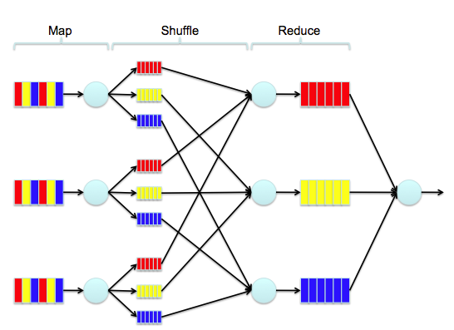
Map-reduce
Similar to “GROUP BY” in relational database

Slide 18
Map-reduce in MongoDB
Map(key, Value)
Key: ‘country’
Value: {count, temp}
Reduce(key, Values)
Key: ‘country’
Values: a tuple of {count, temp}

Slide 19
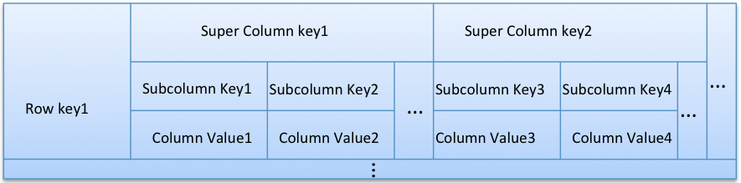
Cassandra
Column-family
  Column
  Super-column
  Column family

Slide 20
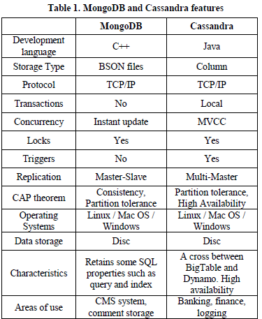
Compared with MongoDB
Transaction
CAP theorem

Slide 21
Benchmark
Workload A: Update heavy workload. This workload has a mix of 50/50 reads and updates.
Workload B: Read mostly workload. This workload has a 95/5 reads/update mix.
Workload C: Read only. This workload is 100% read.
Workload D: Read latest workload. In this workload, new records are inserted, and the most recently inserted records are the most popular.
Workload E: Short ranges. In this workload, short ranges of records are queried, instead of individual records.
Workload F: Read-modify-write. In this workload, the client will read a record, modify it, and write back the changes.
Workload G: Update mostly workload. This workload has a 5/95 reads/updates mix.
Workload H: Update only. This workload is 100% update.

Slide 22
Conclusion
As overall analysis turns out that MongoDB fell short with increase of records used, while Cassandra still has a lot to offer. In conclusion Cassandra show the best results for almost all scenarios.
My conclusion: MongoDB is very powerful in storing and processing unstructured data.

Slide 23
Any Questions?
Thank you!
You can download this slides and python scripts in my Github: oybin1989
  https://github.com/oybin1989/advanced_database

