Slide 1

Wubin Ouyang (M.eng)
Department: System and Computer engineering
NoSQL Databases: MongoDB vs Cassandra
Veronika Aramova & Jorge Bernardino
Notes:
Good Evening, every one. Here is our project, implementation of Qos traffic conditioning.
First, We will review what we talk about in project 1.

Slide 2
Outline of this paper
Main focus is to compare and evaluate two popular NoSQL databases: MongoDB and Cassandra
Introduction of NoSQL.
MongoDB and Cassandra
Comparison between MongoDB and Cassandra
Experiments to evaluate performance

Slide 3
What I will cover today
Introduction to NoSQL databases
NoSQL vs Relational database(ACID vs BASE)
MongoDB and its demonstration
Introduction to Cassandra
Comparisons

Slide 4
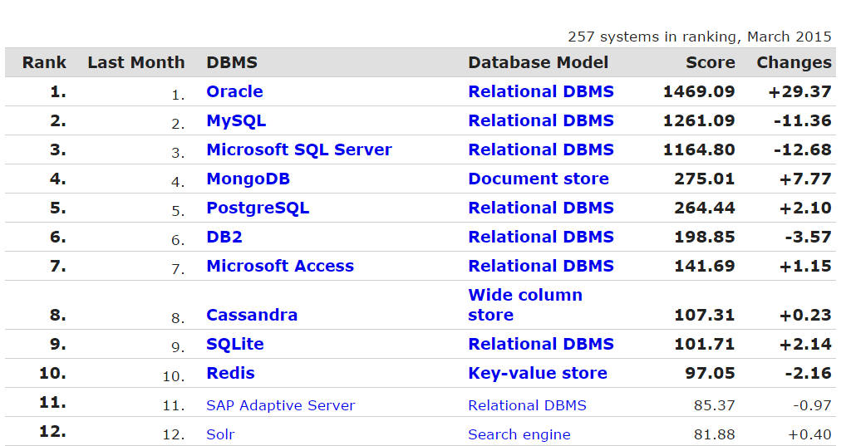
Database Ranking
Relational DBMS prevails over other types of database

Slide 5
NoSQL database emerges
Relational Model was introduced 1970 with Structured Query Language(SQL)
Each table is formed by set of tuples with same attributes.
Tables are connected so data from one table can be related to other by key.

