Slide 1

Customer Retention & Revenue Optimization
RFM Segmentation & Customer Lifecycle Analysis
Karolina Varkulevičiūtė
Notes:
“In this project, I analyzed customer purchasing behavior for Vertex Supply Co., a mid-sized B2B office supply company. The goal was to understand what drives revenue and identify opportunities to improve customer retention using RFM segmentation and cohort analysis.

Slide 2
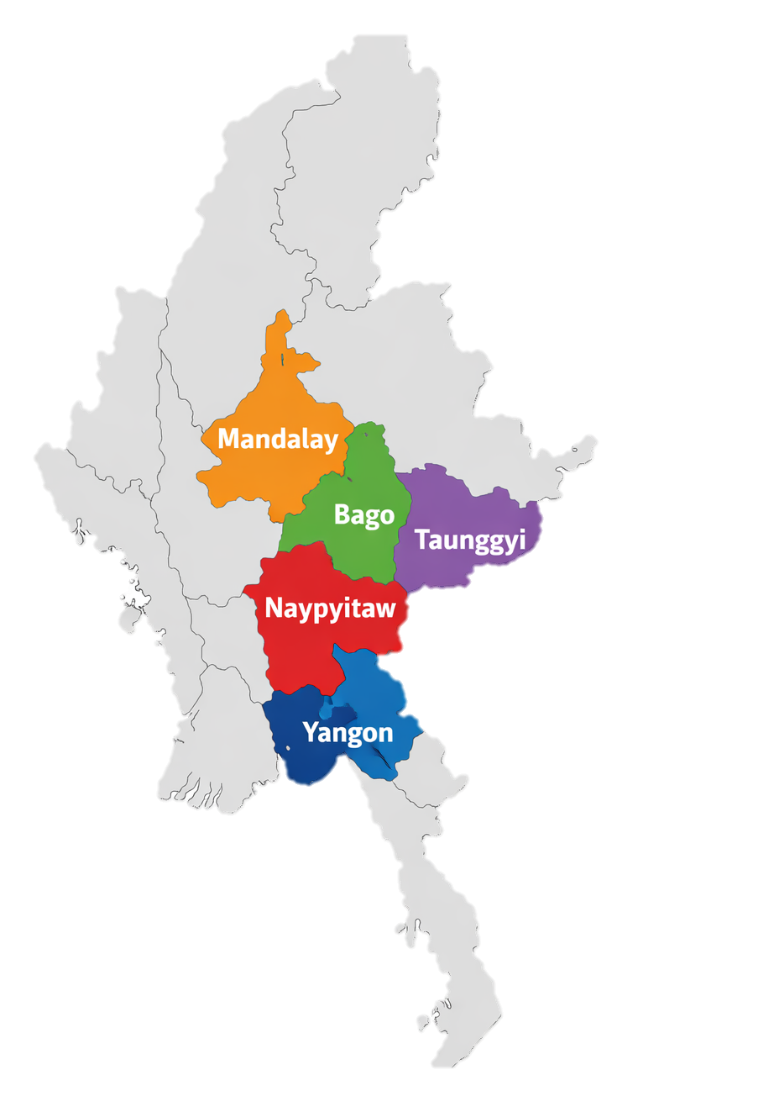
Who is Vertex Supply Co.
Mid-size B2B office supply retailer
Operating across five geographic regions in Myanmar
Serving small to medium enterprise customers

Slide 3
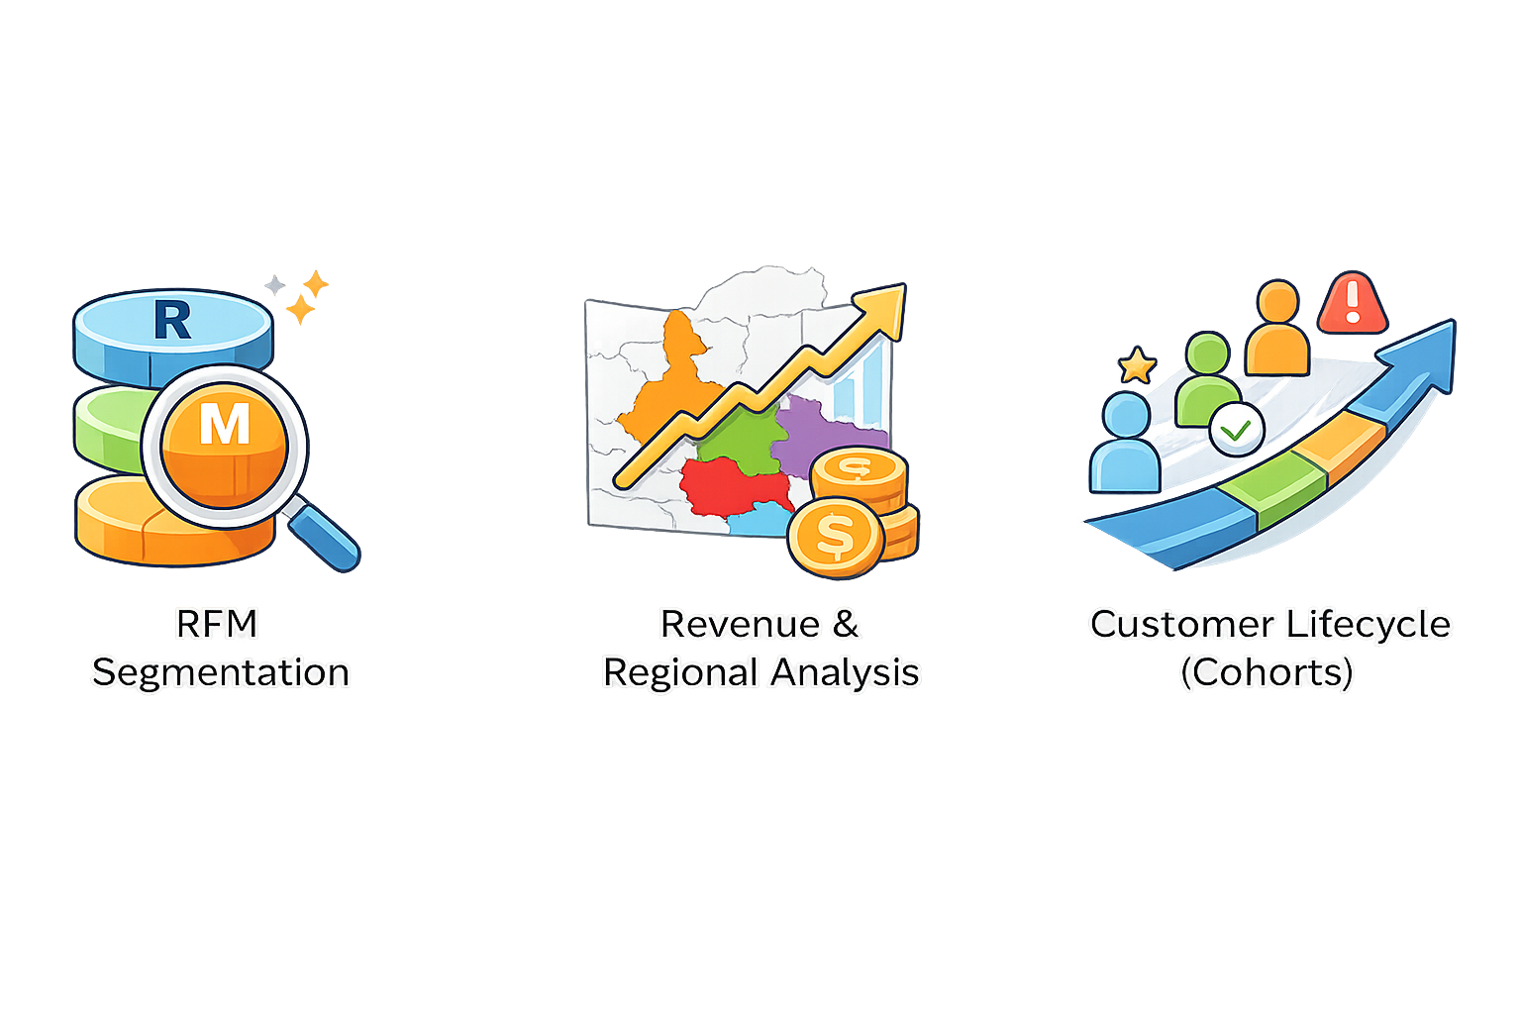
Understanding Customer Value, Behavior, and Lifecycle
We analysed customer behaviour across value, geography, and time to identify drivers of retention and revenue performance.
Notes:
To understand what’s driving performance, I structured the analysis around three dimensions: First, customer value using RFM segmentation. Second, revenue and regional performance to understand where value is generated. And third, customer lifecycle behaviour using cohorts to see how engagement evolves over time. This combination allows us to identify not just who our customers are, but how they change and where we risk losing them.

Slide 4
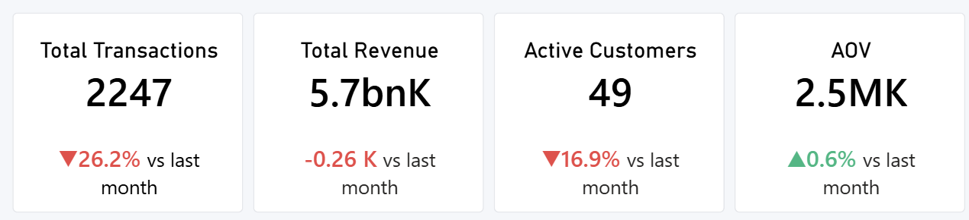
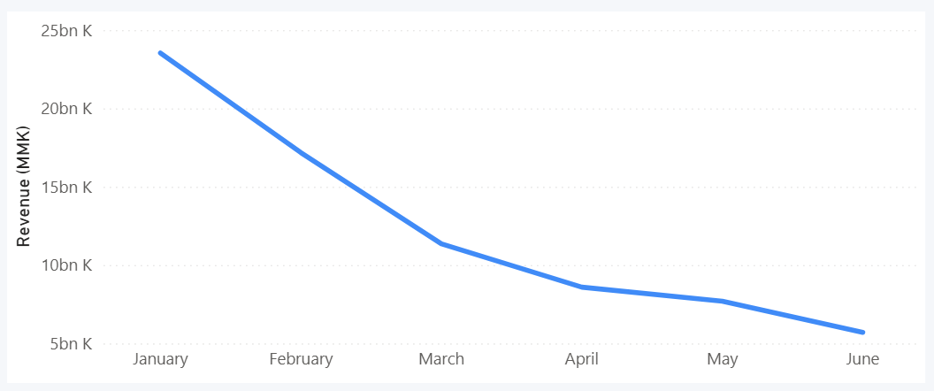
Business Performance is Declining
Latest Month (June ’25)
Revenue decreased by 75% over six months.
Active customers declined from 100 to 49
Monthly transactions dropped from 9.5K to 2.2K
AOV remained stable at ~2.5MK
23.5bn K
5.7 bn K
Notes:
Looking at overall business performance, we see a clear downward trend. Revenue has decreased significantly over the period, alongside a sharp decline in transactions and active customers. Active customers dropped from 100 to 49, while transactions fell from 9.5 thousand to just over 2 thousand. However, average order value has remained stable at around 2.5 million. This indicates that customers who remain are still spending at similar levels. So the decline in revenue is primarily driven by reduced customer activity rather than changes in spending behavior.

Slide 5
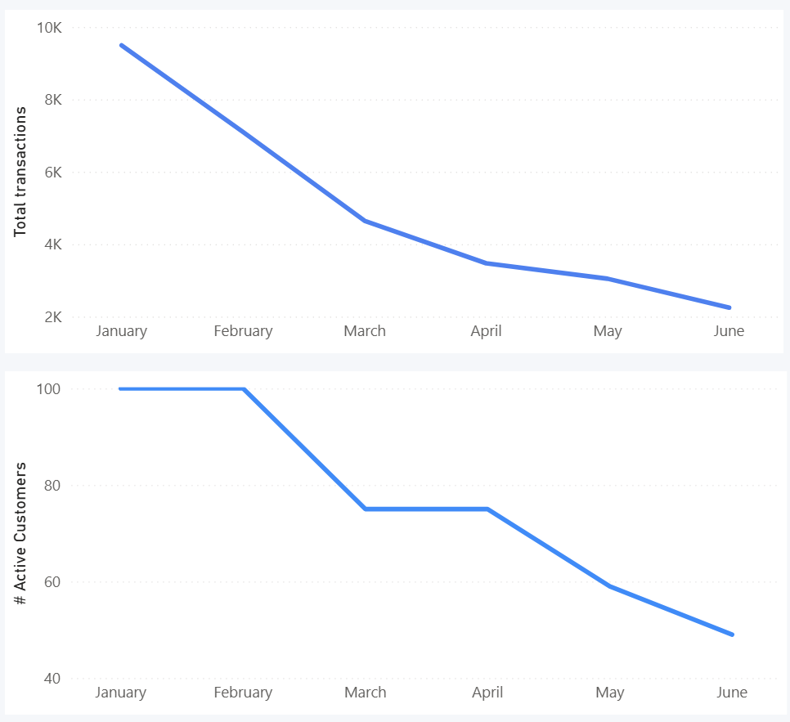
Customer Activity is Steadily Declining
9.5K
Transactions decline from 9.5K to 2.2K (~75%)
Active customers decreased from 100 to 49 (~50%)
Decline is steady with no signs of recovery
Declining customer activity is the primary driver of revenue loss
2.2K
100
49
Notes:
Breaking down customer activity, we see a consistent decline across both transactions and active customers.
Transactions dropped from 9.5 thousand in January to just over 2 thousand in June, representing a 75% decrease.
At the same time, the number of active customers fell from 100 to 49.
Importantly, this decline is steady across the entire period, with no clear signs of recovery.
This indicates that fewer customers are engaging with the business over time, which directly explains the drop in revenue.

Slide 6
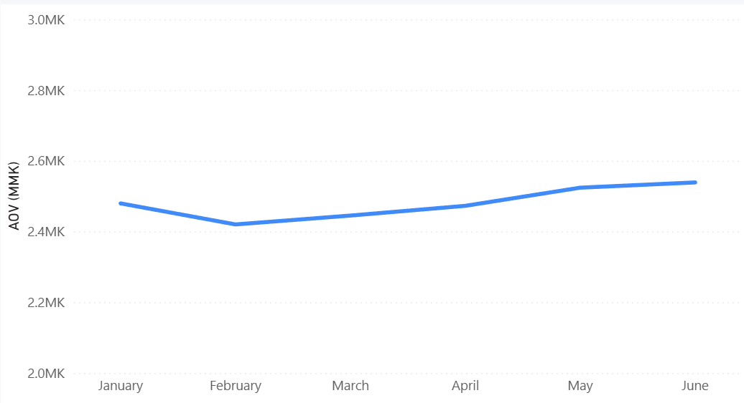
Spending per Customer Remains Stable
AOV remained stable 2.42M-2.54M MMK
No significant change is spending per transaction
Revenue decline is not driven by order size
2.54 MK
2.48 MK
2.42 MK
Notes:
Looking at spending per customer, we see a very different pattern.
Average order value has remained stable throughout the period, fluctuating between roughly 2.42 and 2.54 million.
This indicates that customers who remain active continue to spend at similar levels.
So, the decline in revenue is not driven by customers spending less, but rather by fewer customers making purchases.
This confirms that the core issue is declining customer activity and engagement.
So if the issue is declining customer activity, the next question is — which customers are we losing?

Slide 7
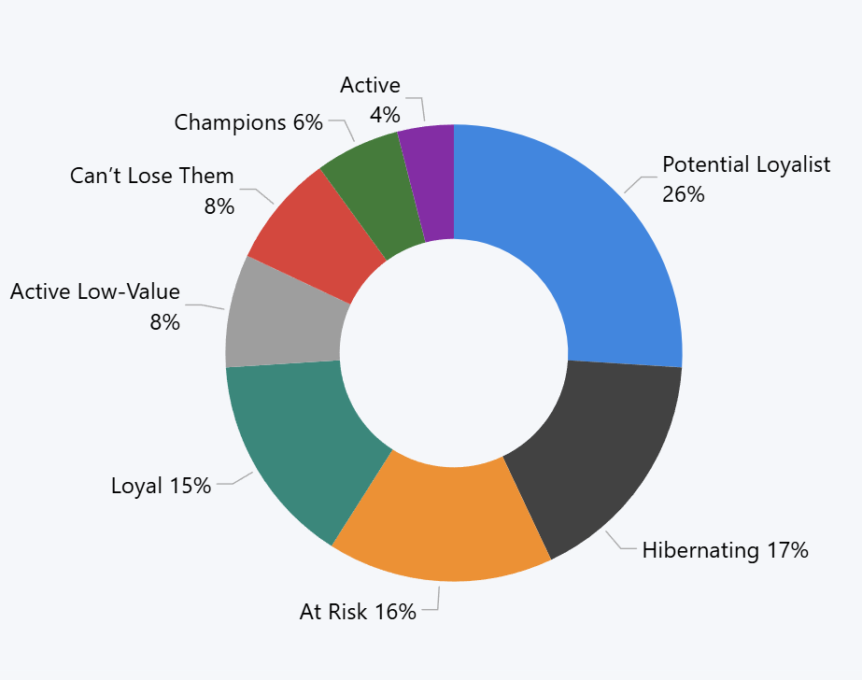
Customer Base Shows High Churn Risk
41% of customers at high risk of churn (Hibernating, At Risk, Can’t Lose Them)
Potential loyalists (26%) represent largest growth opportunity
Only ~25% of customers are high value and actively contributing (Loyal, Champions, Active)
Notes:
Looking at customer segmentation, we see a concerning distribution:
Around 41% of customers fall into high-risk segments, including Hibernating, At Risk, and Can’t Lose Them.
These are customers who were previously engaged but are now showing declining activity.
At the same time, Potential Loyalists represent the largest segment at 26%, indicating a strong opportunity to grow future high-value customers.
However, only about a quarter of the customer base is currently high-value and actively contributing to revenue.
This imbalance suggests that without intervention, the business risks losing a significant portion of its customer base.
So we understand which customers are at risk — but how does this evolve over time?

Slide 8
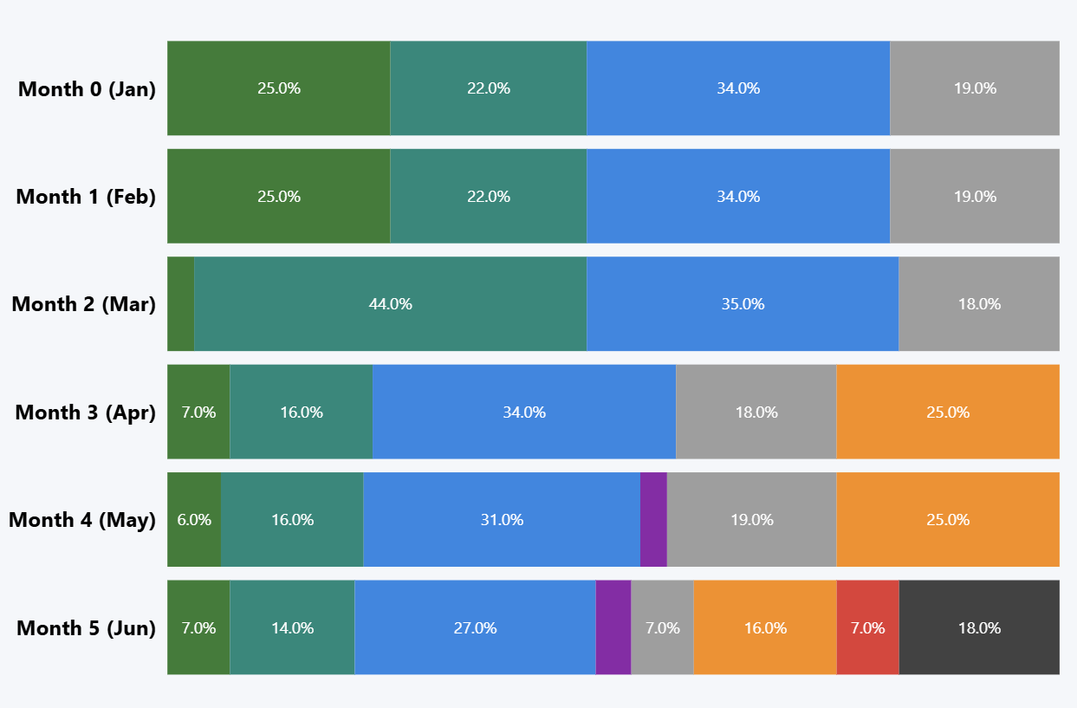
Customers Transition from High-Value to At Risk
High value customers steadily decline as they move into lower engagement segments
By Month 5 a significant portion of customers have moved into “At Risk” or “Hibernating”
This suggests churn occurs gradually through reduced activity not immediate abandonment
Notes:
This view allows us to understand how customer behaviour evolves over time.
We can see that high-value segments such as Champions and Loyal customers steadily decline.
At the same time, customers transition into At Risk and eventually Hibernating segments.
This indicates that churn is not an immediate event, but rather a gradual process driven by declining engagement.
This is important because it suggests there is a window of opportunity to intervene before customers are fully lost.

Slide 9
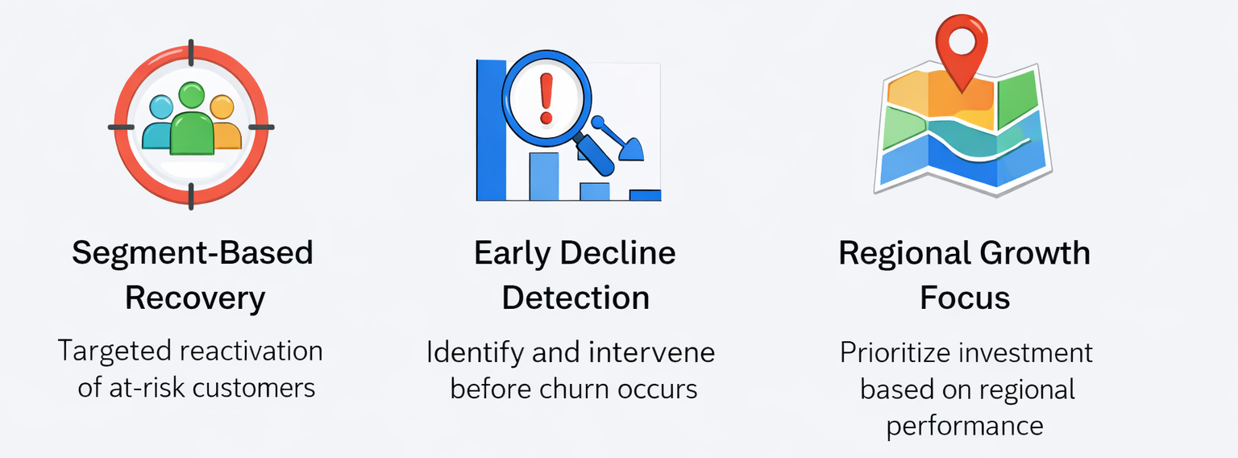
Customer Recovery & Retention Strategy
Three Focus Areas to Address Declining Customer Activity
Notes:
First, segment-based recovery focuses on reactivating customers who are already showing signs of disengagement. Segments like At Risk, Hibernating, and Can’t Lose Them represent previously active and often high-value customers. By targeting these groups with personalized offers and tailored communication, we can recover lost revenue more efficiently than acquiring new customers.
Second, early decline detection builds on the insight that churn is a gradual process. Customers don’t churn suddenly — they move through stages of declining engagement. By monitoring changes in recency and frequency, we can identify early warning signs and intervene before customers become inactive. This allows for proactive retention rather than reactive recovery.
Finally, regional growth focus ensures that resources are allocated where they can have the greatest impact. Since performance varies across regions, investment and marketing efforts should be prioritized based on regional customer behaviour, churn risk, and growth potential. This enables more efficient use of budget and supports scalable growth.

Slide 10

Segment Based Recovery & Reactivation
At Risk (16%)
Declining Engagement, high recovery Potential
Actions:
Personalised win-back campaigns
Time sensitive offers
Impact:
15% At Risk segment reactivation would lead to up to 137M MMK monthly revenue recovery
Can’t Lose Them (8%)
Previously high-value customers
Actions:
High touch outreach (personalised emails, account management)
Exclusive offers
Priority reactivation marketing campaign
Impact:
10% recovery would lead to up to 85M MMK monthly revenue recovery (~2% total June revenue)
Hibernating (17%)
Low engagement, low recovery potential
Actions:
Low-cost reactivation (email, ad, reminder)
Broad campaigns (e.g. seasonal)
Impact:
5% reactivation would lead to up to 46M MMK monthly revenue recovery
Total Potential Revenue Recovery - ~270M MMK (4.5-5% June revenue)
Notes:
This strategy focuses on recovering customers at different stages of disengagement, with tailored actions for each segment.
At Risk customers have the highest probability of recovery through targeted campaigns, while Can’t Lose Them represent high-value customers where even small recovery rates can generate significant revenue impact.
Hibernating customers are less likely to return, so lower-cost strategies are applied.
Overall, even modest recovery rates across these segments could result in approximately 4–5% revenue uplift, representing a meaningful short-term improvement.

Slide 11

Early Detection of Customer Churn
Identify Early Warning Signs
Increase in Recency
Drop in purchase Frequency
Declining Engagement
Trigger Automated Interventions
Email reminders after inactivity threshold
Personalised offers based on past purchase behaviour
Continuous Monitoring
Track segment migration
Identify drop offs early
Measure intervention success
Notes:
This approach focuses on identifying and addressing customer disengagement before churn occurs.
Early warning signals such as increasing recency, declining purchase frequency, and reduced engagement indicate when customers begin to drop off.
By triggering automated interventions — such as reminders after inactivity or personalized offers — the business can re-engage customers at the right moment.
Continuous monitoring of segment migration allows tracking of these changes over time and evaluation of intervention effectiveness.
Overall, this enables a shift from reactive churn management to proactive retention.

Slide 12
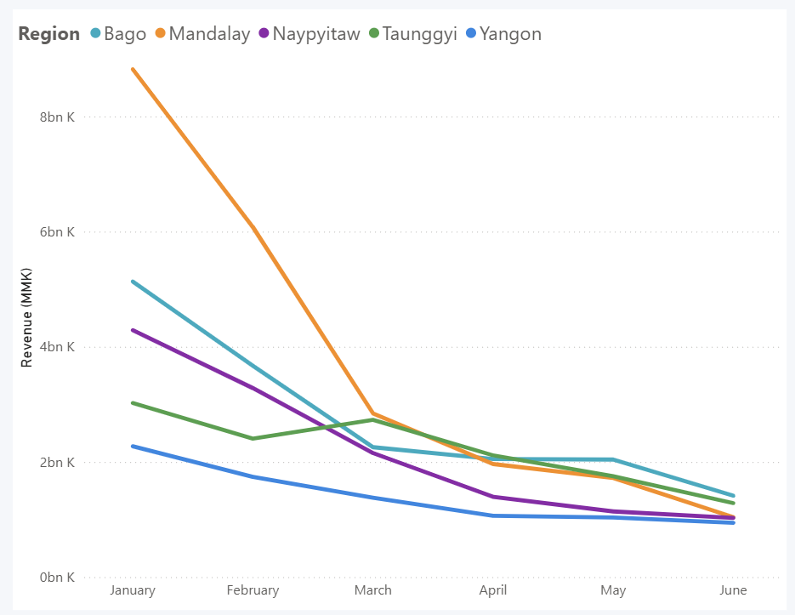
Regional Growth Focus
Mandalay – core growth driver
Double down on acquisition and retention strategies
use as benchmark for other regions
Bago & Taunggyi – stable contributors
Improve conversion and purchase frequency
Naypyitaw – moderate potential
Improve conversion and purchase frequency
Yangon – underperforming market
Investigate customer behaviour & pricing
Target high value segments
Notes:
This strategy focuses on optimizing growth by leveraging differences in regional performance.
Mandalay acts as the primary growth driver, where successful acquisition and retention strategies can be scaled and used as a benchmark for other regions.
Bago, Taunggyi, and Naypyitaw show stable but moderate performance, presenting opportunities to improve conversion and increase purchase frequency.
Yangon underperforms despite having a customer base, indicating lower customer value and the need for targeted improvements in engagement and segmentation.
Overall, regional performance differences are driven more by customer activity than spending, making customer growth and activation the key lever for revenue improvement.

Slide 13
Final Takeaways
📉
Revenue decline is driven my falling customer activity, not spending
High-value customers (Champions & Loyal) are critical to protect
Large churn risk (~33%) is a major recovery opportunity
Potential Loyalists are the key growth segment
Focus on retention, re-engagement and regional optimisation
🏆
⚠️
🌱
🚀

