Slide 1

Terraform on AWS

Slide 2
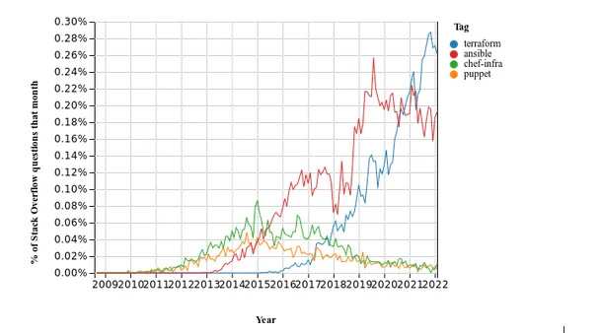
Why use Terraform for IAC tool
Terraform is OpenSource, platform-agnostic and backed by HashiCorp a San Francisco-based company that is the leader in infrastructure automation for multi-cloud environments.
Works with multiple cloud providers such as AWS, Azure, GCP, DigitanalOcean and more
DevOps teams can use one unified, consistent solution to manage each of their cloud infrastructures.
Terraform is written in Go which is known as one of the most efficient programming languages.
State management is a key component of any long-term project, and Terraform keeps track of all changes in the environment.
Terraform is Agentless
Terraform has a large community with enterprise support options

Slide 3
Terraform Workflow
init
validate
plan
apply
destroy
1
2
3
4
5
Used to Initialize a working directory containing terraform config files
This is the first command that should be run after writing a new Terraform configuration
Downloads Providers
Validates the terraform configurations files in that respective directory to ensure they are syntactically valid and internally consistent.
Creates an execution plan
Terraform performs a refresh and determines what actions are necessary to achieve the desired state specified in configuration files
Used to apply the changes required to reach the desired state of the configuration.
By default, apply scans the current directory for the configuration and applies the changes appropriately.
Used to destroy the Terraform-managed infrastructure
This will ask for confirmation before destroying.

Slide 4
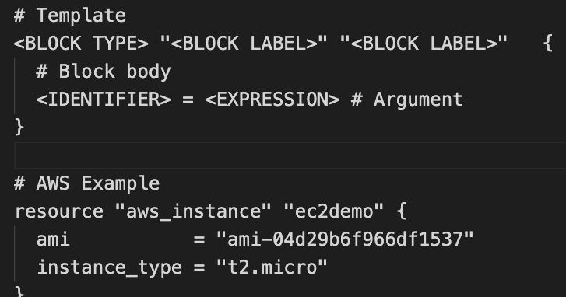
Terraform Language Basics – Configuration Syntax
Block Labels
Block Type
Based on Block Type block labels will be 1 or 2
Example: Resource – 2 labels
Variables – 1 label
Top Level & Block inside Blocks
Top Level Blocks: resource, provider
Arguments
Block Inside Block: provisioners, resource specific blocks like tags

Slide 5
Terraform Language Basics – Configuration Syntax
Argument Name
[or]
Identifier
Argument Value
[or]
Expression

Slide 6
Terraform Basic Blocks
Terraform
Block
Provider
Block
Resource
Block
Special block used to configure some behaviors
HEART of Terraform
Each Resource Block describes one or more Infrastructure Objects
Required Terraform Version
Terraform relies on providers to interact with Remote Systems
Resource Syntax:
How to declare Resources?
List Required Providers
Declare providers for Terraform to install providers & use them
Resource Behavior: How Terraform handles resource declarations?
Terraform Backend
Provider configurations belong to Root Module
Provisioners: We can configure Resource post-creation actions
versions.tf
resource-name.tf

Slide 7
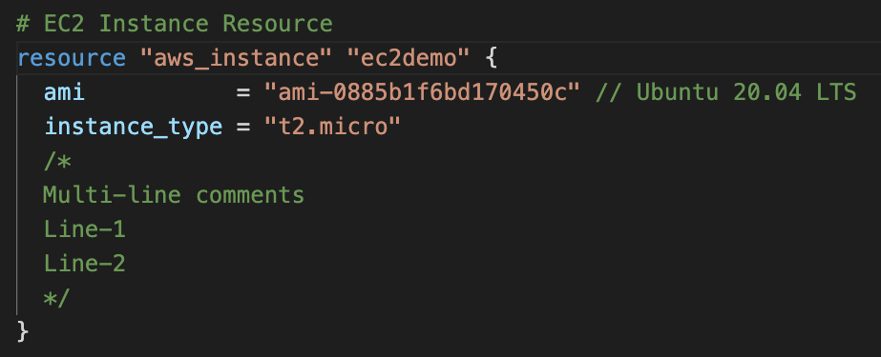
Terraform Language Basics – Configuration Syntax
Single Line Comments with # or //
Multi-line comment

Slide 8








AWS VPC 3-Tier Architecture
AWS Cloud
Availability Zone 1
Availability Zone 2
VPC
VPC – Virtual Private Cloud, enables to isolate area within AWS Cloud, lets you can create various resources securely on AWS
AZ – Availability zone, distinct locations within and AWS Region, engineered to be isolated from failures in other Availability Zones
Internet Gateway – enables internet for your VPC
NAT Gateway does something similar to Internet Gateway (IGW), but it only works one way: Instances in a private subnet can connect to services outside your VPC but external services cannot initiate a connection with those instances.
The instances in the public subnet can send outbound traffic directly to the internet, whereas the instances in the private subnet can't. Instead, the instances in the private subnet can access the internet by using a network address translation (NAT) gateway that resides in the public subnet. The database servers can connect to the internet for software updates using the NAT gateway, but the internet cannot establish connections to the database servers.
Elastic IP – preserved, static IP address, you can choose when you want to release it
Internet gateway
Public subnet
Public subnet
Outbound Communication
NAT gateway
Elastic IP
address
Elastic IP
address
NAT gateway
Private subnet
Private subnet
For
EC2 Instances
For
EC2 Instances
Private subnet
Private subnet
For
Databases
For
Databases

Slide 9
Build Terraform Modules Locally
Build from Scratch
Leverage existing Terraform Modules and change the code as per your need
If already not available, then use this approach
If already available, use the code and modify as per your need
Review existing modules in Terraform Public Registry (Minimum 3 modules to get complete idea)
Less effort and you can start using them in your private infrastructure spaces without public internet access

Slide 10


AWS VPC + EC2 Instance + Security Groups
Admin
AWS Cloud
SSH Port 22
Availability Zone 1
Availability Zone 2
Terraform & AWS Concepts
VPC
Terraform Module: VPC
Internet gateway
Security group port 22
Public subnet
Destination: 0.0.0.0/0
Public subnet
Terraform Module: Security Group
Outbound Communication
NAT gateway
Elastic IP
address
Bastion EC2 Instance
Terraform Module: AWS EC2 Instance
Meta-Argument: depends_on
Security group port 22 & 80
Private subnet
Private subnet
Destination: 10.0.0.0/16
Terraform null_resource
Private EC2 Instance
Private EC2 Instance
Terraform File Provisioner
Terraform Remote-exec Provisioner
Private subnet
Private subnet
For
Databases
For
Databases
Terraform Local-exec Provisioner

Slide 11
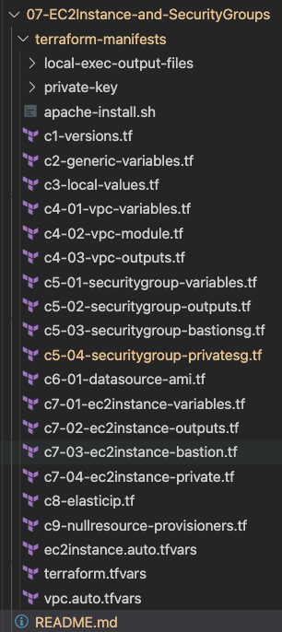
What are we going to learn ?
Create AWS VPC using Terraform Modules
Create AWS Security Groups using Terraform Modules
Create AWS AMI Datasource to get latest AMI ID dynamically
Create AWS EC2 Instance using Terraform Modules
File Provisioner
Null Resource
Remote-exec Provisioner
Variables
Local-exec
Provisioner

Slide 12

AWS VPC + EC2 Instance + Security Groups + AWS ELB Classic Load Balancer
http://hr-stag-myelb-557211422.us-east-1.elb.amazonaws.com
AWS Cloud
http://hr-stag-myelb-557211422.us-east-1.elb.amazonaws.com:81
Availability Zone 1
Availability Zone 2
VPC
Terraform & AWS Concepts
Public subnet
Classic Load Balancer
Public subnet
Terraform Module: ELB Classic LB
Terraform Module: Security Group
NAT gateway
Bastion EC2 Instance
Add Custom SG Rule for Inbound Port 81
Private subnet
Private subnet
Private EC2 Instance
Private EC2 Instance
Private subnet
Private subnet
For
Databases
For
Databases
Internet gateway

Slide 13

AWS VPC + EC2 Instance + Security Groups + AWS ALB Application Load Balancer
http://hr-stag-alb-1575108738.us-east-1.elb.amazonaws.com
AWS Cloud
Availability Zone 1
Availability Zone 2
VPC
Terraform & AWS Concepts
Public subnet
Public subnet
Terraform Module: AWS ALB
NAT gateway
Application Load Balancer
Bastion EC2 Instance
Private subnet
Private subnet
A1
A1
Private EC2 Instance
Private EC2 Instance
Private subnet
Private subnet
For
Databases
For
Databases
Internet gateway

Slide 14





AWS ALB Context Path Based Routing
http://apps.devopsincloud.com/app1
http://apps.devopsincloud.com
http://apps.devopsincloud.com/app2
AWS Cloud
Availability Zone 1
Availability Zone 2
VPC
Public subnet
Public subnet
Application Load Balancer
HTTPS
Internet gateway
NAT gateway
/app1*
/*
/app2*
Bastion EC2 Instance
Private subnet
Fixed Response
Private subnet
A1
A1
AWS Certificate Manager (ACM)
A2
A2
Amazon Route 53
Private EC2 Instance
Private EC2 Instance
Private subnet
Private subnet
For
Databases
For
Databases

