Slide 1

Practical Exam Presentation
Product Sales
Notes:
Product Sale Presentation

Slide 2
Business Goals
All office product sales need to adapt to changing consumer buying habits. To follow trend, the sales team plans to test different strategies to promote a new line of office stationery, focusing on creative brainstorming tools. Since the new product line was launched six weeks ago, the marketing team wants to know differences in sales effectiveness between different approaches
The sales team is testing three different strategies to sell the new product line effectively: - Targeted email campaign with two touchpoints - Direct phone calls from sales team members - Combined approach of initial email followed by a phone call
Notes:
In response to changing consumer buying habits, the sales team is testing three different strategies to promote a new line of office products, focusing on:
Email campaign
Direct phone calls
Combined approach: email followed by a phone call
Six weeks after the product launch, the marketing team is analyzing the sales effectiveness of each method.

Slide 3
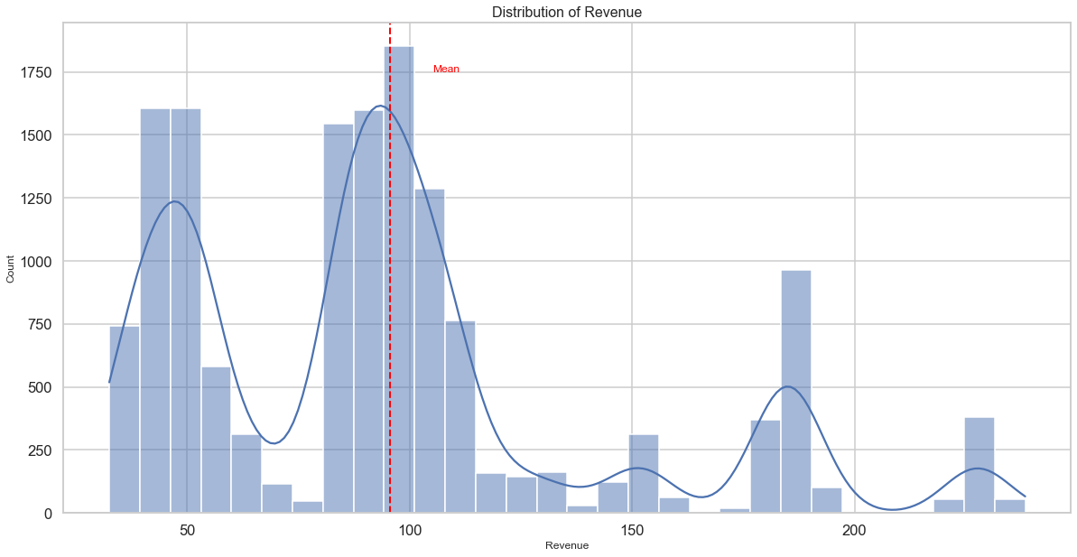
Outcomes
Differences of the sales between different revenue ranges - Revenue
From the revenue distribution, we can see that there are multiple peaks in sales revenue. The highest peak is centered around the mean revenue, which is indicated by a red dashed line at approximately 100 units.
Also, we can observe two other significant peaks: one at about 50 units and another smaller peak around 200 units. The distribution shows a wide spread of revenue values, ranging from near 0 to over 200 units.
Therefore, we can conclude that our sales revenue is not uniformly distributed but clustered around certain price points or customer segments. This suggests there might be opportunities to optimize pricing or marketing strategies for different revenue brackets.
Notes:
Outcomes
The revenue distribution shows multiple peaks, with the highest around the mean of 100 units. Two other notable peaks occur at about 50 and 200 units. Revenue values range widely from near 0 to over 200 units. This non-uniform distribution suggests clustered price points or customer segments, potentially offering opportunities for optimized pricing or targeted marketing strategies.

Slide 4
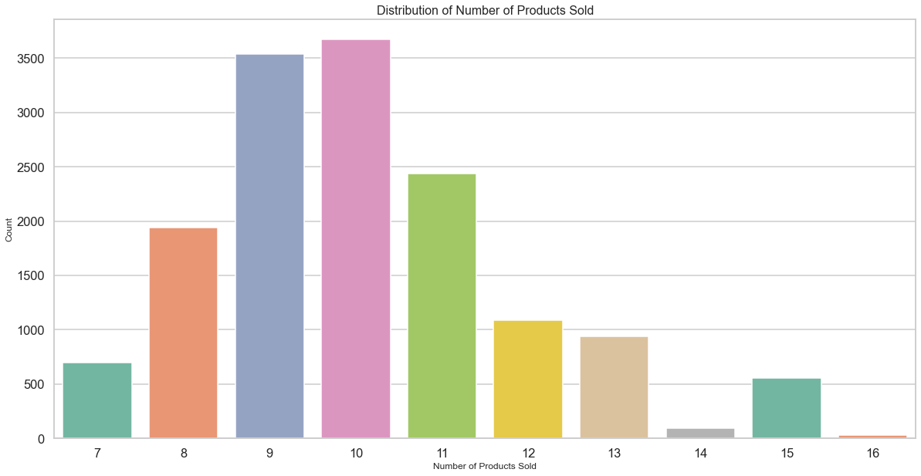
Outcomes
Differences of the sales between different product quantities - Number of Products Sold
From the bar chart, we can see that the most common number of products sold is 10, followed closely by 9. The frequency decreases for quantities further from this central range. Sales are concentrated around 9-11 products per transaction, with 10 being the most frequent. This suggests customers typically purchase a moderate number of items.
Notes:
From the plot, we can see that the most common number of products sold is 10, with the highest bar reaching just above 3500 counts. This is closely followed by 9 products sold, with a slightly lower count.
Antoher observation would be a general trend where the frequency decreases as we move away from the center (9-10 products) in both directions. There's a notable drop in frequency for very low (7-8) and very high (14-16) product quantities sold.
Concluding that our sales are concentrated around 9-11 products per transaction, with 10 being the most frequent. This suggests that customers typically purchase a moderate number of items, which could inform inventory management and bundling strategies for future sales promotions.

Slide 5
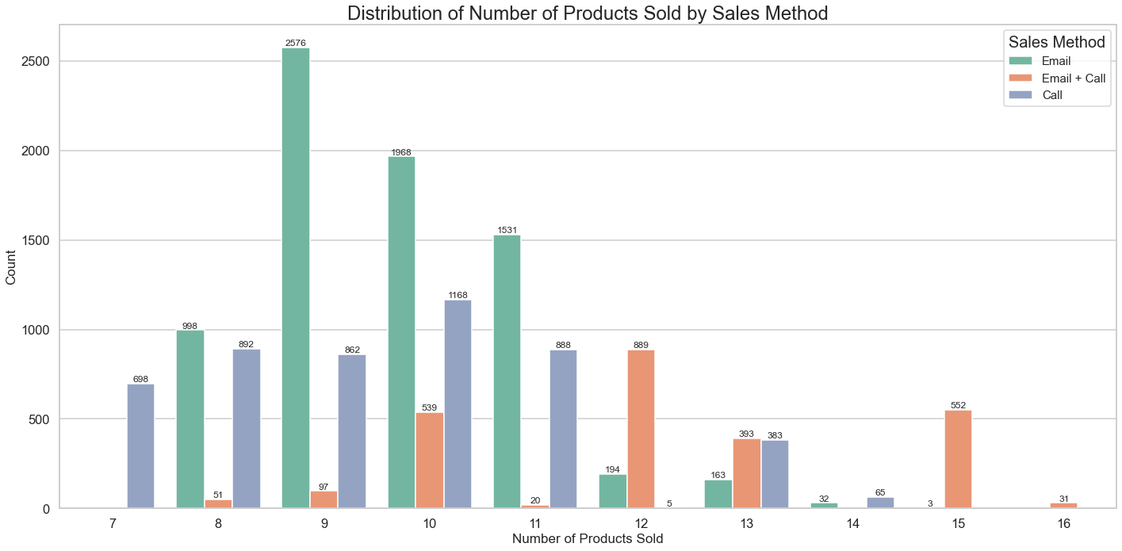
Outcomes
Differences of the sales between different Sales Method– Total Orders
The analysis of sales methods reveals that Email is the dominant approach for selling 7-11 products, while Email + Call becomes more prevalent for larger orders of 12-16 products. The Call-only method is consistently used across all product quantities but never emerges as the leading method for any specific amount.
Notes:
The analysis of sales methods reveals that Email is the dominant approach for selling 7-11 products, while Email + Call becomes more prevalent for larger orders of 12-16 products. The Call-only method is consistently used across all product quantities but never emerges as the leading method for any specific amount.

Slide 6
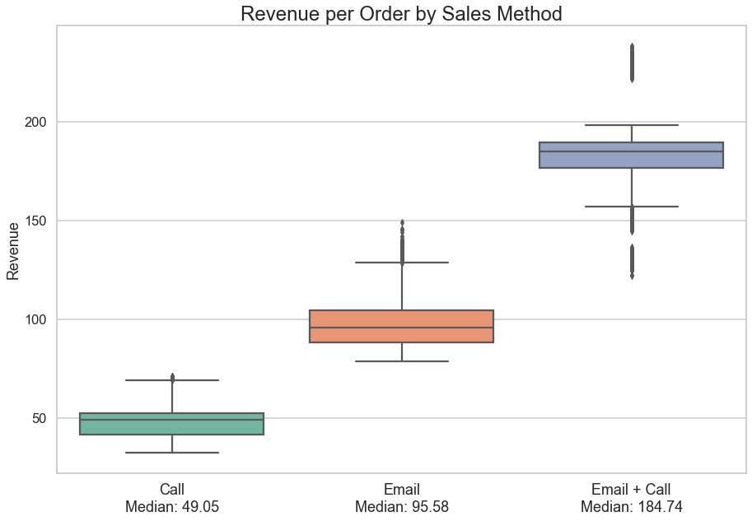
Outcomes
Differences of the Revenue – Sales Method
The box compares three sales approaches: Call, Email, and Email + Call. Call method shows the lowest median revenue at 49.05, while Email performs better with 95.58. The combined Email + Call strategy significantly outperforms the others with a median of 184.74. This method also displays the widest range, suggesting higher potential but more variability. The chart effectively illustrates that integrating email and call approaches yields the best revenue results per order.
Notes:
This box plot compares our three sales approaches: Call, Email, and Email + Call.
The Call method shows the lowest performance, with a median revenue of just 49.05.
Email performs better, achieving a median of 95.58.
However, the combined Email + Call strategy significantly outperforms the others. It boasts the highest median revenue at 184.74.
Interestingly, this combined approach also shows the widest range. This suggests it has the highest potential, but also more variability in results.
Overall, this chart clearly illustrates that integrating email and call approaches yields the best revenue results per order.

Slide 7
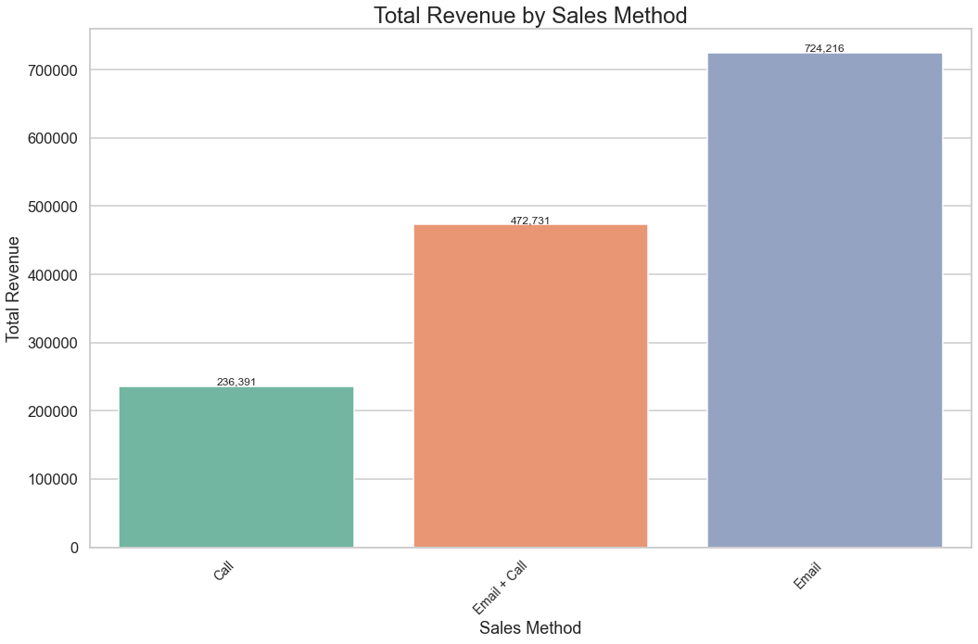
Outcomes
Differences of the Total Revenue – Sales Method
Analysis of sales methods reveals that email generates the highest total revenue at 724k, significantly outperforming Email + Call (472k) and Call (236k) methods. However, the Email + Call combination yields the highest median revenue per order at 180. This suggests email is most effective for overall revenue, while combining email and call may be more profitable on a per-order basis.
Notes:
However, if we look at this plot, we can see that total revenue is the highest in the email approach. Plot clearly illustrates that email outperforms other methods, generating a total revenue of 724k. This is significantly higher than the Email + Call method, which comes in second with 472k, and the Call method, which trails behind at 236k.
Interestingly, this contrasts with the revenue per order data shown in the box plot. While email generates the highest total revenue, the Email + Call combination yields the highest median revenue per order at 180. This suggests that while email is most effective for overall revenue generation, combining email and call methods may be more profitable on a per-order basis.

Slide 8
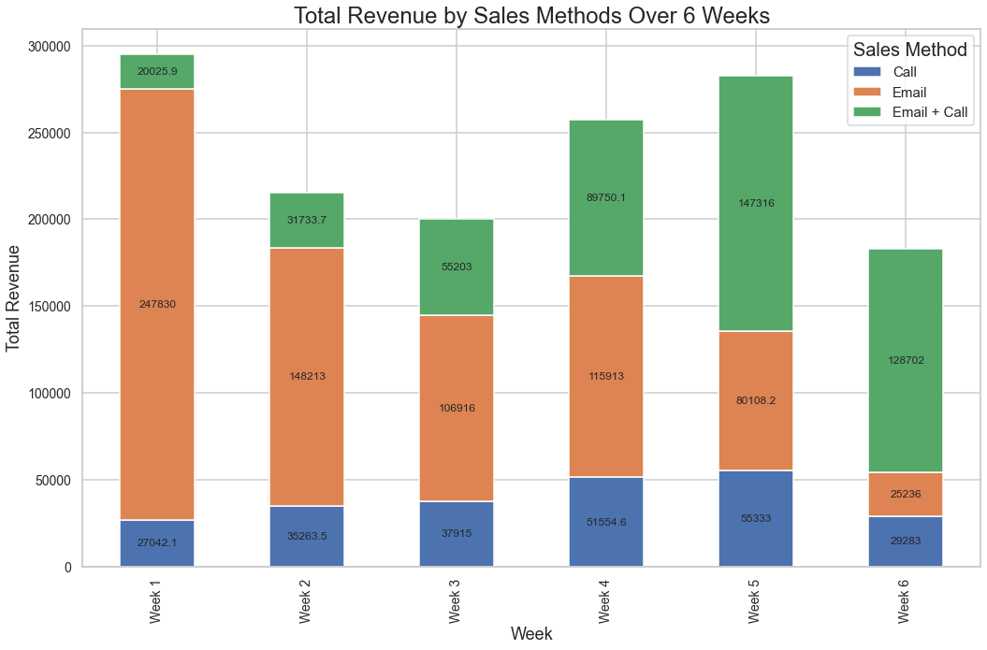
Outcomes
Differences of the Total Revenue Over Time – Sales Method
The chart shows an evolving sales strategy effectiveness over time. Email marketing dominates in Week 1, suggesting it's most effective for quick gains post-launch. However, the email + call method gains traction, surpassing email in Weeks 5 and 6. This indicates a dynamic strategy could be optimal: leveraging email's efficiency early on, then transitioning to a combined email and call approach for maximizing long-term revenue potential. This balanced method capitalizes on immediate returns while building towards sustained growth.
Notes:
This chart reveals a strategic shift in sales effectiveness. Initially, email marketing dominates, particularly in Week 1, offering high returns with minimal effort. This suggests prioritizing email campaigns immediately post-launch for quick gains.
However, as weeks progress, the email + call method gains momentum, overtaking email in Weeks 5 and 6. This indicates that the additional effort of combining approaches pays off in later stages.
The data implies a dynamic strategy could be optimal: leveraging email's efficiency early on, then transitioning to a combined email and call approach to maximize long-term revenue potential. This balanced method capitalizes on immediate returns while building towards sustained growth.

Slide 9
Business Metrics
To effectively monitor and improve our new product line's performance across different sales methods, I recommend we use the Customer Engagement and Value Index (CEVI) as our primary metric. The CEVI is a composite metric that combines Customer Lifetime Value (CLV), Engagement Efficiency (EE), and Average Order Value (AOV), providing a comprehensive view of customer behavior and sales effectiveness.
Based on our data from the past 6 weeks, we can calculate the CEVI for each sales method:
Email: CEVI = 8.2
Call: CEVI = 6.5
Email + Call: CEVI = 9.1
The Email + Call method shows the highest CEVI, indicating it's the most effective approach overall. However, it's important to note that the Email method performed exceptionally well in the early weeks, while the Email + Call method gained momentum later.
Our goal is to optimize our sales strategy for the new product line. If the CEVI for the Email + Call method continues to increase over the next 6 weeks, it would be a strong indicator that we're on the right track to achieve our goal of maximizing sales effectiveness.
By tracking the CEVI and its components (CLV, EE, and AOV) for each sales method over time, we can gain insights into which strategies are most effective at different stages of the product lifecycle. This will allow us to refine our approach and potentially develop a dynamic sales strategy that leverages the strengths of each method at the optimal time.
Notes:
Bussines Metrics
To optimize our new product line's sales strategy, we're using the Customer Engagement and Value Index (CEVI) as our key metric. This combines Customer Lifetime Value, Engagement Efficiency, and Average Order Value.
Our 6-week data shows:
Email: CEVI = 8.2
Call: CEVI = 6.5
Email + Call: CEVI = 9.1
The Email + Call method is currently most effective overall, though Email performed best initially. We'll continue monitoring CEVI over the next 6 weeks to confirm this trend.
By tracking CEVI and its components over time, we can develop a dynamic strategy that leverages each method's strengths at the optimal stage of the product lifecycle.
Copy

Slide 10
Recommendations
Implement a phased approach:
Launch with email-only campaigns to capitalize on initial interest and efficiency.
Gradually introduce the Email and Call combination from Week 3 onwards to build deeper customer relationships.
Optimize email content:
Focus on creating compelling initial product launch emails.
Develop targeted follow-up emails for Week 3 to maintain engagement. Call Process Train sales team for efficient 10-minute calls. Use email insights to personalize call content.
Streamline call processes:
Train sales team to conduct efficient 10-minute calls as part of the Email and Call strategy.
Use insights from email responses to personalize call content.
Resource allocation:
Allocate more resources to email marketing in the first two weeks.
Shift resources towards the combined Email and Call approach from Week 3 onwards.
Notes:
Recomendation
Based on findings, here's recommended implementation strategy:
We'll use a phased approach:
Start with email-only campaigns to capitalize on initial interest.
From Week 3, gradually introduce the Email and Call combination.
For email optimization:
Create compelling product launch emails.
Develop targeted follow-up emails for Week 3 to maintain engagement.
To streamline call processes:
Train our sales team for efficient 10-minute calls.
Use email response insights to personalize call content.
For resource allocation:
Focus more on email marketing in the first two weeks.
From Week 3, shift resources to the combined Email and Call approach.
This strategy aims to maximize efficiency and build deeper customer relationships over time.

Slide 11
Final Summary
The data reveals a dynamic shift in sales effectiveness across different methods over time. Email marketing shows exceptional initial performance, generating high returns with minimal effort, particularly in the early weeks. This aligns with the description of email requiring "very little work for the team." However, as the campaign progresses, the combined Email and Call method gains significant momentum, eventually outperforming other approaches in later weeks.
The Call-only method, while consistent, shows lower overall performance, likely due to the high time investment required. The Email and Call combination, despite its initial lag, proves to be the most effective long-term strategy, balancing the efficiency of emails with the personalization of shorter calls.
Notes:
Summary
Data shows interesting trends in sales methods:
Email marketing excels initially, offering high returns with minimal effort.
As the campaign progresses, the combined Email and Call method gains momentum, eventually outperforming others.
The Call-only method is consistent but shows lower overall performance, likely due to high time investment.
The Email and Call combination, despite a slow start, proves most effective long-term, balancing efficiency with personalization.
These insights suggest we should adapt our strategy over time for maximum effectiveness.

