Slide 1

EM² Grade ___ · Module ___
Module Title — Table of Contents
TOPIC A
Lesson 1
Template — duplicate the 10 lesson slides for each lesson, fill the blanks, and drop in the images.
CCSS ___
Grade ___ · Module ___

Slide 2
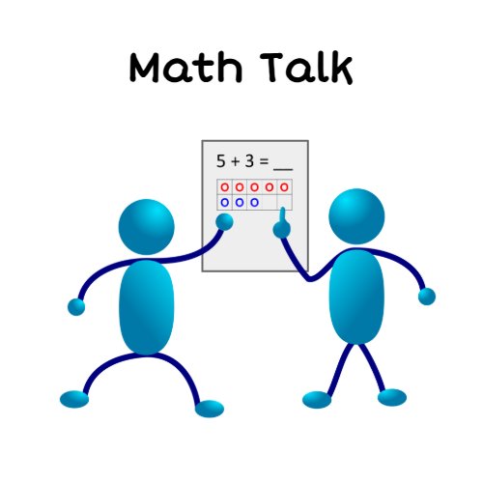
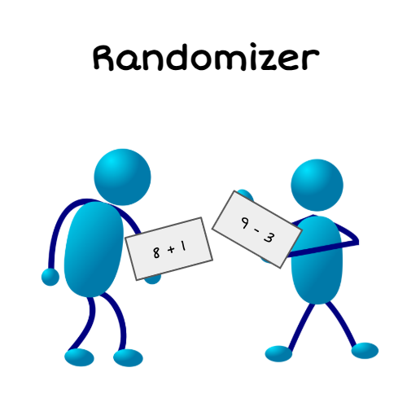
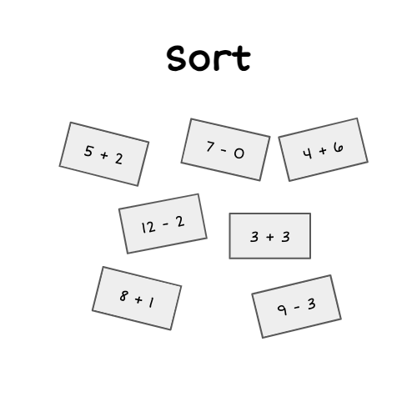
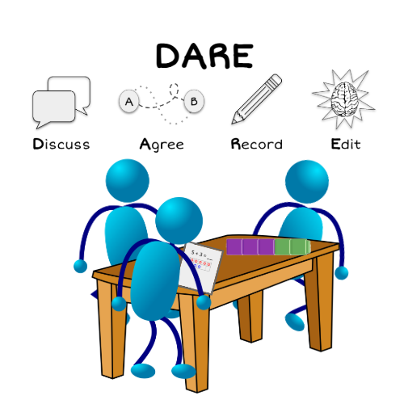
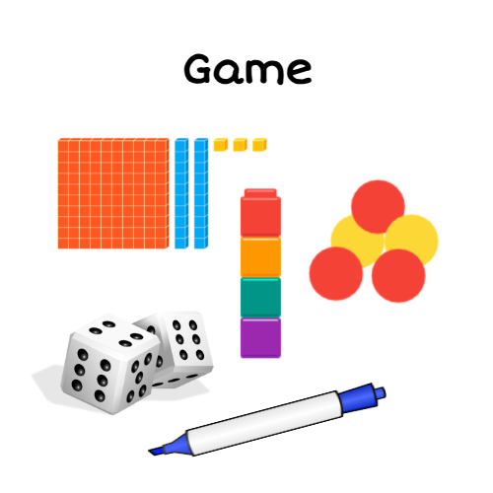
Welcome!
Grade ___ · Module ___ · Lesson 1
TODAY'S SCHEDULE
›
›
›
›
Math Talk
Randomizer
Sort
DARE
Game
CCSS ___
Grade ___ · Module ___ · Lesson 1

Slide 3




MATH TALK
Math Talk Routine
1
2
3
Walk to the Math Talk
Notice & Wonder
Share, Listen, Connect
Gather and stand around the projected Math Talk.
What do you notice? What do you wonder?
Share your thinking and build on others' ideas.
CCSS ___
Grade ___ · Module ___ · Lesson 1

Slide 4
MATH TALK
Math Talk
Drop the Math Talk image here
mathTalkImg
CCSS ___
Grade ___ · Module ___ · Lesson 1

Slide 5
MATH TALK
Math Talk
Drop the Math Talk image here
mathTalkImg
CCSS ___
Grade ___ · Module ___ · Lesson 1

Slide 6
Do these cards match mathematically?
Why or why not?
Drop sort card 1
sortCard1
Drop sort card 2
sortCard2
Drop sort card 3
sortCard3
Tell someone near you:
The cards match because…
The cards do NOT match because…
Who wants to share their thinking?
CCSS ___
Grade ___ · Module ___ · Lesson 1

Slide 7

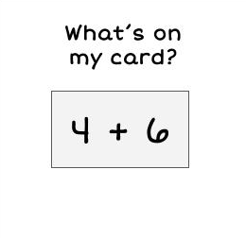
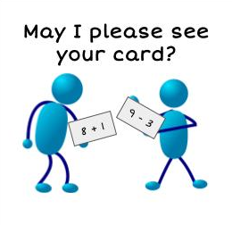
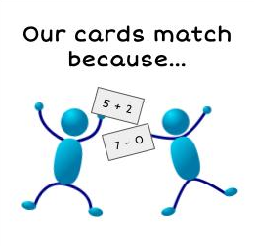
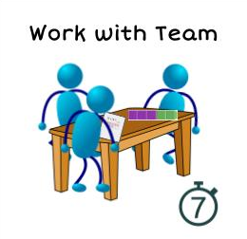
RANDOMIZER
→
SORT
Randomizer Routine
Sort Routine
1. Choose a card from the basket.
2. Find two people whose cards mathematically match yours.
3. Bring the match to the teacher: “Our cards match because…”
1. With your group, prove your cards match and get the full sort from your teacher.
2. Work as a team to sort the cards in a way that makes sense to you.
CCSS ___
Grade ___ · Module ___ · Lesson 1

Slide 8


DARE
DARE Routine
Drop the DARE question here
dareQuestion
CCSS ___
Grade ___ · Module ___ · Lesson 1

Slide 9

DARE
DARE Routine
Drop the DARE answer-guide image here
dareAnswerImg
Share & critique strategies.
Look for your one edit!
What do you notice?
What do you wonder?
CCSS ___
Grade ___ · Module ___ · Lesson 1

Slide 10
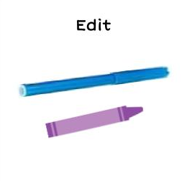
DARE
DARE Routine
Drop the DARE answer-guide image here
dareAnswerImg
Time to Edit!
Use an edit pen or a different color to record new thinking, connections, or strategies.
My edit was…
CCSS ___
Grade ___ · Module ___ · Lesson 1

Slide 11
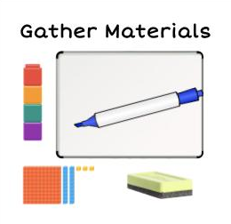
GAME
Game / Task Routine
1
2
Today's Game / Task
Add today's specific game directions or task here.
Gather Materials
Work with Your Team
Get your whiteboard, marker, eraser, and any tools you need.
Play the game or complete the task together, taking turns.
CCSS ___
Grade ___ · Module ___ · Lesson 1

