Slide 1
Introduction to Puppet

Slide 2
Overview
Why Puppet?
Introduction to Puppet
Puppet in a nutshell
Puppet's modules
2

Slide 3
Why Puppet ?
Manage a large number of systems
Poor package management
No reporting
Poor dependency management
Difficult to manage complex configurations
Difficult to read tool configs

Slide 4
What is Puppet
“Puppet is an open source data center automation and configuration management framework.”
“Puppet is a system for automating system administration task.”
An open-source project written in Ruby and released under Apache 2.0 (after v2.7.0)
Scalable to thousands of nodes
Web-based dashboard for reporting
Hundreds of community developed modules

Slide 5
What is Puppet
A declarative language for describing system configuration
We can think of machines in terms of functional roles.
Fine grained package management
Reporting tools allow us to audit current state of systems.
Faster resolution of service requests with fewer errors.
Better and faster system recovery

Slide 6
How Puppet Works?
A client/server based application
The server is called “puppetmaster”
The client is called “node” or “puppet”
SSL identity verification
Puppet enforce new configurations to the system
Idempotency
Detect current state of the system
Change if only needed
Run on regular basis
6

Slide 7
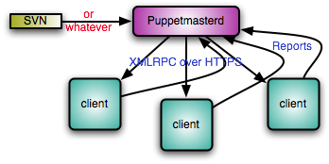
How Puppet Works?
7

Slide 8
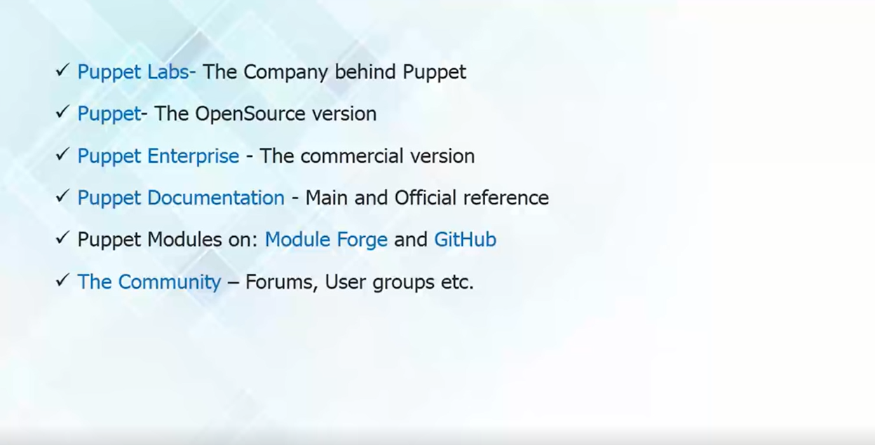
Puppet Environment

Slide 9
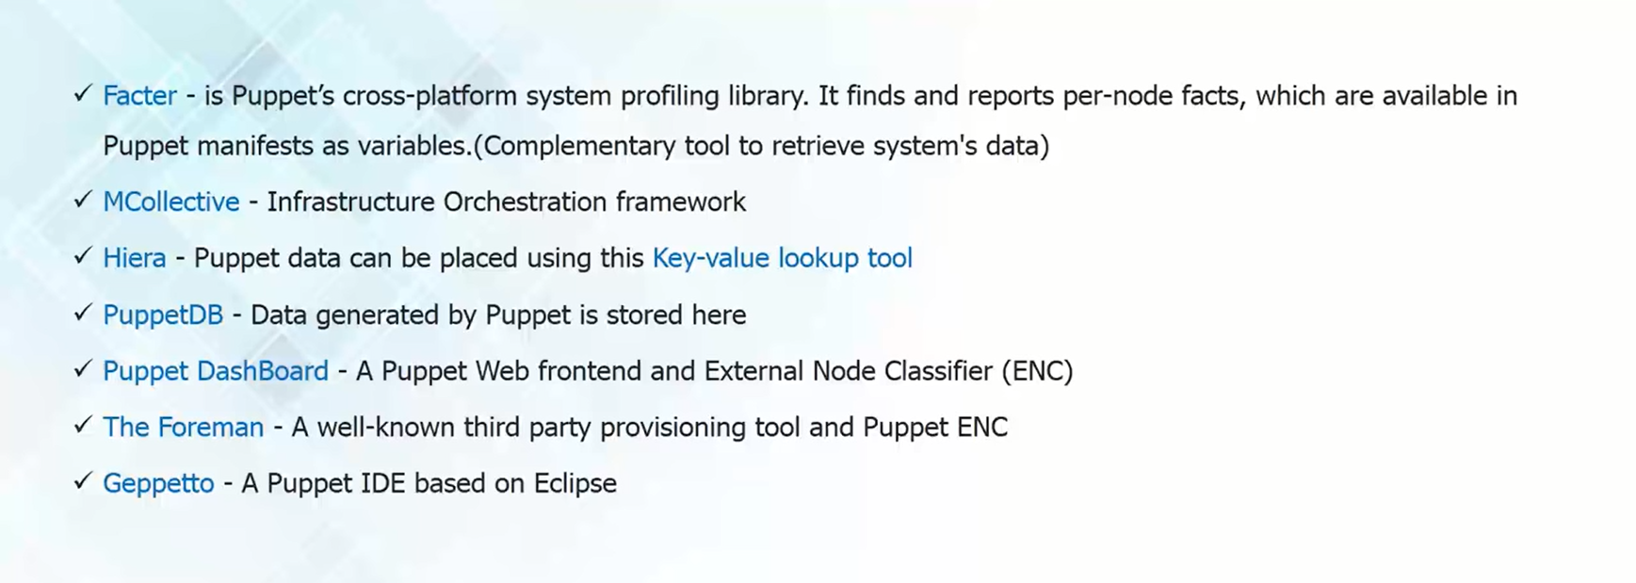
Software Related to Puppet

Slide 10
Puppet in a nutshell
Puppet's language
Resources (file, service, user) – describe configurations using attributes(ensure, mode, source)
Class – a named collection of resources
Manifest – sample puppet code(*.pp)
Variables, Arrays, Hashes, Selectors and If/else, case statements
10

Slide 11
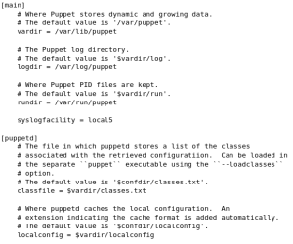

puppet.conf
Basic Knowledge

Slide 12
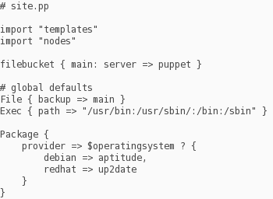
site.pp
Basic Knowledge

Slide 13
Puppet in a nutshell
Example:
package { "ntp":
ensure => installed,
}
service { "ntp":
ensure => running,
require => Package[“ntp”],
}
$file = “/etc/sample”
file { $file:
ensure => present,
source => “puppet:///example/$hostname”,
}
13

Slide 14
Puppet in a nutshell
Templates
Flat files which contains Embedded Ruby(ERB) variables
Version=<%= pkg_version %>
And called in a class
content => template(“version-temp.erb”)
Variable declaration on in the same class or in node declaration
$pkg_version = “1.2.3”
14

Slide 15
Puppet's modules
Modules
Stored at “/etc/puppet/modules” by default
Collection of classes, definitions and resources
Puppet search automatically for modules
Simplifies system administration
15

Slide 16
Puppet's modules
Module Structure
MODULE_PATH/
└──downcased_module_name/
├──files/
├──manifests/
│ ├──init.pp
├──templates/
└──README
16

Slide 17
Puppet's modules
Modules Repositories
Puppet Forge -
http://forge.puppetlabs.com/
David Schmitt's repository - http://git.black.co.at/
Ricardo Brito Da Rocha's repository
https://github.com/rochaporto/repositories
Eshao -
https://github.com/eshao/puppet
Example42 -
http://www.example42.com/
17

Slide 18
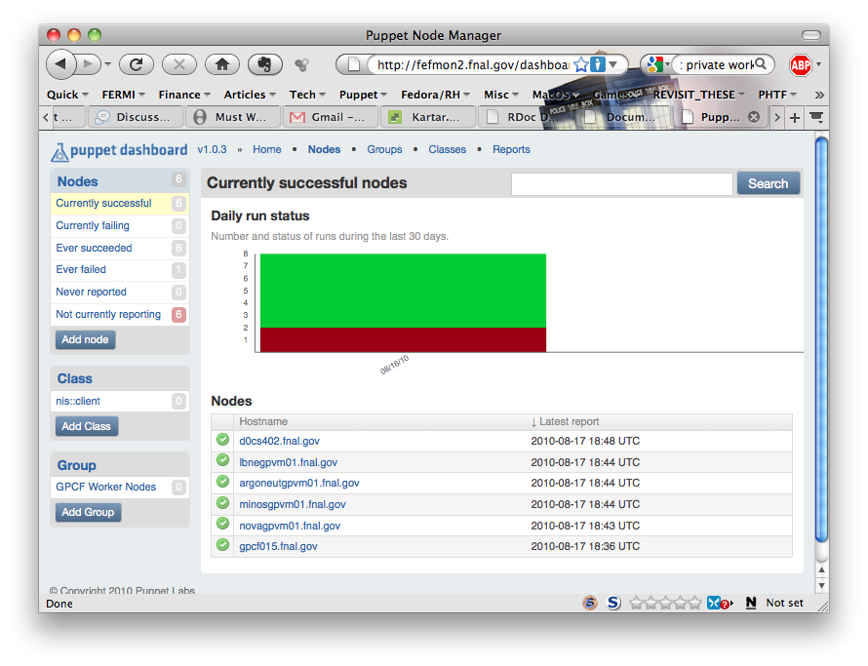
Puppet Dashboard

Slide 19
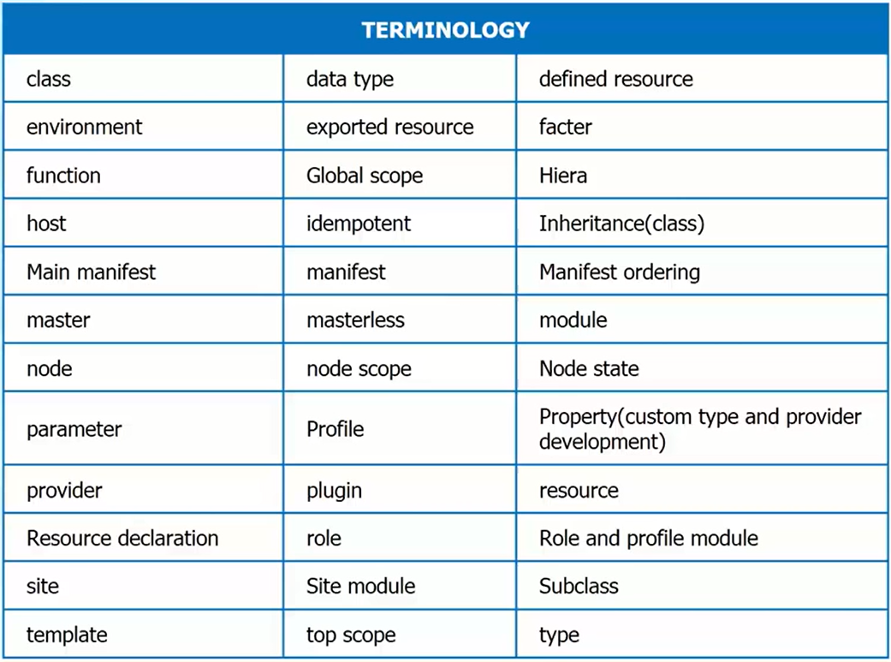
Puppet Terminology

Slide 20
Puppet Advantages
Scalability
Flexibility
Reliability
Cross-Platform
Easy to use
Rapid Growth
20

