Slide 1
Smart Contract Oracles
Advance Topics of Future Internet Research
Winter Term 2017/2018
nina.minnich.karoline.rabe.talk.ppt
Notes:
November 19, 2007
|
| <number>

Slide 2


Parcel Delivery with Smart Contract (Oracles)
Smart Contract
customer
vendor
If: parcel delivered
Then: pay price
Oracle
Event
Inform smart contract
nina.minnich.karoline.rabe.talk.ppt
https://icon-icons.com/icons2/907/PNG/512/truck-side-view_icon-icons.com_70347.png https://d30y9cdsu7xlg0.cloudfront.net/png/165055-200.png

Slide 3
Table of Contents
Smart Contracts
  Definition
  Technical Implementation
  Data Feeds
Oracles
  Definition
  Implementation
    Decentralized Oracles
    Untampered Data Sources
    Trusted Hardware
  Comparison
Conclusion
nina.minnich.karoline.rabe.talk.ppt
Notes:
November 19, 2007
|
| <number>

Slide 4
Smart Contract Characteristics
On the blockchain
No manipulation
Self-enforcement
No trusted intermediary
Rely on data about an event
nina.minnich.karoline.rabe.talk.ppt

Slide 5
Smart Contract Code Example
01 contract DataStorage
02 {
03 //state variables
04 uint256 data;
05 address owner;
06
07 //event definition
08 event logData(uint256 dataToLog);
09
10 //function modifier
11 modifier onlyOwner() {
12 if (msg.sender != owner) throw exception;
13 }
14
15 //constructor
16 function DataStorage(uint256 initData, address initOwner){
17 data = initData;
18 owner = initOwner;
19 }
20 //functions
21 function getData() public returns (uint256 returnedData){
22 return data;
23 }
24
25 function setData(uint256 newData) onlyOwner{
26 logData(newData);
27 data = newData;
28 }
29 }
nina.minnich.karoline.rabe.talk.ppt

Slide 6


Providing Data Feeds
Oracle
Smart Contract
Script
External
API
Feed data
Event triggers execution
Triggering = providing corresponding key
https://d30y9cdsu7xlg0.cloudfront.net/png/9362-200.png
http://download.seaicons.com/icons/iconsmind/outline/512/Key-3-icon.png
nina.minnich.karoline.rabe.talk.ppt

Slide 7



Ideal Oracle Structure
Blockchain
Off-chain
request Data
User
Contract
return Data
Oracle
Contract
obtain Data
https://seeklogo.com/images/P/paypal-logo-C83095A82C-seeklogo.com.png
http://insidebusinessonline.com/wp-content/uploads/2016/09/visa.png
nina.minnich.karoline.rabe.talk.ppt

Slide 8
Decentralized Oracles create Security
Blockchain
ChainLink nodes
request Data
event
route
User
Contract
Oracle
Contract
Core
result
Adapter
return Data
result
Blockchain
Off-chain
obtain Data
Off-chain
External
API
nina.minnich.karoline.rabe.talk.ppt

Slide 9

Untampered Data Sources provide Authenticity Proof
Authenticity Proof
pointer to the document
return document
Data Source
request data
Smart
Contract
return data
nina.minnich.karoline.rabe.talk.ppt
Notes:
Oraclize Bild Quelle angeben
November 19, 2007
|
| <number>

Slide 10
Trusted Hardware run Processes in Enclave
Blockchain
Town Crier Server
Data Source
Town Crier Contract
C_{TC}
Relay
User Contract
C_{U}
Enclave
nina.minnich.karoline.rabe.talk.ppt

Slide 11
Comparison
Decentralized Oracles | Untampered Data Sources | Trusted Hardware
+ Distributed oracle service (security) | + no trust in the oracle needed + information directly via APIs or websites | + decryption in enclave + request data via HTTPS
Costly Agreement on data format No confidentiality | Centralized point of control Decrypted query visible for the oracle | Only Ethereum
nina.minnich.karoline.rabe.talk.ppt

Slide 12
Conclusion
nina.minnich.karoline.rabe.talk.ppt

Slide 13
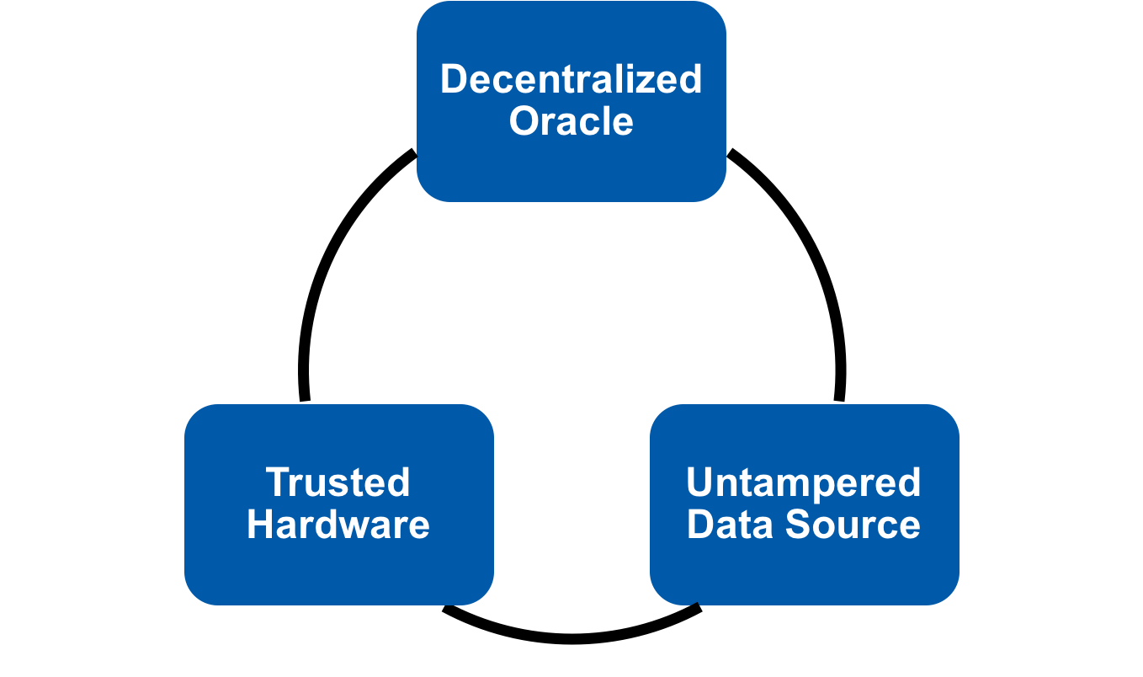
Discussion
+ distributed
+ no trust
+ direct information
+ enclave
+ HTTPS
nina.minnich.karoline.rabe.talk.ppt

Slide 14

Backup
nina.minnich.karoline.rabe.talk.ppt

Slide 15
Smart Contract Platform Comparison
 | Application | Language | Consensus
Ethereum | General | Solidity, Serpent, LLL, bytecode | Proof of Work
Bitcoin | Crypto-currency | Bitcoin Script | Proof of Work
Monax | General | Solidity | Byzantine Fault Tolerance
Lisk | General | JavaScript | Delegated Proof of Stake
Hyperledger | General | Java | Byzantine Fault Tolerance
Counterparty | General | Solidity, Serpent, LLL | Proof of Burn
Stellar | Digital assets | JavaScript | Stellar consensus
Tezos | General | OCaml | OCaml
nina.minnich.karoline.rabe.talk.ppt

Slide 16
Farbschema + Halbtransparenz der Farben
1text
2text
3text
1text
2text
3text
4text
5text
6text
4text
5text
6text
7text
8text
9text
7text
8text
9text
1= 253-202-0 ; 2= 236-101-0 ; 3= 230-0-26
4= 201-192-0 ; 5= 153-192-0 ; 6= 0-157-129
7= 0-90-169 ; 8= 234-234-234 ; 9= 114-16-133
gleiche Farben nur in AutoForm formatieren
Transparenz 50% eingestellt
nina.minnich.karoline.rabe.talk.ppt
Notes:
November 19, 2007
|
| <number>

Slide 17

Formulas & Graphics
Using latex2eps-frontend
  paste latex code:
\begin{displaymath}
1 + e^{i \pi} = 0
\end{displaymath}
  to: http://hausheer.osola.com/latex2png
  former http://www.tik.ee.ethz.ch/~hausheer/latex2eps.php3
  import eps graphic
Edit EPS-graphics in PowerPoint
  import file
  right click on file
    select „Bild bearbeiten“ („edit picture“)
    „Bild in MS-Office Objekt umwandeln?“ -> ja
  un-group file to edit
  Adobe Illustrator, Corel Draw, etc, can be
  used to draw eps-figures
  Matlab, GnuPlot, ... produce eps-figs as result
nina.minnich.karoline.rabe.talk.ppt
Notes:
November 19, 2007
|
| <number>

