Slide 1
Lifestyle Importance Weighted Carbon Footprint Reduction
Karl Roush
Georgia Institute of Technology, AE 2020
Wells Fargo Campus Analytics Challenge

Slide 2
OVERVIEW
Solution
Objective
Initial analysis vs. Machine Learning
Process
Data extraction
Analysis (Initial & ML selection)
Comparisons
Initial analysis vs. Machine Learning
Insights
Concluding remarks
Deployment
Future recomendations
Additional Insights
Q & A

Slide 3
Objective
“to create a machine learning algorithm that minimizes carbon footprint for each customer while maintaining their total quality of life”.
Define Carbon Footprint (CFP) as non-dimensional parameter
Sum of [Activity duration * weight of activity] for all activities
Higher number is worse
Quality of life (QoLI) is correlated to importance
Represented as a percentage of importance
Preserve this number as much as possible for each activity

Slide 4
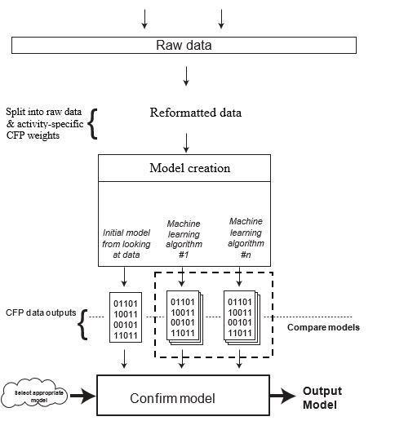
Solution
Initial analysis produced mathematical model
Weights each activity duration by importance
Allow for duration to be “in line” with importance
Machine learning model: SVM
Tested 6 different models to subset
Compared based on accuracy & stdev
Results
Average CFP reduction of 26.16%
ML – model = 98.55% accuracy
Underestimate by 0.0145
Notes:
Logistic regression, Linear discriminant analysis, K-nearest neighbors
Decision Tree, Gaussian Naive Bayes, Support vector machine

Slide 5
PROCESS

Slide 6
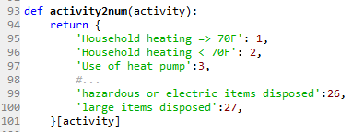
Data extraction
Missing Values
Created index of QoLI and consumption
Allows for easier ref. and measures of central tendancy
Replaced missing values with median value from index
Replacing with zero makes too many assumptions
QoLI
Given as number with no context
Assumed relative percentage
Converted to decimal
Shortened index for referencing activities
Notes:
Assigned a numeric value to each activity

Slide 7
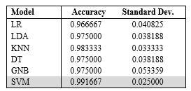
Analysis
Initial Analysis
Need bound since lowest CFP is zero
Weights each activity duration by importance
Allow for duration to be “in line” with importance
Machine Learning models
To be compared based on accuracy & standard deviation on subset
Tested:
Logistic regression
Linear discriminant analysis
K-nearest neighbors
Decision Tree
Gaussian Naive Bayes
Support vector machine
Accuracy and Standard Deviation Results from initial 10-fold cross, by algorithm
Notes:
In k-fold cross-validation, the original sample is randomly partitioned into k equal size subsamples. Of the k subsamples, a single subsample is retained as the validation data for testing the model, and the remaining k-1 subsamples are used as training data. The cross-validation process is then repeated k times (the folds), with each of the k subsamples used exactly once as the validation data.

Slide 8
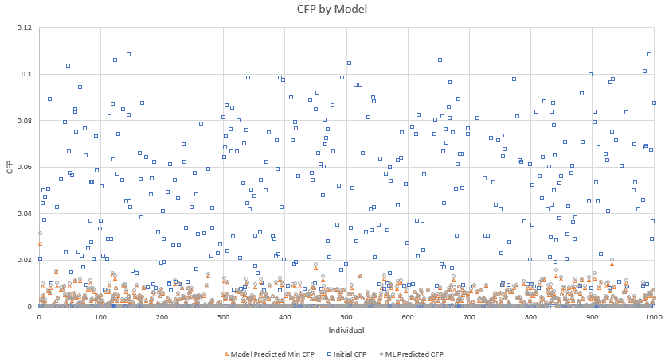
Comparisons
ML vs initial model
Difference (ML-model) between the two output datasets was -1.45%
Accuracy= 98.55%
ML often underestimated the minimum CFP for an individual by about 0.0145.
Notes:
When compared to initial model

Slide 9
Insights
Activities
Showering, heating, and transportation are the most valued
“air travel- small plane” and “oven self-clean” have relatively low importance
High CFP impact → prime target for reducing individual’s total CFP
Overall drastic change between initial CFP and minimized CFP, average of 26.16%
Notes:
Makes sense since they play a crucial role in everyday life

Slide 10
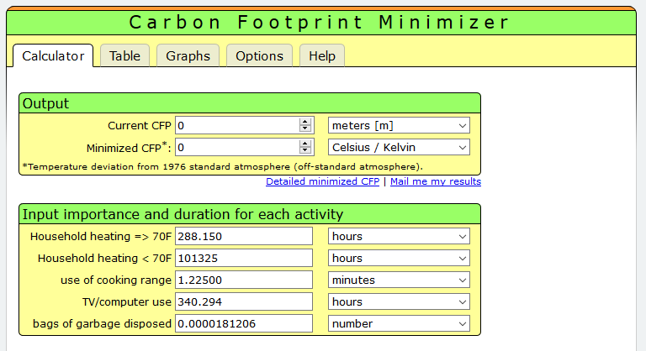
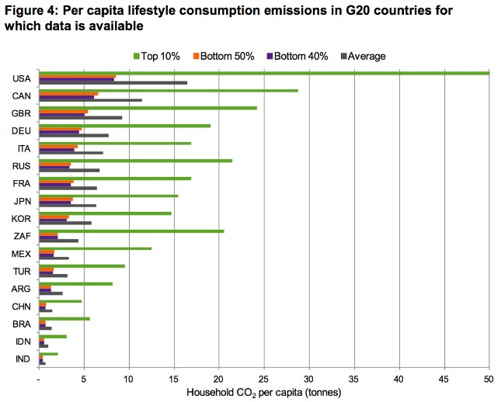
CONCLUSION
Individual Awareness
Provide an online calculator
Gives people an idea of what their CFP actually is
Comparison
Demonstrate comparisons
Household water usage example
Future recommendations
More custom algorithm, tailored exclusively for this task
More training data
“What happened after” analysis
Notes:
What happened after= show people data, see trends if they change

Slide 11
Q & A

Slide 12
Insights (Continued)

Slide 13
Insights (Continued)

Slide 14
Insights (Continued)

Slide 15
Insights (Continued)

Slide 16
Insights (Continued)

