Slide 1
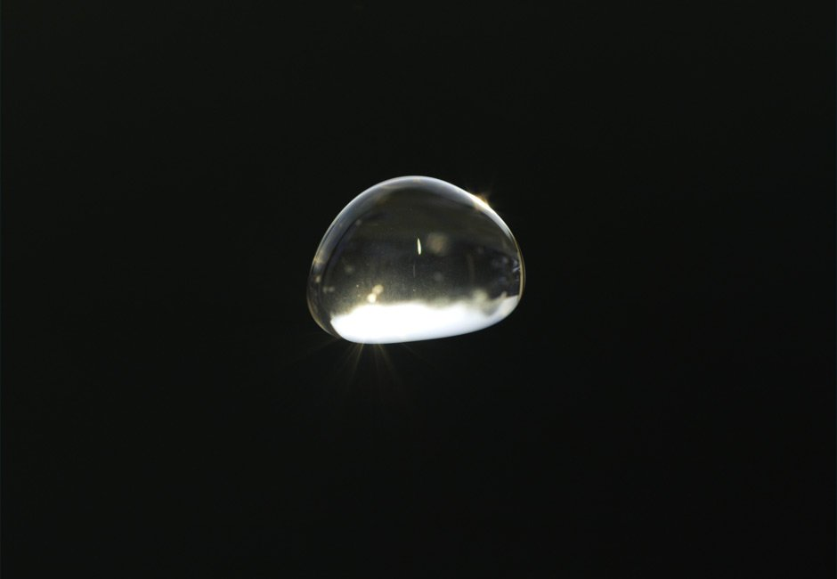
An Improved Protocol for Precipitation Measurement
By Karl Roush

