Slide 1
Literary Investigation of Fuel Type Viability for Scramjet Combustors
Karl Roush
AE 2699- Spring 2018
Ben T. zinn combustion lab

Slide 2
OVERVIEW
Initial Research
How a scramjet works
Fuel injector design
Fuel Types
Conventional (liquid and gas)
Solid
Gelled
Conventional Fuels
Methane
Ethylene
Heptane
JP-10
Hydrogen
Solid Fuels
Advantages/ Disadvantages
Poly-methyl-meth-acrylate (PMMA) test
Gelled Propellants
Overview
Atomization

Slide 3
Initial Research
Compression waves pile up in front of object¹
Stack of compression produces shockwave
Air is slowed down drastically-> needs to be slower for combustion to occur
Scramjet uses high speed to compress air²
Air is supersonic throughout engine (unlike ramjet)
Utilize geometry to create shocks & areas for flame holding
Injector design produces rapid combustion and mixing (allowing for combustor length and weight to be minimized)³
Injector sticks out for better fuel mixing & creates space for flames to form, but requires cooling
Penetration of the fuel stream into the cross flow is governed by the jet-to-freestream momentum flux ratio
The fuel jet interacts with the cross flow to create shock

Slide 4
Types
Liquid
Solid⁴
Gelled Propellants⁵
Currently used
Variable thrust
Fuel is easily replaceable
Requires pressurization and storage container
Shutdown capability
Greater specific impulse than solid fuels
Fuel consumption changes combustion chamber geometry
Requires pre-determined mission profile
Fuel regression rate heavily dependent on incoming air temperature (slightly on pressure)
Denser
Easier to store (stable)
Fluids with additives that have aspects of solid and liquid fuels
Has to be atomized before combustion
Three major types
Pseudo plastic, Shear Thinning, Low-Yield
Viscoelastic Gel
Yield thixotropic
Stored as solid, but liquified upon injection to combustion chamber

Slide 5
Conventional Fuels
Methane⁶
CH₄
Ethylene
C₂H₄
Heptane⁷
H₃C(CH₂)₅CH₃
JP-10
Mixture of (in decreasing order) endo-tetrahydrodicyclopentadiene, exo-tetrahydrodicyclopentadiene, and adamantane
Hydrogen
H₂
Hydrocarbon mixture
30/60/10 molar ratios of methane, ethylene, heptane
Looking at ignition delays
Defined as onset of emission from hydroxyl radicals (when does OH start being emitted)
Has to be rapid in order for efficient combustion in a practical length
Fuel cracking decreases ignition time
Breaking fuel into mixture of small hydrocarbons and hydrogen prior to combustion
Lack of research in hydrocarbon mixtures prior to 2001
Small addition of hydrocarbon contaminants in methane reduced ignition delay (1/3 -> 1/5)

Slide 6
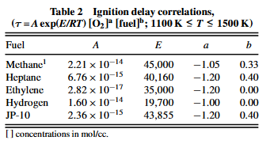
Conventional Fuels (Ignition delays)⁸
Methane
Ethylene
Heptane
Strong inverse dependence on oxygen concentration
Weak direct dependence on methane concentration
Tested 0.5,0.75,1 equivalence rations of ethylene/oxygen/argon
Strong inverse dependence on oxygen concentration
Weak on fuel concentration (ethylene, argon)
Weak dependency on Argon (but set to 0 for consistency within the paper)
Strong negative Oxygen dependency
JP-10
Hydrogen
Used in volume limited applications due to high density
Low vapor pressure (i.e. nonvolatile) limits usage without heated shock tube & premixing system
Tested JP-10 and oxygen in argon at equivalence ratios of 0.5, 0.75, 1.0 ,1.5
Similar ignition delays to heptane
Switches from inverse proportionality to direct at low temps, high pressures; very sensitive to temperatures
Due to formation of HO₂ radical
Does not participate in chain propagation
Favored at low temps due to weak temperature dependence
Hydrocarbon mixture
Not reported due to limited data set (but ~50-70% of heptane)
Not driven by constituent with shortest delay
Small changes in concentration of components did not drastically change ignition time

Slide 7
Solid fuels
Advantages
Denser
Easier to store containers
Operating conditions are closer to normal temperatures (does not have to be kept extremely cold)
Simpler systems
Disadvantages
Fuel consumption changes combustion chamber geometry
Requires pre-determined mission profile
Fuel regression rate heavily dependent on incoming air temperature (slightly on pressure)

Slide 8
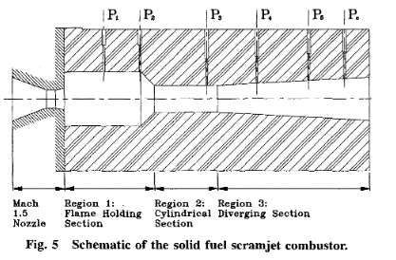
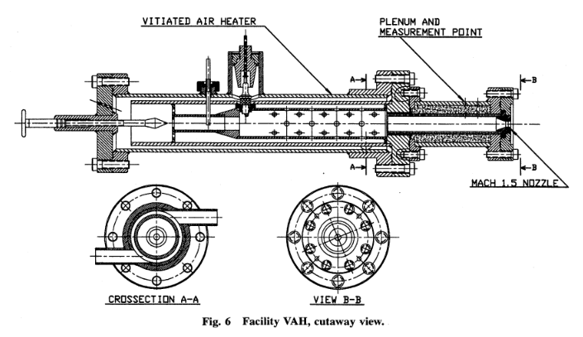
Solid fuel Test⁴
Previous research has shown:
Combustion of solid fuel at good combustion efficiencies
Evidence of spontaneous ignition and stable supersonic combustion with no external aid
Combustor was poly-methyl-methacrylate (PMMA)
Simulated conditions of Mach 5.5, 1500K, 50 atm
Examined solid fuel inherent features:
Fuel regression rate
Fuel-air mixing
Reaction kinetics
Flame holding capacity

Slide 9
Solid fuel Results⁴
Initial stage of operation has very little of evaporating fuel being burned (thermal efficiency starts near zero)
Shock boundary layer interaction develops surface roughness (increases mixing)
Initial combustion outside the motor
Fuel regression rate was calculated as the combination of inlet air mass flow rate, inlet air temperature, inlet air pressure
Increasing fuel regression rate increases fuel in combustor (increase fuel mass flow rate)
Incomplete mixing
More fuel, but limited change in burn rate so, decrease in efficiency
Decrease in thermal efficiency with increase in each parameter
Can be remedied by having multiple bores (increase ratio between bore circumference and cross sectional area)
Larger diversion angles have a decrease in fuel regression rate (best at 3 deg)

Slide 10
Solid fuel Viability⁴
Transition period of inefficiency due to high velocities and insufficient mixing
Negligibly short in realistic propulsion systems
Has to be considered for short operating time systems
Relatively high I_{sp} but lower than liquid fuels
Fuel consumption also changes combustion chamber geometry
Requires pre-determined mission profile
Fuel regression rate primarily dependent on incoming air temperature and slightly on pressure
Performance better at higher altitudes
“These assessments confirm the potential of solid fuel scramjets as worthy candidates for the types of propulsion systems discussed.”

Slide 11
Gelled Propellants Overview⁵
Fluids with additives
Aspects of both solid & liquid fuels
Solid in storage tank
Liquified upon injection
Several types, classified on properties:
Pseudo plastic, Shear Thinning, Low-Yield (non-Newtonian)
Inorganic fuels and water gels such as carbopols fall under this category
Viscoelastic Gel (resist flow, elastic)
Organic Fuels
Yield thixotropic (stressed -> less viscous)
Organic fuels, H2O2 and corresponding acids
Metallized gelled leaves solid aggregates with hollow, permeable configuration
Non-metalized gels:
Lack of research work
Al/HC (aluminum/ hydrocarbon) is one that has been tested
Revealed that gelled propellants have lower combustion efficiency than non-gel
Possible as green alternative:
High test hydrogen peroxide (HPE)/Boron carbide based - SiO2 induced gel propellant
Hydroxyl ammonium nitrate (HAN)
Notes:
Reliant on surface tension, density, flow velocity conditions

Slide 12
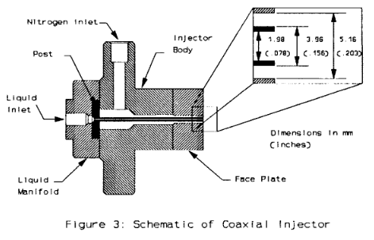
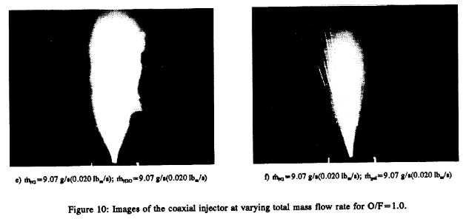
Atomization⁵
Required for higher combustion efficiency
Since more viscous than kerosene or water, harder to atomize
High pressure generation in small angle of jet
Research suggests gelled propellants were unable to produce adequate jet & have significant variation in atomization characteristics
1991 NASA study shows feasibility with a coaxial injector⁹
Atomization improves with:
Liquid flow rate
Overall flow rate

Slide 13
Gelled Propellants Viability^{5,9}
Lower combustion efficiency than liquids
Negligibly short in realistic propulsion systems
Has to be considered for short operating time systems
Increase in complexity
Atomizers
Delivery system
Addition of certain additives could increase burning rates by increasing gel’s vapor pressure
Metalized gel propellants show most promise, but leave solid aggregates after combustion
Needs to liquidity better under applied pressure or atomization
“Increased fluid viscosity lead to decreased atomization quality, and that atomization improved as liquid flow rate increased”
Further research on changing parameters and their affect on droplet size distribution is needed

Slide 14
CONCLUDING REMARKS
Fuel/ propellant Selection
Conventional (liquid and gas)
General use
Most research and testing
Easier to modify and control on the fly
Solid
Possible, specialized use
Requires pre-determined flight profile and environmental parameters
Efficiency needs improvement
Gelled
In development
Without improvements in atomization quality or injection scheme, it currently too inefficient when compared to liquid or solid fuels
Option for “green” propulsion

Slide 15
References
[1] Drummond, J., Diskin, G. and Cutler, A. (2002). Fuel-Air Mixing and Combustion in Scramjets. AIAA, 2002(3878).
[2] Epstein, M. and Kutschenreuter, P. (1994). Fuel Injection System for Scramjet Engines. 5,280,705.
[3] Baurle, R., Fuller, R., White, J., Chen, T., Gruber, M. and Nejad, A. (1997). An Investigation of Advanced Fuel Injection Schemes for Scramjet Combustion. 36th AIAA Aerospace Sciences Meeting and Exhibit.
[4] Cohen-Zur, A. and Natan, B. (1998). Experimental Investigation of a Supersonic Combustion Solid Fuel Ramjet. Journal of Propulsion and Power, 14(6), pp.880-889.
[5] Aggarwal, R., Patel, I. and Sharma, P. (2015). A COMPREHENSIVE STUDY ON GELLED PROPELLANTS. International Journal of Research in Engineering and Technology, 04(09), pp.286-290.
[6] Molnar, M. and Marek, C. (2003). Reduced Equations for Calculating the Combustion Rates of Jet-A and Methane Fuel. NASA STI Program Office.
[7] Ye, J., Medwell, P., Evans, M. and Dally, B. (2017). Characteristics of turbulent n -heptane jet flames in a hot and diluted coflow. Combustion and Flame, 183, pp.330-342.
[8] Colket, M. and Spadaccini, L. (2001). Scramjet Fuels Autoignition Study. Journal of Propulsion and Power, 17(2), pp.315-323.
[9] Green, J., Rapp, D. and Roncace, J. (1991). Flow Visualization of a Rocket Injector Spray Using Gelled Propellant Simulants. AIAA, 2198.

