Slide 1
Astral Workspace: who does what, and where
The project flow and the screens each role uses — Partners, HR, Accounts, Managers, Team leads and Staff · October 2026
Notes:
A guide to the Astral Workspace app: how an audit moves from client to invoice, how everyday requests are approved, and which screens each role works in. Screenshots are from the live app with demo data.

Slide 2






Six groups of people use the app
Your designation decides which menu items you see. Admins can change this in Settings › Access Control.
Partners & Directors
HR Head & HR
Accounts Head & Accounts
Run the firm. See every screen, sign off audits and billing, set up access.
People records, attendance, leave, helpdesk tickets and payroll inputs.
Approve and reimburse expenses, raise invoices, track collections.
Main screens: Audit Dashboard · Reports · Settings
Main screens: Employees · Team Attendance · HR Tickets
Main screens: Expense Approvals · Billing & Invoices
Senior Managers & Managers
Senior Consultants (team leads)
Consultants, Junior Consultants & Associates
Set up audits, assign the team, approve time, leave and expenses.
Lead fieldwork, review work when set as reviewer, approve their team.
Do the audit work, run the timer, submit timesheets, raise requests.
Main screens: Engagements · Team Workload · Approvals
Main screens: My Work · Engagements · Leave Approvals
Main screens: Dashboard · My Work · Timesheets

Slide 3









How an audit moves from client to invoice
Eight steps. Managers set it up, staff do the work and log time, Accounts and Partners bill it.
1 Client
2 Project
3 Engagement
4 Tasks
Add the company you audit
Optional folder for a client’s audits in a year
The audit job: type, deadline, budget hours, team
The active Audit Checklist’s steps become tasks
Manager
Audits › Clients
Manager
Audits › Projects
Manager
Audits › Engagements
Automatic
Audit Checklists
5 Assign
6 Work & time
7 Approve
8 Bill
Owner and reviewer for each task
Start / Stop the timer on a task
Reviewer approves tasks; manager approves the week
Invoices from fees and approved time
Manager
Engagement page · Team Workload
Staff
Audits › My Work
Reviewer · Manager
Audits › Timesheets › Approvals
Accounts · Partner
Audits › Billing & Invoices
Notes:
Forgotten timers stop automatically at 7 PM. Only approved time reaches billing. Changing an Audit Checklist never changes audits that are already running.

Slide 4
Everyday requests and who approves them
Every request starts from the person’s own screen and lands in an approver’s queue.
Request | Raised from | Approved by | Approver’s screen | What happens next
Leave | Leave › Apply Leave | Team lead / manager (HR can too) | Leave › Approvals | Balance updates; shows on the team calendar
Missed punch | Attendance › Regularization | Team lead / manager | Attendance › Regularization | Attendance record is corrected
Expense claim | Expenses › My Expenses | Manager or Accounts | Expenses › Approvals | Accounts marks it Reimbursed
Timesheet (week) | Audits › Timesheets › Submit week | Engagement manager | Audits › Timesheets › Approvals | Only approved time is billed
HR question | HR Helpdesk › Raise a ticket | HR (assigned owner) | HR Helpdesk › HR Tickets | Resolved → Closed, or Reopened

Slide 5
Staff: Consultants, Junior Consultants & Associates
Check in, do the audit work with the timer running, submit the week, and raise your own requests.

Slide 6






A day in the life of a staff member
Six moments, all inside the app.
Arrive
Plan
Work
Hand over
Leave
End of week
Check in on the Dashboard: Office, Home or Client site. Location is recorded.
Open My Work: what’s due today, overdue, or waiting for your review.
Press Start on a task. One timer runs at a time.
Submit the task for review. The reviewer approves or asks for changes.
Stop the timer and check out. Forgotten timers stop at 7 PM.
Timesheets › Submit week. Your manager approves it.
Tip Forgot to start the timer? Use Timesheets › Add time to log it by hand, before you submit the week.

Slide 7
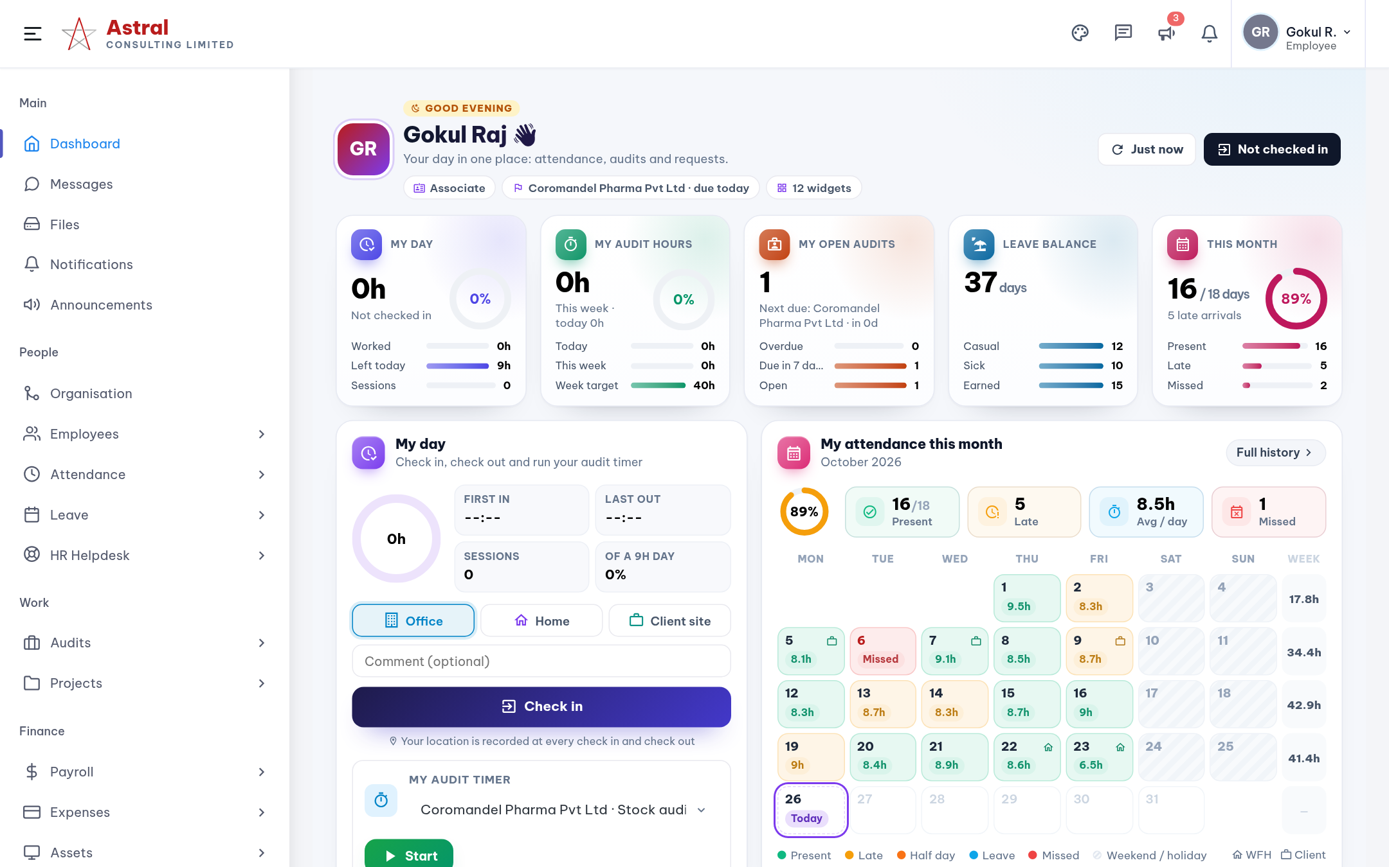
Dashboard: your day on one page
Opens after sign-in. Everything a staff member needs most is here.
1
Check in / out
Pick Office, Home or Client site. Hours worked today fill the ring.
2
Five quick tiles
My day, audit hours, open audits, leave balance and this month’s attendance.
3
My audits
Your open audits with a Start button to begin the timer.
4
Month calendar
Each day shows hours worked or Late, Leave, Missed.

Slide 8
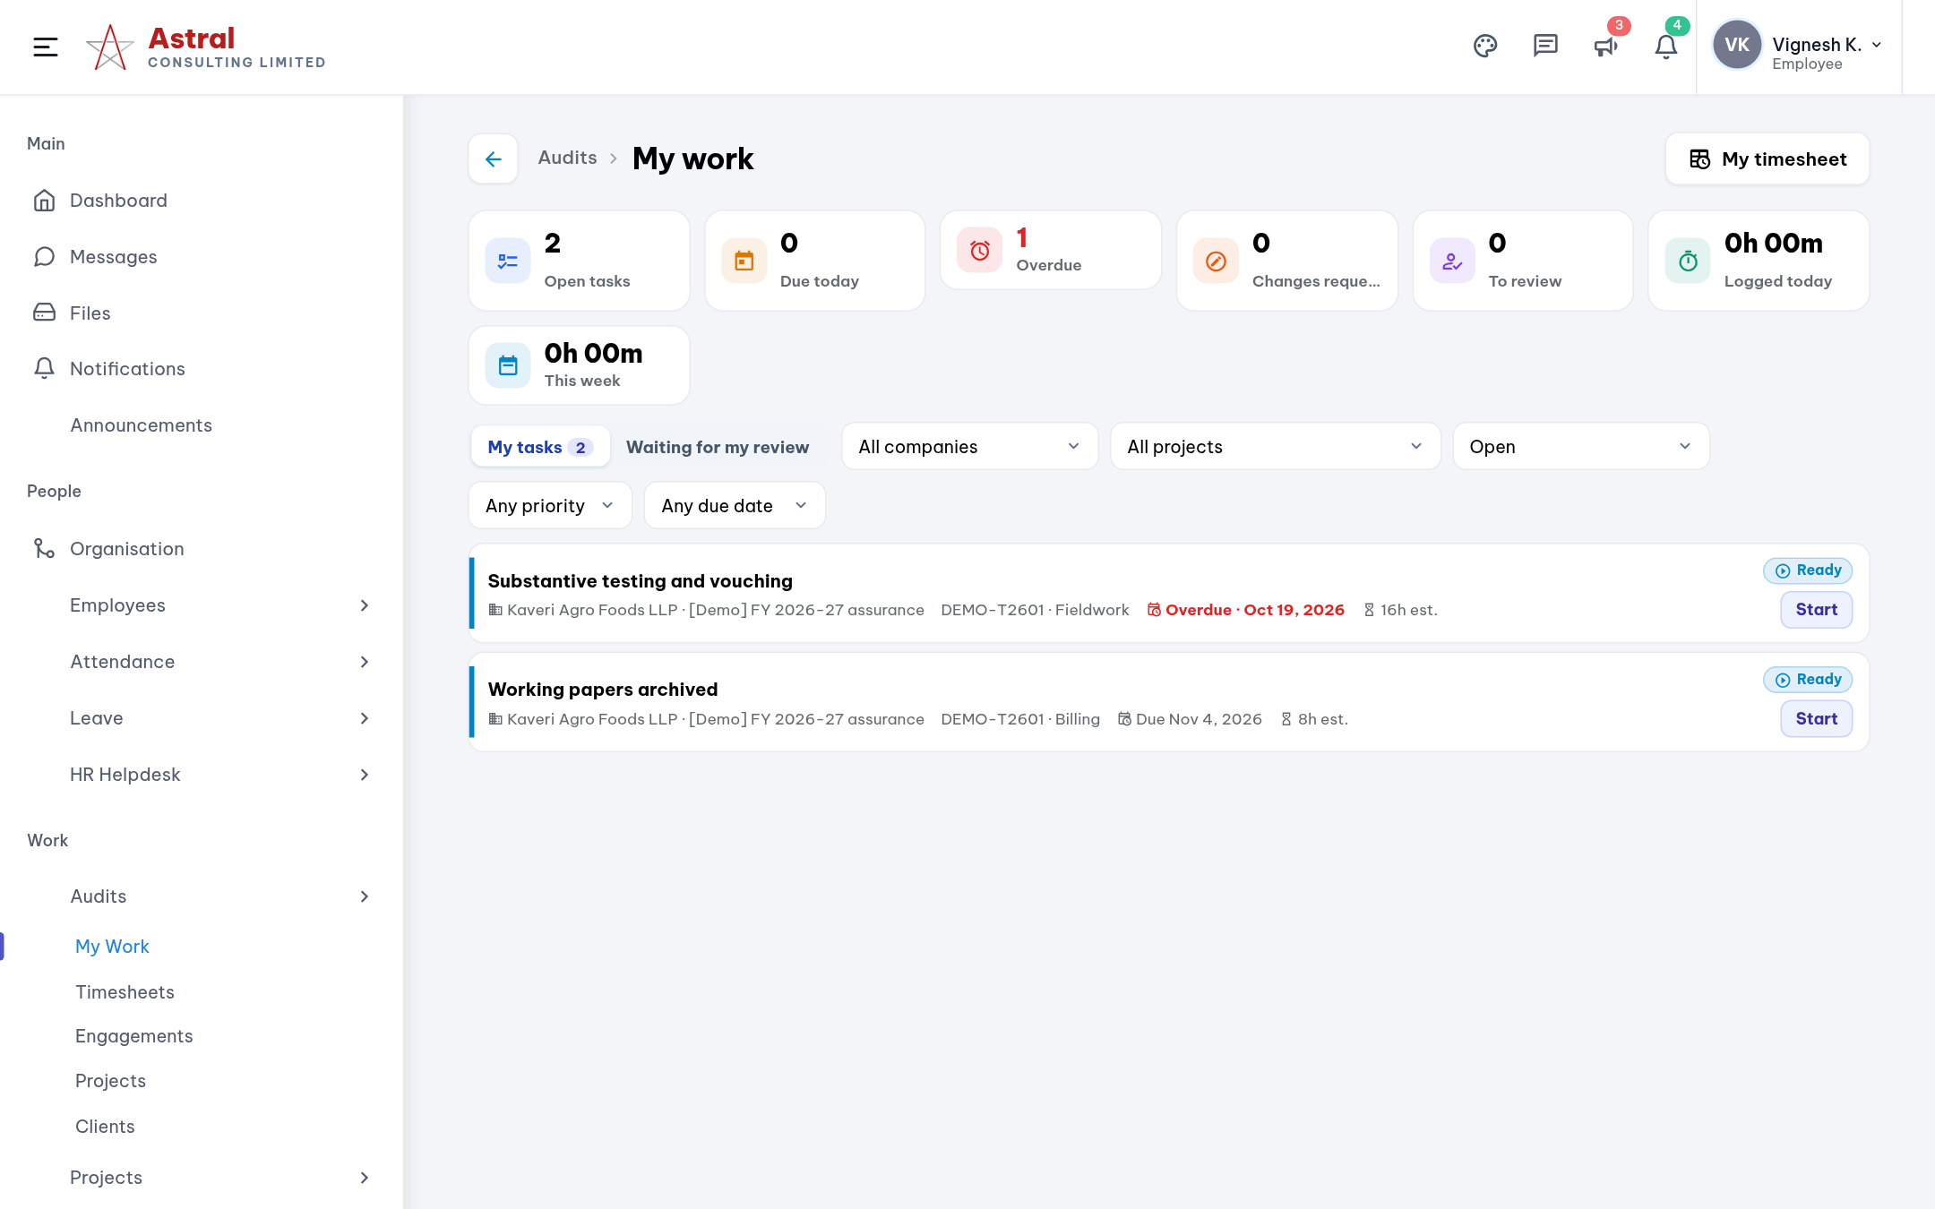
My Work: your task list across all audits
Audits › My Work
1
Counters at the top
Open, due today, overdue, changes requested, to review, time logged.
2
My tasks / Waiting for my review
Switch between work you own and work you review.
3
Start
Starts the timer on that task. The task page opens with the details.
4
Filters
Company, project, status, priority and due date.

Slide 9
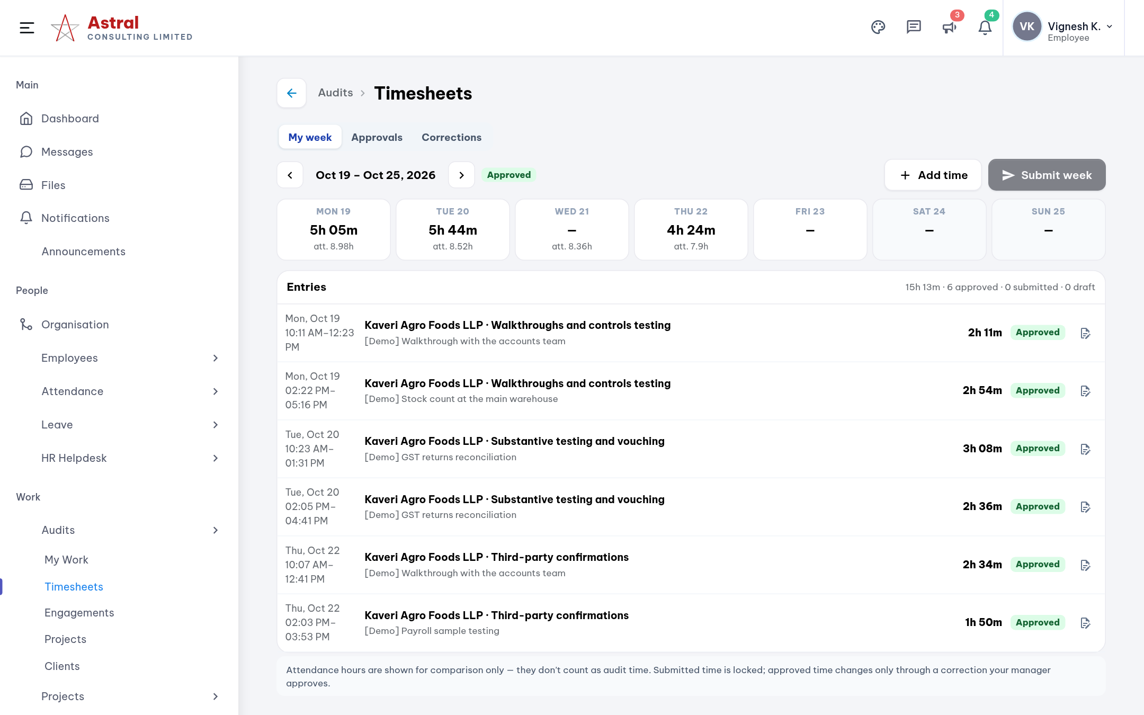
Timesheets: check and submit your week
Audits › Timesheets
1
Day strip
Audit time per day, with attendance hours underneath to compare.
2
Entries
Every timer session or manual entry and its status.
3
Add time · Submit week
Log missed work, then submit. Submitted time is locked.
4
Corrections
Ask for a change to time that is already approved.

Slide 10
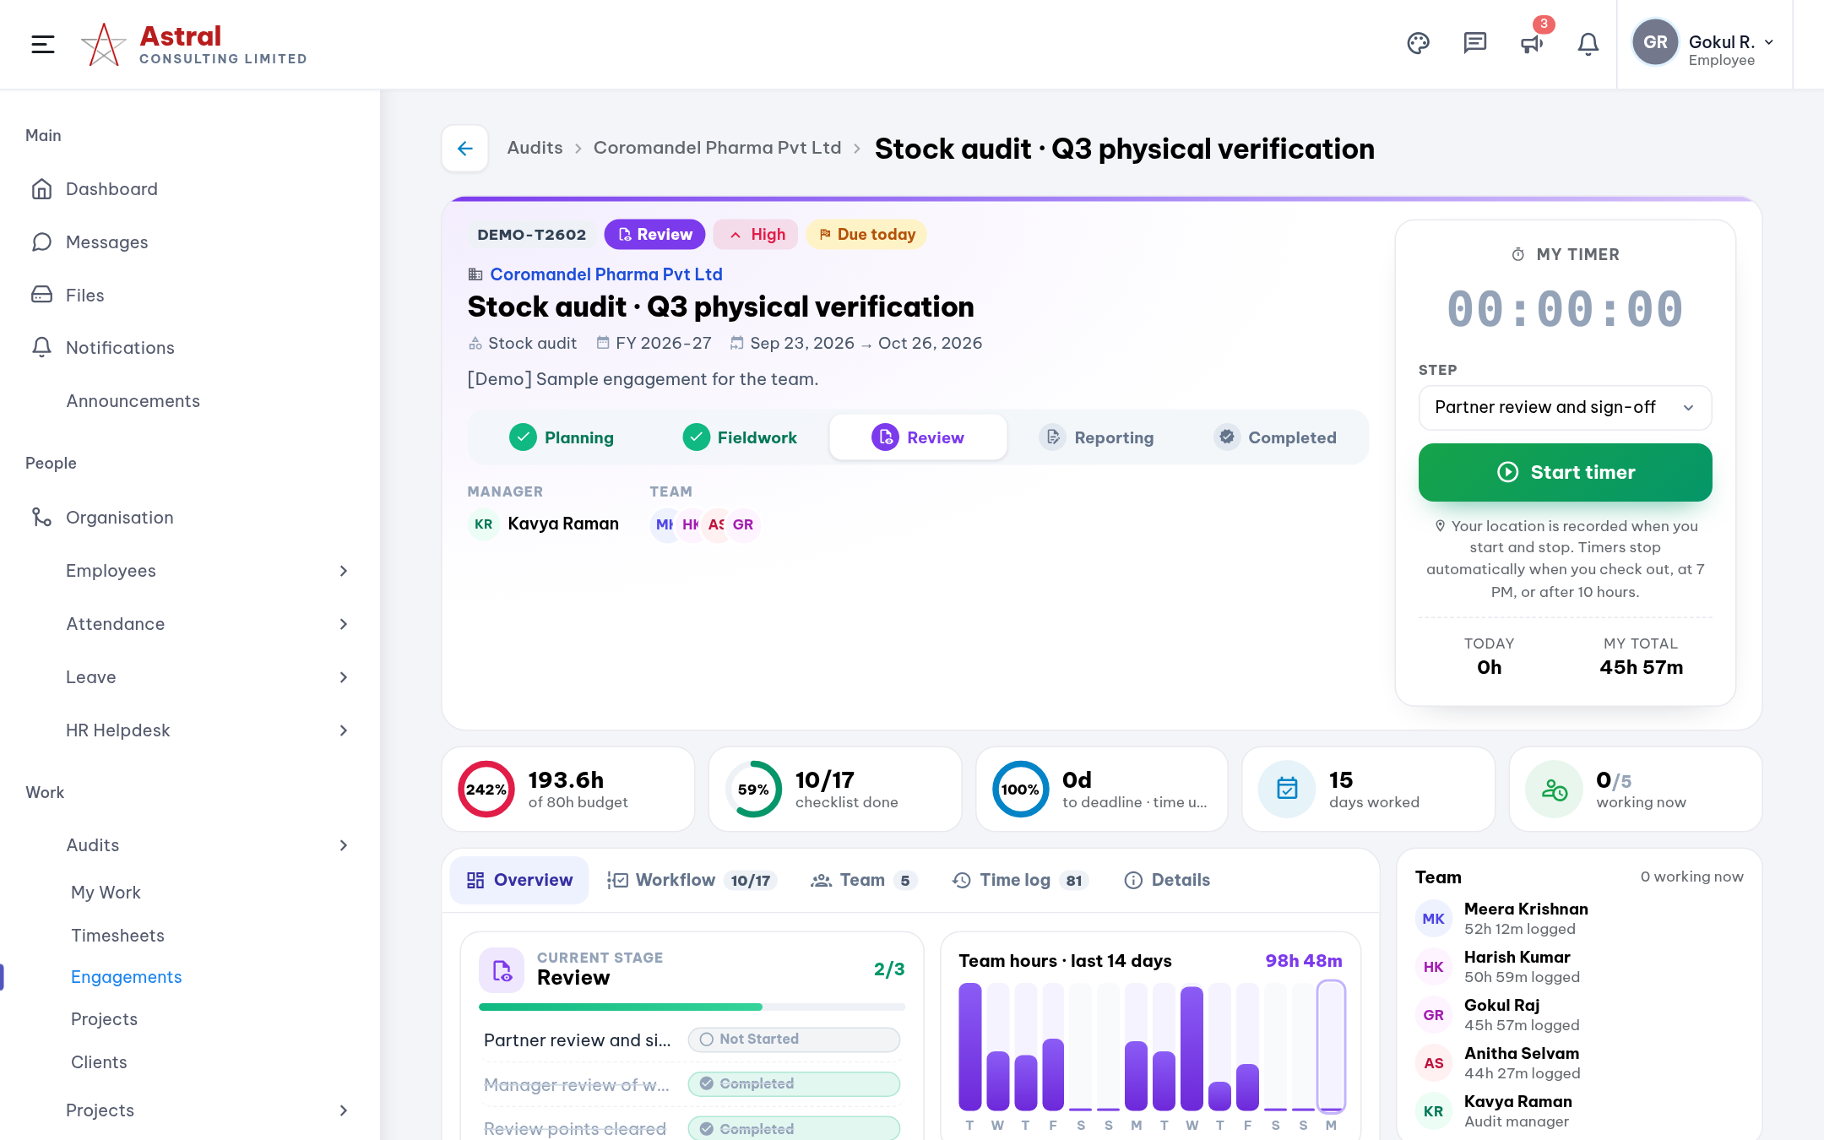
The audit (engagement) page
Audits › Engagements › open an audit
1
Header
Client, audit type, stage, deadline and priority.
2
My timer
Pick the workflow step and press Start timer.
3
Progress
Hours against budget, tasks done, days to deadline.
4
Tabs
Overview, Workflow, Team, Time log and Details.

Slide 11
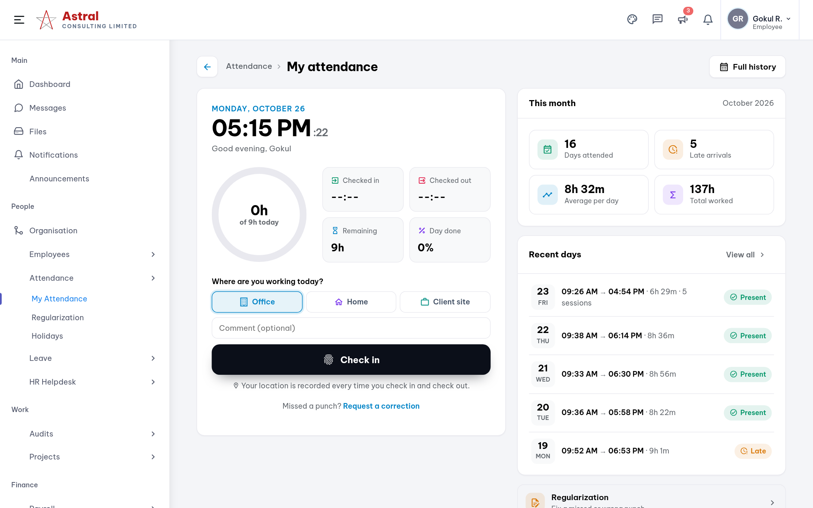
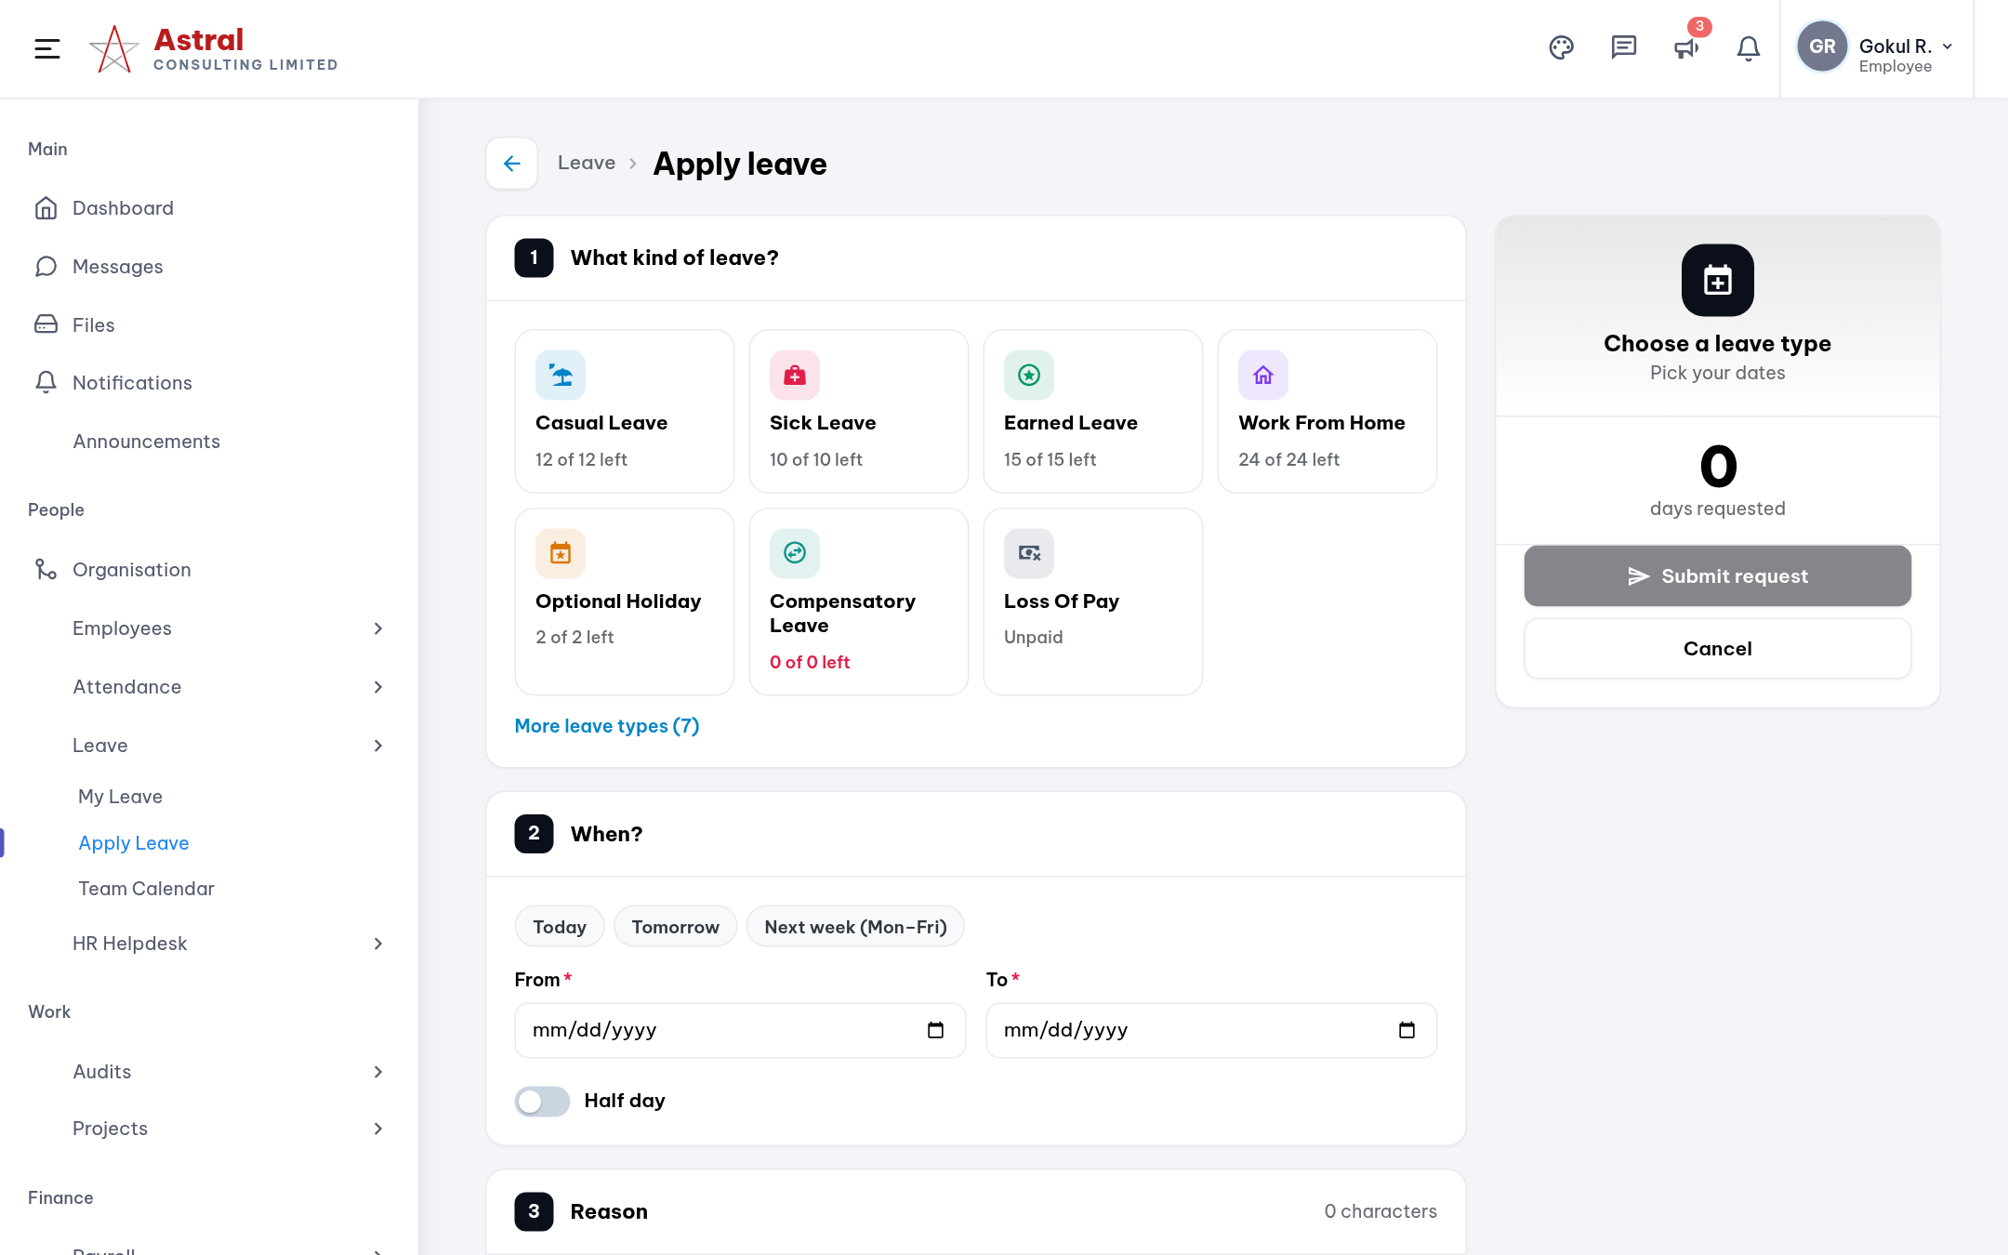
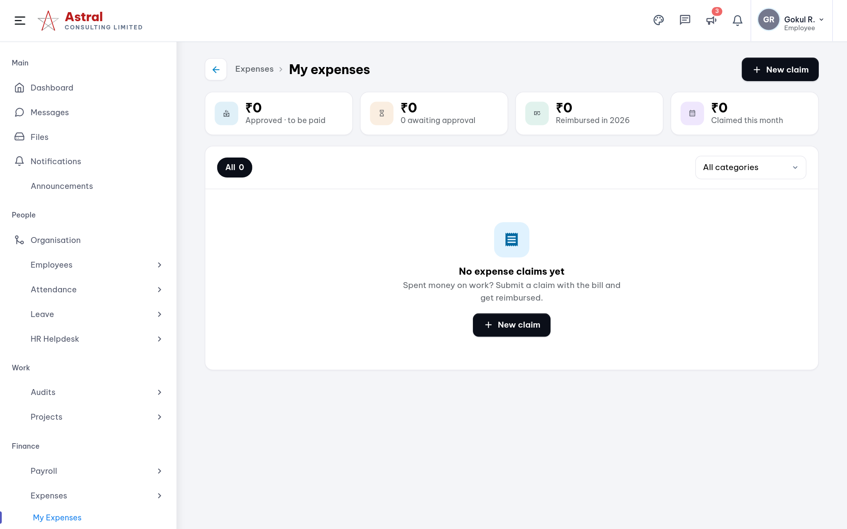
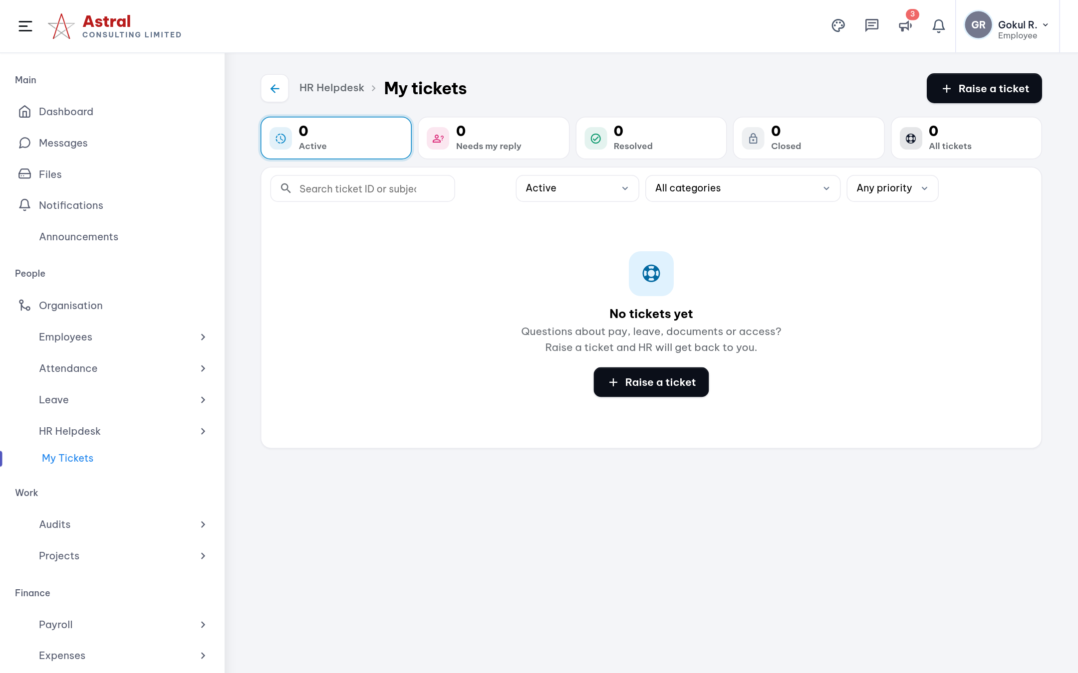
Self-service: attendance, leave, expenses, helpdesk
No forms to email. Each request is tracked until it is approved or resolved.
My Attendance
Attendance › My Attendance
Apply Leave
Leave › Apply Leave
My Expenses
Expenses › My Expenses
HR Helpdesk
HR Helpdesk › My Tickets

Slide 12
Managers & team leads
Senior Managers and Managers set up audits and keep the team balanced. Senior Consultants lead fieldwork and approve their team.

Slide 13
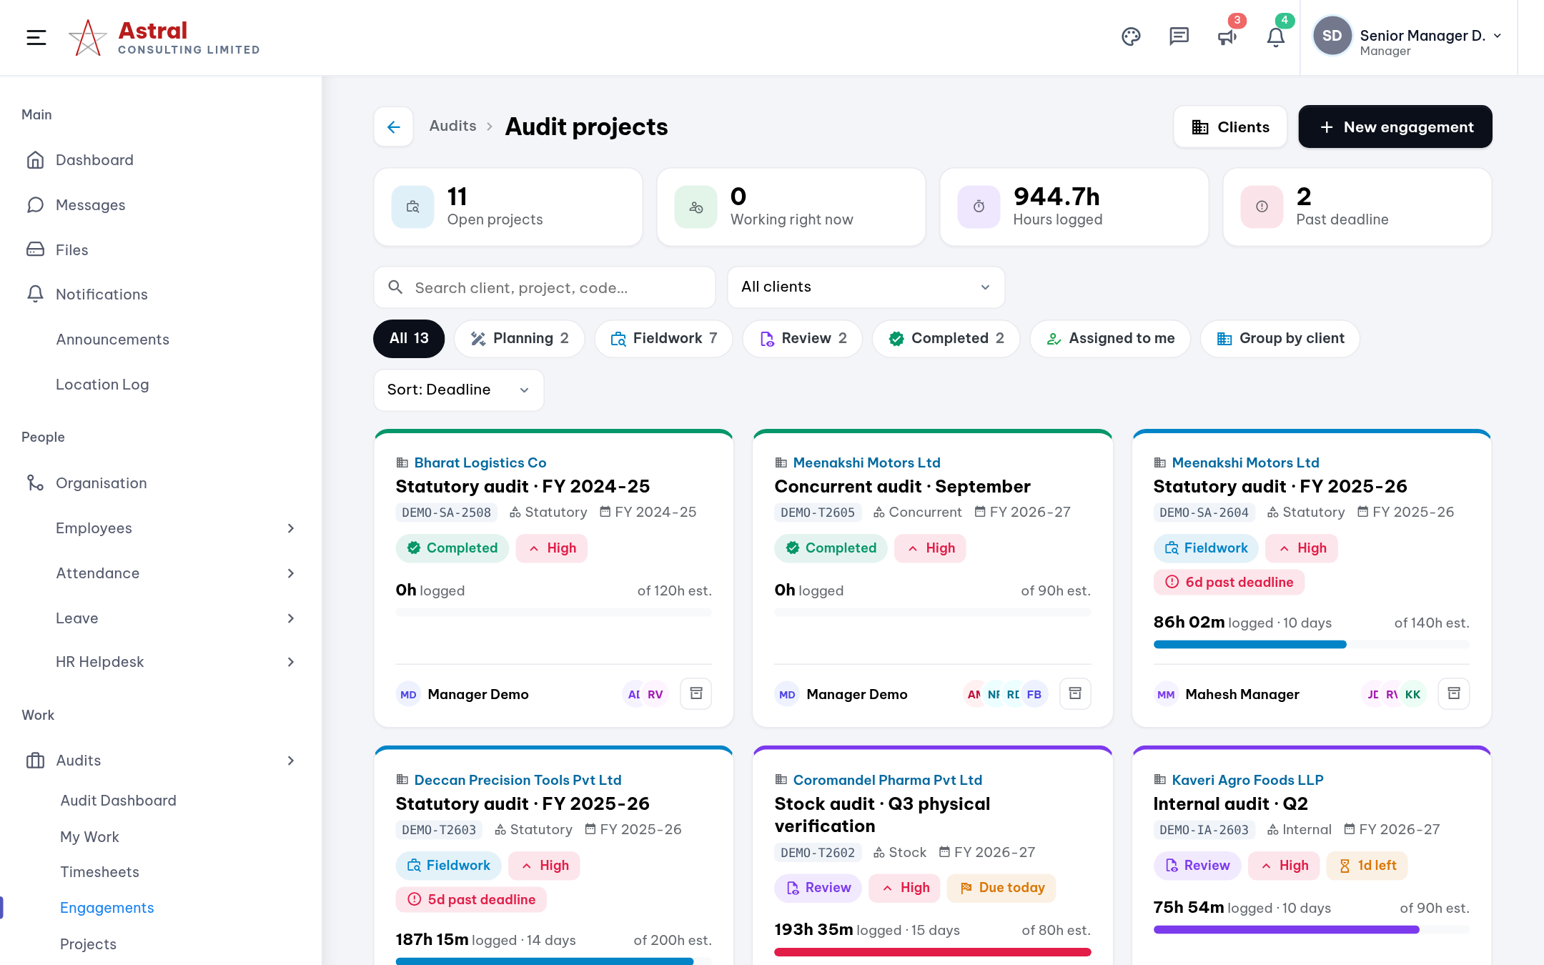
Setting up a new audit
Audits › Engagements › New engagement
1
Pick the client
and optionally a project. Add a new client from the same form.
2
Fill the basics
Audit type, financial year, deadline, budget hours and fee.
3
Choose the checklist
Leave it on Automatic to use the best match.
4
Add the team
Then set an owner and reviewer for each task.

Slide 14
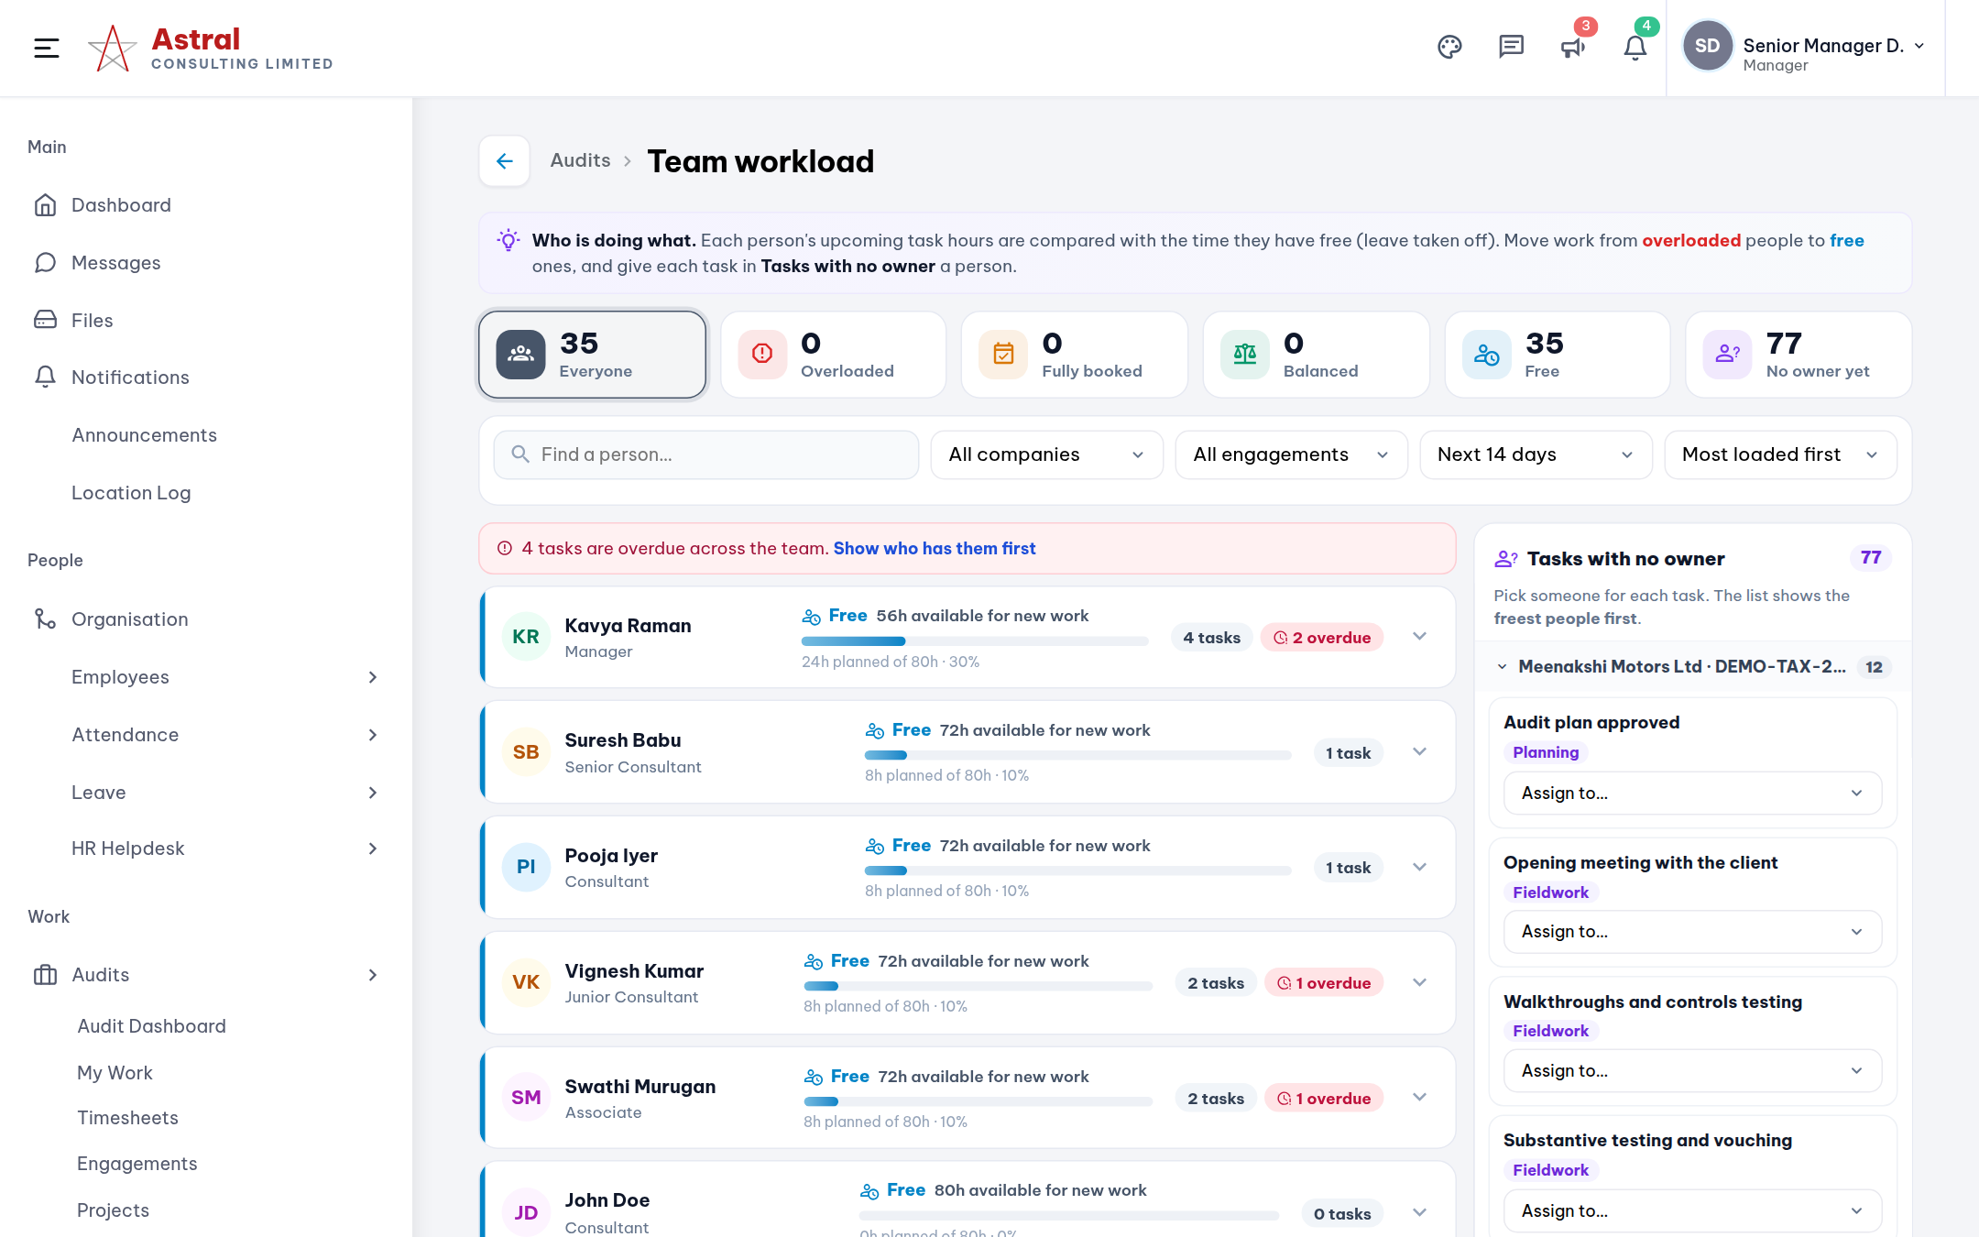
Team Workload: who is free, who is overloaded
Audits › Team Workload
1
Tiles = filters
Overloaded, Fully booked, Balanced, Free and tasks with no owner.
2
Each person
Upcoming task hours against the time they have free (leave taken off).
3
Move a task
Open a person and reassign a task to someone freer.
4
Tasks with no owner
Pick a person; the freest people are listed first.

Slide 15
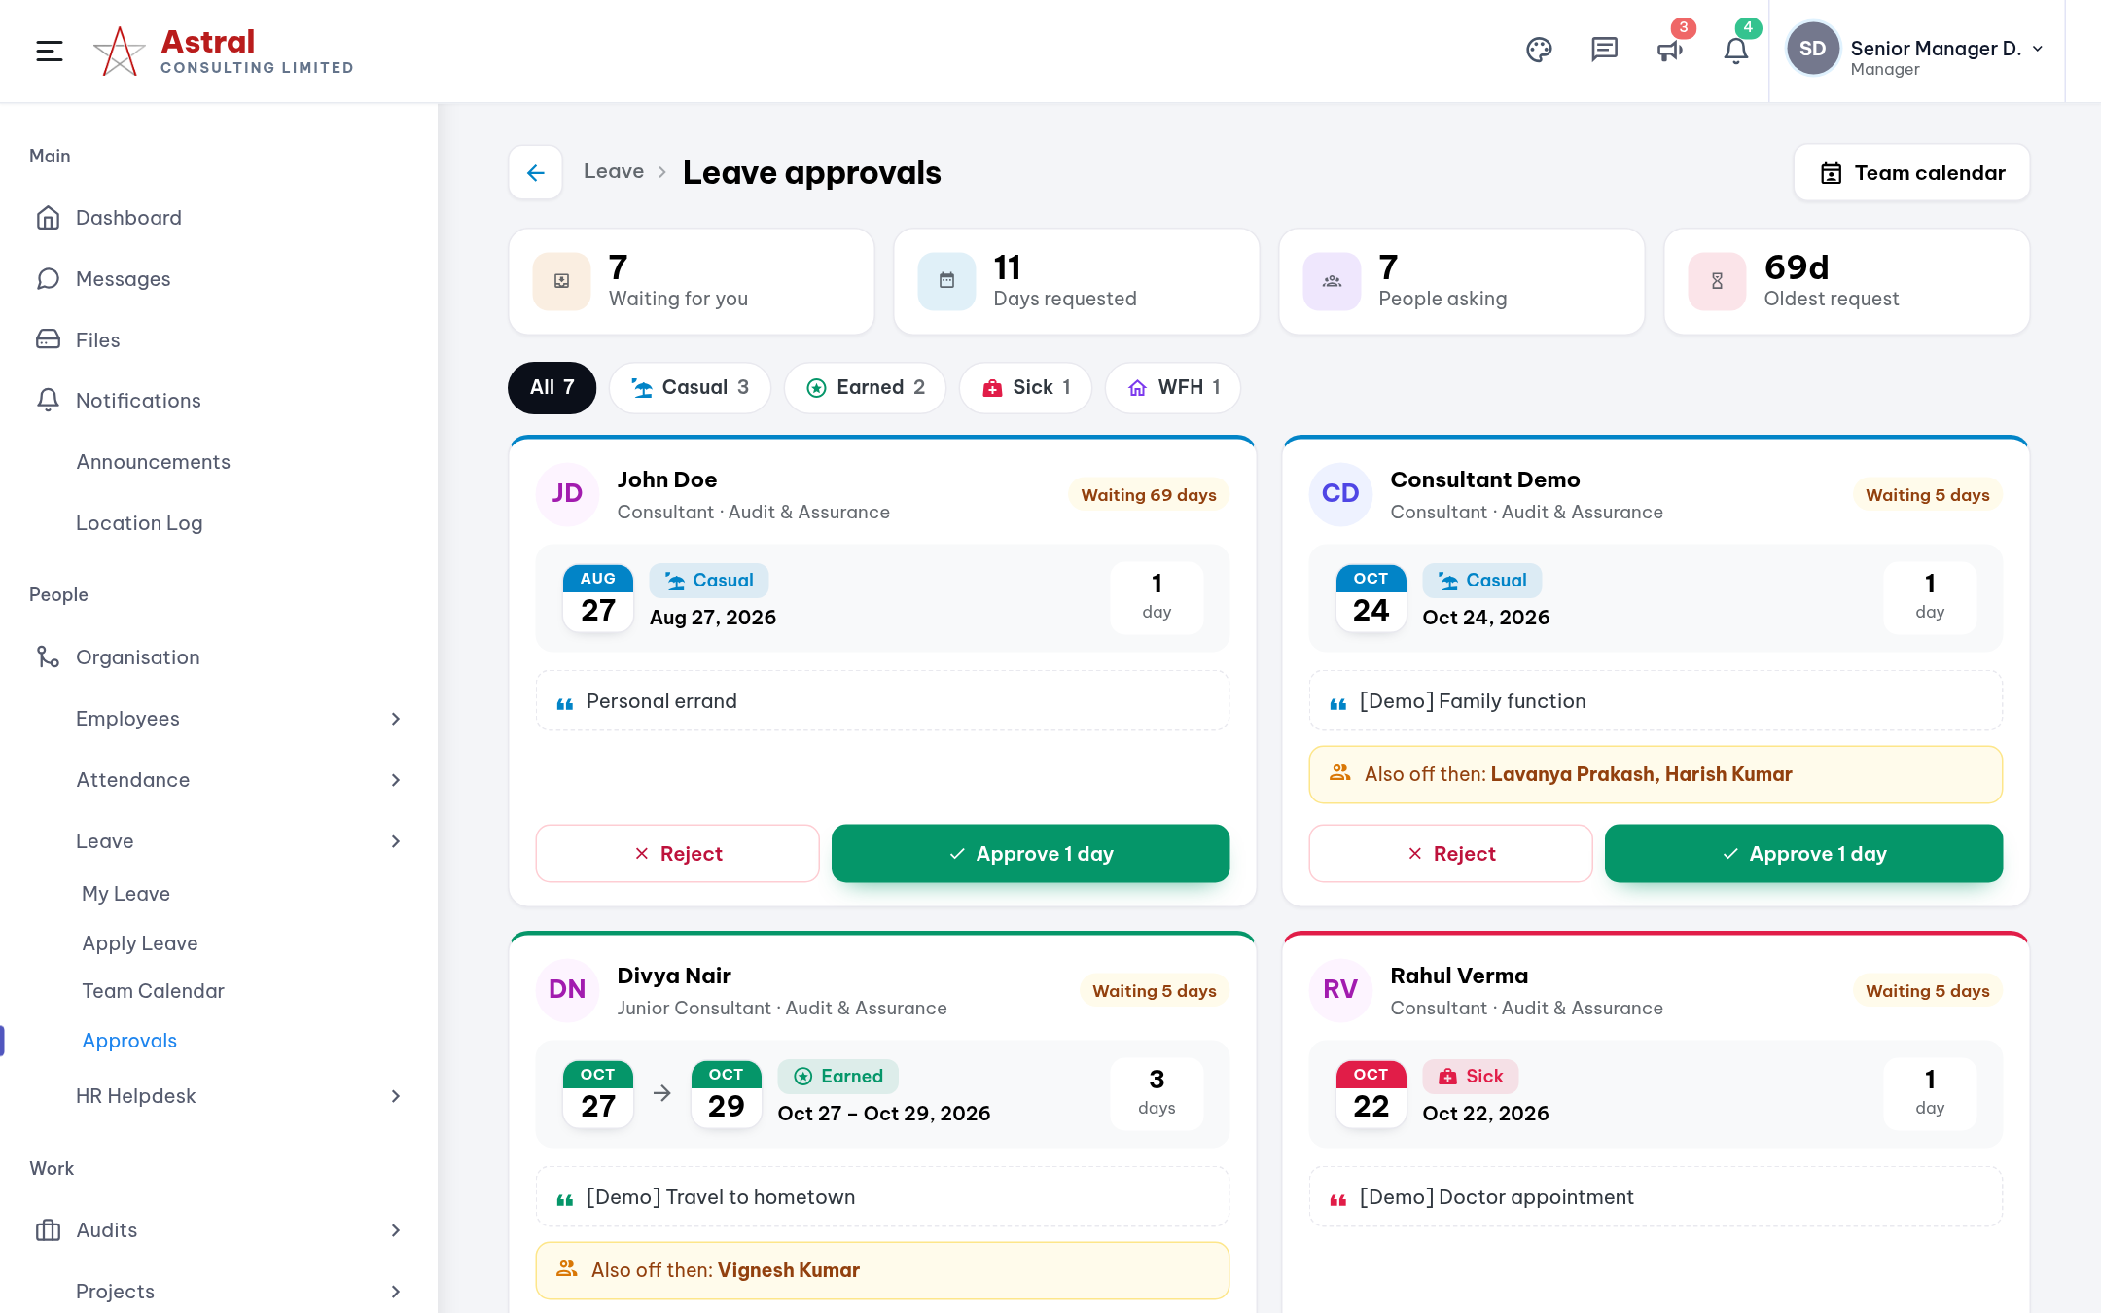
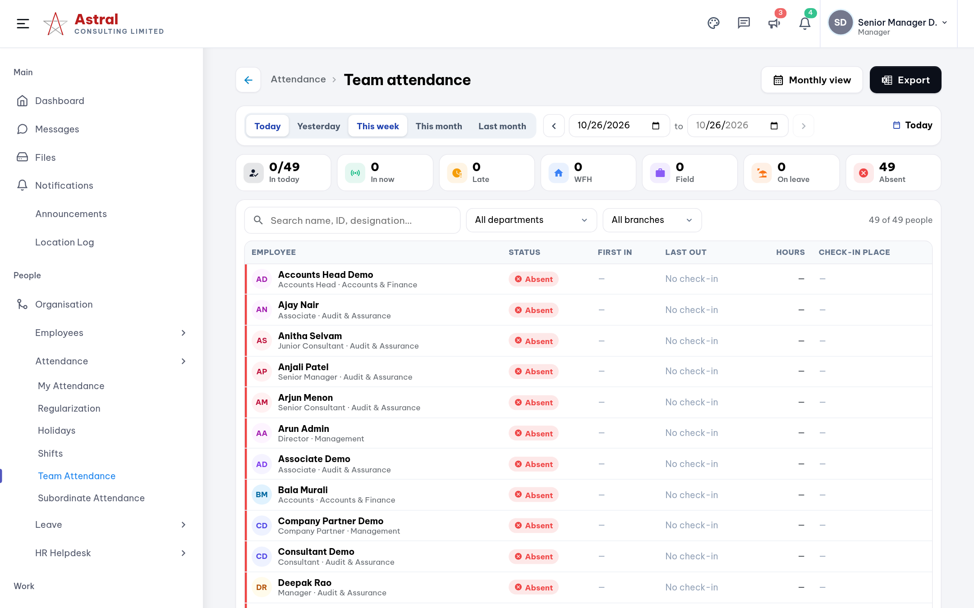
Approving your team
Leave › Approvals and Attendance › Team Attendance. Timesheets › Approvals works the same way.
Leave approvals Approve or reject with one click; clashes with teammates are flagged.
Team attendance Who is in, late or absent for any date range; export to Excel.

Slide 16
HR Head & HR
Own the people records, attendance and leave rules, the helpdesk, and payroll inputs.

Slide 17
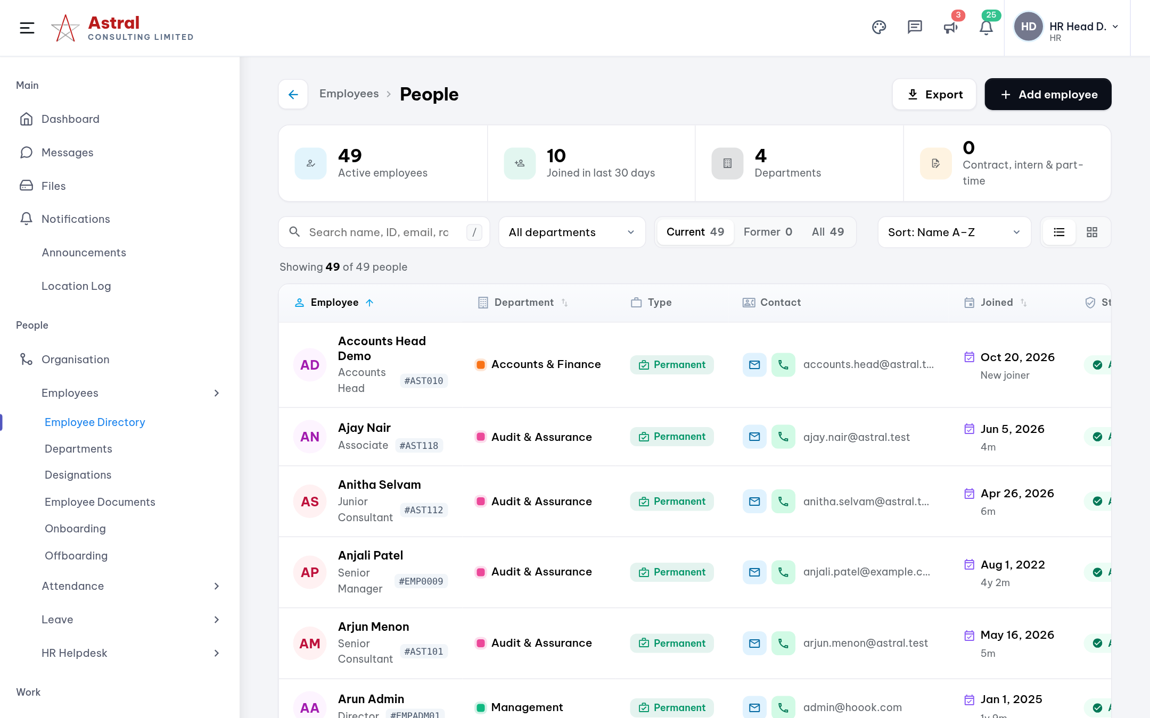
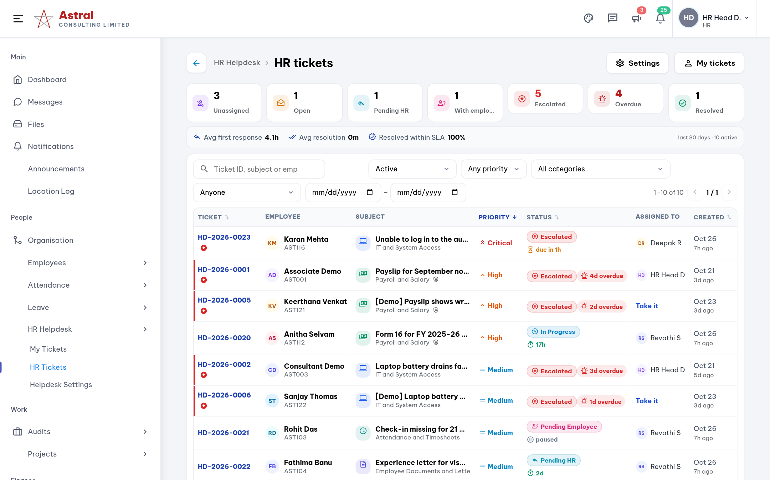
HR: people, attendance and the helpdesk
Employees › Employee Directory and HR Helpdesk › HR Tickets
People Add employees, onboarding and offboarding, documents, departments, shifts and holidays.
Helpdesk Assign tickets, reply or add internal notes, watch SLA timers and escalations.

Slide 18
Accounts Head & Accounts
Approve and reimburse expenses, raise invoices from approved work, and follow up collections.

Slide 19
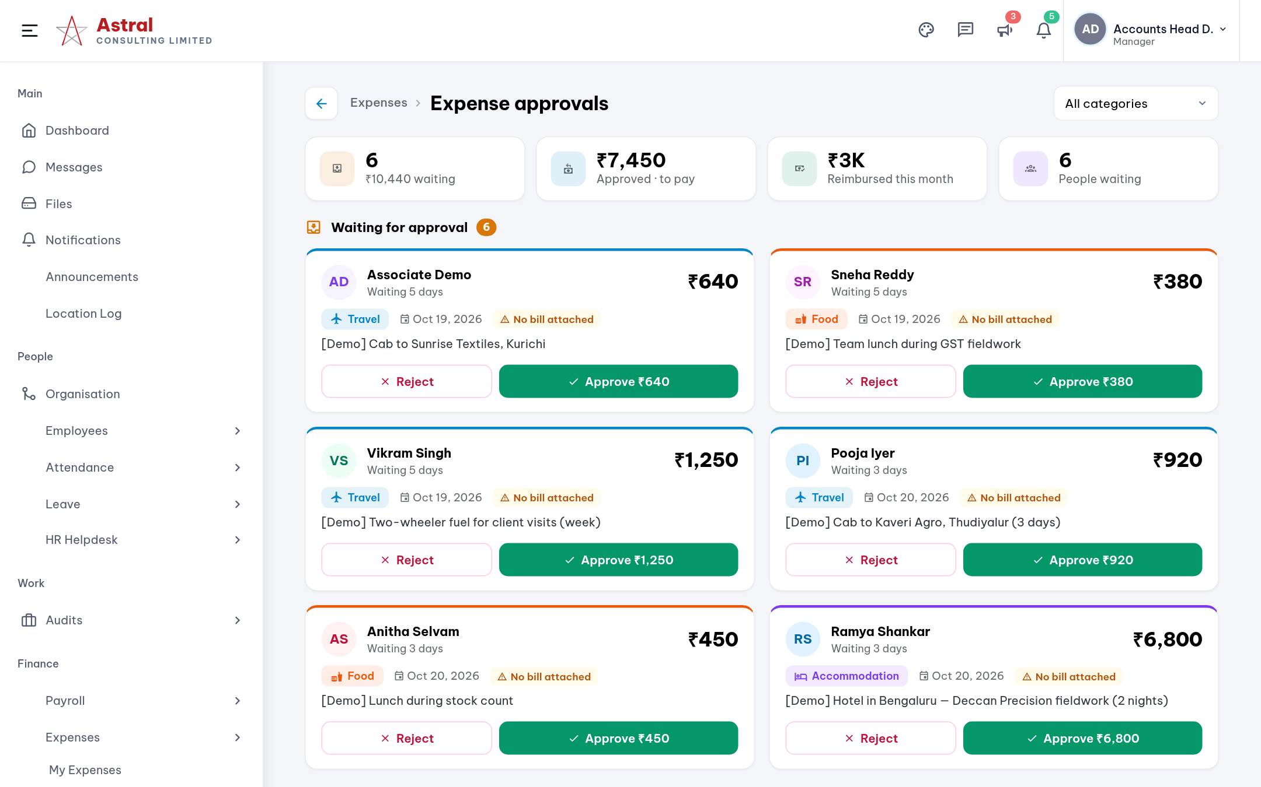
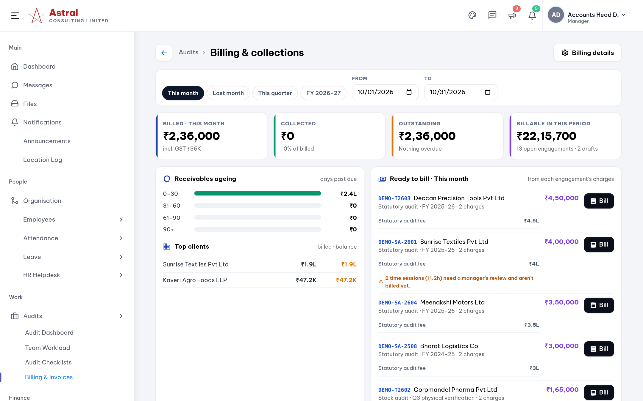
Accounts: expenses and billing
Expenses › Approvals and Audits › Billing & Invoices
Expense approvals Approve or reject each claim, see the bill attached, then mark it Reimbursed.
Billing & collections Ready-to-bill list per engagement, invoices, receivables ageing and payments.

Slide 20
Partners & Directors
See every screen. Watch delivery and money across the firm, and control who can see what.

Slide 21
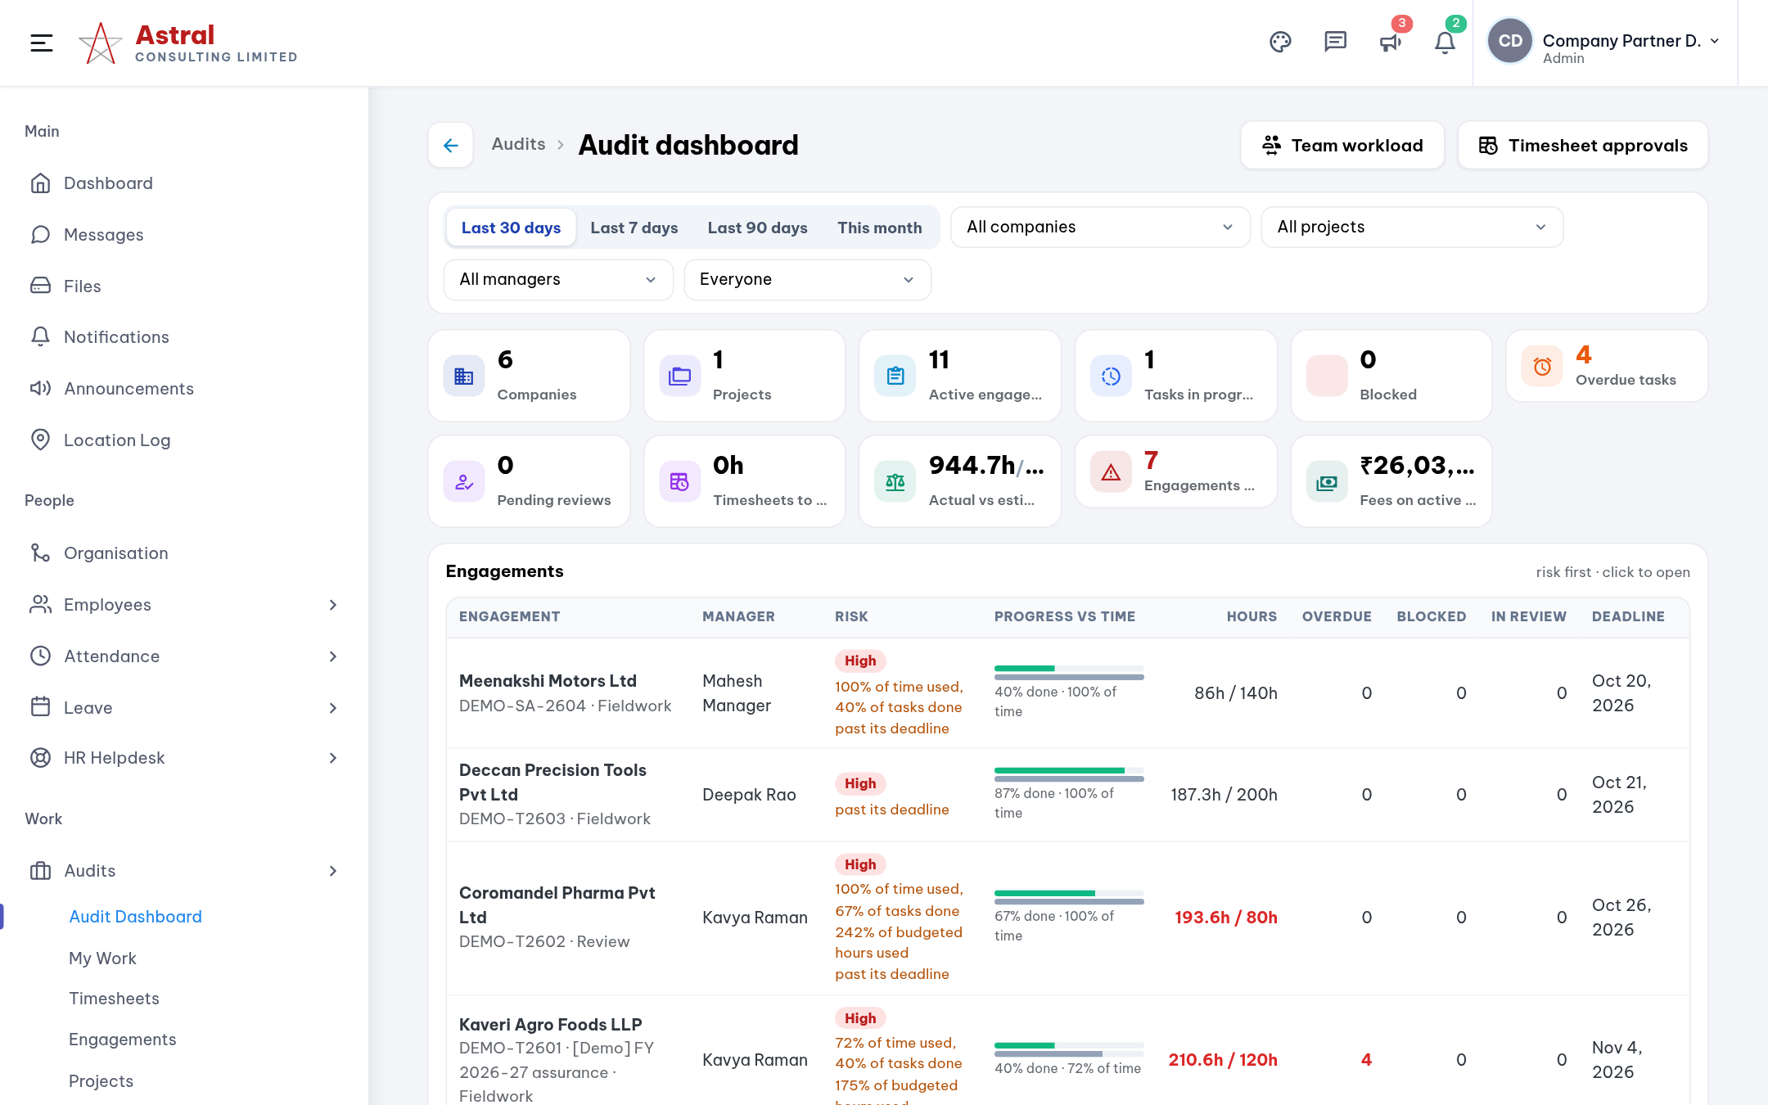
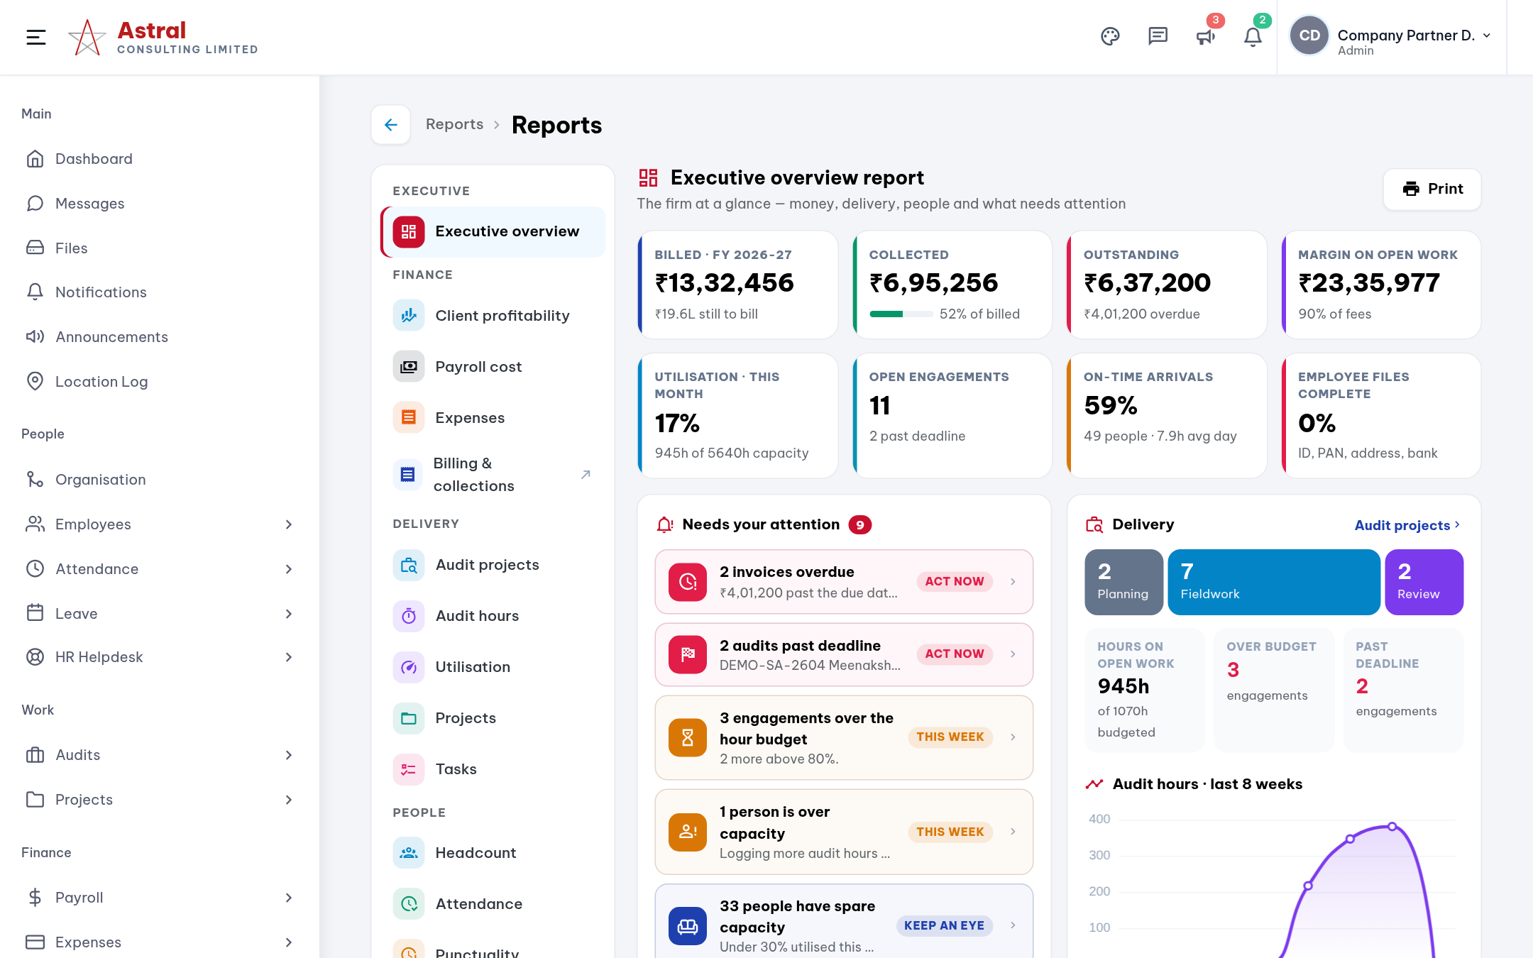
Partners: the firm at a glance
Audits › Audit Dashboard and Reports › Executive overview
Audit Dashboard Every engagement’s risk, hours against budget, overdue and blocked work.
Reports Billed, collected, outstanding, margin, utilisation and punctuality.

Slide 22
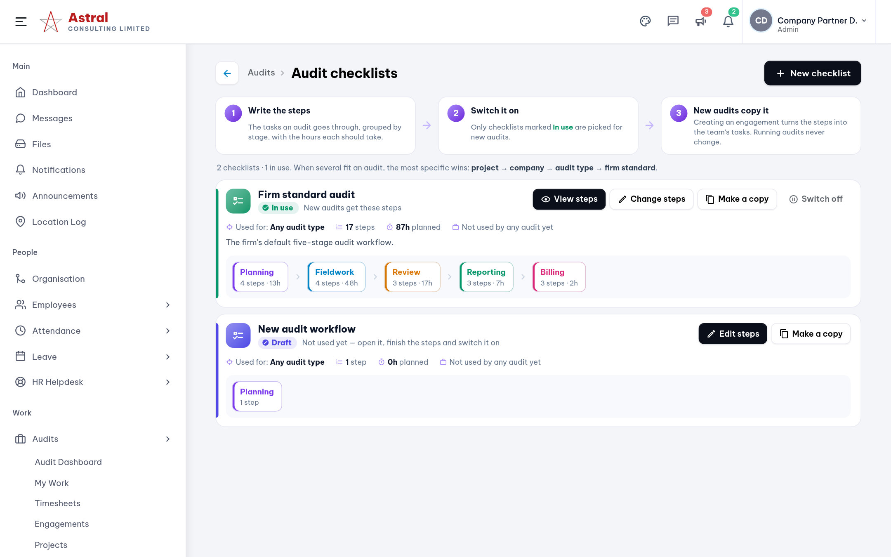
Audit Checklists: the standard steps for every audit
Audits › Audit Checklists (Partners, Directors, Heads, Managers)
1
Write the steps
Tasks grouped by stage, with the hours each should take.
2
Switch it on
Only checklists marked In use are picked for new audits.
3
Most specific wins
Project, then company, then audit type, then the firm standard.
4
Safe to change
Edits make a new version; running audits keep their copy.

Slide 23
Who sees which screen: people & time
Taken from the live access settings, one real user per designation
Screen | Partner / Director | HR Head | HR | Accts Head | Accounts | Sr Manager | Manager | Sr Consultant | Staff*
Dashboard, Messages, Files, My Profile | ✓ | ✓ | ✓ | ✓ | ✓ | ✓ | ✓ | ✓ | ✓
Employee Directory | ✓ | ✓ | ✓ | ✓ | ✓ | ✓ | ✓ | ✓ | –
Departments & Designations | ✓ | ✓ | ✓ | – | – | – | – | – | –
Onboarding & Offboarding | ✓ | ✓ | ✓ | – | – | – | – | – | –
My Attendance & Regularization | ✓ | ✓ | ✓ | ✓ | ✓ | ✓ | ✓ | ✓ | ✓
Shifts | ✓ | ✓ | ✓ | – | – | ✓ | ✓ | – | –
Team & Subordinate Attendance | ✓ | ✓ | ✓ | ✓ | – | ✓ | ✓ | ✓ | –
My Leave, Apply Leave, Team Calendar | ✓ | ✓ | ✓ | ✓ | ✓ | ✓ | ✓ | ✓ | ✓
Leave Approvals | ✓ | ✓ | ✓ | ✓ | – | ✓ | ✓ | ✓ | –
HR Helpdesk: My Tickets | ✓ | ✓ | ✓ | ✓ | ✓ | ✓ | ✓ | ✓ | ✓
HR Helpdesk: HR Tickets | ✓ | ✓ | ✓ | ✓ | – | ✓ | ✓ | ✓ | –
Helpdesk Settings | ✓ | ✓ | ✓ | – | – | – | – | – | –
* Staff = Consultants, Junior Consultants and Associates. Team screens (Team Attendance, approvals, Location Log, Reports) also appear for anyone who has people reporting to them. Directors see the same as Partners. Admins can change any of this in Settings › Access Control.

Slide 24
Who sees which screen: work, money & admin
Taken from the live access settings, one real user per designation
Screen | Partner / Director | HR Head | HR | Accts Head | Accounts | Sr Manager | Manager | Sr Consultant | Staff*
My Work, Timesheets, Engagements, Clients | ✓ | ✓ | ✓ | – | – | ✓ | ✓ | ✓ | ✓
Audit Dashboard | ✓ | ✓ | – | ✓ | ✓ | ✓ | ✓ | – | –
Team Workload & Audit Checklists | ✓ | ✓ | – | ✓ | – | ✓ | ✓ | – | –
Billing & Invoices | ✓ | ✓ | ✓ | ✓ | ✓ | ✓ | – | – | –
Projects & My Tasks | ✓ | ✓ | ✓ | – | – | ✓ | ✓ | ✓ | ✓
My Payslips & Loans | ✓ | ✓ | ✓ | ✓ | ✓ | ✓ | ✓ | ✓ | ✓
Salary Structure | ✓ | ✓ | ✓ | ✓ | – | – | – | – | –
Payroll Runs | ✓ | – | – | ✓ | – | – | – | – | –
My Expenses | ✓ | ✓ | ✓ | ✓ | ✓ | ✓ | ✓ | ✓ | ✓
Expense Approvals | ✓ | ✓ | ✓ | ✓ | – | ✓ | ✓ | ✓ | –
Asset Register & Who Has What | ✓ | ✓ | ✓ | ✓ | – | ✓ | – | – | –
Reports | ✓ | ✓ | ✓ | ✓ | – | ✓ | ✓ | ✓ | –
Settings & Audit Logs | ✓ | ✓ | ✓ | – | – | – | – | – | –
* Staff = Consultants, Junior Consultants and Associates. Team screens (Team Attendance, approvals, Location Log, Reports) also appear for anyone who has people reporting to them. Directors see the same as Partners. Admins can change any of this in Settings › Access Control.

Slide 25

What each status means
The same words appear on every screen.
Audit task
Not Started
Assigned
Ready
In Progress
Submitted
Under Review
Approved
Completed
Side states: Blocked, Changes Requested (back to the owner), Cancelled
Timesheet entry
Draft
Submitted
Approved
Or Rejected: fix it and submit again
Expense claim
Pending
Approved
Reimbursed
Or Rejected
Leave & missed punch
Pending
Approved
Or Rejected; leave can also be Cancelled
Helpdesk ticket
Open
Assigned
In Progress
Pending Employee / HR
Resolved
Closed
Side states: Escalated, Reopened, Rejected

Slide 26
Where do I…?
The quickest path to the things people ask about most.
Check in or out
Dashboard › My day
Claim an expense
Expenses › My Expenses › New claim
Fix a missed punch
Attendance › Regularization
Ask HR a question
HR Helpdesk › Raise a ticket
Apply for leave
Leave › Apply Leave
Download my payslip
Payroll › My Payslips
Start audit work
Audits › My Work › Start
Create an audit (managers)
Audits › Engagements › New engagement
Log time I forgot to time
Audits › Timesheets › Add time
Rebalance the team (managers)
Audits › Team Workload
Submit my week
Audits › Timesheets › Submit week
Bill a client (accounts, partners)
Audits › Billing & Invoices

Slide 27
Don’t see a screen you need?
Ask a Partner or Director to grant it in Settings › Access Control. Changes apply the next time you sign in.

