Slide 1
DRAFT
Colleague Data Mapping

Slide 2
Context: CXOne and Guidewire are used in tandem by operational colleagues to manage the customer interactions, they each capture key information of those customer interactions. There is currently no common ID to link the systems together to tie up the colleague and customer activities so a complex process using fuzzy logic is used to create DIM_AGENT using the CCaaS data from CXOne with the Guidewire data in EDW. This has known limitations but currently used for all colleague reporting. DIM_AGENT Limitations: -> Complex build, hard to maintain -> Coupled with CCaaS and EDW builds -> Fuzzy matching and complex logic used - The ‘fuzzy matching’ is achieved by concatenating the first name & last name from the Guidewire agent data and appending “@hastingsdirect.com” to format an email address to lookup within the CXone agent data. -> Works for circa 98% of colleagues -> CCaaS build issues originally that mean that CXOne system data and the PROD_NICE database had conflicting agent info -> Date formats could be wrong, eg the year 1020 came through -> No end times being sent on hierarchy info in the WFM schema -> Duplicates agents -> Issues caused by name changes – e.g. Married name change -> Agents being given GW IDs someone else was already using. Or two IDs.

Slide 3
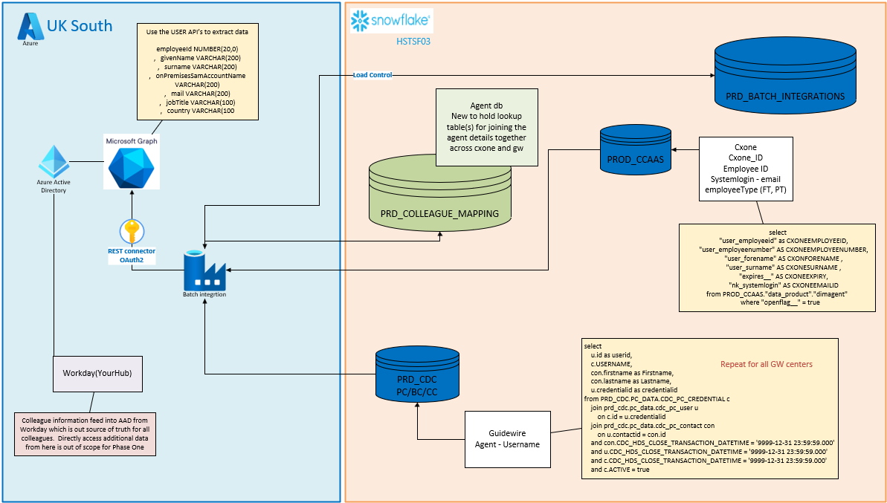
Architecture:

Slide 4
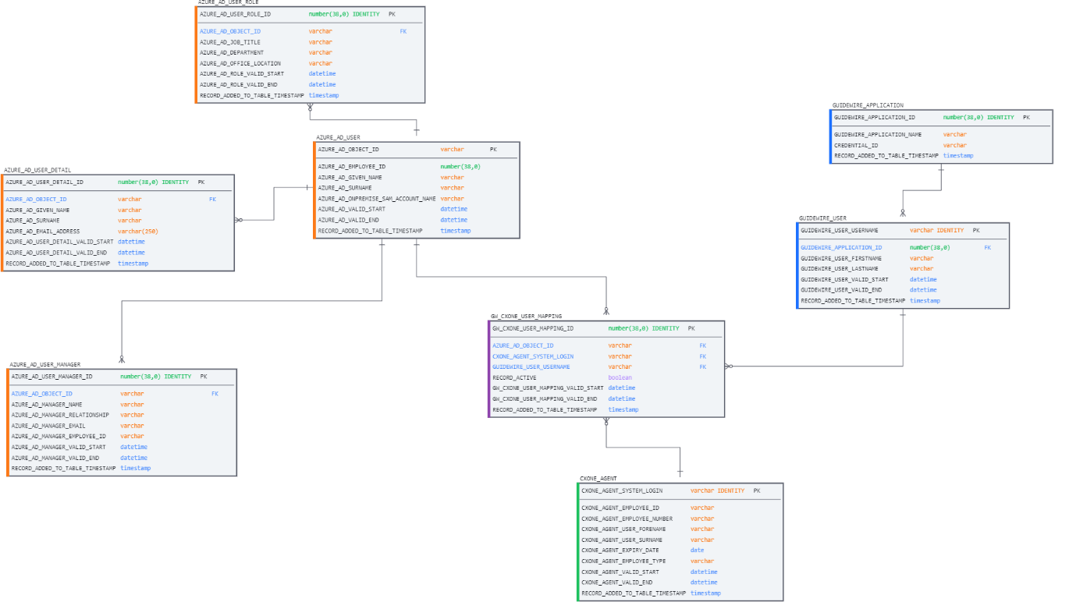
ER Diagram:

Slide 5
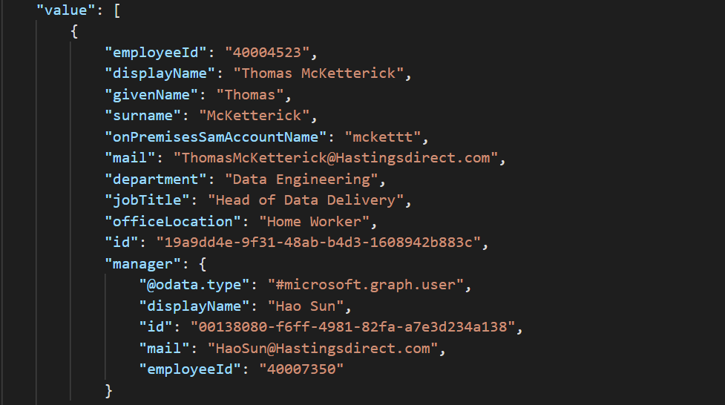
Graph API:
Query:
https://graph.microsoft.com/v1.0/groups/{Group_ID}/members/microsoft.graph.user?$select=employeeId,givenName,surname,onPremisesSamAccountName,mail,department,jobTitle,officeLocation&$expand=manager($levels=max;$select=displayName,id,mail,employeeId)

Slide 6
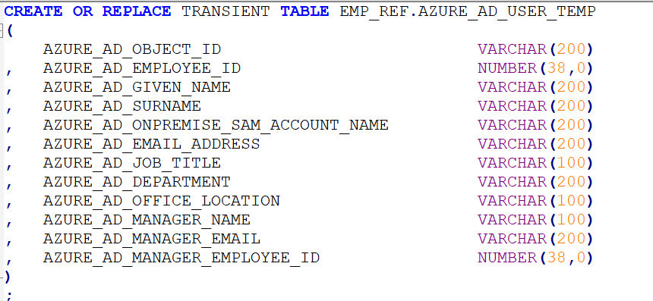
Azure AD Tables(Graph API)
1) AZURE_AD_USER_TEMP:
Each day the “AZURE_AD_USER_TEMP” table will have all the data contained in the table deleted, then all individuals contained in Azure Active Directory will be loaded into the “AZURE_AD_USER_TEMP” table.

Slide 7
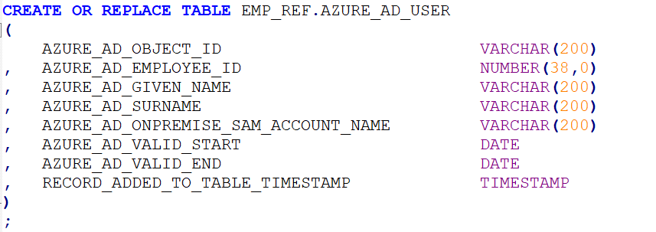
2) AZURE_AD_USER:
The data populated into “AZURE_AD_USER” table is never deleted; new records are incrementally added or existing records are incrementally updated.
The data contained in “AZURE_AD_USER_TEMP” table is joined to the data contained in “AZURE_AD_USER” table using the “AZURE_AD_OBJECT_ID” attribute.
Check whether the values populate in the following attributes in the latest record in table “AZURE_AD_USER_DETAIL” have changed compared to the data loaded in table “AZURE_AD_USER_TEMP”:
AZURE_AD_GIVEN_NAME ,AZURE_AD_SURNAME, AZURE_AD_ONPREMISE_SAM_ACCOUNT_NAME

Slide 8
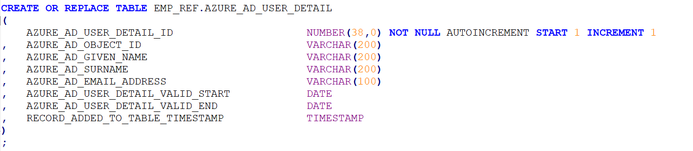
3) AZURE_AD_USER_DETAIL:
The data populated into “AZURE_AD_USER_DETAIL” table is never deleted; new records are incrementally added or existing records are incrementally updated.
The data contained in “AZURE_AD_USER_TEMP” table is joined to the data contained in “AZURE_AD_USER_DETAIL” table using the “AZURE_AD_OBJECT_ID” attribute.
Check whether the values populate in the following attributes in the latest record in table “AZURE_AD_USER_DETAIL” have changed compared to the data loaded in table “AZURE_AD_USER_TEMP”:
AZURE_AD_GIVEN_NAME,AZURE_AD_SURNAME,AZURE_AD_EMAIL_ADDRESS.

Slide 9
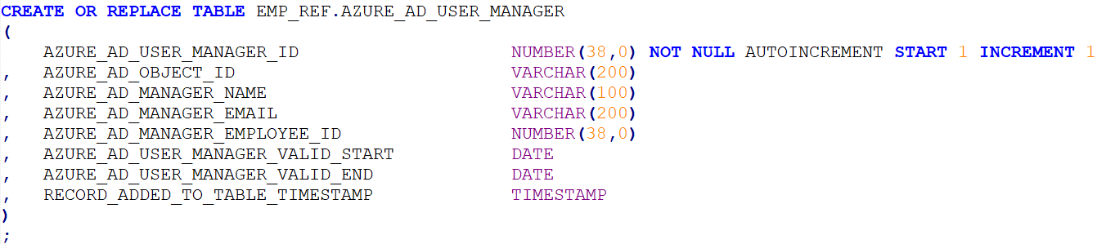
4) AZURE_AD_USER_MANAGER:
The data populated into “AZURE_AD_USER_MANAGER” table is never deleted; new records are incrementally added or existing records are incrementally updated.
The data contained in “AZURE_AD_USER_TEMP” table is joined to the data contained in “AZURE_AD_USER_MANAGER” table using the “AZURE_AD_OBJECT_ID” attribute.
Check whether the values populate in the following attributes in the latest record in table “AZURE_AD_USER_MANAGER” have changed compared to the data loaded in table “AZURE_AD_USER_TEMP”:
AZURE_AD_MANAGER_NAME,AZURE_AD_MANAGER_EMAIL,AZURE_AD_MANAGER_EMPLOYEE_ID

Slide 10
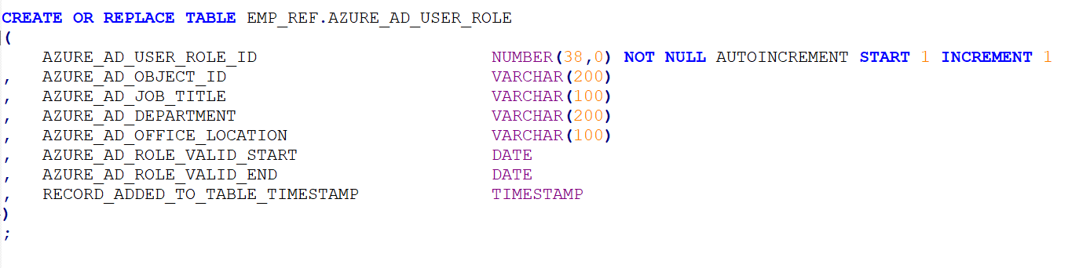
5) AZURE_AD_USER_ROLE :
The data populated into “AZURE_AD_USER_ROLE” table is never deleted; new records are incrementally added, or existing records are incrementally updated.
The data contained in “AZURE_AD_USER_TEMP” table is joined to the data contained in “AZURE_AD_USER_ROLE” table using the “AZURE_AD_OBJECT_ID” attribute.
Check whether the values populate in the following attributes in the latest record in table “AZURE_AD_USER_ROLE” have changed compared to the data loaded in table “AZURE_AD_USER_TEMP”:
AZURE_AD_JOB_TITLE,AZURE_AD_DEPARTMENT,AZURE_AD_OFFICE_LOCATION

Slide 11
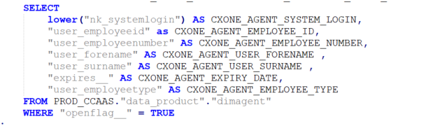
ii) Loading Cxone Data:
1) CXONE_AGENT_TEMP:
Each day the “CXONE_AGENT_TEMP” table will have all the data contained in the table deleted, then all individuals (colleagues)
setup in Guidewire will be loaded into the “CXONE_AGENT_TEMP” table.
Query on Cxone:

Slide 12
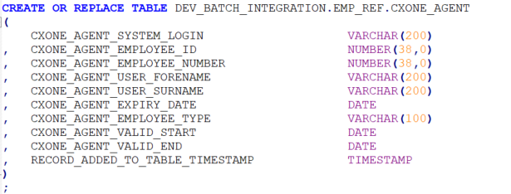
2) CXONE_AGENT :
The data contained in “CXONE_AGENT_TEMP” table is joined to the data contained in “CXONE_AGENT” table using the “CXONE_AGENT_SYSTEM_LOGIN “attribute.
New Records will be inserted to “CXONE_AGENT” from in “CXONE_AGENT_TEMP” table.
Update the following attributes in “CXONE_AGENT” table to the corresponding values contained in “CXONE_AGENT_TEMP” table:
CXONE_AGENT_EMPLOYEE_ID,CXONE_AGENT_EMPLOYEE_NUMBER,CXONE_AGENT_USER_FORENAME,CXONE_AGENT_USER_SURNAME,
CXONE_AGENT_EMPLOYEE_TYPE

Slide 13
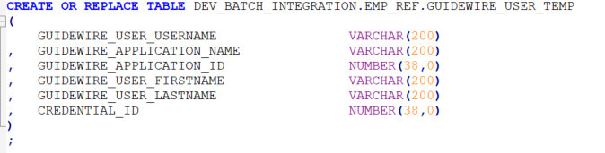
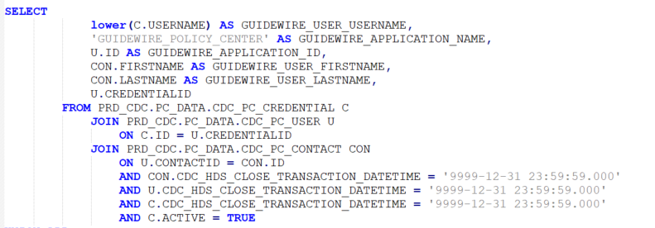
iii) Guidewire Data:
GUIDEWIRE_USER_TEMP:
Each day the “GUIDEWIRE_USER_TEMP” table will have all the data contained in the table deleted, then all individuals (colleagues) setup in Guidewire will be loaded into the “GUIDEWIRE_USER_TEMP” table.
Example: Policy Center

Slide 14
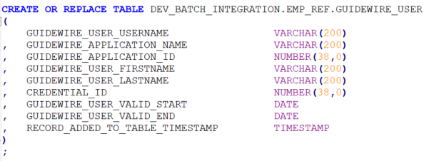
2) GUIDEWIRE_USER:
The data populated into “GUIDEWIRE_USER” able is never deleted; new records are incrementally added or existing records are incrementally updated.
The data contained in “GUIDEWIRE_USER_TEMP” table is joined to the data contained in “GUIDEWIRE_USER” table using the “GUIDEWIRE_USER_USERNAME” attribute.
Update the following attributes in “GUIDEWIRE_USER” table to the corresponding values contained in “GUIDEWIRE_USER_TEMP” table:
GUIDEWIRE_USER_FIRSTNAME,GUIDEWIRE_USER_LASTNAME

Slide 15
Views:
VW_UNIQUE_AZURE_AD_OBJECT_ID_EMAIL_ADDRESS:
->A list of all email addresses associated with an Azure Active Directory Object ID
2) VW_UNIQUE_AZURE_AD_OBJECT_ID_ONPREMISE_SAM_ACCOUNT:
-> A list of on-premises SAM accounts associated with an Azure Active Directory Object ID
3) VW_AZURE_AD_CXONE_LINK:
->Link CXOne to Azure Active Directory
4) VW_AZURE_AD_GUIDEWIRE_LINK :
-> Link Guidewire to Azure Active Directory
5) VW_GUIDEWIRE_CXONE_LINK:
-> Link CXOne to Guidewire using Azure Active Directory
6) VW_AZURE_AD_LATEST:
-> Latest Azure Active Directory Values
7) VW_GUIDEWIRE_POLICY_CXONE_MAPPING:
-> Colleague Reference View for Guidewire Policy Centre.
8) VW_GUIDEWIRE_POLICY_CXONE_MAPPING :
-> Colleague Reference View for Guidewire Billing Centre
9) VW_GUIDEWIRE_POLICY_CXONE_MAPPING:
-> Colleague Reference View for Guidewire Claims Centre

Slide 16
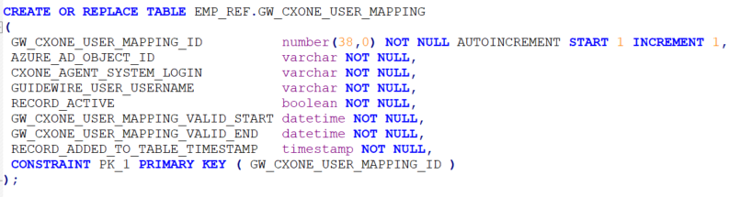
Population of CXone and Guidewire Mapping Table:
1) GW_CXONE_USER_MAPPING:
The table “GW_CXONE_USER_MAPPING” contains the linkage between Azure AD, CXOne and Guidewire.
It joins “GW_CXONE_USER_MAPPING” and “VW_GUIDEWIRE_CXONE_LINK” and uses following attributes to join.
AZURE_AD_OBJECT_ID,CXONE_AGENT_SYSTEM_LOGIN,GUIDEWIRE_USER_USERNAME
New Records will be inserted to “GW_CXONE_USER_MAPPING” from in “VW_GUIDEWIRE_CXONE_LINK” table.
Update the following attributes in “GW_CXONE_USER_MAPPING” table to the corresponding values contained in “VW_GUIDEWIRE_CXONE_LINK” table:
RECORD_ACTIVE, GW_CXONE_USER_MAPPING_VALID_START, GW_CXONE_USER_MAPPING_VALID_END

