Slide 1


Text Document Classification using naive bayes classifier
TEAM MEMBERS:
Siddarth T[ 927622BAL041]
Udayakumar K[927622BAL051]
Karpaga sivaraman D S[927622BAL021]
Amirthavarshini V S[927622BAL002]

Slide 2
PROBLEM STATMENT
The task involves developing a text document classification system using Naive Bayes classifier to automatically categorize documents into predefined classes based on their content.
Key steps include acquiring labeled text data, preprocessing it to remove noise and transform it into a suitable format, extracting features, training the classifier, and evaluating its performance. Hyperparameter tuning and deployment are also crucial.

Slide 3
ABSTRACTION
The project aims to develop a text document classification system using a Naive Bayes classifier to categorize documents automatically.
Key steps include acquiring labeled text data, preprocessing it to remove noise, extracting features, training the classifier, and evaluating its performance. Ensuring scalability, efficiency, and robustness to variations in text data through hyperparameter tuning and deployment are crucial.

Slide 4
PROPOSED SOLUTION : PROPOSED SOLUTION :
Algorithm: Naive Bayes Classifier
Key Components:
Data Acquisition: Gather labelled text documents for training and evaluation.
Pre-processing: Clean and tokenize the text data.
Feature Extraction: Convert text data into numerical features (e.g., bag-of-words, TF-IDF).
Model Training: Implement Naive Bayes algorithm, calculating class priors and feature likelihoods.

Slide 5
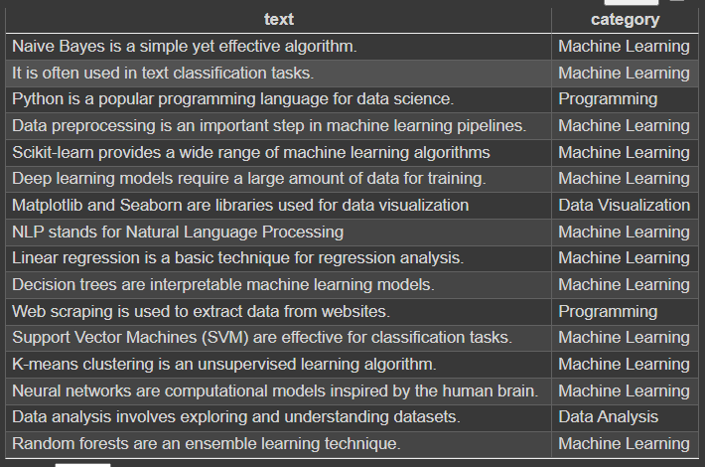
DATASET
Dataset:

Slide 6
PRE-PROCESSING
Preprocessing is a crucial initial step in text document classification, involving the cleaning and organization of text data before analysis.
It includes converting text to lowercase, tokenizing it into individual words, removing punctuation and stopwords, and handling numerical values, contractions, and abbreviations.
Optional steps like stemming, lemmatization, and spell checking can further refine the data.
Preprocessing ensures the text data is standardized and ready for feature extraction and classification by the Naive Bayes Classifier.

Slide 7
PROJECT CODE
import pandas as pd
from sklearn.model_selection import train_test_split
from sklearn.feature_extraction.text import CountVectorizer
from sklearn.naive_bayes import MultinomialNB
from sklearn.metrics import accuracy_score, classification_report
data = pd.read_csv('dataset.csv')
X_train, X_test, y_train, y_test = train_test_split(data['text'], data['category'], test_size=0.2, random_state=42)
vectorizer = CountVectorizer()
X_train_vec = vectorizer.fit_transform(X_train)
X_test_vec = vectorizer.transform(X_test)
clf = MultinomialNB()
clf.fit(X_train_vec, y_train)
predictions = clf.predict(X_test_vec)
print("Accuracy:", accuracy_score(y_test, predictions))
print("Classification Report:\n", classification_report(y_test, predictions))

Slide 8
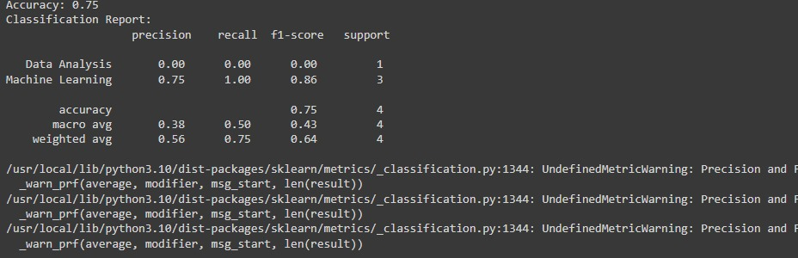
OUTPUT
Output :

