Slide 1

The Development & Application of Autoencoder for the Anomaly Detection Task in the CMS Experiment at the Large Hadron Collider at CERN
Maksim Karpov
2nd-year student, MA program in Data Science,
Faculty of Computer Science, HSE
Higher School of Economics , Moscow, 2017
www.hse.ru

Slide 2
Outline
Data preparation
3-layer autoencoder & Results
5-layer autoencoder & Results
Higher School of Economics , Moscow, 2017
www.hse.ru

Slide 3

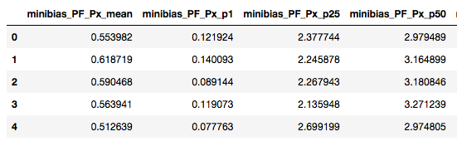
Data Description
26,046 examples & 2695 (!!) features
Each lumisection is described by percentiles, means and stds of distributions of physical features of particles of particular quantiles.
Features were normalized in [0, 1] range.
Dataframe was split into random train (22,139) and test (3907) samples.
photo
photo
photo
Higher School of Economics , Moscow, 2017

Slide 4
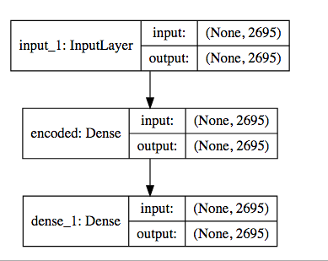
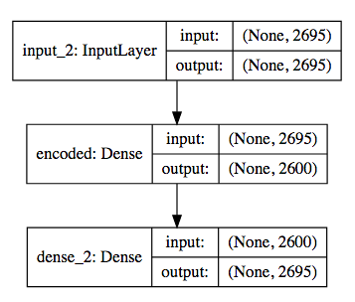
Training Procedure: Simple Autoencoder with one compressive layer
Autoencoder architecture: input (2695 neurons) – *** – output (2695 neurons).
10 different nets were tested (with step in 100 neurons).
Training period – 200 epochs, loss is MSE (mean squared error), optimizer Adamax.
photo
photo
photo
Higher School of Economics , Moscow, 2017

Slide 5
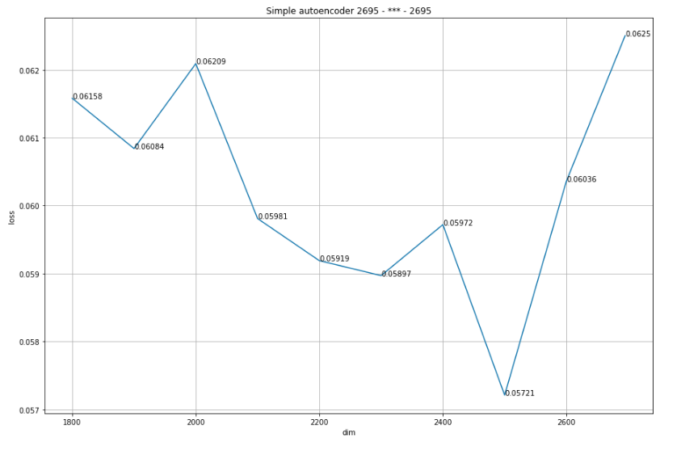
Results on the Graph
photo
photo
photo
Higher School of Economics , Moscow, 2017

Slide 6
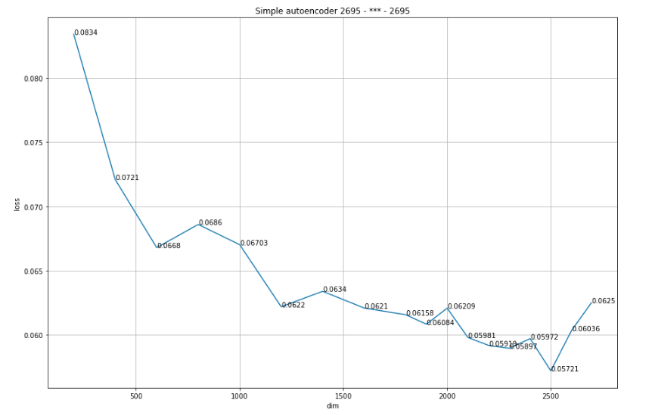
Results on the Graph (expanded to lowest nodes – 200 neurons)
photo
photo
photo
Higher School of Economics , Moscow, 2017

Slide 7
Training Procedure II: Autoencoder with three hidden layers
Autoencoder architecture: input (2695 neurons) – 1350/1900/2400 – *** – 1350/1900/2400 – output (2695 neurons).
There were three different cases with immediate layers = 1350, 1900, 2400.
Training period – 200 epochs, loss is MSE (mean squared error), optimizer Adamax.
photo
photo
photo
Higher School of Economics , Moscow, 2017

Slide 8
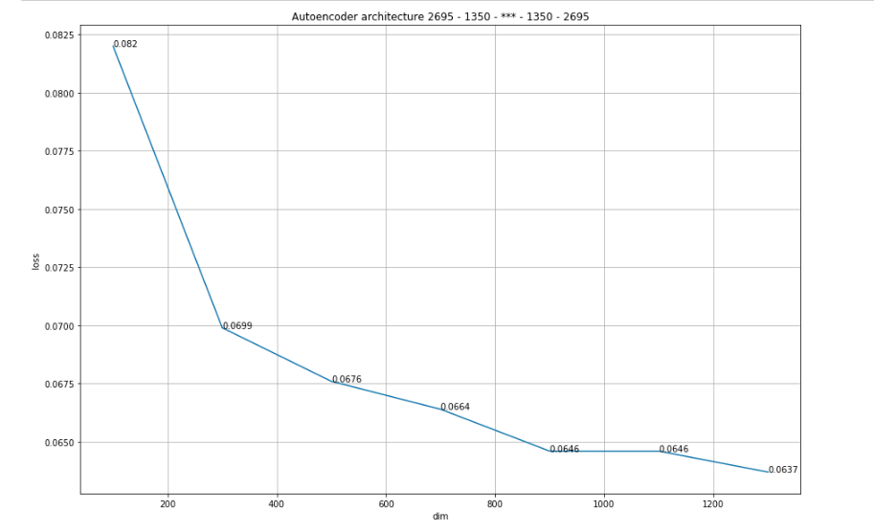
Results
photo
photo
photo
Higher School of Economics , Moscow, 2017

Slide 9
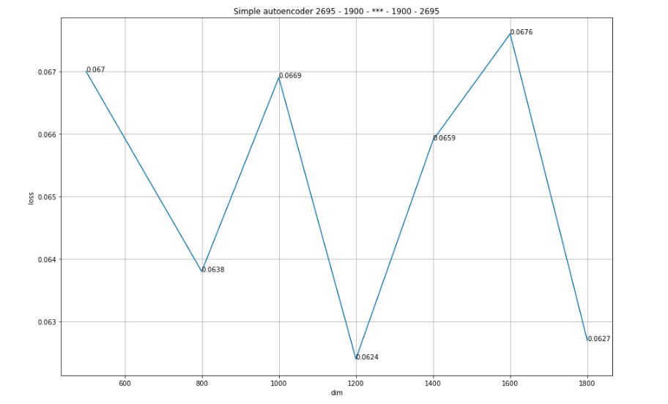
Results
photo
photo
photo
Higher School of Economics , Moscow, 2017

Slide 10
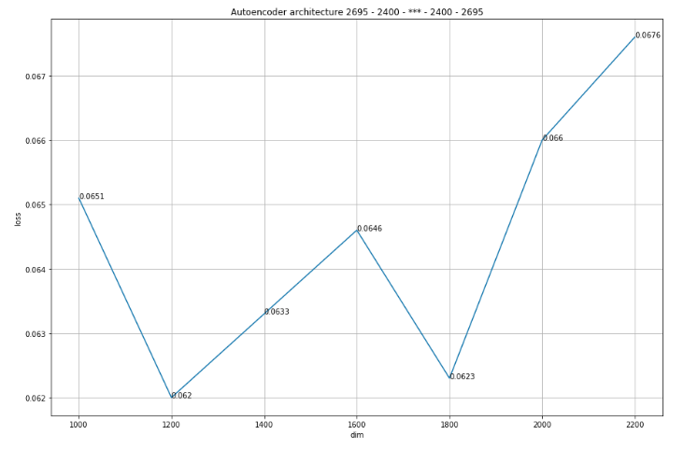
Results
photo
photo
photo
Higher School of Economics , Moscow, 2017

Slide 11
Conclusion
The best result has shown 3-layer net with 2500 neurons in bottle-neck, so reduction by 7%;
The deeper nets show approximately equal and a little bit poorer results because of overfitting caused by lack of data (only 22,000 objects).
photo
photo
photo
Higher School of Economics , Moscow, 2017

Slide 12
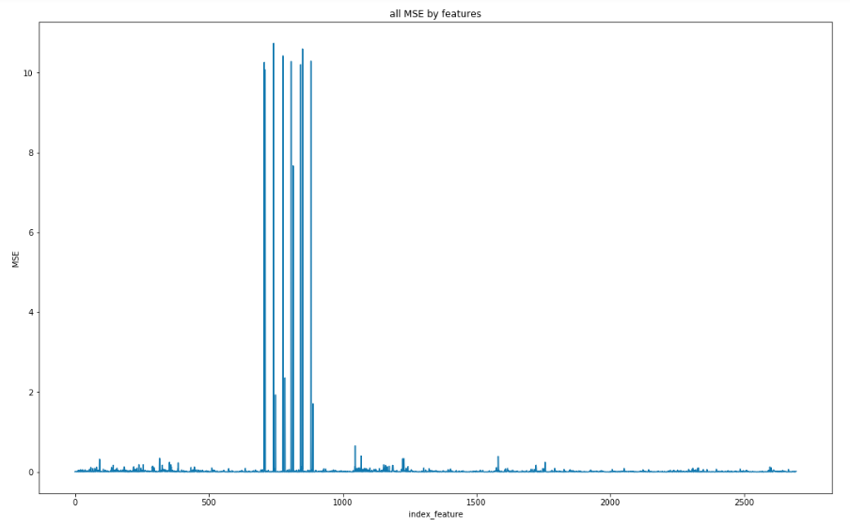
BONUS
photo
photo
photo
Higher School of Economics , Moscow, 2017

Slide 13
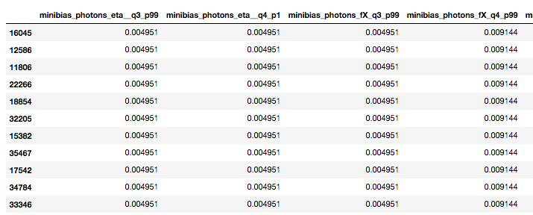
photo
photo
Test MSE: 0.02434
photo
Higher School of Economics , Moscow, 2017

Slide 14


