Slide 1

The Development & Application of Autoencoder for the Anomaly Detection Task in the CMS Experiment at the Large Hadron Collider at CERN
Maksim Karpov
2nd-year student, MA program in Data Science,
Faculty of Computer Science, HSE
Higher School of Economics , Moscow, 2017
www.hse.ru

Slide 2

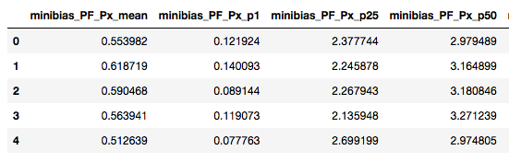
Data Description
26,046 examples & 2695 (!!) features
Each lumisection is described by percentiles, means and stds of distributions of physical features of particles of particular quantiles.
Features were normalized in [0, 1] range.
Dataframe was split into random train (22,139) and test (3907) samples.
photo
photo
photo
Higher School of Economics , Moscow, 2017

Slide 3
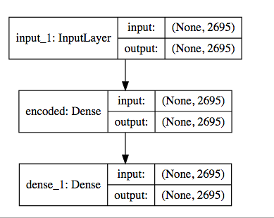
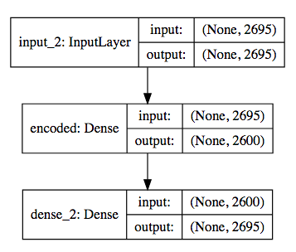
Training Procedure: Simple Autoencoder with one compressive layer
Autoencoder architecture: input (2695 neurons) – *** – output (2695 neurons).
10 different nets were tested (with step in 100 neurons).
Training period – 200 epochs, batch_size = 500, loss is MSE (mean squared error), optimizer Adamax.
photo
photo
photo
Higher School of Economics , Moscow, 2017

Slide 4
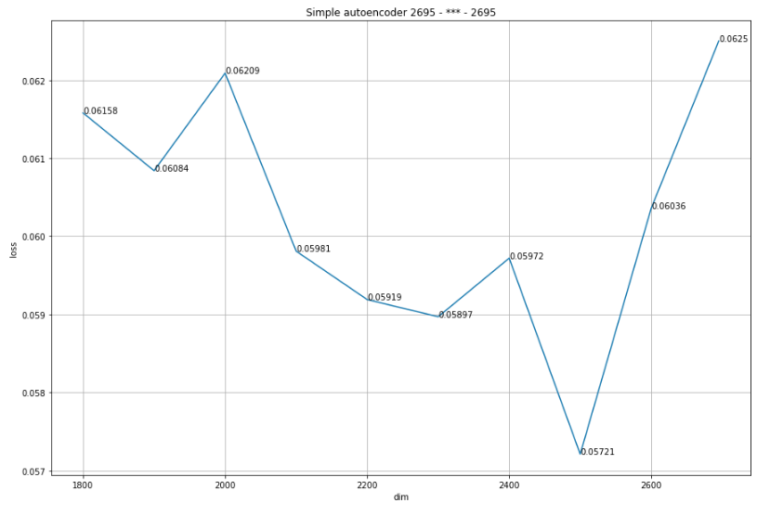
Results on the Graph
photo
photo
photo
Higher School of Economics , Moscow, 2017

Slide 5


