Slide 1

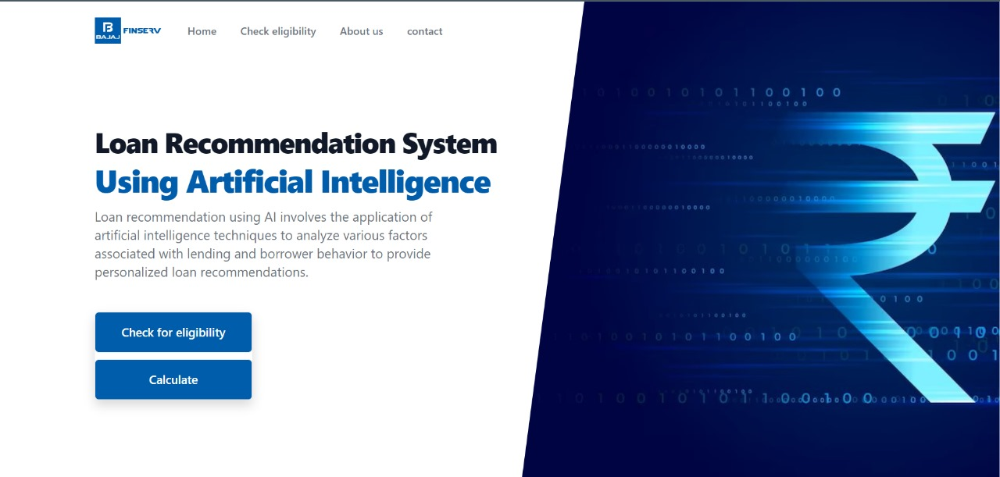
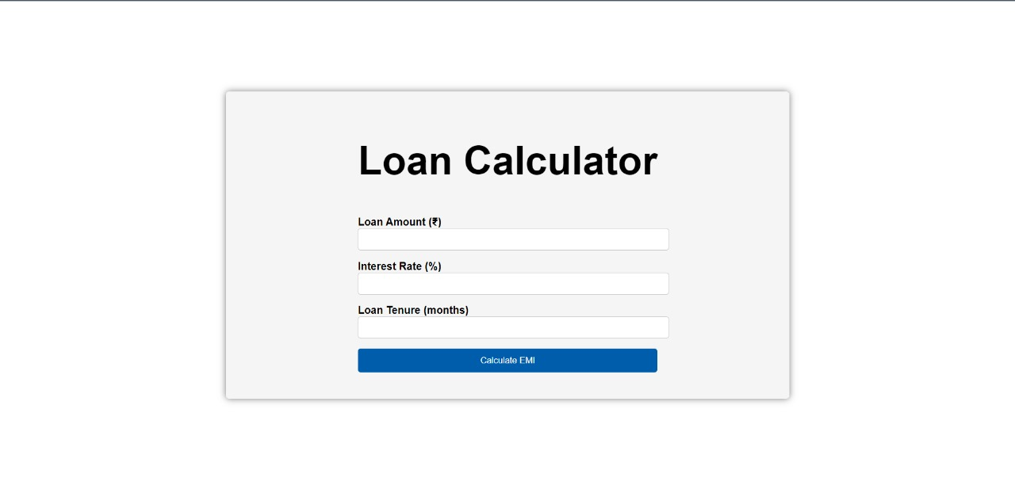
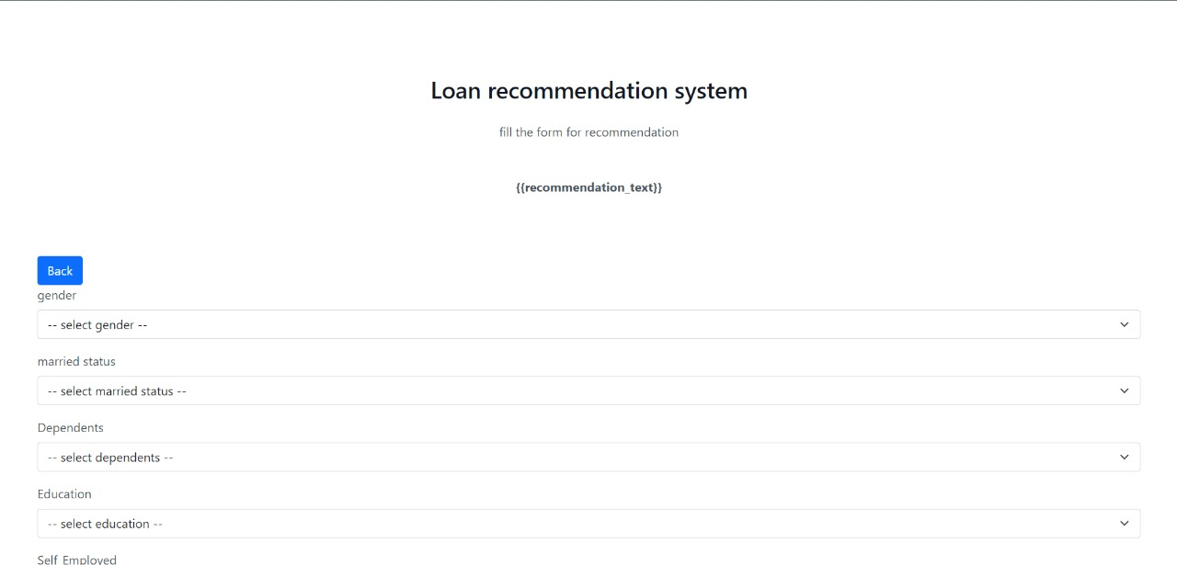
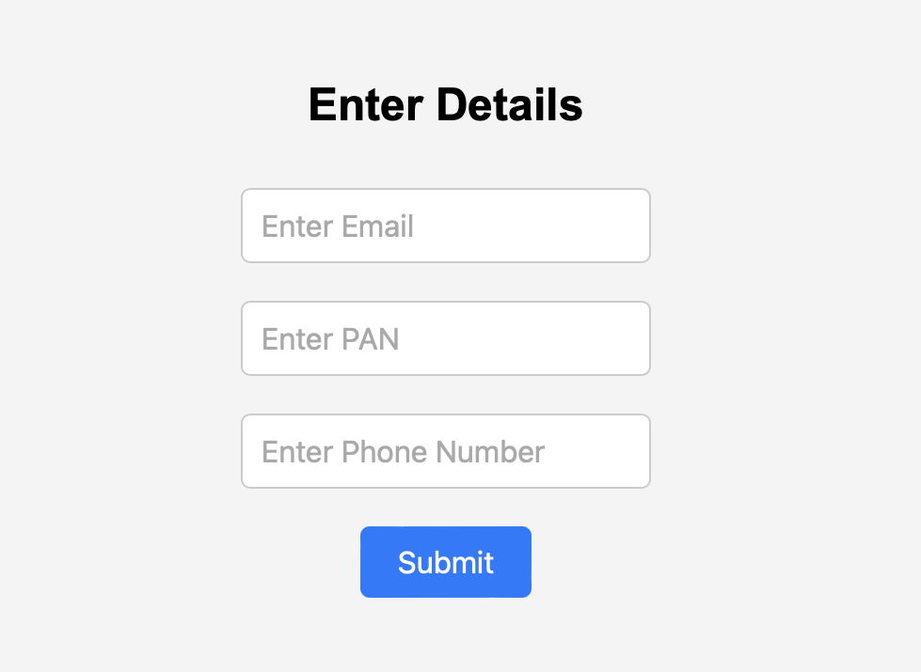
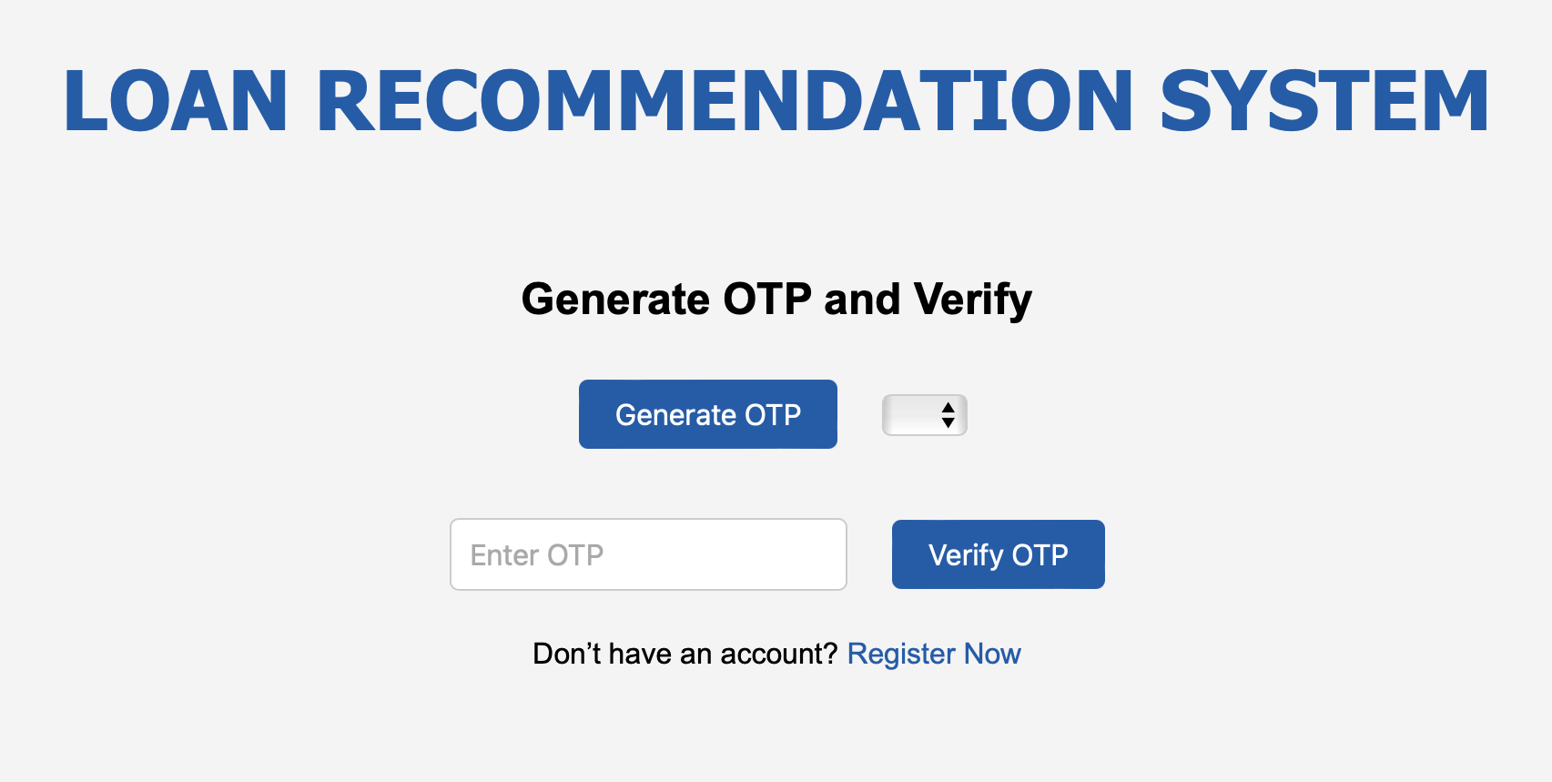
AI BASED LOAN RECOMMENDATION SYSTEM
PROBLEM STATEMENT
SOLUTION
Choosing the right loan from numerous options can be overwhelming and time-consuming for naïve users . There's a lack of personalized guidance, leading to mismatches between borrowers and loan products.
Our aim is to develop a Loan Recommendation System that uses artificial intelligence and machine learning algorithm that gives an accurate output to tailor the needs of the user using it.
The design we have used makes sure that any person with zero experience in finance field will get the requirements met.
CHALLENGES FACED
OUTPUT
Connecting the python files with the html files using flask.
We have also faced finding a perfect dataset meeting the requirements of the problem statements.
TECH STACK
Connecting the python files with the html files using flask.
We have also faced finding a perfect dataset meeting the requirements of the problem statements.

Slide 2
