Slide 1

Fellow placement prediction
with Data Science
Ahmad Karrabi
May 2023

Slide 2

Outline
Executive Summary
Introduction
Methodology
EDA
Conclusion
Appendix

Slide 3
Executive Summary
Data collected from Company Database
The ‘Placed’ feature shows that successfulness of fellow placement at the end of program.
Data explored using visualization. Gathered relevant columns to be used as features. Changed all categorical variables to binary using scikitlearn label encoder. Standardized data and used GridSearchCV to find best parameters for machine learning models. Visualize accuracy score of all models.
Four machine learning models were produced: Logistic Regression, Decision Tree Classifier, and K Nearest Neighbors, and Random forest classification. Find Random Forest Classification with better results with accuracy rate of about 58.312%.

Slide 4
Introduction
Pathrise is an online program that provides 1-on-1 mentorship, training, and advice to help job seekers get the best possible jobs in tech.
Every two weeks, Pathrise welcomes a new cohort of fellows. If a candidate is interested in joining the program and successfully passes all stages of admission process, they receive an offer to join Pathrise and become a fellow.
The first 2 weeks in the program are called a free trial period and a fellow can withdraw within this free trial period without any penalty. After 2 weeks, a fellow needs to sign an ISA (Income Share Agreement) with the pathrise if they want to stay in the program. The entire program lasts up to a year, including 8 weeks of the core curriculum. If a fellow is unable to find a job within a year after joining Pathrise, his/her contract is terminated. However, there might be some exceptions. For instance, if someone was on a break, they may extend their contract for the period of the break.
On average, for fellows who stay with pathrise after their free trial period, it takes about 4 months to receive a final job offer. However, there is a lot of variation in fellows’ outcomes. Being able to predict how fast every single fellow is going to find a job is crucial for this business. In this exercise pathrise provide you with a sample of information they collected from their fellows from the moment they joined our program. Please don’t expect this data set to be perfect, it never happens in the real world.
The main goal of this analysis is to derive insights around:
1- if a fellow will ultimately be placed at a company
2- and how long until a placement can be expected.

Slide 5
Methodology

Slide 6
Methodology
Executive Summary
Data collection methodology:
From Company Databases
Perform exploratory data analysis (EDA) using visualization
Using Seaborn and Matplotlib libraries
Perform data preprocessing
Create new features
From existing features
Remove unnecessary rows and columns
Perform predictive analysis using classification models
Dealing with missing values
Filled with relevant values
Filled as new categories
Select existing features

Slide 7
Predictive Analysis (Classification)
4 classification models selected for first target.
Every model’s hyper parameters tuned individually.
Accuracy selected as primary metric for evaluate models.
Model improved through:
Changed dealing with missing values strategy
Remove less important feature
Retuned hyper parameters

Slide 8
EDA

Slide 9
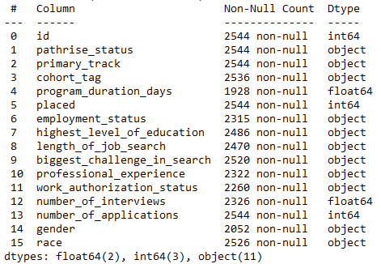
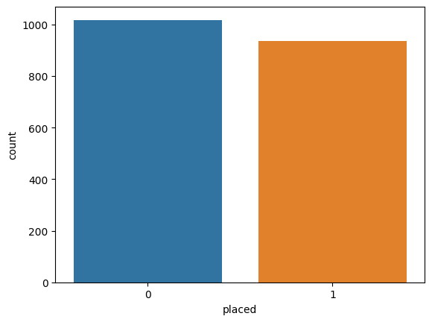
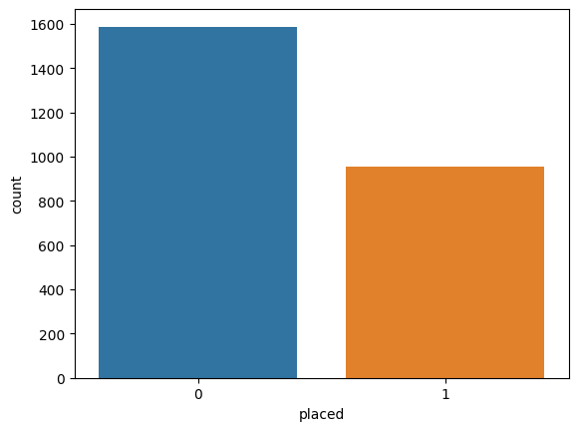
Dataset types and balance check
Numerical features
Categorical features
How Data unbalanced
at start based on Target feature

Slide 10
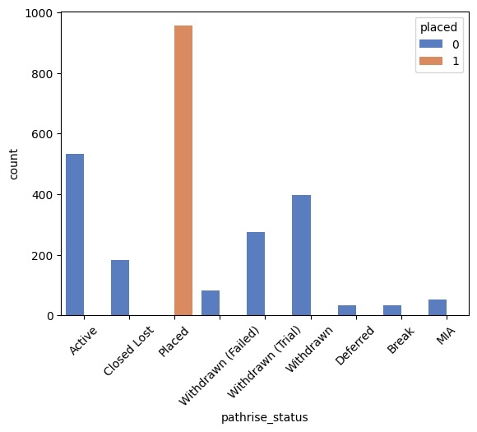
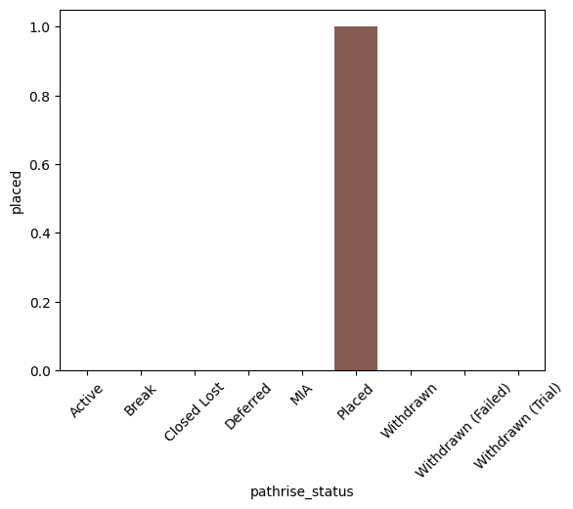
Pathrise status
Count
Compare to placement
Has direct relation to target feature
Dropped rows based on pathrise status
Dropped the feature

Slide 11
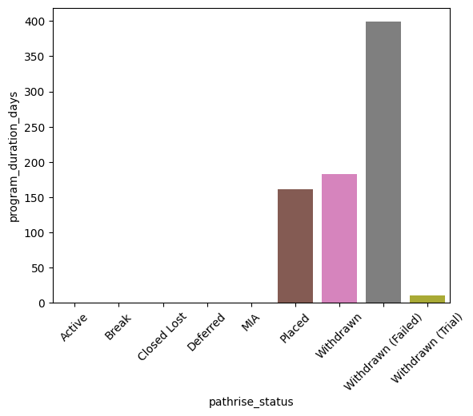
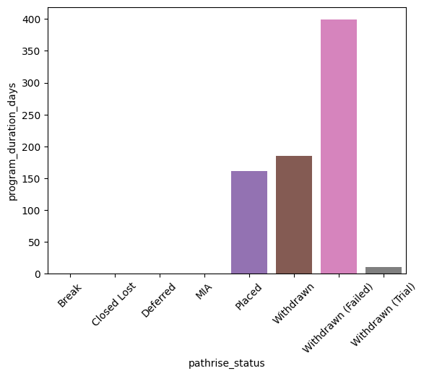
Program duration days
At start
After Preprocessing

Slide 12
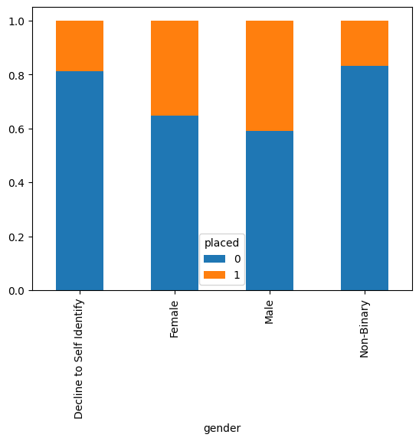
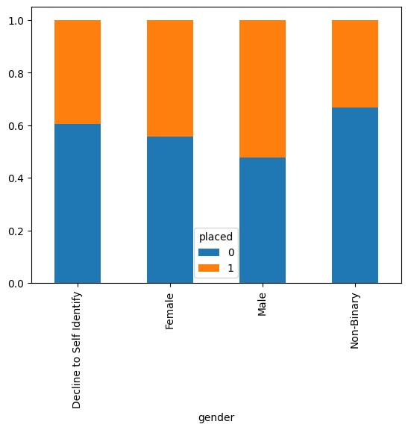
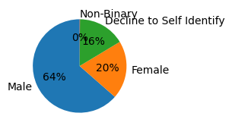
Gender
At start
After Preprocessing

Slide 13
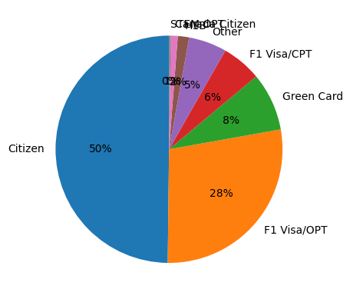
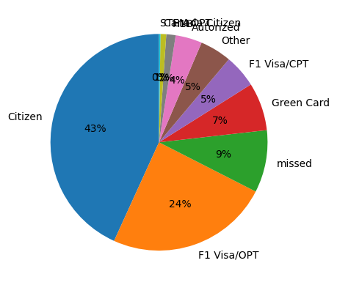
Work Authorization Status which placed
At start
After Preprocessing

Slide 14
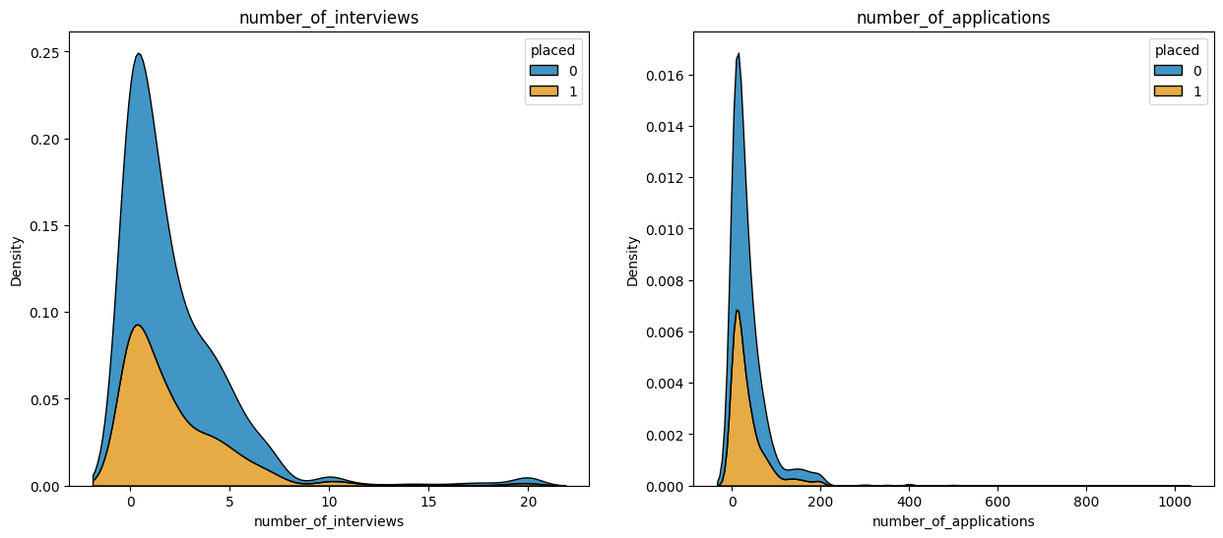
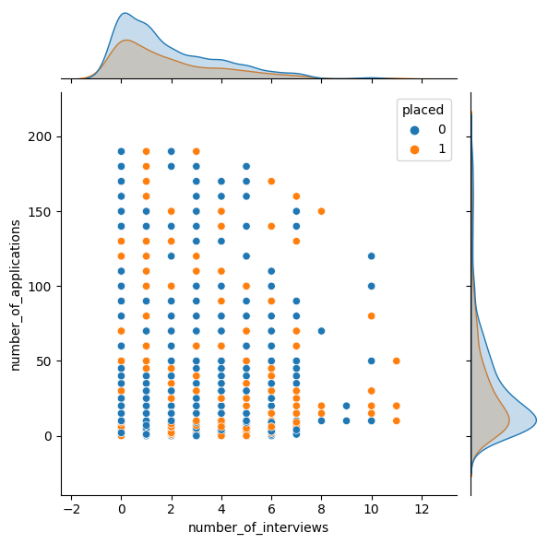
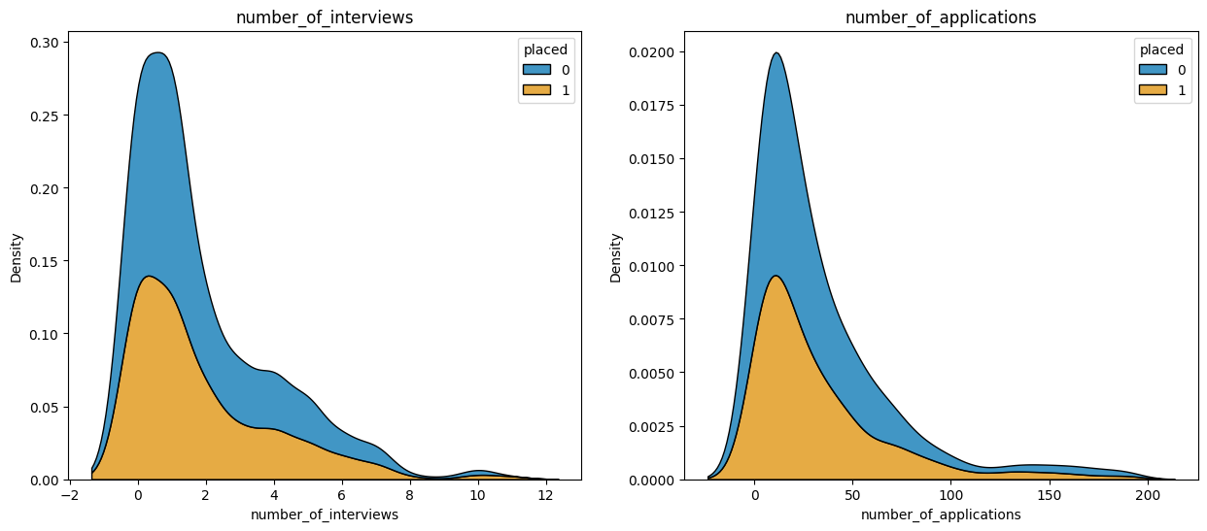
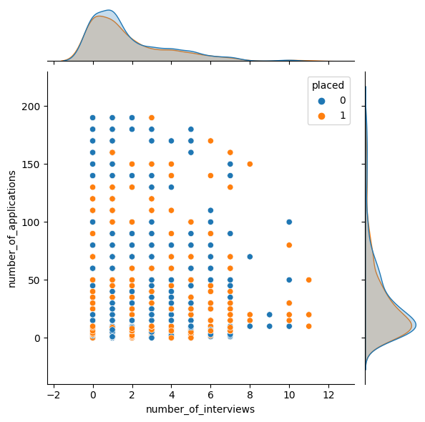
Number of interviews & Number of applications
At start
Domain knowledge: Usually, it is not an accurate number
It is more inaccurate over long periods
After Preprocessing

Slide 15
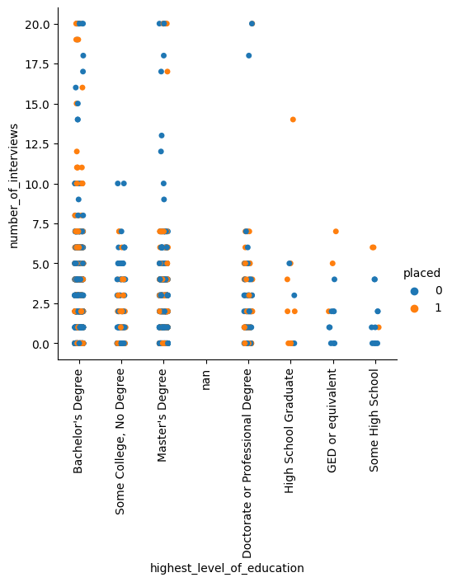
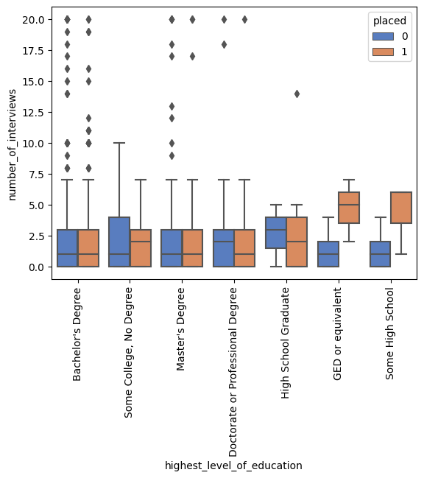
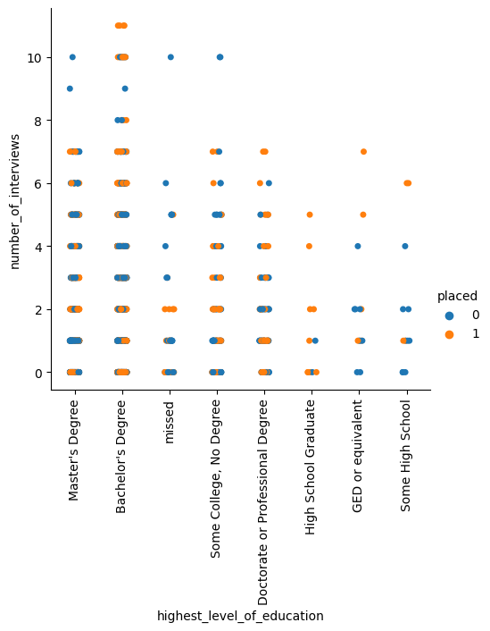
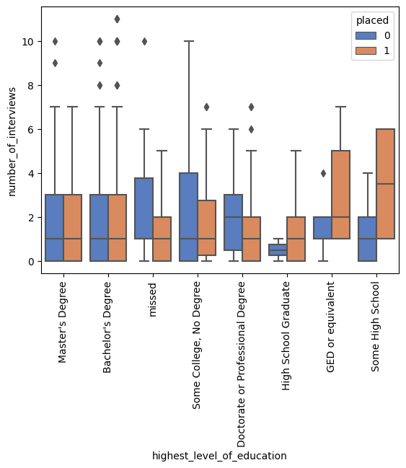
Number of interviews vs Highest level of education
At start
After Preprocessing

Slide 16
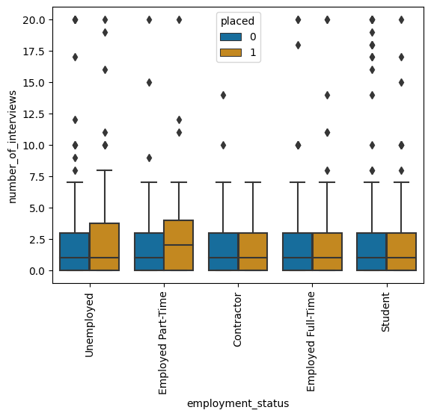
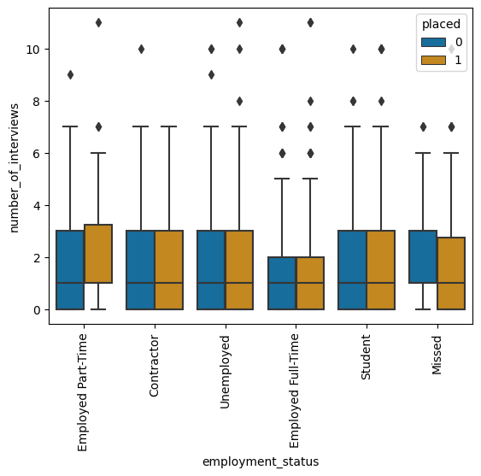
Number of interviews vs Highest level of education
At start
After Preprocessing

Slide 17
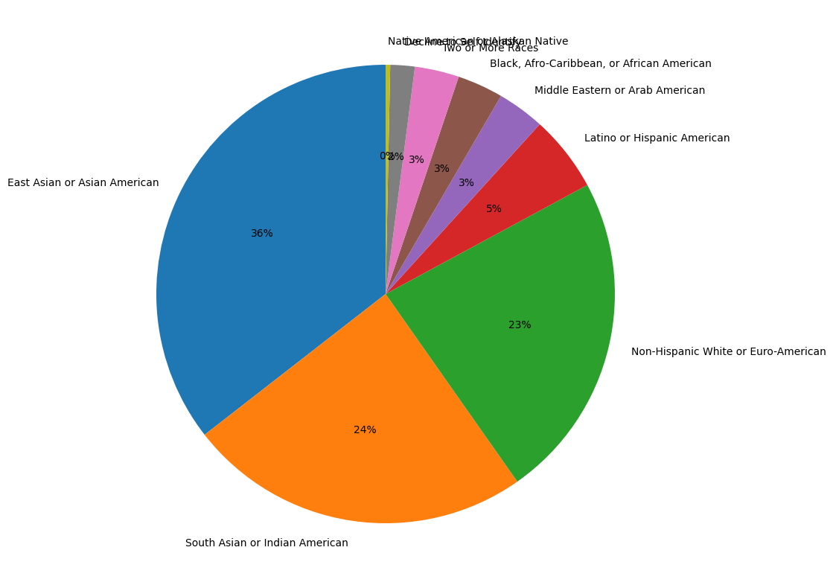

Race
At start
After Preprocessing

Slide 18
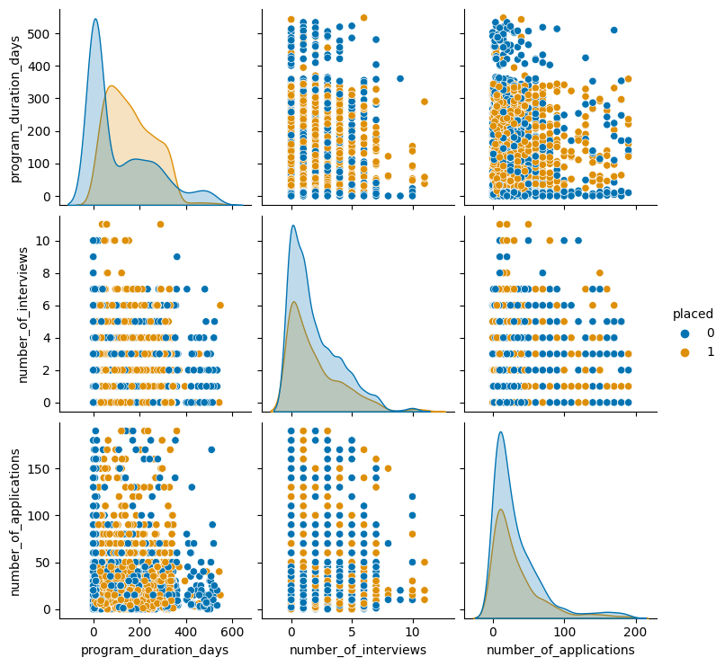
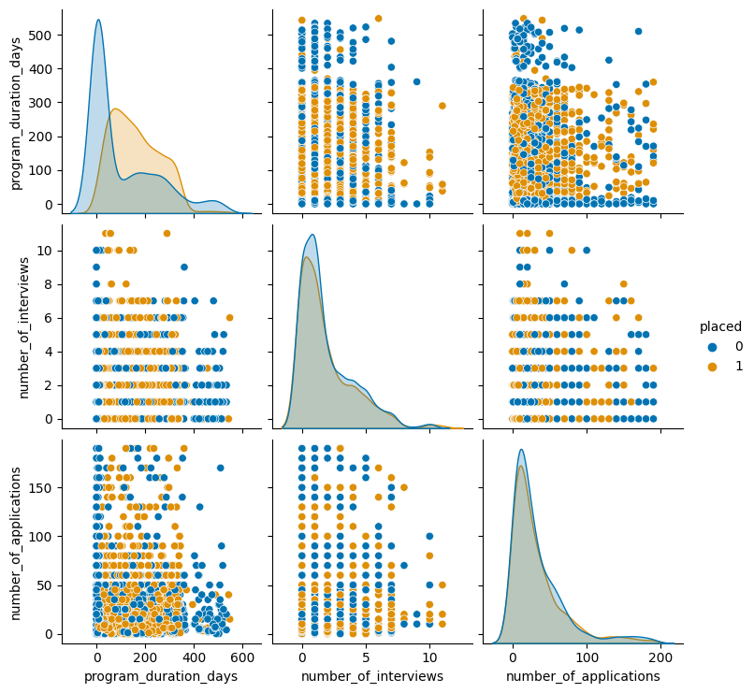
Compare numerical features
At start
After Preprocessing

Slide 19
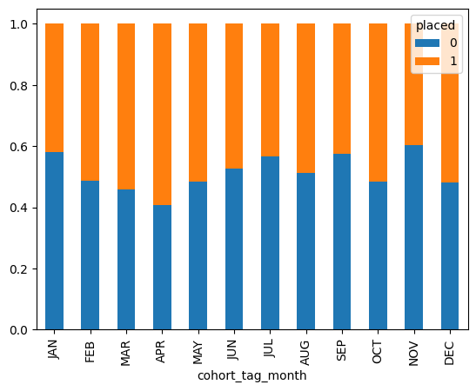
Compare numerical features
April is the best Month
November is the worst

Slide 20
Feature Creation
Create cohort_tag_month & cohort_tag_furthnight from cohort_tag
OCT19A
OCT
A

Slide 21
Remove unnecessary data
id
pathrise_status
cohort_tag
Program_duration_day when working on predicting placement
Placed when working on predicting duration days

Slide 22
Dealing with Missing values
length_of_job_search with 'Less than one month’ : maximum
highest_level_of_education with 'missed’
biggest_challenge_in_search with 'Hearing back on my applications’
Race with 'Decline to Self Identify’
cohort_tag_month with 'FEB’ : mean
cohort_tag_fortnight with ’B’ : mean
program_duration_days with 0 when pathrise_status='Break’ or ‘MIA’

Slide 23
Predictive Analysis

Slide 24
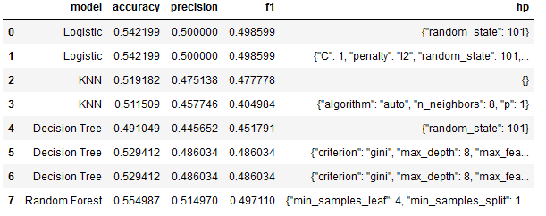
Classification Accuracy

Slide 25
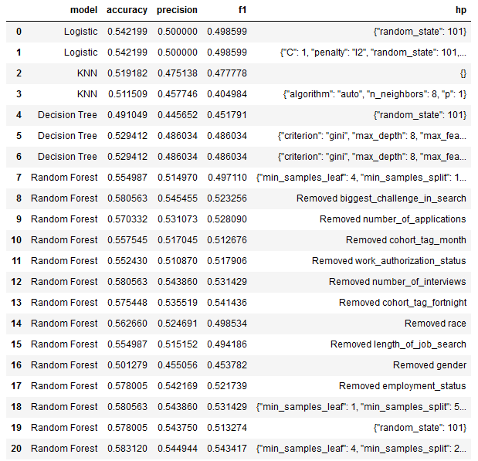
Classification Accuracy
Tuning Hyper Parameters again

Slide 26
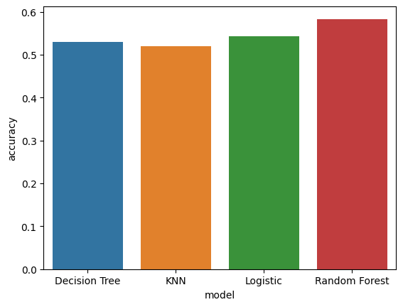
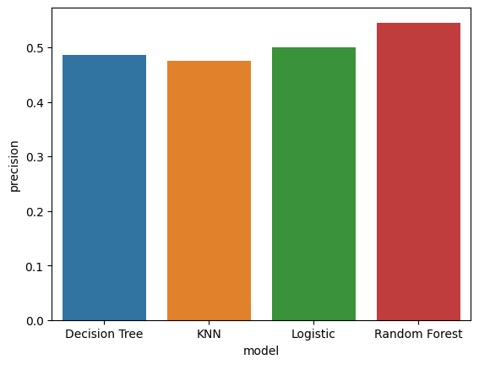
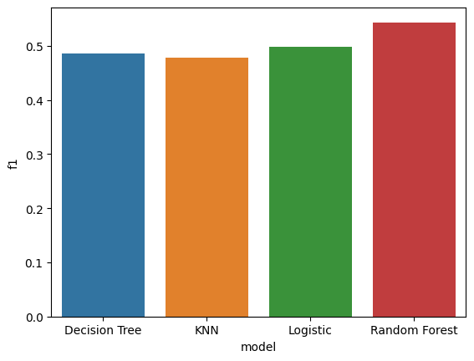
Classification Accuracy
Accuracy
precision
F1 score
"min_samples_leaf": 4
"min_samples_split": 2
"n_estimators": 80
"random_state": 101
Chosen Model: Random Forest
Hyper Parameters:

Slide 27
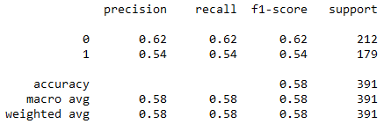
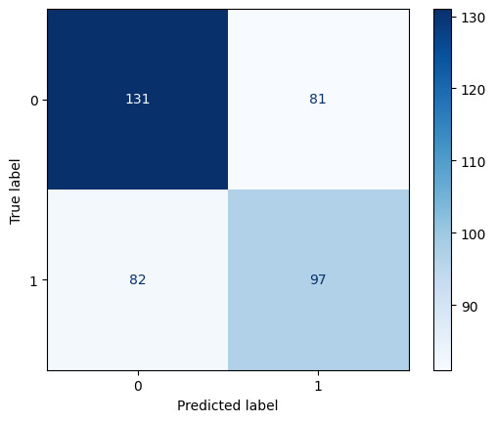
Confusion Matrix
Type I error: 20.7 %
Faulty detect True (FP)
Type II error: 20.9 %
Failed to detect False (FN)

Slide 28
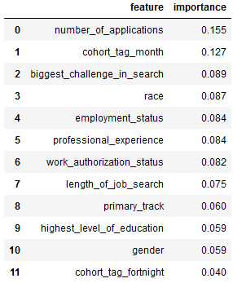
Feature Importance

Slide 29
Conclusions
Random Forest Model works better
April is the best month to join the program
Citizen has better opportunities between other Work Authorization Statuses
Number of applications has a major effect on the result so it’s better to prevent missing values somehow

Slide 30
Appendix

Slide 31
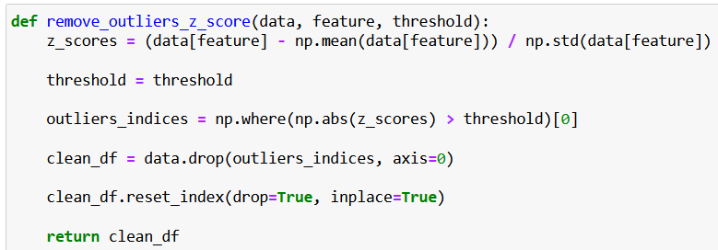
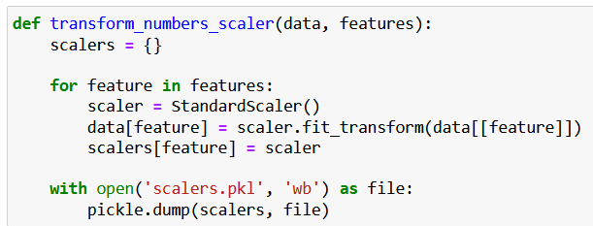
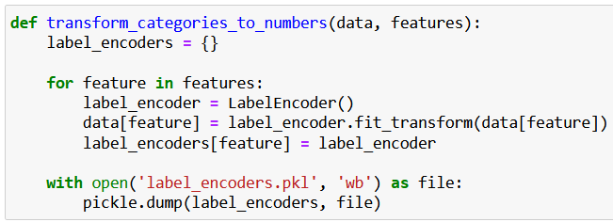
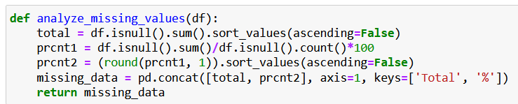
Appendix

Slide 32
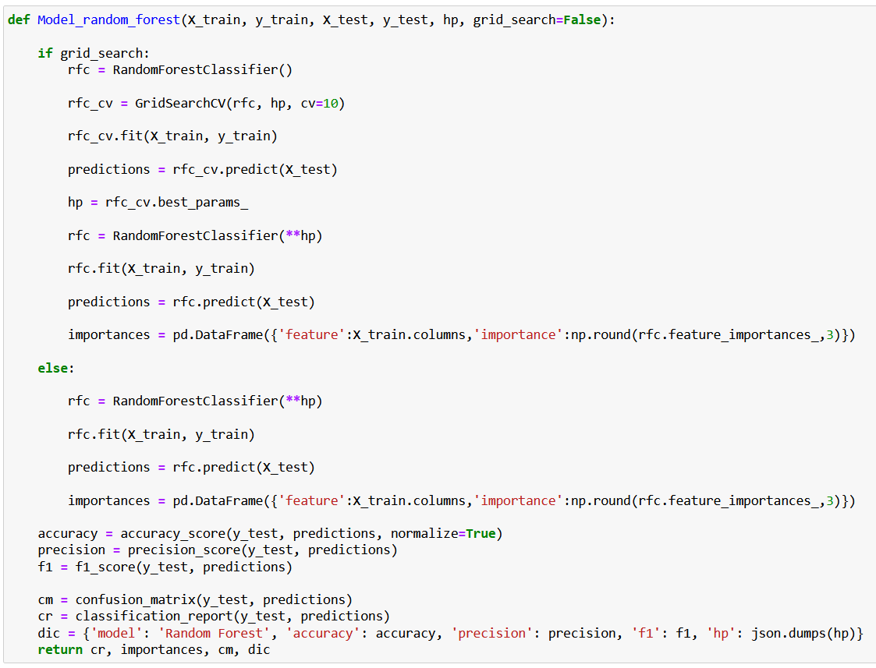
Appendix

Slide 33
Thank You

