Slide 1

Automotive Market Analysis Using Web Scraping & Python (CarWale) – A Deep Dive into Price, Mileage & Performance Trends
Presented by
K. Ashok
17 May 2025

Slide 2
About me
Background : B-tech
Why Data Science : Love for extracting insights and making data-driven decisions
work experience : NA
GitHub: https://github.com/karrea09
LinkedIn: https://www.linkedin.com/in/ashok-k-086477175/

Slide 3
Business Problem & Domain
Understand car market trends from scraped CarWale data
Help brands and users compare models by price, mileage, bhp, etc.
Identify segment leaders, pricing gaps, and value models

Slide 4
Objective of the Project
Scrape and analyse car listings from CarWale
Uncover hidden patterns across brands, fuel types, and price bands
Visualize competitive positioning and market opportunities

Slide 5
Web Scraping – Details
Website: carwale.com
Tools Used: Python, Requests, Beautiful Soup
Approach:
Crawled paginated car listings
Extracted model, brand, price, mileage, bhp, fuel type, rating, transmission
Saved to structured Data Frame for analysis

Slide 6
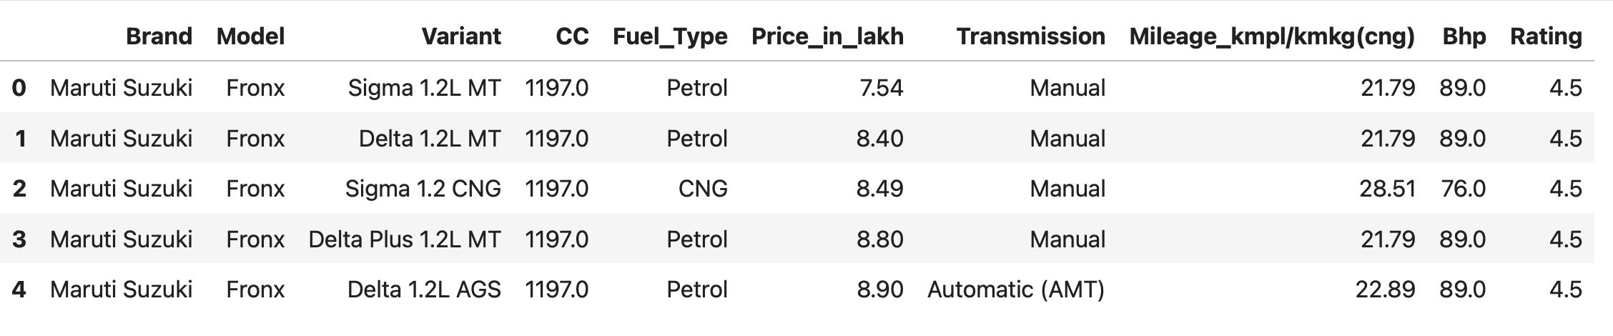
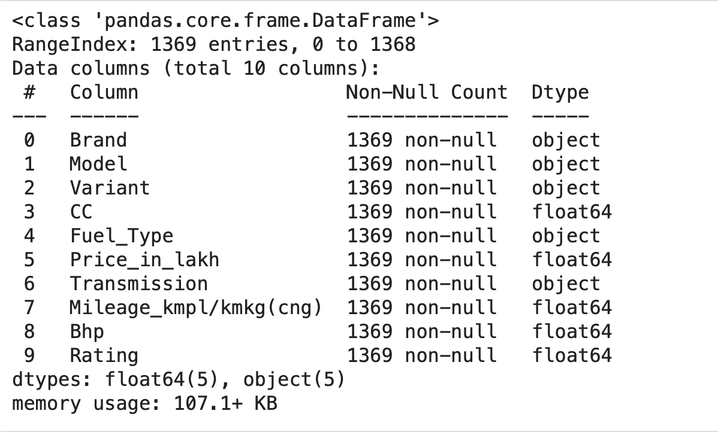
Summary of the Data
1300+ car variants
10 columns: Brand, Model, Variant, Price, Fuel Type, Transmission, Mileage, BHP, Rating, etc.
Brands included: Maruti, Tata, Kia, Skoda, Toyota, MG, BMW, etc.

Slide 7
Data Cleaning
Performed extensive cleaning to ensure consistency and reliability across scraped data:
Handled missing values:
Manually checked variant rows missing Mileage or BHP.
Retrieved missing values from additional page sections (e.g., bottom of the CarWale variant page).
Appended values into specific positions in feature lists based on index matching.
Standardized format:
Used regular expressions to extract numerical values from mixed strings like "1997 cc, 22kmpl, 22bhp".
Removed unwanted text and units, and converted Price, Mileage, BHP, and CC to numerical types.
This meticulous cleaning process improved dataset completeness and formatting, enabling accurate downstream analysis and visualization.

Slide 8
Data Manipulation
Created calculated fields:
Value Score = (Mileage × BHP) / Price
Difference between Automatic vs Manual price
Grouped data by Brand, Fuel, Model for summaries

Slide 9
Bivariate Analysis
Price vs Mileage
Price vs BHP
Price difference between Manual vs Automatic
Brand vs Fuel Type (stacked bar)
Clustering based on Price, Mileage, BHP

Slide 10
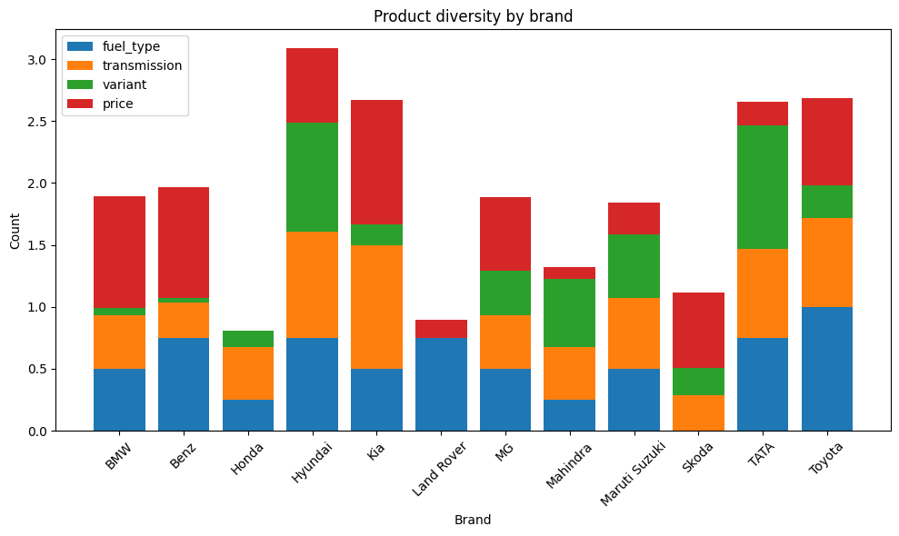
Key Business Questions
Which brands offer widest portfolio?

Slide 11
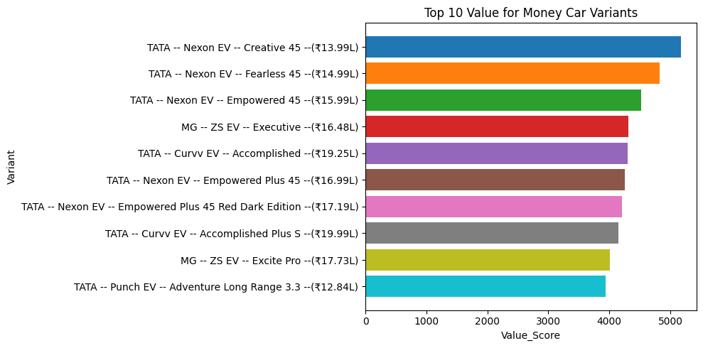
Which car variants offer the best value for money (high mileage + decent BHP at low price)?

Slide 12
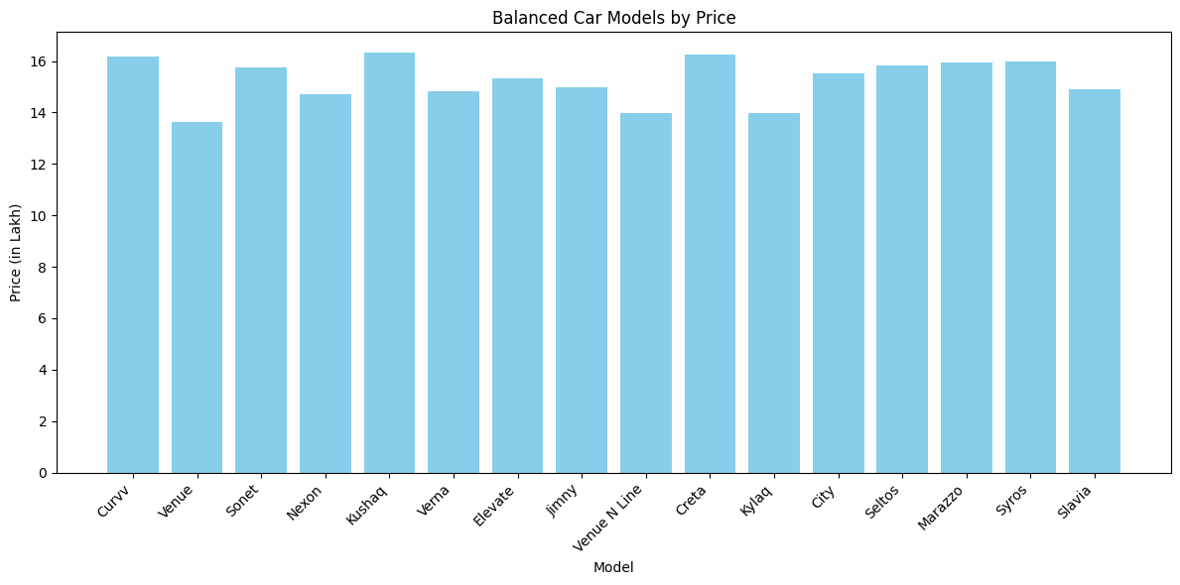
Which car models have the most balanced configuration (moderate price, mileage, and performance)?

Slide 13
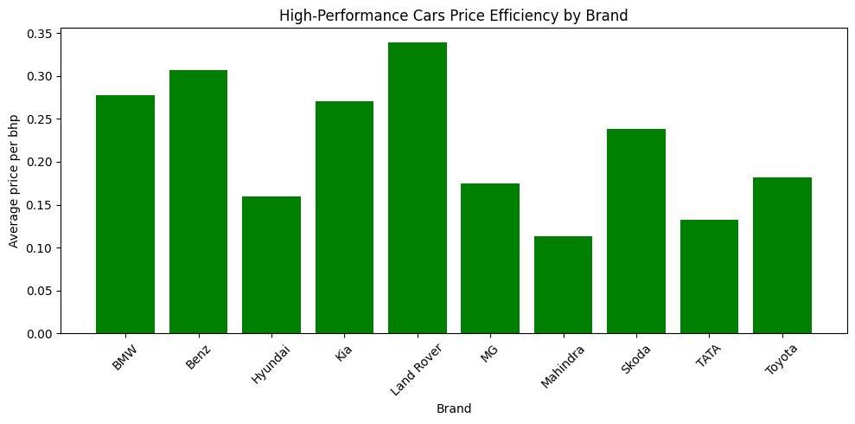
Are certain brands under pricing high-performance variants compared to competitors? (>75 percentile of Bhp) & (price/bhp)

Slide 14
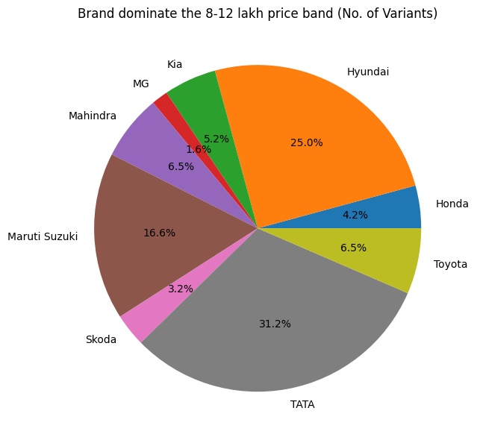
Which brands dominate the ₹8–₹12 lakh price band? (More no. of variants b/w 8-12lc)

Slide 15
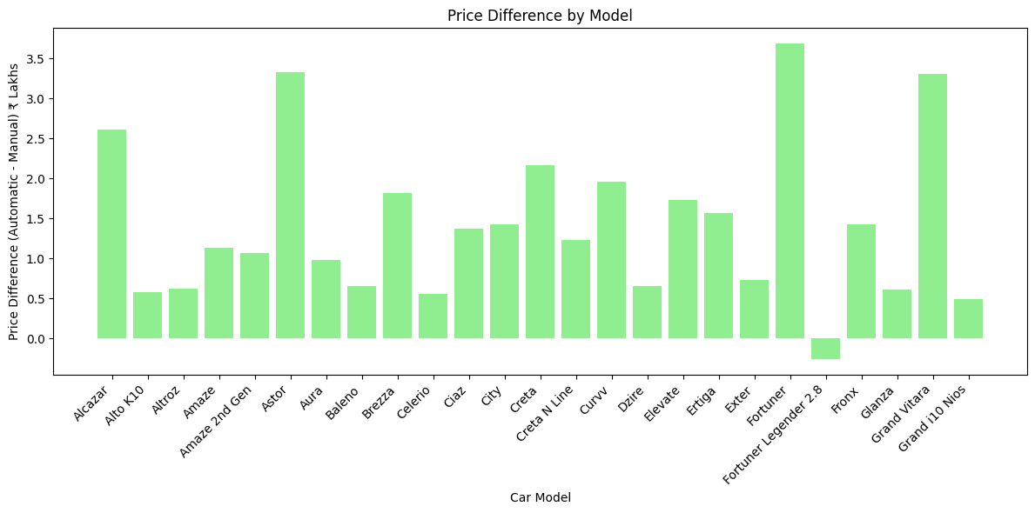
What is the average price difference between manual and automatic variants within the same model? (Automatic – Manual )

Slide 16
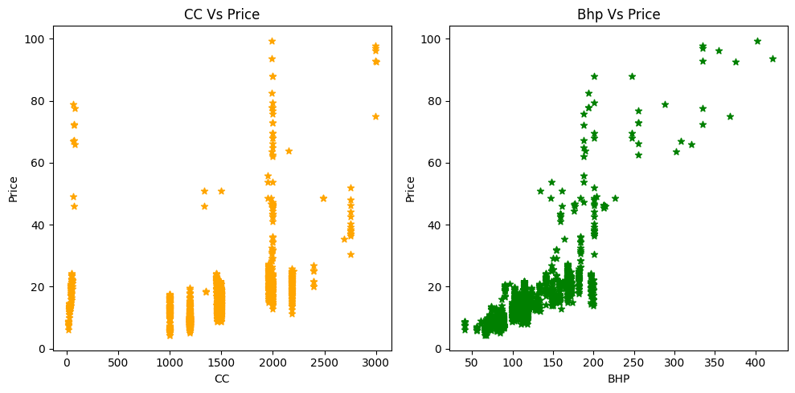
Do higher CC or BHP cars always cost more, or are there pricing inefficiencies?

Slide 17
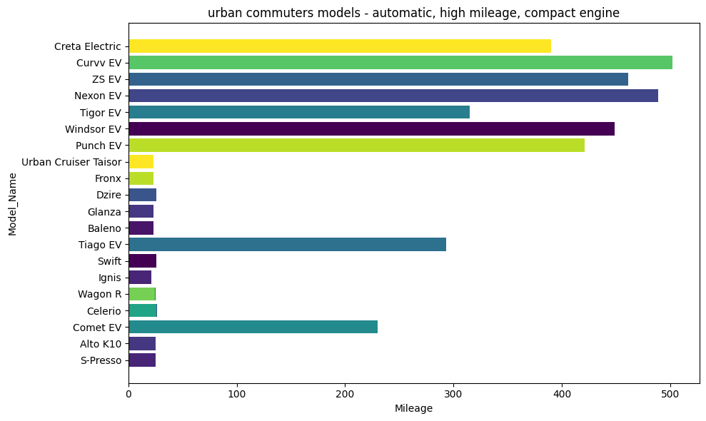
Which car variants are ideal for urban commuters (automatic, high mileage, compact engine)?

Slide 18
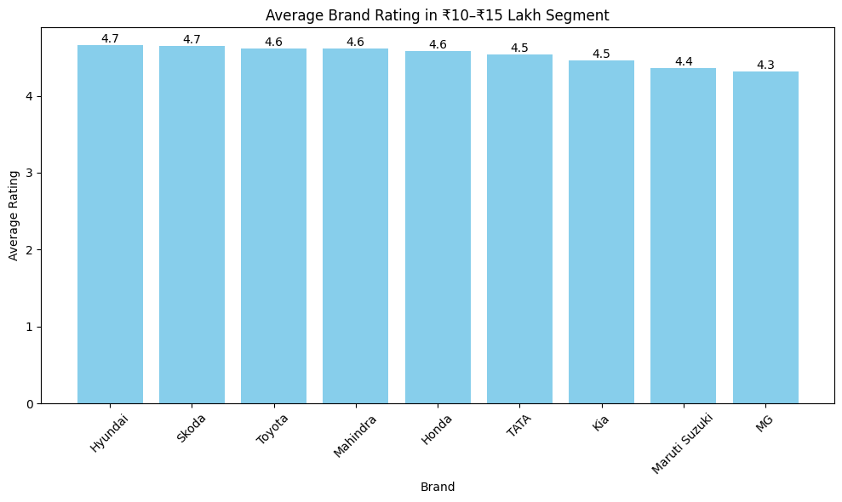
Which brand offers the best overall ratings in the ₹10–₹15 lakh segment?

Slide 19
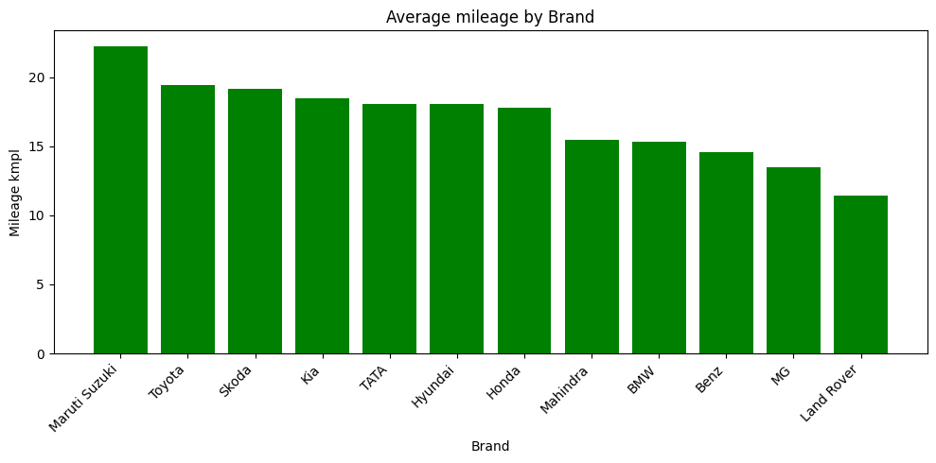
Is there a brand that consistently offers higher mileage across its line up than competitors?

Slide 20
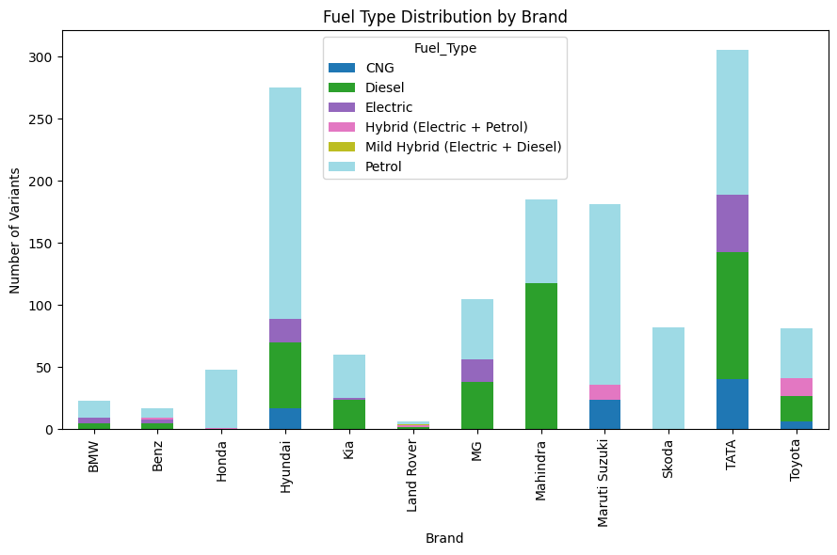
Which fuel types are being offered most frequently by each brand?

Slide 21
Conclusion (Key findings)
TATA dominates the ₹8–₹12 lakh segment, contributing 31.2% of all variants in that band.
Hyundai follows closely, leading with 25% share in the same segment.
Maruti Suzuki has the highest number of petrol and CNG variants, showing strong presence in fuel economy-focused offerings.
MG and Tata stand out in Electric Vehicle offerings, reflecting rapid adaptation to EV trends.
Mahindra, TATA, and MG offer high-performance variants at lower average price per BHP, indicating potential under pricing opportunities.
Maruti Suzuki, Toyota, and Skoda show highest average mileage, exceeding 20 kmpl, suggesting strong efficiency across their line ups.

Slide 22
Challenges & Experience
Inconsistent Data Across Variants:
Mileage and BHP details were missing for some car variants or appeared only at the bottom of the page, requiring manual inspection and positional insertion into scraped data.
Unstructured Feature Text:
Extracted features came as merged strings like "1997 cc, 22kmpl,kg, 22bhp" — used regular expressions to clean and separate CC, Mileage, and BHP into usable numeric values.
Custom Fixes for Partial Data:
Implemented index-based logic to insert missing values into the right position per row, based on the car’s specific variant layout and missing field.
Dynamic Website Structure:
Class names and layout occasionally varied between models, requiring adaptive scraping logic and HTML inspection for each case.
Hands-On Learning:
Strengthened skills in practical EDA, string handling, regex, and web scraping under real-world variability, enhancing ability to manage messy data sources.

Slide 23

THANK YOU

