Slide 1
SpamGuard-ML

Slide 2
CONTENTS
ABSTRACT
INTRODUCTION
LIBRARIES AND PACKAGES
DATA SET
ALGORITHM-NAIVE BAYES
EDA AND DATA PROCESSING
IMPLEMENT BAG OF WORDS
IMPLEMENTATION OF ML MODEL
CODE
CONCLUSION
REFERENCES

Slide 3
ABSTRACT
Spam emails are known as unrequested commercialised emails or deceptive emails sent to a
specific person or a company. Spams can be detected through natural language processing
and machine learning methodologies.Machine learning methods are commonly used in spam
filtering .These methods are used to render spam classifying emails to either ham (valid
messages) or spam (unwanted messages)with the use of machine learning classifiers.The
proposed work show cases differentiating features of the contents of documents.There has
been olot of work has been performed in the area of spam filtering which is limited to some
domains.Research on spam email detectioneither focuses on natural language processing
methodologies on single machine learning algorithms or one natural language processing
technique on multiple machine learning algorithms. In this project a multiple pipeline is
developed to review the machine learning methodologies.

Slide 4
INTRODUCTION
Short message service sms is one of the popular communication service in which a message is sent electronically.
Various organizations deal with SMS for communicating with their clients customers banks and other government organizations also use SMS for communication.
Also, many business organizations use these service for advertising purpose.
So due to large usage of SMS camera it has become one of the most favorite places for hackers and spammers.
A spam message is generally any unwanted message that is sent to users mobile phone
Spam messages include advertisements,free services promotions awards etc…

Slide 5
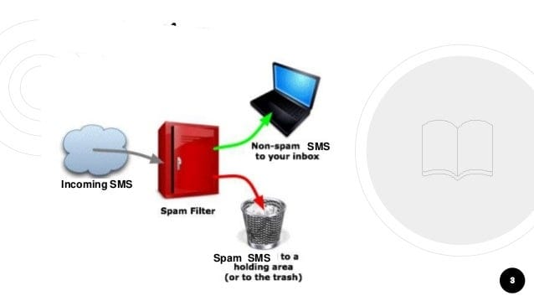
CONT’D
So there must be a system which could tell the end user whether they received messages SPAM or not, non SPAM message is known as HAM.
So by identifying the abovementioned problems and issues we have developed a system which can identify whether a message is spam or have based on the content of the message using machine learning technique.

Slide 6
LIBRARIES AND PACKAGES
Numpy
Pandas
Nltk
Matplotlib.pyplot
Seabron
PLATFROM
JUPYTER NOTEBOOK
PROGRAMMING LANGUAGE
PYTHON

Slide 7
NUMPY
It stands for numerical python
It is a library consisting of multi dimensional array objects and a fundamental package for scientific computing with python
PANDAS
Pandas is a python library used for working with data sets.
It has functions for analyzing, cleaning,exploring and manipulating data.
NLTK
It stands natural language tool kit
It is a platform used for building python programms that work with human language data for applying in statistical natural language processing(nlp)

Slide 8
MATPLOTLAB.PYPLOT:
Matplotlib is a platform that is used for data visualisation and graphical plotting
Matplotlib is a multi platform data visualisation library built on numpy arrays
SEA BORN:
It is a library for making statistical graphics
It integrates closely with pandas data structures
It helps to explore and understand your data

Slide 9
DATA SET
Data set is a collection of data pieces that can be treated by computer as a single unit for analysis.
The raw data collected is obtained from the online resource koggle which will be used to train machine learning models.
The data was originally available in English language, and it was obtained in the comma separated value CSV format.
It contains one set of SMS messages in English and tagged according being ham or spam nearly 5,574 messages.
It has 2 columns where the one column has ham or spam and other column has corresponding text message.

Slide 10
ALGORITHM-NAÏVE BAYES
Navie bayes algorithm is a supervised learning algorithm which is based on base theorem and used for solving classification problems.
It is mainly used in text classification that includes a high dimensional training data set.
Navie bayes is a “probabilistic classifier which means it predicts on the basis of the probability of an object”.
NAVIE: it is called naive because it assumes that the occurrence of a certain feature is independent of the occurrence of other future.
BAYES: It is called base because it depends on the principle of bayes theorem.

Slide 11
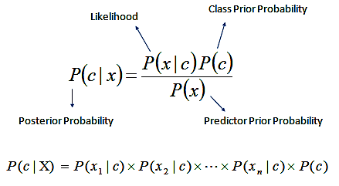

Slide 12
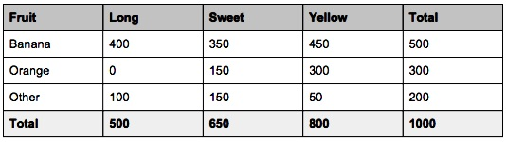
For example a fruit i.e Banana it has Attributes like yellow sweet and long.
Even if these features depend on each other or upon the existence of the other features all of these properties independently contribute to the probability that these fruit is banana and that’s why it is known as Navie.
Naive Bayes senses based on event that happened in previous context and calculates the likelihood of that word for event occurring again in the future.
For example if a word appears in a spam email but not in a ham email the algorithm would most likely classify it as spam.

Slide 13
TYPES OF NAÏVE BAYES MODEL:
There are three types of naïve bayes model:
Gaussian: The gaussian model assumes that features follow a normal distribution. This means if predictors take continuous value instead of discrete then model assumes that this values are sampled from gaussian distribution.
Multinomial: It guesses the tag text such as an email or a newspaper story using bayes theorem.
Bernoulli: Bernoulli NB implements the naive bayes training and classification algorithm that it is good at handling Boolean or binary attributes

Slide 14
ADVANTAGES:
It is one of the fast and easy ml algorithms to predict a class of data sets
It can be used for binary as well as multi class classifications.
It is the most popular choice for text classification problems.
APPLICATIONS:
It is used for credit scoring.
It is used in medical data classification.
And used to detect spam or ham messages.

Slide 15
EDA AND DATA PROCESSING
The first step is to read the SMS data as pandas frame by using read function.
Here we contain 2 columns that is V1 &V2 and remaining contain null values for that reason we delete that columns.
By using drop function we deleted that columns and we changed the column name V1 as “LABLES” and V2 as “TEXT”.
Next we are finding their length that is the number of rows in our data and also counting the number of spam and ham messages.
Then the data set is described by using describe function which has count, unique, top and frequency features.

Slide 16
After that we find the length of the text in each row by using LEN function.
We plot the histogram plot which it shows the maximum number of frequency on
the length of each text and it is mixed of both spamming and hamming messages.
After this step who explored spamming and hamming message length separately.
For encoding purpose we have applied for “HAM-0” and “SPAM-1” by using map
function, and the label is converted text to numeric.

Slide 17
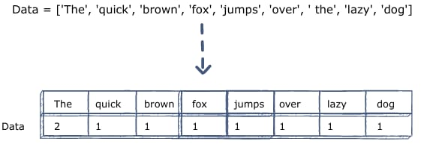
IMPLEMENT THE BAG OF WORDS
SKlearn library that is future extraction which could take the text word.
Then we improt countVectorizer on to data set that is our textdata which is going to convert into vector format.
It is used to transform a given text into a vector on the basis of the frequency (count) of each word appears in the entire text.

Slide 18
By using model selections we need to import train and test data that is x_train ,x_test,y_train and y_test.
Here we assign the x_ train to “TEXT” column and target value that is y_train to “LABEL” column, where that test size is 20% and train size is 80%.
Actually it is a sparse matrix doesn’t print that is bag of words can converted text data into sparse matrix.
A matrix is a two-dimensional data object made up of m rows and n columns most of the elements of the matrix have 0 value ,then it is called sparse matrix.
Sparse matrix is going to take or evaluate the values the non-zero elements and avoid zero elements so it takes less memory to store.

Slide 19
IMPLEMENTATION OF ML MODEL
Now, from the sklearn we import the Naive bayes classifier in that we use “ MULTINOMIAL NAÏVE BAYES” and also “BERNOULLI NAIVE BAYES” that is our model.
Now we feed the data set into our model that is which going to predict our test data.
After that it print the predicted data.
Now we evaluate the score that is accuracy precision and recall score it is important to evaluate the performance of classifications model in order to reliable use the models.

Slide 20
Accuracy function computes subset accuracy that is the set of labels predicted for a sample must exactly match the corresponding set of labels in y_test.
Precision also called positive predictive value that is the fraction of relevant instances among the retrieved instances.
Recall is also known as sensitivity that is the fraction of the relevant instances.
F-Score is a measure of test’s accuracy it is calculated from the precision and recall of the test.
Here Bernolli NB has best accuracy precision , recall and F score.

Slide 21
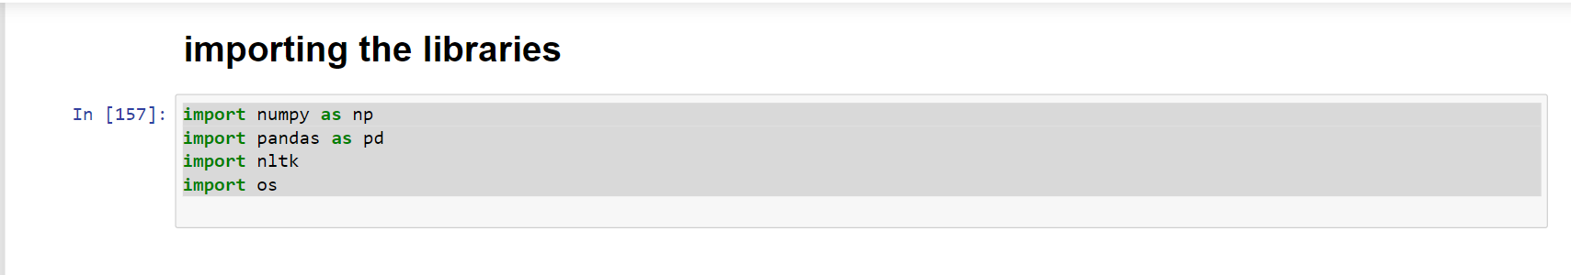
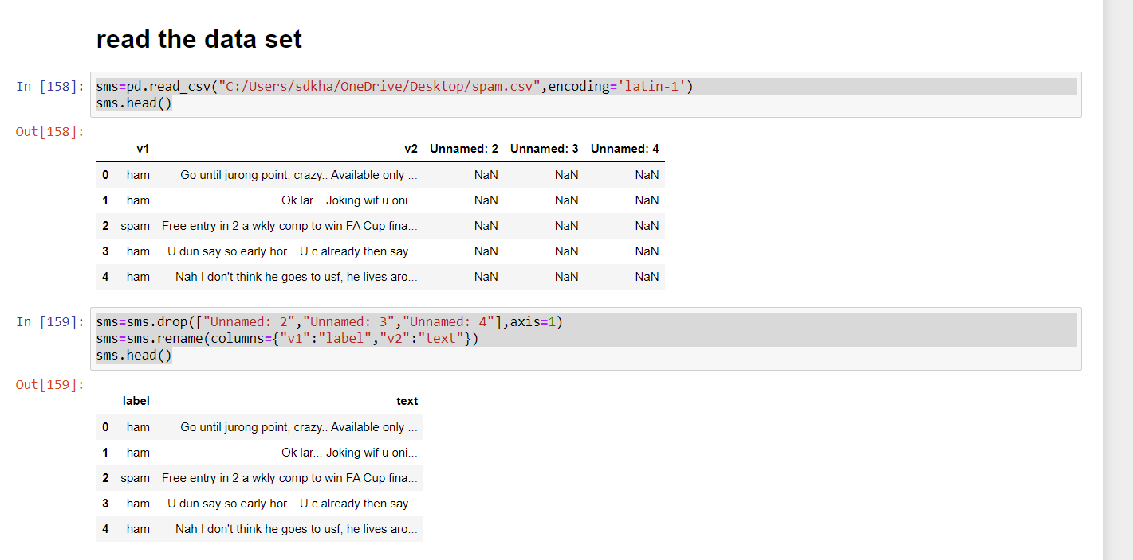
CODE

Slide 22
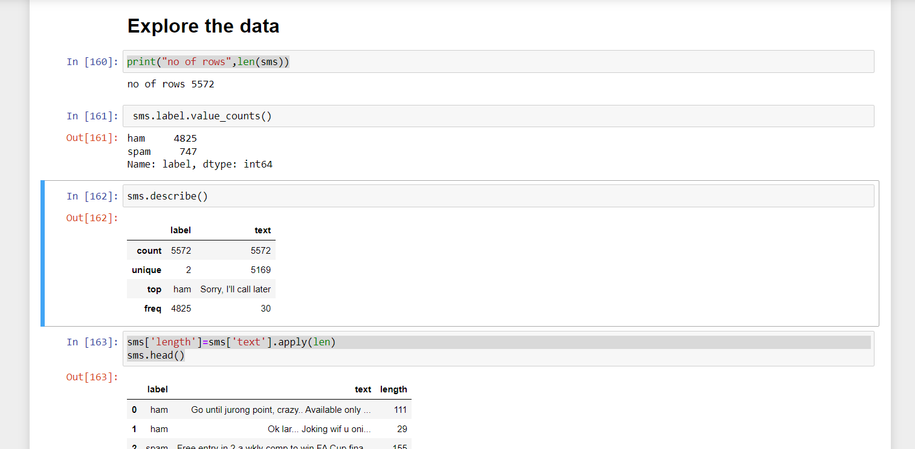
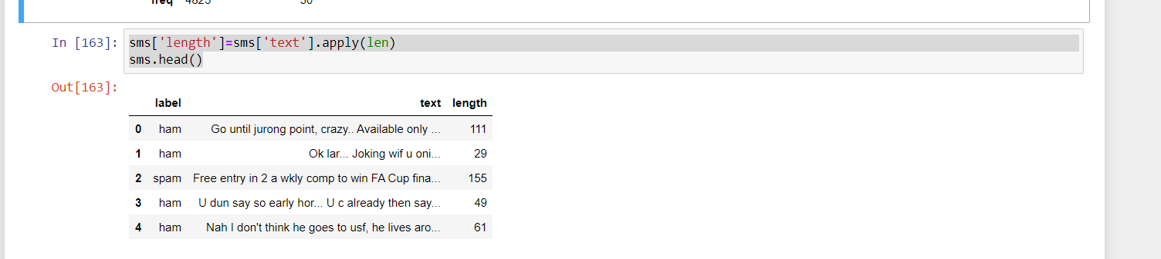

Slide 23
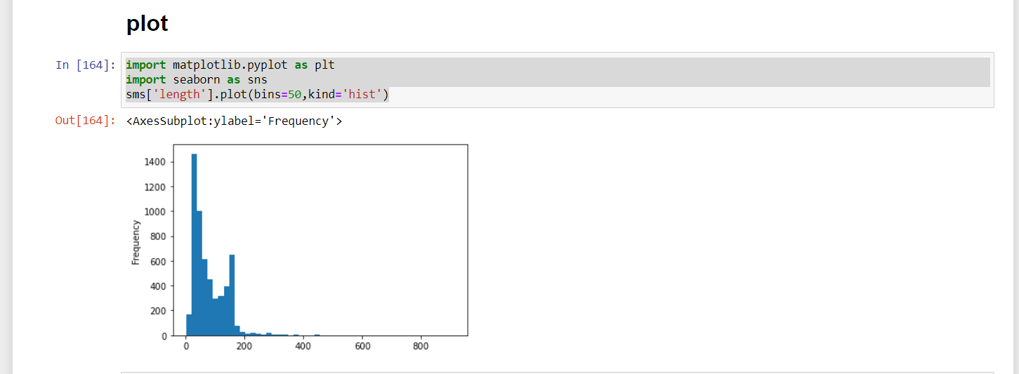

Slide 24
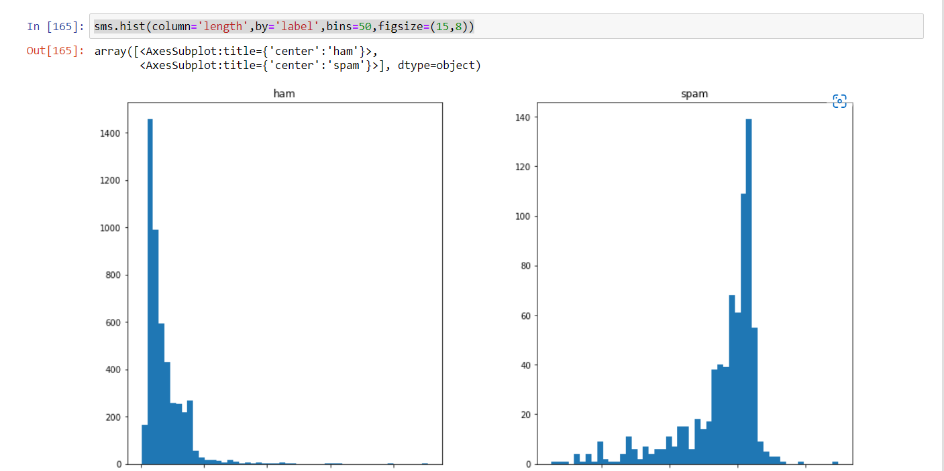
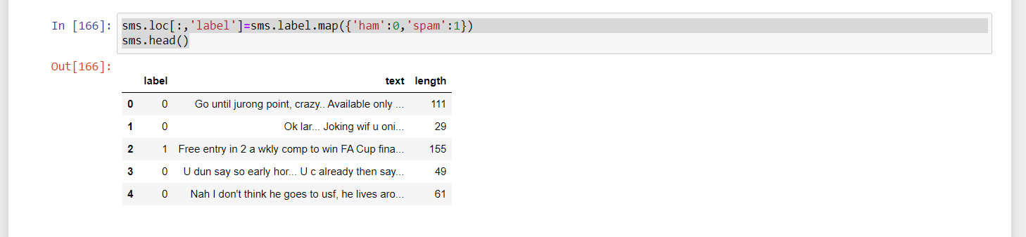

Slide 25
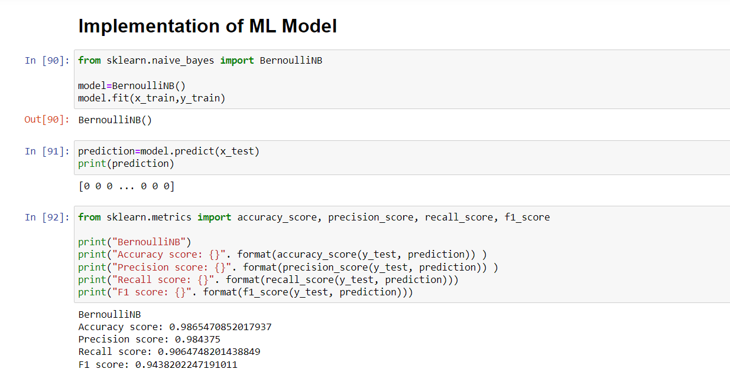
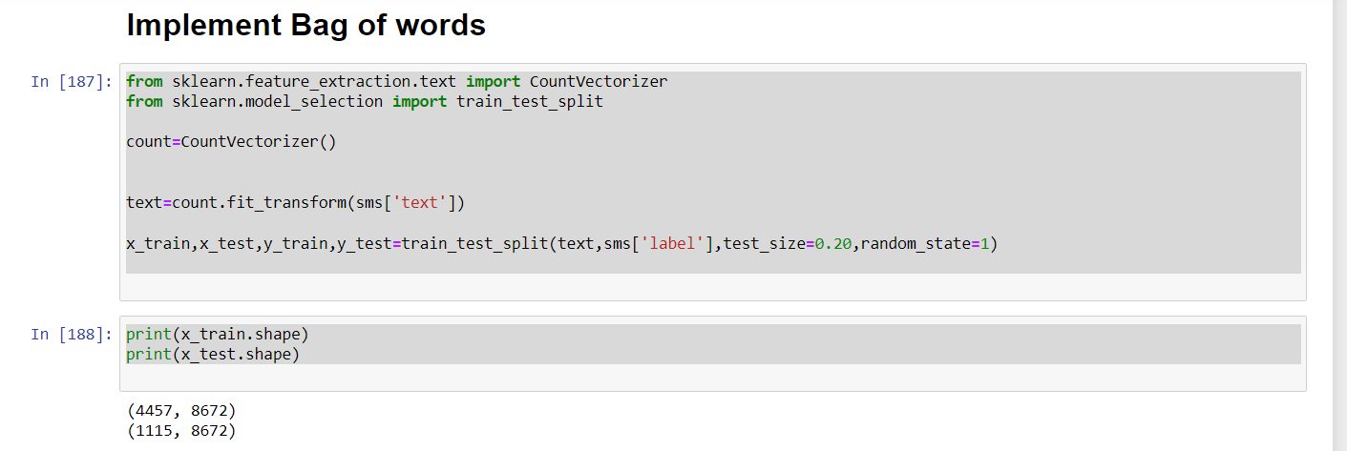

Slide 26
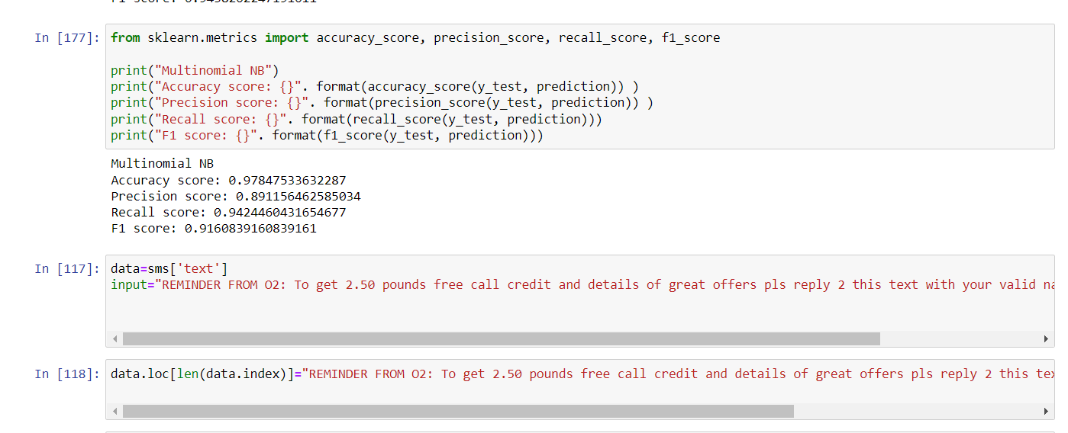

Slide 27
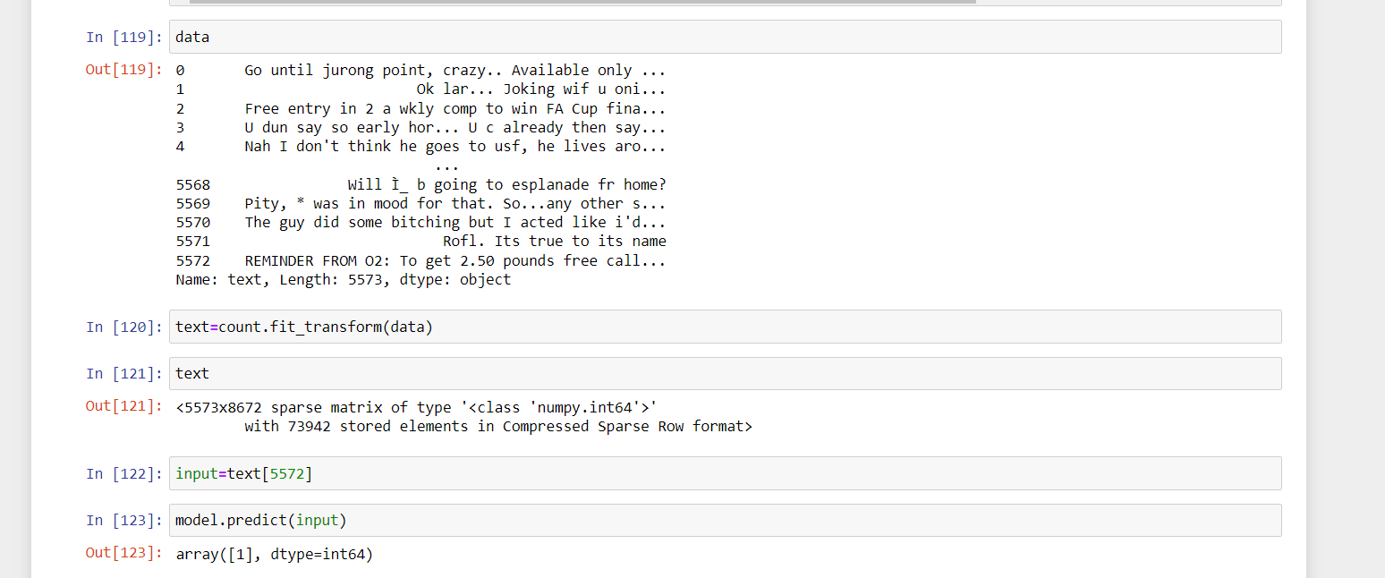

Slide 28
CONCLUSION
The increase usage of emails, this study focuses on using automated ways to detect spam emails.
And the study uses various machine learning algorithms to detect them.
And it concludes that NAÏVE BAYES algorithm , it’s a efficiency and accuracy rate are far better than other approaches.

Slide 29
REFERNCES
https://www.kaggle.com/datasets/uciml/sms-spam-collection-dataset
https://www.javatpoint.com/machine-learning-naive-bayes-classifier
https://vitalflux.com/accuracy-precision-recall-f1-score-python-example/
https://stackoverflow.com/questions/60636444/what-is-the-difference-between-x-test-x-train-y-test-y-train-in-sklearn

Slide 30


