Slide 1
A NEUROMORPHIC SOLUTION FOR THE AGING AMERICAN SIGN LANGUAGE (ASL) POPULATION
KARRINGTON STANLEY
FALL 2025

Slide 2

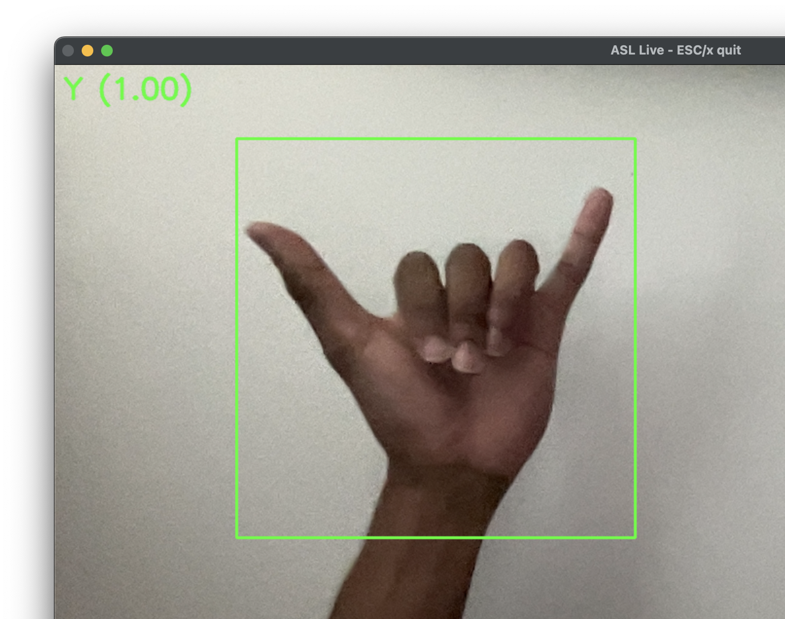
ABSTRACT
There is an increasing number of older adults that are experiencing their motor and cognitive skills declining. With this, comes the need for tools to be able to communicate, especially for individuals who use ASL.
Ataxia and Parkinson’s disease interfere with nerve systems and makes it challenging for individuals to communicate normally.
The problem I am addressing is whether neuromorphic models will be able to learn an individual’s gesture methods, even though they might be unstable or irregular.
The method of my research is to design a neuromorphic model that can recognize ASL gestures. I will then test the accuracy of the system to figure out if it is capable to use for the older adults that struggle with declining cognitive skills.

Slide 3
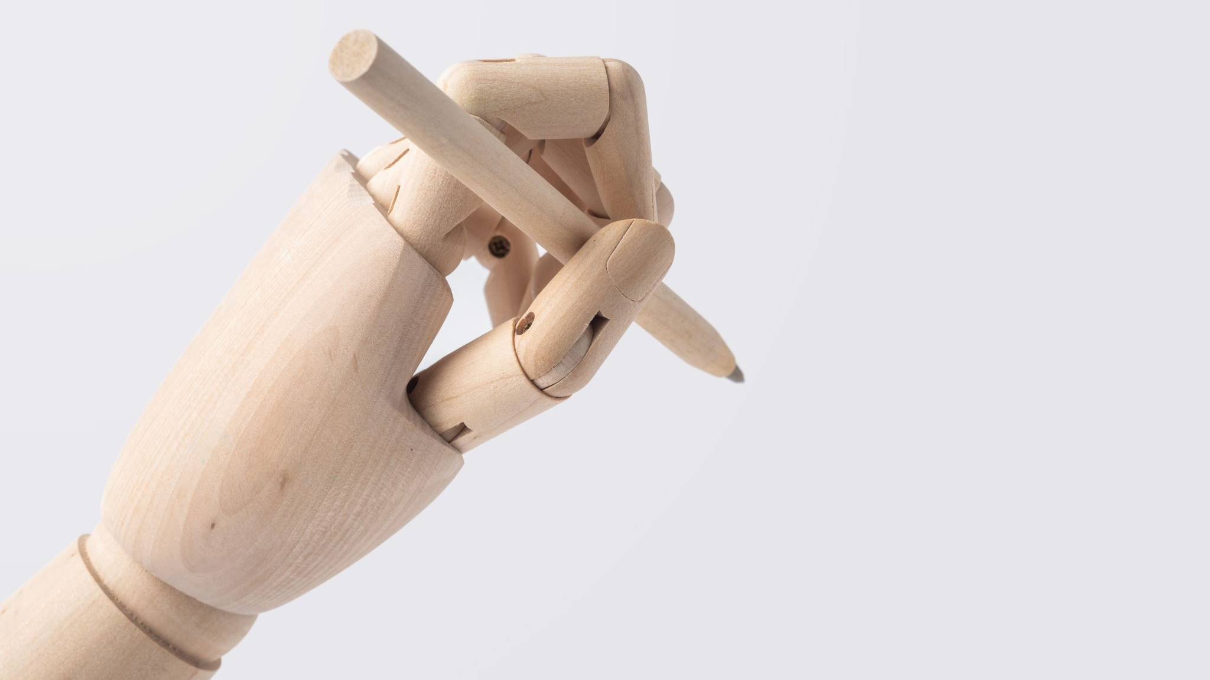

RESEARCH QUESTION
To what extent can neuromorphic models accurately recognize ASL gestures that would be used by aging adults with diminished motor skills?

Slide 4
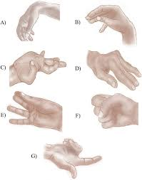
Introduction
According to the study titled "The Application of Technology to Improve Cognition in Older Adults," there is a notable decrease in birth rates globally, accompanied by an increase in life expectancies. This demographic shift is contributing to the growth of older adult populations.
However, the advancement of age has been correlated with cognitive decline in individuals over the age of 60, as well as the development of cognitive degenerative diseases such as Alzheimer’s disease and Ataxia .
These conditions directly affect the enjoyment and engagement of older adults in social spaces. To help enhance social and communication skills, researchers are actively exploring methods by which technology can improve cognitive performance.

Slide 5
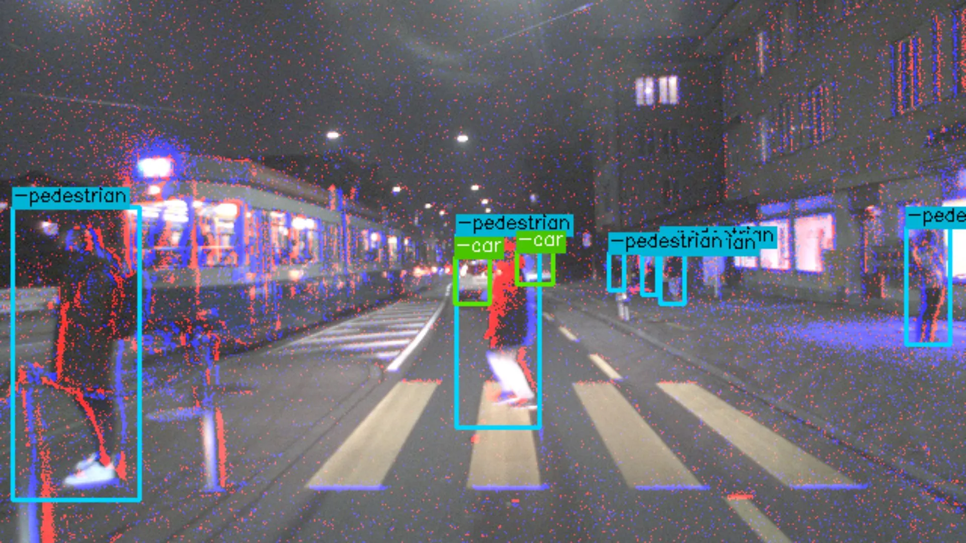
Introduction cont.
Adults who utilize ASL may encounter difficulties in communication when affected by conditions such as Ataxia, which diminishes muscle coordination, or Parkinson’s disease, which induces involuntary movements.
It is possible to develop and customize assistive technology for these patients. Neuromorphic cameras are an innovative approach; they are human-like devices designed to learn the communication methods of these individuals.
These cameras can would and learn ASL gestures just as a human can be implemented into a software program for real-world use.

Slide 6
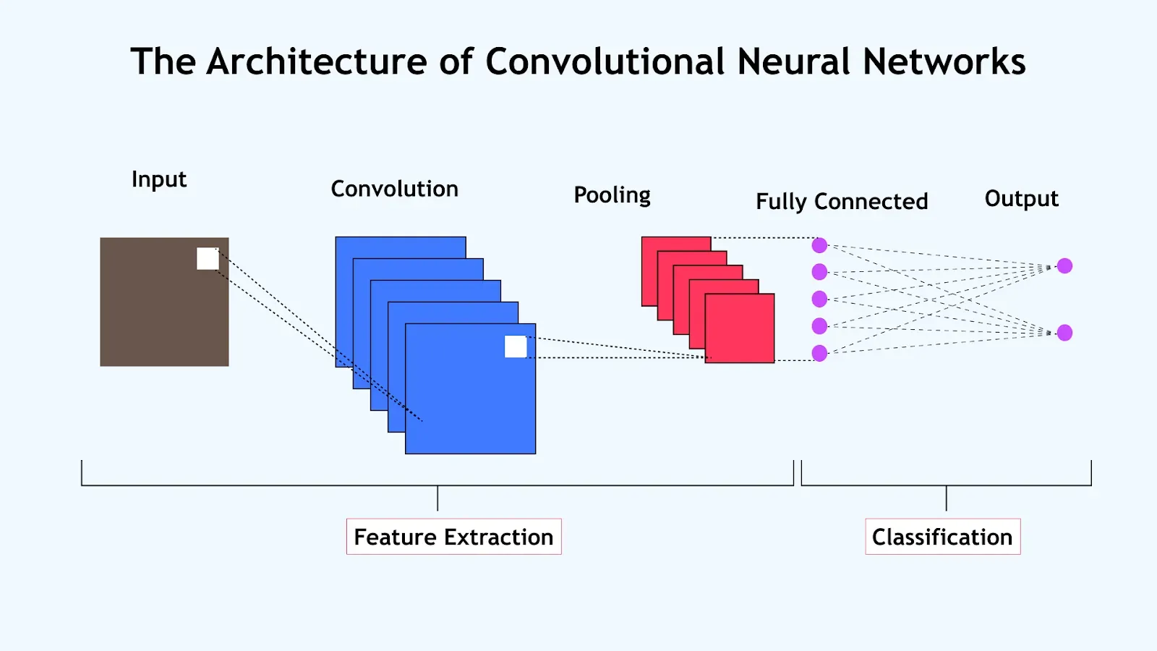
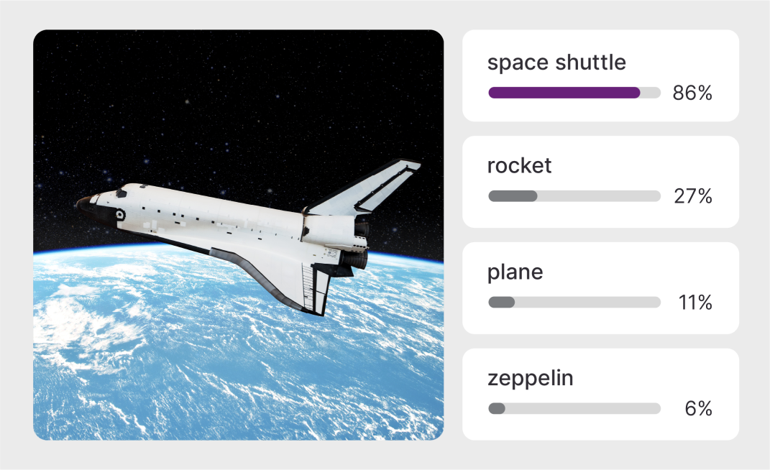
Convolutional Neural Network (cnn) – mobilenetv3 small
Lightweight Image Classification Model
Efficient and Fast, Used on Qualcomm smartphones
Classifies images using ImageNet dataset

Slide 7
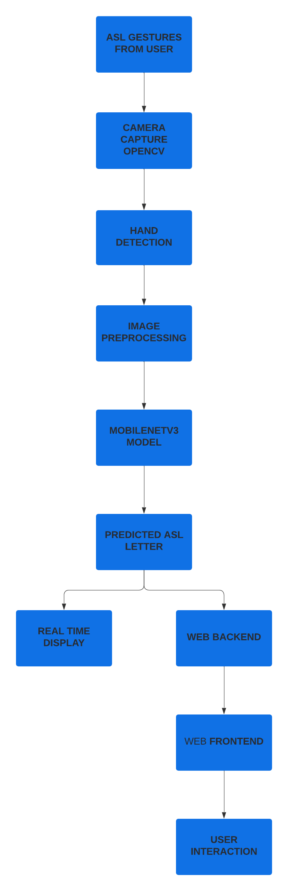
Methodology
The video frames are used to isolate the hand only.
ASL hand gestures are captured on camera using OpenCV.
The captured hand images are normalized to be input into the MobileNetV3.
MobileNetV3 goes through training/evaluations and is quizzed on the corresponding ASL letters.
The predicted letter is shown in the live recognition.
The letter is sent to webpage, to show on the webpage frontend.
The frontend shows recognized letters when the user interacts with the system.

Slide 8
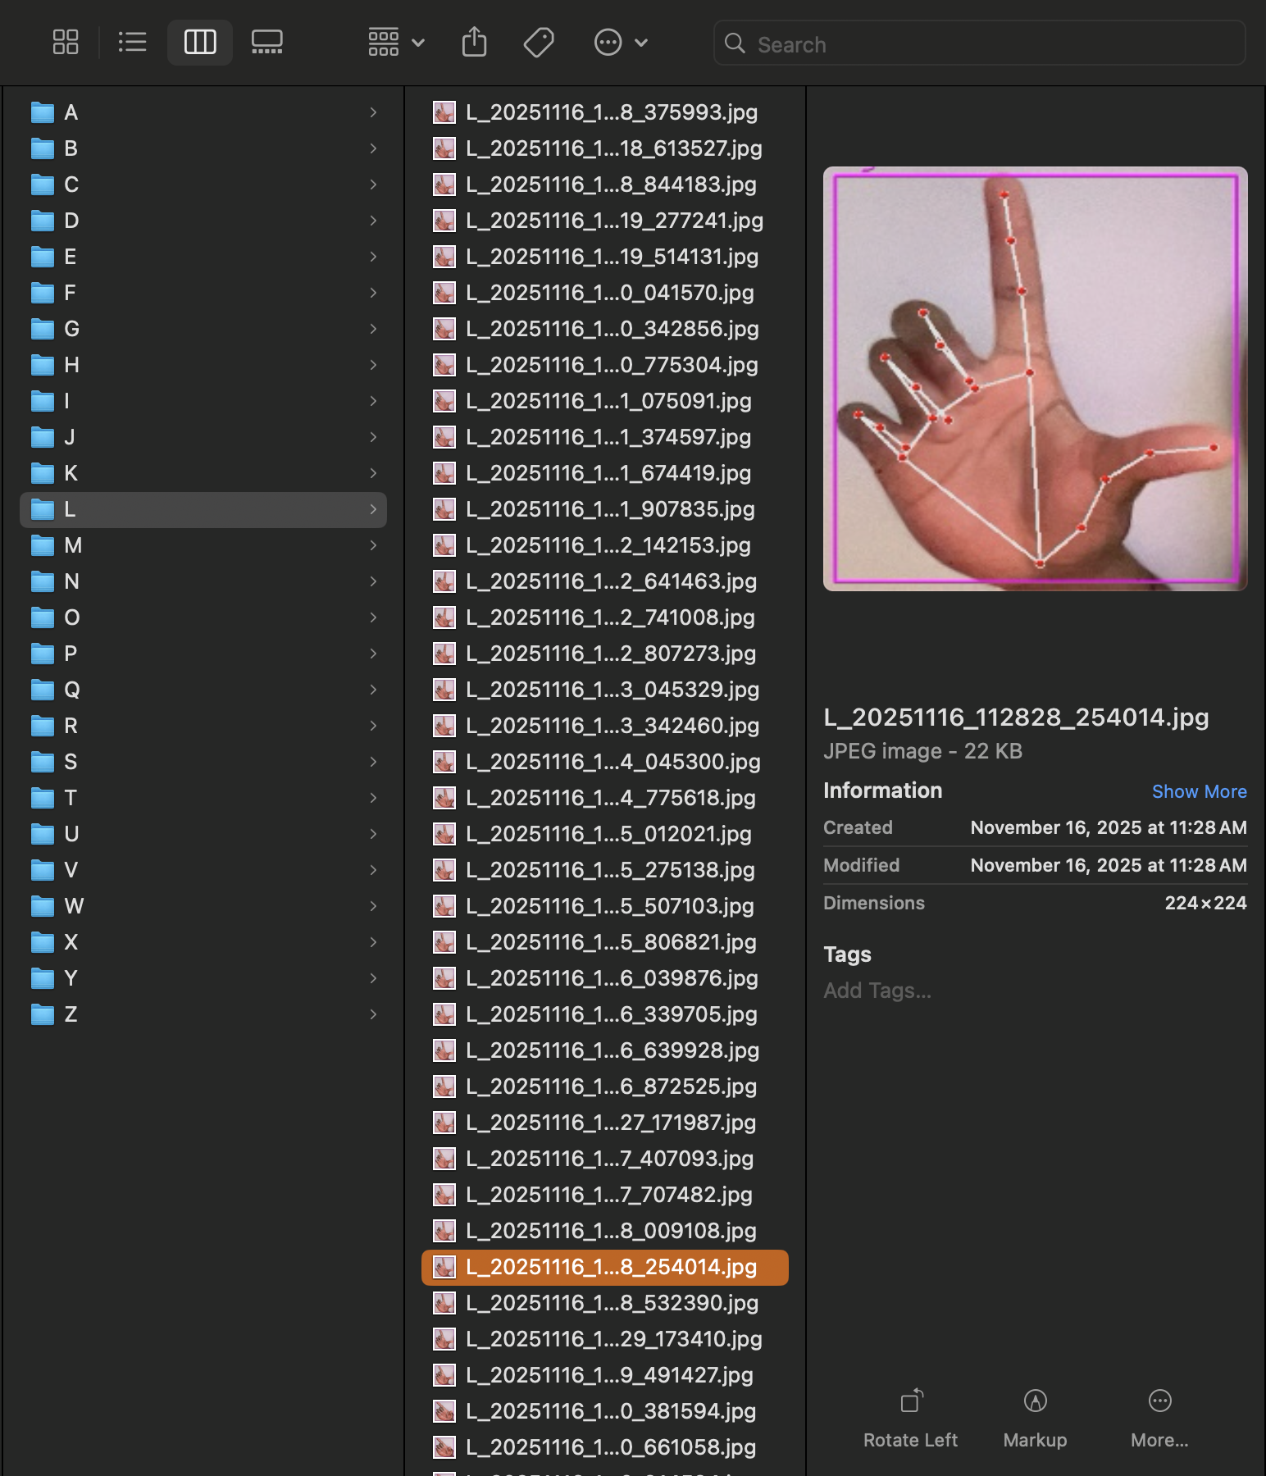
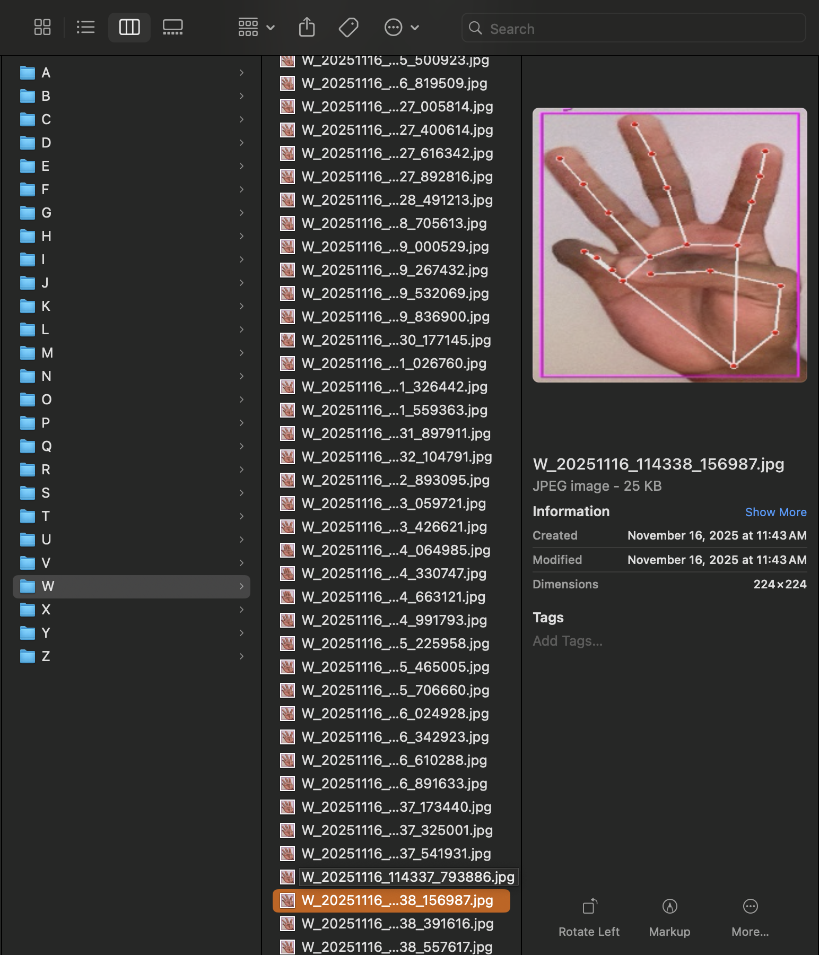
ASL datasets

Slide 9
Accuracy

Slide 10
Website implementation

Slide 11
conclusion

Slide 12
Ethical considerations/limitations

