Slide 1
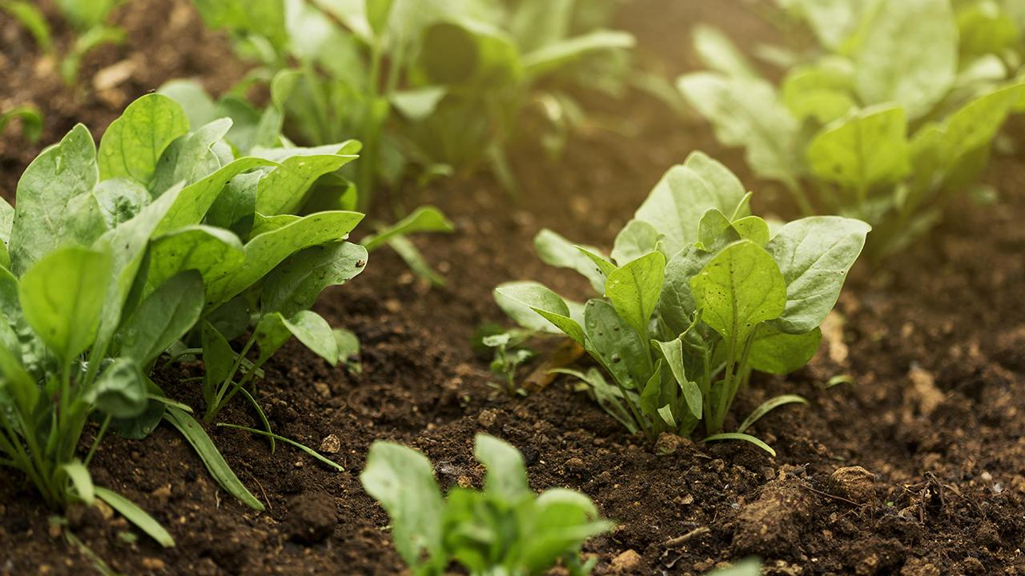
Optimal Crop Watering System for Precision Agriculture with Emphasis to Weather Conditions
Project Guide: Mr. M M SivaKrishna _{M.Tech (Ph.D)}
Team Members:
1. K. Suchita (20P31A0526)
2. K. Hari Rama Reddy (20P31A0525)
3. S. Aparna (21P35A0504)
4. K. Veerendra Nadh Reddy (20P31A0532)

Slide 2
Abstract
This Project presents the implementation of Automatic ON/OFF water pumping system without any farmer intervention.
An Automatic Crop Watering System based on soil moisture and weather conditions is designed and implemented to optimize water usage in agriculture.
The system integrates soil moisture sensors and weather condition data to regulate irrigation schedules efficiently.
By continuously monitoring soil moisture levels, the system ensures that crops receive adequate water while preventing under-watering and also over-watering, which can lead to water wastage and soil degradation.
Additionally, the system including of weather forecasts enables the system to adapt irrigation schedules dynamically based on rainfall, temperature, and humidity, further enhancing water conservation efforts.

Slide 3
Problem Statement
Develop an IoT system in modern agriculture, where there is a growing need for an intelligent and efficient automatic water pumping system that optimizes irrigation practices. The system should use the sensors data, such as temperature, humidity, soil moisture sensor to automatically ON/OFF water pumping system without any farmer intervention.
The system must be capable of accommodating the unique water requirements of various crops while minimizing water wastage. To achieve this, the system must integrate seamlessly with cloud services through APIs for data storage and analysis.
This system should contribute to sustainable agriculture practices by reducing water wastage, minimizing manual intervention, and increasing overall crop productivity by offering a scalable and adaptable approach to modern agricultural challenges.

Slide 4
Motivation
The primary motivation behind the Automatic Crop Watering System based on soil moisture and weather conditions is to improve agricultural water management efficiency while promoting sustainability. Here are the key motivations:
Water Conservation
Enhanced Crop Yields
Resource Efficiency
Environmental Sustainability
Precision Agriculture
Remote Monitoring and Control
The main motivation behind this project is to address the challenges of water scarcity, optimize agricultural productivity, and promote sustainable farming practices through the integration of advanced technology and data-driven irrigation management techniques.

Slide 5
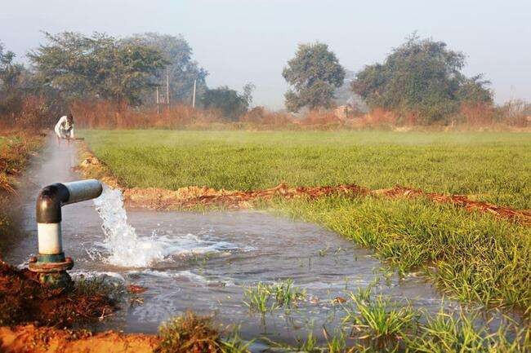
Existing System and it’s Drawbacks
The existing systems typically rely on soil moisture sensors and timers to control the operation of water pumps. These systems are designed to automate irrigation by activating the pump when the soil moisture falls below a certain threshold and deactivating it once the moisture level is restored. And also these systems have been beneficial in reducing manual labor, but they come with certain drawbacks such as:
Optimization of Water Schedules
Limited Precision
Lack of Weather Integration
Lack of Remote Monitoring and Analytics
Scalability Issues

Slide 6
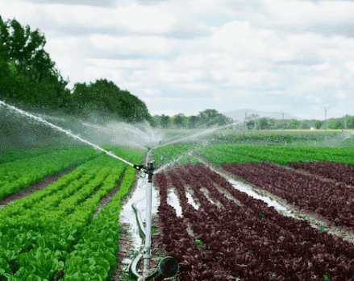
Proposal System
The System that is proposed has a wide scope to automate complete irrigation system.
The Proposed System has features like monitoring Temperature, Humidity and Moisture in agricultural fields through sensors and automates the ON/OFF Conditions of the Water Pump.
It is a Remote-based water pump monitoring and controlling system. By using this system, farmers can automate watering from anywhere without going to their fields everyday.
It is a simple method to operate. This model’s primary goal is to offer a cutting-edge method of operating water pumping system which helps us in getting efficient crop yields.

Slide 7
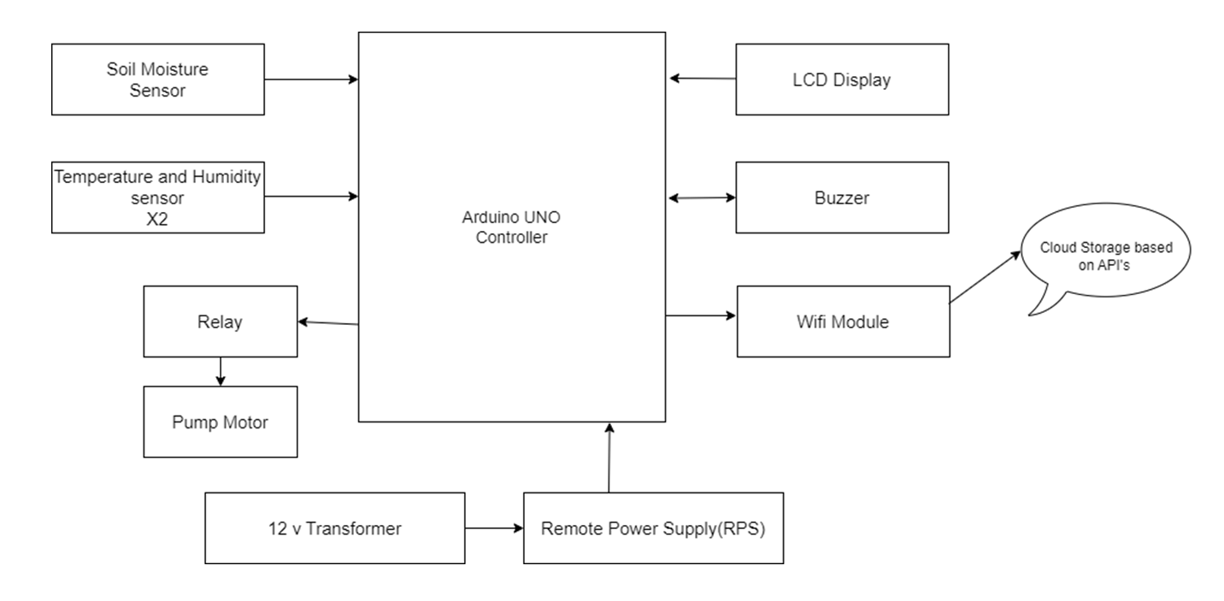
Block Diagram of Proposal System

Slide 8
Feasibility Study of Proposed System
In the Proposed System, the sensors are viably integrated such that soil moisture sensors, weather sensors are utilized in an compatible and accurate manner for getting output.
As we are utilizing ML in our system, the feasibilty for precise agriculture methods is high for various crops. It is because, we can analyze the complexity of the model and train the data which is available based on computational requirements.
Also, we will be able to verify technical feasibility by integrating APIs for cloud connectivity, by enabling seamless data transfer and storage.
This system is impacted ecologically by conserving water.
It is highly scalable and adaptable due to it’s ability to scale for different field sizes and crop types.
This system assess ease of use for farmers by ensuring a user-friendly interface.
It is also econommically feasible, by managing costs with potential savings in water usage and increased crop yields over time.

Slide 9
Functional Requirements
Hardware Component Requirements
NodeMCU ESP8266
Soil Moisture Sensor
Temperature and Humidity Sensor
DC Motor
LCD Display
Relay
Remote Power Supply
Wi-Fi Module
Voltage Regulators
Other Misc Components
Software Component Requirements
Arduino IDE compiler
Embedded C Programming language
Flask Framework

Slide 10
Non - Functional Requirements
Usability: The interface should be user-friendly for both data input and result interpretation.
Maintainability: The system should be easy to maintain and update over time. Components should be modular and replaceable, and software should be well-documented
Accuracy: The accuracy of weather forecasting, soil moisture sensing, and irrigation control should meet predefined standards to ensure precise water management.
Reliability: The system should operate reliably under varying environmental conditions. It should have built-in mechanisms to handle sensor failures or communication disruptions.
Scalability: The system should be scalable to accommodate different field sizes and crop types.
Robustness: The ACWS should be robust enough to withstand environmental factors such as temperature fluctuations, humidity, dust, and water exposure without compromising performance
Security: Measures should be in place to protect the system from unauthorized access or tampering.
Efficiency: The system should operate efficiently in terms of resource utilization, including power consumption, processing time, and water usage.

Slide 11
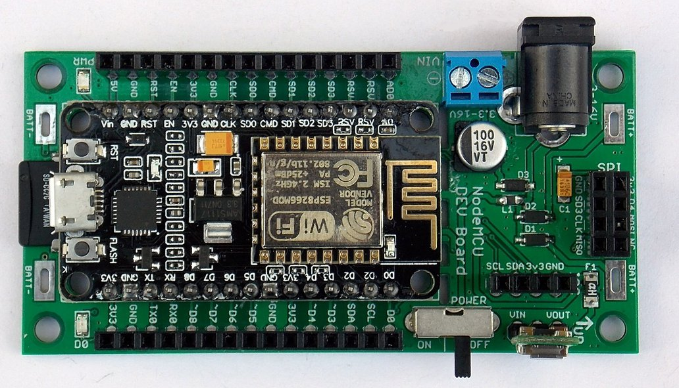
NODEMCU ESP8266
The NodeMCU ESP8266 features a Tensilica 32-bit RISC CPU Xtensa LX106 (80MHz clock speed) which operates at 3.3V. It has 4MB of Flash memory and 64K of SRAM. An on-board voltage regulator allows input voltages from 7-12V. It has 16 digital IO pins, 1 analogue input. It also supports SPI and I2C.
It also features on-board 2.4GHz Wi-Fi and has a PCB antenna giving good range.
The ESP8266, designed and manufactured by Espressif Systems, contains the crucial elements of a computer: CPU, RAM, networking (WiFi), and even a modern operating system and SDK.
The NodeMCU, with its versatility, including its ability to be programmed and used from the Arduino IDE, makes it along with this prototyping board the perfect experimenter’s solution.

Slide 12
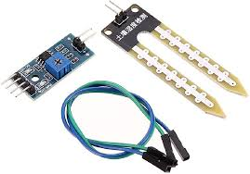
Soil Moisture Sensor
This soil moisture sensor module is used to detect the moisture of the soil. It measures the volumetric content of water inside the soil and gives us the moisture level as output. The module has both digital and analog outputs and a potentiometer to adjust the threshold level.
Soil moisture sensors are installed in the root zone of plants to accurately monitor soil moisture levels where it matters most for plant growth.
Soil moisture sensors typically operate based on one of two principles: resistance-based or capacitance-based. Resistance-based sensors measure the electrical resistance between two electrodes embedded in the soil, which varies with the moisture content. Capacitance-based sensors measure the dielectric constant of the soil, which changes as the soil moisture level fluctuates.

Slide 13
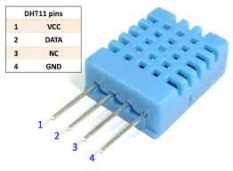
Temperature & Humidity Sensor
The DHT11 sensor is capable of measuring both temperature and humidity within a specified range.
The sensor comes with a dedicated NTC to measure temperature and an 8-bit microcontroller to output the values of temperature and humidity as serial data.
The sensor can measure temperature from 0°C to 60°C and humidity from 20% to 70% with an accuracy of ±1°C and ±1%.
The DHT11 sensor utilizes a capacitive humidity sensor and a thermistor to measure humidity and temperature
Changes in capacitance due to humidity variations and changes in resistance due to temperature variations are converted into digital signals by an internal analog-to-digital converter.

Slide 14
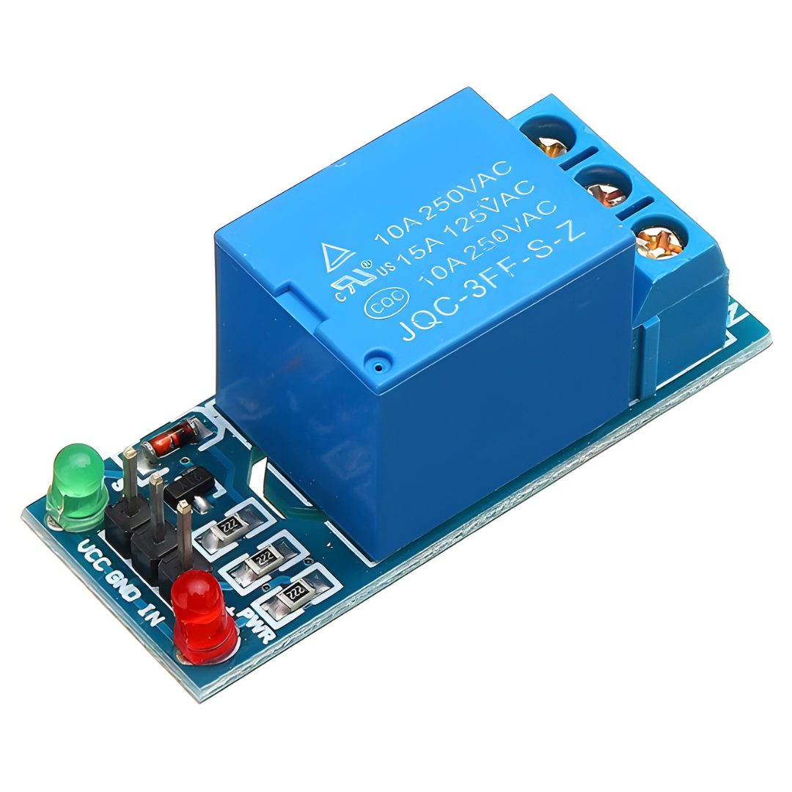
Relay
A relay is an electrically operated switch that is used to on/off the system.
It consists of a coil and one or more sets of contacts.
When an electrical current is applied to the coil of a relay, it generates a magnetic field that attracts an armature, causing the contacts to close or open, depending on the relay type.
This allows the relay to control the flow of electrical power to a load, such as a motor, lamp, or heating element.
1-channel 5V control Single-Pole Double-Throw (SPDT) High-level trigger AC power relay board can be controlled directly via a microcontroller and switch up to 10A at 250 V AC.

Slide 15
Implementation of UI design
Here, we will use arduino software along with Weather Data Collection and Integration Software.
Integrate with the APIs for accessing data.
In this project we will be provided with Graphical User Interface for interacting with the system.
This helps us in displaying real-time sensor data, irrigation schedules, and system status through the mobile application.
BUT HOW?
We require computer with all the above software installed and available at the interface such that arduino will take care of the system and perform all operations. By the end it will store the data into cloud through APIs and display the messages to farmer by showing that moisture, temperature levels along with water pump is ON/OFF at a particular time based on input and from analysis of gathered data.

Slide 16
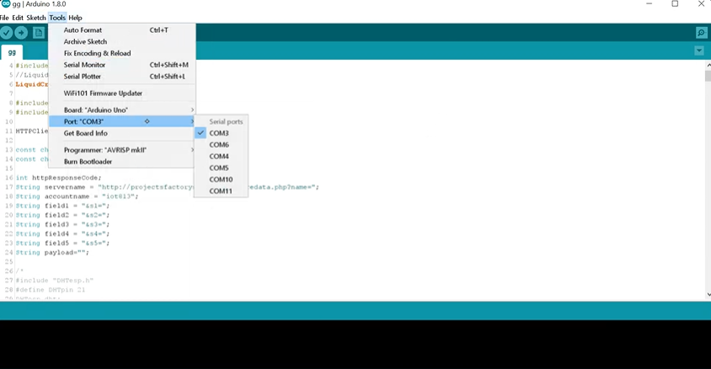

Slide 17
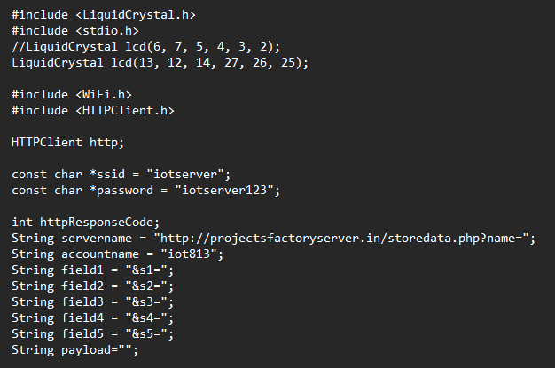
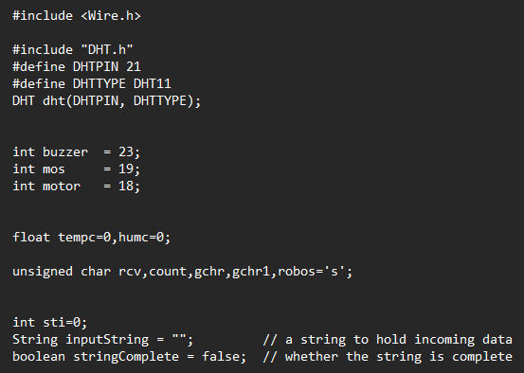
Code

Slide 18
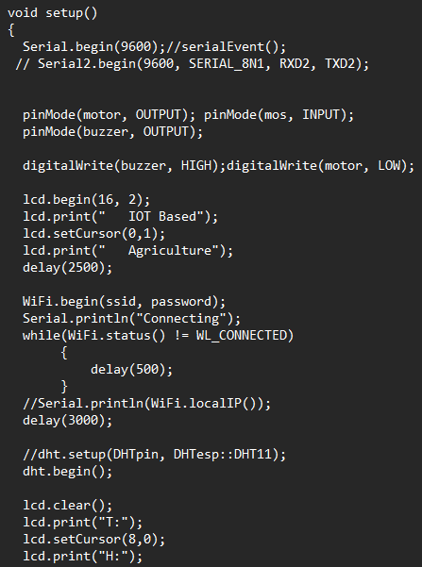
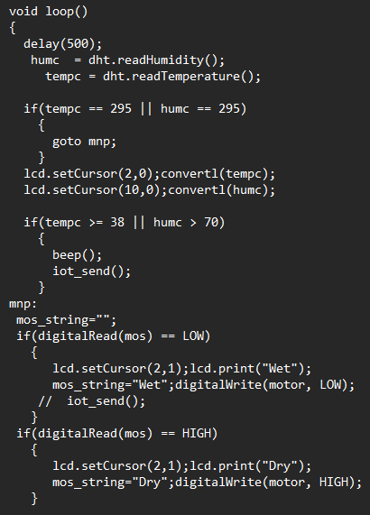
Code

Slide 19
Test Cases
S.No | Soil Moisture(%) | Temp(°C) | Humidity(%) | Expected Output | OutputDisplay | Water Pump(ON/OFF) | Result
1 | 30(Dry) | 25 | 50 | Soil Dry, Pump on | Dry | ON | Pass
2 | 50(Moist) | 25 | 50 | Soil Moist, Pump on | Moist | OFF | Fail
3 | 70(Wet) | 25 | 50 | Soil wet, Pump off | Wet | OFF | Pass
4 | 30(Dry) | 35(Hot) | 50 | Soil Dry, pump on | Dry | ON(Longer time run) | Pass
5 | 50(Moist) | 35(Hot) | 50 | Soil Moist, Pump off | Moist | OFF | Pass
6 | 70(Wet) | 35(Hot) | 50 | Soil wet, Pump off | Wet | OFF | Pass
7 | 30(Dry) | 15(Cold) | 50 | Soil wet, Pump off | Dry | ON(Shorter time run) | Fail
8 | 50(Moist) | 15(Cold) | 50 | Soil Moist, Pump off | Moist | OFF | Pass
9 | 70(Wet) | 15(Cold) | 50 | Soil wet, Pump off | Wet | OFF | Pass

Slide 20
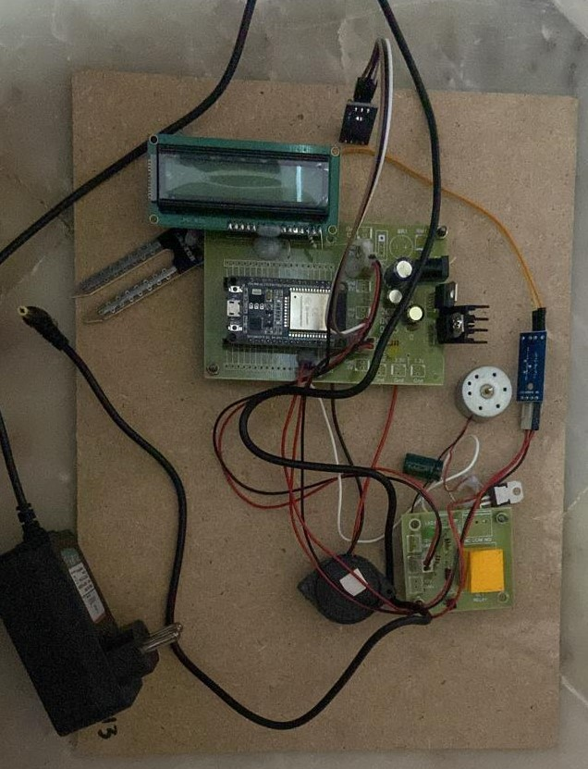
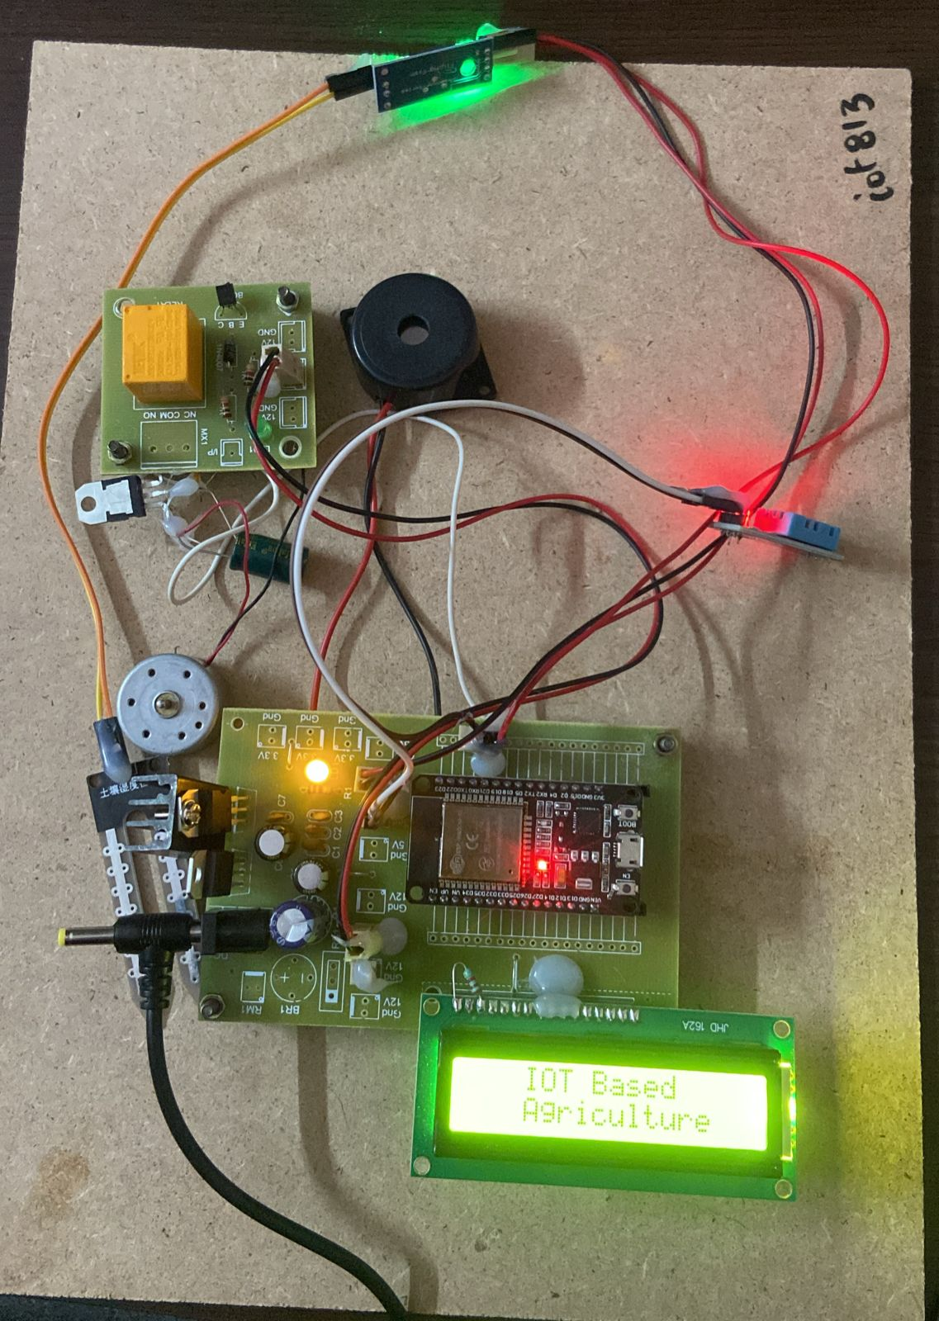
Work Progress

Slide 21
Discussions and Result
IoT Sensors: These sensors measure various environmental parameters such as soil moisture, temperature, humidity, light intensity, and possibly other factors relevant to crop growth.
Cloud Server or Central System: Receives data from multiple IoT devices, stores it securely, and performs data analytics and prediction tasks.
Machine Learning Model: Trained on historical data of crop growth and environmental conditions, this model predicts future crop growth based on current environmental parameters.
Remote monitoring and control: Farmers can remotely monitor the system's operation and make adjustments as needed via a web interface or mobile application, enhancing convenience and efficiency.
Automated Watering: The system can autonomously adjust watering schedules based on real-time environmental conditions and predicted crop growth needs, leading to optimized water usage.
Improved Crop Yield: Through accurate prediction of crop growth and timely watering, the system can potentially enhance crop yield and quality.

Slide 22
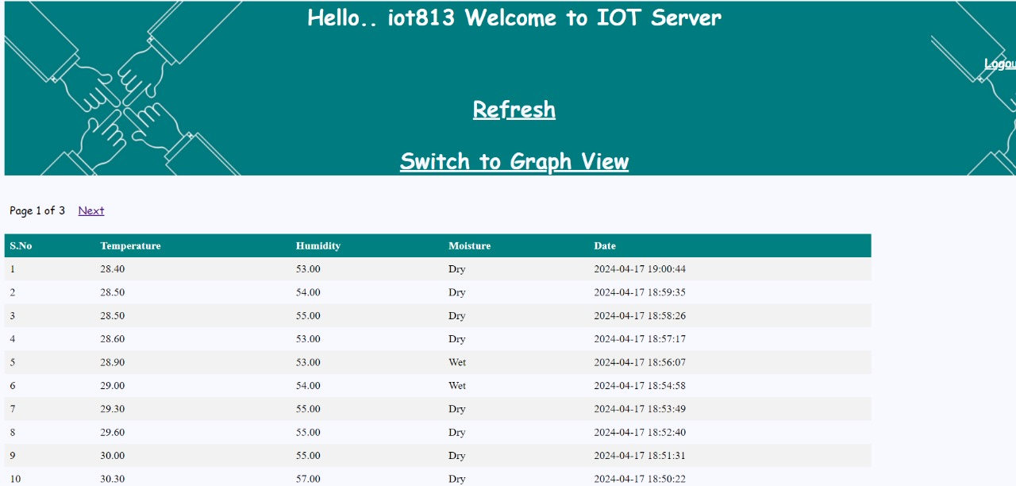
Result

Slide 23
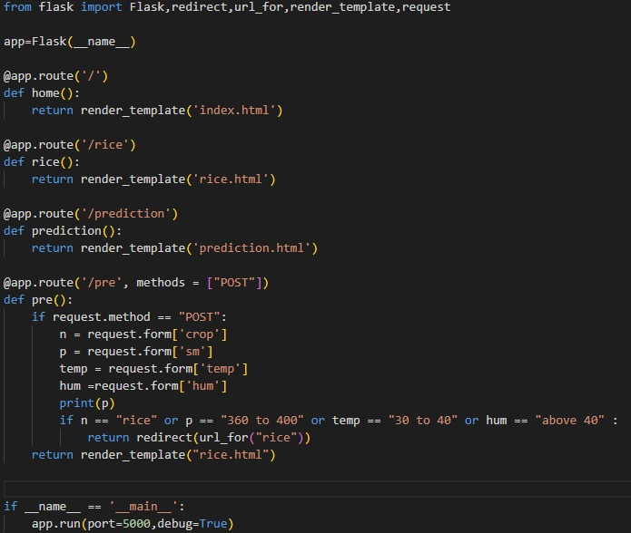
Code

Slide 24
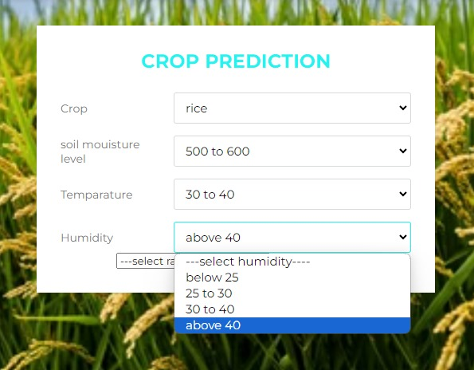
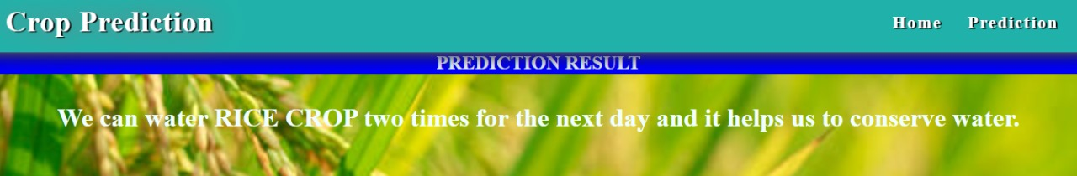
Output

Slide 25
Conclusion
In conclusion, the development of the Automatic Crop Watering System (ACWS) based on soil moisture and weather conditions represents a significant advancement in precision agriculture and water management practices. Through the integration of advanced technology, data-driven decision-making, and automation, the ACWS offers a sustainable solution for optimizing irrigation schedules, conserving water resources, and enhancing crop yields.
By continuously monitoring soil moisture levels and incorporating real-time weather data, the ACWS ensures that crops receive the appropriate amount of water at the right time, minimizing the risk of over or under-watering.
This precision irrigation approach not only promotes healthier plant growth and improved crop yields but also reduces water wastage and environmental impact associated with conventional irrigation methods.

Slide 26
References
https://www.sciencedirect.com/science/article/abs/pii/S2213138822003599
https://www.researchgate.net/publication/367398621_IoT_Smart_Irrigation_System_for_Precision_Agriculture
https://www.sciencedirect.com/science/article/pii/S2772427122000791

Slide 27
Nayyar, Anand & Puri, Vikram. (2016). Smart farming: IoT based smart sensors agriculture stick for live temperature and moisture monitoring using Arduino, cloud computing & solar technology. The international conference on communication and computing (ICCCS-2016)
Gorli, Ravi & Yamini G. (2017). Future of Smart Farming with Internet of Things. Journal of Information technology and Its Applications.
S. jegadeesan, dr. g. k. d. Prasanna venkatesan Smart cow health monitoring, farm environmental monitoring and control system using wireless sensor networks, International journal of advanced engineering technology, Jan-March 2016.
Vaibhavraj S. Roham, Ganesh Pawar, Abhijit Patil & Prasad Rupnar, Smart Farm using Wireless Sensor Network, International Journal of Computer Applications, National Conference on Advances in Computing, NCAC 2015.
Anushree M K & Krishna R. (2018). A smart farming using Arduino based technology. International Journal of Advance Research,Ideas and Innovations in Technology.

Slide 28
THANK YOU

