Slide 1
HOSPITAL MANAGEMENT SYSTEM
Capstone Project review -1
BATCH NUMBER : 3
Presented By:
K. Vijaya Durga - 25B11AI514 (AIML) P. Sadwika - 25B11AIA48 (AIML)
. K. Rupa Reddy – 25B11AI510 (AIML) N. Gyaneswari – 25B11AI791 (AIML)
Academic Year: 2026-2027
Under esteemed guidance
Dr P Kishorekumar
Associate Professor
Department of AIML
Aditya University

Slide 2
Outline
Introduction
Problem statement
Objectives
System scope

Slide 3
1. Introduction
The Hospital Management System (HMS) is a database-based system designed to manage and organize the day-to-day activities of a hospital.
It stores important information about patients, doctors, departments, appointments, medical records, medicines, prescriptions, bills, rooms, and staff.
The system helps maintain hospital information in a structured and efficient manner.
Instead of maintaining records manually, the hospital can use a centralized database to store, retrieve, update, and manage information easily.
This improves accuracy, reduces data duplication, saves time, and makes hospital management more efficient.

Slide 4
2. Problem Statement
In a traditional hospital, patient and hospital records may be maintained manually or in separate systems. Managing large amounts of information such as patient details, doctor details, appointments, medical records, medicines, rooms, and billing can become difficult.
Manual record keeping can lead to:
1. Data duplication
2. Loss of important information
3. Difficulty in searching records
4. Errors in maintaining patient information
5. Difficulty in managing appointments
6. Problems in maintaining billing and medicine records
7. Time-consuming record updates
Therefore, a Hospital Management System is required to store and manage all hospital-related information in a centralized and organized database.

Slide 5
3. Objectives
Identify the major entities involved in Hospital management system.
Identify suitable attributes for each entity.
Establish relationships between the identified entities.
Design an Entity–Relationship (ER) diagram.
Convert the ER model into a relational database schema.
Identify Primary Keys and Foreign Keys.

Slide 6
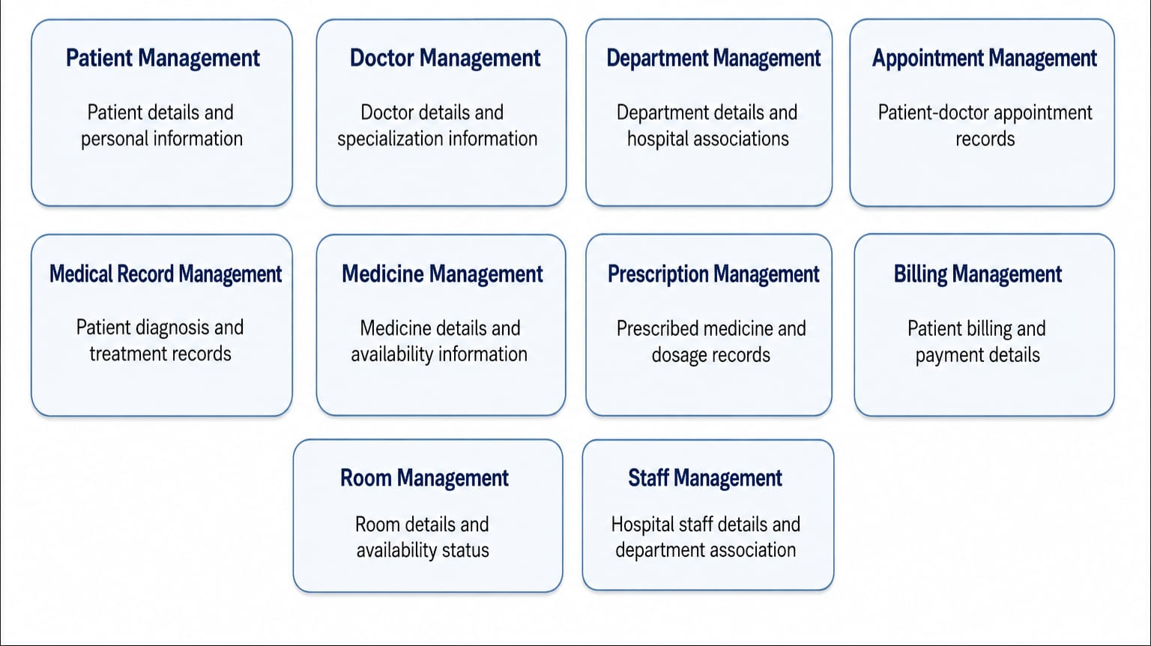
4. System Scope

Slide 7
5. Entities and Attributes
ENTITY | KEY ATTRIBUTES
Patient | Patient_ID (PK), Patient_Name, DOB, Gender, Phone, Address
Doctor | Doctor_ID (PK), Doctor_Name, Specialization, Phone, Email, Department_ID (FK)
Department | Department_ID (PK), Department_Name, Location, Phone, Head_Doctor, Description
Appointment | Appointment_ID (PK), Patient_ID (FK), Doctor_ID (FK), Appointment_Date, Appointment_Time, Status
Medical_Record | Record_ID (PK), Patient_ID (FK), Doctor_ID (FK), Diagnosis, Treatment, Record_Date
Medicine | Medicine_ID (PK), Medicine_Name, Category, Manufacturer, Quantity, Unit_Price
Prescription | Prescription_ID (PK), Patient_ID (FK), Doctor_ID (FK), Medicine_ID (FK), Dosage, Duration
Billing | Bill_ID (PK), Patient_ID (FK), Bill_Date, Consultation_Fee, Medicine_Fee, Total_Amount
Room | Room_ID (PK), Room_Number, Room_Type, Department_ID (FK), Room_Charge, Status
Staff | Staff_ID (PK), Staff_Name, Role, Phone, Email, Department_ID (FK)

Slide 8
6. Relationships and Cardinality
Relationship | Cardinality | Meaning
Department - Doctor | 1 : M | One department can have many doctors.
Department - Staff | 1 : M | One department can have many staff members.
Department - Room | 1 : M | One department can have many rooms.
Patient - Appointment | 1 : M | One patient can have many appointments.
Doctor - Appointment | 1 : M | One doctor can have many appointments.
Patient – Medical Record | 1 : M | One patient can have many medical records.
Doctor – Medical Record | 1 : M | One doctor can have many medical records.
Patient - Prescription | 1 : M | One patient can have many prescription.
Doctor - Prescription | 1 : M | One doctor can have many prescription.
Medicine - Prescription | 1 : M | One medicine can be included in many prescription.
Patient - Billing | 1 : M | One patient can have many bills.
Patient - Room | 1 : M | One patient can be allocated many rooms.
Department - Course | 1 : M | One department can offer many courses.

Slide 9
7. Relational Database Schema
Patient | Patient (Patient_ID , Patient_Name, DOB, Gender, Phone, Address) | PK : Patient_ID
Doctor | Doctor (Doctor_ID , Doctor_Name, Specialization, Phone, Email, Department_ID) | PK: Doctor_ID | FK: Department_ID
Department | Department (Department_ID , Department_Name, Location, Phone, Head_Doctor, Description) | PK: Department_ID
Appointment | Appointment (Appointment_ID , Patient_ID , Doctor_ID , Appointment_Date, Appointment_Time, Status) | PK: Appointment_ID | FK: Patient_ID, Doctor_ID
Medical_Record | Medical_Record (Record_ID , Patient_ID , Doctor_ID , Diagnosis, Treatment, Record_Date) | PK: Record_ID | FK: Patient_ID, Doctor_ID
Medicine | Medicine (Medicine_ID , Medicine_Name, Category, Manufacturer, Quantity, Unit_Price) | PK: Medicine_ID
Prescription | Prescription (Prescription_ID , Patient_ID , Doctor_ID , Medicine_ID , Dosage, Duration) | PK: Prescription_ID | FK: Patient_ID, Doctor_ID, Medicine_ID
Billing | Billing (Bill_ID , Patient_ID , Bill_Date, Consultation_Fee, Medicine_Fee, Total_Amount) | PK: Bill_ID | FK: Patient_ID
Room | Room (Room_ID , Room_Number, Room_Type, Department_ID , Room_Charge, Status) | PK: Room_ID | FK: Department_ID
Staff | Staff (Staff_ID , Staff_Name, Role, Phone, Email, Department_ID) | PK: Staff_ID | FK: Department_ID

Slide 10
8. ER Diagram

Slide 11
9. Team Responsibilities and GitHub
Team Member | Assigned responsibility
Student 1 | Project title, introduction, and problem statement, Objectives
Student 2 | Scope, and entity identification, Attributes, Primary Keys, and Foreign Keys,
Student 3 | Relationships and cardinality, Relational schema and ER diagram
Student 4 | GitHub repository and PPT documentation
GitHub Repository: Add the repository name and link here

Slide 12
10. Conclusion
The proposed Hospital Management System identifies ten major hospital entities for the database.
The attributes, Primary Keys, and Foreign Keys for each entity have been identified.
The relationships and cardinalities between the entities have been defined.
The ER diagram and relational database schema have been designed.
The database design provides a structured foundation for efficient hospital data management and database implementation in Review-II.

