Slide 1
Homologous Sequence Identification Using Hidden Markov Models with Regional Substitution Rates
Mike McAllister
Advisor Dr. Karro

Slide 2

Bioinformatics Introduction
Vast Amounts of sequence data
Human Genome ~3.3 billion base pairs
Computational methods needed to understand and organize data
Biological wet labs most accurate, but too resource intensive
Genomes constantly undergoing changes which leads to evolution
Notes:
is an interdisciplinary field that develops methods and software tools for understanding biological data. As an interdisciplinary field of science, bioinformatics combines computer science, statistics, mathematics and engineering to study and process biological data.

Slide 3

Hypothesis
The sensitivity of Hidden Markov Models in identifying homologous sequences can be increased by accounting for regional substitution rates.
Create the computational tools to facilitate the creation of these adjusted models
Test the effectiveness of models in simulated and real environments.

Slide 4

Background - HMM
Inspiration – Occasionally Dishonest Casino

Slide 5

HMM - Preliminaries
Stochastic process - A method of randomly generating a sequence of “outputs”
Markov process - A stochastic process where the distribution of step i depends only on the result of step i-1 and no previous steps i to i-2
Markov System – has states and discrete steps. At each time step t you are in exactly one state. Transition between states is Markov process

Slide 6

HMM - Example
Dishonest Casino – Fair Dice are swapped out for loaded dice occassionally
Loaded Dice – Prob of 6 = .5 ; Prob of 1-5 = .1 each
Start with Fair Dice
Fair -> Loaded Transition Probability (a_{fl}) = .01
Loaded -> Fair Transition Probability (a_{lf}) = .1

Slide 7
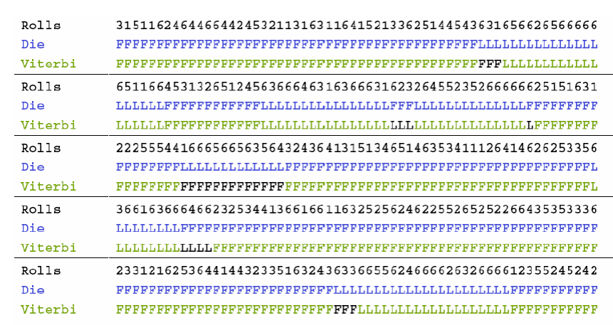
HMM - Results
(Durbin 1998)

Slide 8
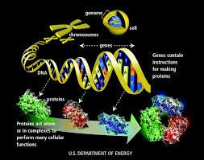
Background - Genome
Genome composed of DNA (Deoxyribonucleic acid)
DNA composed of 4 bases: Adenine, Thymine, Cytosine, and Guanine. (A,T,C,G)
Computer Science translation – really long string (3 billion chars) with an alphabet {A, C, G, T}

Slide 9

Background - Mutations
Changes in DNA from ancestor sequence
Can take place in 3 forms (ex. Ancestor sequence AAA)
Substitution – ex. AGA
Insertion – ex. AAGA
Deletion – ex. AA

Slide 10
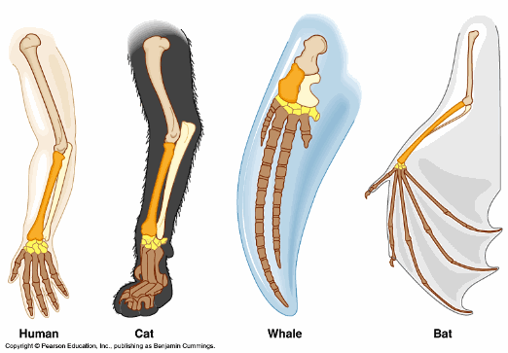
Background - Homology
Homologous sequences are sequences descended from a common ancestor sequence.
How to identify?
Search for high scoring alignments
Use profile HMMs … to be discussed later

Slide 11
Background - Alignment
GTACCCGAT
GTACCTGAT
GTACCTG_T
GTACCCGAT
GGTACCCGAT
G-TACCTG-T
GGTACCCGAT

Slide 12
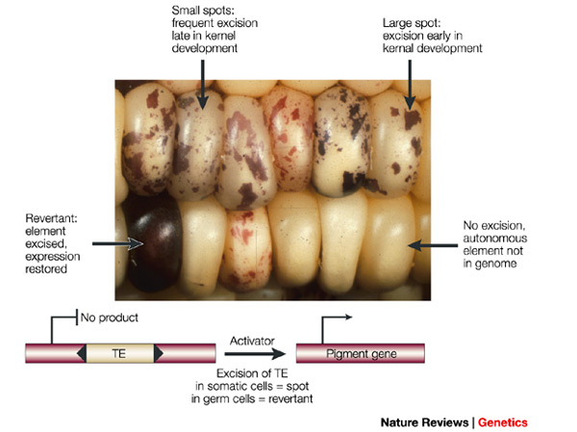
Transposable Elements
Sequences of DNA that insert copies of themselves into the genome.
Highly prevalent – estimates range from 45 – 69% of genome
Considered non-functional
Change in an unconstrained manner as opposed to genes which are more likely to be conserved
Notes:
Repeative elements may comprise over 2/3rds of human genome
http://journals.plos.org/plosgenetics/article?id=10.1371/journal.pgen.1002384

Slide 13
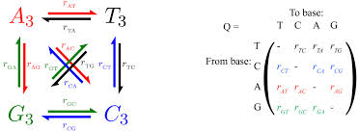
Rate of Change
Definition: Neutral Substitution rate – rate at which bases under go substitutions when not under evolutionary pressure
Varies by region of the genome - new variable my project is trying to capture
Use subset of Transposable elements to determine relative rate of change for each region.
Notes:
(Hardison, R., Roskin, K., Yang, S., & et al. 2003)

Slide 14
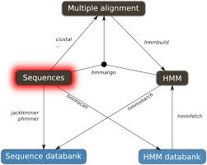
Related Work - HMMER
HMMER aims to be significantly more accurate [than BLAST and other tools] and more able to detect remote homologs, because of the strength of its underlying probability models.” (Finn et Al. 2011)
Probability models are profile HMMs

Slide 15
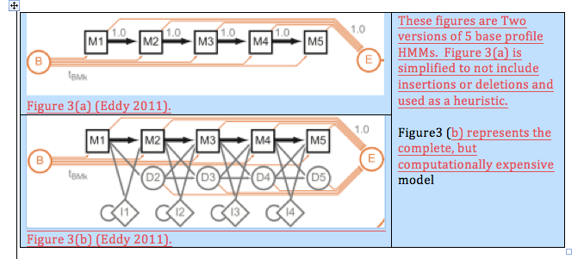
Profile HMM

Slide 16

Hypotheses Reloaded
The sensitivity of Hidden Markov Models in identifying homologous sequences can be increased by accounting for regional substitution rates.

Slide 17
Software Tool
Input
HMM profile of Transposable Elements to be found (HMMER can generate from multiple sequence alignment)
Genomic sequence to be searched
Regional substitution rates (optional)
Output
Set of subsequences that match the new HMM profiles
Optional (HMM profiles generated)

Slide 18
Implementation
Editing HMMs
Human readable files
Transitioning between D values and emission probabilities

Slide 19
Implementation
Defining Region
Length define by number of repeat bases (50,000)
Expected vs. Actual d value
Data From Chromosome 5 from Repeats within .1 d value of MLT1A (593 Partitions)

Slide 20
Implementation
Other files handle:
creation of HMM File for each partition
extracting relevant sequence data for each partition
Forking HMMER process to run on each partition
Aggregating and summarizing the results from partitions

Slide 21
Initial Results
Basic Metric – Total number of bases found by each method
Problem program did the worse than original in almost every tested case. Example Results were along the lines of
Repeat MLT1A. Chromosome 5
Modified | Original
2,775,965 | 2,785,424

Slide 22
Simulation
Initial Results did not match expectation. Simulator was built to see why.
Simulated PSM and fasta file generated.
What was learned–
Program appeared to be functioning as expected
There was a pattern to results that I had not noticed before. Areas of more change performed better in modified than original. Areas of less change performed worse.
Many changes were small numbers of bases added to end of particular repeat

Slide 23
Initial Results Revisited
 | Modified | Original
Regional Rate of Change Higher | 1,026,405 | 1,014,884
Regional Rate of Change Lower | 1,749,560 | 1,770,540
Total | 2,775,965 | 2,785,424

Slide 24
Different Metrics
Count of Partitions with 100 or more bases than other method
 | Modified | Original
Regional Rate of Change Higher | 50 | 20
Regional Rate of Change Lower | 23 | 88
Partitions with 100 or more records and higher number of repeat elements found
MLT1A | Modified | Original
Chromosome 3 | 16 | 16
Chromosome 5 | 30 | 16

Slide 25
Other Investigation

Slide 26
Other Investigation
Question: Would higher rates of change typically get better results regardless of regional rate of change and where is the limit?
Built a simple hillClimber program to try and gain some insight.
Mostly inconclusive – typically more bases but less repeats with higher change up to -3%
Outlier – L2 (HMM D = .38; Real D = .41, optimal HMM -7% change) More repeats in -7% than original model

Slide 27

Questions

Slide 28
References
HMMER web server: interactive sequence similarity searching R.D. Finn, J. Clements, S.R. Eddy Nucleic Acids Research (2011) Web Server Issue 39:W29-W37.
Eddy SR. Accelerated Profile HMM Searches. PLoS Comput. Biol. 2011;7:e1002195.[PMC free article] [PubMed]
Durbin, R., Eddy, S., Krogh, A. , & Mitchison, G. (1998) Biological Sequence Analysis Probabilitstic models of proteins and nucleic acids
Karro, J. E., Peifer, M., Hardison, R. C., Kollmann, M., & von Grunberg, H. H. (2007). Exponential Decay of GC Content Detected by Strand-Symmetric Substitution Rates Influences the Evolution of Isochore Structure. Mol. Biol. Evol., 362-374.
Lander, E., Linton, L., Birren, B., & et al. (2001). Initial sequencing and analysis of the human genome. Nature, 409:860-921.
Moore, A (2014). Hidden Markov Models. powerpoint used in 620K class
Hardison, R., Roskin, K., Yang, S., & et al. (2003). Covariation in frequencies of substitution, deletion, transposition, and recombination during eutherian evolution. Genome Res., 13:13-26.
Travis J. Wheeler; Jody Clements; Sean R. Eddy; Robert Hubley; Thomas A. Jones; Jerzy Jurka; Arian F. A. Smit; Robert D. Finn Nucleic Acids Research (2013) Database Issue 41:D70-82. doi: 10.1093/nar/gks1265
Watson, J. D., & Crick, F. H. C. A structure for deoxyribose nucleic acid. Nature 171, 737–738 (1953) (link to article)

