Slide 1
Groovy
Groovy provides solutions to improve yours applications. It’ll help you in areas like:
simplifying java code
routine tasks automation
business logic modeling in domain-specific languages (DSLs)
ad-hoc scripting for your daily tasks
improving code readability
and especially enjoining in code writing

Slide 2
Maven Setup
<plugin>
<groupId>org.codehaus.gmavenplus</groupId>
<artifactId>gmavenplus-plugin</artifactId>
<version>2.0.0</version>
<executions>
<execution>
<goals>
<goal>compile</goal>
<goal>compileTests</goal>
</goals>
</execution>
</executions>
</plugin>
<dependency>
<groupId>org.apache.groovy</groupId>
<artifactId>groovy-all</artifactId>
<version>3.0.13</version>
</dependency>

Slide 3
Gradle Setup
apply plugin: 'groovy'
dependencies {
implementation 'org.codehaus.groovy:groovy-all:3.0.13'
}

Slide 4
How to run groovy
You can run groovy script with:
groovy application
groovy KnowledgeExchange\src\main\groovy\forjava\GroovyDemo.groovy
groovy console
groovyconsole

Slide 5
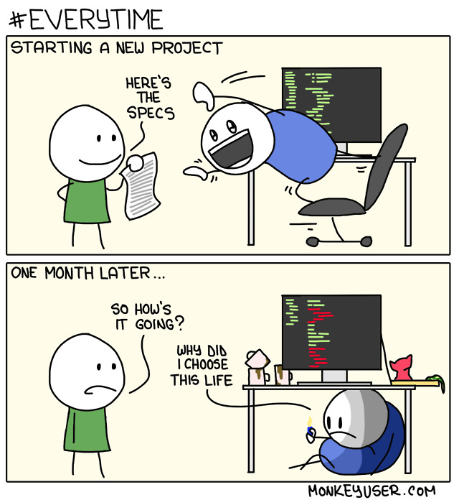
Make Java groovy
It’s coding time!!!

Slide 6
You

