Slide 1
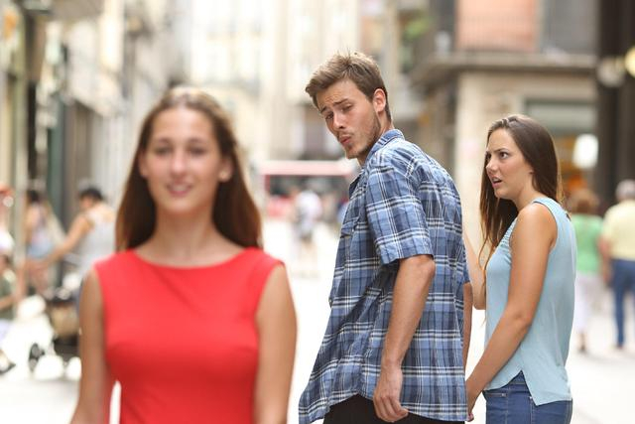
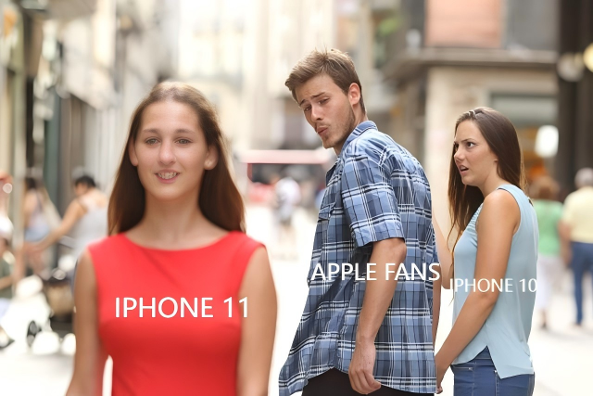

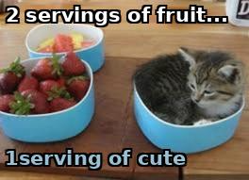
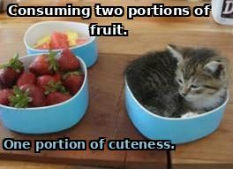
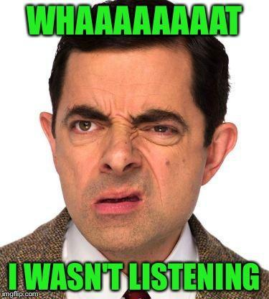


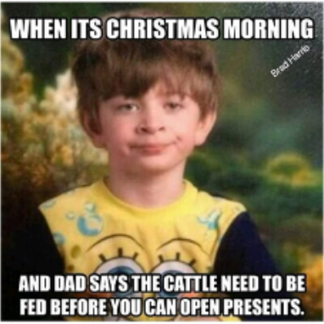
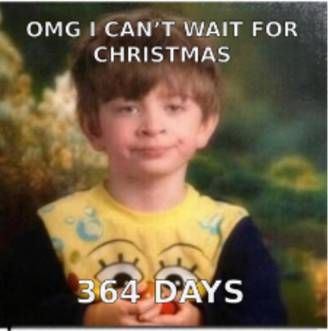
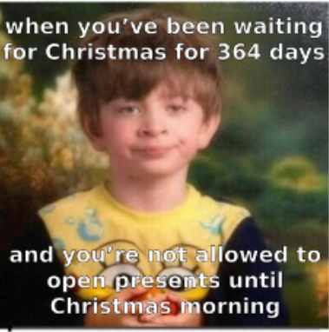
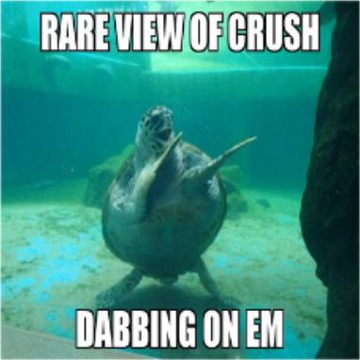
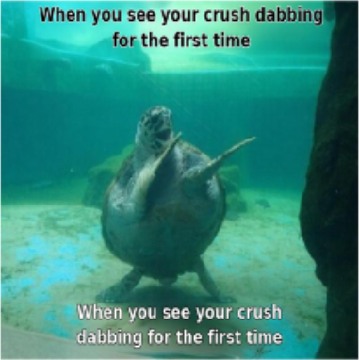
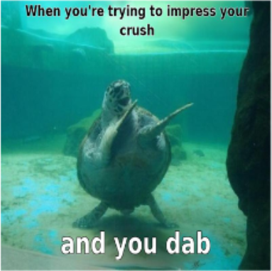
From Perception to Punchline:
HUMOR
Empowering VLM with the Art of In-the-wild Memes
NeurIPS 2026
Xueyan Li
*1
Yingyi Xue
*1,2
Mengjie Jiang
3
Qingzi Zhu
1
Yazhe Niu
†4
Hierarchical Understanding and Meme Optimization
[1] Shanghai AI Laboratory [2] Fudan University [3] Columbia Engineering, Columbia University [4] CUHK MMLab
01 What makes a caption a meme?
02 HUMOR: hierarchical reasoning → local preferences → stable optimization
Same visual relation, different
A
Hierarchical CoT
B
Template-local reward
C
Group-wise optimization
context-specific punchlines.
Template
Meme
Template intent → diverse contextual groundings.
Compare within a template; learn a group ranking.
Use the group ranking as the policy target. Stay close to
1 MULTI-SCENARIO ASSOCIATION
Training pairs span five types: wrong text, wrong location,
the CoT reference during optimization.
A confusing work problem → bewildered reaction
boring, detailed boring, and generated memes.
1 Sample captions from the CoT policy
Original
Boring
A bad joke → exaggerated "painful" response
≻
2 Pairwise reward → EBC → local targets
Social ignorance → refusing to listen
3 Update policy; keep CoT as reference
USER INPUT
Trace back to the compatible scene
Technology · “Apple fanatic”
2 REVERSE-ANCHOR FROM A REAL MEME
Preference
Gold c → infer U: socializing / ignorance.
A · Subject
B · New focus
C · Neglected
Trace back; retain other associations.
BCE loss
APPLE FANS
IPHONE 11
IPHONE 10
Expected wins
Why rank within a group?
1 Estimate preferences inside template G.
Single-image scores barely separate quality.
Good-path mass α > 0; mean humor gap ≤ δ.
2 Sum wins; normalize sparse comparisons.
For h ∈ [0,1], KL bounds possible degradation. It does not
In-group ranks make differences easier to
INFERENCE Explore/select; no gold caption.
3 Rank candidates → local policy targets.
guarantee improvement.
compare.
03 Does HUMOR improve meme quality and diversity?
04 Meme generation across themes
Model / variant
Hum. ↑
Read. ↑
Rel. ↑
Orig. ↑
Sim. ↑
Dist. ↑
Human % ↑
CoT vs. 7B base
Human reference
Single-path CoT
HUMOR-CoT
Qwen2.5-7B
2.39
3.35
2.91
2.57
0.576
0.564
75.7
Humor
+0.29
Christmas
Qwen2.5-32B
2.54
3.52
3.09
2.76
0.564
0.566
82.2
Readability
+0.35
Love · humor
InternVL3-8B
2.39
2.79
3.04
2.79
0.545
0.564
62.7
GLM-4.1V-9B-Thinking
1.73
2.62
2.75
2.71
0.602
0.572
45.1
Relevance
+0.59
Family tradition
Keye-VL-8B-preview
2.35
3.19
2.99
2.71
0.585
0.580
69.0
Originality
+0.33
Delayed excitement
GPT-4o
2.70
2.99
3.21
2.97
0.603
0.552
91.3
Gemini-2.5-flash
2.81
3.29
3.25
2.88
0.600
0.561
—
Similarity
+0.064
HUMOR-CoT
2.68
3.70
3.50
2.90
0.640
0.590
91.5
+0.026
Romance
CoT: Single Path
1.87
2.79
2.68
2.45
0.637
0.570
86.0
Context swap
Happiness · humor
CoT: Self-Improve
2.38
3.68
3.00
2.65
0.629
0.578
89.1
Human Rate
+15.8 pp
CoT: Subquestion
1.85
3.32
2.58
2.47
0.639
0.597
87.2
Crush · dabbing
HUMOR-RL (preview)
2.83
3.67
3.55
2.79
0.631
0.588
92.3
Rare moment
Human scores: 30 Prolific raters, 0–5. Human Rate: Gemini-2.5-pro.
RL preview: 2.83 humor
Sim.: bge-base-en-v1.5. Dist.: context-swapped generations. Bold = best.
Orig. 2.90 → 2.79
05 Does the reward recover human preference rankings?
06 Does HUMOR generalize to unseen templates?
Reward backbone / state
G1 · τ ↑
G2 · τ ↑
G3 · τ ↑
G4 · τ ↑
G5 · τ ↑
1
Human
Qwen2.5-VL-7B · base
0.16
0.28
0.47
-0.10
0.29
Human MaxDiff ranks vs. model pairwise +
2
HUMOR-CoT
Qwen2.5-VL-7B · trained
0.47
0.56*
0.42
0.14
0.47
EBC ranks.
3
Qwen 32B
Qwen2.5-VL-32B · base
0.16
0.16
-0.02
0.14
0.29
4
Keye
Qwen2.5-VL-32B · trained
0.29
0.47*
0.07
0.30
0.42
Keye aligns best; Qwen gains are mixed or
5
InternVL
Keye-VL-8B · base
0.05
0.09
0.16
0.29
0.16
6
Qwen 7B
Keye-VL-8B · trained
0.78***
0.77***
0.78***
0.78***
0.78***
limited.
7
Caption
Theme
Emotion
Humor
Punchline
Cultural
Context
Spread
GLM
100 MaxDiff raters · 5 templates · *p<.05, ***p<.001
20 unseen templates · Gemini-2.5-pro mean rank ↓
HUMOR · NeurIPS 2026
yingyixue7@gmail.com

