Slide 1
A Ray of Hope Charitable Trust
GROUP-13 SERVICE LEARNING PRESENTATION
Saarthi: An AI-Powered Teaching Copilot for Personalized, Differentiated Learning Support
PRESENTED BY
PARTNER ORGANIZATION
Utkarsh Singh
240701222224
A Ray of Hope Charitable Trust

Slide 2
The Purpose of My Service Learning
Bridging Ground-Level Teaching & Software Engineering
Direct Classroom Presence
Purpose-Built Technical Contribution
Service learning begins with consistent physical presence. Teaching weekly sessions builds empathy for how children approach unfamiliar concepts.
Engineering skills amplify community work when grounded in real constraints. Saarthi emerged directly from challenges observed during volunteer hours.
•
Weekly Continuity: Showing up consistently to build student trust.
•
Problem-First Design: Software shaped by real classroom preparation friction.
•
Diagnostic Observation: Identifying real cognitive bottlenecks in math and reading.
•
Multiplier Effect: Helping every volunteer's teaching hour go further.
•
Patient Mentorship: Adapting instruction pace to individual comfort levels.
•
Full-Stack Ownership: Designing, coding, and structuring the complete system solo.
Core Principle: Technology cannot replace a patient volunteer, but structured tooling ensures limited preparation time translates into tailored support for every child.

Slide 3
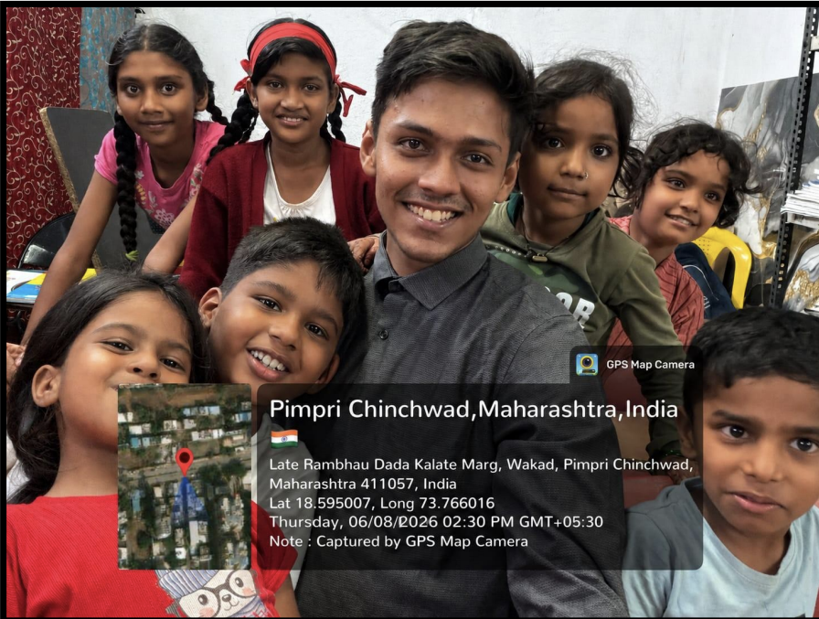

02 / ORGANIZATION CONTEXT
About A Ray of Hope Charitable Trust
A Ray of Hope Charitable Trust provides dedicated educational support and mentorship to children from underserved backgrounds who face limited academic resources at home.
The Learning Environment
•
Community Center Classrooms: Small-group and one-on-one tutoring sessions in Wakad.
Insert NGO Classroom Photograph
Place GPS-tagged field photograph from A Ray of Hope Charitable Trust center (Late Rambhau Dada Kalate Marg, Wakad, Pimpri Chinchwad).
•
Diverse Age & Skill Groups: Children with varied schooling continuity learning side by side.
•
Volunteer-Driven Model: Instruction relies on committed volunteers guiding foundational literacy and numeracy.
Aspect Ratio: 4:3 / Landscape Field Evidence
•
Shared Mission: Giving every child a fair shot at academic confidence and foundational mastery.
Wakad, Pimpri Chinchwad, Maharashtra

Slide 4

03 / INDIVIDUAL OWNERSHIP
My Individual Contribution
No Team, No Hand-Offs — End-to-End Execution
Every aspect of this work from the weekly in-person teaching sessions, of which I conducted approximately 14 visits, to architecting and coding the Saarthi prototype represents my independent effort.
01 / I Teach
02 / I Mentor
03 / I Encourage
04 / I Build
Direct Instruction
Session Continuity
Confidence Building
Software Engineering
Guiding small groups and one-on-one sessions in mathematics and reading at each child's pace.
Tracking individual learning bottlenecks between visits so student progress never stalls.
Celebrating small breakthroughs like finished worksheets and solved word problems.
Sole developer of Saarthi across React/Next.js, FastAPI, PostgreSQL, and FAISS RAG pipelines.

Slide 5
04 / FIELD OBSERVATIONS
The Classroom Context
Foundational Subjects & Multi-Level Classrooms
Weekly Instructional Focus Areas
Three-Tier Learner Spectrum
•
Fractions & Number Sense: Visual representations of like and unlike fractions.
Within a single group (e.g., Grade 5 Mathematics), students demonstrate widely divergent mastery levels:
•
Word Problems: Translating everyday scenarios into arithmetic operations.
•
Struggling Tier: Requires visual aids and foundational prerequisite review.
•
Mental Math: Building calculation fluency and numerical confidence.
•
On-Track Tier: Ready for guided practice on grade-level concepts.
•
Reading Support: Comprehension and vocabulary scaffolding for word problems.
•
Advanced Tier: Needs multi-step challenge problems to stay engaged.
•
Focus & Patience: Sustaining attention across 45-minute study blocks.

Slide 6
05 / PROBLEM STATEMENT
The Core Problem
Structural Bottlenecks in Volunteer Teaching
Delivering personalized instruction across mixed-ability groups introduces four recurring operational challenges for volunteers:
BOTTLENECK 01
BOTTLENECK 02
Preparation Overhead
BOTTLENECK 03
BOTTLENECK 04
Heterogeneous Pacing
Progress Visibility
Session Continuity
Single-speed lessons leave struggling learners behind while advanced students lose focus.
Crafting three distinct activity sets manually requires hours of preparation time per session.
Informal notes make tracking student mastery across weeks fragmented and unreliable.
Without structured post-session analysis, planning the next session lacks diagnostic grounding.

Slide 7
06 / PROJECT MOTIVATION
Why Saarthi: Turning Limited Prep Time into Differentiated Classroom Impact
Saarthi acts as an intelligent teaching copilot. Instead of replacing volunteer judgment, it automates lesson structuring, resource lookup, and progress synthesis so every session builds systematically on the last.
STEP 1
STEP 2
STEP 3
Plan the Lesson
Teach & Assess
Recommend What's Next
Generate structured, curriculum-grounded lesson plans split across three learning tiers.
Deliver targeted group activities while logging student scores and qualitative observations.
Synthesize session outcomes into actionable recommendations for the following week.

Slide 8
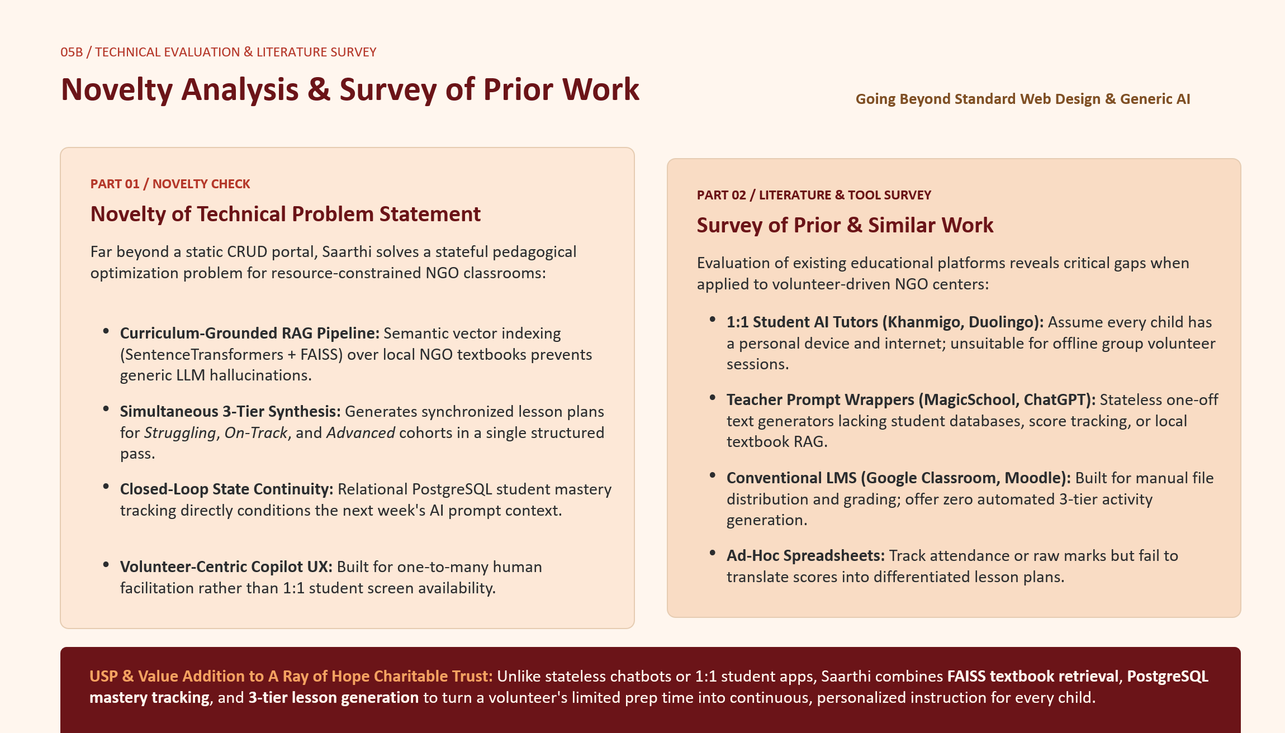

Slide 9
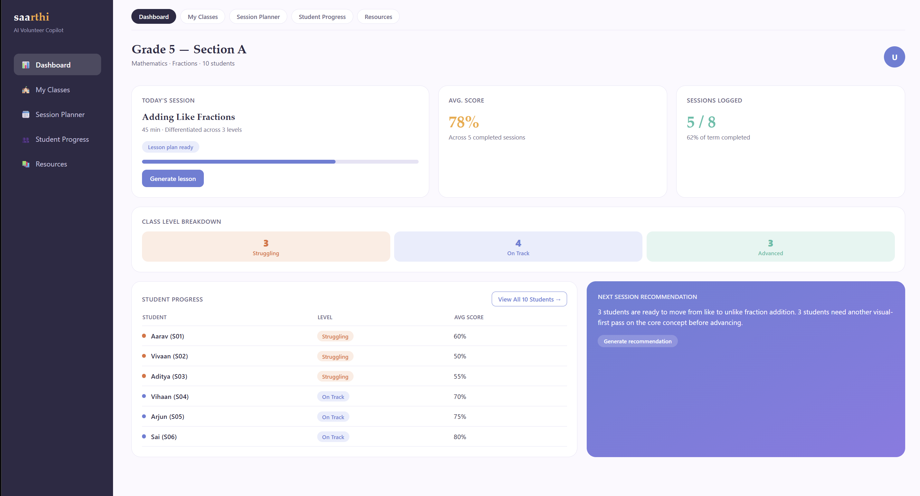

07 / PRODUCT OVERVIEW
Introducing Saarthi: The Volunteer Copilot
https://github.com/karshTD/Saarthi.git
Unified Workspace for Volunteers
Saarthi centralizes class rosters, session preparation, differentiated activity sheets, and longitudinal student tracking into a clean web interface.
•
Active Session Summary: Displays current topic, duration, and 3-level readiness status.
Website Screenshot Placeholder 01: Main Volunteer Dashboard
•
Class Level Breakdown: Visualizes student distribution across Struggling, On Track, and Advanced tiers.
Insert full 16:9 screenshot of the Saarthi Dashboard showing Grade/Section header, Today's Session card, Class Level Breakdown bar, Student Progress table, and Next Session Recommendation card.
•
Student Progress Table: Tracks individual scores and tier assignments across logged sessions.
Route: /dashboard • Aspect Ratio: 16:9 Browser Viewport
•
Next-Session Recommendation Panel: Surfaces AI-synthesized instructional guidance.
Main Dashboard & Application Interface

Slide 10
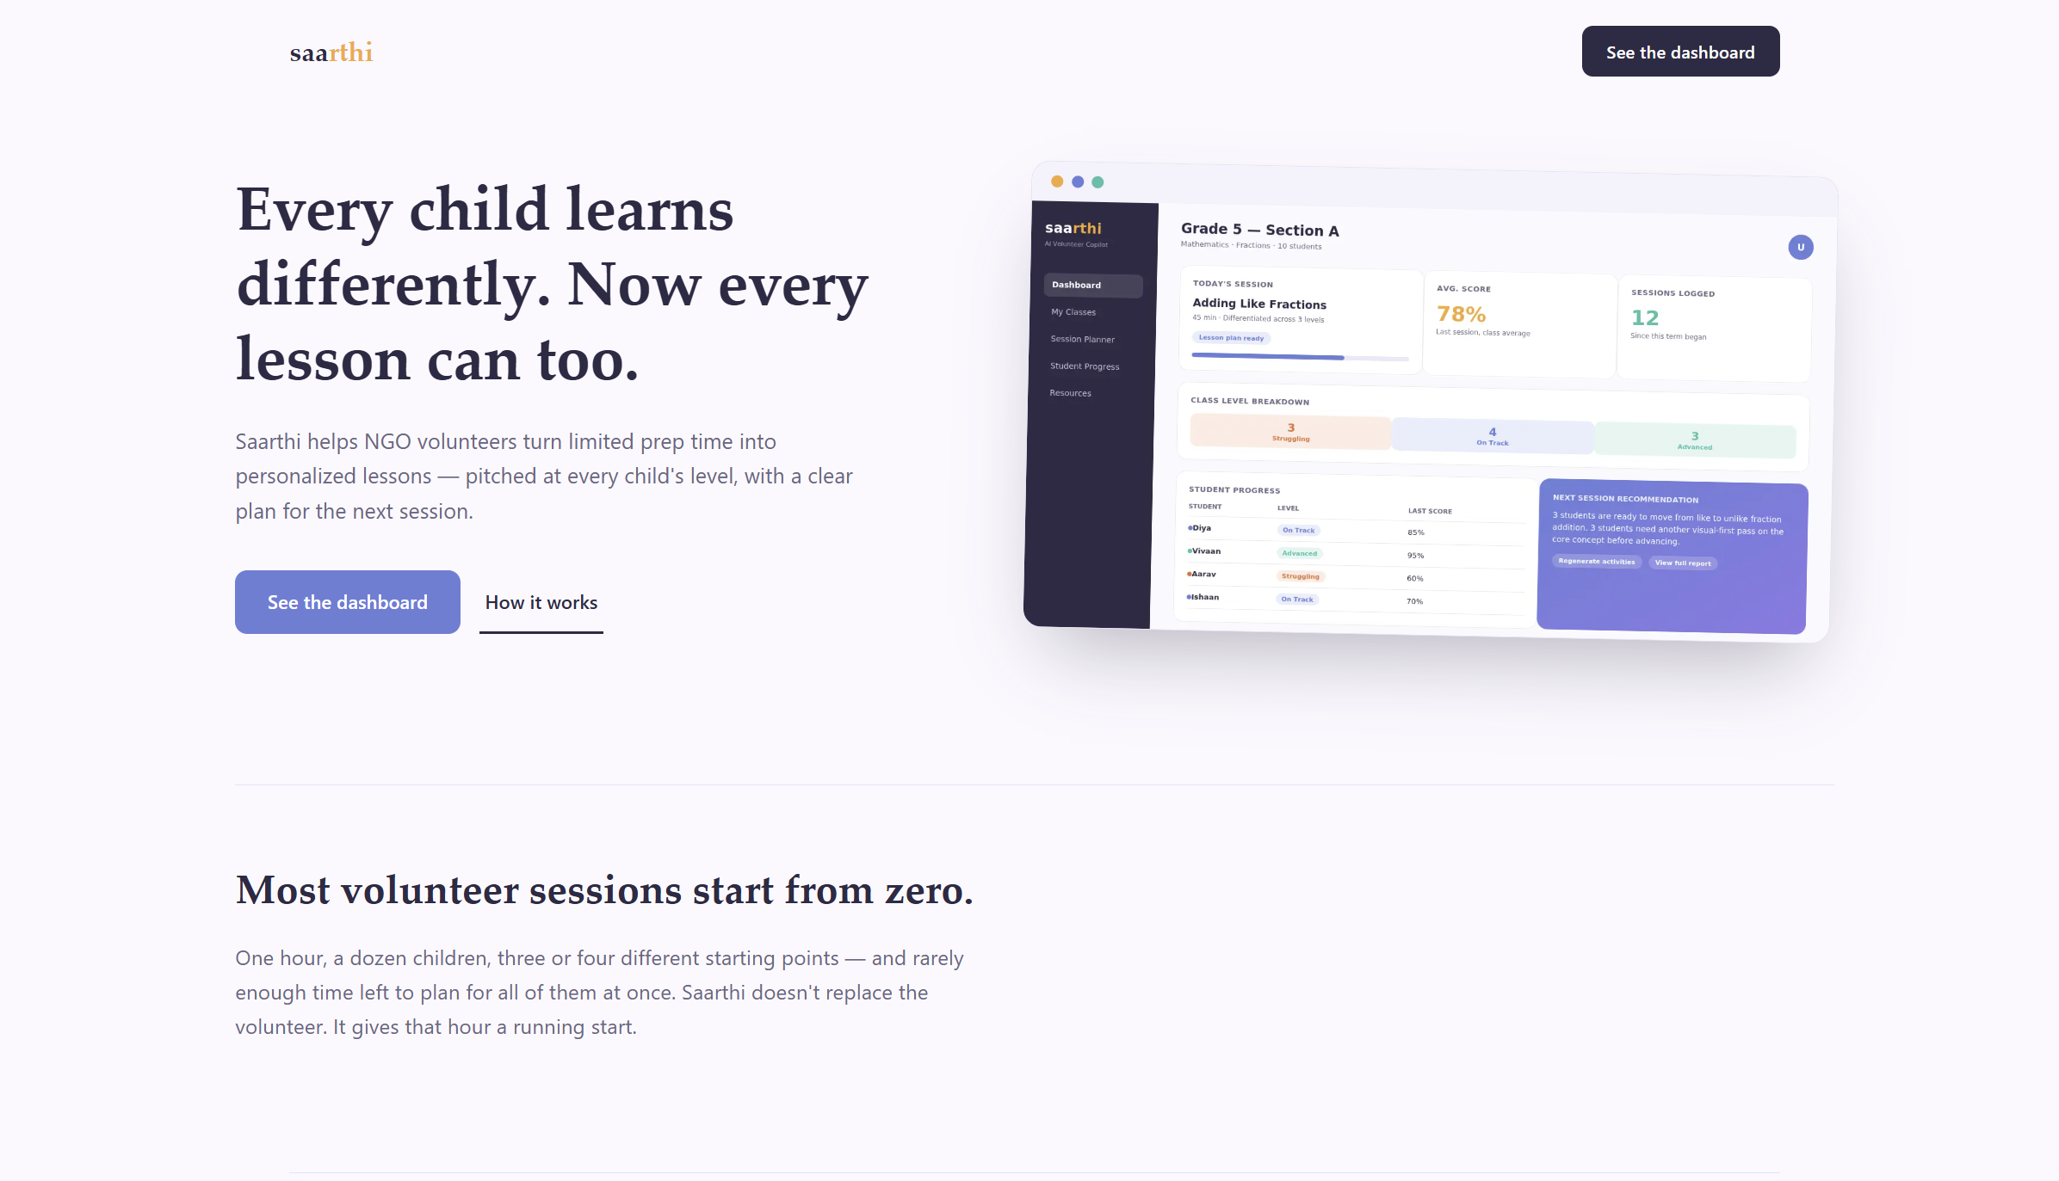
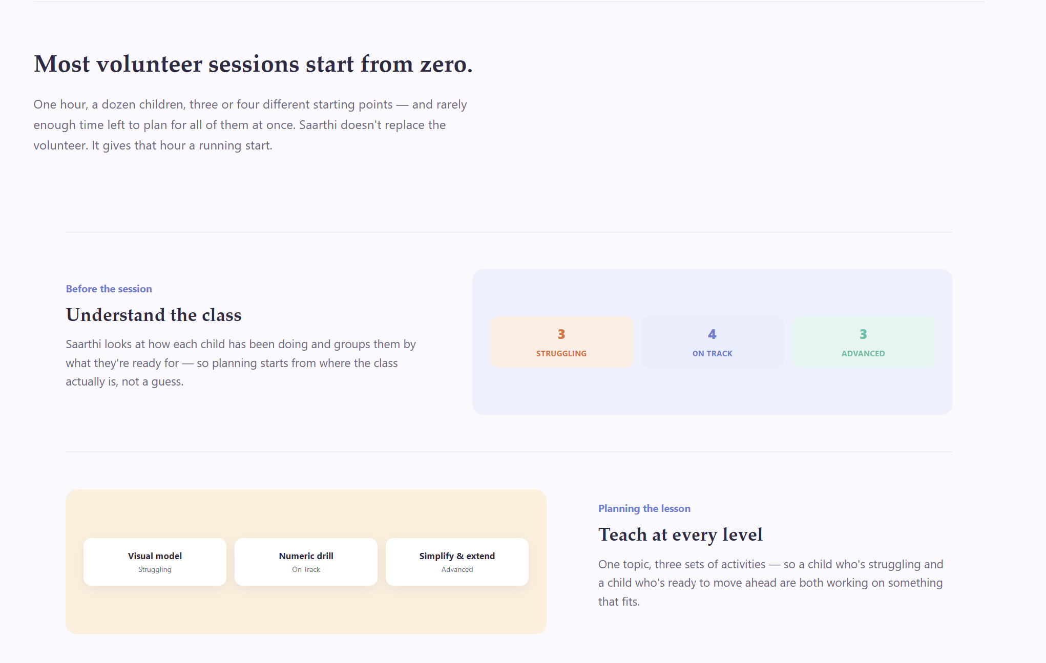
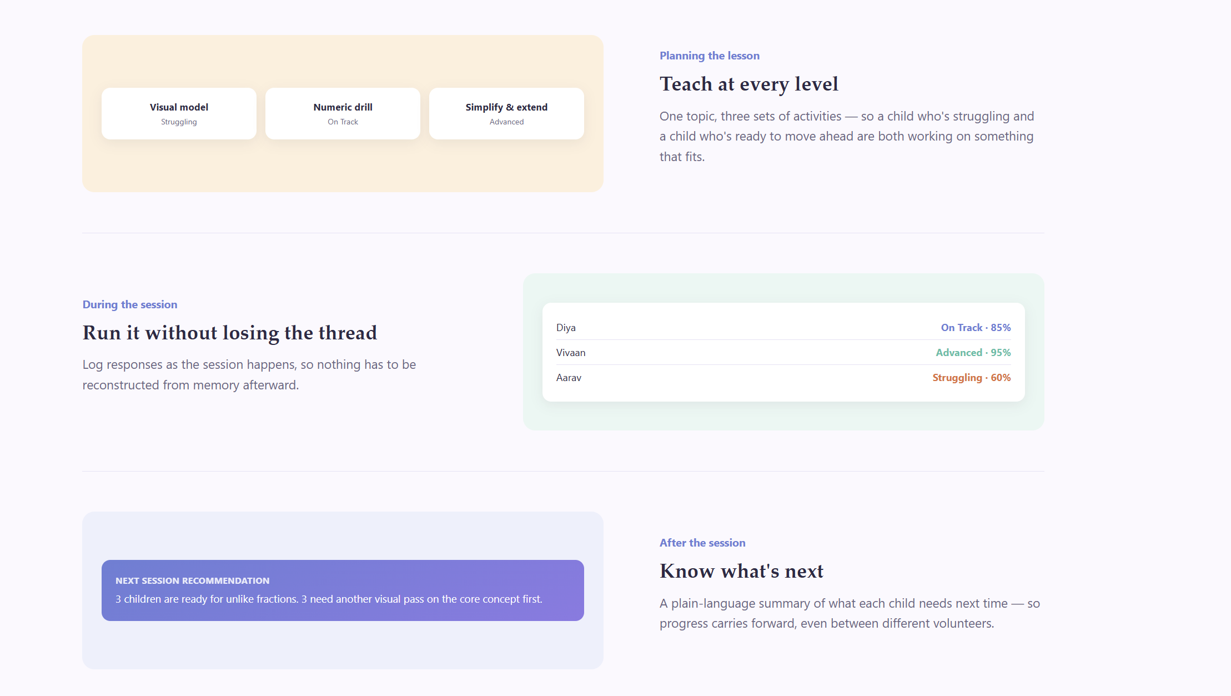
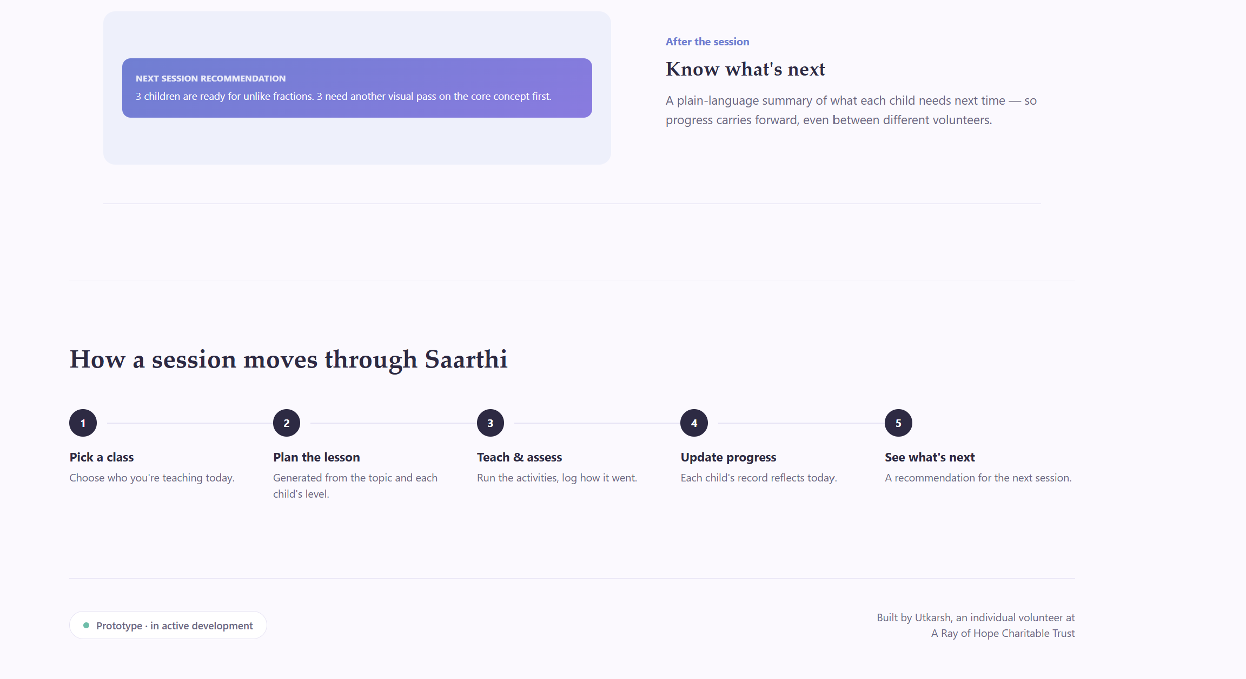

Slide 11
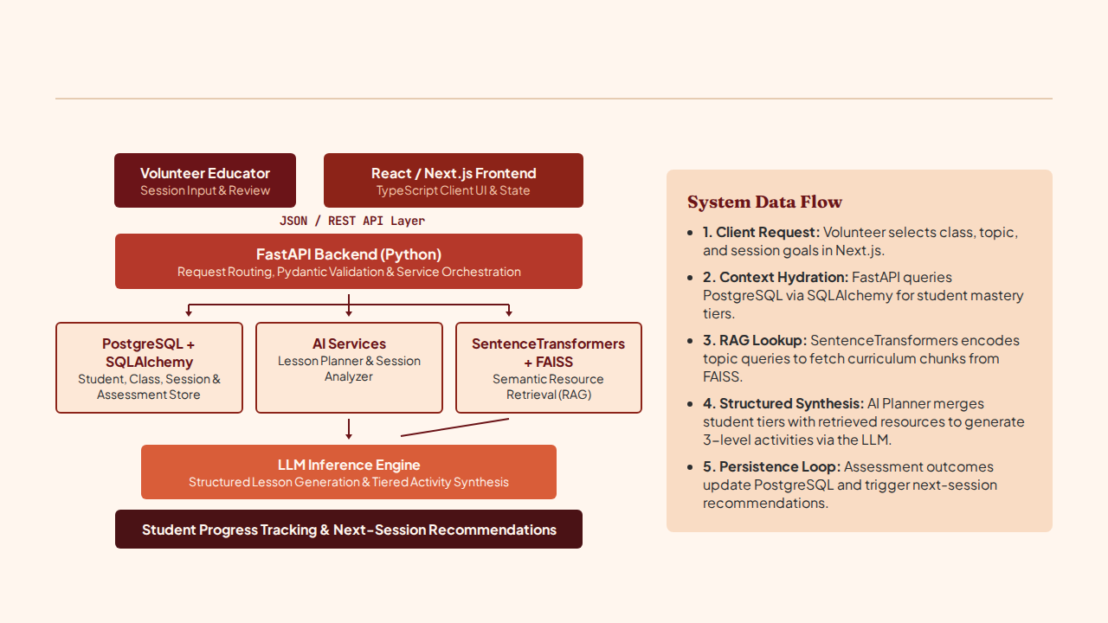
09 / SYSTEM ARCHITECTURE
Saarthi End-to-End Architecture
Modular Full-Stack & RAG Pipeline

Slide 12
10 / ENGINEERING STACK
Technology Stack & Layer Responsibilities
Production-Grade Open-Source Tooling
System Layer | Core Technologies | Architectural Role in Saarthi
Frontend Client | React, Next.js, TypeScript | Type-safe volunteer dashboard, session planner views, and student progress tracking UI.
Backend API | FastAPI, Python, Pydantic | Asynchronous REST endpoints, schema validation, and orchestration of database and AI pipelines.
Relational Database | PostgreSQL, SQLAlchemy | Persistent ORM models for classes, student profiles, session logs, and assessment rubrics.
AI Generation | LLM Planner & Analyzer | Structured JSON generation for 3-tier differentiated lessons and post-session diagnostic summaries.
Retrieval / RAG | SentenceTransformers, FAISS | Dense vector indexing of educational books and CSV templates for grounded lesson context.
DevOps & Tooling | Docker, Git, GitHub | Containerized multi-service environment and version-controlled modular repository.

Slide 13
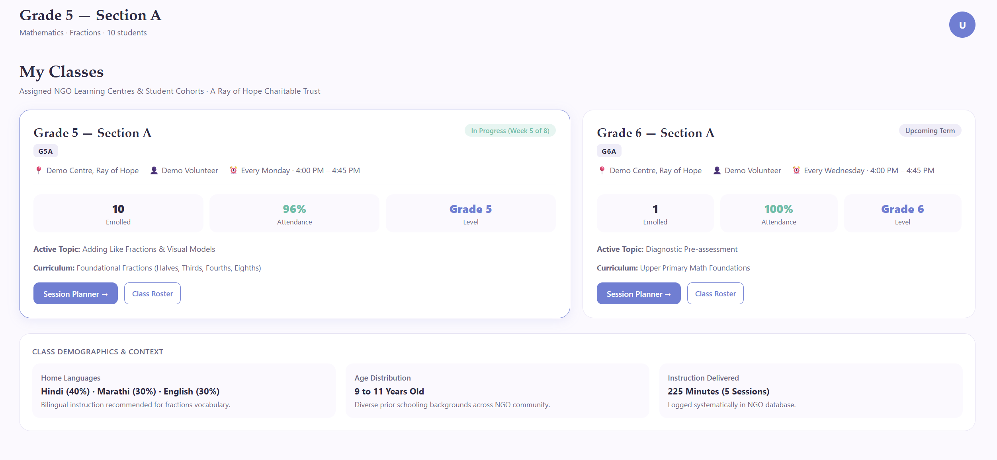

11 / FRONTEND ARCHITECTURE
Frontend Experience & Class Management
React / Next.js & TypeScript Implementation
Designed for Low-Friction Volunteer Use
Built with Next.js and strict TypeScript interfaces, the client application minimizes navigation complexity before and during live classroom sessions.
Website Screenshot Placeholder 02: Class & Student Management
•
Roster Organization: Groups learners by grade, section, and current mastery tier.
Insert full screenshot of the "My Classes" and Student Roster screen showing student learning tiers (Struggling, On Track, Advanced), historical scores, and individual profile cards.
•
Type-Safe API Contracts: Shared schemas between FastAPI Pydantic models and TypeScript interfaces.
Route: /classes • Aspect Ratio: 16:9 Browser Viewport
•
Immediate Context Switching: One-click transition from class roster to session planner.
•
Scannable Visual Hierarchy: High-contrast status indicators for rapid classroom reference.

Slide 14
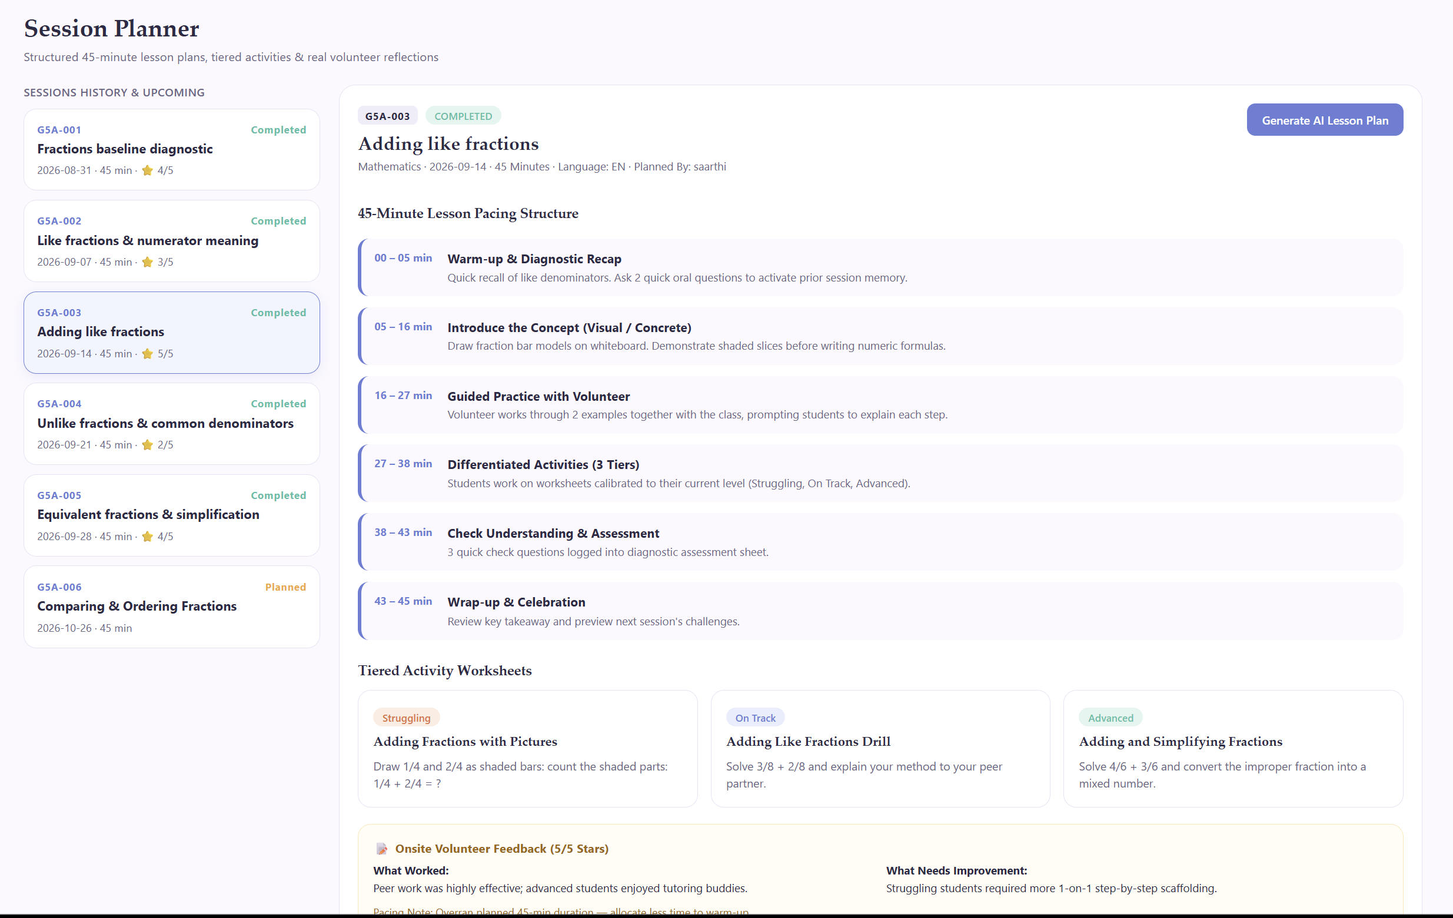

12 / GENERATIVE PEDAGOGICAL ENGINE
AI-Powered Differentiated Lesson Planning
Structured Multi-Tier Activity Synthesis
From Topic Input to 3-Tier Plans
Instead of returning generic walls of text, the AI Planner generates structured lesson blocks calibrated to the class's exact distribution of learning levels.
•
Foundational Tier (Struggling): Concrete visual analogies and step-by-step guided worksheets.
Website Screenshot Placeholder 03: Lesson Planner & Generated Output
Insert full screenshot of the Session Planner interface displaying topic selection (e.g., Adding Like Fractions) and the generated 3-level differentiated lesson plan tabs.
•
Core Tier (On Track): Standard conceptual practice problems aligned with session goals.
•
Extension Tier (Advanced): Multi-step word problems requiring deeper reasoning.
Route: /planner • Aspect Ratio: 16:9 Browser Viewport
•
Time-Boxed Segments: Pacing guidance for a 45-minute volunteer teaching block.

Slide 15


13 / RETRIEVAL-AUGMENTED GENERATION
Resource Retrieval with SentenceTransformers & FAISS
Grounding AI Outputs in Curated Learning Material
Why Retrieval-Augmented Generation?
Unconstrained LLMs often produce examples that mismatch local grade levels. RAG anchors lesson plans in verified exercises from our curated repository.
Technical Retrieval Pipeline
Website Screenshot Placeholder 04: Resource Repository & RAG Library
•
1. Ingestion: Parse structured CSV templates and book problems into topic-tagged text chunks.
Insert screenshot of the Saarthi "Resources" tab showing indexed curriculum materials, topic tags, and retrieved reference exercises used to ground lesson plans.
•
2. Embedding: Encode chunks into dense vector representations via SentenceTransformers.
•
3. FAISS Indexing: Store vectors in a fast similarity search index for low-latency lookup.
Route: /resources • Aspect Ratio: 16:9 Browser Viewport
•
4. Context Injection: Pass top-k retrieved examples into the LLM prompt during lesson generation.

Slide 16
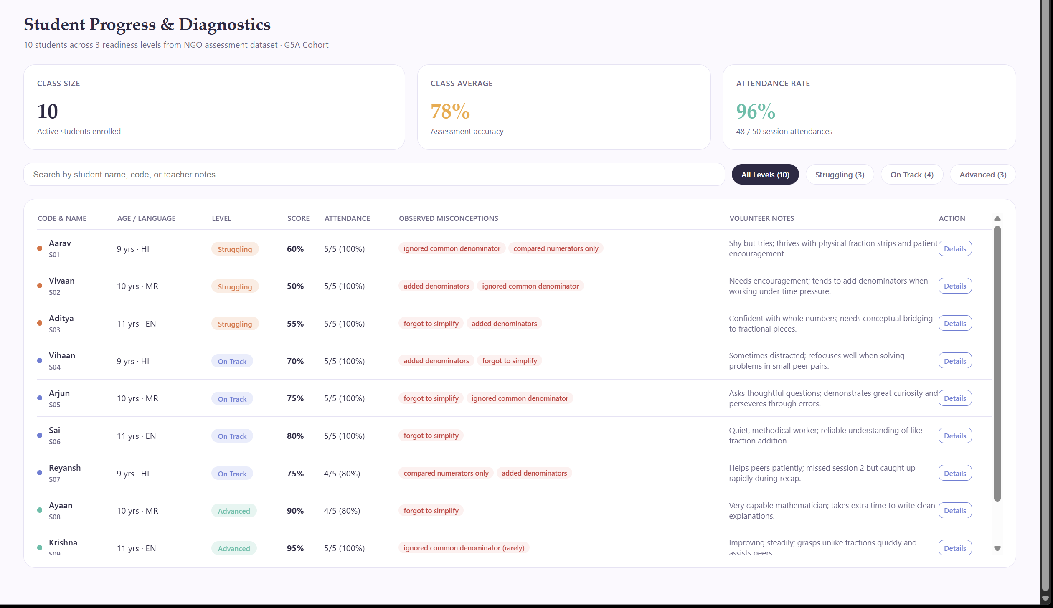

15 / LONGITUDINAL CONTINUITY
Progress Tracking & Next-Session Recommendations
Data-Driven Continuity Across Weeks
Sustaining Momentum Week to Week
By storing session histories in PostgreSQL, Saarthi prevents instructional reset between weekly visits and gives volunteers immediate clarity on what to teach next.
•
Longitudinal Trajectories: Visualizes student score history across sequential sessions.
Website Screenshot Placeholder 06: Student Progress & Recommendations View
•
Sub-Group Readiness Alerts: Highlights which students are ready to advance (e.g., from like to unlike fractions).
Insert screenshot of the Student Progress view and Next-Session Recommendation panel showing multi-session score trends and actionable group pacing advice.
•
Targeted Remediation Flags: Pinpoints learners needing another visual-first pass.
Route: /progress • Aspect Ratio: 16:9 Browser Viewport
•
One-Click Regeneration: Seeds the next session's lesson plan directly from recommendations.

Slide 17


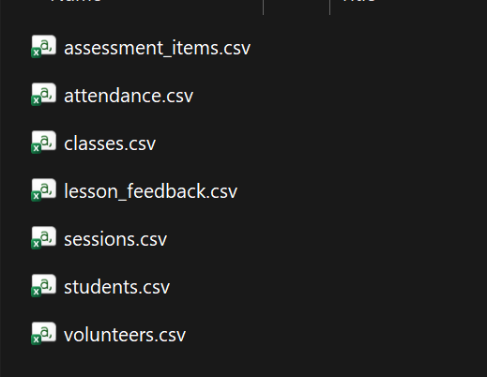


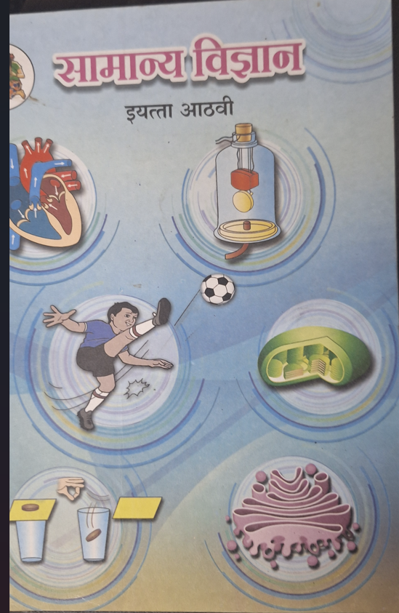

16 / DATA CURATION & GROUNDING
Collecting & Structuring Data for Lesson Plans
To ensure Saarthi generates pedagogically sound activities rather than generic AI text, I curated learning materials from physical textbooks and structured them into standardized CSV templates for RAG indexing.
How Structured Data Powers Saarthi
•
Schema Consistency: Maps concepts by prerequisite order and difficulty tier.
Evidence Placeholder A: Educational Books & Worksheets
Evidence Placeholder B: Structured CSV Data Templates
Insert screenshot of the CSV dataset containing columns for Grade, Subject, Topic, Difficulty Tier, Sample Problems, and Pedagogical Hints.
•
Vector Indexing: Feeds clean text chunks into SentenceTransformers and FAISS.
Insert photographs of physical mathematics/reading books and reference worksheets used during sessions at A Ray of Hope Charitable Trust.
•
Tier Calibration: Supplies concrete baseline problems for Struggling, On Track, and Advanced activity generation.
Source Material Photograph
CSV Schema & Ingestion Evidence
From Physical Textbooks to Structured CSV Templates

Slide 18
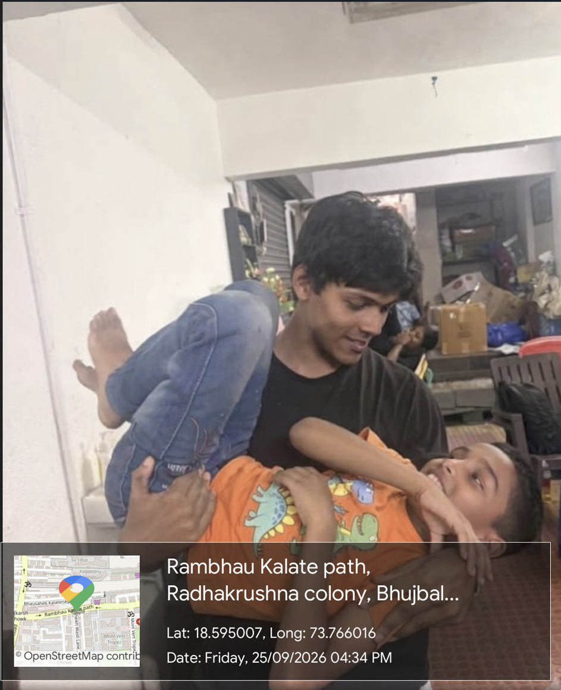
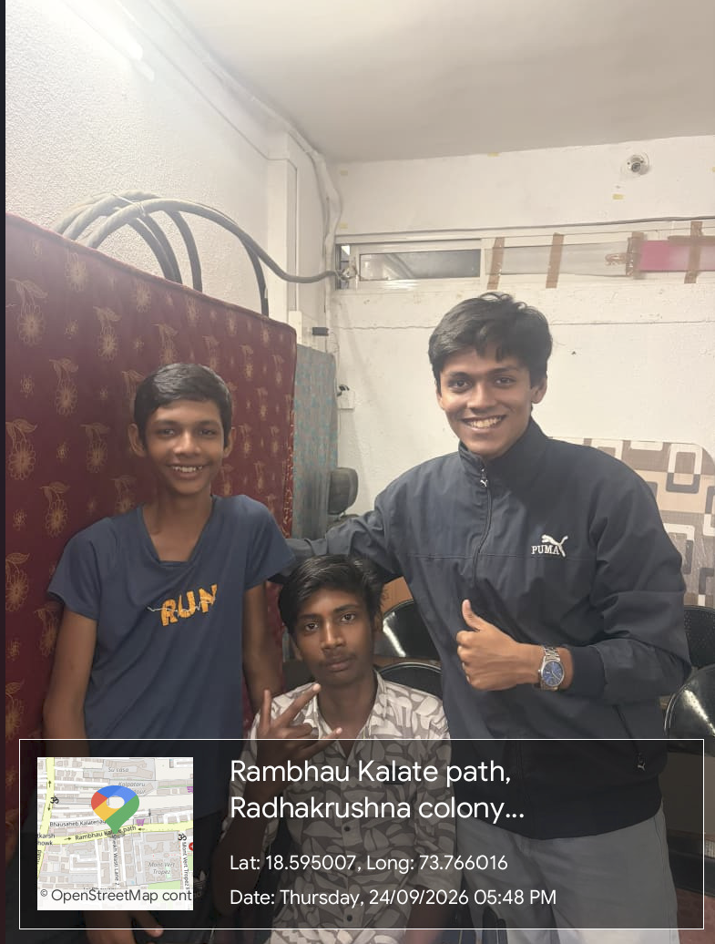
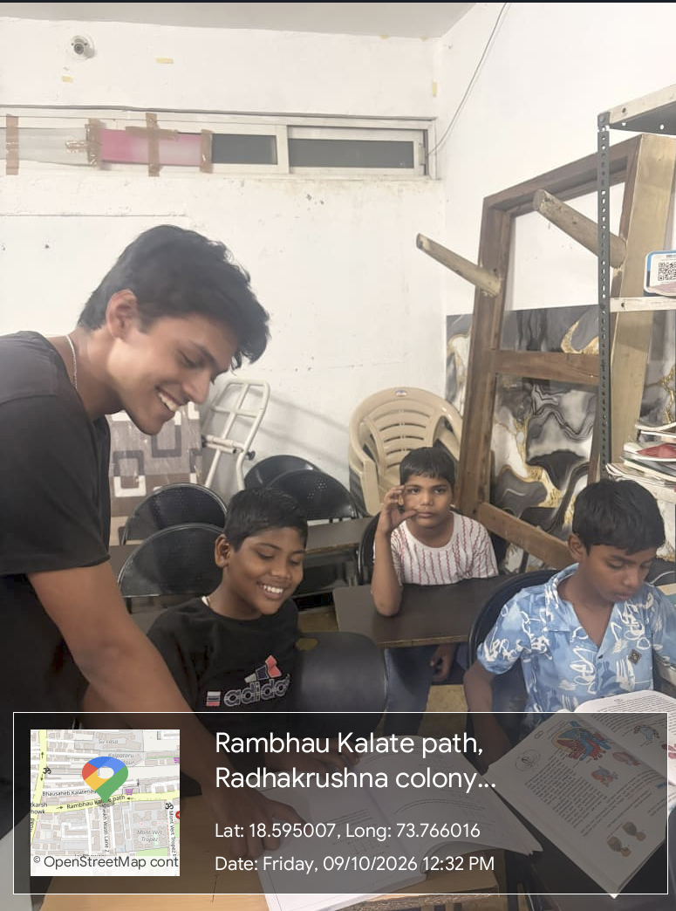

17 / FIELDWORK EVIDENCE
Service Learning in Practice: Moments from My Sessions
On-Ground Teaching in Wakad, Pimpri Chinchwad
What Field Sessions Taught Me
Showing up week after week turned abstract software requirements into human realities:
Field Photograph Placeholder 01: Classroom Group Session
Field Photograph Placeholder 02: Student Mentorship & Encouragement
•
Trust Precedes Pedagogy: Children engage deeper when the same volunteer returns consistently.
Insert GPS-verified classroom teaching photograph showing group instruction and notebook exercises at Late Rambhau Dada Kalate Marg, Wakad.
Insert GPS-verified photograph capturing one-on-one mentoring and celebrating small student milestones outside/inside the center.
•
Small Wins Matter: Solving one fraction problem independently builds lasting confidence.
GPS Map Camera Evidence • Wakad, Pune
GPS Map Camera Evidence • Wakad, Pune
•
Practical Tooling: Classroom observations directly shaped Saarthi's 3-tier activity structure.

Slide 19
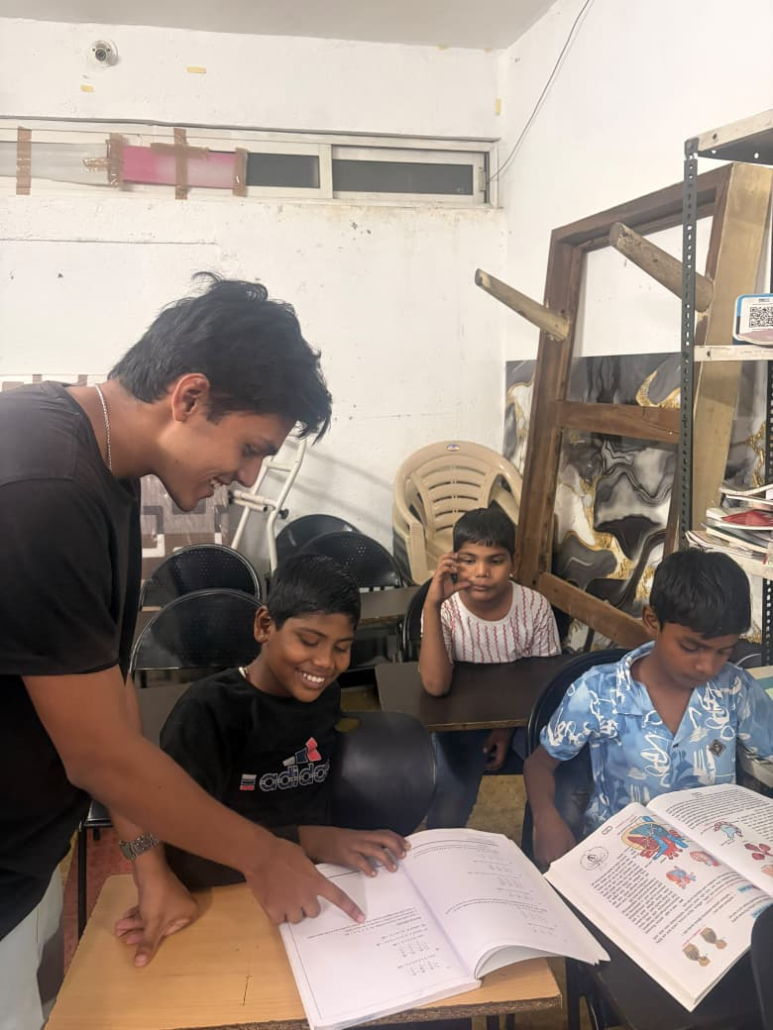
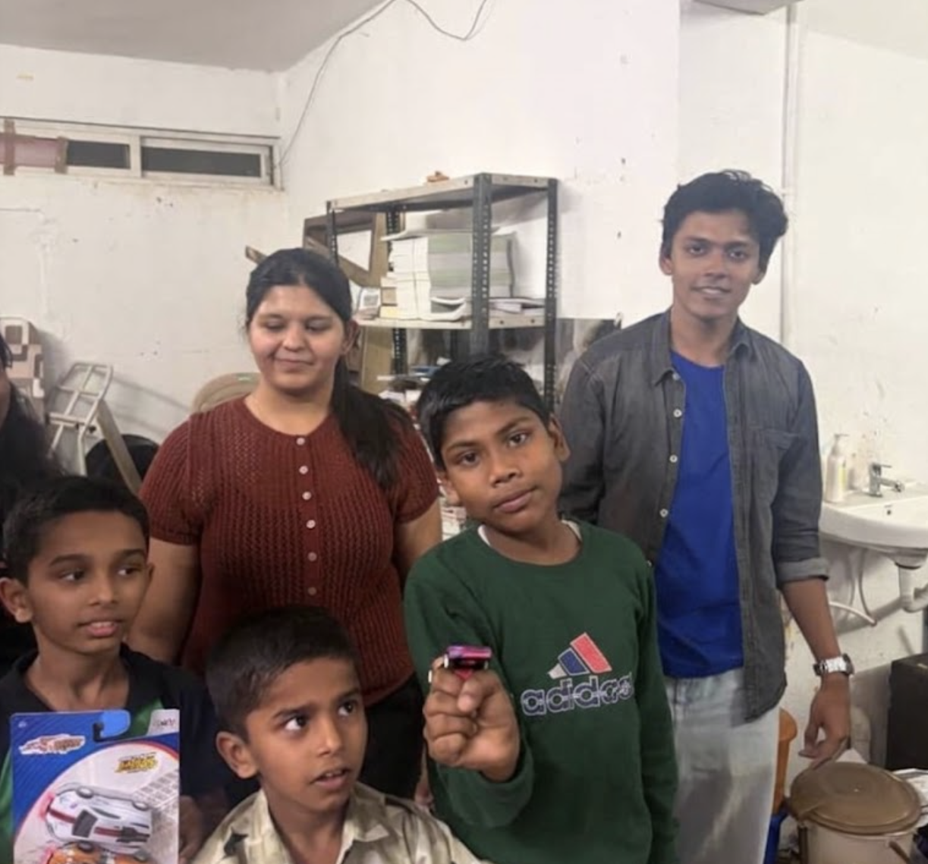
MY GALLERY ☺

Slide 20
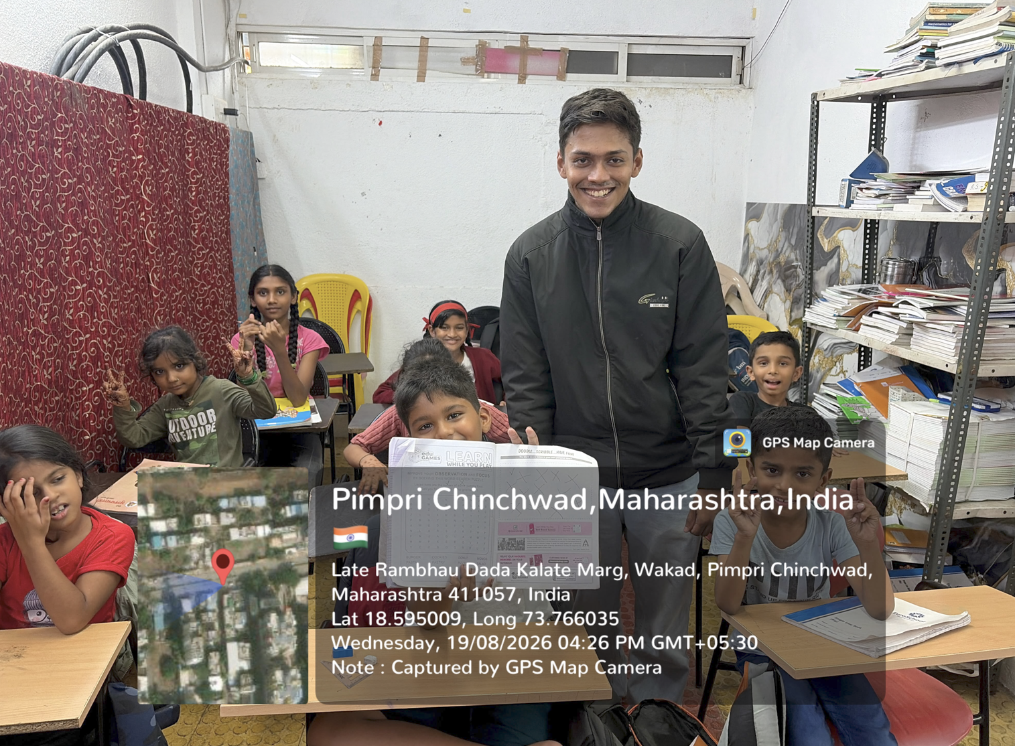
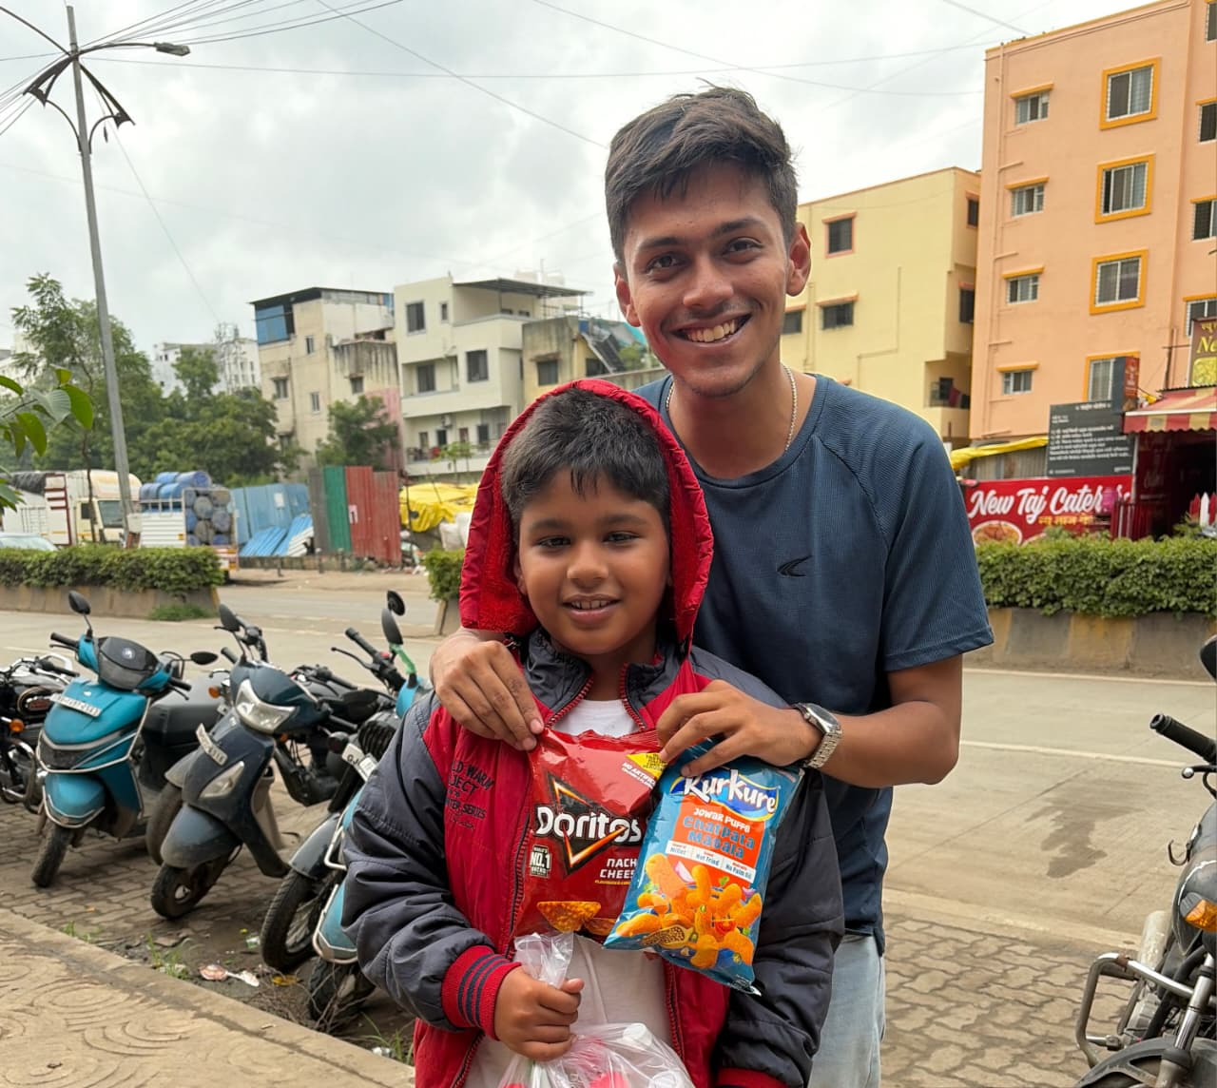
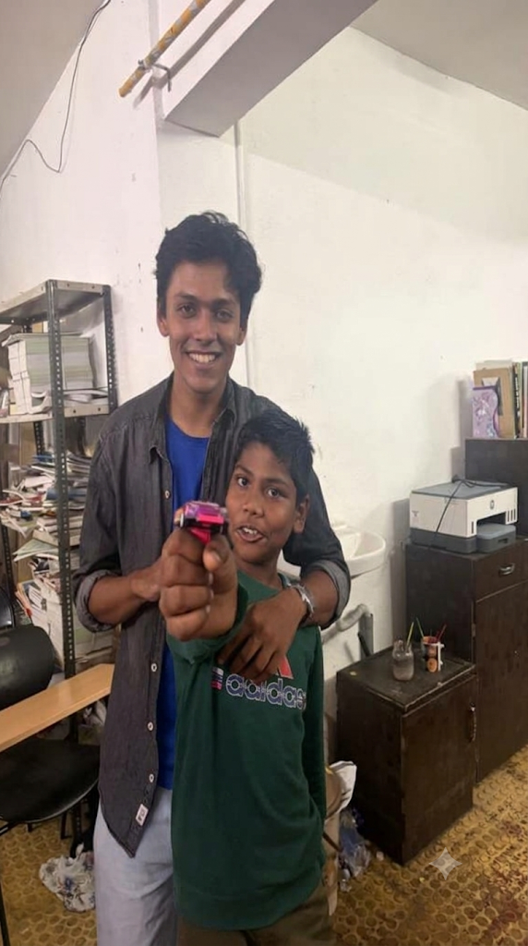
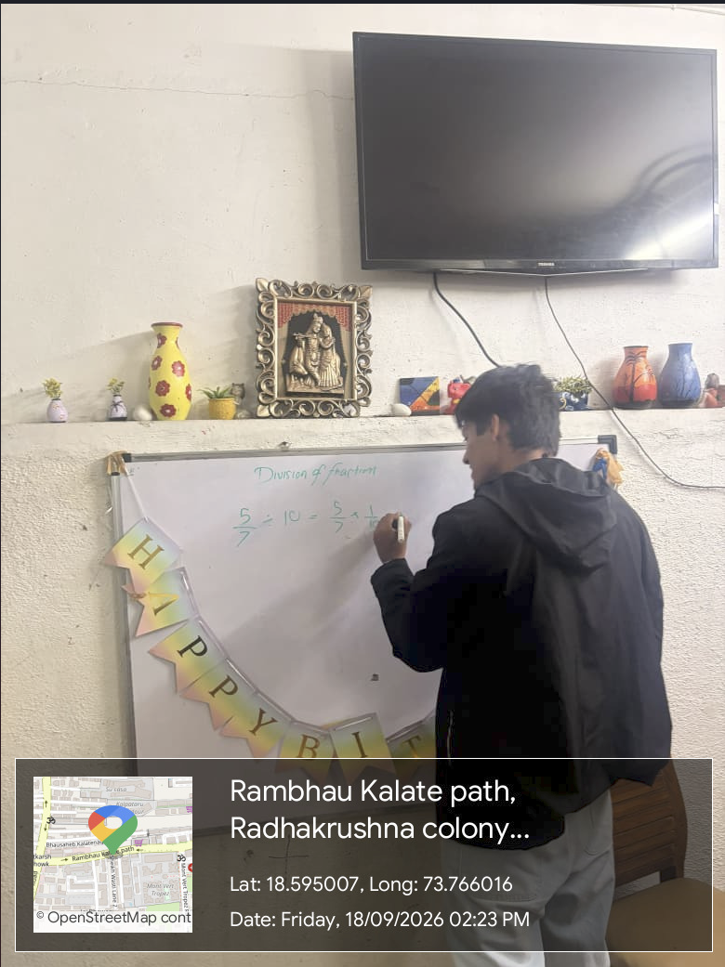
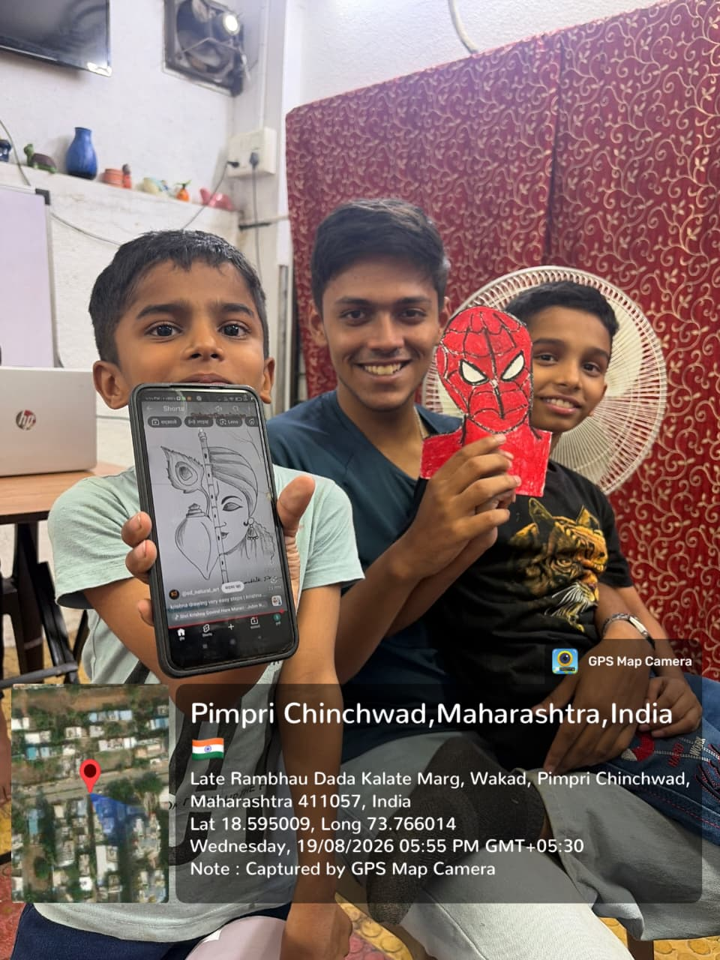

Slide 21

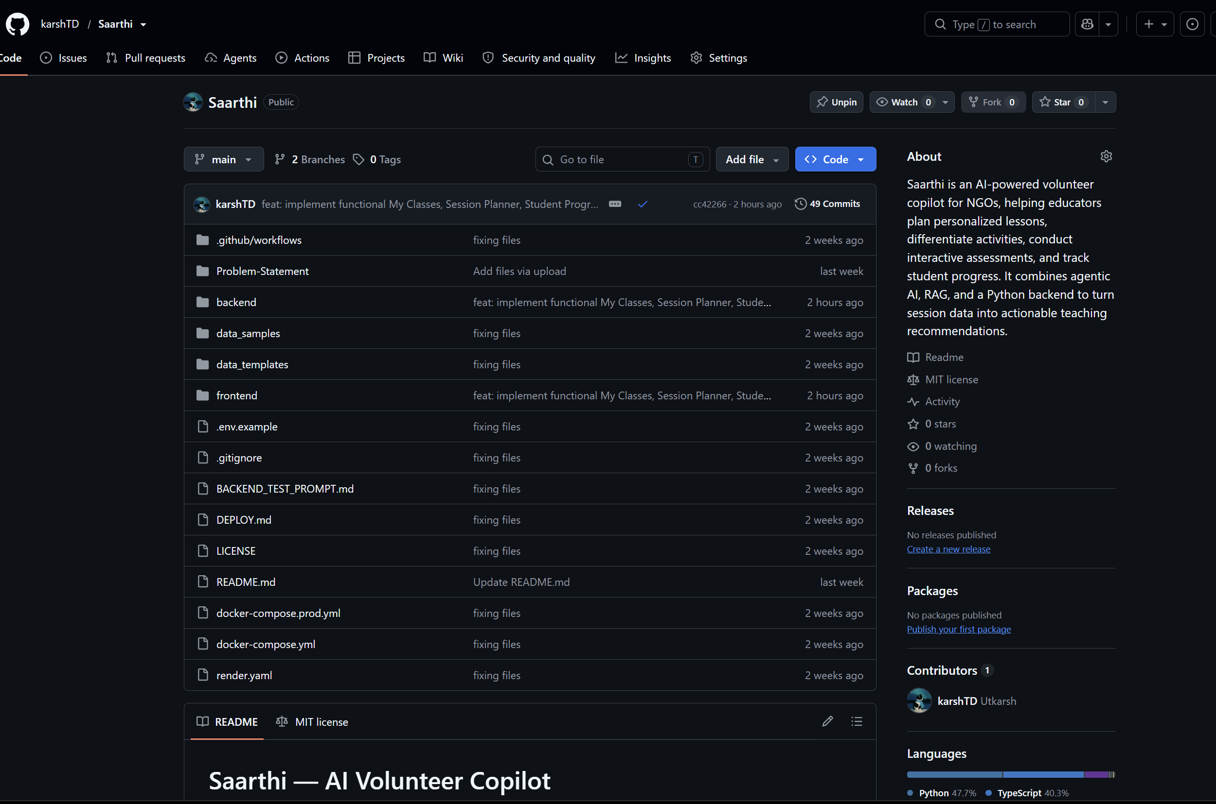
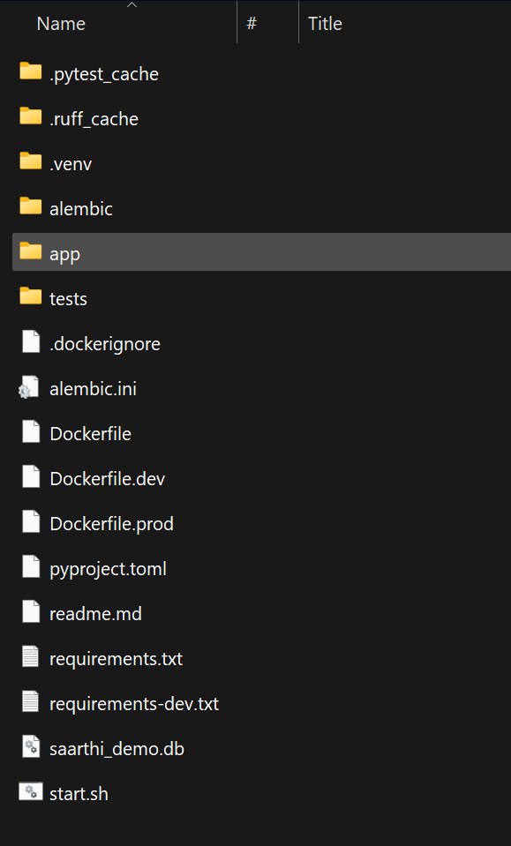
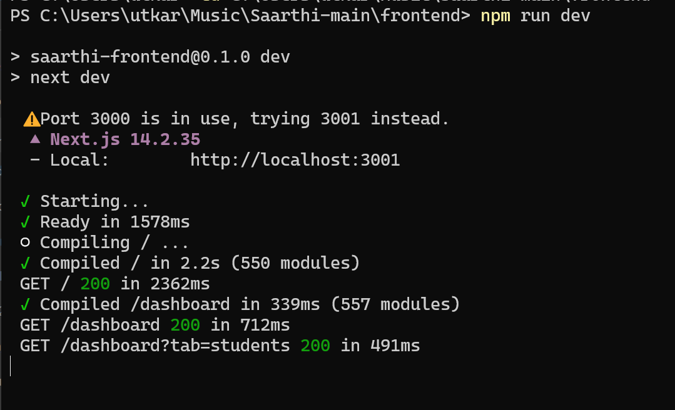
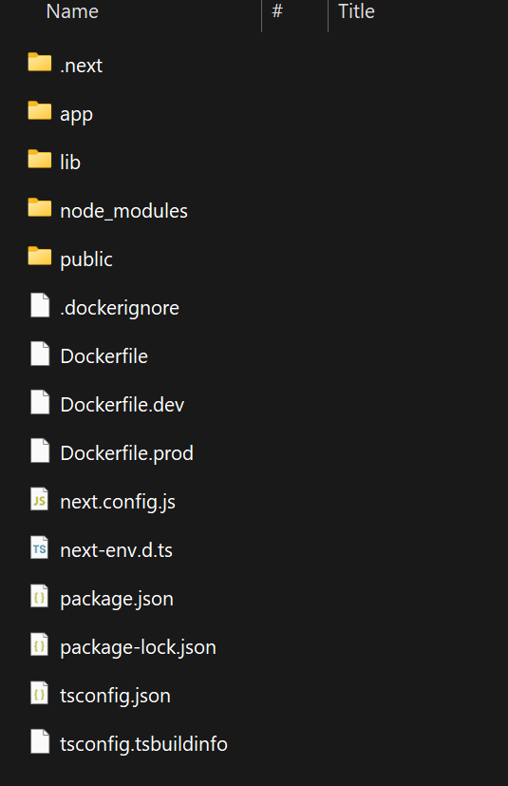

Slide 22

18 / CRITICAL REFLECTION
Learning, Responsibility, and Impact
Personal Growth as a Volunteer & Engineer
Civic & Pedagogical Responsibility
•
Accountability to Learners: Recognizing that consistency and patience directly influence a child's willingness to tackle difficult concepts.
•
•
Respecting Individual Pace: Moving away from one-size-fits-all instruction toward empathetic, tiered scaffolding.
•
.
•
Community Grounding: Understanding how NGO volunteers operate under real time and resource constraints.
•

Slide 23
A RAY OF HOPE CHARITABLE TRUST • SERVICE LEARNING EVALUATION
Thank You
Individual contribution, shared mission — combining weekly classroom mentorship with thoughtful AI engineering to support personalized learning for every child.
Utkarsh Singh, Group – 13, 24070122224

