Slide 1

Video Game Discovery System
Designing a Recommendation System to Connect Users to New and Relevant Games

Slide 2
Agenda
Key Points
Motivation
Data
Problem Space
Cleaning + EDA
Preprocessing + Modeling
Next Steps

Slide 3

Key Points
I designed a content-based recommendation system for users to find games most like their own, based on cosine similarity from feature vectors of textual and numerical data.
I used a baseline cosine similarity function enhanced with feature weights from a multilayer perceptron (MLP).

Slide 4
Motivation
Product Rec Systems are critical in the digital marketplace age.
I found a video game virtual library system without a rec system, called Backloggd.
I decided to implement a rec system from the ground up based on some of the most popular games from the site.

Slide 5
Data
Data comes from source, which is a subset of 1,099 unique games which comes from a larger set of 12,000 games. The 1,099 games featured in this subset are the most popular from the original set.
Title - title of the game
Team - studio(s) behind the game
Rating - average rating out of 5
Times Listed - Number of times users included the game in their personal library
Genres - genres pertaining to the game
Summary - written summary of the game
Reviews - user written reviews, collected at time of scraping
Plays - total number of plays for the game based on the site
Playing - how many people are actively playing this at the time of scraping
Backlogs - how many people bought the game but haven’t opened it yet
Wishlist - how many people want the game but haven’t bought it yet
Note - I drop the column “Number of Reviews” as it is the same exact data as “Times Listed”, there was an HTML error during data scraping for this.

Slide 6

Textual and Numerical
The data is split into 2 groups. The first is text values, being
Title
Team
Genres
Summary
Reviews
The second is numerical values, being
Rating
Times Listed
Plays
Playing
Backlogs
Wishlist

Slide 7
Basic Cleaning
Basic cleaning involved dropping 15 missing values (13 ratings, 1 team, 1 summary). < 1 % of data removed, so no integrity loss.
Release date was converted to datetime.
The other numerical values were converted to ints.
To ensure only unique games are included in the set, I drop duplicates based on the Title column. This reduces the number of rows from 1,512 to 1,085.

Slide 8

Problem Space
Form feature vectors from textual data t and numerical data n for each item i in the set.
The user will then provide their chosen item, and will be provided the top 3 most similar scores based on cosine similarity rankings.
I will use different iterations of this system.
1. First, with just cosine similarity of feature vectors as a baseline.
2. Then, apply weights found through multilayer perceptron (MLP) to the baseline to enhance the recommendations.

Slide 9

Limitations
One major limitation to this problem is the lack of reference labels in the set. Without a clear way to quantify the success of the similarity rankings, this work will be focused on optimizing the approach to achieve these rankings, rather than the outcome of the rankings themselves.
Some ways to address this limitation:
Human evaluation
Synthetic data generation
Check consistency with known relationships

Slide 10
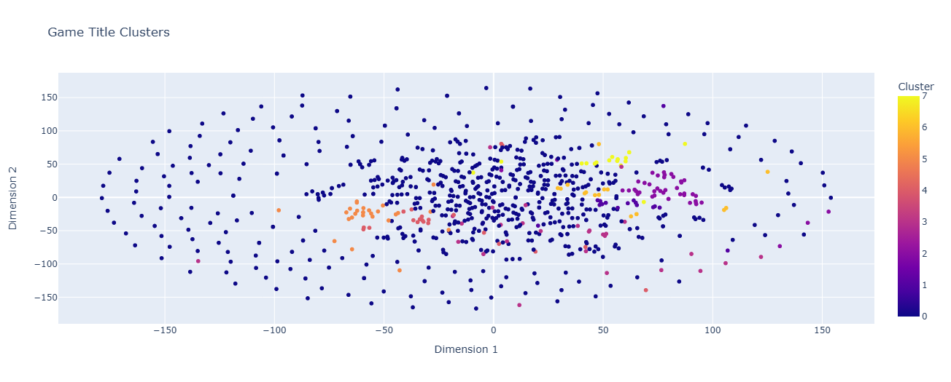
Title: kmeans text clustering
The franchises with enough weight in the set to be made their own clusters are
Pokémon
Assassin's Creed
Mario
Sonic
I avoid using Title as a predictor for the set.

Slide 11
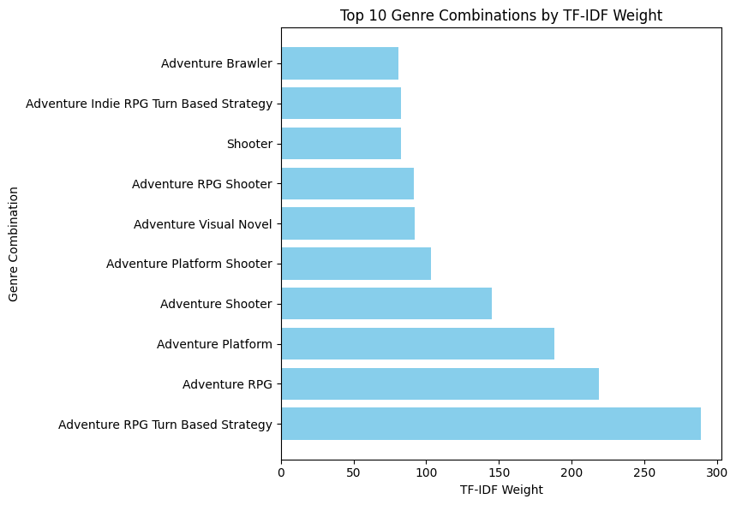
Genres: keyword extraction with tf-idf
23 total unique genres within the set, creating a total of 254 genre combinations
Each game can have more than one genre listed, such as [‘Adventure’, ‘RPG’, ‘Shooter’]
I avoid clustering here as genres are relatively simplistic in comparison to the other textual data, and want to provide more granularity.
It is clear being an adventure game is favored in this dataset, as 9 of the top 10 genres have adventure within their combination.
I assign each game a new feature, called Genre_Weight, which is the relevant genre combination weighted score.

Slide 12
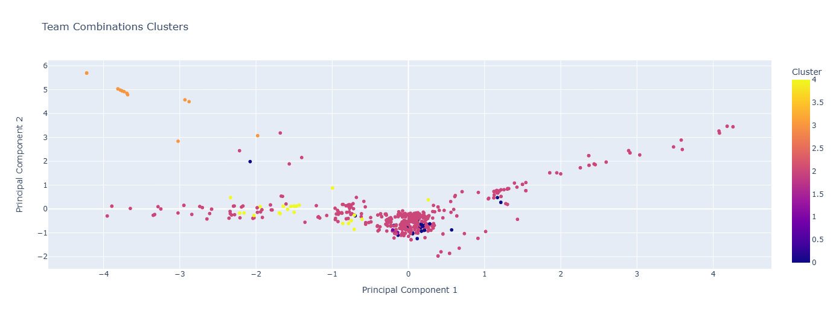
Teams: kmeans text clustering
There are 655 unique teams in the set. Same as genres, they appear as combinations for each respective game, such as [‘EA’, 2k Games’].
Nintendo (right), Capcom (bottom right), Ubisoft (top left), and Sony (bottom left), and all have their own respective branches. In the center of the graph is where we find our more independent and smaller game studios. I assign each game its respective team cluster under Team_Cluster.

Slide 13
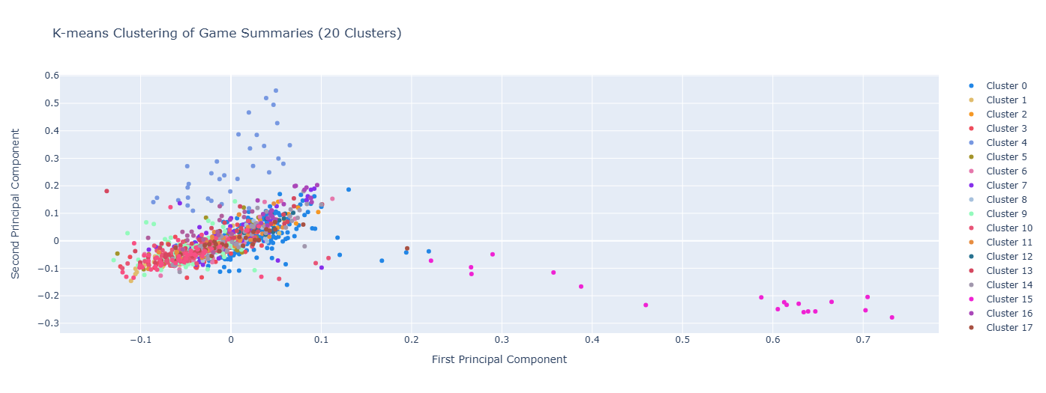
Summary: kmeans text clustering
From looking at the titles, I know some clusters will be entirely dedicated to the more popular franchise. To work around this, I identify the most frequent words within the summaries and add them as custom stopwords.
I assign each game its cluster value as Summary_Cluster.

Slide 14
Reviews: Sentence transformation
Reviews are the most unstructured feature within the textual data. I start with tokenization and cleaning.
Reviews per game are separated through outer square brackets []. Each game can have multiple reviews, these are separated by slashes \. Use of \\n to denote newlines, needs to be removed.
Additionally, I use langdetect to find a total of 7 unique languages, with the majority being in English (1024 reviews), followed by Portuguese (50 reviews), and Spanish (9 reviews).
With a multilingual presence, I use distiluse-base-multilingual-cased-v from SBert to create embeddings for each review. These embeddings are then stored as ‘Embeddings’ for each game.

Slide 15
Forming Feature Vectors
I start by standardizing Rating, Times Listed, Plays, Playing, Backlogs, and Wishlist with StdScalar().
Now, it is time to form the feature vector for each game.
From our sentence transformer embeddings, I need to convert each review into a numpy array. I can then concatenate the 1 dimensional features with this high dimensional array to form a feature vector for each game, based on all textual and numerical data present in the set.
Now that we have our feature vectors, we can try different approaches to best rank them based on similarity score.

Slide 16
Baseline
As a baseline, I can just use cosine similarity to take a given game and output the x most similar titles. This is the most straightforward and simple approach. However, there are a few things we don’t account for here with this approach:
no feature importance or weighting taking place, each feature contributes equally in the similarity score.
curse of dimensionality, our feature vectors are very high dimensional.
any biases present in the set.

Slide 17
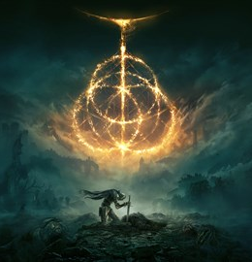
Elden Ring Query with Baseline
I use Elden Ring (because it’s the first game in the set, and a very popular one) as a baseline. It is a dark medieval fantasy world, with an emphasis on difficulty. The top three most similar titles returned are
Metroid Dead 0.99
Kirby and The Forgotten Land 0.99
Super Mario Odyssey 0.98
Not the most compelling list. For example, Metroid Dead is a 2-d platformer, while Mario and Kirby are much more lighthearted and intended for young kids. Additionally, the similarity scores are very high and very similar across all three titles, suggesting proper differences are not accounted for.

Slide 18
MLP Implementation
Advantages of MLP:
Flexible Architecture: MLPs can be easily adapted to handle high-dimensional outputs by adjusting the output layer.
Non-linear Mapping: They can learn complex, non-linear relationships between inputs and high-dimensional outputs.
End-to-end Learning: MLPs learn the entire mapping from input to output in one go, without needing separate dimensionality reduction steps.

Slide 19
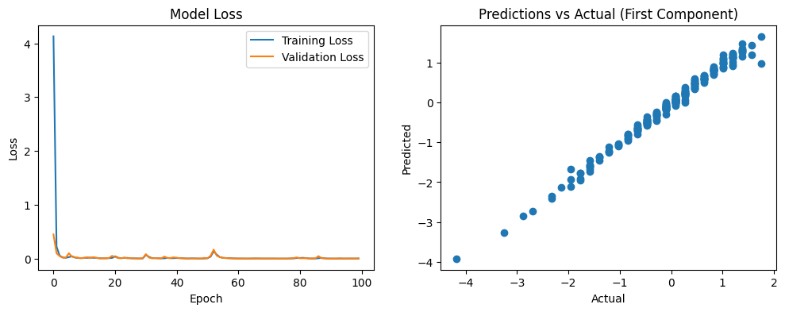
MLP Performance
While the predictions look good, validation loss plateaus, and training loss decreases sharply, suggesting overfitting. To address this, I incorporate the following:
L2 Regularization
Batch Normalization
Dropout Layers
ReduceLROnPlateau
Early Stoppage
Increased epochs to 200

Slide 20
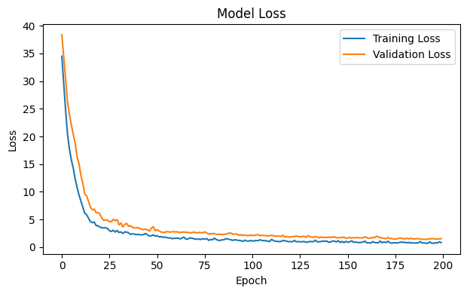
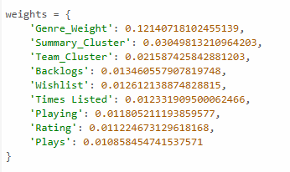
Improved MLP Performance
Much better now. I can then pull the weights form the first layer and implement them back into the baseline cosine similarity calculation.

Slide 21
Elden Ring Query with Weighted Cosine Similarity
I query on Elden Ring again, and this time get much better results.
Witcher 3, 0.35
Bloodborne, 0.31
Dark Souls, 0.29
Much better in my opinion. All three are dark medieval fantasy settings, just like Elden Ring. We see the Teams_Cluster weight come into play here, as Bloodborne and Dark Souls are from the same dev team behind Elden Ring.

Slide 22
Next Steps
The next steps in this project would be to polish the system for more personalized recs, as well as providing pre labeled data to help with similarity rankings.
Hybrid Content-Collaborative Approach
Implement a prelabeled training set that includes user statistics and preferences.
Incorporate collaborative filtering techniques to leverage user-item interactions.
Combine content-based features with collaborative features to create a more robust hybrid model.
User Feedback Integration
Implement a mechanism to collect and incorporate user feedback on recommendations.
Use this feedback to continuously improve the model's performance over time.
Personalization
Develop user profiles based on their game preferences and playing history.
Tailor recommendations to individual users based on their profiles.

