Slide 1
Understanding the Drivers of Churn in a Telecom Company
Team 11
Karshni Mitra (karshnim)
Yi-Hsueh (Alex) Yang (yihsuehy)

Slide 2
Motivation
Average churn rate for a telecom company can range from 10-65%, higher than most industries, 22% in the US
According to Harvard Business Review, the cost for acquiring new customers is 5 times higher than retaining old customers.

Slide 3
Value
Marketing Budget Estimation
Calculate revenue lost, set baseline and limits for the marketing team to set up the budget for promotion
03
Churning Early Identification
Allows strategies to be planned accordingly to prevent lost
01
02
Churning Reasons Analysis
Further identify the probable reasons of customer churning for company to analyze strategy

Slide 4
Problem Statement
Based on Tom Mitchell’s definition of ML:
P(T, E + ΔE) > P(T, E)
where,
P → Recall and Accuracy
T → Binary Classification for churn/not churn and multi-label classification for churning categories
E → Customer data from a Telecom Company

Slide 5
Results
Our XGBClassifier can predict customer churning with a recall of 0.84
Our RandomForestClassifier can predict the churning category reasons of those who churned with an accuracy of 0.89

Slide 6
Key Findings
The company should pay no more than $3,300 on customer with high churn risk or $2,300 on those with low risk for promotion incentives.
Among all churning reasons, the competitive counterparts is costing the largest issue, the company should work on more it’s product quality and data plans.
The company is losing approximately $3,300 on customers with high churn risk or $2,480 on those with low risk because of its competitive counterparts.
Apart from competitors, the company is losing more money on those with lower churn risk than those with high risk.

Slide 7
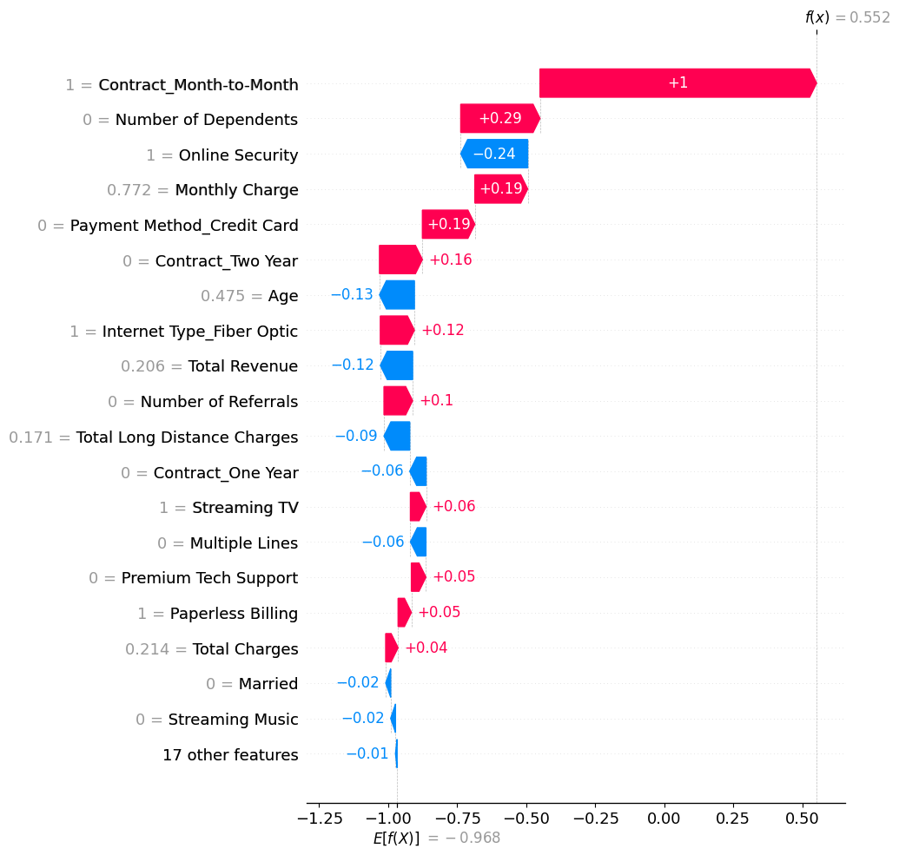
Feature Importance

Slide 8
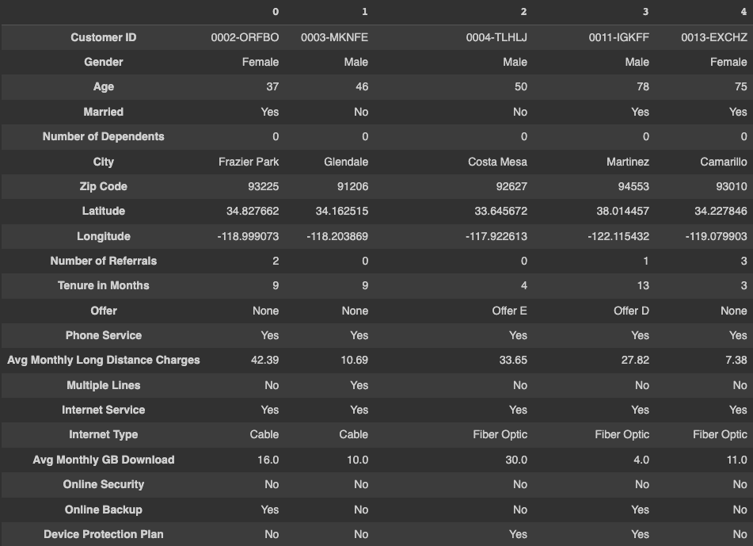
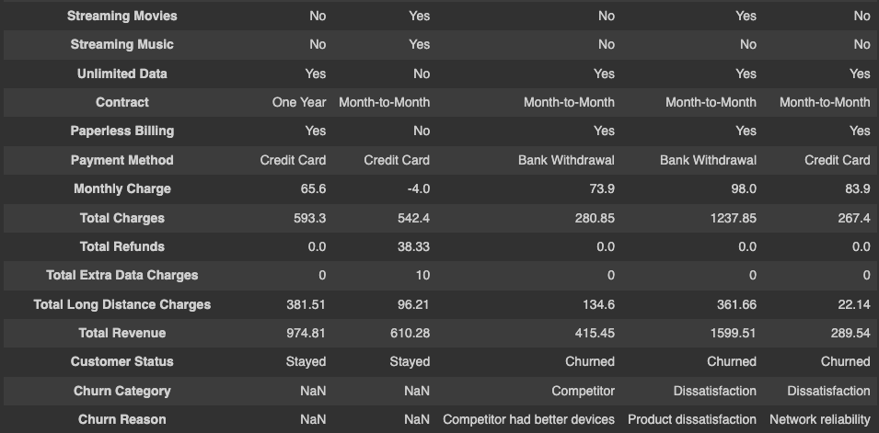
Dataset
Customer Churn dataset from Telecom Company from data.world.
Primarily around the west coast (California)
Dataset consists of 7043 rows and 38 features

Slide 9
Exploratory Data Analysis

Slide 10
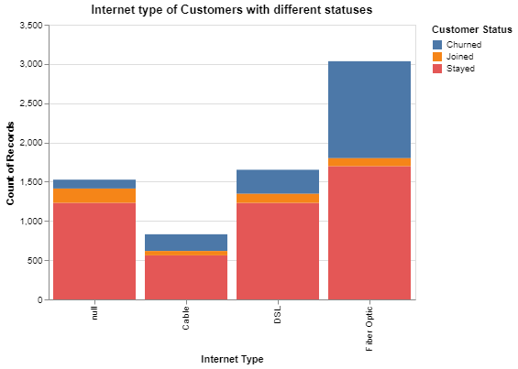
Churn Status to other Columns

Slide 11
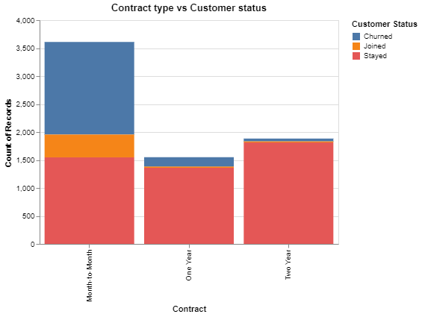
Churn Status to other Columns

Slide 12
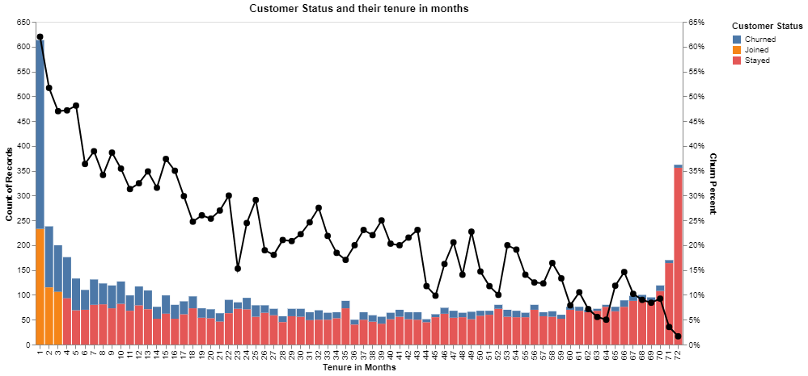
Churn over time

Slide 13
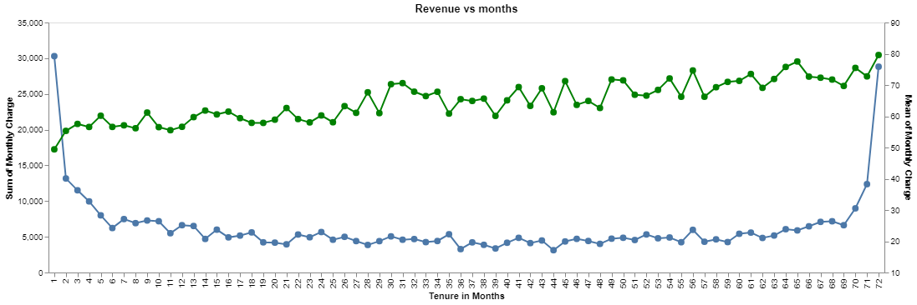
Revenue Analysis

Slide 14
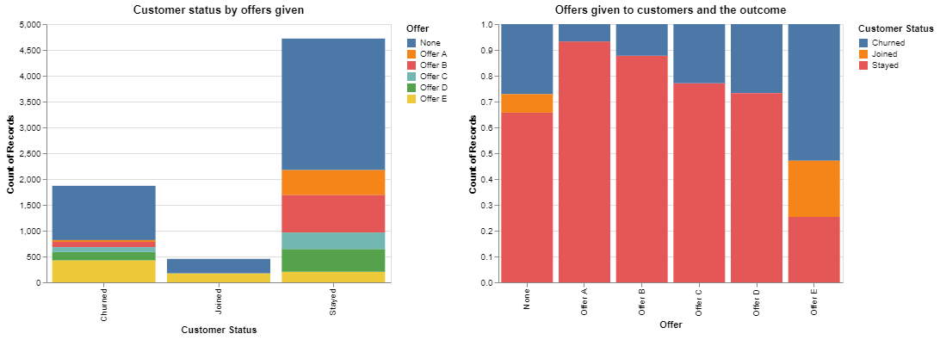
Churn Status to other Columns

Slide 15
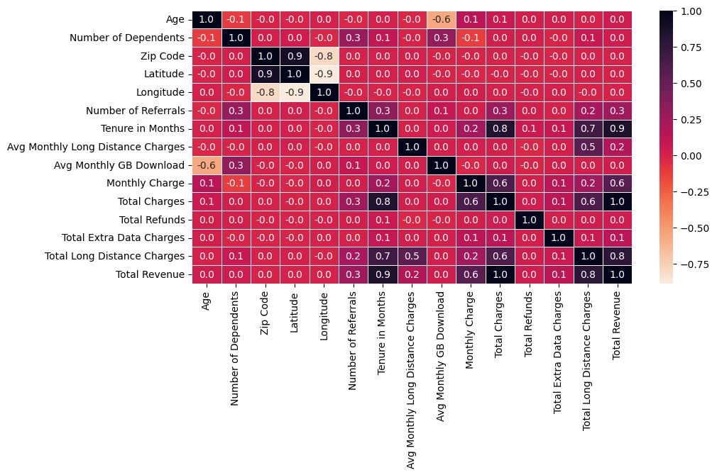
Correlations

Slide 16
Data Preprocessing

Slide 17

Duplicate Value Check

Slide 18
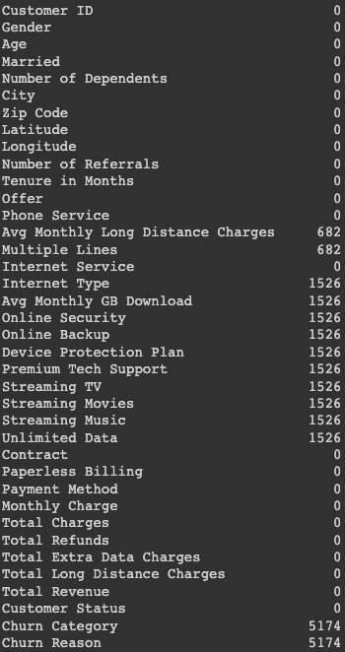
Dealing with Missing Value
Imputer: Mean, Median, Distribution
Missing not at Random (MNAR)
→ No Internet Service / No Phone Service

Slide 19
Outliers Detection
Outliers in a dataset can represent extreme values of customer behavior or other factors that could be relevant to the churn prediction problem.
We are not removing the outliers to keep the relationship between customer's response and their status as real as possible.

Slide 20

Check Imbalance
→ RandomOverSample()

Slide 21
ML Pipeline

Slide 22
Architecture
GridSearchCV()
Preprocessing_pipeline()
GaussianNB()
Numerical Pipeline
LogisticRegression()
Categorical Pipeline_1
RandomOverSampler()
KNeighborsClassifier()
Input Data
SVC()
Categorical Pipeline_2
RandomForestClassifier()
XGBClassifier()

Slide 23
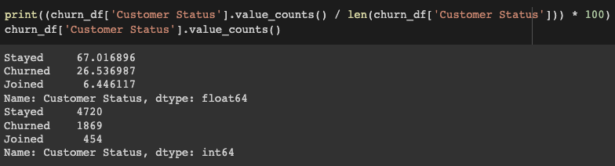
Baseline - Churn Rate Classification

Slide 24
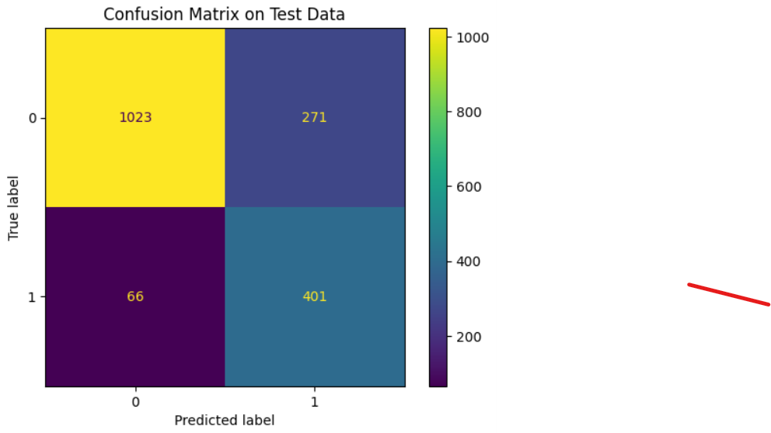
Observations - Churn Rate Classification

Slide 25
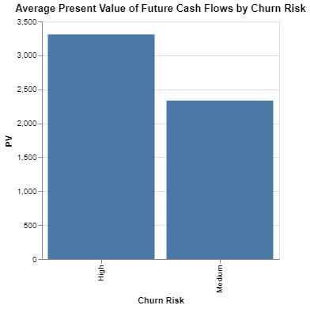
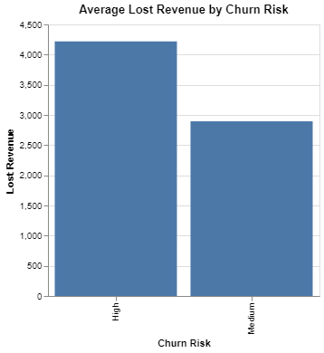
Lost Revenue - Churn Rate Classification

Slide 26
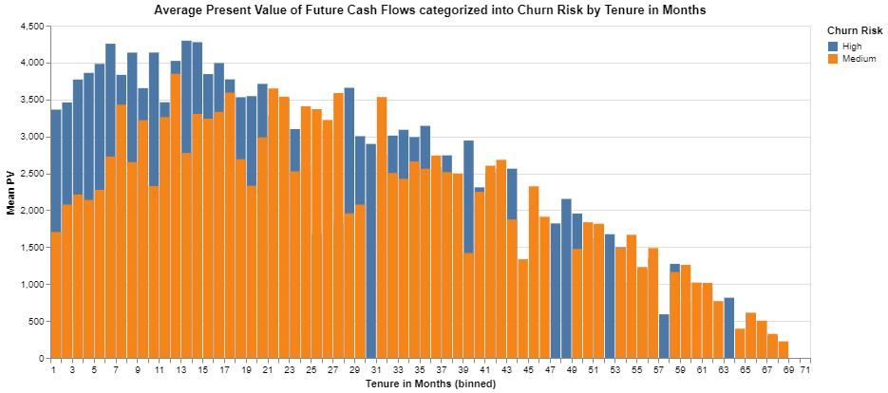
Lost Revenue - Churn Rate Classification

Slide 27

Baseline - Churn Categories Classification
churn_y_pred[0:5] → [2 1 4 1 1]
churn_y_pred_proba[0:5] →
[[0.165 0.295 0.35 0.09 0.1 ]
[0.18 0.305 0.19 0.185 0.14 ]
[0.3 0.185 0.03 0. 0.485]
[0.105 0.4 0.14 0.21 0.145]
[0.1 0.37 0.3 0.125 0.105]]

Slide 28
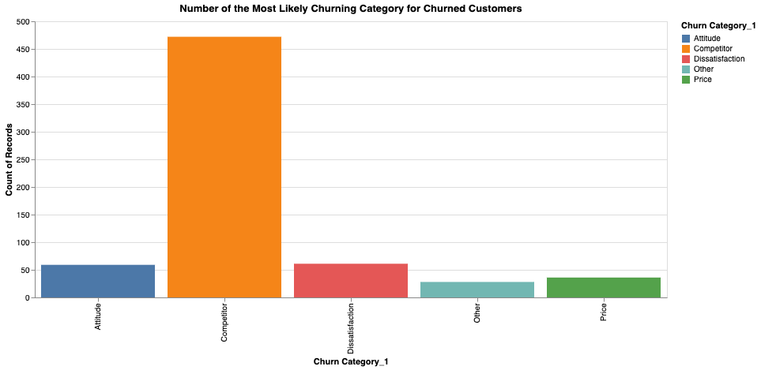
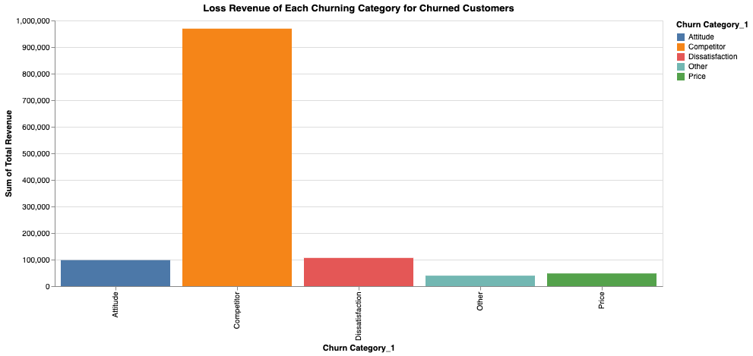
Observations - Churn Categories Classification

Slide 29
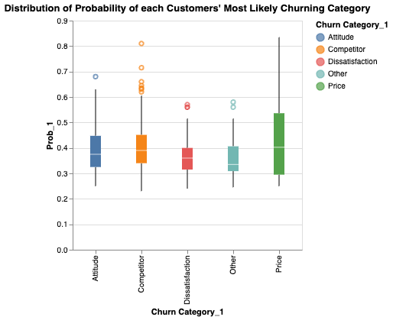
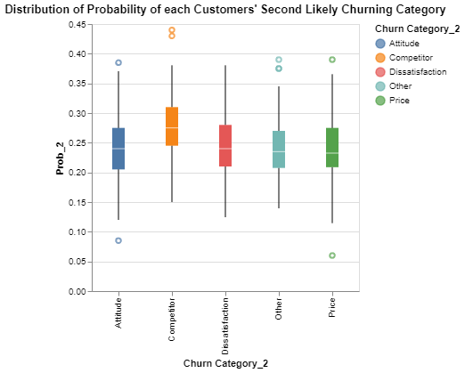
Observations - Churn Categories Classification

Slide 30
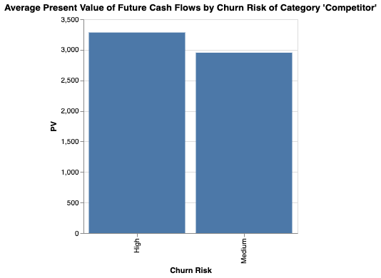
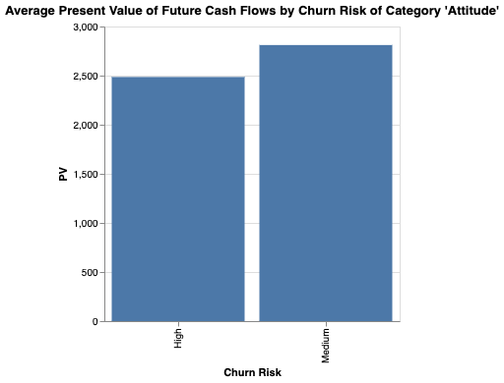
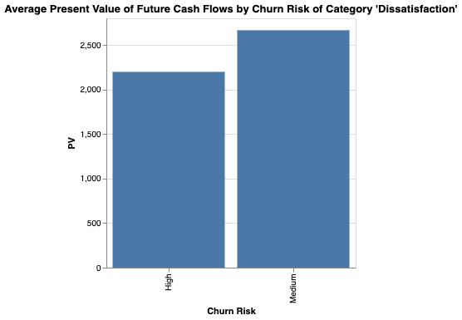
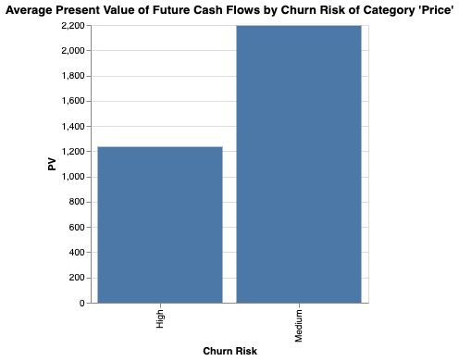
Lost Revenue - Churn Rate Classification

Slide 31
Future Work

Slide 32
Future Work
Understand why our competitors are doing better than us in terms of device and data products. Are their costs lower? What kind of promotions do they employ?
Make better use of the geographic data and target customers in regions with less churn with retention and acquisition strategies.

Slide 33
References

Slide 34
Data Source: https://data.world/mcc450/telecom-churn
https://hbr.org/2022/12/in-a-downturn-focus-on-existing-customers-not-potential-ones
https://www.techmahindra.com/en-in/blog/maximizing-business-profit-through-telecom-analytics-solutions/
https://www.statista.com/statistics/816735/customer-churn-rate-by-industry-us/

