Slide 1
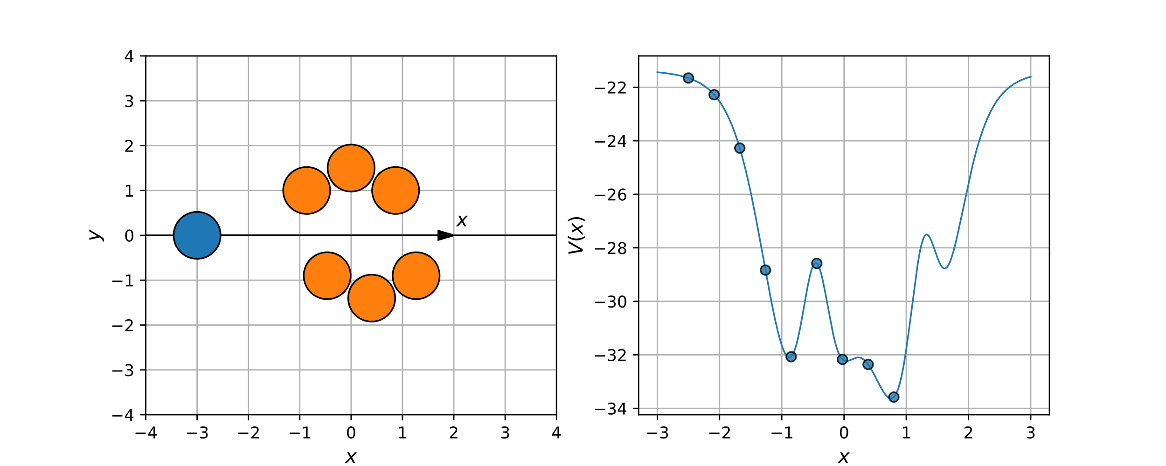
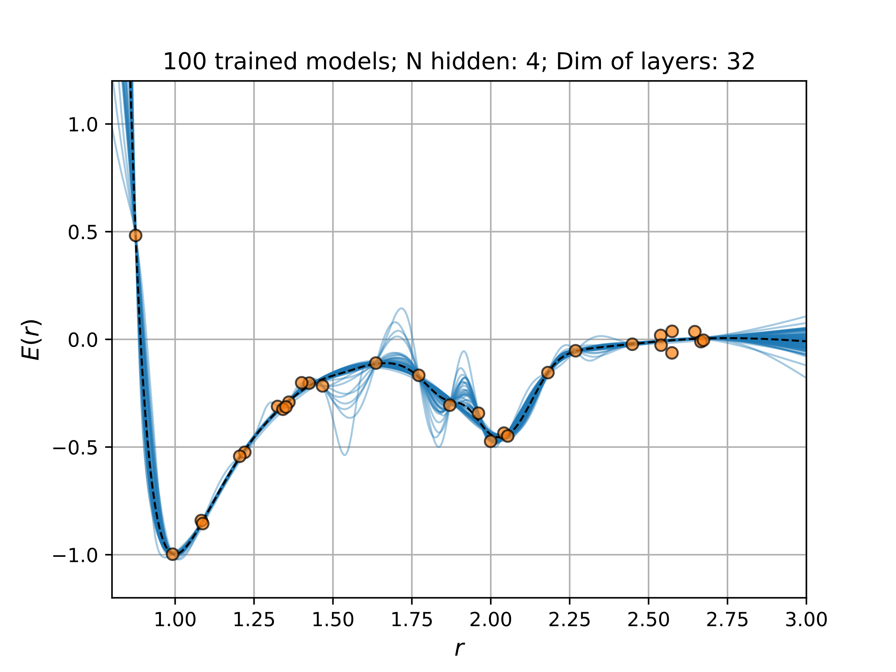
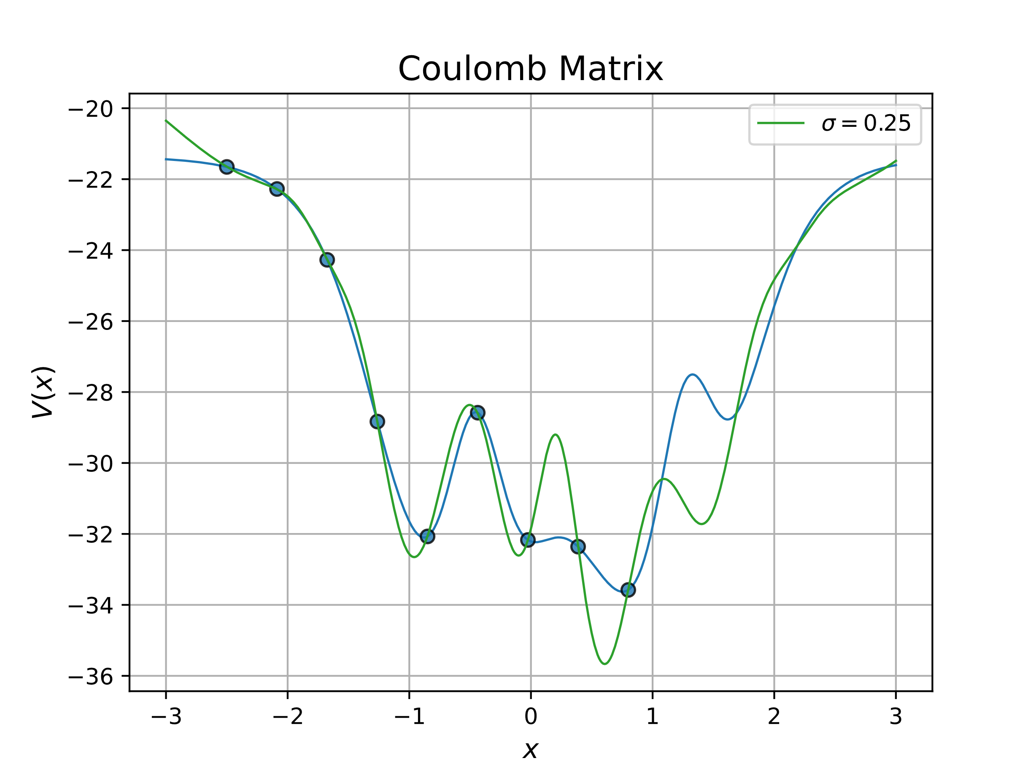
Regression

Slide 2
Outline
What is regression?/Motivation
Parametric regression
Ordinary Least Squares (OLS) Regression
Ridge Regression
Kernel Ridge Regression
Exercises to illustrate points
Benefits/disadvantages
Exercises: Using Neural Networks for regression

Slide 3
Parametric Regression – OLS regression
Derivation & idea
Exercise 29

Slide 4
OLS Regression – Exercise 29

Slide 5
Parametric Regression – OLS regression
Derivation & idea
Exercise 29
Benefits:
Closed form solutions
Disadvantages:
Has tendency to overfit
We have to assign form of fit

Slide 6
Parametric Regression – Ridge Regression
Derivation & idea
Exercise 29

Slide 7
Ridge Regression – Exercise 29

Slide 8
Parametric Regression – Ridge Regression
Derivation & idea
Exercise 29
Benefits:
Closed form solutions
Less prone to overfitting
Disadvantages:
We have to assign form of fit

Slide 9
Parametric Regression – Kernel Ridge Regression
Derivation & idea
Exercise 34

Slide 10
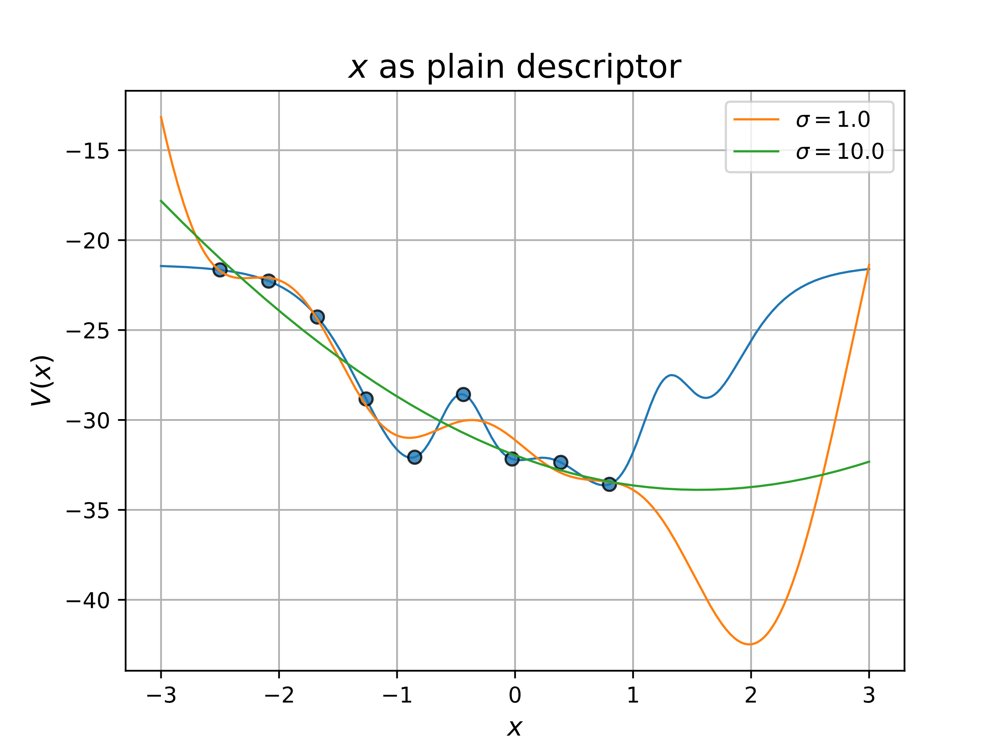
Kernel Ridge Regression – Exercise 34

Slide 11
Parametric Regression – Kernel Ridge Regression
Derivation & idea
Exercise 34
Benefits
Has closed from solutions
Kernel & data decides fit
Disadvanteges
Hyperparameters for kernel
Regression usages in general

Slide 12
Using Neural Networks for Regression
Universal function approximator
Minimize loss as always
Exercise 51 and 53

Slide 13
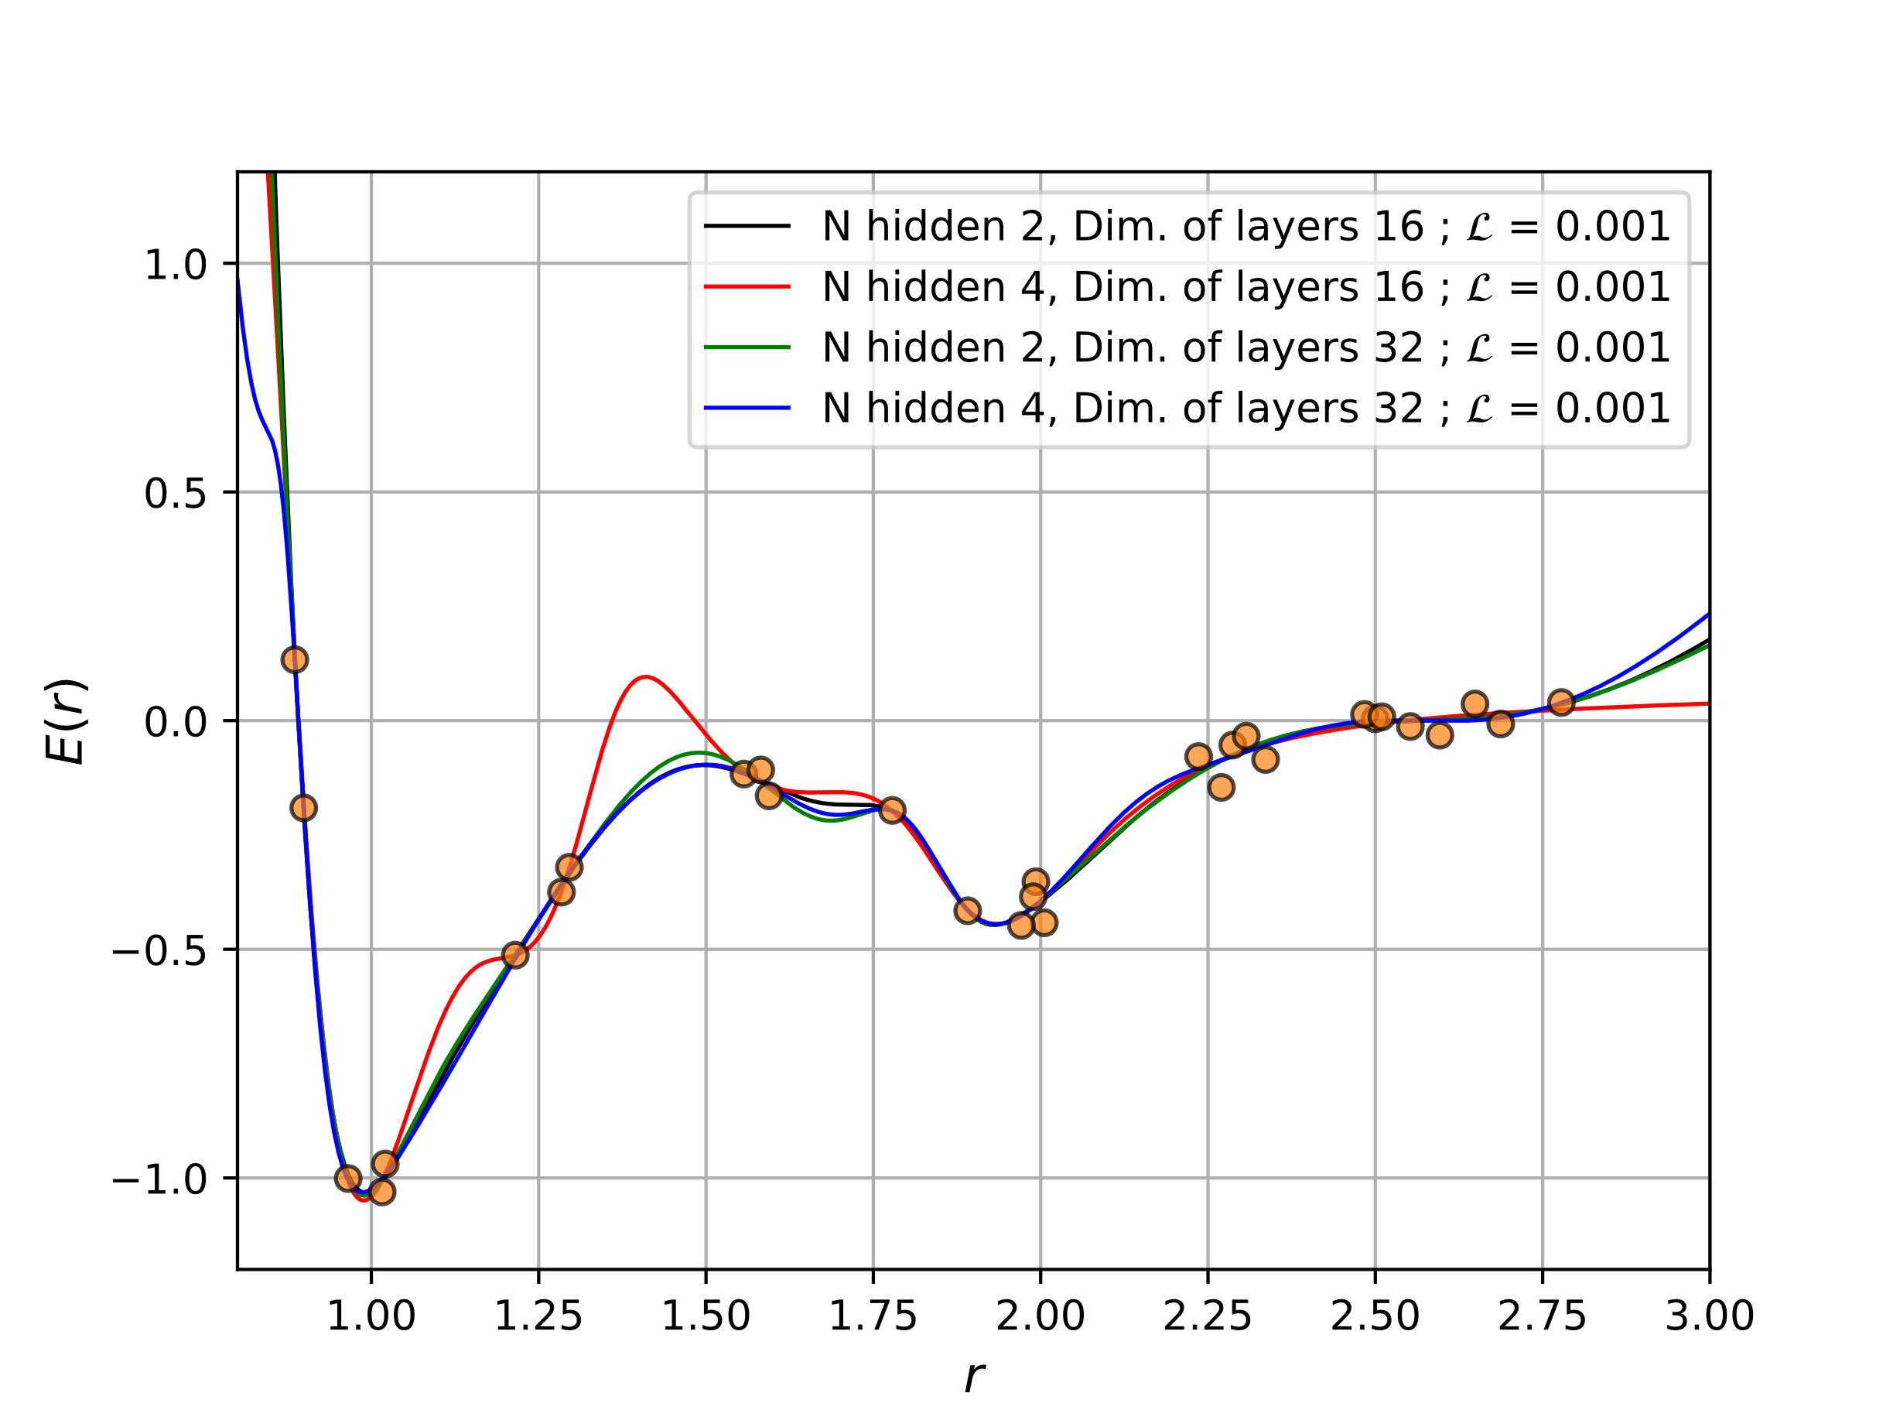
Exercise 51
Fit noisy data with Neural Network
Overfitting
Reproducibility → No closed form
Uncertainties? → Gaussian Process Regression

Slide 14
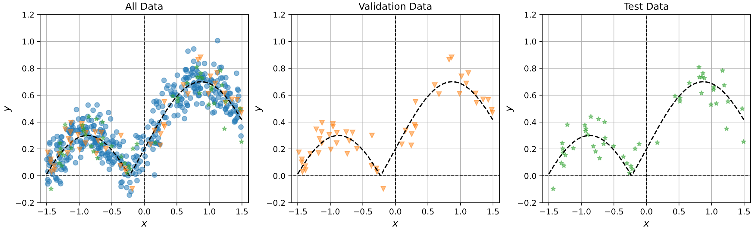
Exercise 53
Try and fit again
Combat overfitting
Regularization term
Early stopping
Many methods

Slide 15
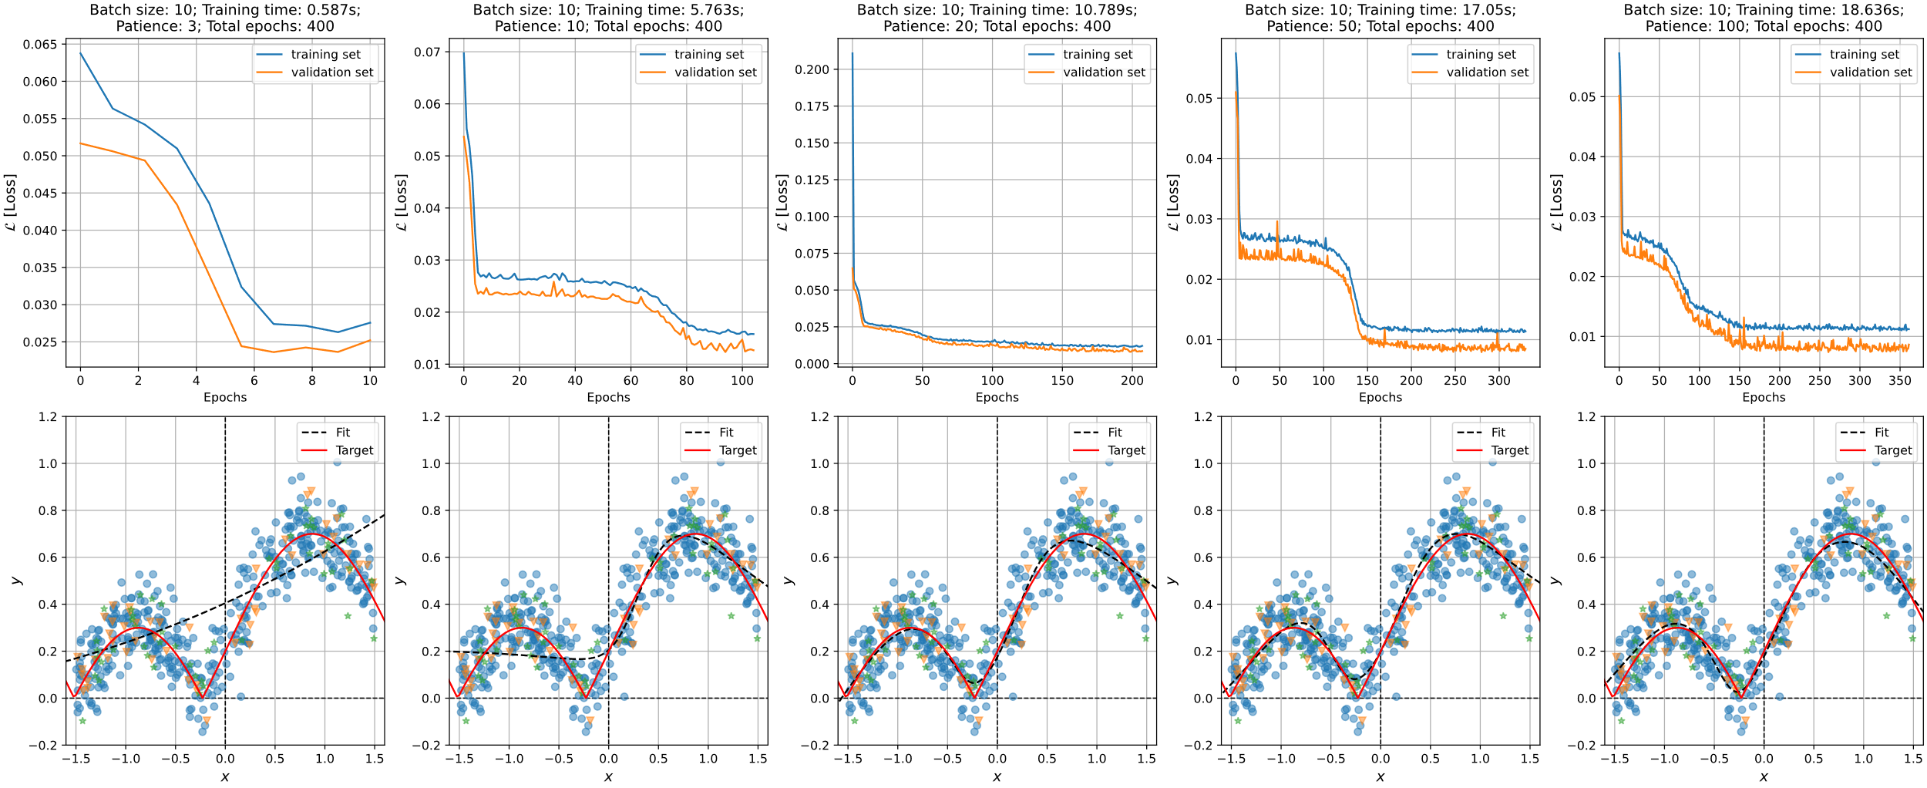
Exercise 53

