Slide 1
Finding highly active catalysts with genAI

Slide 2
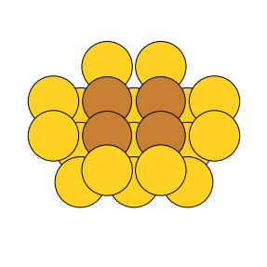
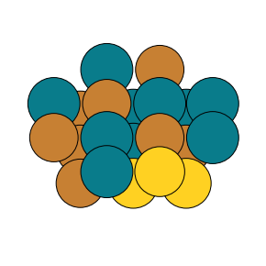
The problem: Find highly active catalysts at different surfaces
Reaction under investigation: CO₂ + H₂ ⇌ CO + H₂O (RWGS)
Main idea: Change composition of surface, and find reactivity
Element pool of 3 yields 3.5billion conf.
Very large search space → genAI tools and other search algorithms
Keep simple no strain effects, and stability.
active sites
(100 facet)
Change composition
Find reaction rate for given surface

Slide 3
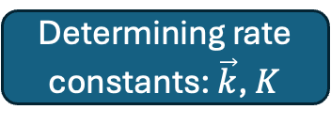
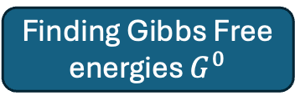

Outline for next slides
How is the rate determined?
Determining rate constants: $\vec{k}$, $K$
Finding Gibbs Free energies $G^{0}$
Finding $E_{form}$ & $E_{act}$

Slide 4
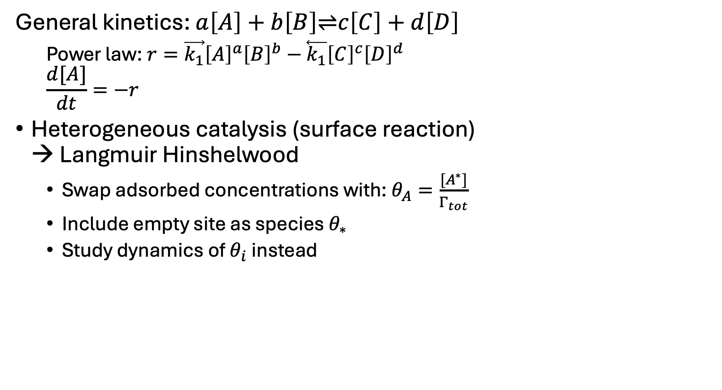
Breaking down the problem – 1. step: find rate
General kinetics: $a\left[A\right]+b\left[B\right]\text{⇌}c\left[C\right]+d\left[D\right]$
Power law:$r=\vec{k_{1}}{\left[A\right]}^{a}{\left[B\right]}^{b}−\overset{⃖}{k_{1}}{\left[C\right]}^{c}{\left[D\right]}^{d}$
$$\frac{d[A]}{dt}=−r$$
Heterogeneous catalysis (surface reaction) → Langmuir Hinshelwood
Swap adsorbed concentrations with: $θ_{A}=\frac{[A^{∗}]}{Γ_{tot}}$
Include empty site as species $θ_{∗}$
Study dynamics of $θ_{i}$ instead
CO₂ + H₂ ⇌ CO + H₂O
Turn into elementary steps
Adsorptions
(1) H₂ + 2 * ↔ H* + H*
(2) CO₂ + * ↔ CO₂*
(3) H₂O + * ↔ H₂O*
(4) CO + * ↔ CO*
CO-O path and H₂O formation
(5) CO₂* + * ↔ CO* + O* (RDS)
(6) H₂O* + * ↔ OH* + H*
(7) OH* + * ↔ O* + H*
Find rate using Langmuir-Hinselwood
Reaction rate R

Slide 5
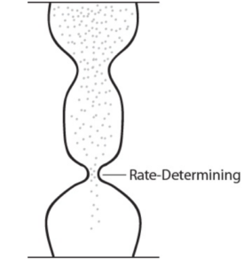
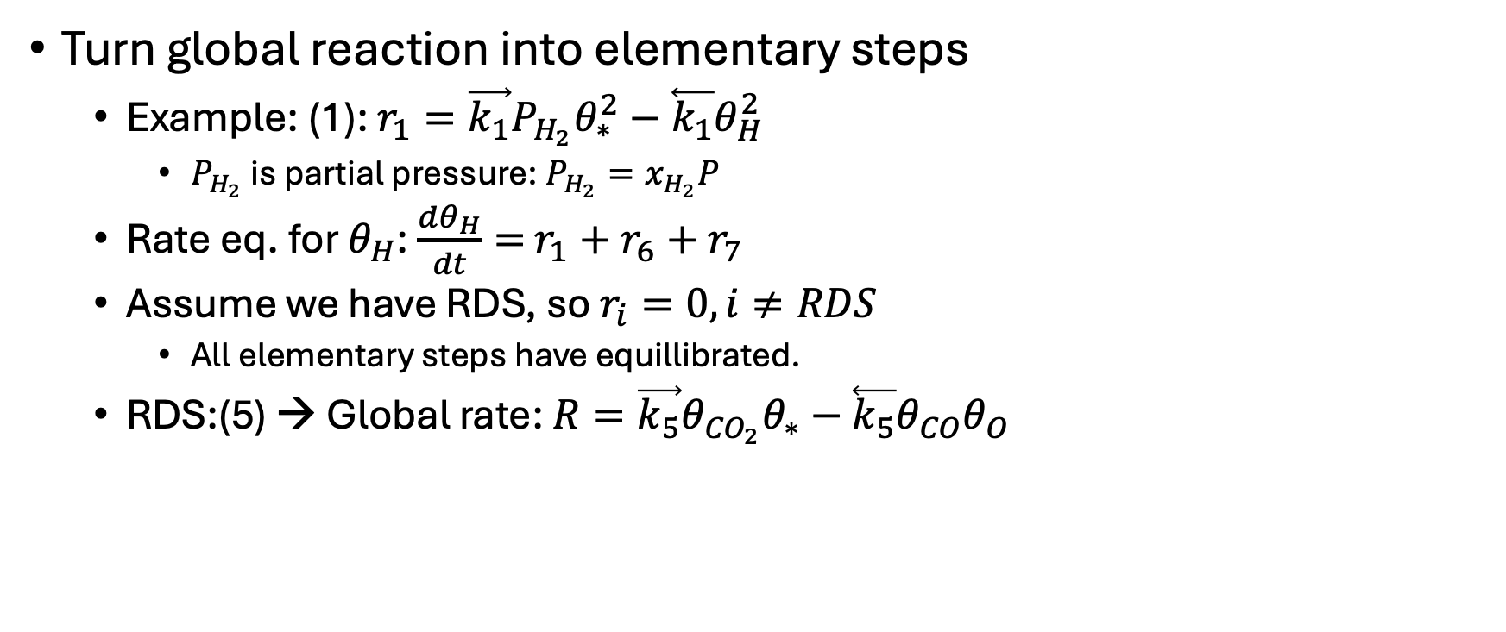
Breaking down the problem – 1. step: find rate
Turn global reaction into elementary steps
Example: (1): $r_{1}=\vec{k_{1}}P_{H_{2}}θ_{∗}^{2}−\overset{⃖}{k_{1}}θ_{H}^{2}$
$P_{H_{2}}$ is partial pressure: $P_{H_{2}}=x_{H_{2}}P$
Rate eq. for $θ_{H}$: $\frac{dθ_{H}}{dt}=$ $r_{1}+r_{6}+r_{7}$
Assume we have RDS, so $r_{i}=0, i≠RDS$
All elementary steps have equillibrated.
RDS:(5) → Global rate: $R=\vec{k_{5}}θ_{{CO}_{2}}θ_{∗}−\overset{⃖}{k_{5}}θ_{CO}θ_{O}$
CO₂ + H₂ ⇌ CO + H₂O
Turn into elementary steps
Adsorptions
(1) H₂ + 2 * ↔ H* + H*
(2) CO₂ + * ↔ CO₂*
(3) H₂O + * ↔ H₂O*
(4) CO + * ↔ CO*
CO-O path and H₂O formation
(5) CO₂* + * ↔ CO* + O* (RDS)
(6) H₂O* + * ↔ OH* + H*
(7) OH* + * ↔ O* + H*
Find rate using Langmuir-Hinselwood
Reaction rate R

Slide 6
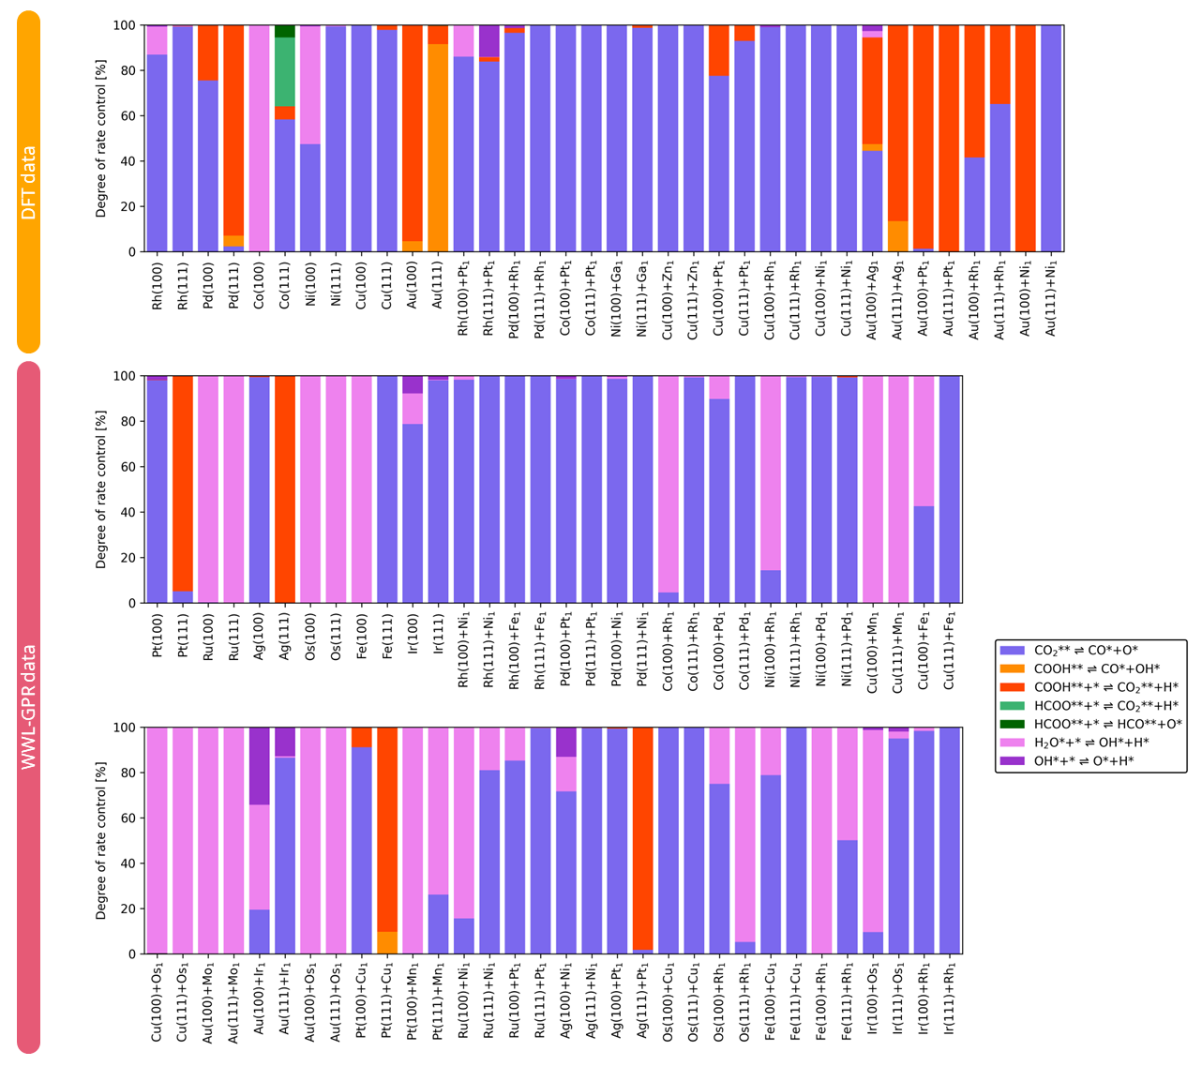
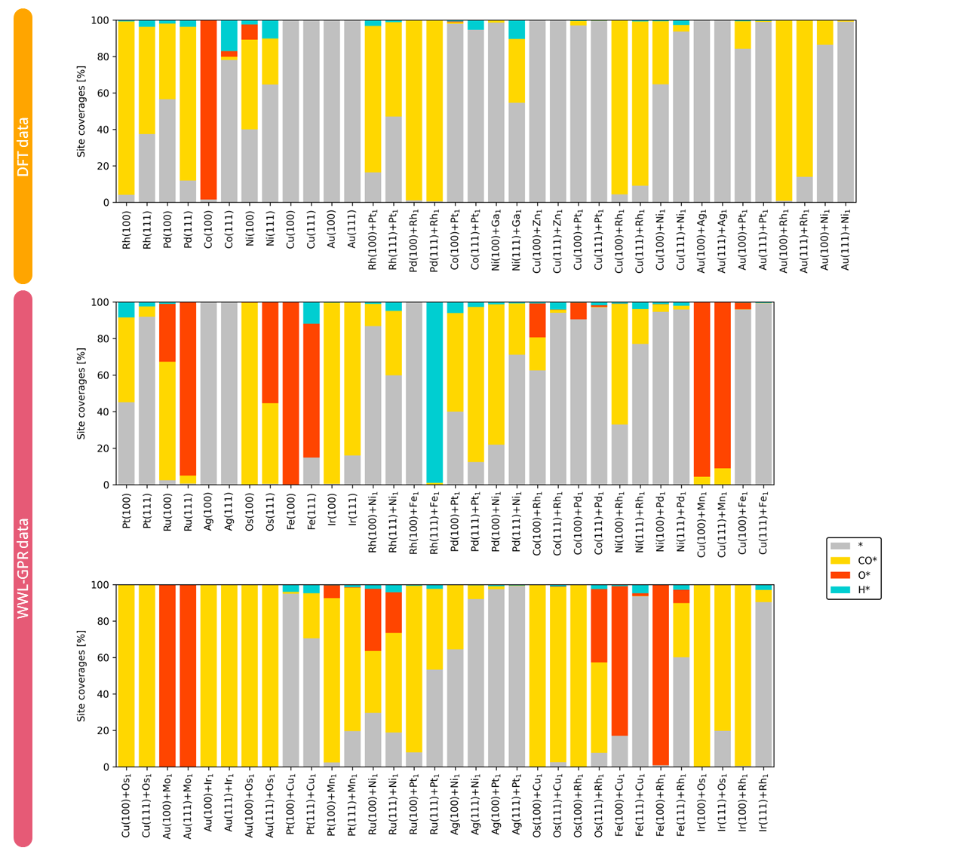
RWGS on metals and single-atom alloys – Why elementary step 5?
CO₂* dissociation RDS for most materials
Most abundant reaction intermediates: CO*, O*, H*
Notes:
Could we use another color for CO to not confuse it with the carboxyl path?
- I made it dark blue

Slide 7
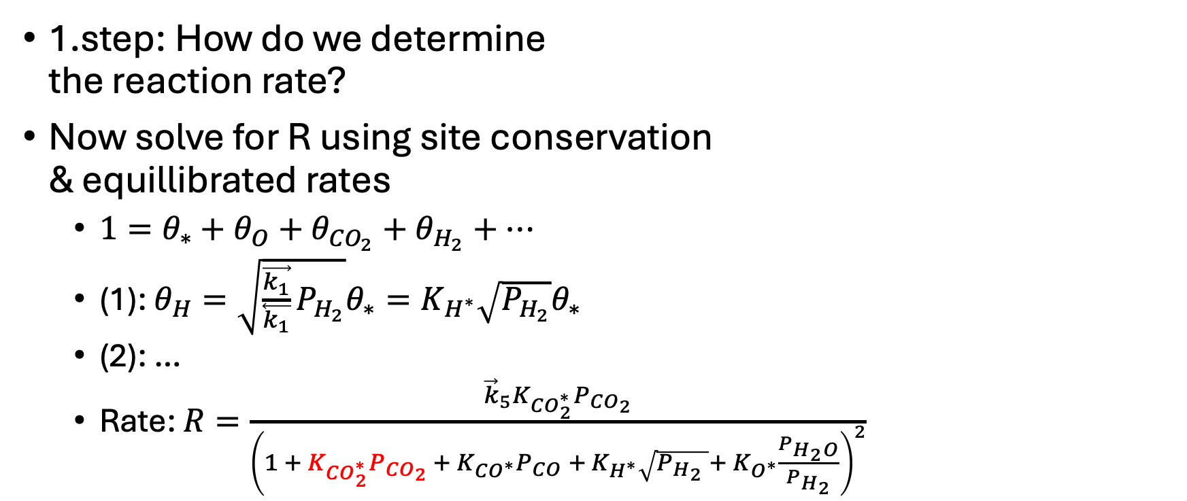
Breaking down the problem – 1. step: find rate
1.step: How do we determine the reaction rate?
Now solve for R using site conservation & equillibrated rates
$1=θ_{∗}+θ_{O}+θ_{{CO}_{2}}+θ_{H_{2}}+…$
(1): $θ_{H}=\sqrt{\frac{\vec{k_{1}}}{\overset{⃖}{k_{1}}}P_{H_{2}}}θ_{∗}=K_{H^{∗}}\sqrt{P_{H_{2}}}θ_{∗}$
(2): …
Rate: $R=\frac{{\vec{k}}_{5}K_{{CO}_{2}^{∗}}P_{{CO}_{2}}}{{\left(1 + K_{CO_{2}^{∗}}P_{CO_{2} }+ K_{CO^{∗}}P_{CO} + K_{H^{∗}}\sqrt{P_{H_{2}} }+ K_{O^{∗}}\frac{P_{H_{2}O}}{P_{H_{2}}}\right)}^{2}}$
CO₂ + H₂ ⇌ CO + H₂O
Turn into elementary steps
Adsorptions
(1) H₂ + 2 * ↔ H* + H*
(2) CO₂ + * ↔ CO₂*
(3) H₂O + * ↔ H₂O*
(4) CO + * ↔ CO*
CO-O path and H₂O formation
(5) CO₂* + * ↔ CO* + O* (RDS)
(6) H₂O* + * ↔ OH* + H*
(7) OH* + * ↔ O* + H*
Find rate using Langmuir-Hinselwood
Reaction rate R

Slide 8
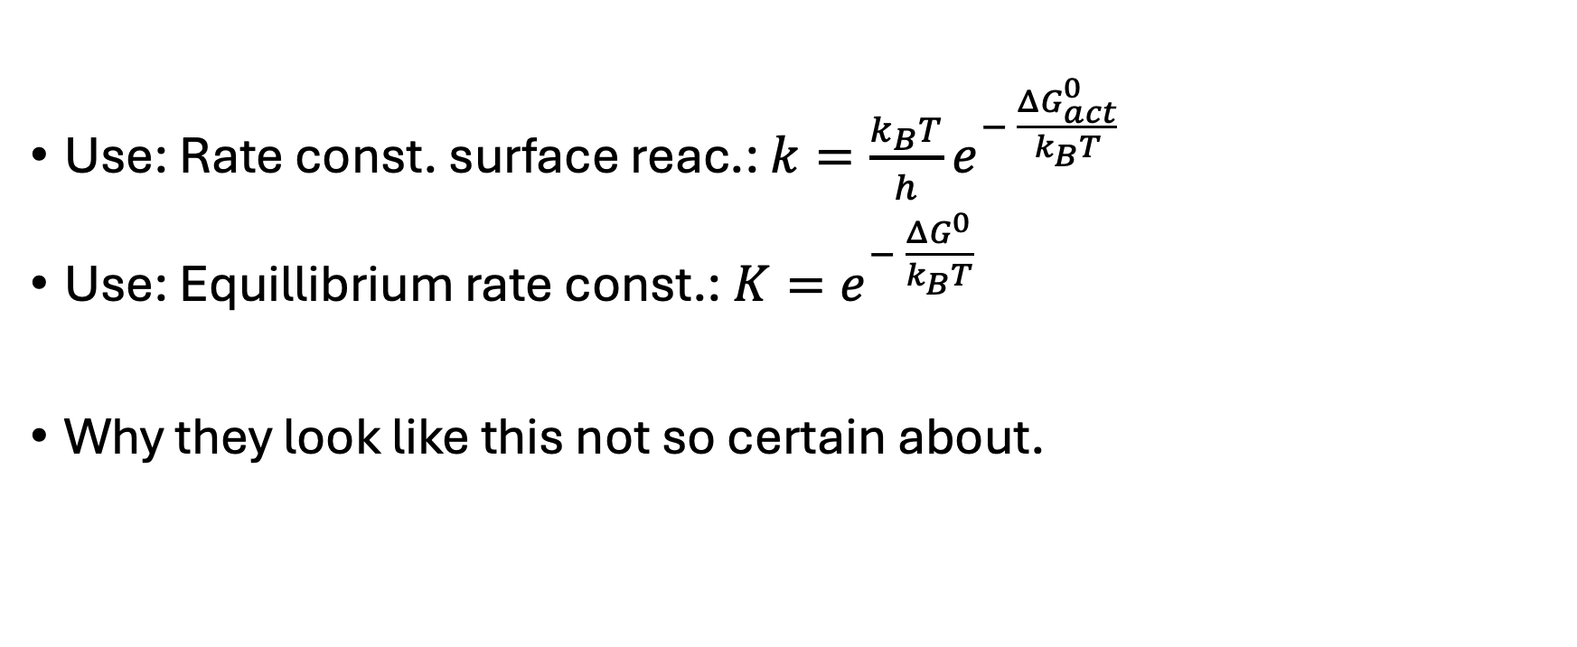
Breaking down the problem – 2. step: rate const.
Use: Rate const. surface reac.: $k=\frac{k_{B}T}{h}e^{− \frac{ΔG_{act}^{0}}{k_{B}T}}$
Use: Equillibrium rate const.: $K=e^{− \frac{ΔG^{0}}{k_{B}T}}$
Why they look like this not so certain about.
CO₂ + H₂ ⇌ CO + H₂O
Turn into elementary steps
Adsorptions
(1) H₂ + 2 * ↔ H* + H*
(2) CO₂ + * ↔ CO₂*
(3) H₂O + * ↔ H₂O*
(4) CO + * ↔ CO*
CO-O path and H₂O formation
(5) CO₂* + * ↔ CO* + O* (RDS)
(6) H₂O* + * ↔ OH* + H*
(7) OH* + * ↔ O* + H*
Find rate using Langmuir-Hinselwood
Reaction rate R

Slide 9
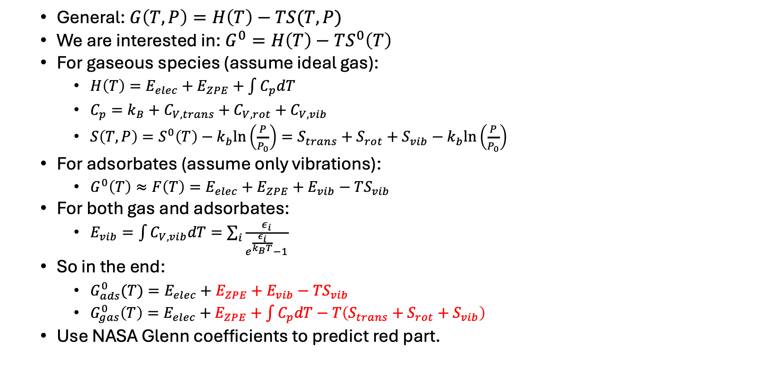
Breaking down the problem – 3. step: Gibbs energy
General: $G\left(T,P\right)=H\left(T\right)−TS(T,P)$
We are interested in: $G^{0}=H\left(T\right)−TS^{0}\left(T\right)$
For gaseous species (assume ideal gas):
$H\left(T\right)=E_{elec}+E_{ZPE}+\int{C_{p}dT}$
$C_{p}=k_{B}+C_{V,trans}+C_{V,rot}+C_{V,vib}$
$S\left(T,P\right)=S^{0}\left(T\right)−k_{b}ln\left(\frac{P}{P_{0}}\right)=S_{trans}+S_{rot}+S_{vib}−k_{b}ln\left(\frac{P}{P_{0}}\right)$
For adsorbates (assume only vibrations):
$G^{0}\left(T\right)≈F\left(T\right)=E_{elec}+E_{ZPE}+E_{vib}−TS_{vib}$
For both gas and adsorbates:
$E_{vib}=\int{C_{V,vib}dT}=\sum_{i}{\frac{ε_{i}}{e^{\frac{ε_{i}}{k_{B}T}}−1}}$
So in the end:
$G_{ads}^{0}(T)=E_{elec}+E_{ZPE}+E_{vib}−TS_{vib}$
$G_{gas}^{0}\left(T\right)=E_{elec}+E_{ZPE}+\int{C_{p}dT}−T\left(S_{trans}+S_{rot}+S_{vib}\right)$
Use NASA Glenn coefficients to predict red part.
CO₂ + H₂ ⇌ CO + H₂O
Turn into elementary steps
Adsorptions
(1) H₂ + 2 * ↔ H* + H*
(2) CO₂ + * ↔ CO₂*
(3) H₂O + * ↔ H₂O*
(4) CO + * ↔ CO*
CO-O path and H₂O formation
(5) CO₂* + * ↔ CO* + O* (RDS)
(6) H₂O* + * ↔ OH* + H*
(7) OH* + * ↔ O* + H*
Find rate using Langmuir-Hinselwood
Reaction rate R

Slide 10

Breaking down the problem – 3. step: Gibbs energy
We calculate using clean slab as reference:
$E_{f}=E_{surf. +ads}−E_{surf}−\sum_{i}{μ_{i}N_{i}}$
$G_{ads}^{0}=E_{f}+E_{ZPE}+E_{vib}−TS_{vib}$
$G_{gas}^{0}=E_{ZPE}+\int{C_{p}dT}−T\left(S_{trans}+S_{rot}+S_{vib}\right)$
We can now find $ΔG^{0}$ and $ΔG_{act}^{0}$ given $E_{f}$ and $E_{act}$
CO₂ + H₂ ⇌ CO + H₂O
Turn into elementary steps
Adsorptions
(1) H₂ + 2 * ↔ H* + H*
(2) CO₂ + * ↔ CO₂*
(3) H₂O + * ↔ H₂O*
(4) CO + * ↔ CO*
CO-O path and H₂O formation
(5) CO₂* + * ↔ CO* + O* (RDS)
(6) H₂O* + * ↔ OH* + H*
(7) OH* + * ↔ O* + H*
Find rate using Langmuir-Hinselwood
Reaction rate R

Slide 11
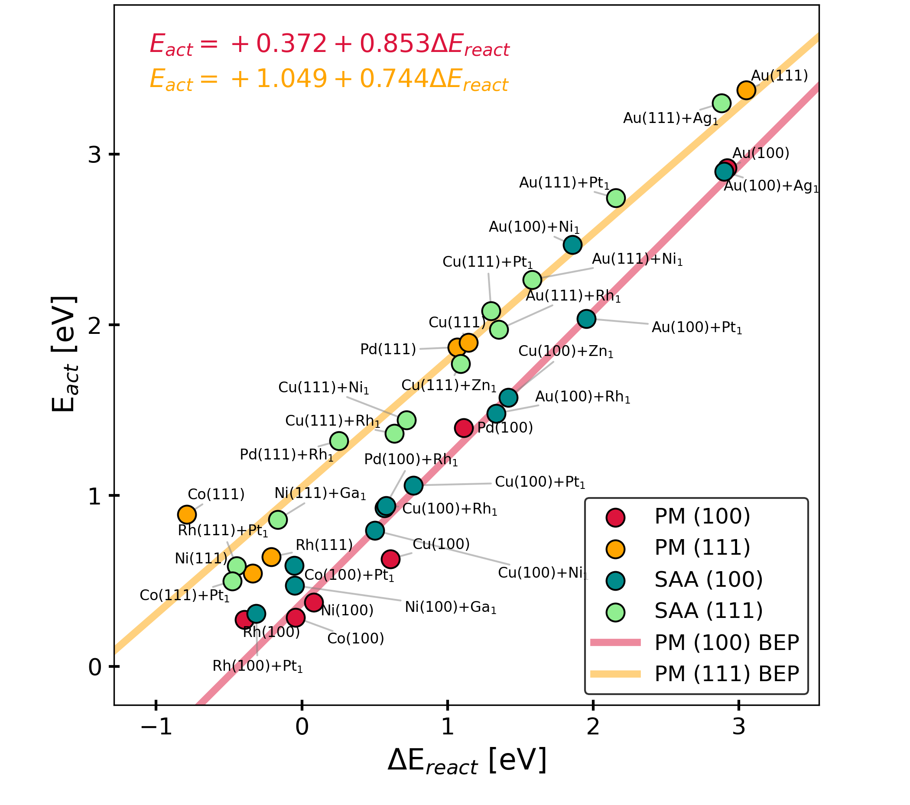
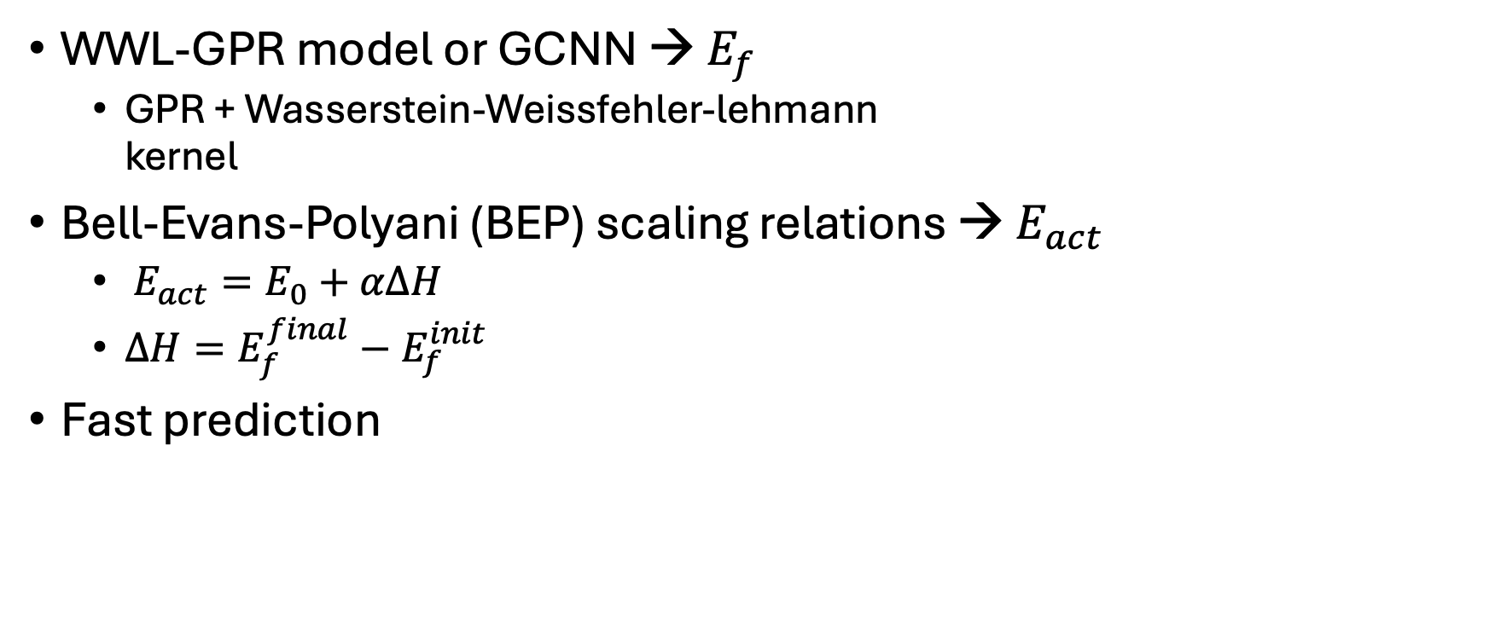
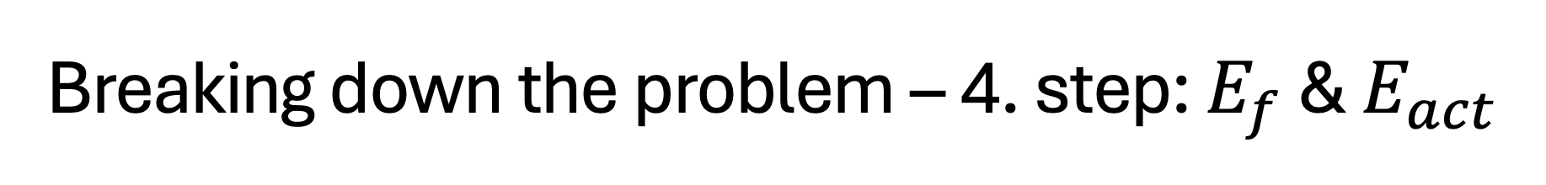
Breaking down the problem – 4. step: $E_{f}$ & $E_{act}$
WWL-GPR model or GCNN → $E_{f}$
GPR + Wasserstein-Weissfehler-lehmann kernel
Bell-Evans-Polyani (BEP) scaling relations → $E_{act}$
$E_{act}=E_{0}+αΔH$
$ΔH=E_{f}^{final}−E_{f}^{init}$
Fast prediction

Slide 12
Let’s look at some code for implementing this ☺

Slide 13
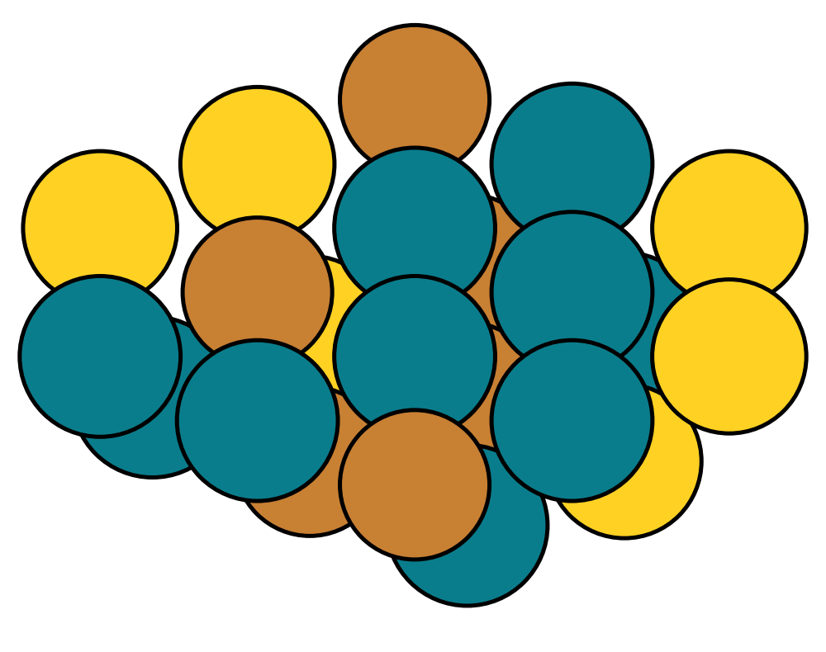
Reaction rate from surface composition
DFT energies (obtained with slab models)
Cluster model including site atoms and their neighbors
DFT DB (RWGS on SAAs)
WWL-GPR graph model
Surface composition
Python function
Adsorption energies
Reaction rate
From rate equation or microkinetic modeling
Adsorption modes DB
All adsorbate configurations involving site atoms
Brown: site atoms
Yellow: neighbor atoms
Notes:
Could we use another color for CO to not confuse it with the carboxyl path?
- I made it dark blue

