Slide 1
Diffusion model debugging

Slide 2
Outline
Quick recap of problem & summary
Not being able to produce high rate structures unconditionally
Identification of the problem
What I think the solution may be

Slide 3
Problem statement
Investigate RWGS: CO₂ + H₂ ⇌ CO + H₂O on metallic alloys
Example: 111-surface with only 4 active sites
Element pool of 3 yields 3.5billion conf.
Approximation: Ignore effect of stability/geometrical DOF’s.
Use generative models to help guide → Diffusion model
Swap elements
Reaction rate
Brown: site atoms
Yellow: neighbor atoms

Slide 4



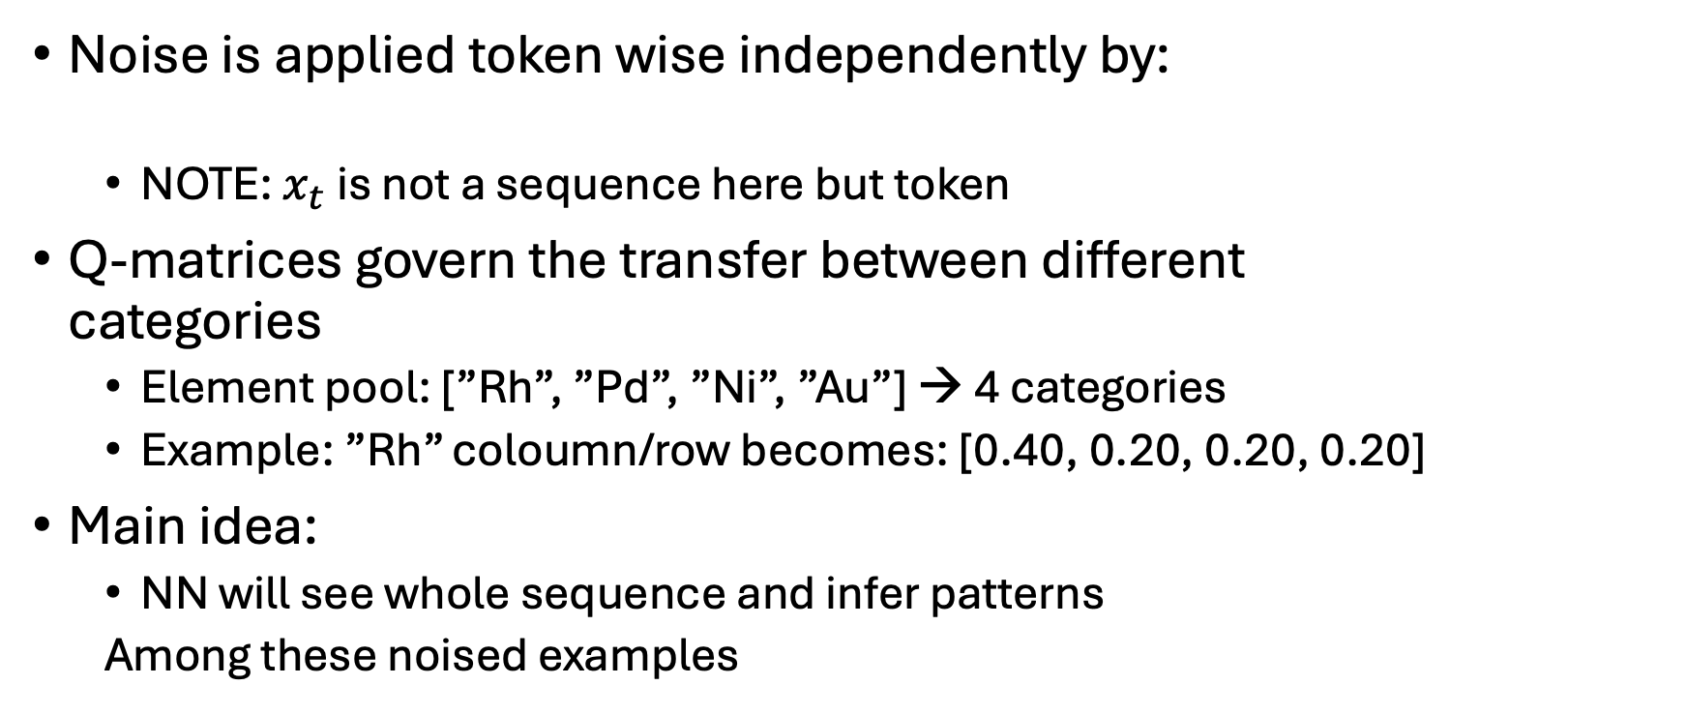
How I implemented this
Noise is applied token wise independently by:
NOTE: $x_{t}$ is not a sequence here but token
Q-matrices govern the transfer between different categories
Element pool: [”Rh”, ”Pd”, ”Ni”, ”Au”] → 4 categories
Example: ”Rh” coloumn/row becomes: [0.40, 0.20, 0.20, 0.20]
Main idea:
NN will see whole sequence and infer patterns
Among these noised examples
0.40
Rh
0.20
Pd
0.20
0.20
Ni
Au

Slide 5
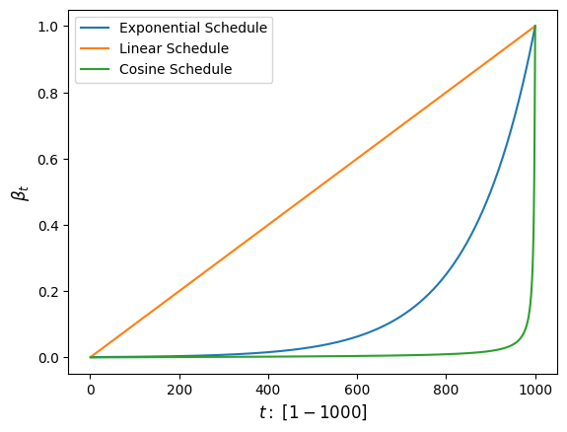
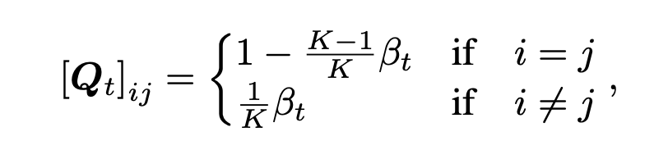
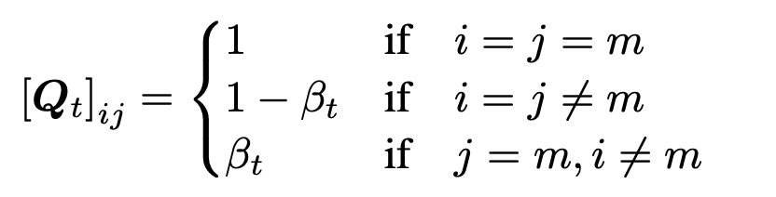
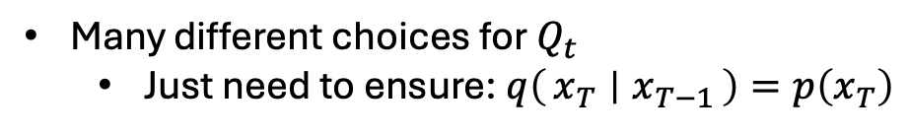
Q-matrices
Many different choices for $Q_{t}$
Just need to ensure: $q\left(x_{T} ∣ x_{T−1}\right)=p\left(x_{T}\right)$
Uniform transitions
Absorbing state formulation

Slide 6
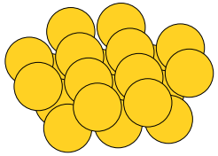
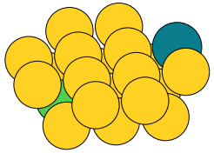
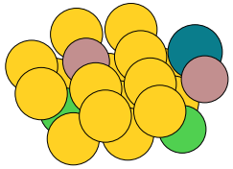
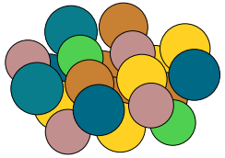
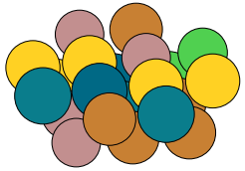
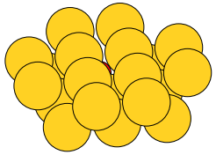
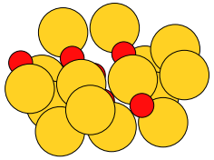
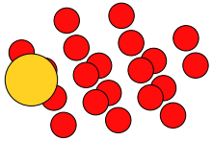
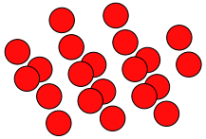










How I implemted this: Diffusion examples
Used Exponential schedule with $β_{t}∈\left[1{⋅10}^{−4},1{⋅10}^{−1}\right]$
Uniform diffusion; $x_{t}∼q(x_{t}|x_{t−1})$
$$t=\frac{T}{4}$$
$$t=\frac{T}{2}$$
$$t=\frac{3T}{4}$$
$$t=T$$
$$t=0$$
Absorbing diffusion; $x_{t}∼q(x_{t}|x_{t−1})$
$$t=\frac{T}{4}$$
$$t=\frac{T}{2}$$
$$t=\frac{3T}{4}$$
$$t=T$$
$$t=0$$

Slide 7











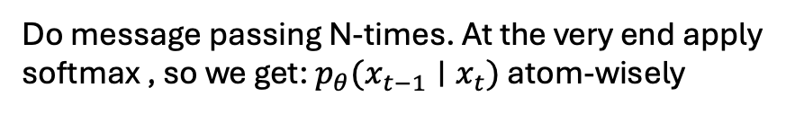



How I implemented this
The denoising part: $p_{θ}\left(x_{t−1} ∣ x_{t}\right)$
A GNN using a fully learnable message-passing scheme.
Edges → Bonds
$$\left[\begin{matrix}0 \\ 0 \\ 1\end{matrix}\right]$$
$$\left[\begin{matrix}0 \\ 0 \\ 1\end{matrix}\right]$$
$$\left[\begin{matrix}1 \\ 0 \\ 0\end{matrix}\right]$$
$$\left[\begin{matrix}0 \\ 0 \\ 1\end{matrix}\right]$$
softmax
$$\left[\begin{matrix}0 \\ 0 \\ 1\end{matrix}\right]$$
$$\left[\begin{matrix}1 \\ 0 \\ 0\end{matrix}\right]$$
softmax
$$\left[\begin{matrix}1 \\ 0 \\ 0\end{matrix}\right]$$
$$\left[\begin{matrix}0 \\ 1 \\ 0\end{matrix}\right]$$
$$\left[\begin{matrix}1 \\ 0 \\ 0\end{matrix}\right]$$
$$\left[\begin{matrix}0 \\ 1 \\ 0\end{matrix}\right]$$
Do message passing N-times. At the very end apply softmax , so we get: $p_{θ}(x_{t−1}∣x_{t})$ atom-wisely
Generate $x_{t−1}∼p_{θ}(x_{t−1}∣x_{t})$
Input graph: $x_{t}$

Slide 8
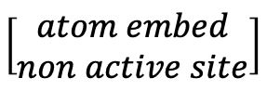
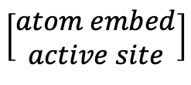
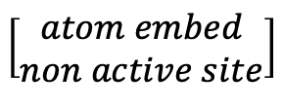
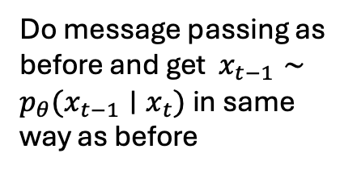
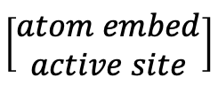
Few changes since last time
Changed the embeddings
Now atomic embedding + active and non active site embeddings
Both learnable
Message passing still the same
$$\left[\begin{matrix}atom embed \\ non active site\end{matrix}\right]$$
$$\left[\begin{matrix}atom embed \\ non active site\end{matrix}\right]$$
$$\left[\begin{matrix}1 \\ 0 \\ 0\end{matrix}\right]$$
$$\left[\begin{matrix}0 \\ 0 \\ 1\end{matrix}\right]$$
$$\left[\begin{matrix}1 \\ 0 \\ 0\end{matrix}\right]$$
$$\left[\begin{matrix}atom embed \\ active site\end{matrix}\right]$$
Do message passing as before and get $x_{t−1}∼p_{θ}(x_{t−1}∣x_{t})$ in same way as before
$$\left[\begin{matrix}1 \\ 0 \\ 0\end{matrix}\right]$$
$$\left[\begin{matrix}0 \\ 1 \\ 0\end{matrix}\right]$$
$$\left[\begin{matrix}atom embed \\ active site\end{matrix}\right]$$
Embed each atom via a learnable embedding and sites via active and non active site embedding
Input graph: $x_{t}$

Slide 9
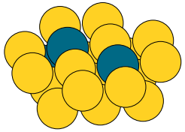
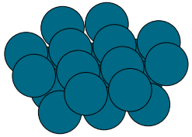
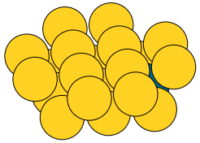
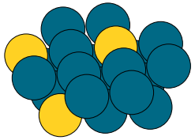
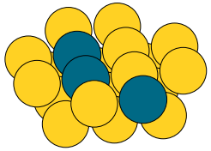
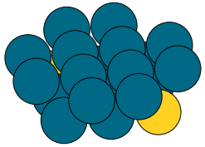

Testing my implementation
Trial dataset: 400 structures 50:50 split between 2 classes
Blue atoms: Pd, Yellow atoms: Au
Set categorical space: $\left[Au, Pd, Rh, Ni, Ga, Cu\right]$
Using Classifier free guidance: Drop probability: 10%
1000 timesteps
Tried both Uniform transitions & Absorbing state
Training set
Class 1
Class 2
Class 1
Class 2
Class 1
Class 2

Slide 10
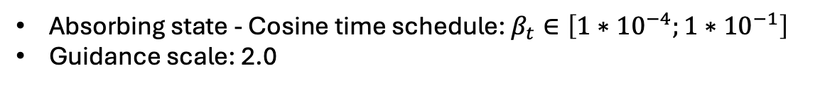
Testing my implementation
Absorbing state - Cosine time schedule: $β_{t}∈\left[1{∗10}^{−4};1{∗10}^{−1}\right]$
Guidance scale: 2.0
Conditioned on class 1
Conditioned on class 2

Slide 11

Testing my implementation
Uniform transitions - Cosine time schedule: $β_{t}∈\left[1{∗10}^{−4};2{∗10}^{−1}\right]$
Guidance scale: 2.0
Conditioned on class 1
Conditioned on class 2

Slide 12
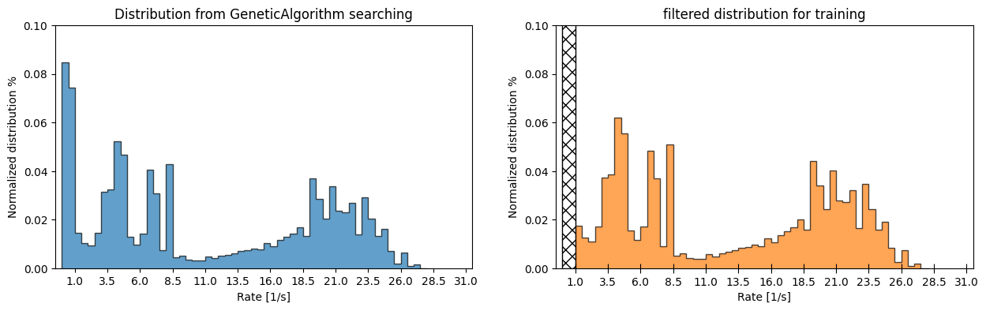

Tried conditioning on the reaction rate
Where im at now.
Tried class-divisions & samples from GeneticAlgorithm
Element pool: $\left[Au, Pd, Rh, Cu\right]$
Num. samples $∼5000$

Slide 13
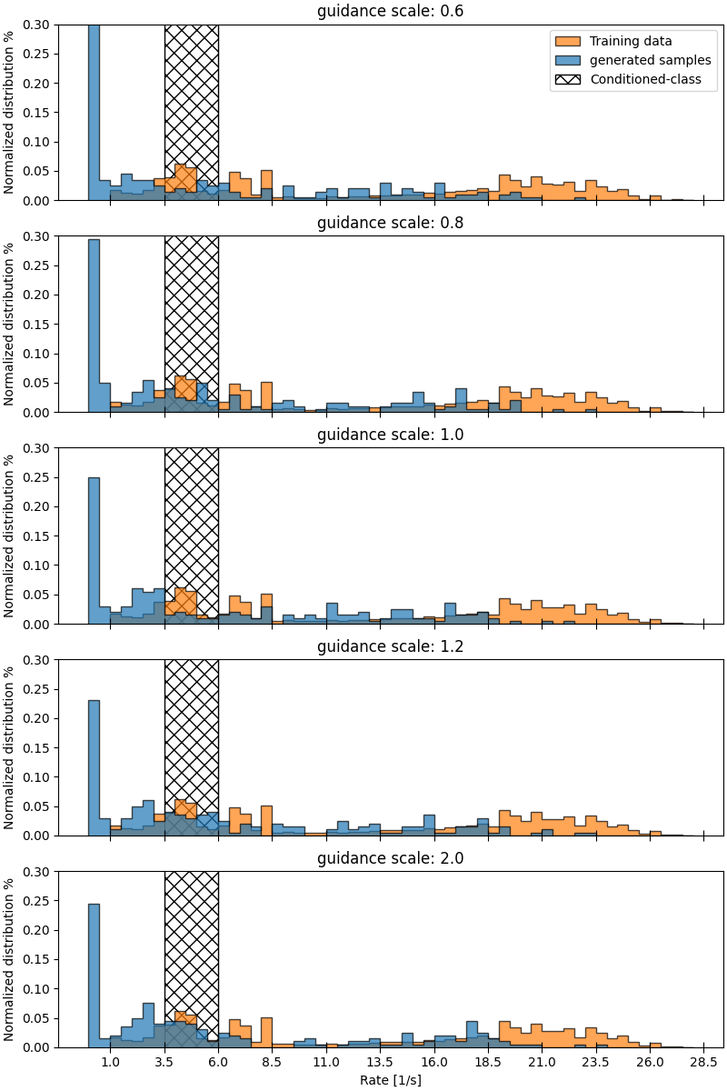
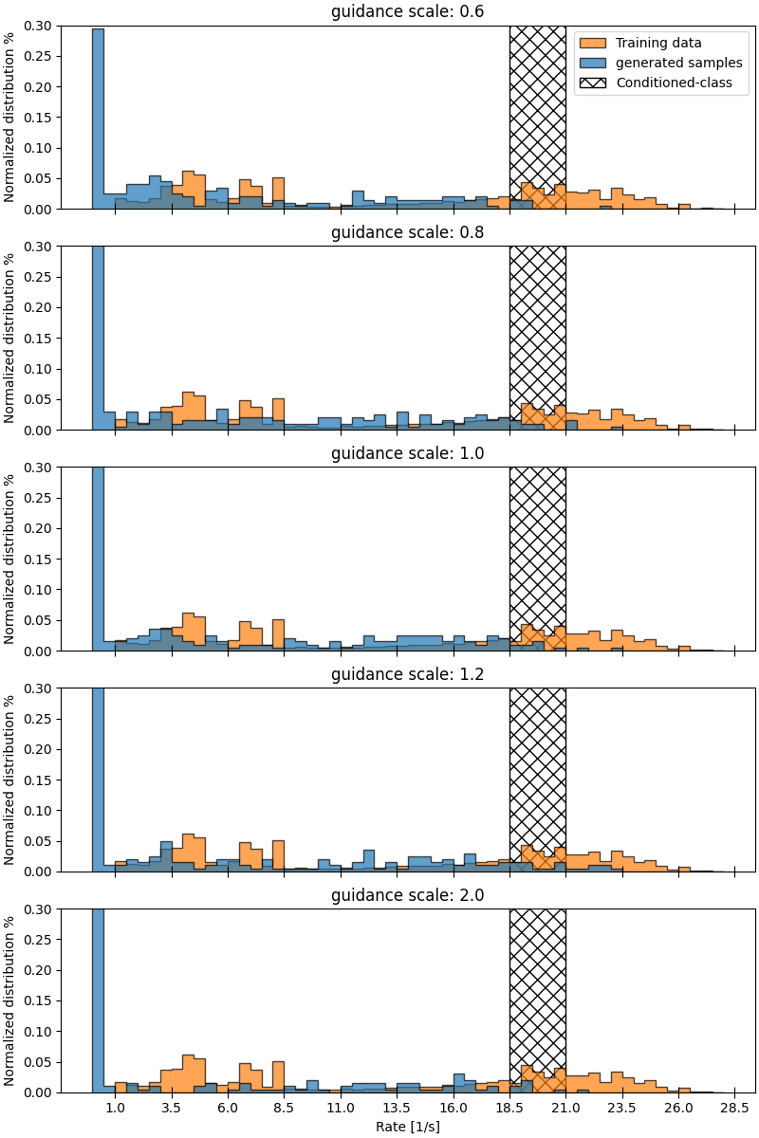

Slide 14
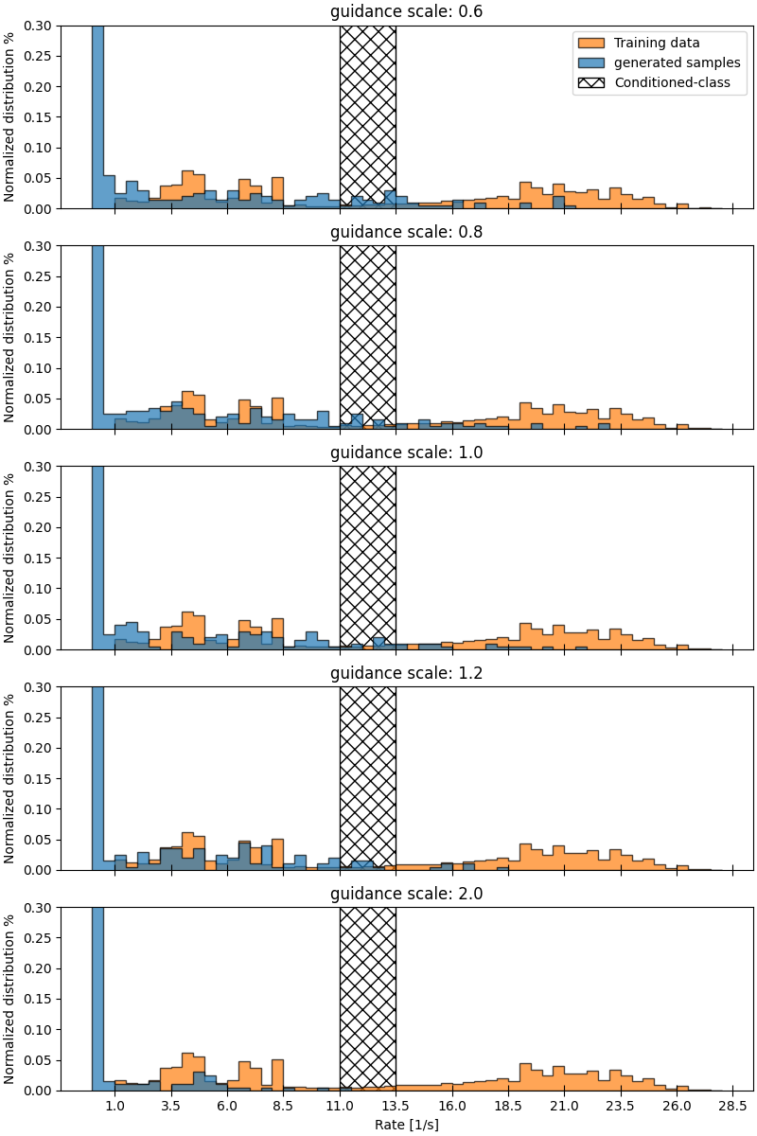
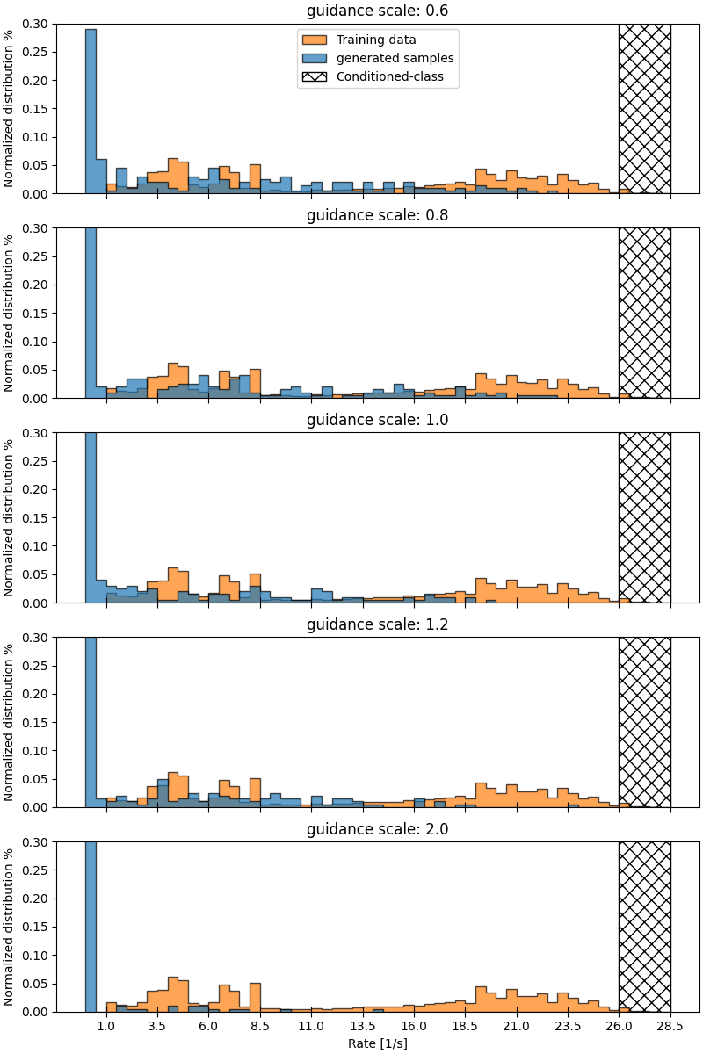

Slide 15
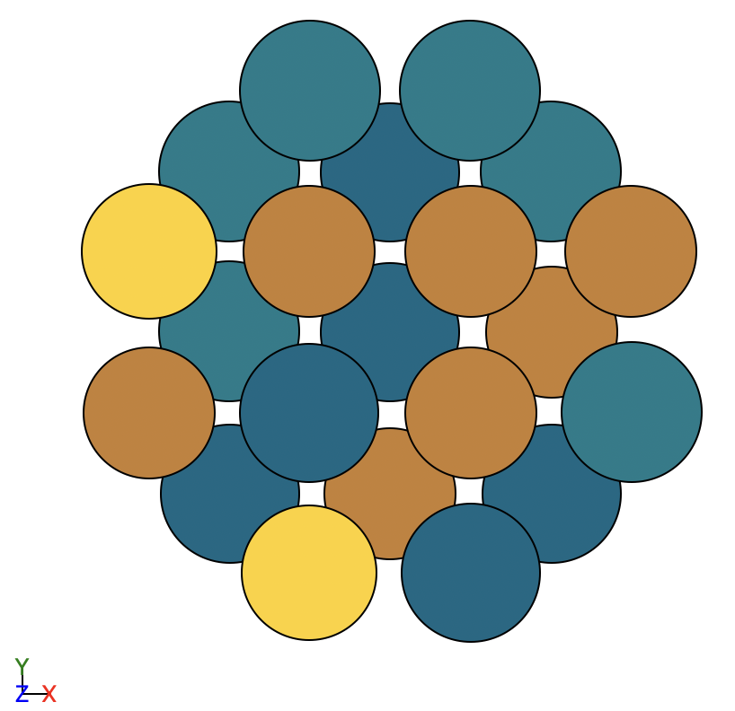
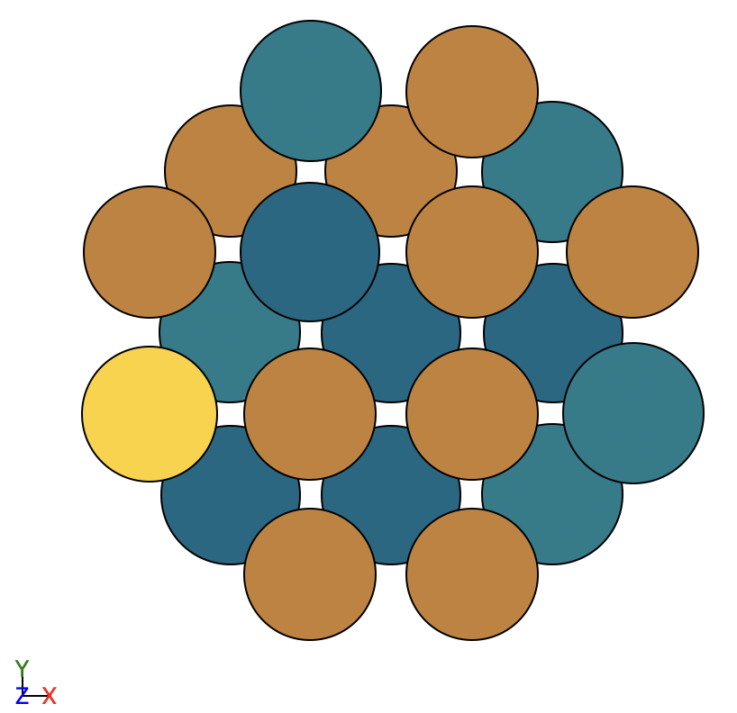
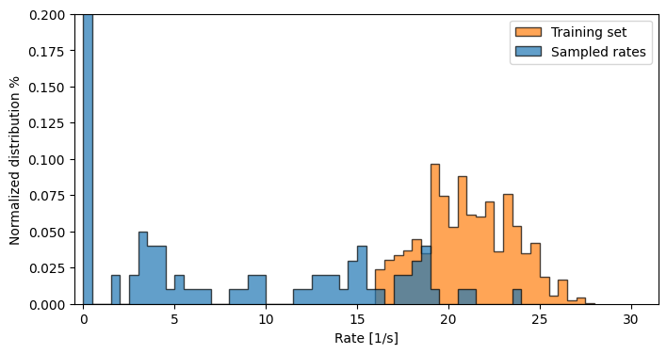
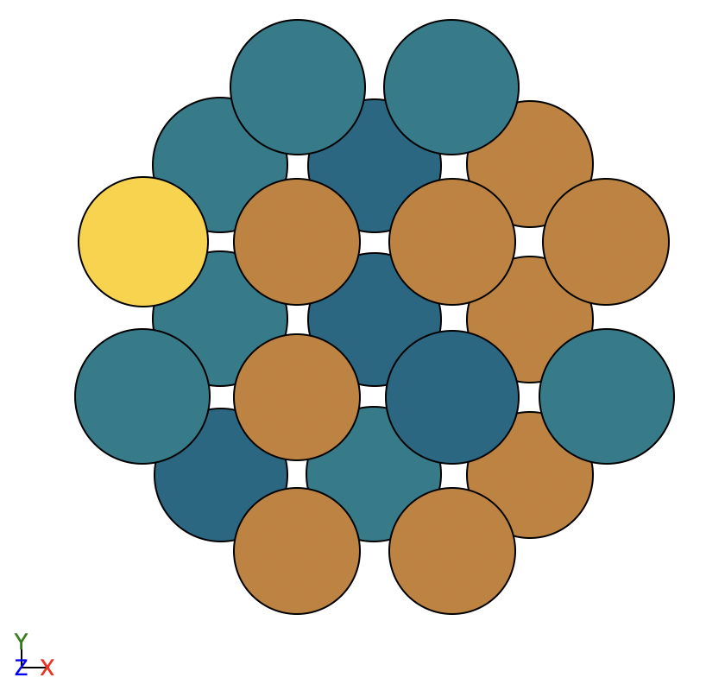
Unconditional generation on high rates only
Still not great
All samples have 3Cu + 1Pd on active sites, how many samples do i get with this configuration?

Slide 16
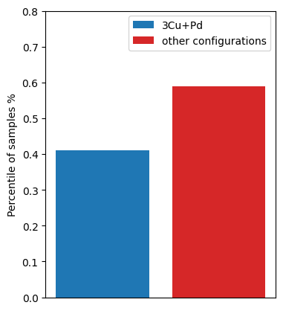




Unconditional generation on high rates only
If model cannot distinguish the environments we end up with average statistics.
$P\left(Atom=Cu\right)=0.75$, $P\left(Atom=Pd\right)=0.25$
Independently of site or prior configuration
$p_{3Cu+Pd}=4⋅{0.75}^{3}⋅0.25∼0.42$
$$≈$$
$$≈$$
$$≈$$

Slide 17






Unconditional generation on high rates only
But how can this happen? I was very confused
Thought messsage passing would allow prediction of ”missing sites”
It worked in my simple case but not here
sample
sample
$$x_{t}$$
$$x_{t−1}$$
$$x_{t}$$
$$x_{t−1}$$
sample
$$x_{t}$$
$$x_{t−1}$$

Slide 18
What is the problem?
Left me with 3 options:
GNN cannot resolve these environments even when noise is present?
Maybe the ”vanilla” D3PM implementation is not well suited?
We produce probabilites for all atoms at once and sample independently
Maybe a bug in the code somewhere

Slide 19






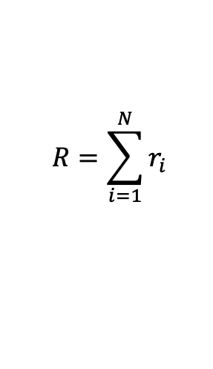

Identifying the problem
Started testing the GNN backbone seperately
Should be able to predict rates if it can distinguish
$$\left[\begin{matrix}atom embed \\ \end{matrix}\right]$$
$$\left[\begin{matrix}atom embed \\ \end{matrix}\right]$$
$$r_{i}=$$
MLP
$$\left[\begin{matrix}atom embed \\ \end{matrix}\right]$$
$$r_{i}=$$
MLP
$$R=\sum_{i=1}^{N}{r_{i}}$$
$$\left[\begin{matrix}atom embed \\ \end{matrix}\right]$$
Input graph: $x$
Do message passing and finally use MLP to predict rate of i’th atom
Sum the individual rates to get global rate

Slide 20
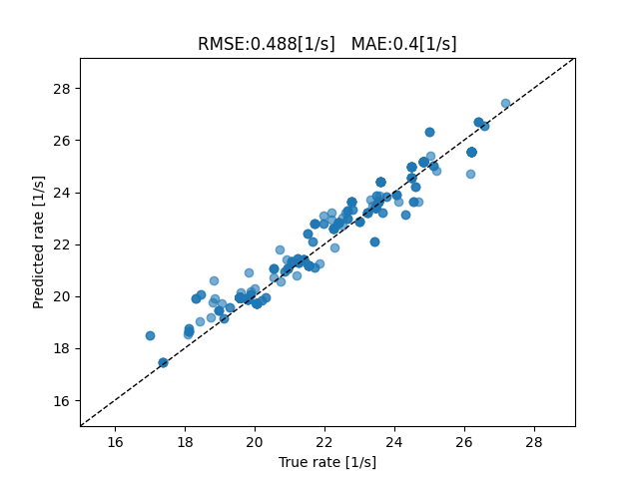
Identifying the problem
This works!

Slide 21
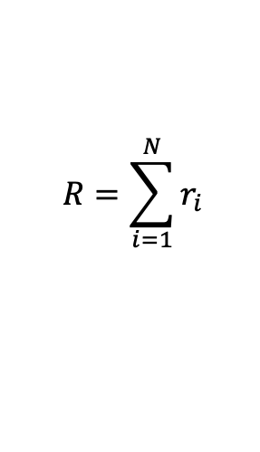
Identifying the problem
So it is possible to distinguish the structures using the GNN
Main difference here is the ”global pooling” at the end
Allows all atoms to ”attend” to property
What if I added similar thing to my diffusion model?
$$R=\sum_{i=1}^{N}{r_{i}}$$

Slide 22
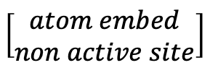


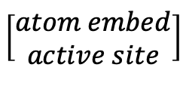
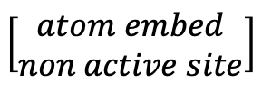
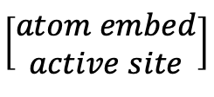
Identifying the problem
How I initially attempted the pooling.
Do message passing as before for $N$ iterations
Pool by mean:
$x_{glob}=\frac{1}{M}\sum_{i=1}^{M}{x_{i}}$
$$p_{θ}\left(x_{t−1} ∣ x_{t}\right)=MLP\left[\begin{matrix}x_{glob} \\ x_{i}\end{matrix}\right]$$
$$\left[\begin{matrix}atom embed \\ non active site\end{matrix}\right]$$
$$\left[\begin{matrix}atom embed \\ non active site\end{matrix}\right]$$
$$\left[\begin{matrix}atom embed \\ active site\end{matrix}\right]$$
$$\left[\begin{matrix}atom embed \\ active site\end{matrix}\right]$$
Do message passing N-times. At the very end apply softmax , so we get: $p_{θ}(x_{t−1}∣x_{t})$ atom-wisely
Generate $x_{t−1}∼p_{θ}(x_{t−1}∣x_{t})$
Input graph: $x_{t}$

Slide 23
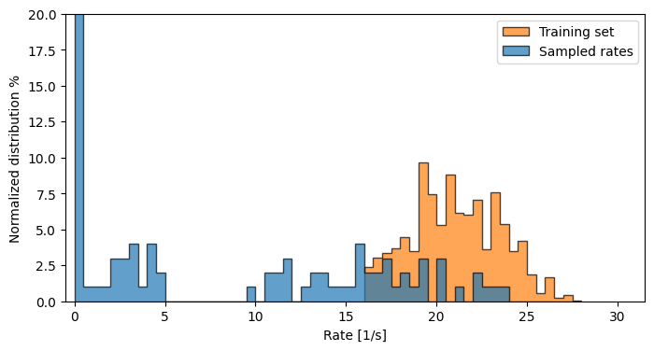


Did it help?
No pooling, as initially implemented
Yes! – Somewhat
Distributions are still slightly shifted?
Maybe ”Attention is all I need”
Almost spot on with % of elements in structures
Mean pooling
Attention based pooling

Slide 24




Did it help?
No pooling, as initially implemented
Yes! – Somewhat
Distributions are still slightly shifted?
Maybe ”Attention is all I need”
Mean pooling
Attention based pooling

Slide 25


What about conditioning?
Divided high rate samples into ”lower” and ”upper” part around mean
Lower half conditioning
Upper half conditioning

Slide 26
What are my thoughts now?
”If neighbor is Pd then I should be Cu needs to be stronger”
Best solution → Self attention + More geometrical information to distinguish sites.
I blur information in message passing?
Still think it is solvable, but maybe need to rethink GNN into a transformer instead?

