Slide 1
Diffusion models
Part 5

Slide 2
Outline
Brief summary
Detailed review of ”final model”
Quick note on diffusion process
What else have I been doing

Slide 3
Problem statement
Investigate RWGS: CO₂ + H₂ ⇌ CO + H₂O on metallic alloys
Example: 111-surface with only 4 active sites
Element pool of 3 yields 3.5billion conf.
Approximation: Ignore effect of stability/geometrical DOF’s.
Use generative models to help guide → Diffusion model
Swap elements
Reaction rate
Brown: site atoms
Yellow: neighbor atoms

Slide 4
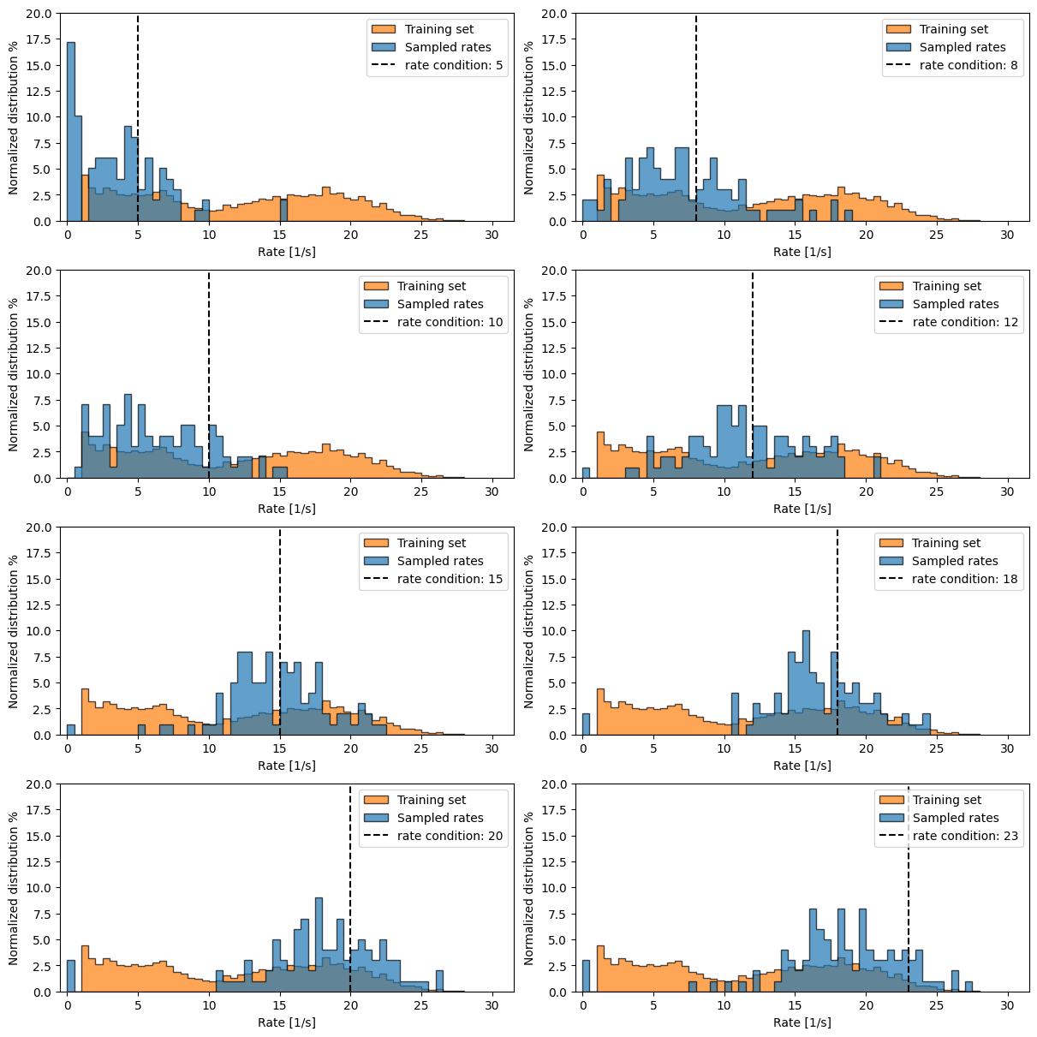
Brief summary
Showed finally working model
Temperature: 1.0

Slide 5
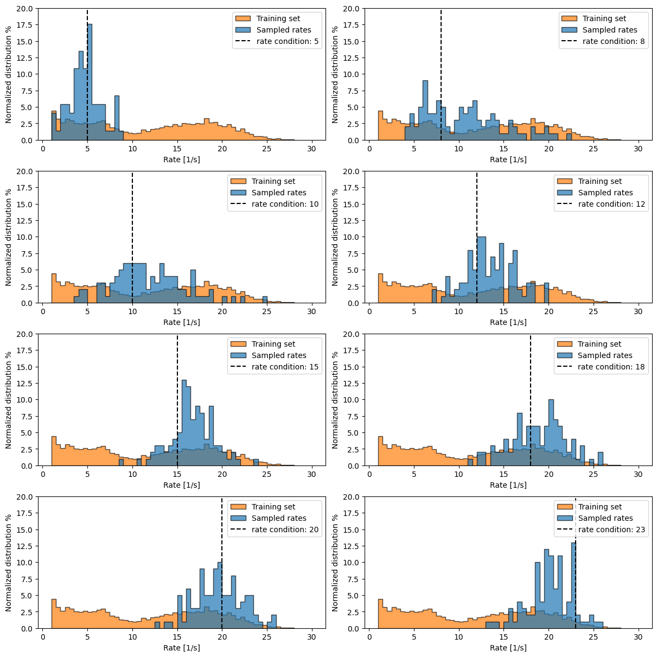
Brief summary
Temperature: 0.5

Slide 6
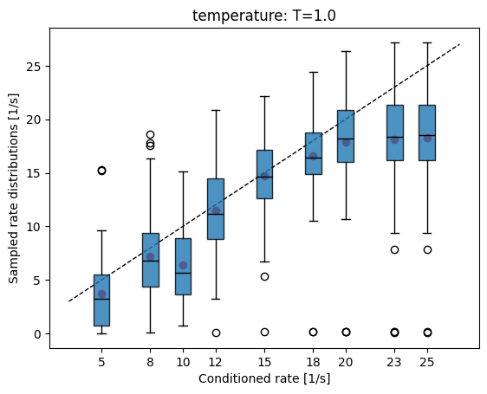
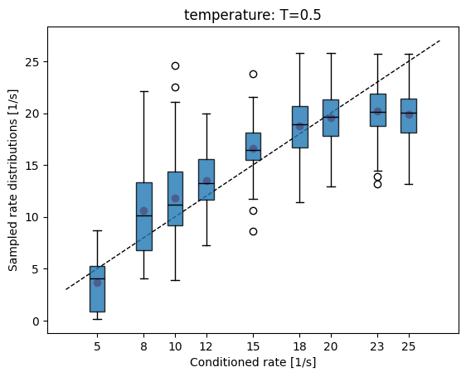
Brief summary
So it works!

Slide 7
Review of final model implementation
Embedding block
Interaction blocks
Global distance-aware interaction
Logit head

Slide 8
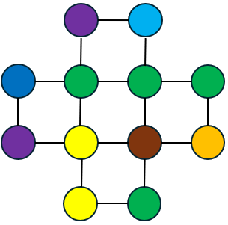
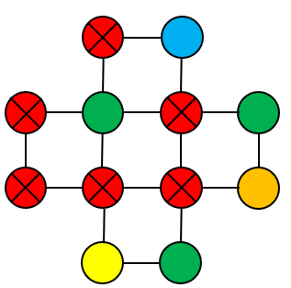



Embedding block
Information we want to embed: $G(x_{i},{\vec{r}}_{i},t,y)$
$x_{i}$ → Atomic species / token sitting at site $i$ at time $t$
${\vec{r}}_{ij}$ → Relative information about environment from fixed grid
$t$ → current timestep
$y$→ condition we would like walk towards
$t=0, y=(E_{f}=−0.8\left[eV\right], rate=8000\left[1/s\right])$
$t=\frac{2}{T}, y=(E_{f}=−0.8\left[eV\right], rate=8000\left[1/s\right])$
$$(x_{i},{\vec{r}}_{i})$$
$${(x}_{i},{\vec{r}}_{i})$$

Slide 9


Embedding block
$x_{i}$ → Learnable vector for each species
$$G(x_{i},{\vec{r}}_{i},t,y)$$
Emb. Element species

Slide 10


Embedding block
$s_{i}$ → Learnable vector for site state
Active or not Active
Share same embedding
Green → active site Yellow → Not active
Emb. site type active/non active
$$s_{i}$$
$$G(x_{i},{\vec{r}}_{i},t,y)$$
Emb. Element species

Slide 11




Embedding block
Green → active site Yellow → Not active
Emb. distances to active sites
$$d_{i}$$
Emb. site type active/non active
$$s_{i}$$
$$d_{ij}$$
$$d_{i}=SORT\left(\left[d_{i1},d_{i2},…\right]\right)$$
$$\tilde{d_{i}}=MLP(d_{i})$$
$$G(x_{i},{\vec{r}}_{i},t,y)$$
Sort to keep permutation invariance
Emb. Element species

Slide 12





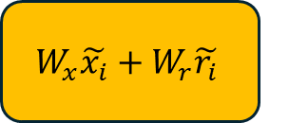

Embedding block
Emb. distance to active sites
$$d_{i}$$
$$\tilde{d_{i}}$$
$$\tilde{d_{i}}||\tilde{s_{i}}$$
$$\tilde{r_{i}}$$
Emb. site type active/non active
$$s_{i}$$
$$\tilde{s_{i}}$$
$$W_{x}\tilde{x_{i}}+W_{r}\tilde{r_{i}}$$
$$\tilde{v_{i}}$$
$$G(x_{i},{\vec{r}}_{i},t,y)$$
Emb. Element species
$$\tilde{x_{i}}$$

Slide 13
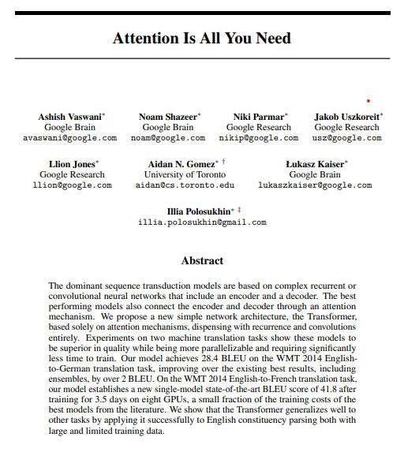
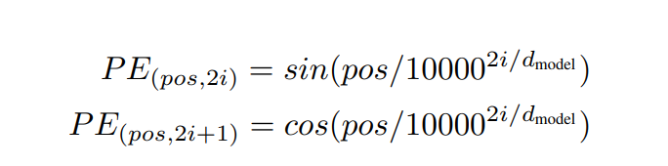










Embedding block
Emb. distance to active sites
$$d_{i}$$
$$\tilde{d_{i}}$$
$$\tilde{d_{i}}||\tilde{s_{i}}$$
$$\tilde{r_{i}}$$
Emb. site type active/non active
$$s_{i}$$
$$\tilde{s_{i}}$$
$$W_{x}\tilde{x_{i}}+W_{r}\tilde{r_{i}}$$
$$\tilde{v_{i}}$$
$$G(x_{i},{\vec{r}}_{i},t,y)$$
Emb. Element species
$$\tilde{x_{i}}$$
Comes from paper → Primarily used as ”positional encoder” between words in sequence
Sinusoidal embedding

Slide 14
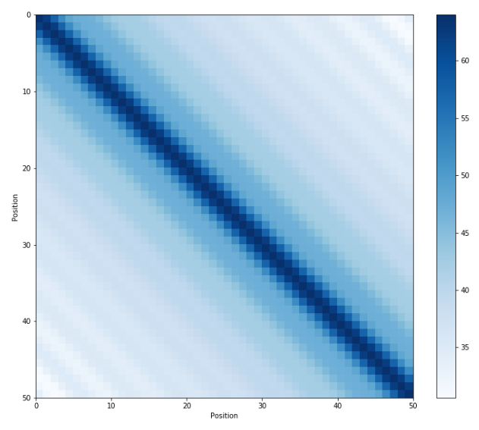








Embedding block
Properties:
All entries: [-1;1]
Positions far from eachother have zero overlap → Dissimilar
”Well suited for discrete time diffusion” – ChatGPT
Nicolai also uses
Emb. distance to active sites
$$d_{i}$$
$$\tilde{d_{i}}$$
$$\tilde{d_{i}}||\tilde{s_{i}}$$
$$\tilde{r_{i}}$$
Emb. site type active/non active
$$s_{i}$$
$$\tilde{s_{i}}$$
$$W_{x}\tilde{x_{i}}+W_{r}\tilde{r_{i}}$$
$$\tilde{v_{i}}$$
$$G(x_{i},{\vec{r}}_{i},t,y)$$
Emb. Element species
$$\tilde{x_{i}}$$
Sinusoidal embedding
MLP
$$\tilde{t}$$
$$\tilde{y}$$

Slide 15









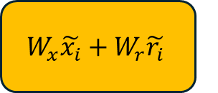


Embedding block
Embedding block
Emb. distance to active sites
$$d_{i}$$
$$\tilde{d_{i}}$$
$$\tilde{d_{i}}||\tilde{s_{i}}$$
$$\tilde{r_{i}}$$
Emb. site type active/non active
$$s_{i}$$
$$\tilde{s_{i}}$$
$$W_{x}\tilde{x_{i}}+W_{r}\tilde{r_{i}}$$
$$\tilde{v_{i}}$$
$$G(x_{i},{\vec{r}}_{i},t,y)$$
Emb. Element species
$$\tilde{x_{i}}$$
Sinusoidal embedding
MLP
$$\tilde{t}$$
$$\tilde{y}$$

Slide 16





Next up: Interaction block
$${\tilde{v_{i}}}^{0}$$
$$MLP\left(\tilde{v_{i}}\right||\tilde{v_{j}})$$
$$m_{ij}$$
$$\tilde{y}$$
$$\tilde{t}$$

Slide 17
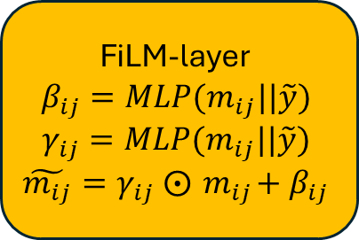
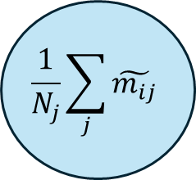


Interaction block
FiLM-layer $$β_{ij}=MLP(m_{ij}||\tilde{y})$$
$$γ_{ij}=MLP(m_{ij}||\tilde{y})$$
$$\tilde{m_{ij}}=γ_{ij} ⨀{ m}_{ij}+β_{ij}$$
$$MLP\left(\tilde{v_{i}}\right||\tilde{v_{j}})$$
$$\frac{1}{N_{j}}\sum_{j}{\tilde{m_{ij}}}$$
$${\tilde{v_{i}}}^{0}$$
$$m_{ij}$$
$$\tilde{m_{ij}}$$
$$\tilde{y}$$
$$\tilde{m_{i}}$$
$$\tilde{t}$$

Slide 18
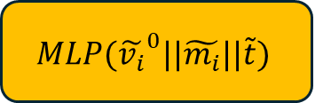
Interaction block
FiLM-layer $$β_{ij}=MLP(m_{ij}||\tilde{y})$$
$$γ_{ij}=MLP(m_{ij}||\tilde{y})$$
$$\tilde{m_{ij}}=γ_{ij} ⨀{ m}_{ij}+β_{ij}$$
$$MLP\left(\tilde{v_{i}}\right||\tilde{v_{j}})$$
$$\frac{1}{N_{j}}\sum_{j}{\tilde{m_{ij}}}$$
$${\tilde{v_{i}}}^{0}$$
$$m_{ij}$$
$$\tilde{m_{ij}}$$
$$\tilde{y}$$
$$\tilde{m_{i}}$$
$$MLP({\tilde{v_{i}}}^{0}||\tilde{m_{i}}||\tilde{t})$$
$$\tilde{t}$$

Slide 19
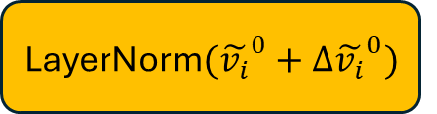


Interaction block
FiLM-layer $$β_{ij}=MLP(m_{ij}||\tilde{y})$$
$$γ_{ij}=MLP(m_{ij}||\tilde{y})$$
$$\tilde{m_{ij}}=γ_{ij} ⨀{ m}_{ij}+β_{ij}$$
$$MLP\left(\tilde{v_{i}}\right||\tilde{v_{j}})$$
$$\frac{1}{N_{j}}\sum_{j}{\tilde{m_{ij}}}$$
$${\tilde{v_{i}}}^{0}$$
$$m_{ij}$$
$$\tilde{m_{ij}}$$
$$\tilde{y}$$
$$\tilde{m_{i}}$$
$$MLP({\tilde{v_{i}}}^{0}||\tilde{m_{i}}||\tilde{t})$$
LayerNorm$({\tilde{v_{i}}}^{0}+Δ{\tilde{v_{i}}}^{0})$
$$Δ{\tilde{v_{i}}}^{0}$$
$${\tilde{v_{i}}}^{1}$$
$$\tilde{t}$$

Slide 20


Interaction block
FiLM-layer $$β_{ij}=MLP(m_{ij}||\tilde{y})$$
$$γ_{ij}=MLP(m_{ij}||\tilde{y})$$
$$\tilde{m_{ij}}=γ_{ij} ⨀{ m}_{ij}+β_{ij}$$
$$MLP\left(\tilde{v_{i}}\right||\tilde{v_{j}})$$
$$\frac{1}{N_{j}}\sum_{j}{\tilde{m_{ij}}}$$
$${\tilde{v_{i}}}^{0}$$
$$m_{ij}$$
$$\tilde{m_{ij}}$$
$$\tilde{y}$$
$$\tilde{m_{i}}$$
$$MLP({\tilde{v_{i}}}^{0}||\tilde{m_{i}}||\tilde{t})$$
LayerNorm$({\tilde{v_{i}}}^{0}+Δ{\tilde{v_{i}}}^{0})$
$$Δ{\tilde{v_{i}}}^{0}$$
$${\tilde{v_{i}}}^{1}$$
$$\tilde{t}$$
$$\tilde{y}$$
$$\tilde{t}$$

Slide 21



Interaction block
Interaction block
FiLM-layer $$β_{ij}=MLP(m_{ij}||\tilde{y})$$
$$γ_{ij}=MLP(m_{ij}||\tilde{y})$$
$$\tilde{m_{ij}}=γ_{ij} ⨀{ m}_{ij}+β_{ij}$$
$$MLP\left(\tilde{v_{i}}\right||\tilde{v_{j}})$$
$$\frac{1}{N_{j}}\sum_{j}{\tilde{m_{ij}}}$$
$${\tilde{v_{i}}}^{0}$$
$$m_{ij}$$
$$\tilde{m_{ij}}$$
$$\tilde{y}$$
$$\tilde{m_{i}}$$
$$MLP({\tilde{v_{i}}}^{0}||\tilde{m_{i}}||\tilde{t})$$
LayerNorm$({\tilde{v_{i}}}^{0}+Δ{\tilde{v_{i}}}^{0})$
$$Δ{\tilde{v_{i}}}^{0}$$
$${\tilde{v_{i}}}^{1}$$
$$\tilde{t}$$
$$\tilde{y}$$
$$\tilde{t}$$

Slide 22






Next: Global distance aware interaction
$${\vec{r}}_{i}$$
$${Q\tilde{v_{i}}}^{t}$$
Dot product
$$s_{ij}$$
$${\tilde{v_{i}}}^{t}$$
$${K\tilde{v_{j}}}^{t}$$
$${V\tilde{v_{j}}}^{t}$$

Slide 23
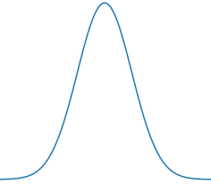



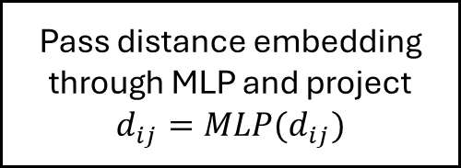

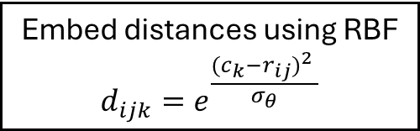
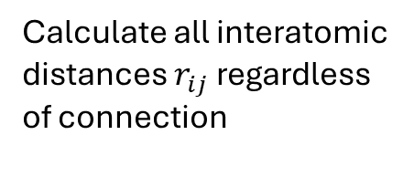



Global distance aware interaction
$$r_{ij}$$
$$r_{i}$$
Calculate all interatomic distances $r_{ij}$ regardless of connection
$$r_{ij}$$
$$r_{ij}$$
Emb. all interatomic distances
$${\vec{r}}_{i}$$
$$d_{ij}$$
$${Q\tilde{v_{i}}}^{t}$$
Embed distances using RBF $${d_{ijk}=e}^{\frac{{{(c}_{k}−r_{ij})}^{2} }{σ_{θ}}}$$
Dot product
$$s_{ij}$$
$$0$$
$$c_{k}$$
$${\tilde{v_{i}}}^{t}$$
$${K\tilde{v_{j}}}^{t}$$
$${V\tilde{v_{j}}}^{t}$$
Pass distance embedding through MLP and project $$d_{ij}=MLP(d_{ij})$$

Slide 24




Global distance aware interaction
Global distance aware interaction
Emb. all interatomic distances
$${\vec{r}}_{i}$$
$$d_{ij}$$
$${Softmax(d}_{ij}+s_{ij})$$
$$w_{ij}$$
$${Q\tilde{v_{i}}}^{t}$$
Dot product
$$s_{ij}$$
$${\tilde{v_{i}}}^{t}$$
$${K\tilde{v_{j}}}^{t}$$
$$\sum_{j}{w_{ij}}{V\tilde{v_{j}}}^{t}$$
$${V\tilde{v_{j}}}^{t}$$
$$\tilde{h_{i}}$$

Slide 25





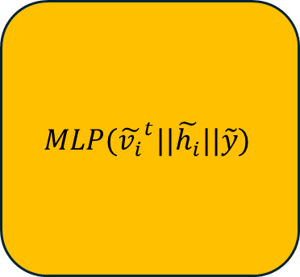

Finally: Logit head
$$MLP({\tilde{v_{i}}}^{t}||\tilde{h_{i}}||\tilde{y})$$
$${\tilde{v_{i}}}^{t}$$
$$\tilde{h_{i}}$$
$$\log{p_{i}(x_{0}|x_{t},y)}$$
$$Softmax(\log{p_{i}\left(x_{0} | x_{t},y\right)})$$
$$p_{i}\left(x_{0} | x_{t},y\right)$$
$$\tilde{y}$$

Slide 26
Review of final model implementation
Embedding block
Interaction blocks
Global distance-aware interaction
This is what seems to having solved all issues
Logit head

Slide 27
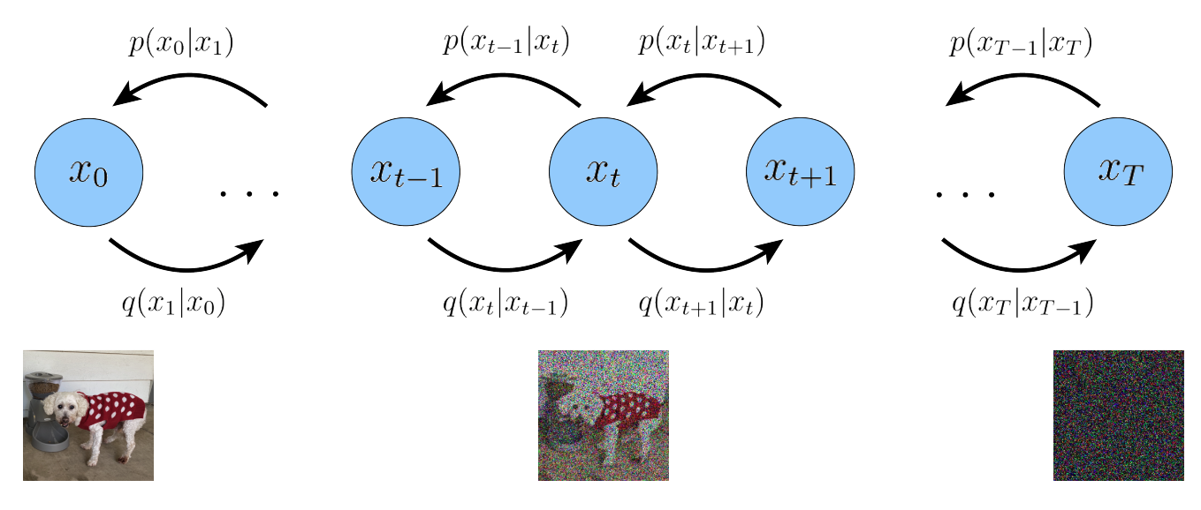

Quick note on diffusion models
Final output of GNN is producing $p_{i}\left(x_{0} | x_{t},y\right)$
Distribution is over: $t=0$, and not $t−1$ for each node
Diffusion process below is maybe a bit misleading
Reverse process is constrained by noising process

Slide 28




Quick note on diffusion process
In practice forward noising process is designed:
$$q\left(x_{t} | x_{t−1}\right)$$
Such that at $T$ we end at simple distribution:
$q\left(x_{T} | x_{T−1}\right)=q\left(x_{T}\right)$
$$x_{t−1}$$
$$x_{t}$$
$$q\left(x_{t} | x_{t−1}\right)$$

Slide 29
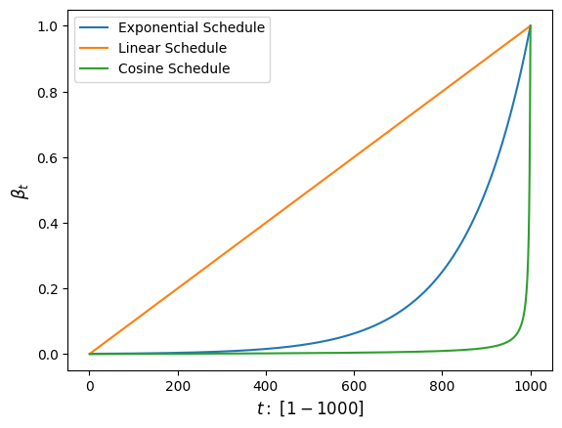
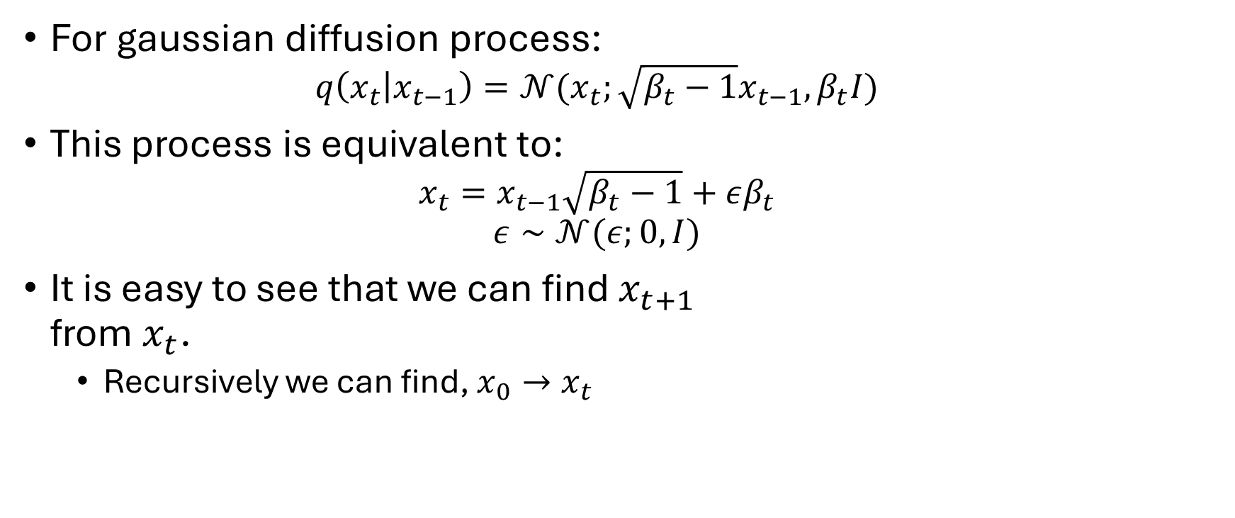
Quick note on diffusion process
For gaussian diffusion process:
$$q\left(x_{t} | x_{t−1}\right)=𝒩(x_{t};\sqrt{β_{t}−1}x_{t−1},β_{t}I)$$
This process is equivalent to:
$$x_{t}=x_{t−1}\sqrt{β_{t}−1}+εβ_{t}$$
$$ε∼𝒩(ε;0,I)$$
It is easy to see that we can find $x_{t+1}$ from $x_{t}$.
Recursively we can find, $x_{0}→x_{t}$

Slide 30










Quick note on diffusion process
This is just an implicit statement of ”Markov property” and gives:
We can ”jump” anywhere
$$x_{0}$$
$$x_{t−1}$$
$$x_{t}$$
$$…$$
$$q\left(x_{t} | x_{t−1}\right)$$
$$q\left(x_{t−1} | x_{0}\right)$$
$$q\left(x_{t} | x_{0}\right)$$

Slide 31
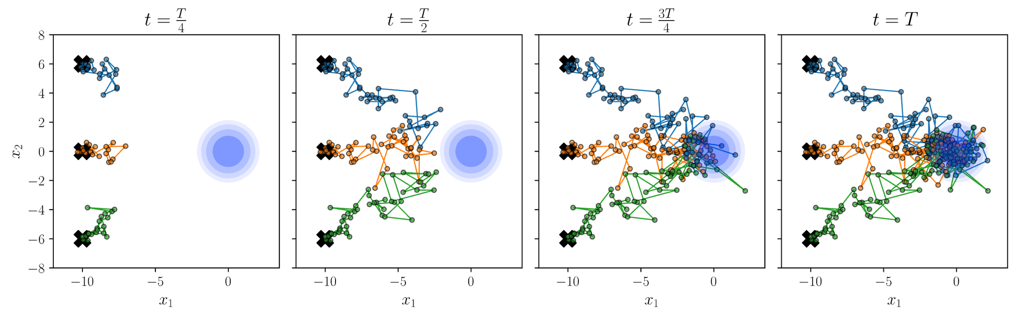

Quick note on diffusion process
Simulating sampling from $q\left(x_{t} | x_{0}\right)$ in 2D

Slide 32










Quick note on diffusion process
Here is the trick: Bayes’ theorem
$$q\left(x_{t} | x_{t−1},x_{0}\right)=q\left(x_{t} | x_{t−1} \right)$$
$$q\left(x_{t−1} | x_{t},x_{0}\right)$$
$$x_{0}$$
$$x_{t−1}$$
$$x_{t}$$
$$…$$
$$q\left(x_{t} | x_{t−1}\right)$$
$$q\left(x_{t−1} | x_{0}\right)$$
$$q\left(x_{t} | x_{0}\right)$$

Slide 33
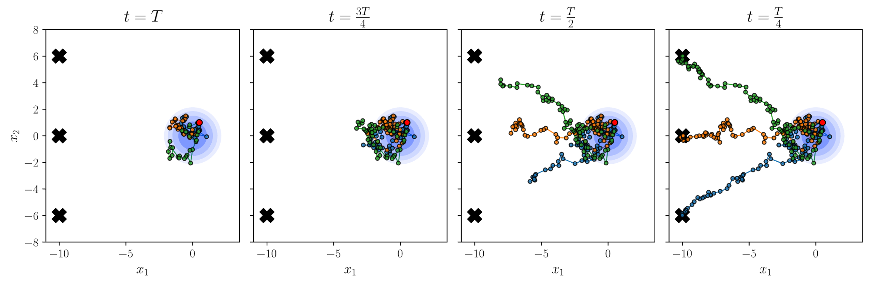

Quick note on diffusion process
Simulating sampling from $q\left(x_{t−1} | x_{t},x_{0}\right)$ in 2D
However this is not what we want, we will always end at $x_{0}$
We do not know $x_{0}$ when sampling

Slide 34
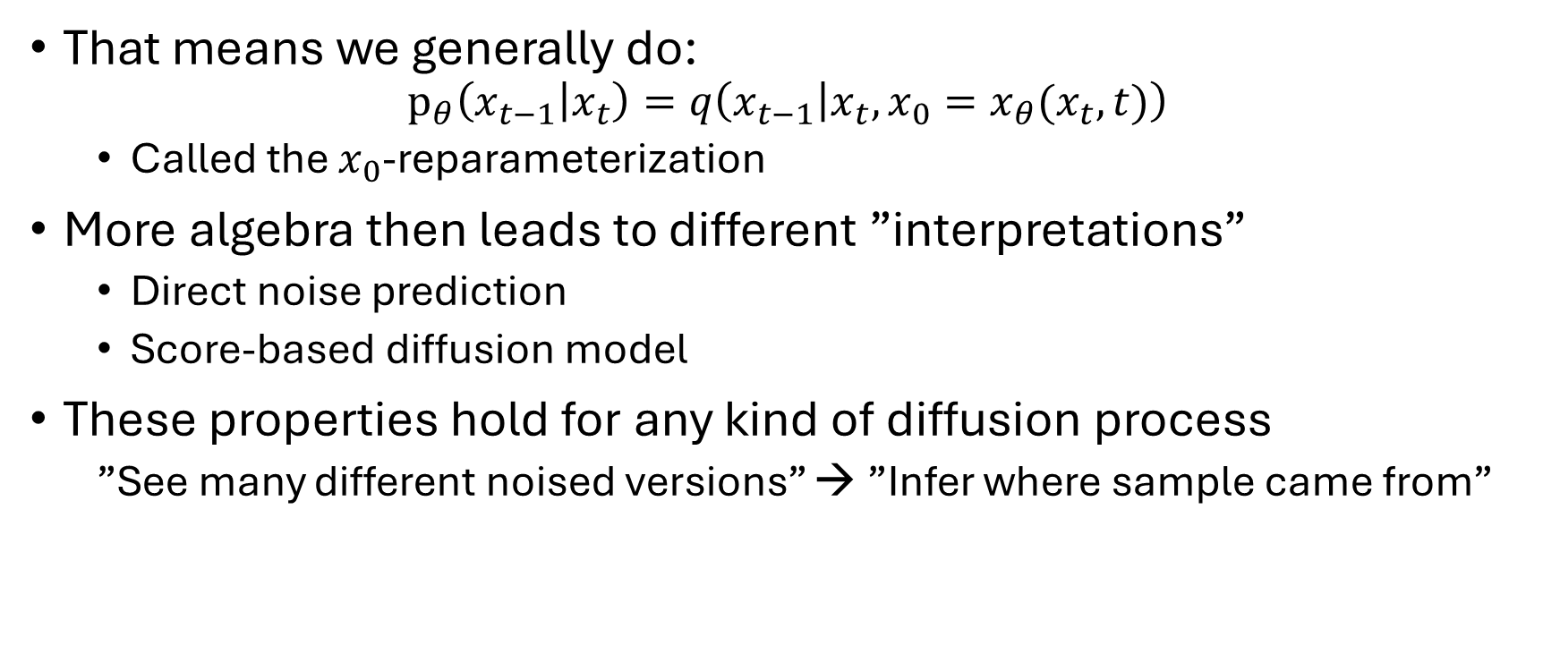
Quick note on diffusion process
That means we generally do: $p_{θ}\left(x_{t−1} | x_{t}\right)=q\left(x_{t−1} | x_{t},x_{0}=x_{θ}(x_{t},t)\right)$
Called the $x_{0}$-reparameterization
More algebra then leads to different ”interpretations”
Direct noise prediction
Score-based diffusion model
These properties hold for any kind of diffusion process
”See many different noised versions” → ”Infer where sample came from”

Slide 35



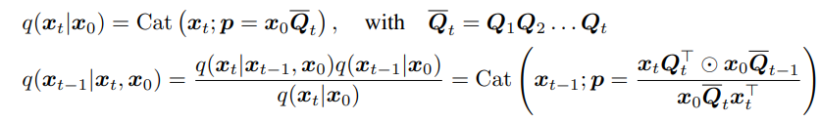

Quick diffusion process note
No different for discrete diffusion process
$x_{t}$ single token/species at time t in sequence
And from this definition we get:

Slide 36
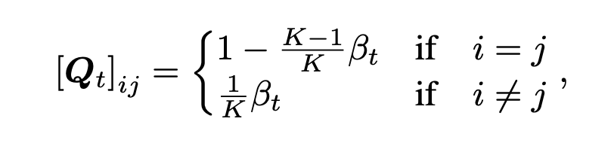
Discrete space diffusion
Quick reminder of Q-matrices
Q-matrices govern the transfer between different categories
Element pool: [”Rh”, ”Pd”, ”Ni”, ”Au”] → 4 categories
Example: ”Rh” coloumn/row becomes: [0.40, 0.20, 0.20, 0.20]
0.40
Rh
0.20
Pd
0.20
0.20
Ni
Au

Slide 37
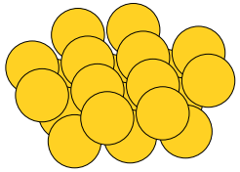
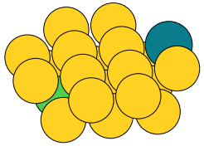
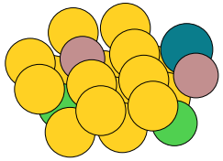
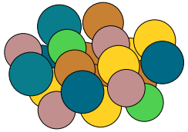
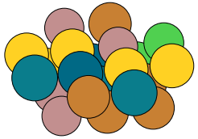
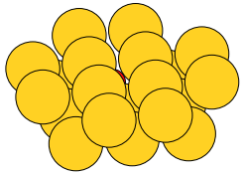













Discrete space diffusion examples
Used Exponential schedule with $β_{t}∈\left[1{⋅10}^{−4},1{⋅10}^{−1}\right]$
Uniform diffusion; $x_{t}∼q(x_{t}|x_{t−1})$
$$t=\frac{T}{4}$$
$$t=\frac{T}{2}$$
$$t=\frac{3T}{4}$$
$$t=T$$
$$t=0$$
Absorbing diffusion; $x_{t}∼q(x_{t}|x_{t−1})$
$$t=\frac{T}{4}$$
$$t=\frac{T}{2}$$
$$t=\frac{3T}{4}$$
$$t=T$$
$$t=0$$

Slide 38


Quick diffusion process note
No different for discrete diffusion process
$x_{t}$ single token/species at time t in sequence
And from this definition we get:
And the $x_{0}$-reparameterization ”sum over all possible versions of $x_{0}$”

Slide 39
What else have I been doing
Implemented stability as condition aswell
Went from only considering nearest neighbors to whole surface
Same task just more elements

Slide 40



Stability estimation
To estimate stability we first apply inversion symmetry
Take invert through inversion center
Top-view of plane
Apply symmetry

Slide 41

Stability estimation
Workflow
Select elements of slab
Apply inversion
Do variable cell relaxation with MLIP
Get estimate for $E_{f}$

Slide 42


Workflow for stability
Choose composition
Apply inversion
Do variable cell relaxation

Slide 43


Very preliminary results
["Rh", "Pt", "Pd", "Co", "Cu", "Zn", "Au", "Ag", 'Fe', 'Os', 'Mo', 'Ir', 'Ru', "Ni"]
1000 structures with random search
Broad element pool of 14 elements
rate & $E_{f}$
CHGNet used for relaxation
$f_{max}=0.05[\frac{eV}{Å}]$
Cross = condition
Only 20 samples per condition

