Slide 1
Finding/Designing highly active catalysts with genAI

Slide 2
Outline
Problem introduction
Motivation
Detailed description
Some preliminary results
What I think is next

Slide 3
Problem introduction
Investigate RWGS: CO₂ + H₂ ⇌ CO + H₂O on metallic alloys
Example: 111-surface with only 4 active sites
Element pool of 3 yields 3.5billion conf.
Approximation: Ignore effect of stability/geometrical DOF’s.
Use genAI tools
Swap elements
Reaction rate
Brown: site atoms
Yellow: neighbor atoms

Slide 4
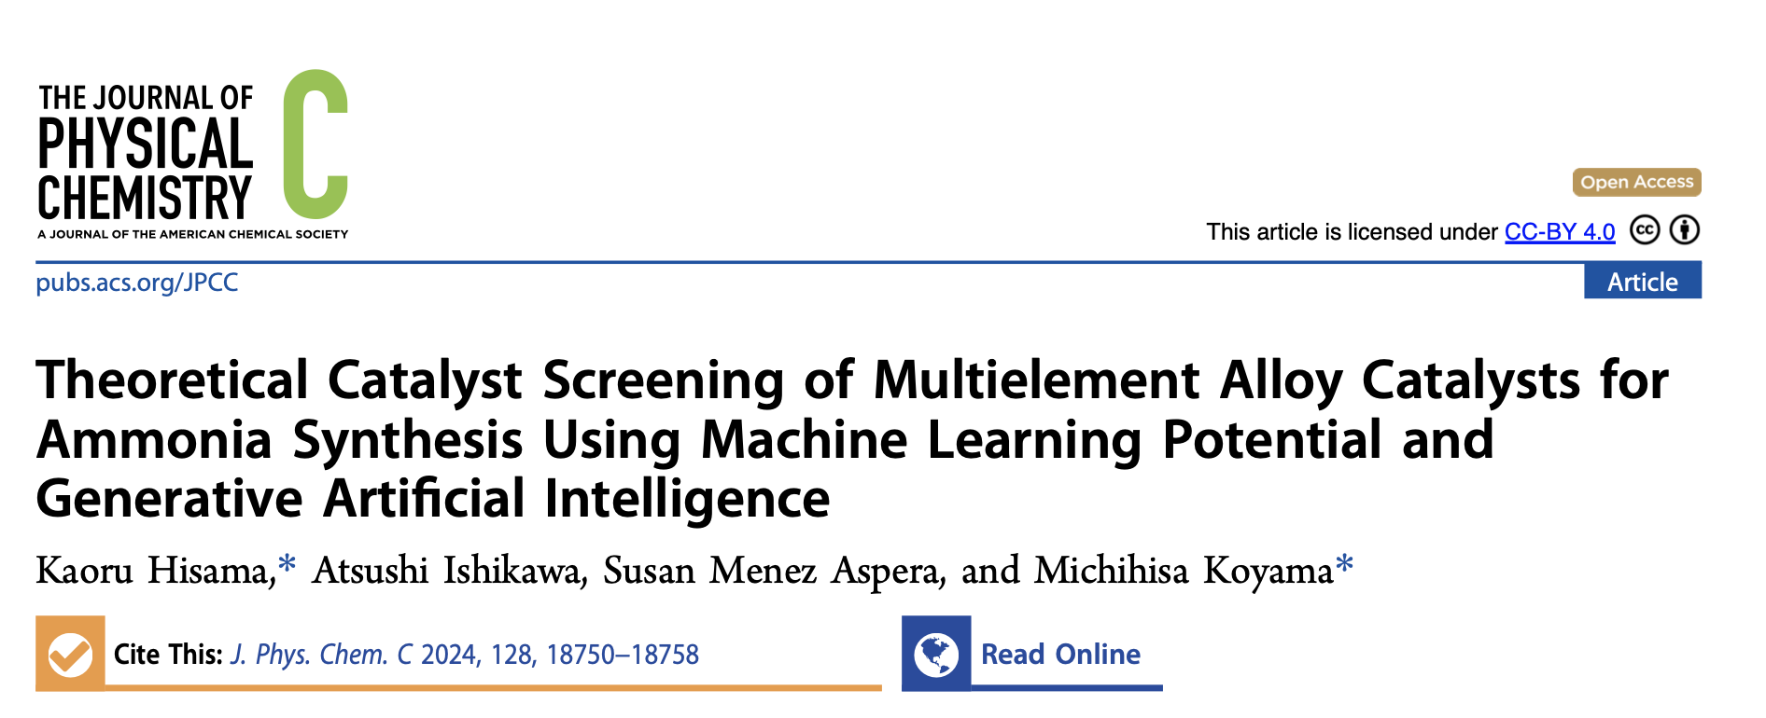
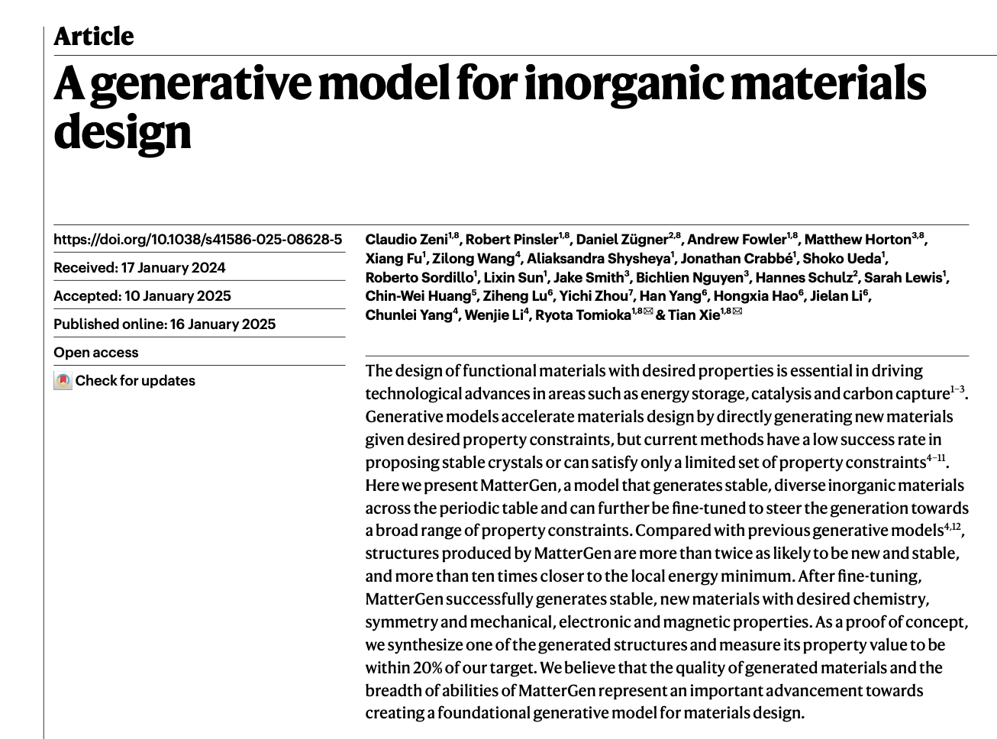
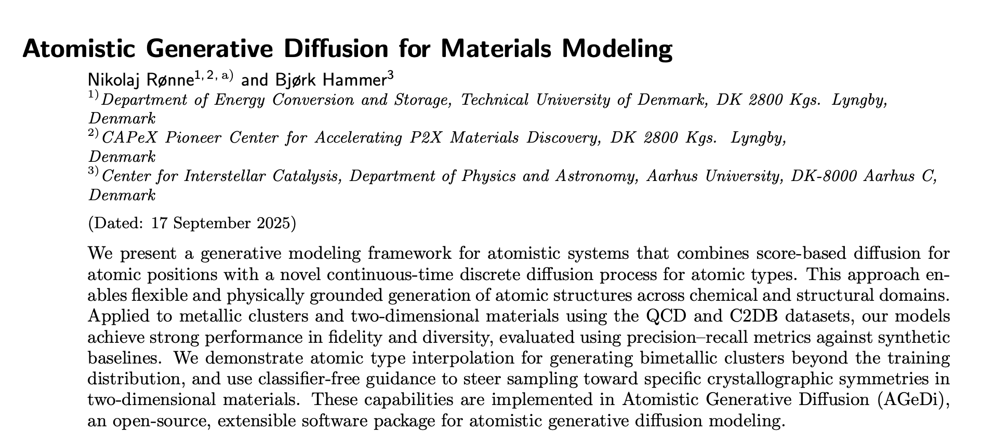
Motivation

Slide 5
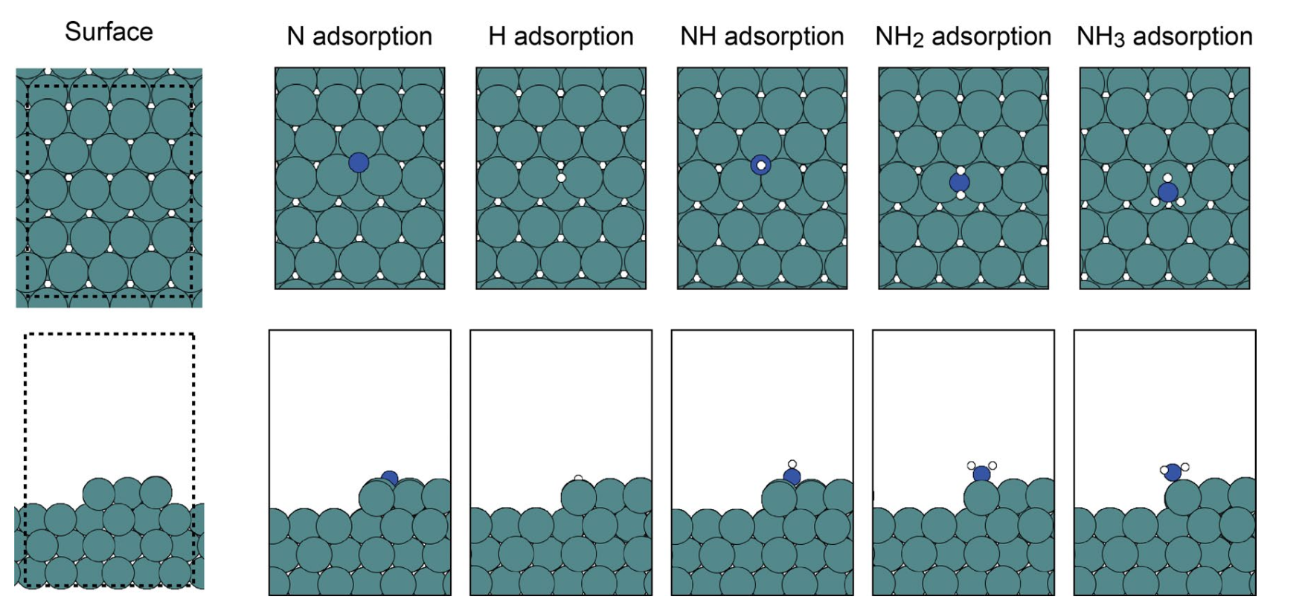
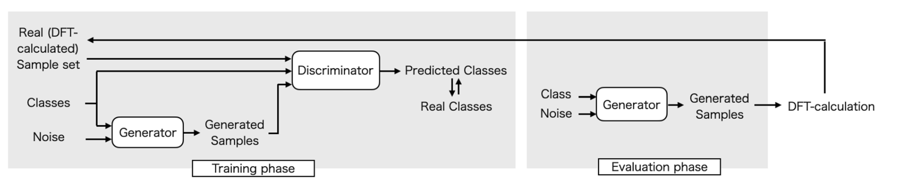
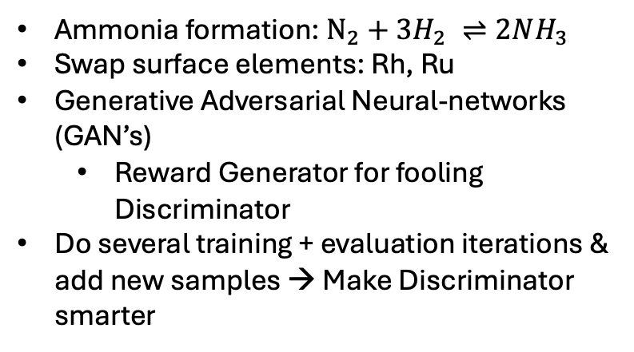
Motivation
Ammonia formation: $N_{2}+{3H}_{2} ⇌2NH_{3}$
Swap surface elements: Rh, Ru
Generative Adversarial Neural-networks (GAN’s)
Reward Generator for fooling Discriminator
Do several training + evaluation iterations & add new samples → Make Discriminator smarter

Slide 6
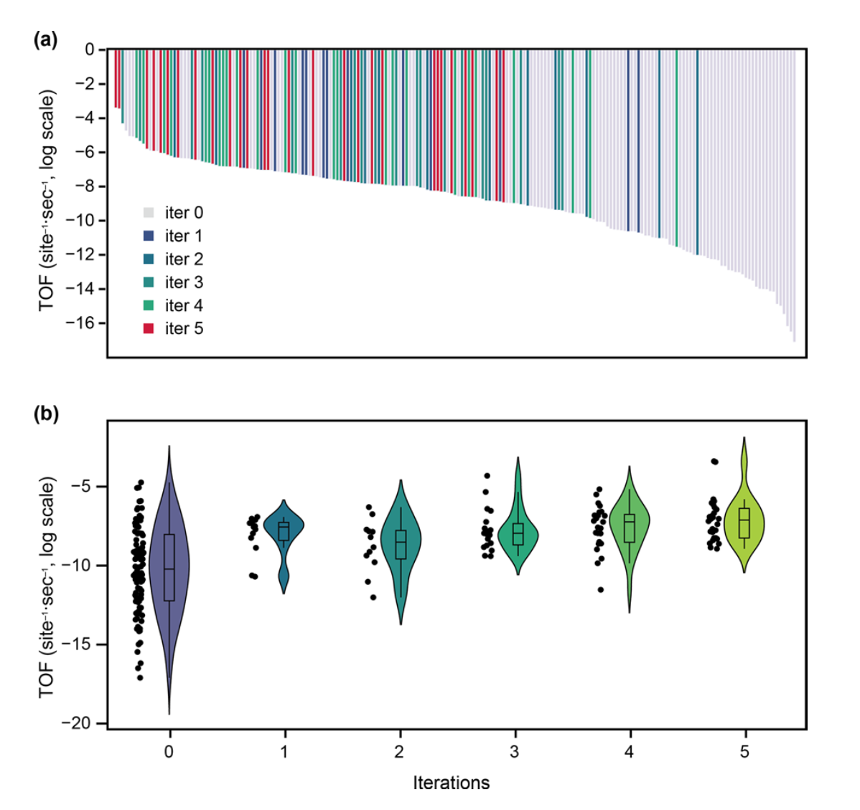
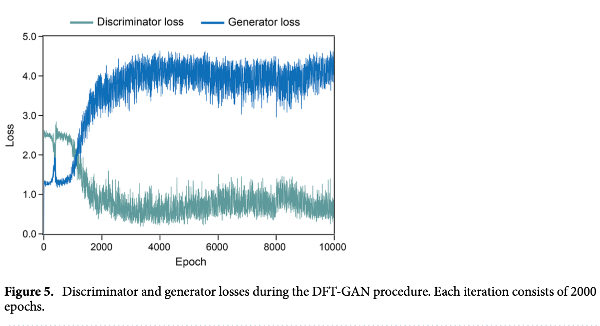
Motivation

Slide 7
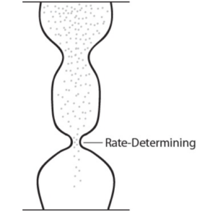
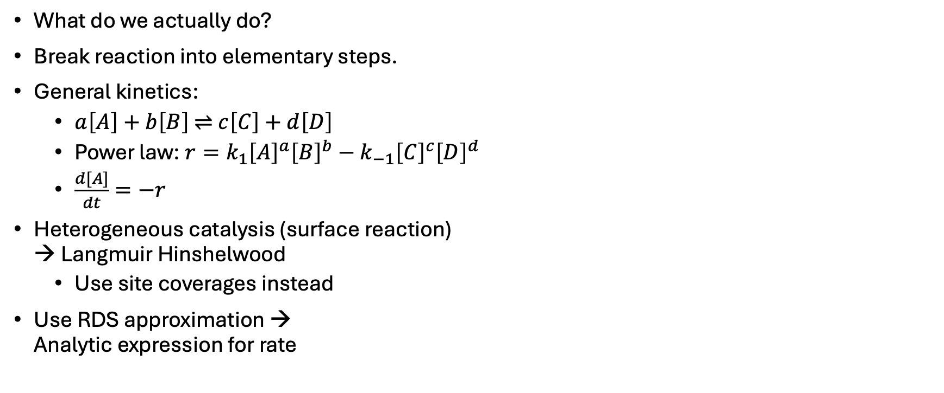
Detailed description
CO₂ + H₂ ⇌ CO + H₂O
Turn into elementary steps
Adsorptions
(1) H₂ + 2 * ↔ H* + H*
(2) CO₂ + * ↔ CO₂*
(3) H₂O + * ↔ H₂O*
(4) CO + * ↔ CO*
CO-O path and H₂O formation
(5) CO₂* + * ↔ CO* + O* (RDS)
(6) H₂O* + * ↔ OH* + H*
(7) OH* + * ↔ O* + H*
What do we actually do?
Break reaction into elementary steps.
General kinetics:
$a\left[A\right]+b\left[B\right] \text{⇌} c\left[C\right]+d\left[D\right]$
Power law:$r=k_{1}{\left[A\right]}^{a}{\left[B\right]}^{b}−k_{−1}{\left[C\right]}^{c}{\left[D\right]}^{d}$
$\frac{d[A]}{dt}=−r$
Heterogeneous catalysis (surface reaction) → Langmuir Hinshelwood
Use site coverages instead
Use RDS approximation → Analytic expression for rate
Find rate using Langmuir-Hinshelwood
Reaction rate R

Slide 8
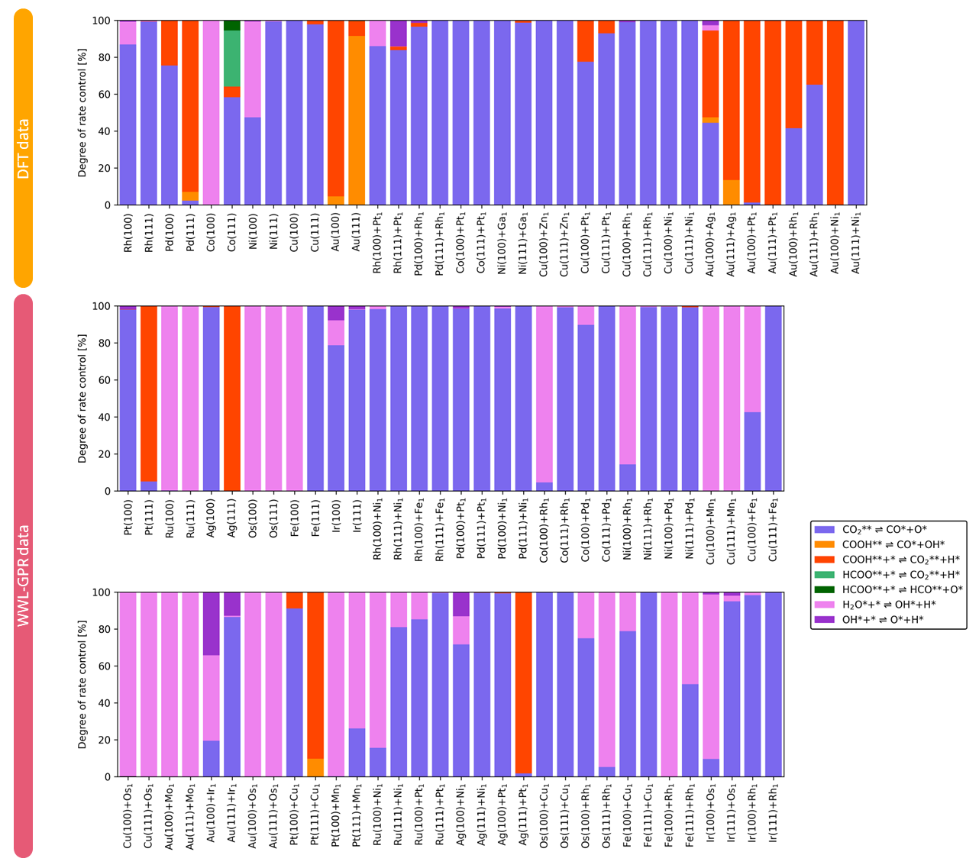
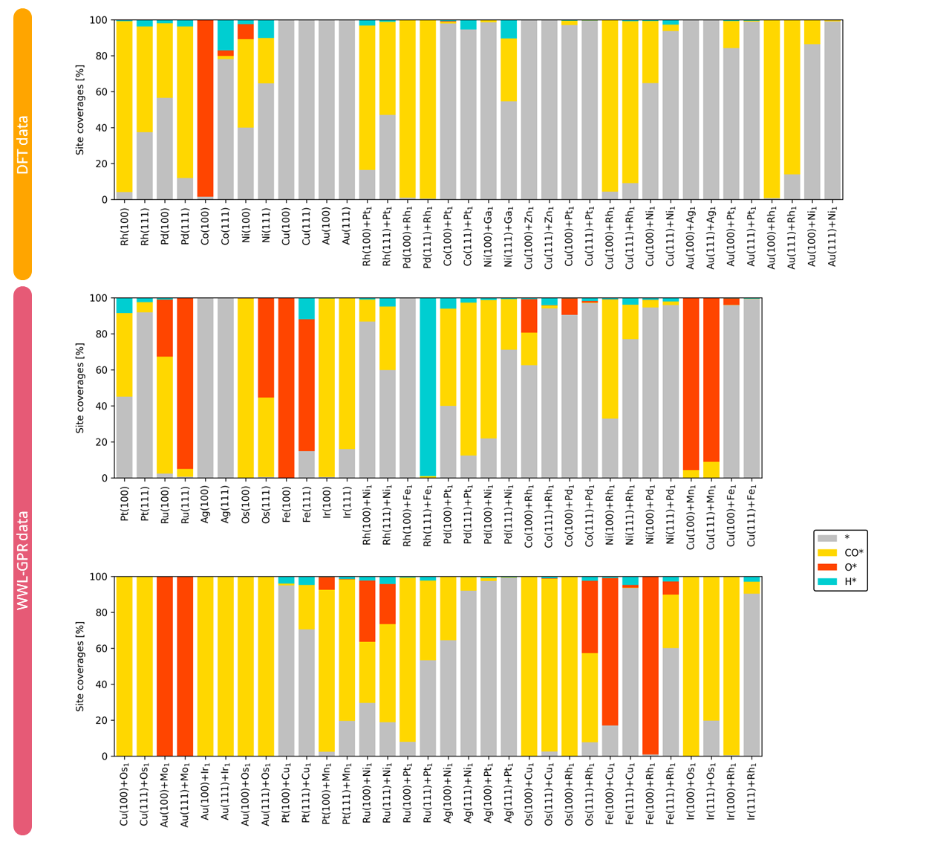
RWGS on metals and single-atom alloys – Why elementary step 5?
CO₂* dissociation RDS for most materials
Most abundant reaction intermediates: CO*, O*, H*
Notes:
Could we use another color for CO to not confuse it with the carboxyl path?
- I made it dark blue

Slide 9
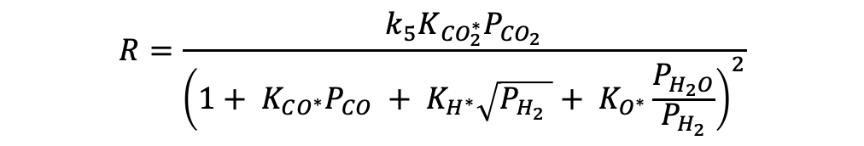

Detailed description
CO₂ + H₂ ⇌ CO + H₂O
Turn into elementary steps
Use RDS approximation → Step 5.
Solve for global rate:
Boils down to finding $E_{f}$ & $E_{act}$
Adsorptions
(1) H₂ + 2 * ↔ H* + H*
(2) CO₂ + * ↔ CO₂*
(3) H₂O + * ↔ H₂O*
(4) CO + * ↔ CO*
CO-O path and H₂O formation
(5) CO₂* + * ↔ CO* + O* (RDS)
(6) H₂O* + * ↔ OH* + H*
(7) OH* + * ↔ O* + H*
$$R=\frac{k_{5}K_{{CO}_{2}^{∗}}P_{{CO}_{2}}}{{\left(1+ K_{CO^{∗}}P_{CO} + K_{H^{∗}}\sqrt{P_{H_{2}} }+ K_{O^{∗}}\frac{P_{H_{2}O}}{P_{H_{2}}}\right)}^{2}}$$
Find rate using Langmuir-Hinshelwood
Reaction rate R

Slide 10
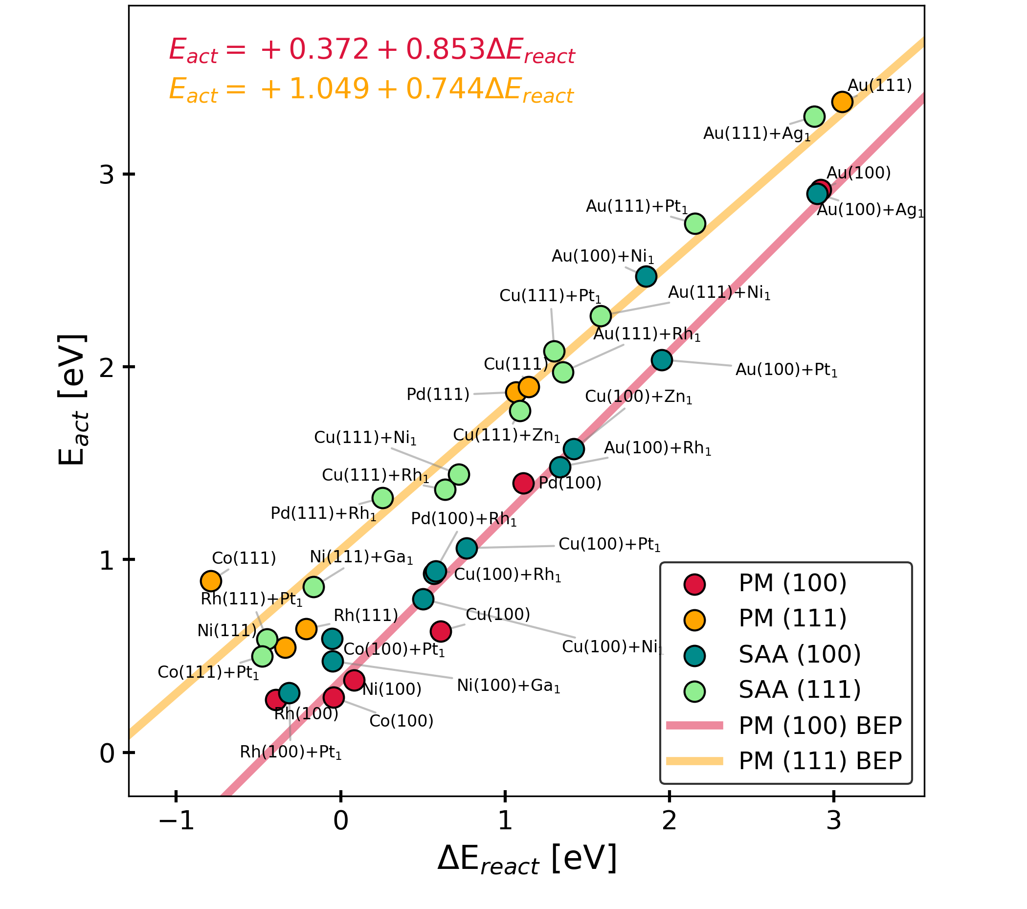

Detailed description
WWL-GPR model or GCNN → $E_{f}$
GPR + Wasserstein-Weissfehler-lehmann kernel
Bell-Evans-Polyani (BEP) scaling relations
$E_{act}=E_{0}+αΔH$
$ΔH=E_{f}^{final}−E_{f}^{init}$

Slide 11
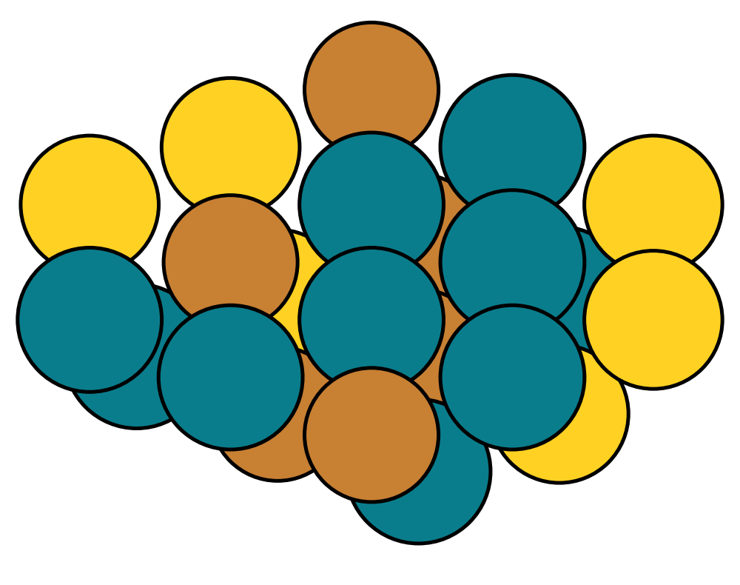
Detailed description - How do we do this in practice?
DFT energies (obtained with slab models)
Cluster model including site atoms and their neighbors
DFT DB (RWGS on SAAs)
WWL-GPR graph model
Surface composition
Python function
Adsorption energies
Reaction rate
From rate equation or microkinetic modeling
Adsorption modes DB
All adsorbate configurations involving site atoms
Brown: site atoms
Yellow: neighbor atoms
Notes:
Could we use another color for CO to not confuse it with the carboxyl path?
- I made it dark blue

Slide 12
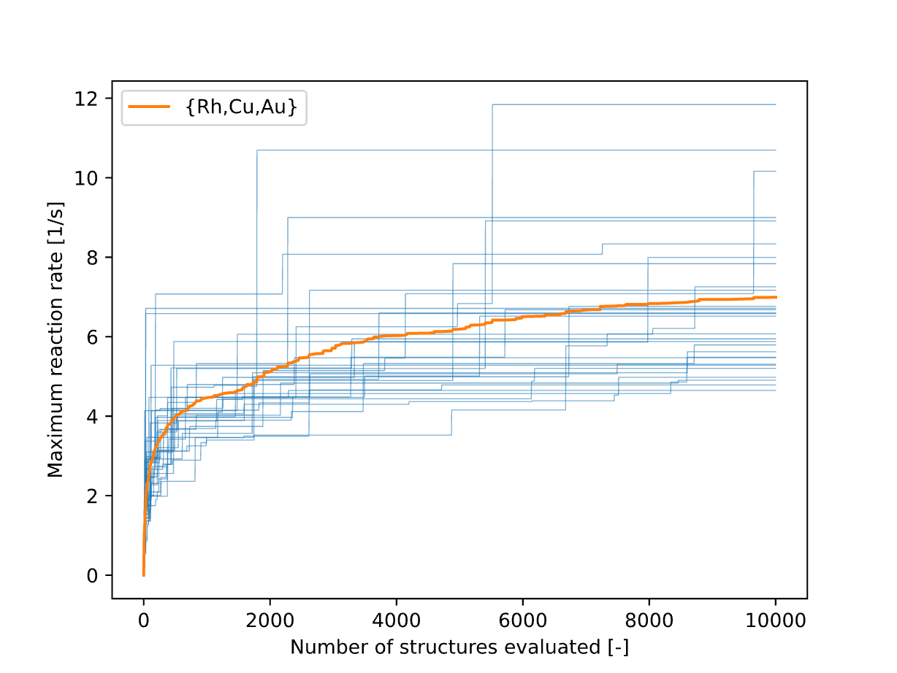
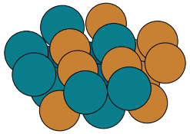
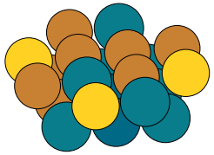
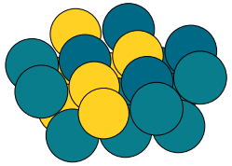
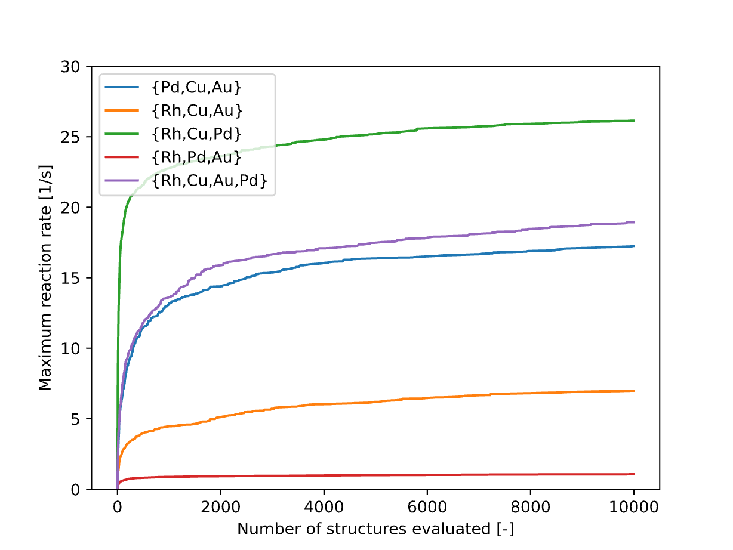
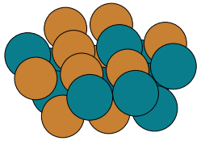
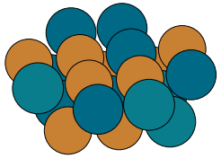
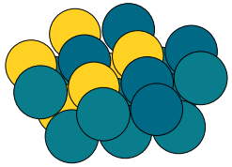
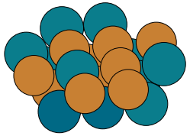
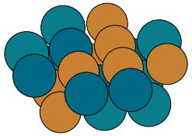
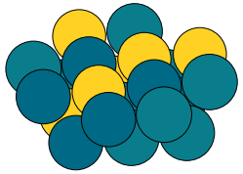









Preliminary results – Random search
{Rh,Cu,Pd}
{Rh,Cu,Au,Pd}
{Rh,Pd,Au}
$$R=\text{34.4}\text{2 [1/}\text{s}\text{]}$$
$$R=\text{25.5}\text{9[1/}\text{s}\text{]}$$
$$R=\text{1.4}\text{1[1/}\text{s}\text{]}$$
$$R=\text{34.}\text{33 [1/}\text{s}\text{]}$$
$$R=\text{23.5}\text{9[1/}\text{s}\text{]}$$
$$R=\text{1.38}\text{[1/}\text{s}\text{]}$$
$$R=\text{3}\text{0}\text{.}\text{39 [1/}\text{s}\text{]}$$
$$R=\text{23.4}\text{9[1/}\text{s}\text{]}$$
$$R=\text{1.34}\text{[1/}\text{s}\text{]}$$

Slide 13
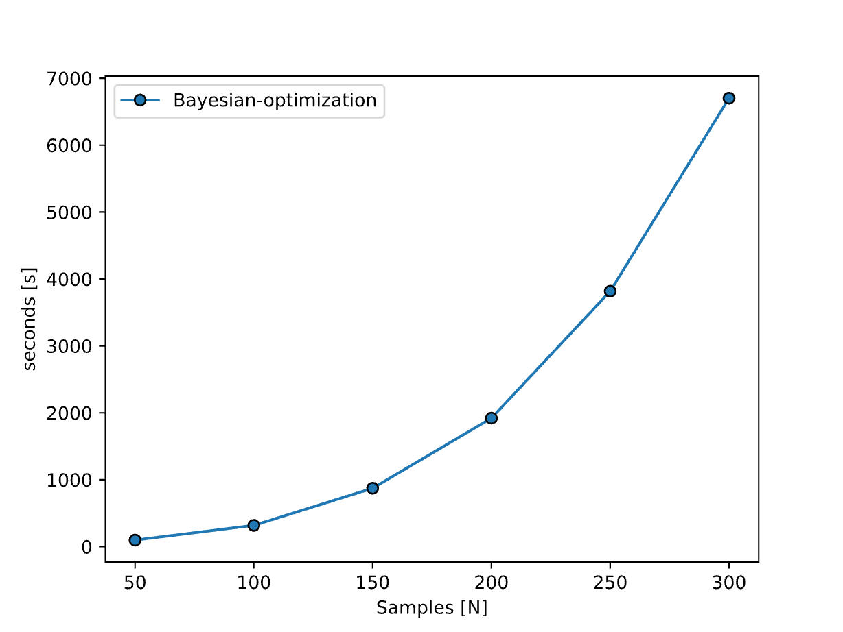
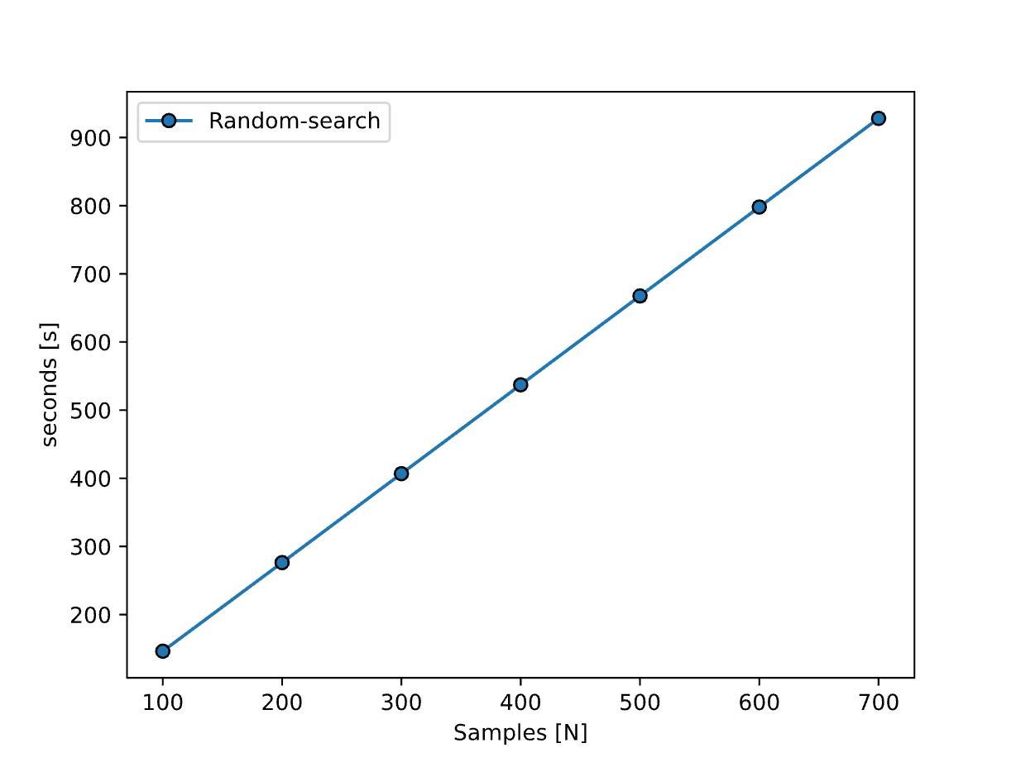
Preliminary results – Bayesian vs. Random search

Slide 14
What’s next?
Try: Bayesian optimization
Check if rate is mainly given by active site elements
Implement genAI tools
Check how well RDS approximation holds?
Any suggestions?
Notes:
Change plots into distributions instead.
Implement diffusion model → Check whether it is better – Find different training schemes and other.
Try to change the random searching to something that depends on prior info.

