Slide 1
Discrete Denoising Diffusion Probabilistic models – in inverse design of metal alloy catalysts

Slide 2
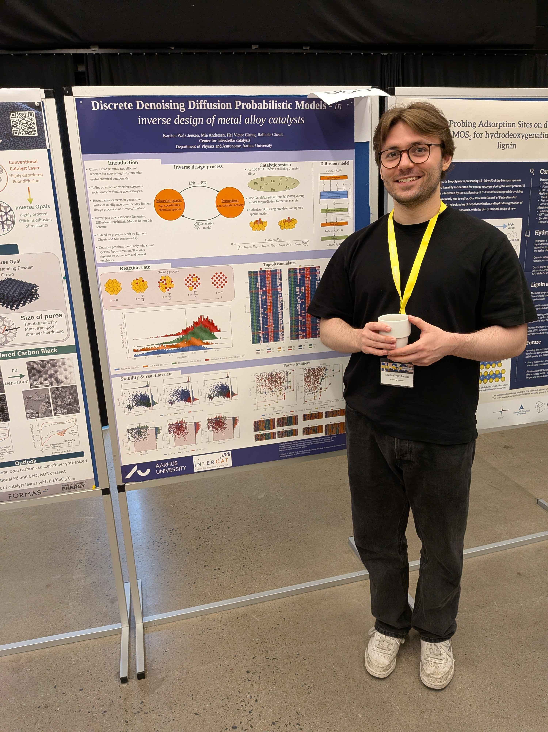
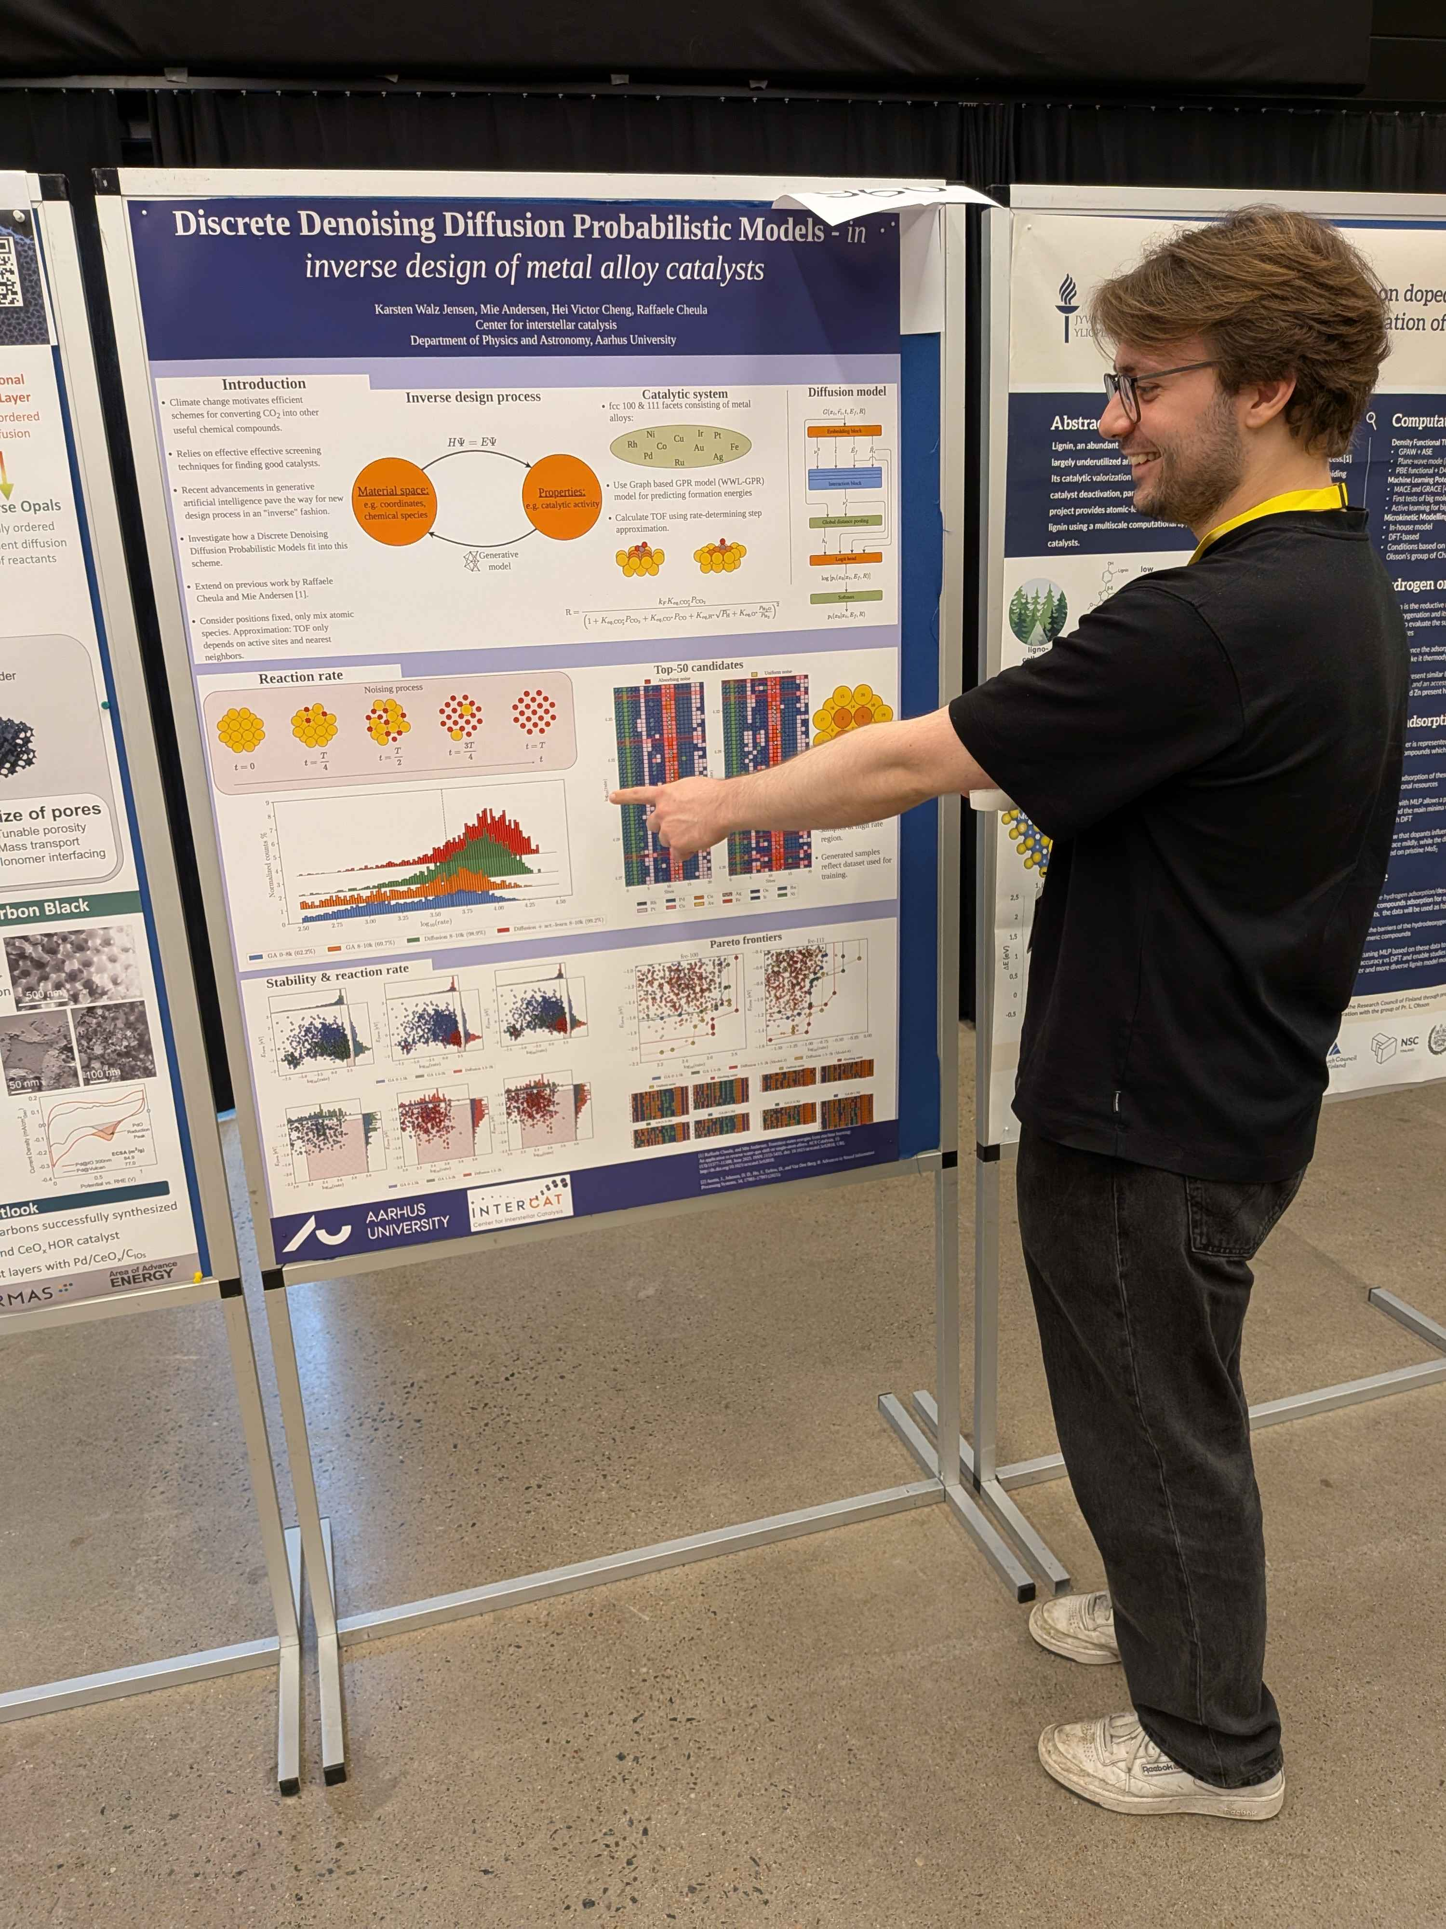
Nordic symposium 21

Slide 3
Outline
Introduction
Problem statement
Diffusion models in general
Implementation
Results & discussion
Concluding remarks

Slide 4
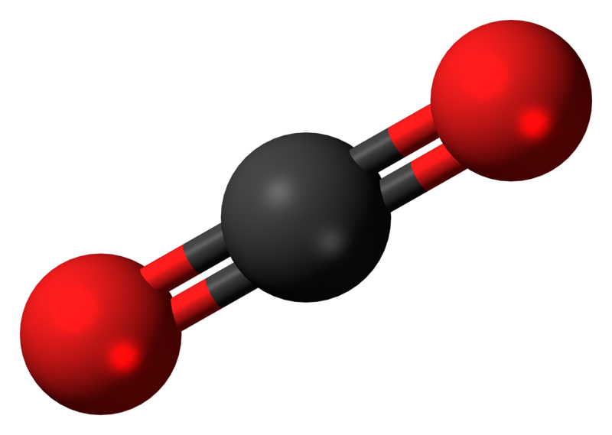

Introduction
Climate change $→$ Motivates efficient $CO_{2}$ converstion methods
Promising reaction: Reverse Water Gas Shift
$$CO_{2}+H_{2}⇌CO+H_{2}O$$
Big problem: $CO_{2}$ is very stable $→$ need harsh reaction conditions
Not feasable in practice

Slide 5
Introduction
Climate change $→$ Motivates efficient $CO_{2}$ converstion methods
Promising reaction: Reverse Water Gas Shift
$$CO_{2}+H_{2}⇌CO+H_{2}O$$
Big problem: $CO_{2}$ is very stable $→$ need harsh reaction conditions
Not feasable in practice
Can we do anything?

Slide 6
Introduction
Climate change $→$ Motivates efficient $CO_{2}$ converstion methods
Promising reaction: Reverse Water Gas Shift
$$CO_{2}+H_{2}⇌CO+H_{2}O$$
Big problem: $CO_{2}$ is very stable $→$ need harsh reaction conditions
Not feasable in practice
Can we do anything? – Yes, through catalysts!

Slide 7
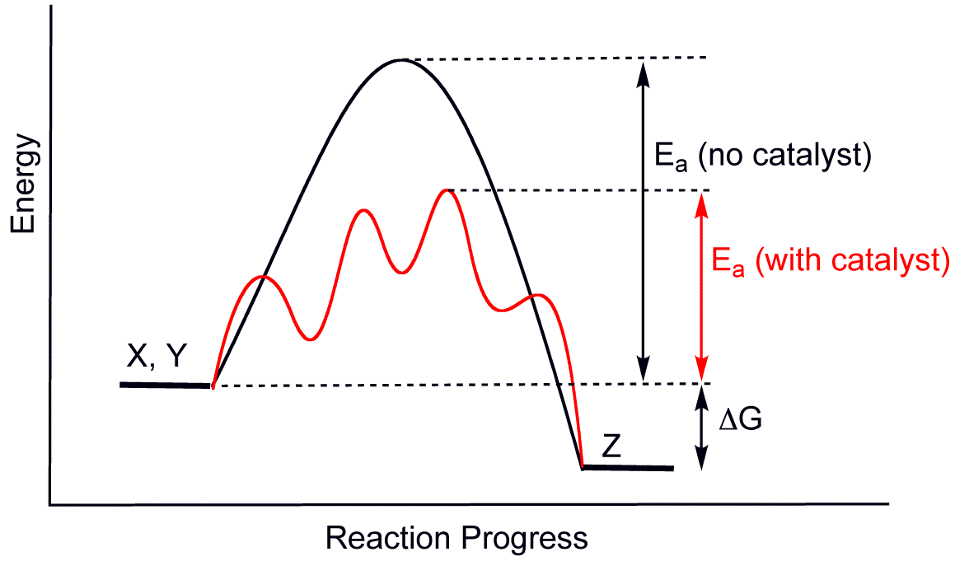

Introduction
Catalysts $→$ Materials which facilitates reactions
Offer alternate pathways in energy landscape
Combination of elementary steps & material properties

Slide 8



Introduction
Another big problem are competing pathways:
$$CO_{2}+{4H}_{2}⇌{CH}_{4}+2H_{2}O$$
Is thermodynamically favored at lower temperatures!
$${CO}_{2}$$
$$H_{2}$$
Catalyst

Slide 9
Heterogeneous catalysis

Slide 10
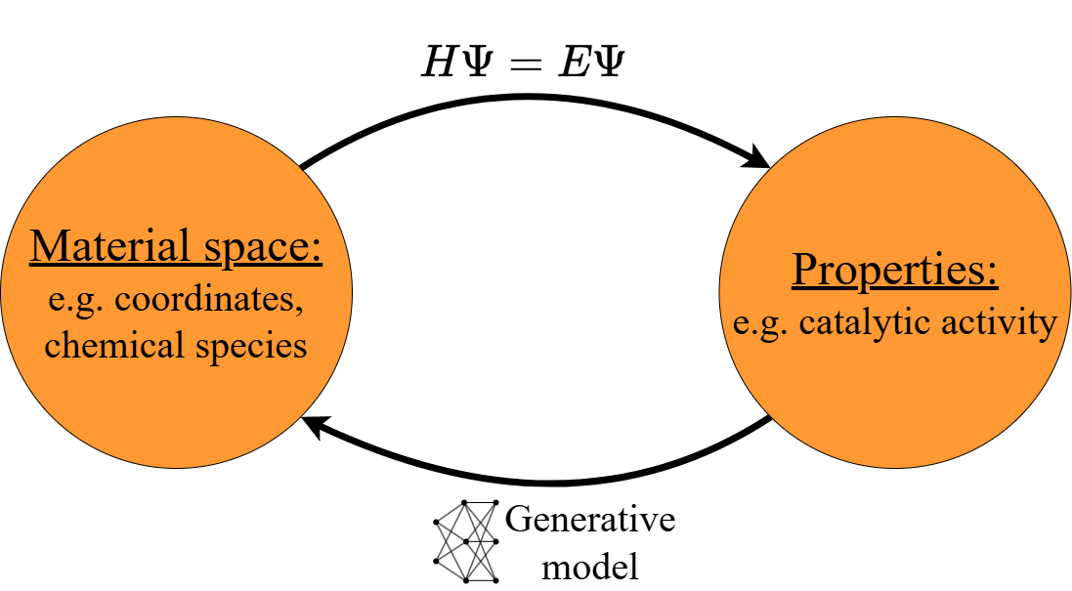
Introduction
Inverse design process

Slide 11
Introduction

Slide 12
Problem statement
“We will extend on the previous work \cite{cheula_saas} on Single Atomic Alloys (SAAs). We will try to answer how a diffusion model can be integrated into a traditional search algorithm to find good catalysts. We will restrict the problem to only considering the atomic species of the 100 and 111 fcc surfaces. To do this, we must implement a diffusion model and understand its inner workings. We will also try to answer how they can be used when multiple properties are desired. In our case, stability and reaction rate.”

Slide 13
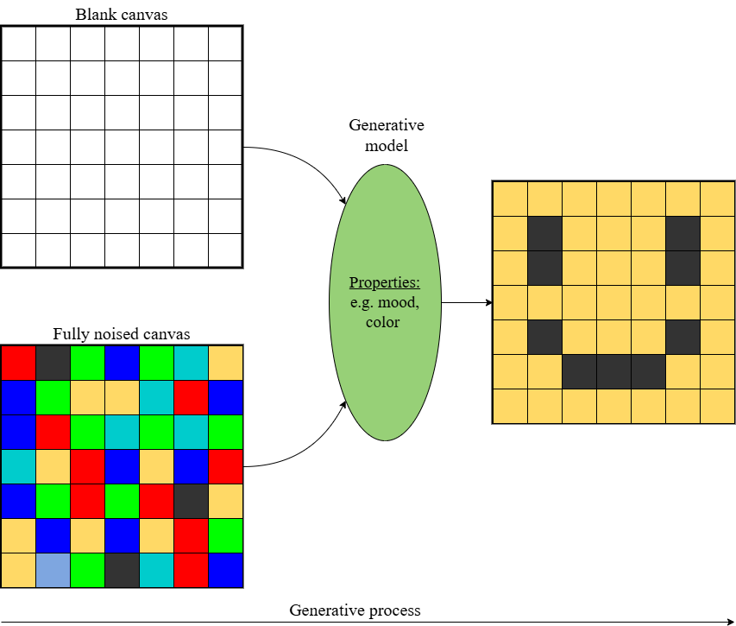
Diffusion models
General generative process

Slide 14
Diffusion models
What happens under the hood

Slide 15
Diffusion models
Especially for complex situations

Slide 16
Diffusion models
Diffusion models

Slide 17
Diffusion models
hej

Slide 18
Implementation

Slide 19
Results

Slide 20
Results

Slide 21
results

Slide 22
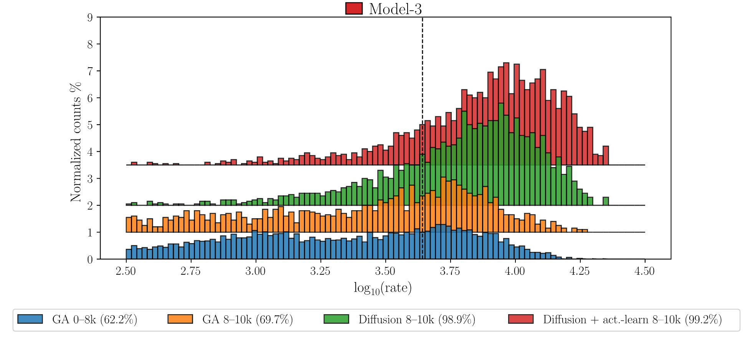
results

Slide 23
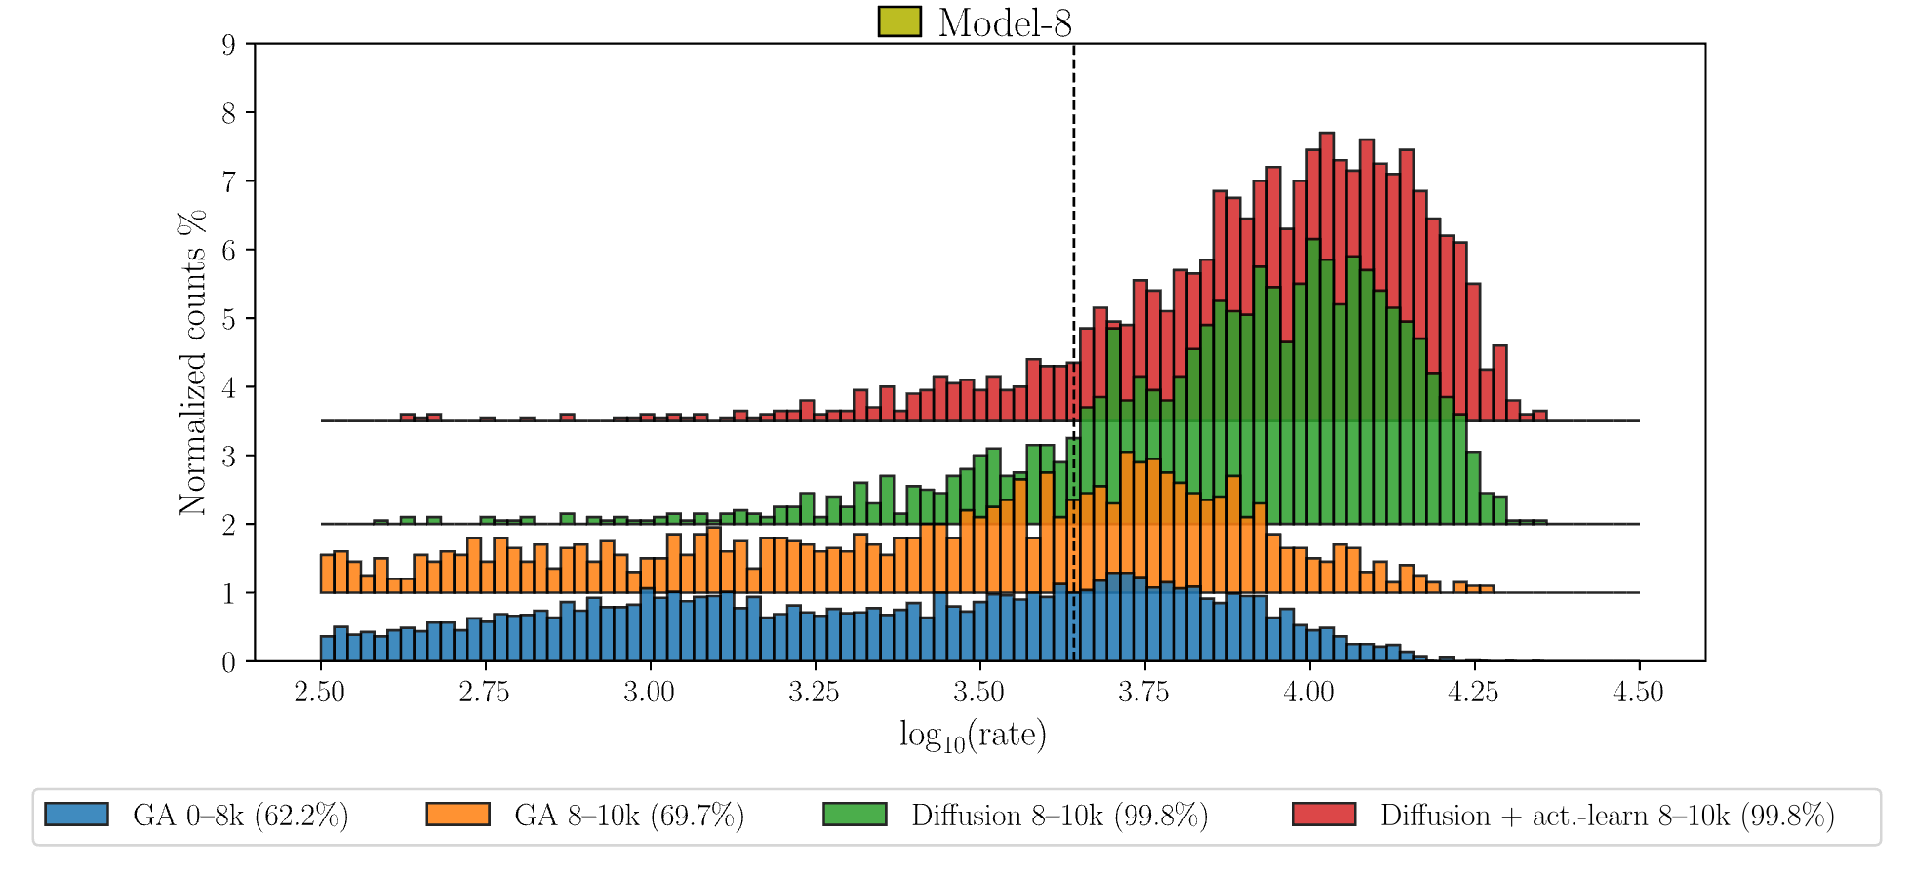
results

Slide 24
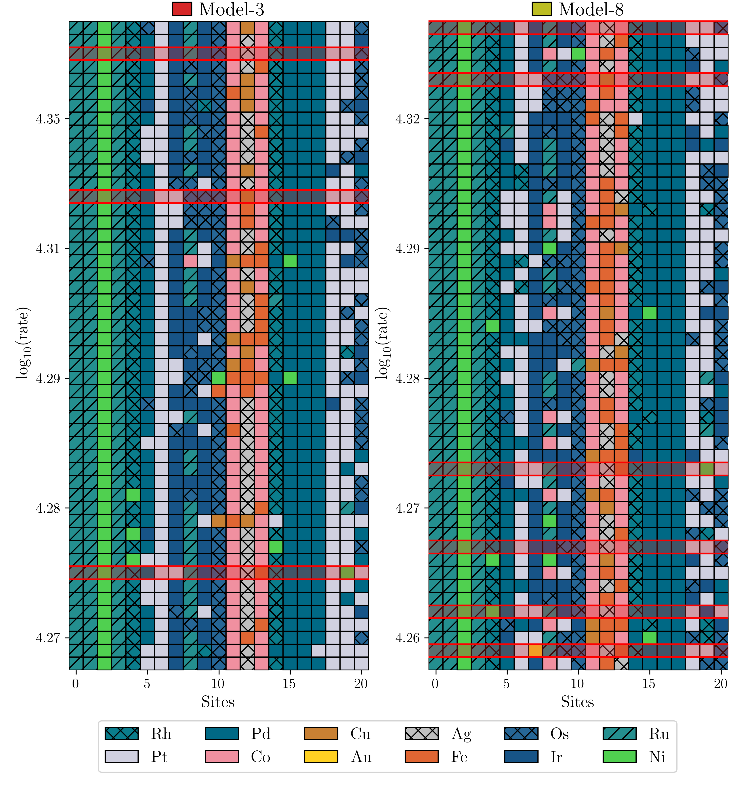
results

Slide 25
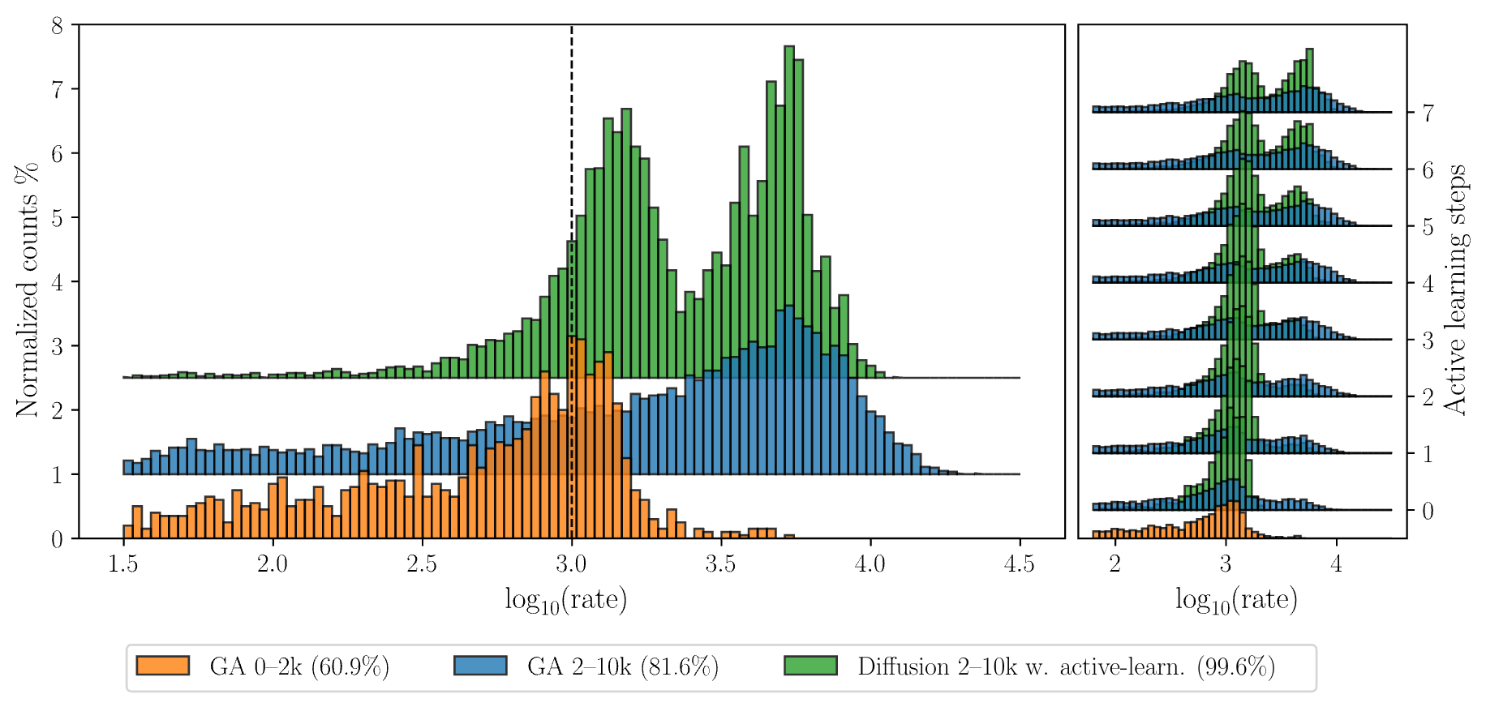
results

Slide 26
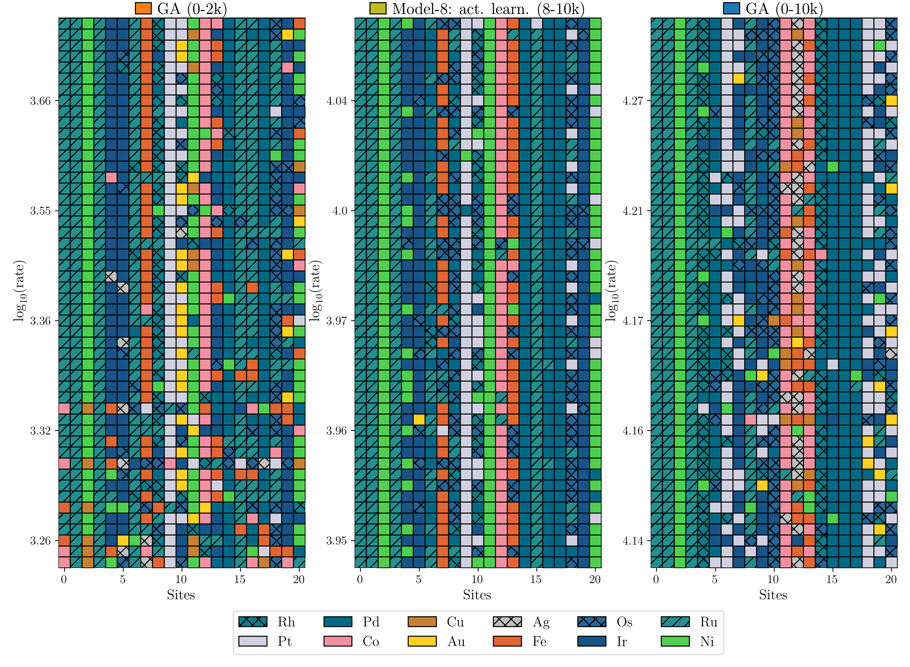
results

Slide 27
Main results

Slide 30
Concluding remarks

Slide 31
Insert Quote text, for next level ENTER and TAB
Insert Name

