Slide 1
Diffusion models
Part 4

Slide 2
Outline
Summary of where we left of last time
Identifying the problem
New findings

Slide 3
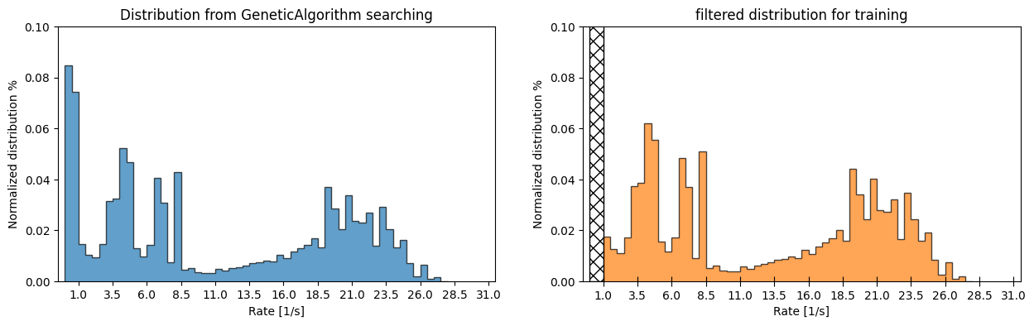

Tried conditioning on the reaction rate
Where im at now.
Tried class-divisions & samples from GeneticAlgorithm
Element pool: $\left[Au, Pd, Rh, Cu\right]$
Num. samples $∼5000$

Slide 4
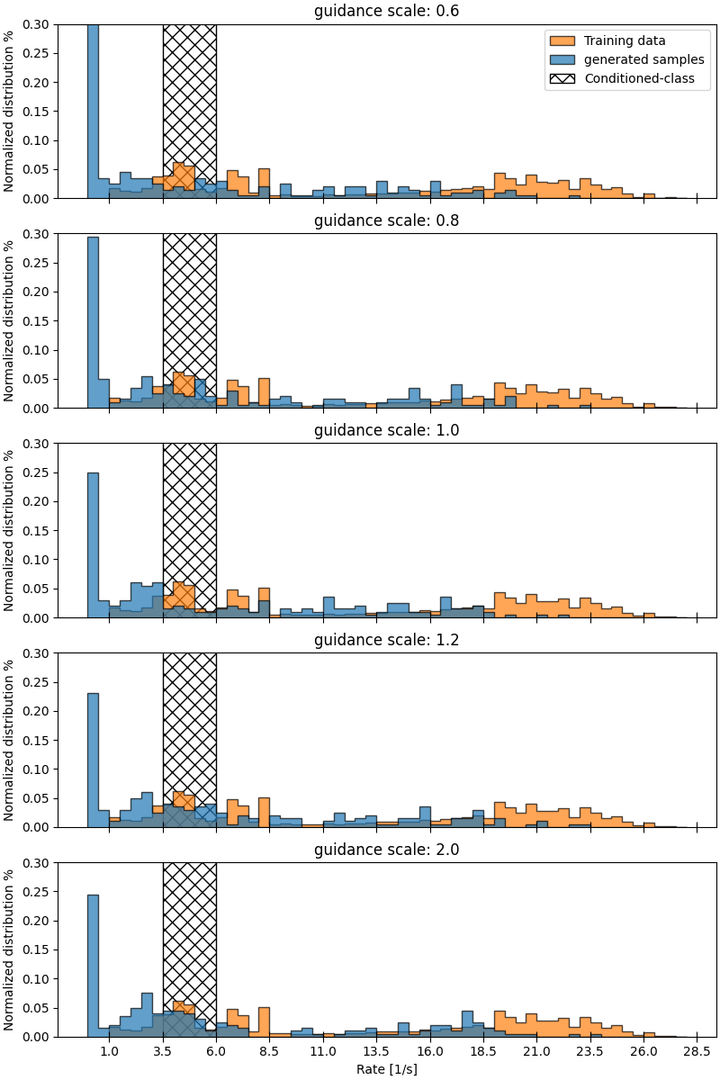
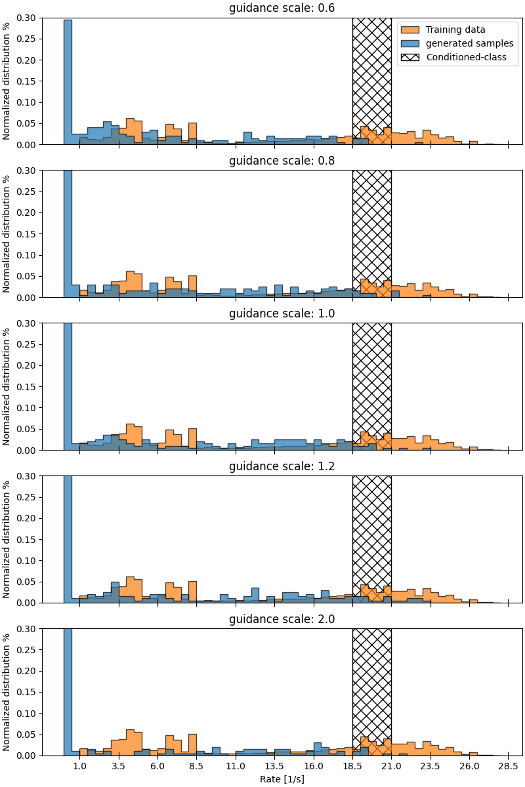

Slide 5
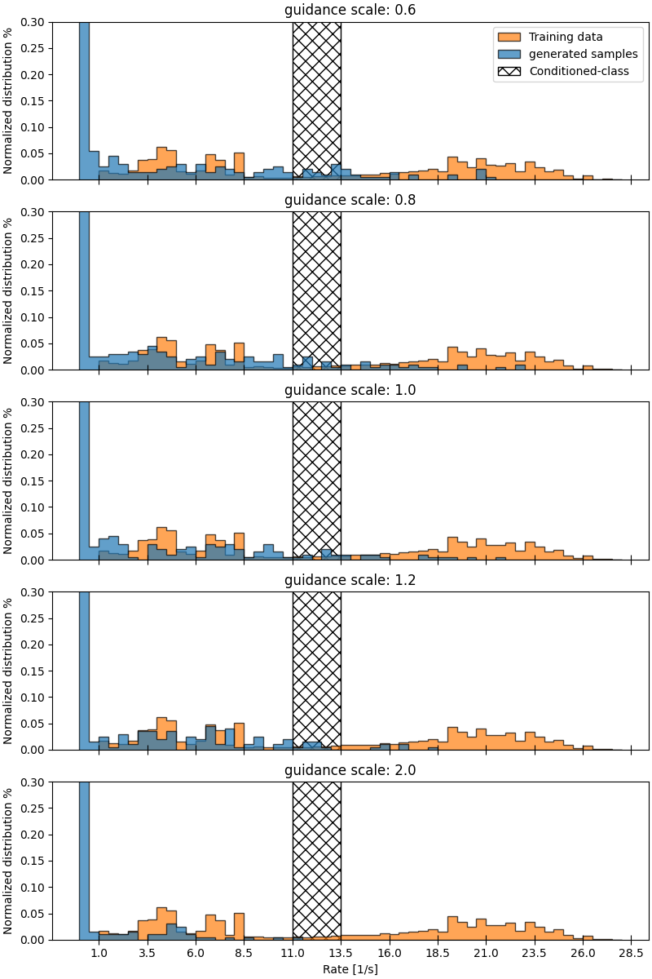
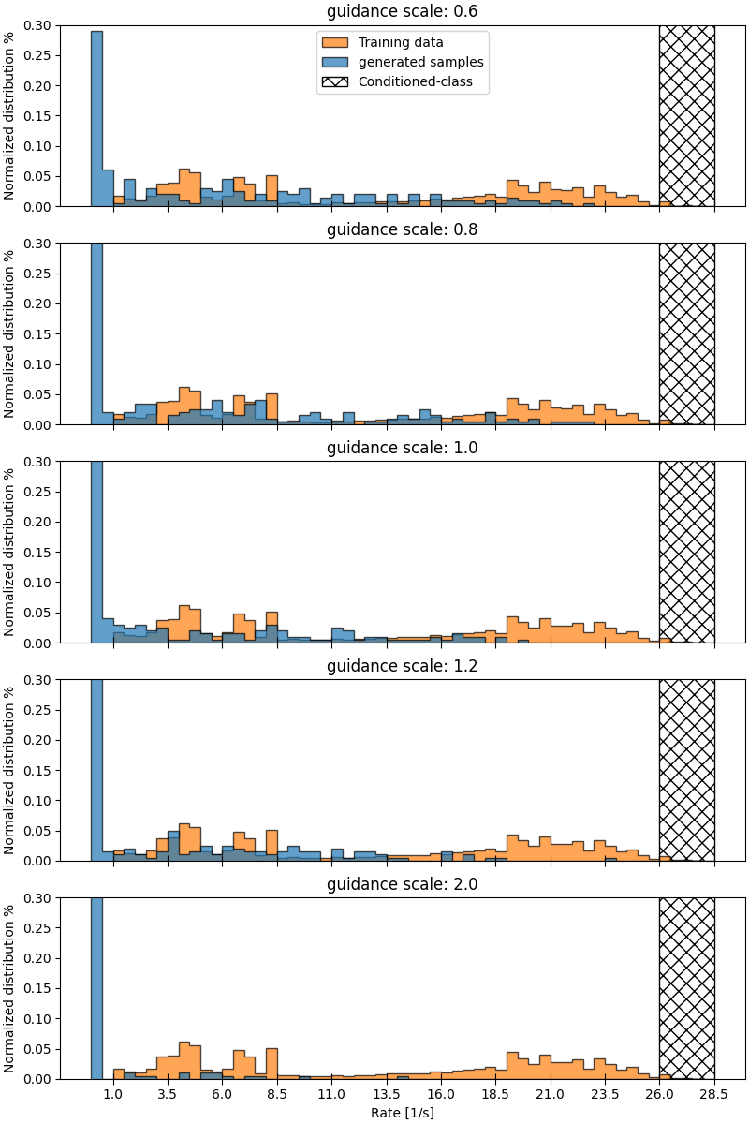

Slide 6
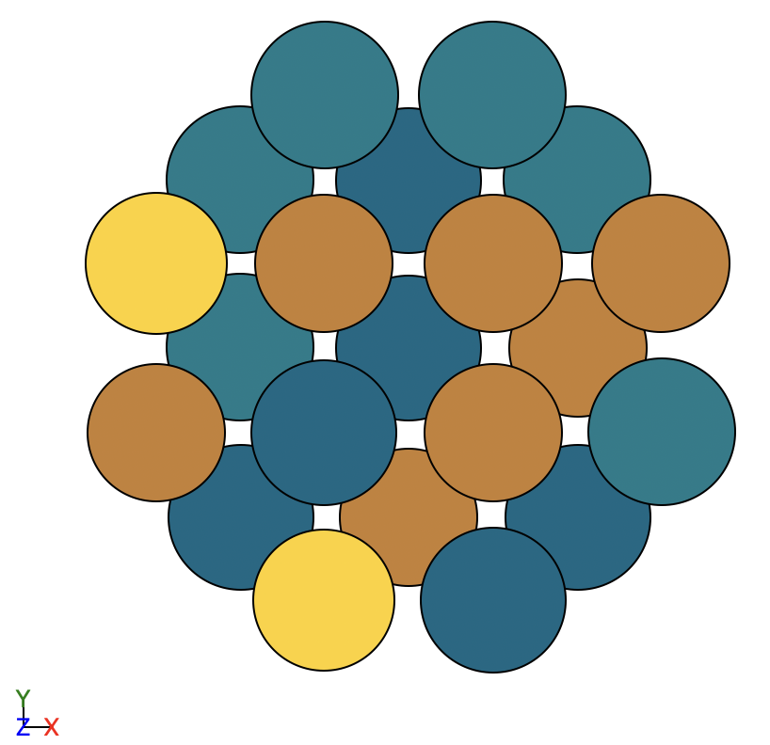
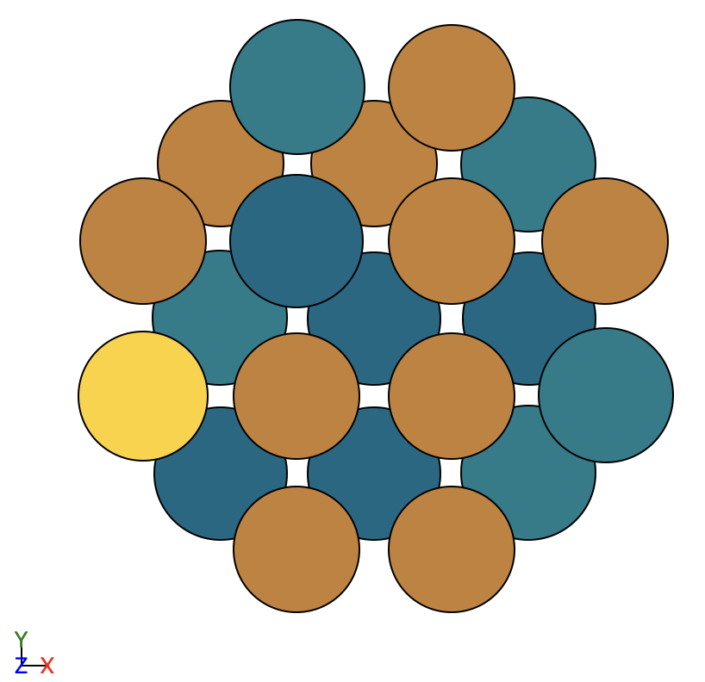
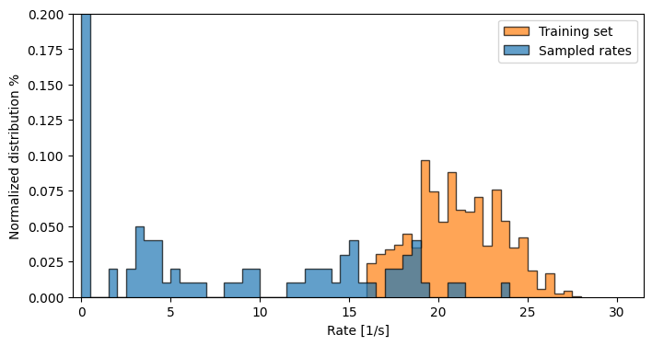
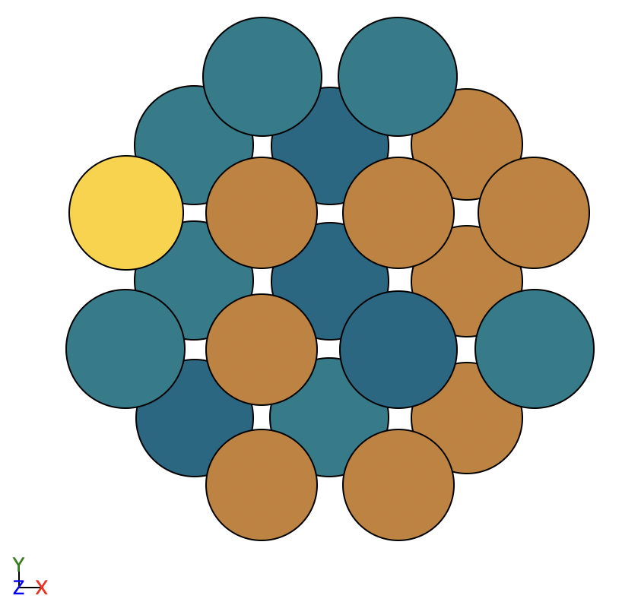
Unconditional generation on high rates only
Still not great
All samples have 3Cu + 1Pd on active sites, how many samples do i get with this configuration?

Slide 7







Identifying the problem
Started testing the GNN backbone seperately
Should be able to predict rates if it can distinguish
Pool by mean:
$x_{glob}=\frac{1}{M}\sum_{i=1}^{M}{x_{i}}$
$$\left[\begin{matrix}atom embed \\ \end{matrix}\right]$$
$$\left[\begin{matrix}atom embed \\ \end{matrix}\right]$$
$$\left[\begin{matrix}atom embed \\ \end{matrix}\right]$$
$$R=MLP(x_{glob})$$
$$\left[\begin{matrix}atom embed \\ \end{matrix}\right]$$
Input graph: $x$
Do message passing and finally use MLP to predict rate of i’th atom
Sum the individual rates to get global rate

Slide 8
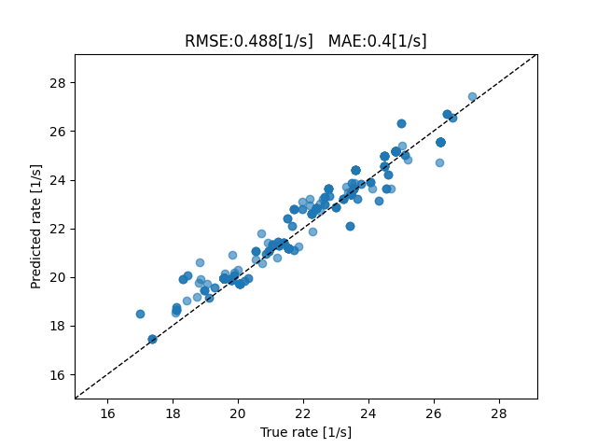
Identifying the problem
This seemed to work!
BUT

Slide 9
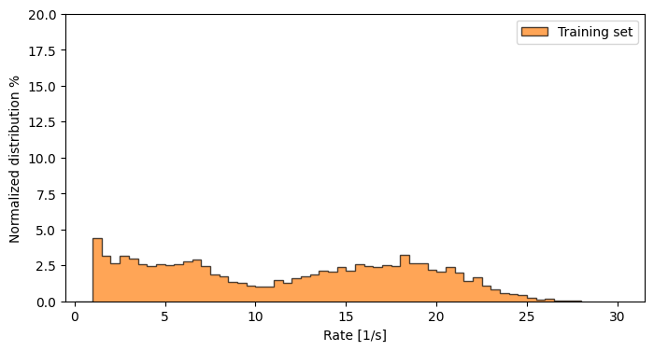
Small problem
Dataset is generated by GeneticAlgorithm
Produces the same structure many times
Before removing copies
After removing copies

Slide 10
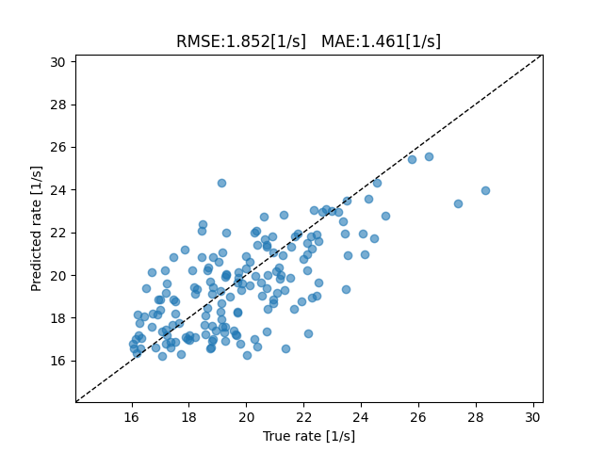
Identifying the problem
With filtered samples
Still somewhat works
But choices reflect previous knowledge

Slide 12

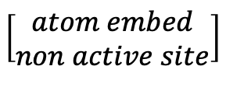


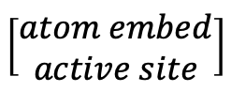

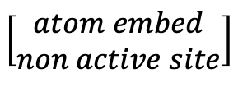
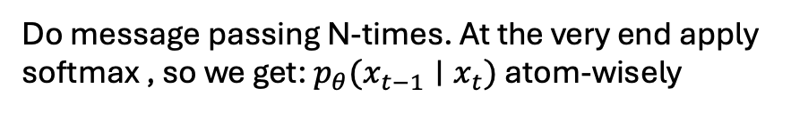

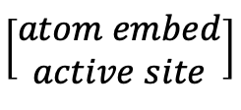
Identifying the problem
How I initially attempted the pooling.
Do message passing as before for $N$ iterations
Pool by mean:
$x_{glob}=\frac{1}{M}\sum_{i=1}^{M}{x_{i}}$
$$p_{θ}\left(x_{t−1} ∣ x_{t}\right)=MLP\left[\begin{matrix}x_{glob} \\ x_{i}\end{matrix}\right]$$
$$\left[\begin{matrix}atom embed \\ non active site\end{matrix}\right]$$
$$\left[\begin{matrix}atom embed \\ non active site\end{matrix}\right]$$
$$\left[\begin{matrix}atom embed \\ active site\end{matrix}\right]$$
$$\left[\begin{matrix}atom embed \\ active site\end{matrix}\right]$$
Do message passing N-times. At the very end apply softmax , so we get: $p_{θ}(x_{t−1}∣x_{t})$ atom-wisely
Generate $x_{t−1}∼p_{θ}(x_{t−1}∣x_{t})$
Input graph: $x_{t}$

Slide 13
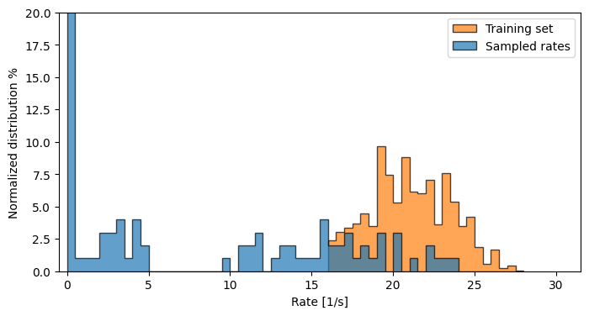
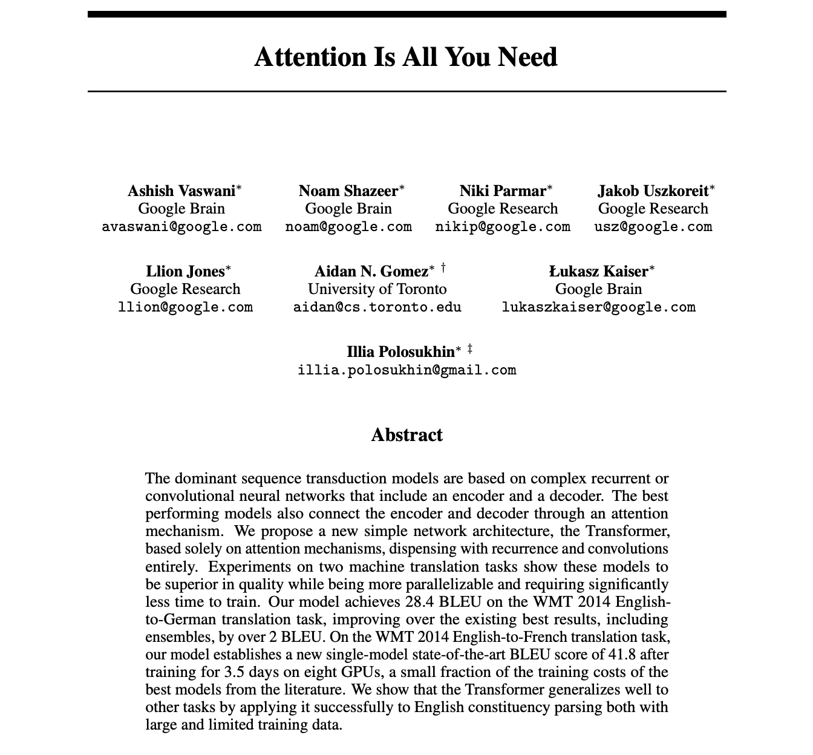
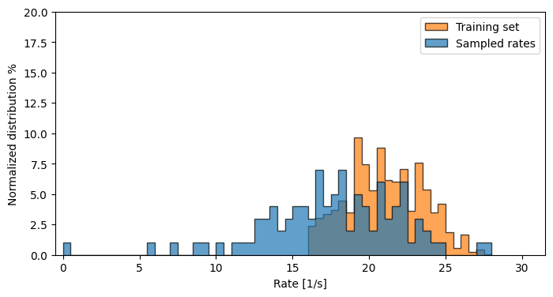
Did it help?
No pooling, as initially implemented
Yes! – Somewhat
Distributions are still slightly shifted?
Maybe ”Attention is all I need”
Almost spot on with % of elements in structures
Mean pooling

Slide 14
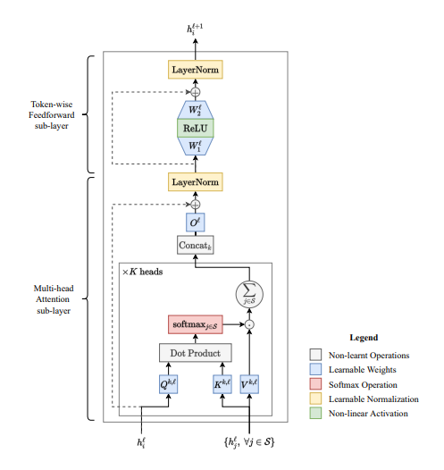
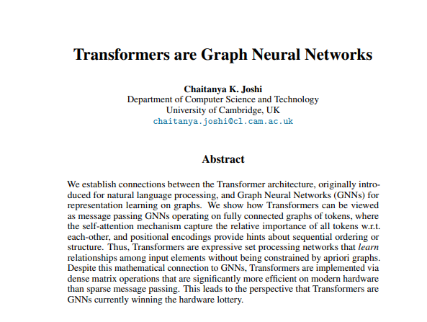
Identifying the problem
Maybe try a ”transformer-based” pooling

Slide 15
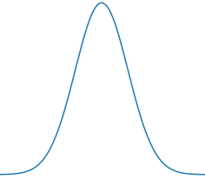
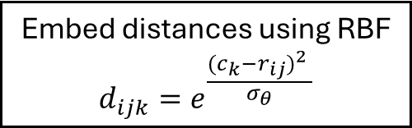







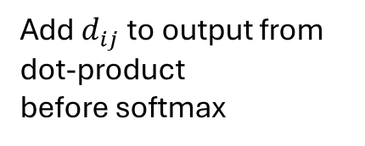


Added a little modification
$$r_{ij}$$
$$h_{i}$$
Calculate all interatomic distances $r_{ij}$ regardless of connection
$$r_{ij}$$
$$r_{ij}$$
Added distance bias
Embed distances using RBF $${d_{ijk}=e}^{\frac{{{(c}_{k}−r_{ij})}^{2} }{σ_{θ}}}$$
$$0$$
$$c_{k}$$
$$r_{max}$$
Add $d_{ij}$ to output from dot-product before softmax
Pass distance embedding through MLP $$d_{ij}=MLP(d_{ij})$$

Slide 16
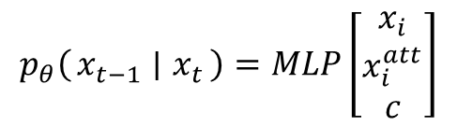


New pooling strategy
Do message passing as usual to get $x_{i}$
After message passing apply attention based pooling as outlined to get: $x_{i}^{att}$
Also add condition if conditional: $c$
$$p_{θ}\left(x_{t−1} ∣ x_{t}\right)=MLP\left[\begin{matrix}x_{i} \\ x_{i}^{att} \\ c\end{matrix}\right]$$
$$\left[\begin{matrix}atom embed \\ non active site\end{matrix}\right]$$
$$\left[\begin{matrix}atom embed \\ non active site\end{matrix}\right]$$
$$\left[\begin{matrix}atom embed \\ active site\end{matrix}\right]$$
$$\left[\begin{matrix}atom embed \\ active site\end{matrix}\right]$$
Do message passing N-times. At the very end apply softmax , so we get: $p_{θ}(x_{t−1}∣x_{t})$ atom-wisely
Generate $x_{t−1}∼p_{θ}(x_{t−1}∣x_{t})$
Input graph: $x_{t}$

Slide 17
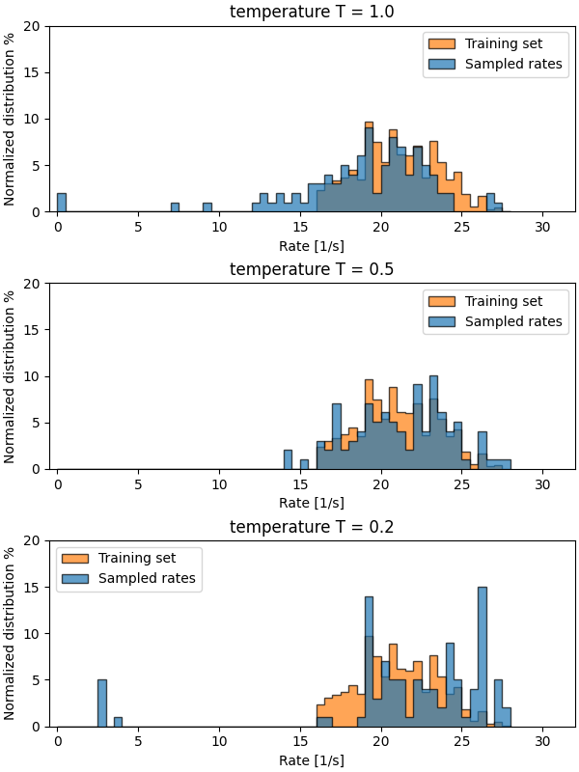
Did it help?
Yes, again somewhat.
Temperature trick seemed to help
Shift could be due to non-conditioning?

Slide 18
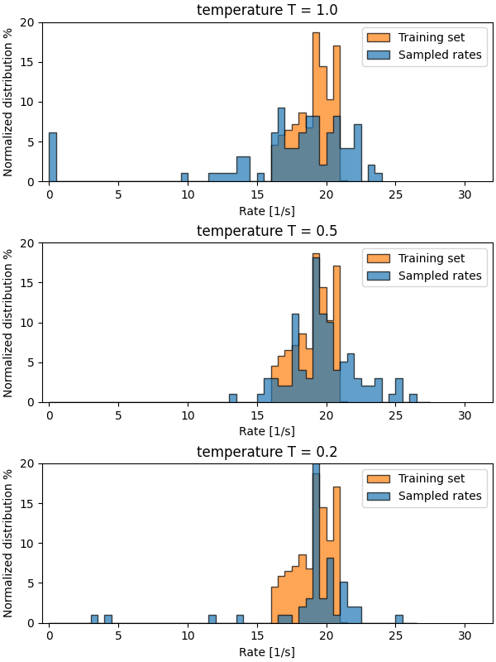
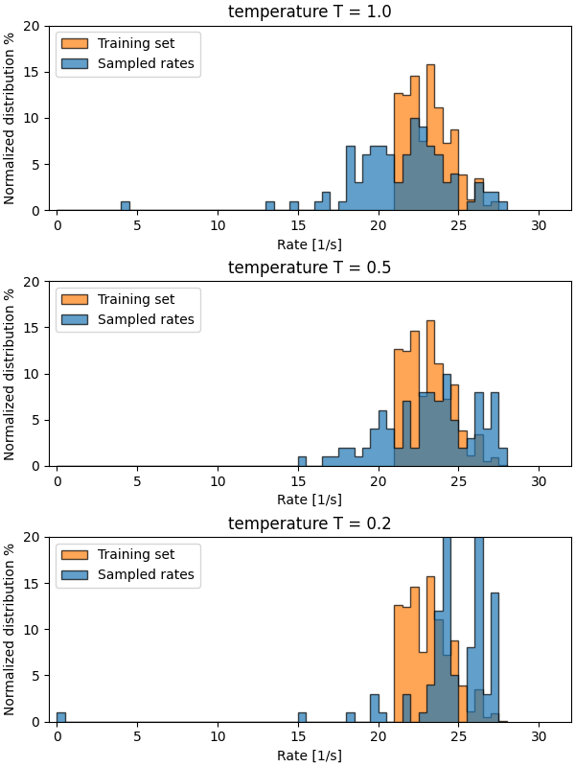
Divided distribution

Slide 19
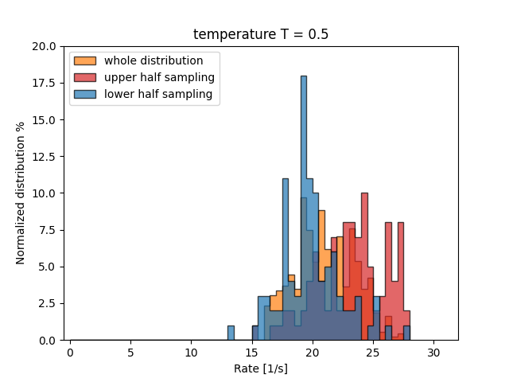
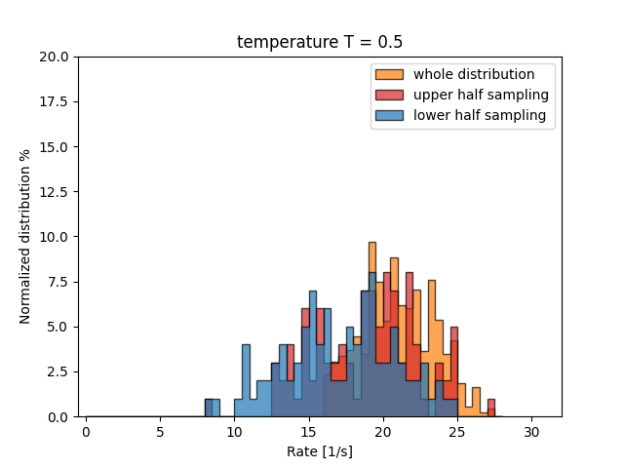
Plotted together
Transformer based pooling
Mean pooling

Slide 20
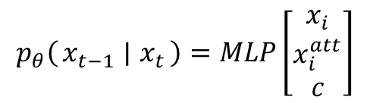
Why did this ”fix” my problem?
Rate is determined by relative position + element composition
Discrete space diffusion models do not incentivise getting correct motifs
Loss factorizes per token/atom → NN therefore needs to capture semantics strongly
With only message passing → Each node almost predicts its own probabilities
We force model to consider all other nodes in the graph before making prediction
Want to predict: [Hi, my, name, is, karsten, and, …, the, end]
Diffusion start from: [MASK, MASK, name, MASK, karsten, and, …, MASK, MASK]
If I have no way of measuring distance or placement between words, it becomes very hard if not impossible
$$p_{θ}\left(x_{t−1} ∣ x_{t}\right)=MLP\left[\begin{matrix}x_{i} \\ x_{i}^{att} \\ c\end{matrix}\right]$$

Slide 21
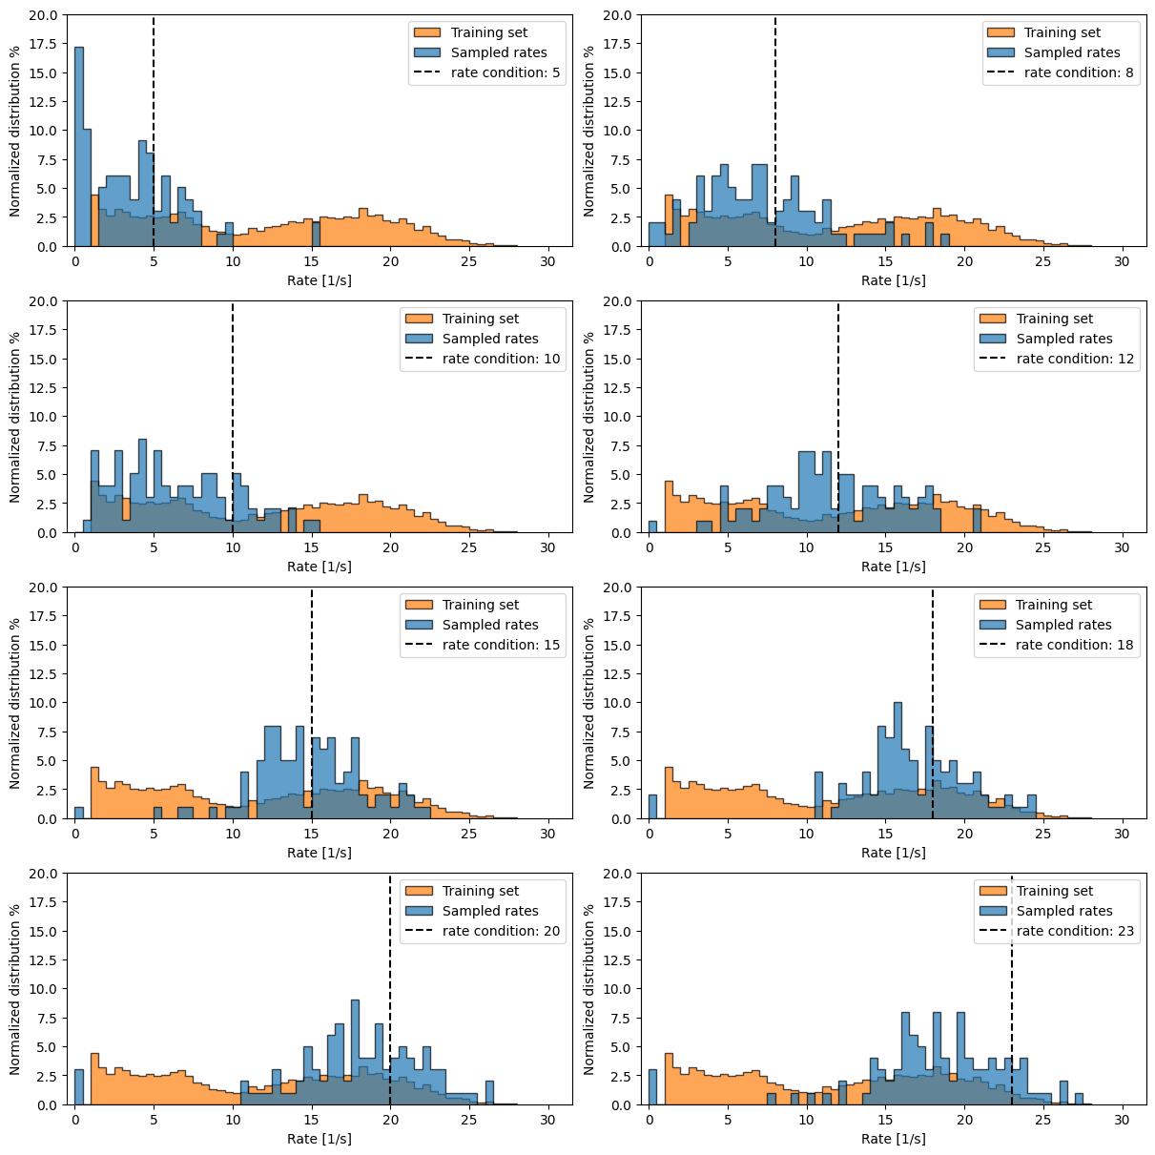
What now?
Went to conditioning
It works!
Tried many things
Not sure what really made it work
Think it is the pooling
Temperature: 1.0

Slide 22
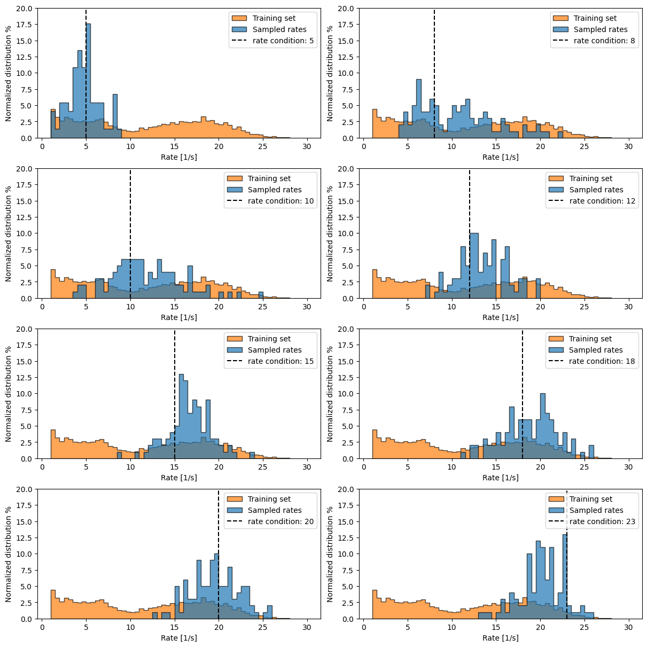
What now?
Temperature: 0.5

Slide 23
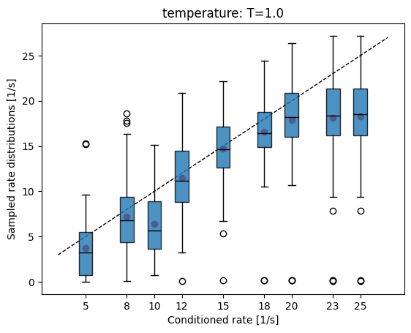
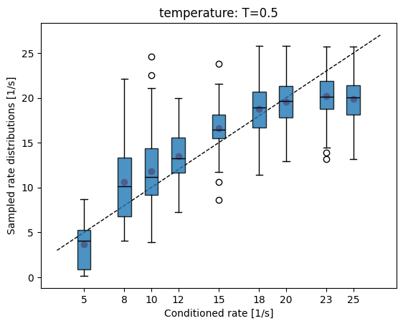
Summarized results

Slide 24
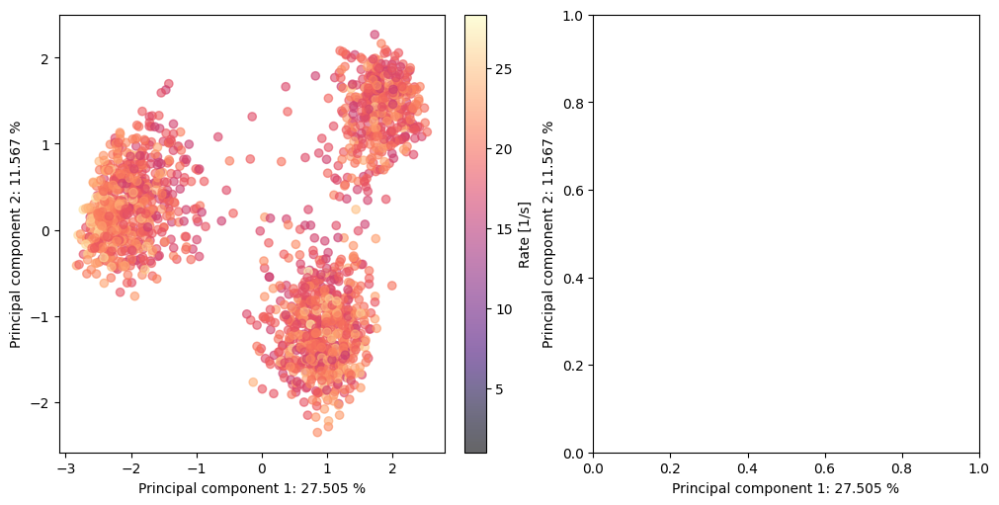
What now?
Distributions are still quite broad?
Maybe not bad actually?
Still seems to struggle towards high rates
PCA of all unique high rate structures
Can confuse model if rate is only condition available
Need to find some kind of new feature
Or additional conditioning paramete
Stability?

