Slide 1
Diffuson models
Part 3

Slide 2
Outline
Problem statement
Diffusion model theory in general
Summary of where I am at

Slide 3
Problem statement
Investigate RWGS: CO₂ + H₂ ⇌ CO + H₂O on metallic alloys
Example: 111-surface with only 4 active sites
Element pool of 3 yields 3.5billion conf.
Approximation: Ignore effect of stability/geometrical DOF’s.
Use generative models to help guide → Diffusion model
Swap elements
Reaction rate
Brown: site atoms
Yellow: neighbor atoms

Slide 4
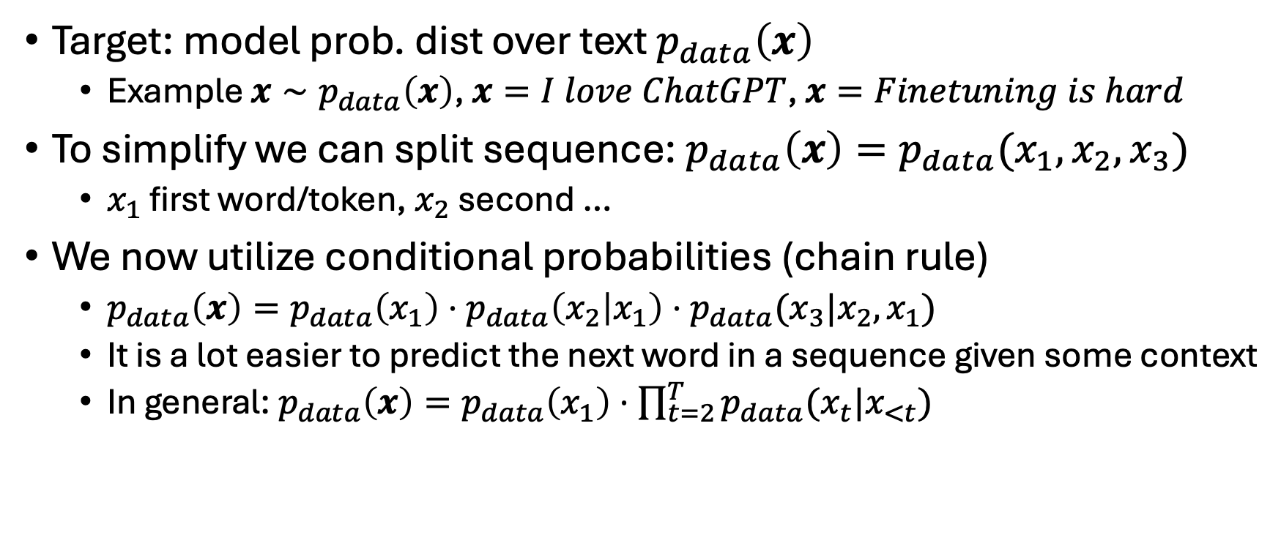
Diffusion model theory
Target: model prob. dist over text $p_{data}\left(x\right)$
Example $x∼p_{data}\left(x\right)$, $x=I love ChatGPT$, $x=Finetuning is hard$
To simplify we can split sequence: $p_{data}\left(x\right)=p_{data}(x_{1},x_{2},x_{3})$
$x_{1}$ first word/token, $x_{2}$ second …
We now utilize conditional probabilities (chain rule)
$p_{data}\left(x\right)=p_{data}\left(x_{1}\right)⋅p_{data}\left(x_{2} | x_{1}\right)⋅p_{data}(x_{3}|x_{2},x_{1})$
It is a lot easier to predict the next word in a sequence given some context
In general: $p_{data}\left(x\right)=p_{data}\left(x_{1}\right)⋅\prod_{t=2}^{T}{p_{data}(x_{t}|x_{<t})}$

Slide 5
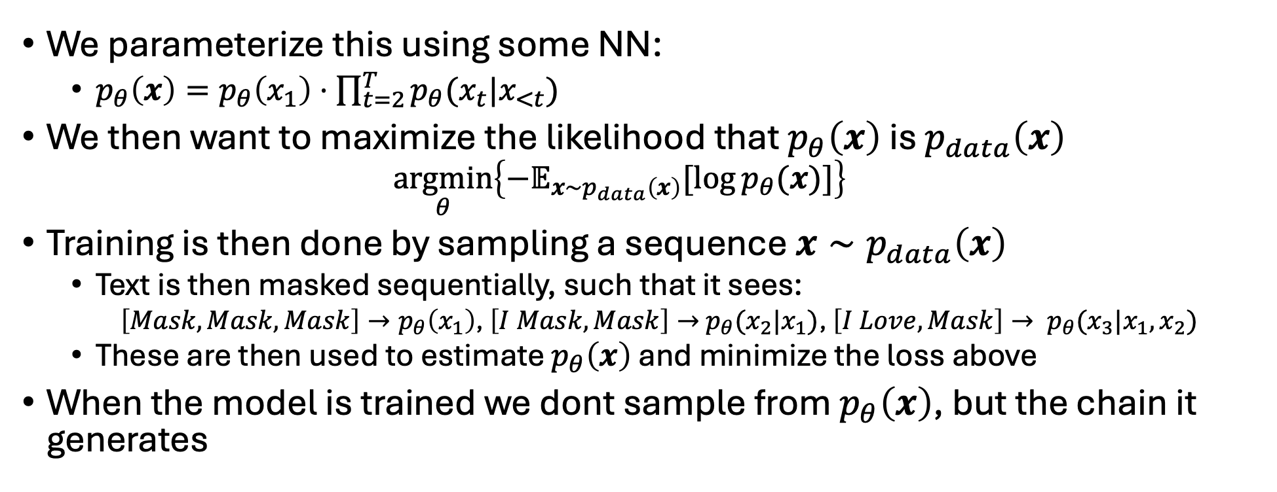
Diffusion model theory
We parameterize this using some NN:
$p_{θ}\left(x\right)=p_{θ}\left(x_{1}\right)⋅\prod_{t=2}^{T}{p_{θ}(x_{t}|x_{<t})}$
We then want to maximize the likelihood that $p_{θ}\left(x\right)$ is $p_{data}\left(x\right)$
$$\underset{θ}{argmin}\left\{−𝔼_{x∼p_{data}\left(x\right)}[\log{p_{θ}(x)}]\right\}$$
Training is then done by sampling a sequence $x∼p_{data}\left(x\right)$
Text is then masked sequentially, such that it sees:
$\left[Mask, Mask, Mask\right]→p_{θ}\left(x_{1}\right)$, $\left[I Mask, Mask\right]→$ $p_{θ}(x_{2}|x_{1})$, $\left[I Love, Mask\right]→ p_{θ}(x_{3}|x_{1},x_{2})$
These are then used to estimate $p_{θ}\left(x\right)$ and minimize the loss above
When the model is trained we dont sample from $p_{θ}\left(x\right)$, but the chain it generates
Notes:
Training is then done by feeding an entire sequnce ”x” and then letting the NN see sequentially unmasked sequences and predicting the logits.

Slide 6
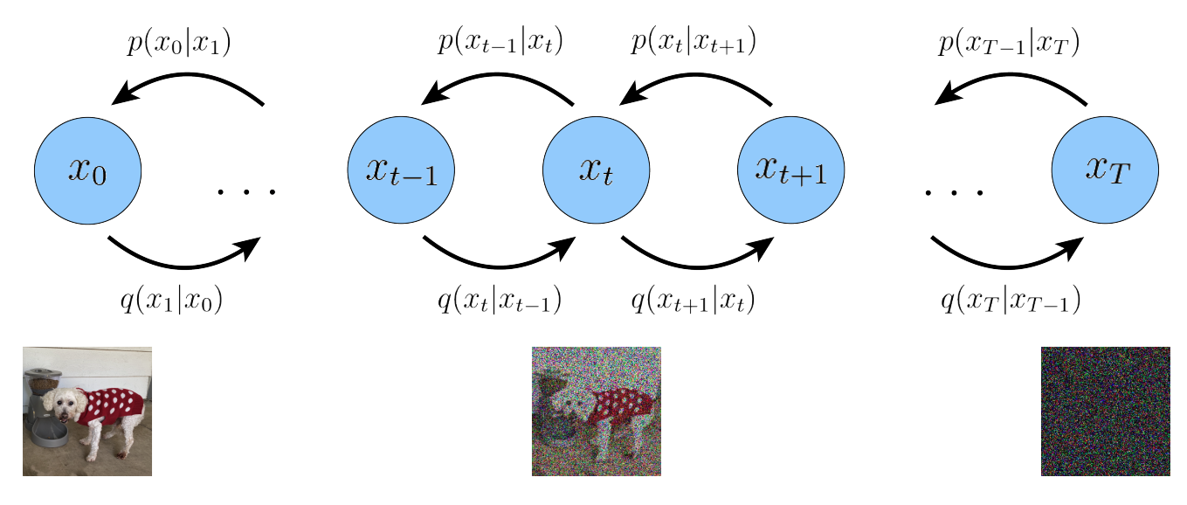

Diffusion model theory
Similar for diffusion models: Again model prob. dist over text $p_{data}\left(x\right)$
Instead introduce $p(x_{0},x_{1},x_{2},…,x_{T})$, where $p_{data}\left(x\right)=p\left(x_{0}\right)$
Where $x_{t}$ is a gradually noised version of the text sequence $x_{0}$
Idea is to train an NN to do the reverse process of this markov chain

Slide 7

Diffusion model theory
Because they start and end at same place we
The idea is that $q\left(x_{T} | x_{T−1}\right)=p\left(x_{T−1} | x_{T}\right)=p(x_{T})$
Where $p\left(x_{T}\right)$ is a simple distribution
E.g. uniform for each token/word in sequence → $x_{T}=Trump is moron$
Absorbing state → $x_{T}=MASK MASK MASK$

Slide 8
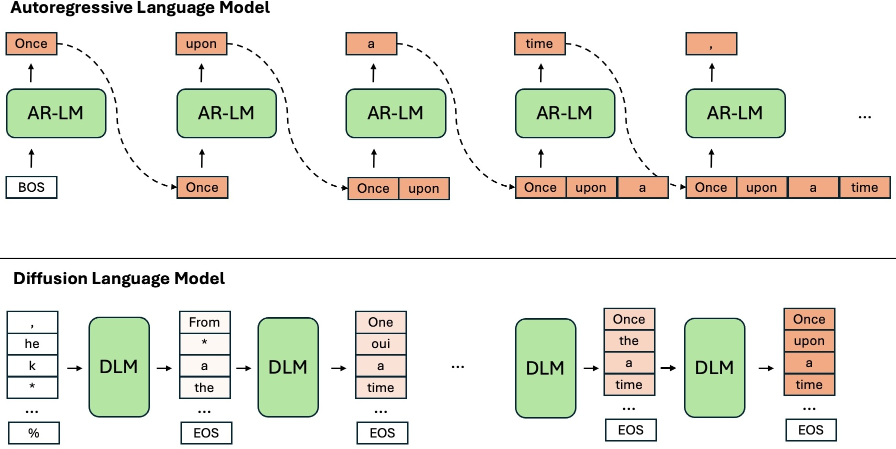
Diffusion model theory

Slide 9

Diffusion model theory
Again we want to maximize some likelihood of a learned distribution matching $p_{data}\left(x\right)$
Again we want to utilize conditional probabilites because it easier to infer stuff from context

Slide 10
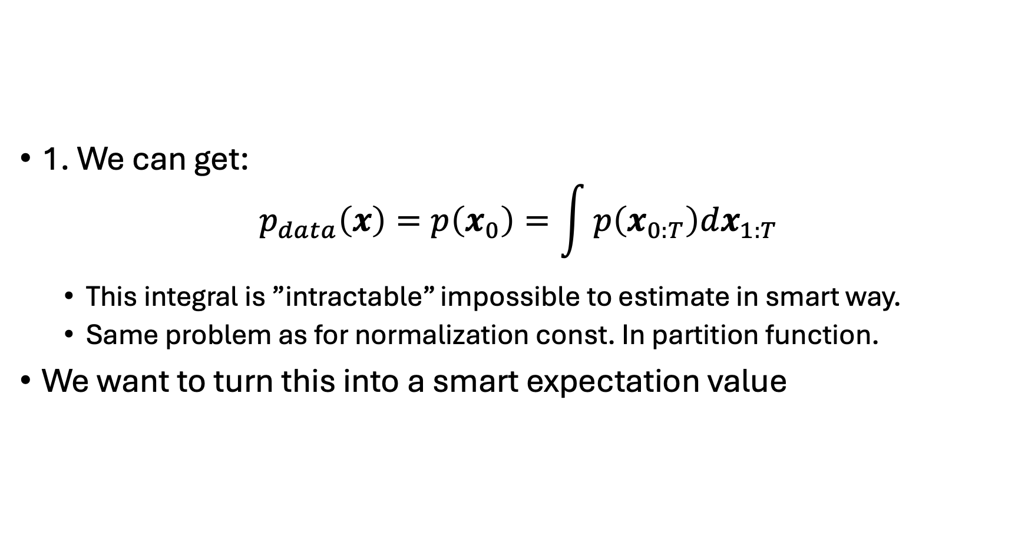
Diffusion model theory
1. We can get:
$$p_{data}\left(x\right)=p\left(x_{0}\right)=\int{p\left(x_{0:T}\right)dx_{1:T}}$$
This integral is ”intractable” impossible to estimate in smart way.
Same problem as for normalization const. In partition function.
We want to turn this into a smart expectation value
Notes:
Bottom probability comes from chain rule of probabilities + markovian chain

Slide 11
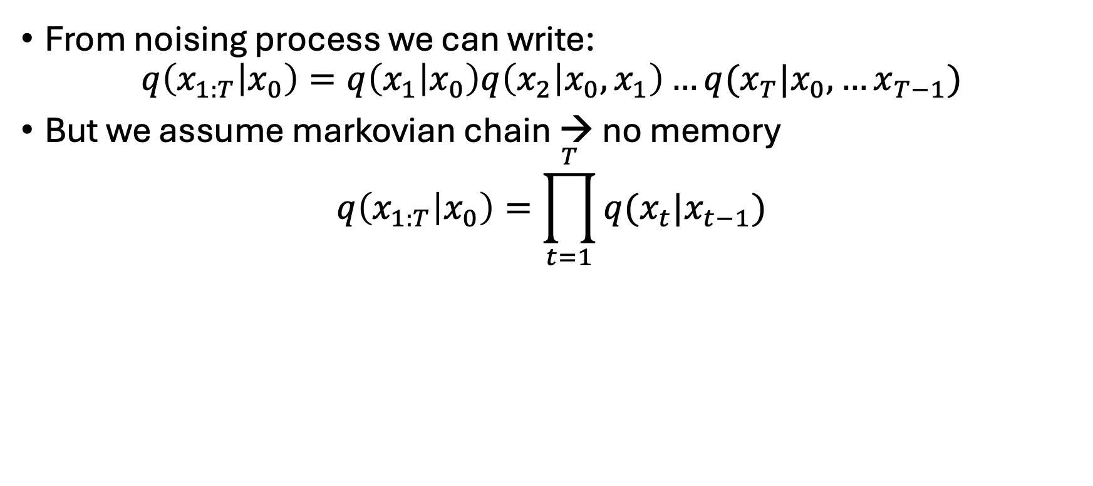
Diffusion model theory
From noising process we can write:
$$q\left(x_{1:T} | x_{0}\right)=q\left(x_{1} | x_{0}\right)q\left(x_{2} | {x_{0},x}_{1}\right)…q(x_{T}|x_{0},…x_{T−1})$$
But we assume markovian chain → no memory
$$q\left(x_{1:T} | x_{0}\right)=\prod_{t=1}^{T}{q(x_{t}|x_{t−1})}$$
Notes:
A transition only depends on the previous version not on the whole chain.

Slide 12
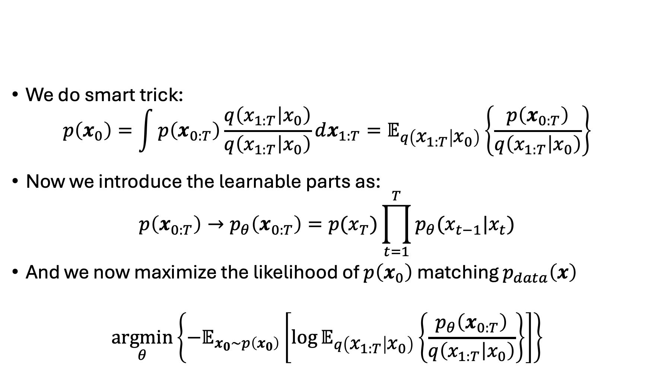
Diffusion model theory
We do smart trick:
$$p\left(x_{0}\right)=\int{p\left(x_{0:T}\right)\frac{q\left(x_{1:T} | x_{0}\right)}{q\left(x_{1:T} | x_{0}\right)}dx_{1:T}=𝔼_{q\left(x_{1:T} | x_{0}\right)}}\left\{\frac{p\left(x_{0:T}\right)}{q\left(x_{1:T} | x_{0}\right)}\right\}$$
Now we introduce the learnable parts as:
$$p\left(x_{0:T}\right)→p_{θ}\left(x_{0:T}\right)=p(x_{T})\prod_{t=1}^{T}{p_{θ}(x_{t−1}|x_{t})}$$
And we now maximize the likelihood of $p\left(x_{0}\right)$ matching $p_{data}\left(x\right)$
$$\underset{θ}{argmin}\left\{−𝔼_{x_{0}∼p\left(x_{0}\right)}\left[\log{𝔼_{q\left(x_{1:T} | x_{0}\right)}\left\{\frac{p_{θ}\left(x_{0:T}\right)}{q\left(x_{1:T} | x_{0}\right)}\right\}}\right]\right\}$$
Notes:
Very convoluted expression

Slide 13
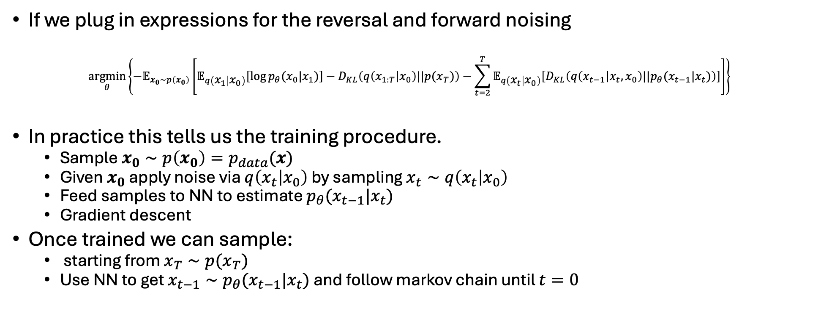
Diffusion model theory
If we plug in expressions for the reversal and forward noising
$$\underset{θ}{argmin}\left\{−𝔼_{x_{0}∼p\left(x_{0}\right)}\left[𝔼_{q\left(x_{1} | x_{0}\right)}\left[\log{p_{θ}(x_{0}|x_{1})}\right]−D_{KL}\left(q\left(x_{1:T} | x_{0}\right)||p(x_{T})\right)−\sum_{t=2}^{T}{𝔼_{q\left(x_{t} | x_{0}\right)}\left[D_{KL}\left(q\left(x_{t−1} | x_{t},x_{0}\right)||p_{θ}(x_{t−1}|x_{t})\right)\right]}\right]\right\}$$
In practice this tells us the training procedure.
Sample $x_{0}∼p\left(x_{0}\right)=p_{data}(x)$
Given $x_{0}$ apply noise via $q\left(x_{t} | x_{0}\right)$ by sampling $x_{t}∼q\left(x_{t} | x_{0}\right)$
Feed samples to NN to estimate $p_{θ}(x_{t−1}|x_{t})$
Gradient descent
Once trained we can sample:
starting from $x_{T}∼p(x_{T})$
Use NN to get $x_{t−1}∼p_{θ}(x_{t−1}|x_{t})$ and follow markov chain until $t=0$

Slide 14



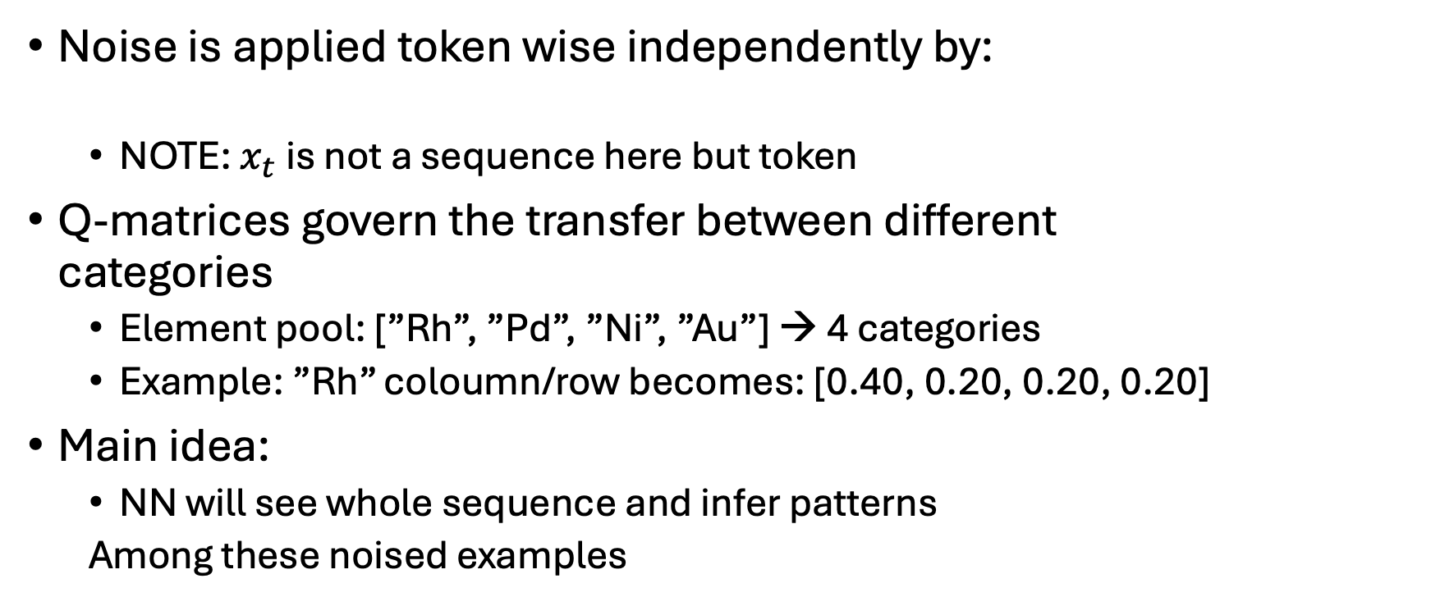
Discrete space diffusion
Noise is applied token wise independently by:
NOTE: $x_{t}$ is not a sequence here but token
Q-matrices govern the transfer between different categories
Element pool: [”Rh”, ”Pd”, ”Ni”, ”Au”] → 4 categories
Example: ”Rh” coloumn/row becomes: [0.40, 0.20, 0.20, 0.20]
Main idea:
NN will see whole sequence and infer patterns
Among these noised examples
0.40
Rh
0.20
Pd
0.20
0.20
Ni
Au

Slide 15
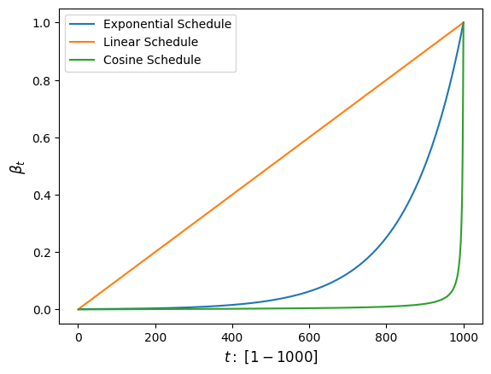
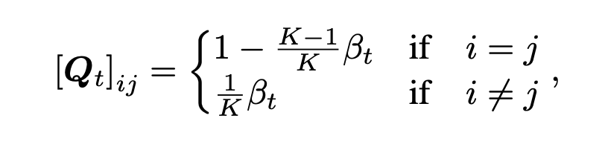
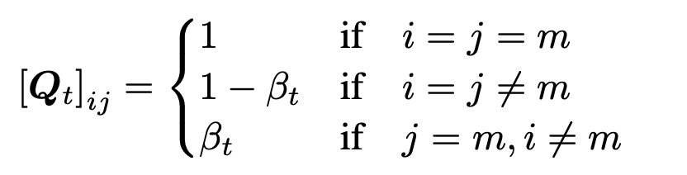
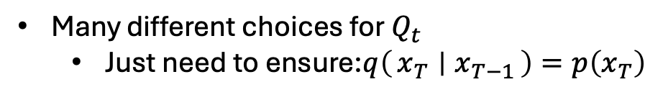
Q-matrices
Many different choices for $Q_{t}$
Just need to ensure:$q\left(x_{T} ∣ x_{T−1}\right)=p\left(x_{T}\right)$
Uniform transitions
Absorbing state formulation

Slide 16
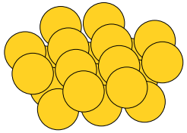
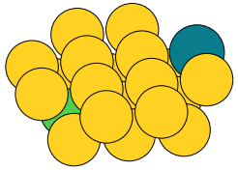
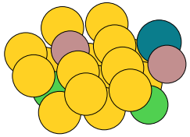
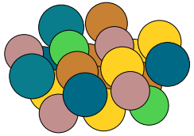
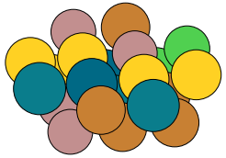
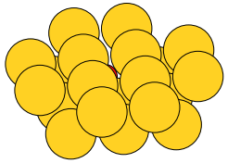
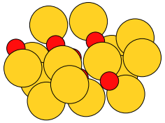
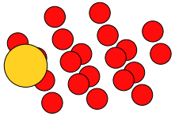
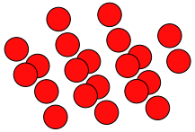










How I implemted this: Diffusion examples
Used Exponential schedule with $β_{t}∈\left[1{⋅10}^{−4},1{⋅10}^{−1}\right]$
Uniform diffusion; $x_{t}∼q(x_{t}|x_{t−1})$
$$t=\frac{T}{4}$$
$$t=\frac{T}{2}$$
$$t=\frac{3T}{4}$$
$$t=T$$
$$t=0$$
Absorbing diffusion; $x_{t}∼q(x_{t}|x_{t−1})$
$$t=\frac{T}{4}$$
$$t=\frac{T}{2}$$
$$t=\frac{3T}{4}$$
$$t=T$$
$$t=0$$

Slide 17











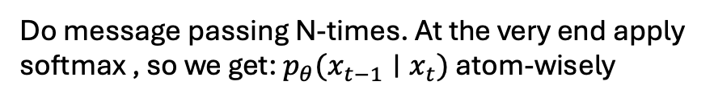



How I implemented this
Scheduling & forward diffusion already talked about
The denoising part: $p_{θ}\left(x_{t−1} ∣ x_{t}\right)$
A GNN using a fully learnable message-passing scheme.
Edges → Bonds
$$\left[\begin{matrix}0 \\ 0 \\ 1\end{matrix}\right]$$
$$\left[\begin{matrix}0 \\ 0 \\ 1\end{matrix}\right]$$
$$\left[\begin{matrix}1 \\ 0 \\ 0\end{matrix}\right]$$
$$\left[\begin{matrix}0 \\ 0 \\ 1\end{matrix}\right]$$
softmax
$$\left[\begin{matrix}0 \\ 0 \\ 1\end{matrix}\right]$$
$$\left[\begin{matrix}1 \\ 0 \\ 0\end{matrix}\right]$$
softmax
$$\left[\begin{matrix}1 \\ 0 \\ 0\end{matrix}\right]$$
$$\left[\begin{matrix}0 \\ 1 \\ 0\end{matrix}\right]$$
$$\left[\begin{matrix}1 \\ 0 \\ 0\end{matrix}\right]$$
$$\left[\begin{matrix}0 \\ 1 \\ 0\end{matrix}\right]$$
Do message passing N-times. At the very end apply softmax , so we get: $p_{θ}(x_{t−1}∣x_{t})$ atom-wisely
Generate $x_{t−1}∼p_{θ}(x_{t−1}∣x_{t})$
Input graph: $x_{t}$

Slide 18
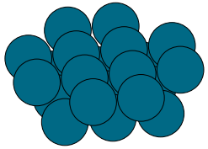
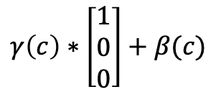
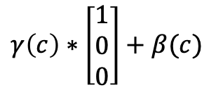
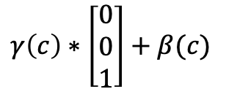

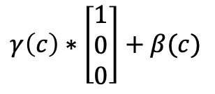
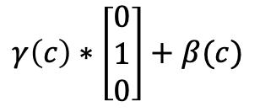
How I implemented this
As mentioned: Could be nice with guidance
Does not change anything in the derivations? Just $p_{θ}(x_{t−1}∣x_{t},c)$
For now only class labels → Embedded into learnable vector $c$
Additionally two MLPs: $γ\left(c\right), β(c)$ which sees the condition
Shifts the inputs of the GNN
$$γ\left(c\right)∗\left[\begin{matrix}1 \\ 0 \\ 0\end{matrix}\right]+β(c)$$
$$γ\left(c\right)∗\left[\begin{matrix}0 \\ 0 \\ 1\end{matrix}\right]+β(c)$$
Class 1: Pure Au
Class 2: Pure Pd
$$γ\left(c\right)∗\left[\begin{matrix}1 \\ 0 \\ 0\end{matrix}\right]+β(c)$$
Do message passing and softmax as shown earlier
$$γ\left(c\right)∗\left[\begin{matrix}1 \\ 0 \\ 0\end{matrix}\right]+β(c)$$
$$γ\left(c\right)∗\left[\begin{matrix}0 \\ 1 \\ 0\end{matrix}\right]+β(c)$$

Slide 19
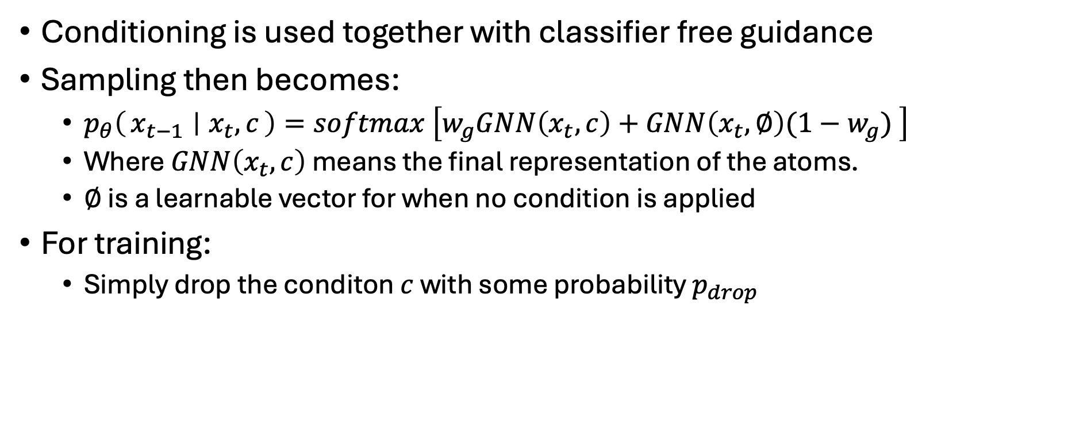
How I implemented this
Conditioning is used together with classifier free guidance
Sampling then becomes:
$p_{θ}\left(x_{t−1} ∣ x_{t},c\right)=softmax \left[w_{g}GNN\left(x_{t},c\right)+GNN\left(x_{t},∅\right)(1−w_{g}) \right]$
Where $GNN\left(x_{t},c\right)$ means the final representation of the atoms.
$∅$ is a learnable vector for when no condition is applied
For training:
Simply drop the conditon $c$ with some probability $p_{drop}$

Slide 20
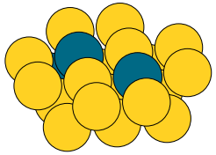

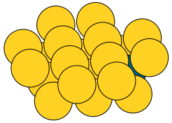
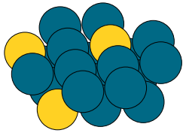
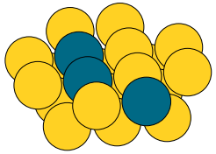
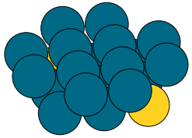

Testing my implementation
Trial dataset: 400 structures 50:50 split between 2 classes
Blue atoms: Pd, Yellow atoms: Au
Set categorical space: $\left[Au, Pd, Rh, Ni, Ga, Cu\right]$
Using Classifier free guidance: Drop probability: 10%
1000 timesteps
Tried both Uniform transitions & Absorbing state
Training set
Class 1
Class 2
Class 1
Class 2
Class 1
Class 2

Slide 21
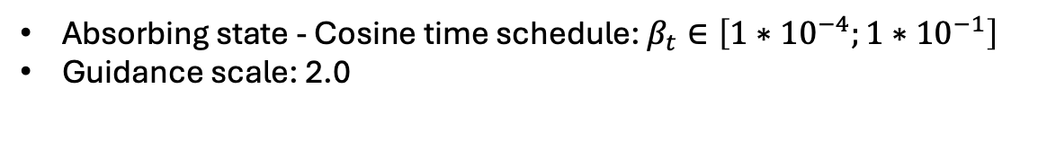
Testing my implementation
Absorbing state - Cosine time schedule: $β_{t}∈\left[1{∗10}^{−4};1{∗10}^{−1}\right]$
Guidance scale: 2.0
Conditioned on class 1
Conditioned on class 2

Slide 22

Testing my implementation
Uniform transitions - Cosine time schedule: $β_{t}∈\left[1{∗10}^{−4};2{∗10}^{−1}\right]$
Guidance scale: 2.0
Conditioned on class 1
Conditioned on class 2

Slide 23
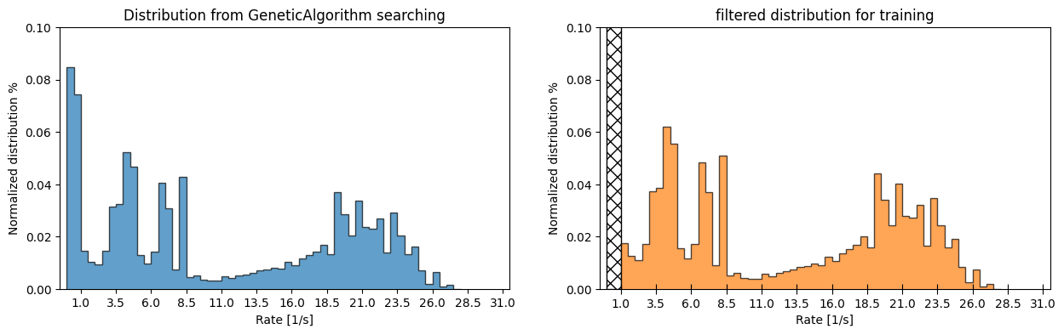

Tried conditioning on the reaction rate
Where im at now.
Tried class-divisions & samples from GeneticAlgorithm
Element pool: $\left[Au, Pd, Rh, Cu\right]$
Num samples $∼5000$

Slide 24
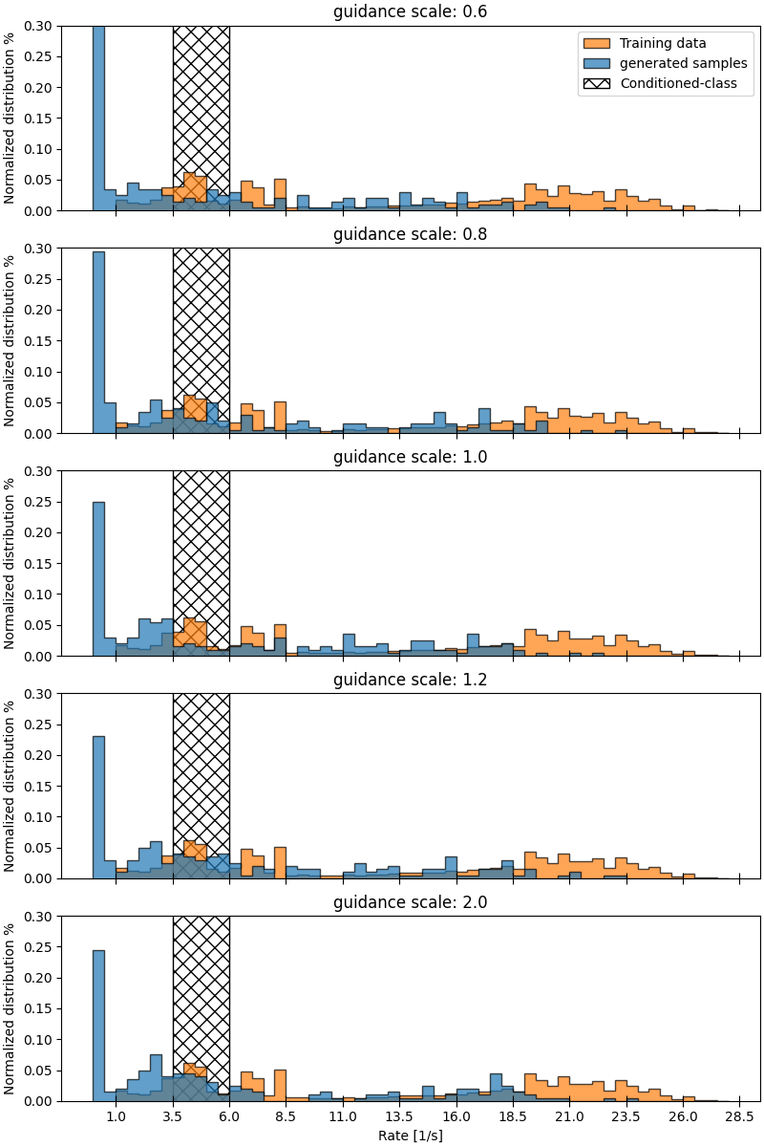
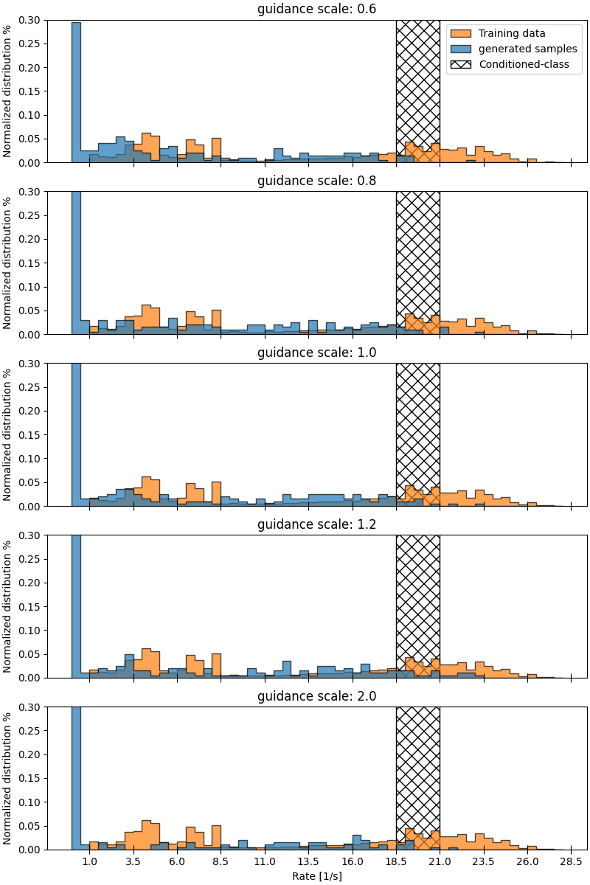

Slide 25
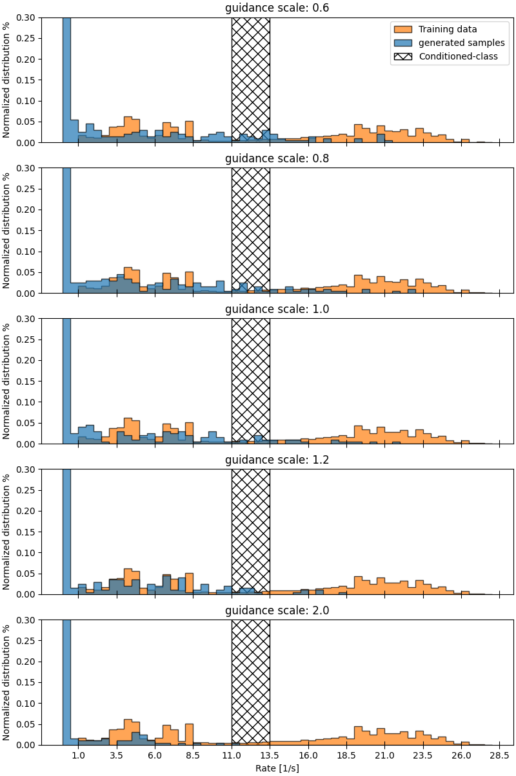
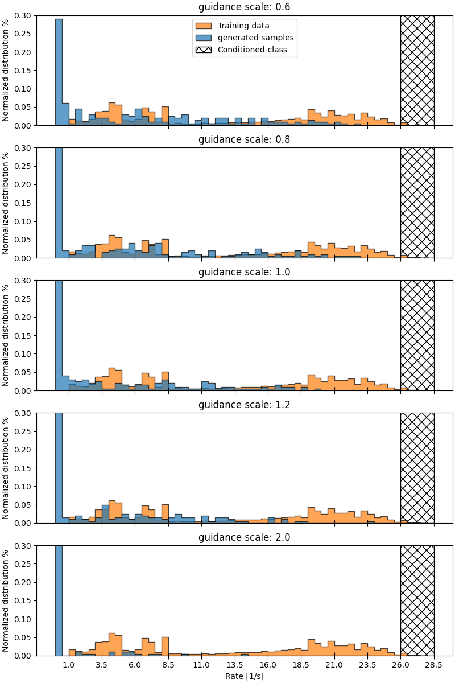

Slide 26
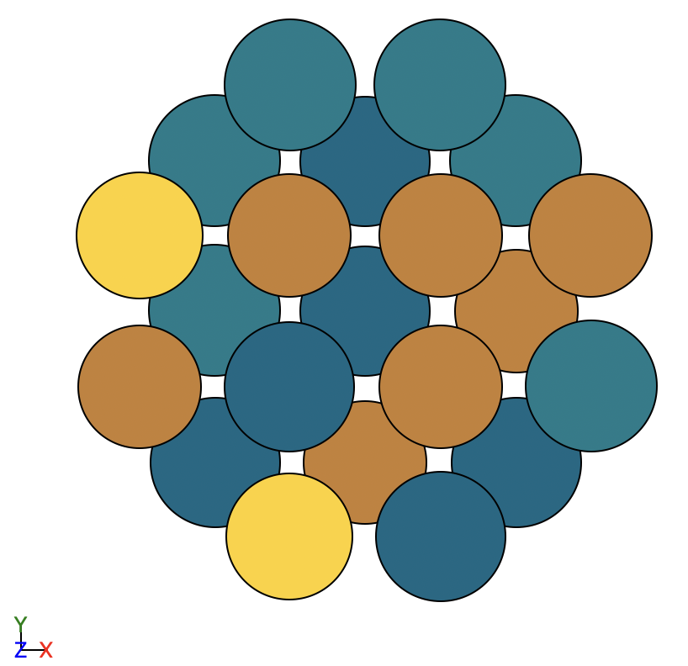
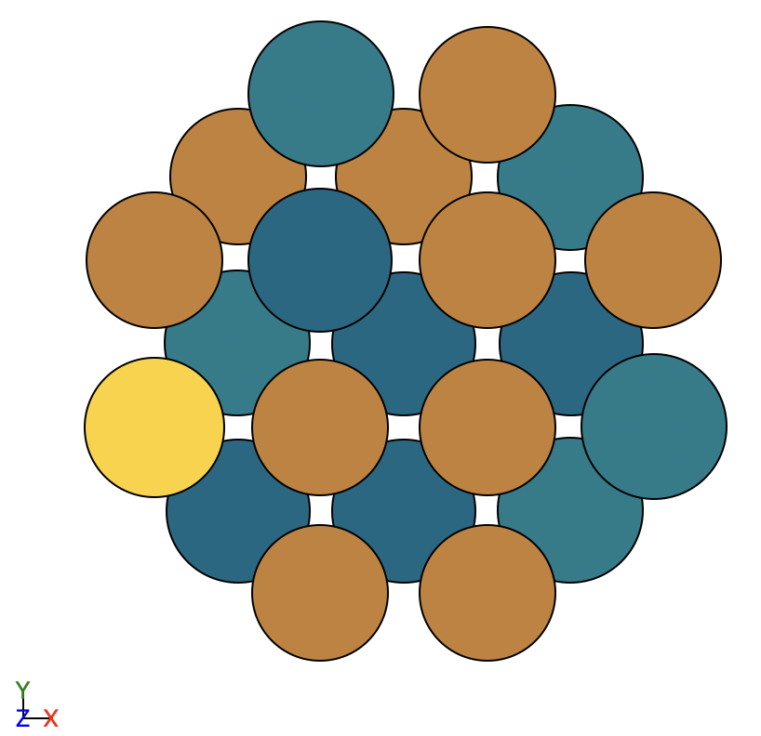


Unconditional generation on high rates only
Still not great
All samples have 3Cu + 1Pd on active sites, how many samples do i get with this configuration?

Slide 27


Unconditional generation on high rates only
If model cannot distinguish the environments the best it can do is 75% of copper and 25% Pd on the active sites alone.
$p_{3Cu+Pd}=4⋅{0.75}^{3}⋅0.25∼0.42$

Slide 28
What is the problem?
Inherit problem with discrete space diffusion
Forward noising process for each pixel/token/atom is independent → Hence sampling is also
Relies only on NN to capture semantics and generate
Rates are highly determined by ”where” these 3Cu + Pd is located
GNN only atomic embeddings + permutation invariance → no spatial awareness but all samples will for sure have 3Cu + Pd somewhere

Slide 29





Simple test
Need to embed some kind of geometrical information.
Tried unique embedding per site together with onehot
Also needed to filter out rotated versions of motif
$$\left[\begin{matrix}one hot \\ site embedding\end{matrix}\right]$$
$$\left[\begin{matrix}one hot \\ site embedding\end{matrix}\right]$$
$$\left[\begin{matrix}one hot \\ site embedding\end{matrix}\right]$$
$$\left[\begin{matrix}one hot \\ site embedding\end{matrix}\right]$$

Slide 30
Solutions
Current solution could work, but main problem is the degeneracy of the rate.
Have to sort out all rotated versions of the same motif.
Or condition on the different motifs also works
Maybe make rate calculation depend on more atoms?
Can also impose constrained sampling strategy?
Can make model learn the counts in the center

Slide 31

Solutions?
Score-based diffusion approach is maybe better
Also works for discrete space diffusion
But problem is still unsolvable without proper geometric information

