Slide 1
300mm Characterization tool prepared by Karsten Beckmann
11/18/2018

Slide 2
Summary
The program is setup to measure novel NVM devices
Parts contain:
  Automatic Data handling and storage
  Customizable electrical characterization in Python
    Instrument classes are available
  Direct plotting of traces and saving option
  Wafer plot of statistical Scalar values
  Yield and/or Spec check
  Easy programmability of measurement sequence

Slide 3
Program Overview
Initialization
config file
Configuration
Instruments
Main GUI
Execution
Prober
Matrix
Copy
Starts exc.
E-Characterization
B1500A
B1500A
Stop
ErrorQueue
E5274A
IVplotData
Oscilloscope
Warnings
Control
StatOutValues
Pulse Gen.
Results Window
creates
Results Display Handling
Statistical Data Handling

Slide 4
Program Overview
Main.py - Initialization
Copy
Instruments
Results Handling
Main GUI
E-Characterization
config file
Configuration
Warnings
Control
Prober
Matrix
Starts exc.
B1500A
Results Window
B1500A
Stop
ErrorQueue
E5274A
Prober Window
IVplotData
Oscilloscope
StatOutValues
Pulse Gen.
Statistical Output Window
creates
Execution
Statistical Data Handling

Slide 5
Variables
E-Characterization
  StatOutValues: Data Handling Batch class
    Receives Data Handling Row class
  IVplotData: Queue
    Receives a dictionary with keys: “Traces”, “Xaxis” (makes first list in Traces the x axis), “Xlabel”, “Ylabel”, “Title”, “MeasurementType”, “ValueName”
  ErrorQueue: Queue
    Receives warning from instruments during execution.
  Stop: Queue
    Receives stop signal from the GUI, can be used during e-char definition to stop long programs i.e. Retention and endurance

Slide 6
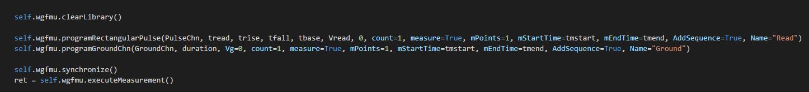

Creation of a custom Measurement
Check if all your instruments are available – currently supported:
  B1500A (self.B1500A)
  B1530A (self.wgfmu)
  E5274A (8 SMU Mainframe) (self.E5274A)
  Agilent 81110A (Pulse Generator) (self.PG81110A)
  LeCroy WavePro 740Zi (Oscilloscope) (self.Oscilloscope)
  Matrix and Prober control are implemented in the base program
Define your definition variables (SMU’s, Pulse Channels, voltages, currents etc)
  Make sure you have comments below to explain each variable
Define your characterization and execute it
  Example for B1530A read:
Calculate the desired values from what the tool class returns (I-V or C-V data)

Slide 7
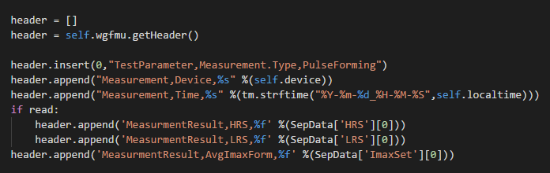
Creation of a custom Measurement
Create your header:
  Pull the header from the tool and add your stuff for the measurement you are performing:
Head the retrieved data to another Thread to save it:
  The dataStr is a 2D list of your values, the outer list contains the rows.
  Make sure your last header rows contain the column Names in the correct order (V, I, t, R etc)
Create your data handling (dh) values and add them to a row as a list:
Calculate the Values from what the Tool Class returns (I-V or C-V data)

Slide 8

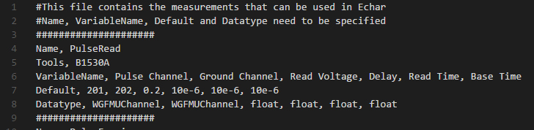
Creation of a custom Measurement
Add a row to the Batch class which is ‘self.StatOutValues’
  The execution will grab this Batch after the Measurement is complete and combine Values with the same Name (i.e. LRS or HRS)
After the program has been build it needs to be added to the Measurement File:
  Name must be the exact name of the Definition, case sensitive (White spaces get removed)
  Tools, refers to the required tools (B1530A is the WGFMU)
  VariableName will show up in the GUI
  Datatype, standard values are float, bool, int. Some tools have special menu option i.e. WGFMUChannel

Slide 9
Statistical Data Handling
This sub-program consists of 3 classes:
  Value
  Row
  Batch
Value
  contains a statistical
  representation of a list of
  values (or a single value initially)
Row
  Contains Values and Handles their merging when calculating Die/Device summary or measurement summary
Batch
  Contains a list of rows and handles the saving of those
Batch
Row 1
Value 1
Value 2
Value 3
Row 2
Value 1
Value 4
Value 5
Row n
Value 2
Value n
Value 4

Slide 10
Configuration
This class governs all critical information for the measurement
  Yield/Specs (extracted from a file and filtered with the SpecCode
  Matrix list (extracted from a file)
  Wafer information
  Die Information
  Instrument values
  Various other parameters

Slide 11
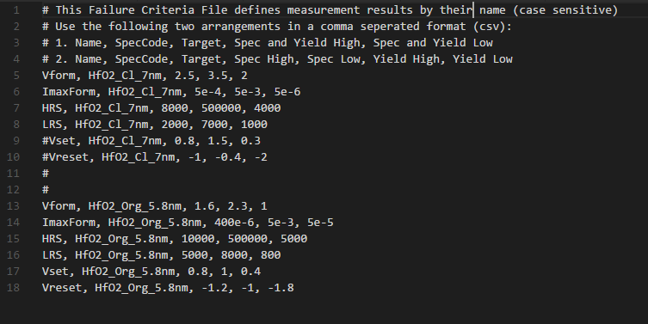
Spec File
The Spec file is integrated with the Configuration Class handling the filtering of the file while the Specs is sent to each “Value” class to determine the Yield
‘#’ starts a comment line

Slide 12
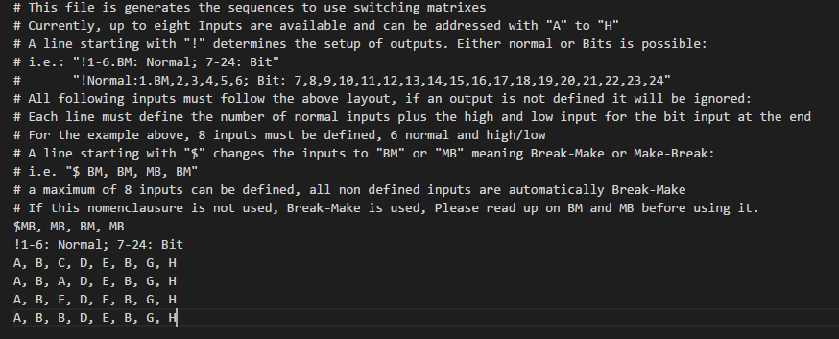
Matrix File
Be aware that the Bit input can very quickly result in a large number of measurements: 2^3 = 8, 2^16=65536
‘#’ starts a comment line

