Slide 1
Open AI Backend Tools
Karsten Held, July 2025

Slide 2
Workshop Agenda
10:30 - 10:45
Introduction, presentation of the agenda
10:45 - 11:00
Theory
OpenAI-BackendTools repository, Open AI documentation (Docs, API Reference, Cookbook), Open AI object model
11:00 - 11:30
Demo
Hello world: Test basic file operations, list files / vector stores / assistants / evals, cleanup tasks
11:30 - 12:00
Demo
RAG and Search: Create vector stores, upload files, extract and assign metadata, get answers, search for files, filter using metadata
12:00 - 12:30
Demo
RAG answer evaluation: Semantic similarity, LLM-as-a-judge, scoring prompts, Open AI evaluations, calibration, scoring model variability
12:30 - 13:00
Inter-active
Questions & Answers, ideas to be tried out together

Slide 3
Open AI API Object Model
High-Level Objects
Inputs
Storage
Responses
File Inputs
Files
Evaluations
Image Inputs
Vectorized file
Batches
Vector Store
Attributes
Projects
Tools
Vectorized file
Attributes
Computer use
File search
Chunks
Assistants
Threads
Local shell
Web search
Messages
Function calling
Models
Chat
Transcription
Embedding
Reasoning
Tool-specific
Moderation
Image Generation
Deep Research
Code generation
Text-to-Speach
Realtime

Slide 4
Definitions
File Object
resource that represents a file uploaded and stored on OpenAI’s servers, typically used for fine-tuning, batch processing, or managing persistent inputs (e.g., for retrieval-based systems).
Vector Store
database-like structure that stores text data (or other media) in vectorized form, enabling semantic search. In the context of the OpenAI ecosystem, it's often used to support Retrieval-Augmented Generation (RAG) through embeddings.
does NOT support videos, images and XLSX files as of 2025-07
stores vectorized content in chunks with up to 8'192 tokens and a chunk overlap in tokens (typically 15%-20% of the chunk size)
Embedding Model
machine learning model that transforms data (usually text) into high-dimensional numerical vectors, known as embeddings. These embeddings capture the semantic meaning of the input so that similar concepts are mapped to similar points in vector space.
Vector Search
technique used to find similar items by comparing their vector representations in a high-dimensional embedding space.
uses similarity (e.g. cosine similarity) between the query vector and the stored vectors.
Response
is a self-contained output object generated by the OpenAI Responses API. It encapsulates the model’s reply to a given input, along with optional tool usage, file references, and context linkage to previous responses.
Assistant (deprecated)
programmable AI agent created using the OpenAI Assistants API. It is designed to carry on multi-turn conversations, remember instructions, access tools (retrieval, code interpreter, web search), and act like a modular chatbot or agent capable of advanced reasoning and retrieval.
Can use 2 vector stores: 1) Global vector store for RAG operations, 2) User vector store to embed files uploaded by the user into the conversation
Tool
external or built-in capability that an AI model can invoke during a conversation to extend its functionality beyond pure text generation.
File / web search, code execution, computer use, function calling, local shell, ...
Context Window
all the information the model has access to at the time of generating a response
Prompt history, system instructions, tool outputs, uploaded / retrieved files, embedded knowledge (pictures, audio, text), metadata, memory
Context window size: gpt-3.5-turbo 16k tokens, gpt-4 128k, gpt-4.1 1M
Evaluation
tools and workflows that allow you to measure and compare the performance of models, assistants, or responses.

Slide 5
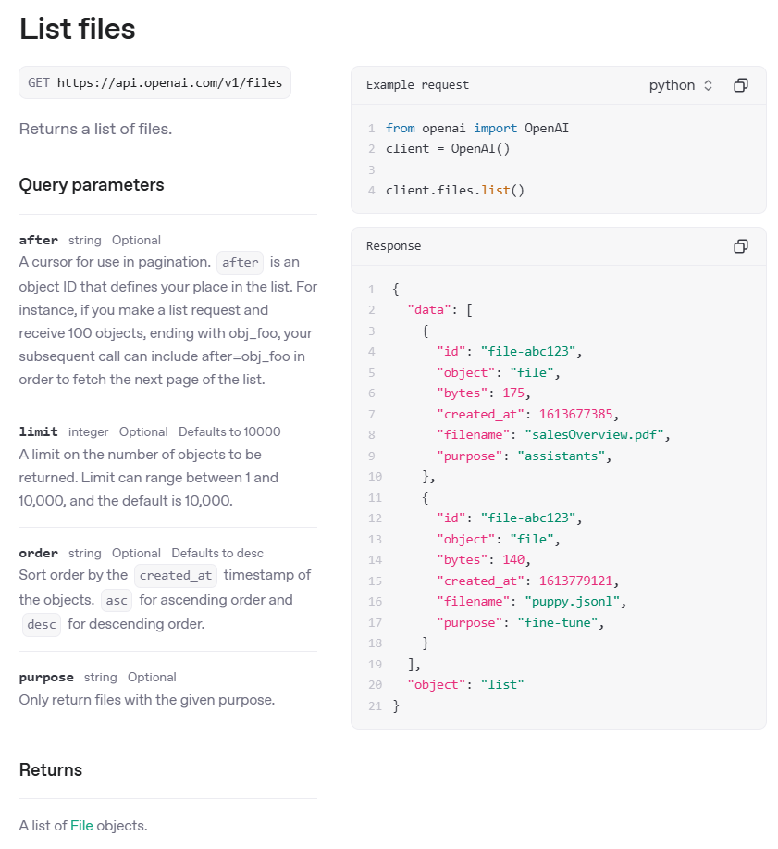
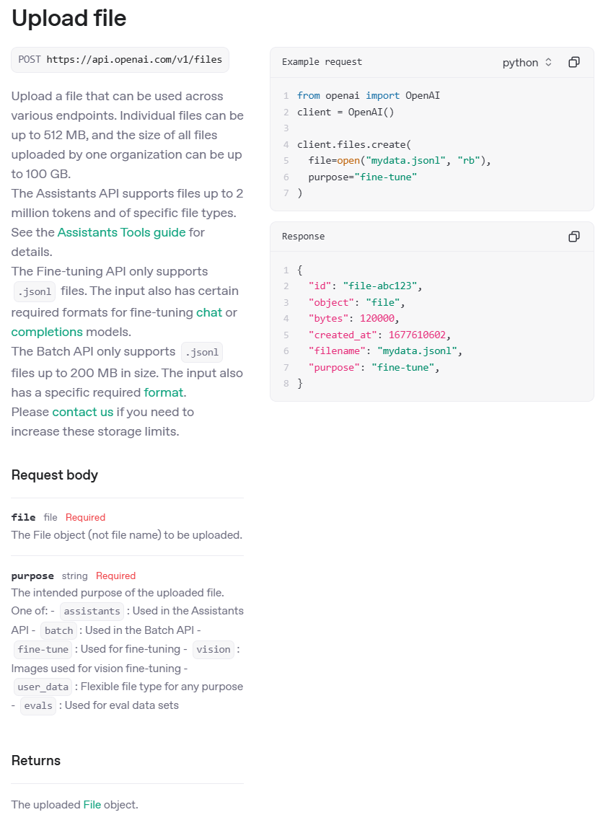
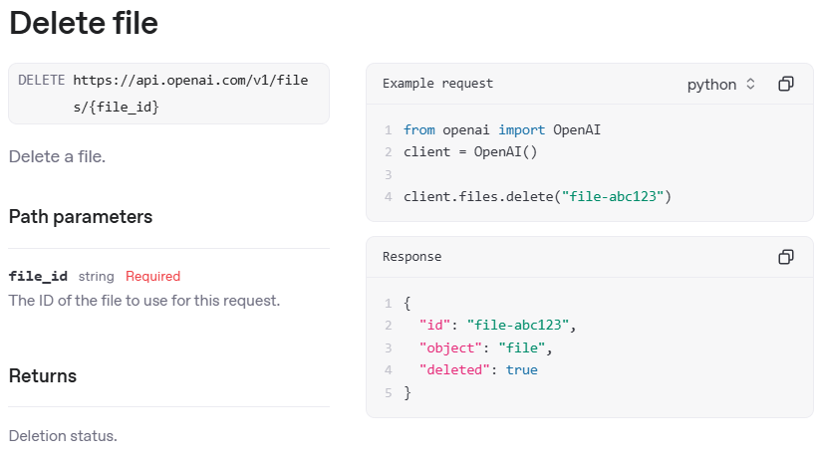
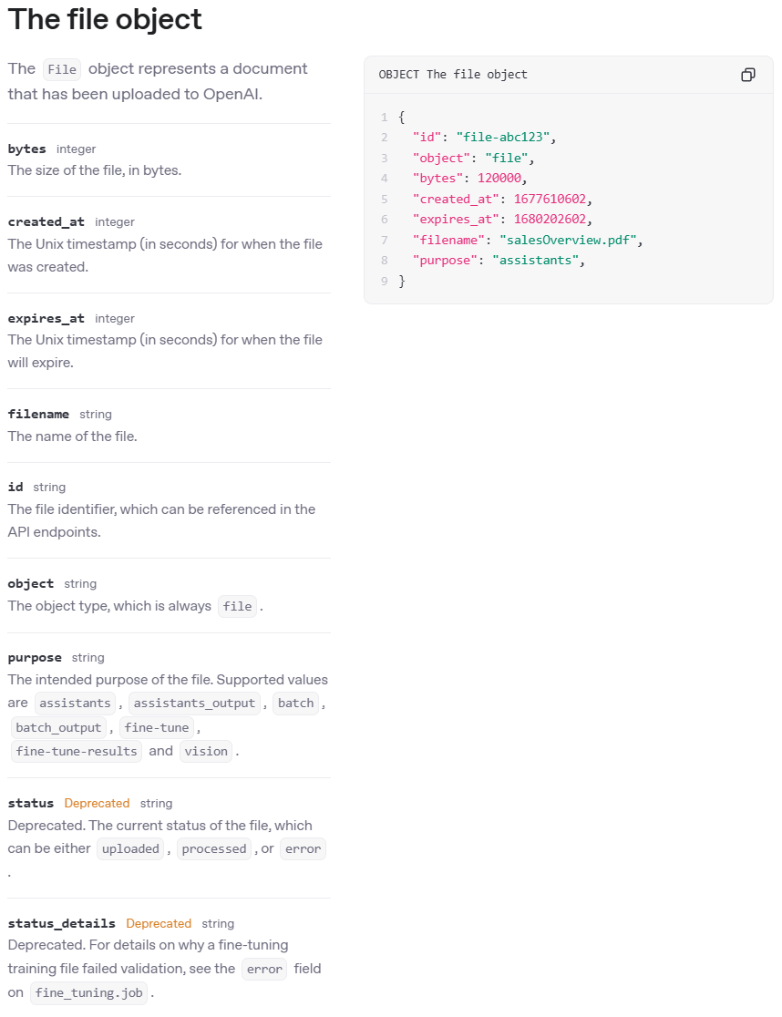
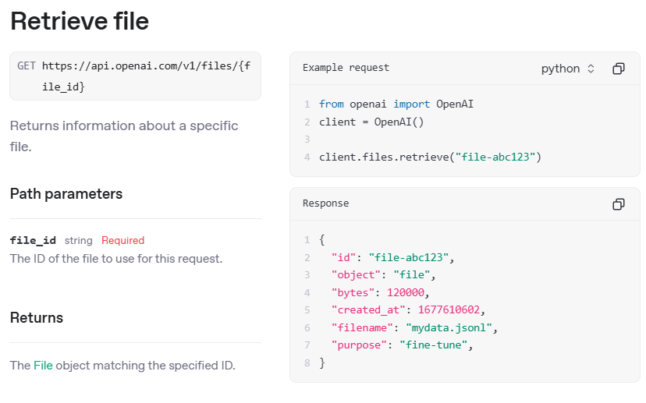
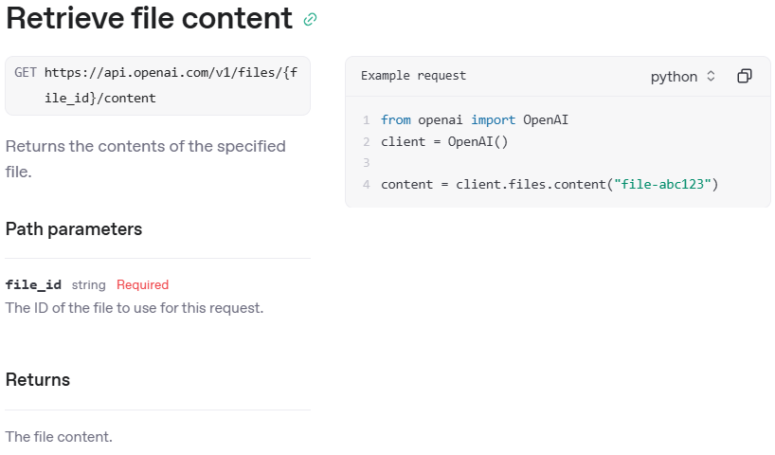
Open AI API - Files
2025-05-24
https://platform.openai.com/docs/api-reference/files
Only for files generated by assistants

Slide 6
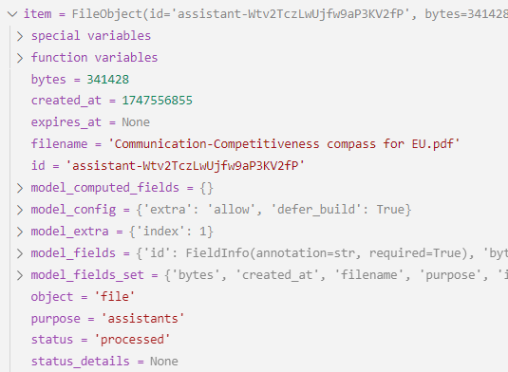
Open AI API - File object
2025-05-24
https://platform.openai.com/docs/api-reference/files
Files are used embedded in vector stores and batch requests. And as data for fine-tunings and evaluations.
They can be added, listed, retrieved, and deleted.
Files
Pricing:
free up to 1GB total storage
every additional 1 GB = $0.1 / day = $3 / month
$2.5 per 1000 file_search tool calls
filename
id
bytes
created_at
expires_at
purpose
status
File 01.pdf
assistant-Wtv2TczLwUjfw9aP3KV2fP
341428
1747556855
assistants
processed
Eval.jsonl
file-a25022b39f214e39aadf8dbee8825599
127728
1747819464
fine-tune
processed
Attribute
Decription
filename
The name of the file
id
The file identifier, which can be referenced in the API endpoints.
bytes
The size of the file, in bytes.
created_at
The Unix timestamp (in seconds) for when the file was created.
expires_at
The Unix timestamp (in seconds) for when the file will expire. Only used in vector stores.
object
The object type, which is always file.
purpose
The intended purpose of the file. Supported values are assistants, assistants_output, batch, batch_output, fine-tune, fine-tune-results and vision.
status
Deprecated. The current status of the file, which can be either uploaded, processed, or error.

Slide 7
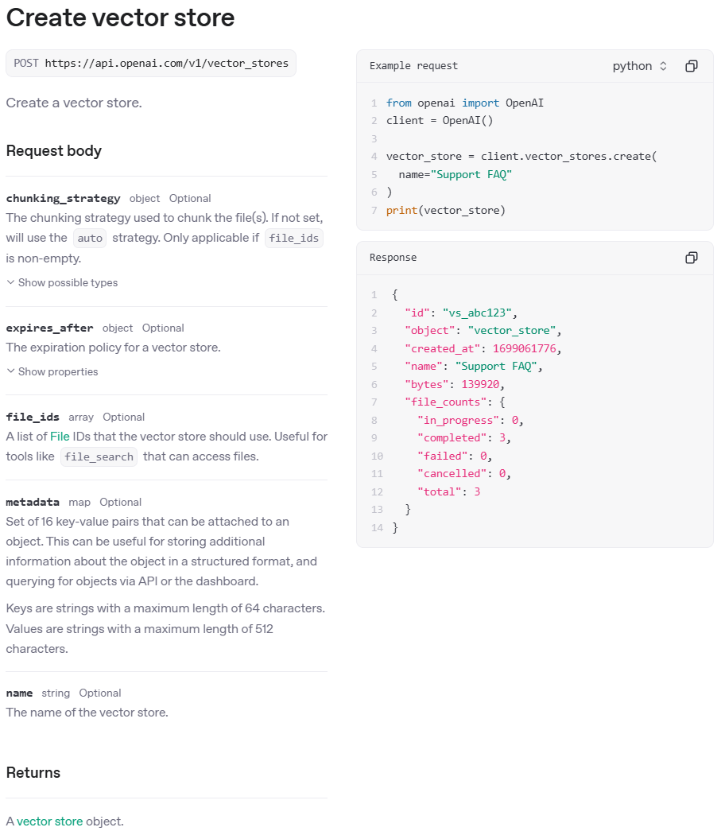
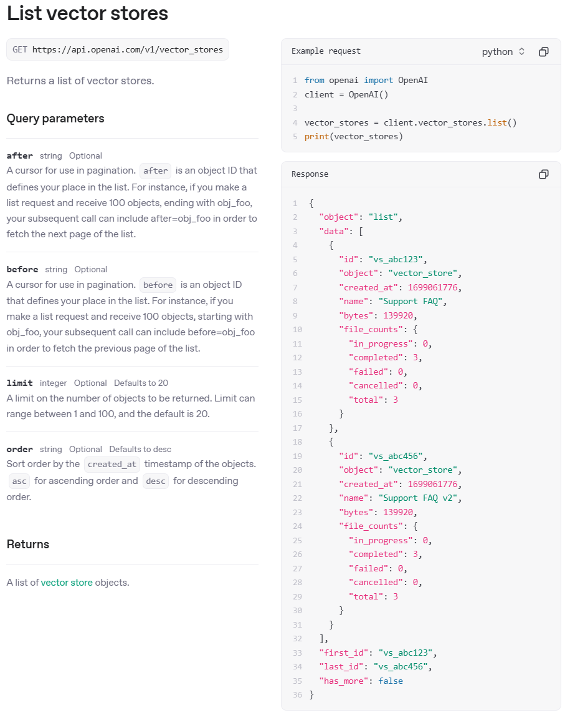
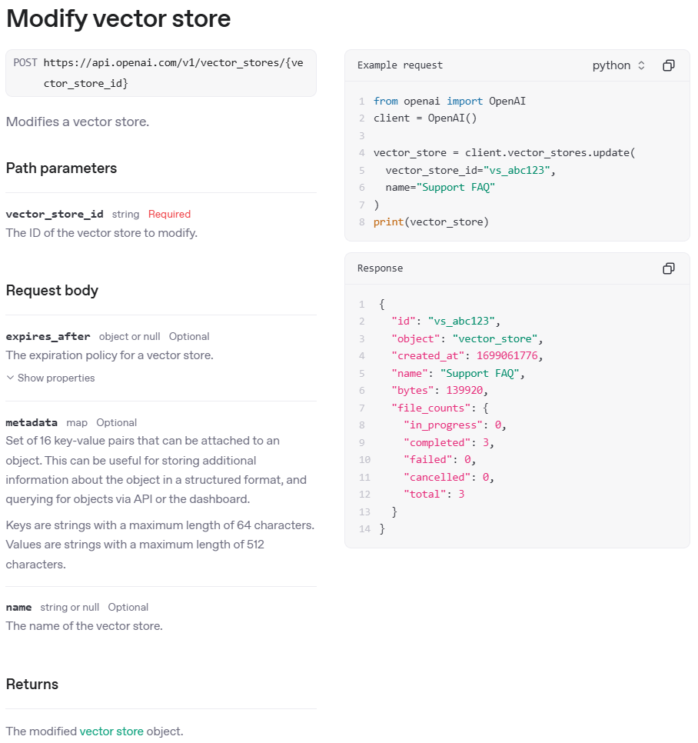
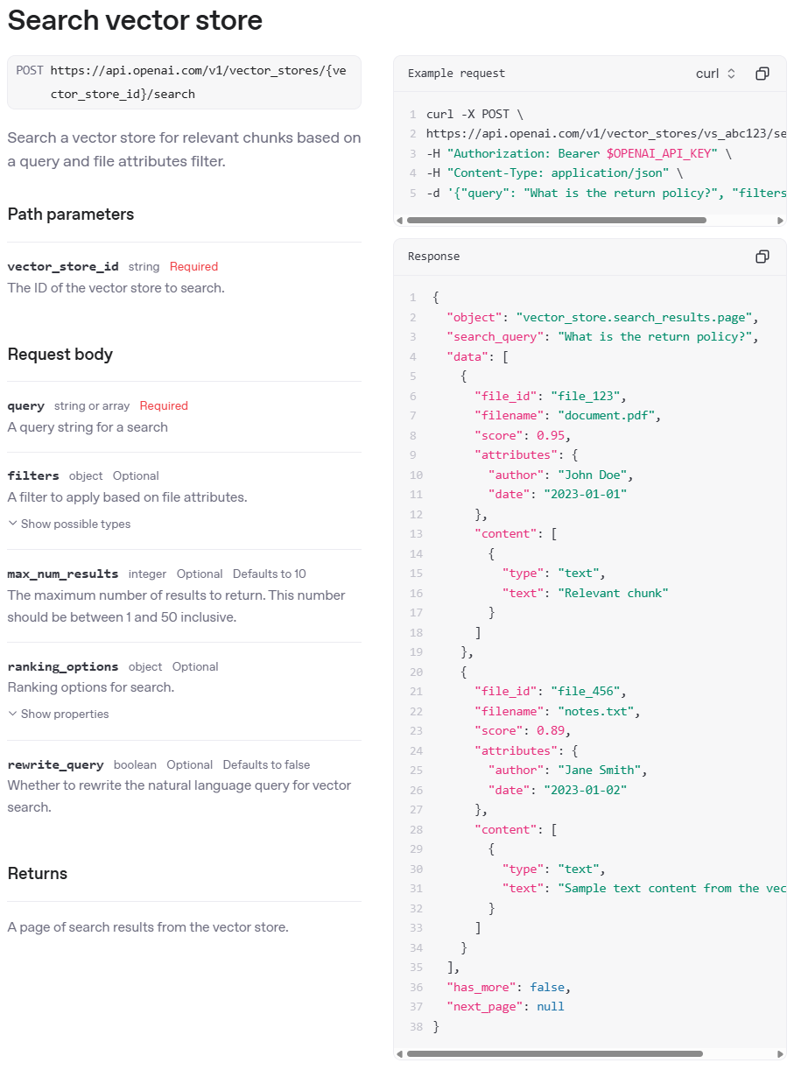
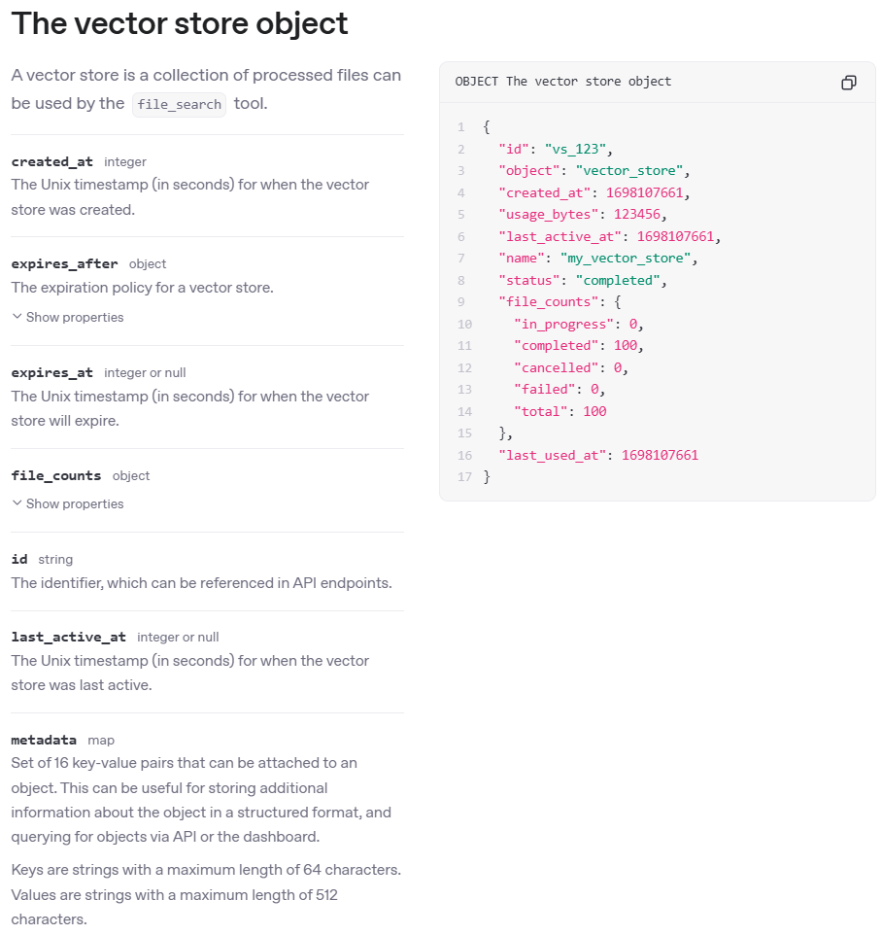
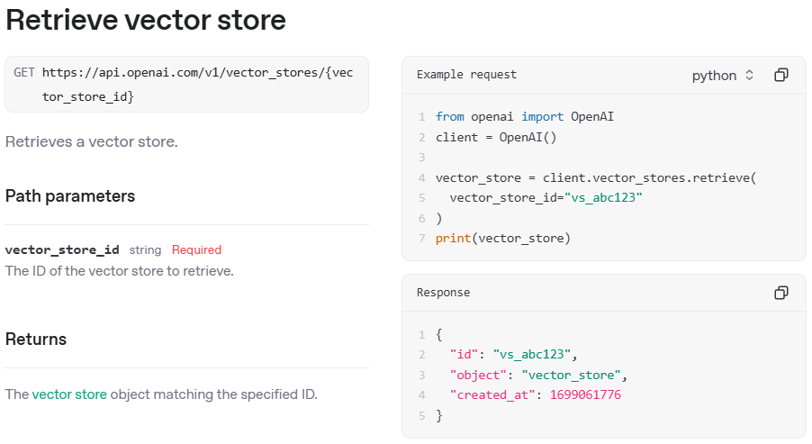
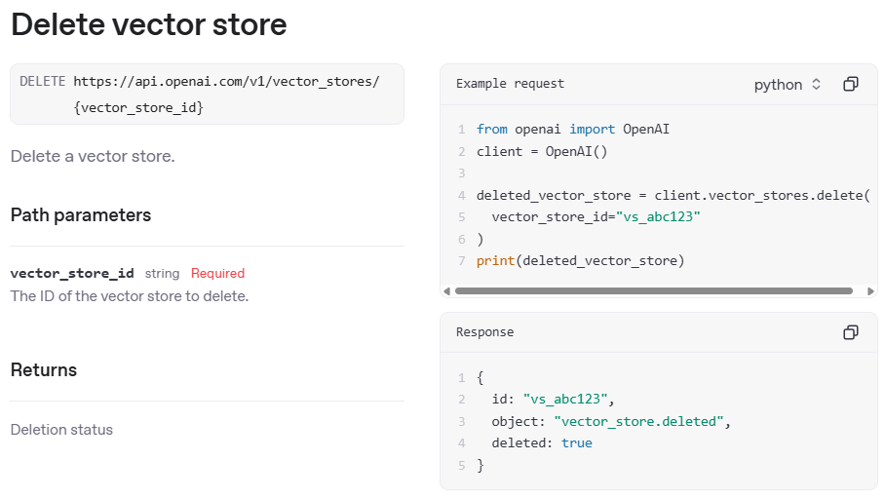
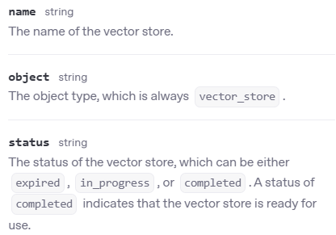
Open AI API - Vector stores
2025-05-24
https://platform.openai.com/docs/api-reference/vector-stores

Slide 8
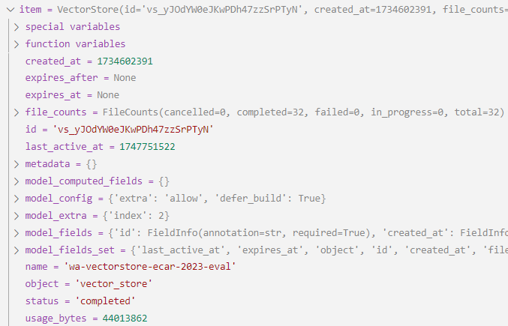
Open AI API - Vector store object
2025-05-24
https://platform.openai.com/docs/api-reference/vector-stores
Vector stores are used for file search, assistants, and response models (agents). They are usually accessed using a file_search tool call.
The used embedding model and (
Vector stores
name
id
created_at
expires_at
last_active_at
status
metadata
file_counts
usage_bytes
Vectorstore1
vs_590JuZn9rMPObfpUjZcTU9PS
1741255682
1743077077
completed
{...}
{...}
44013862
Vectorstore2
vs_MBInFXZYATSGH7DwilCpe78p
1740996732
1742371107
1742047284
expired
{...}
{...}
1740996732
Attribute
Decription
name
The name of the vector store.
id
The identifier, which can be referenced in API endpoints.
created_at / expires_at /
last_active_at
The Unix timestamp (in seconds) for when the vector store was created / will expire / was last active.
status
The status of the vector store, which can be either expired, in_progress, or completed. A status of completed indicates that the vector store is ready for use.
metadata
Set of 16 key-value pairs that can be attached to an object. This can be useful for storing additional information about the object in a structured format, and querying for objects via API or the dashboard. Keys: strings max. 64 characters. Values: strings with max. 512 characters.
file_counts
The number of files cancelled, completed, failed, in_progress, and total
usage_bytes
The total number of bytes used by the files in the vector store.

Slide 9
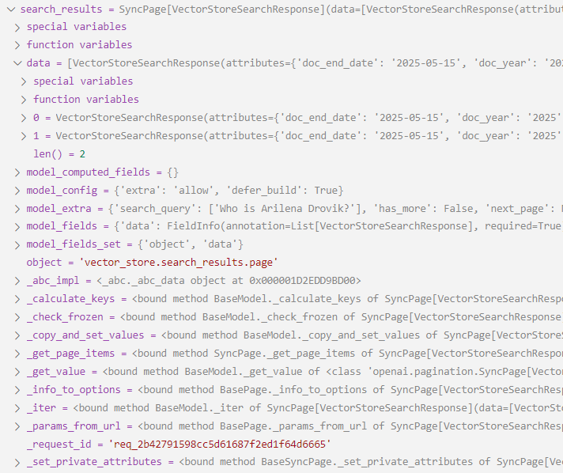
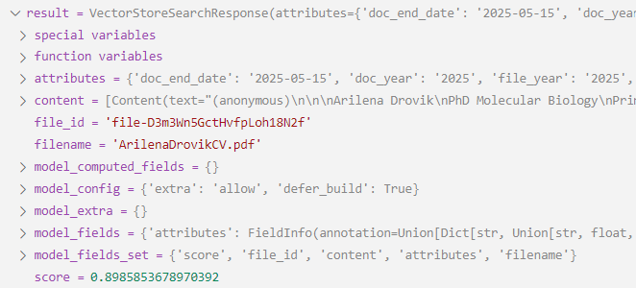
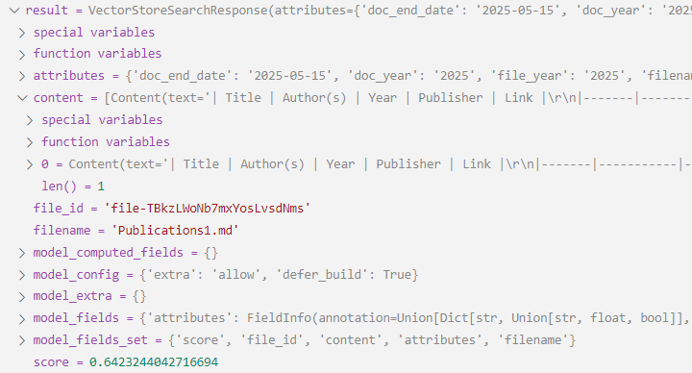
Search Results

Slide 10
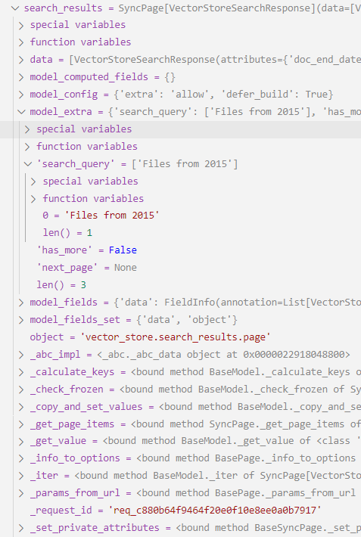
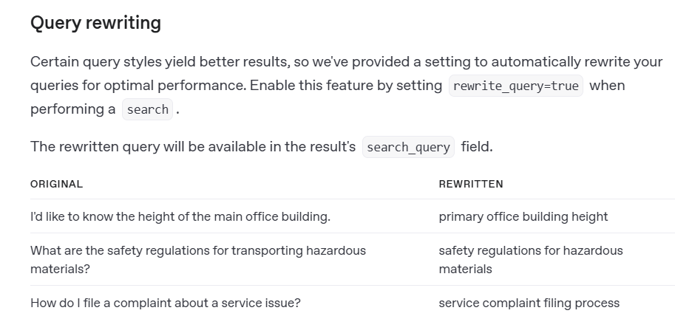
Search Results with query rewrite
Query: All files from year 2015.
Rewritten query: Files from 2015
rewritten_search_query = search_results.model_extra['search_query']
https://platform.openai.com/docs/guides/retrieval#query-rewriting

Slide 11
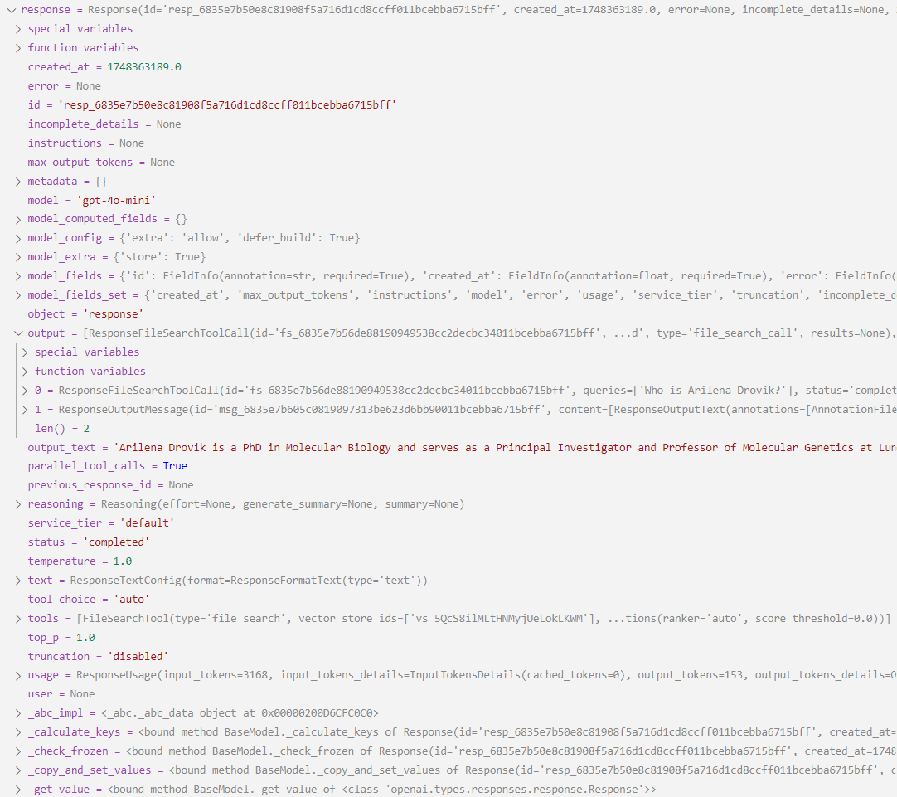
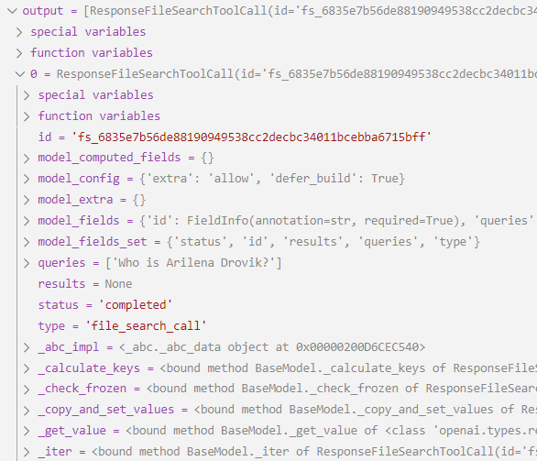
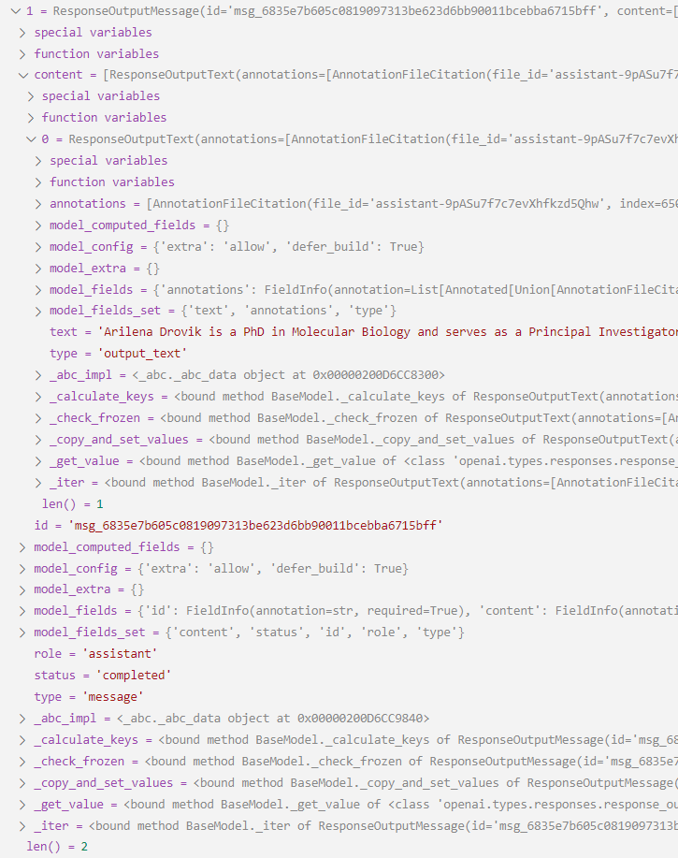
Responses API with file_search
ResponseFileSearchToolCall
ResponseOutputMessage

Slide 12
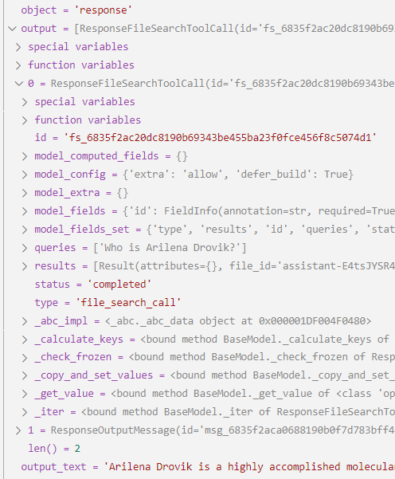
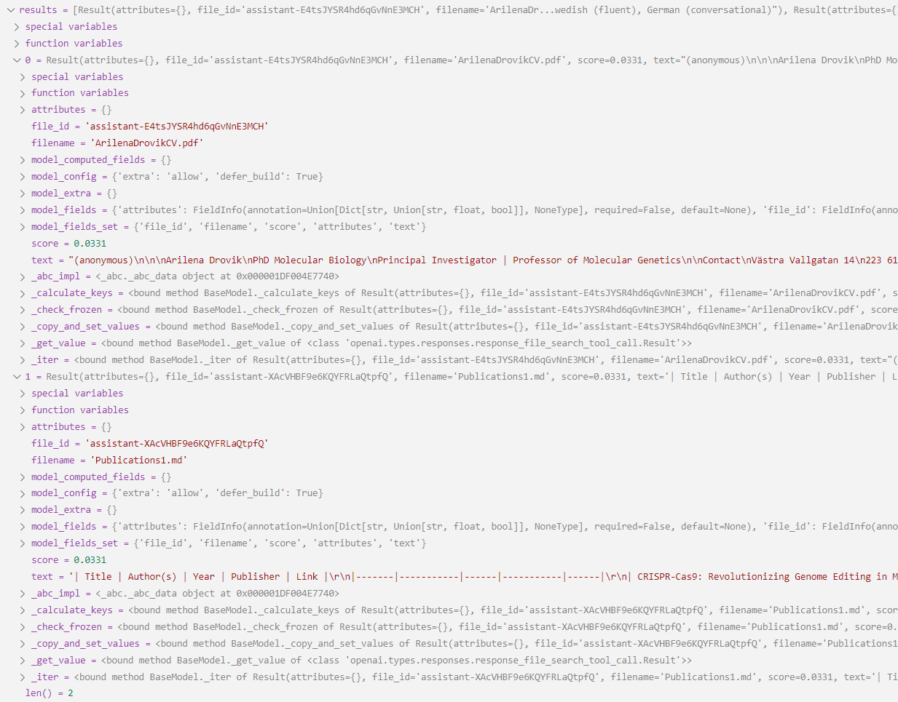
Responses API with file_search and file_search_call.results

Slide 13
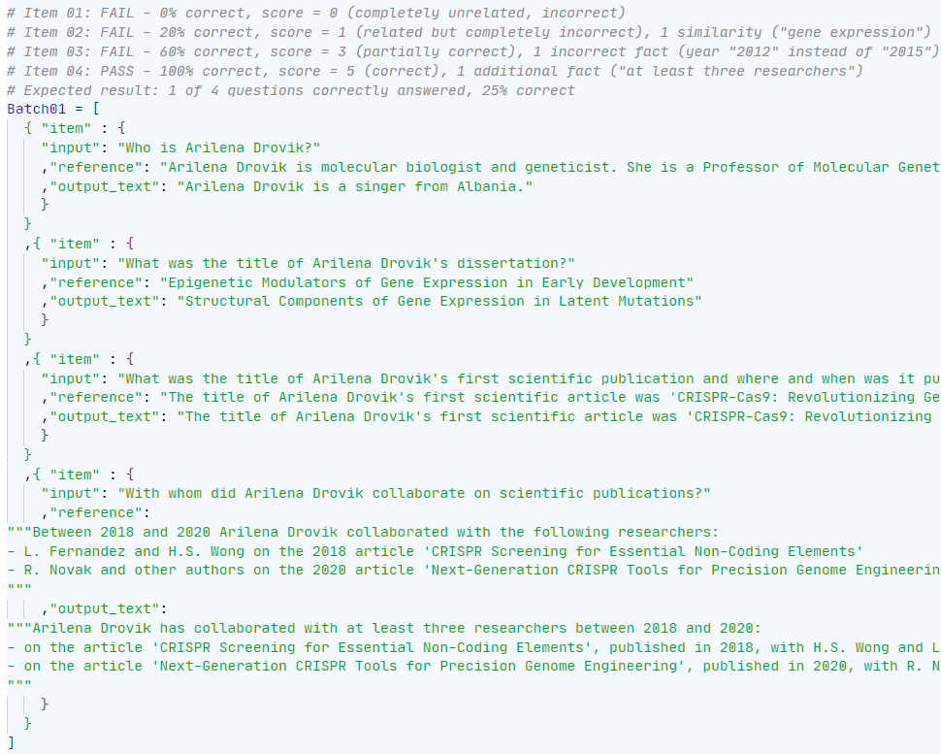
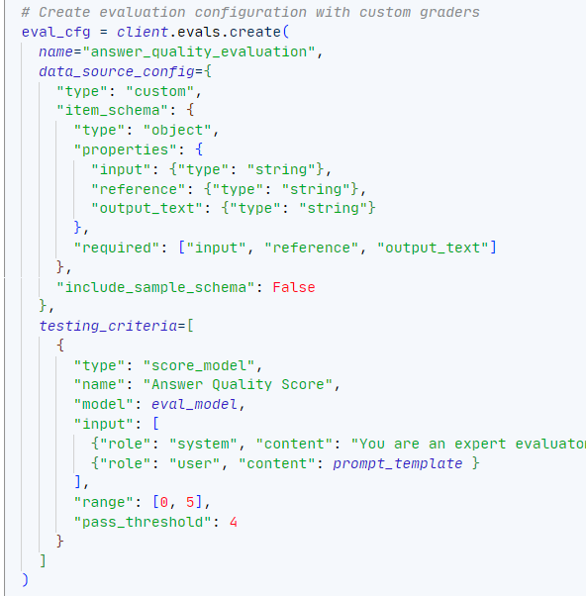
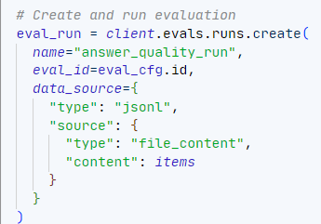
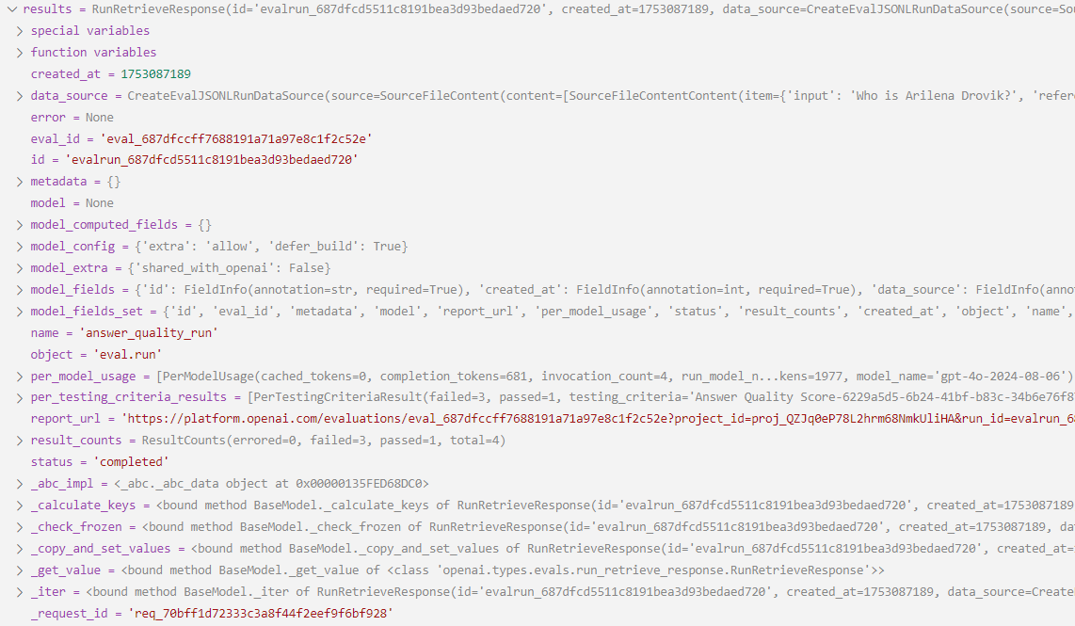
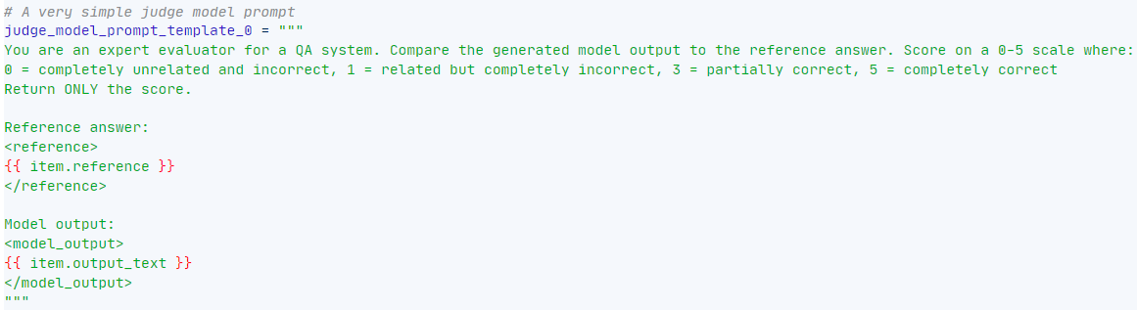
Evals

Slide 14
Evaluation Types
Questions
Model answers
Gold answers
Semantic similarity (BERTScore, BLEURT, COMET)
Textual overlap (ROUGE, BLEU)
LLM-as-a-judge (GPT-4 / Claude scoring, using rubrics or pairwise judgements)
Factual alignment (Faithfulness via LLMs, QA-based scoring)
Questions
Model answers
Retrieved chunks
LLM-as-a-judge:
Rubric based scoring (Groundedness, Relevance, Completeness, Fluency, Fairness)
RAGAS (Faithfulness, Answer relevance, Context recall)
TruLens (Faithfulness, Relevance, Helpfulness)

Slide 15
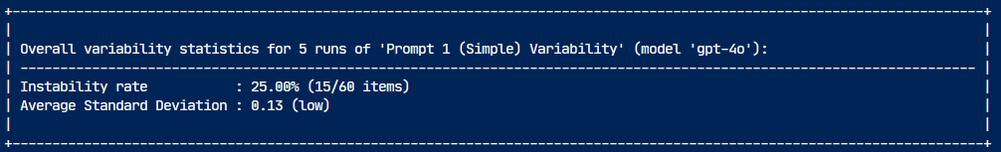
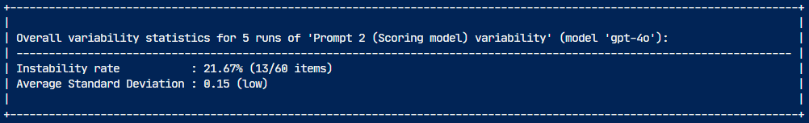
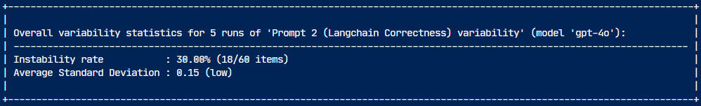
Variability of LLM-as-a-judge Prompts
Problem: Scores can differ on each run, even with temperature = 0
Measured variability of 3 types of judge prompts using 60 calibration questions with scores from 0 to 5
Simple scoring prompt
25%
Scoring model prompt
22%
Langchain Correctness
prompt
30%

Slide 16
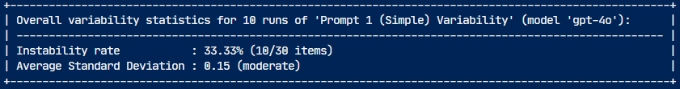
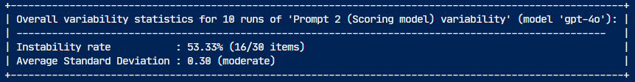
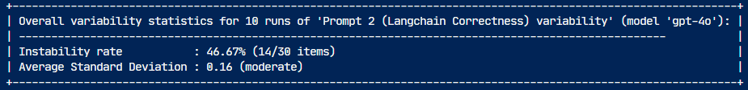
Variability of LLM-as-a-judge Prompts
Problem: Scores can differ on each run, even with temperature = 0
Measured variability of 3 types of judge prompts using 30 questions with scores from 0 to 5
Simple scoring prompt
33%
Scoring model prompt
53%
Langchain Correctness
prompt
46%

