Slide 1
Open AI Backend Tools
Karsten Held, May 2025

Slide 2
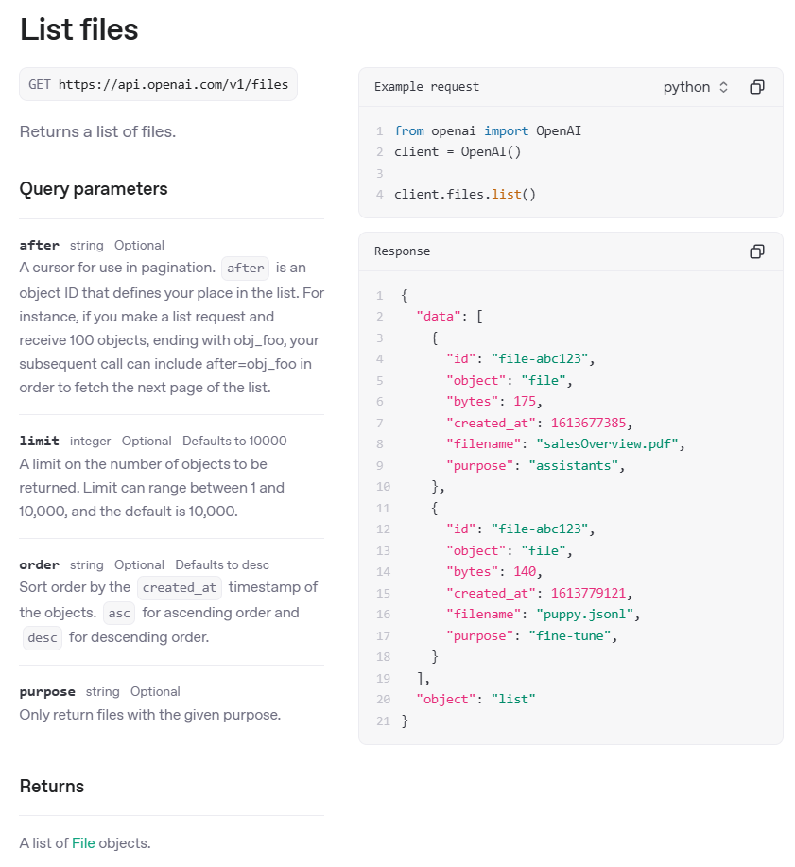
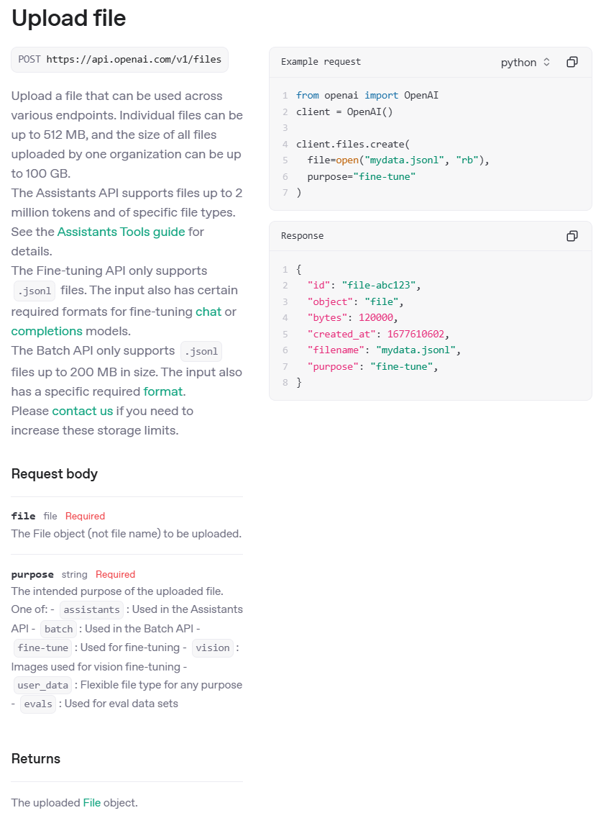
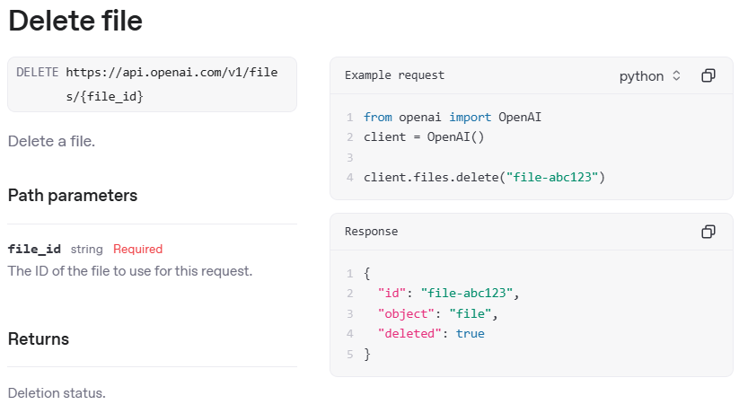
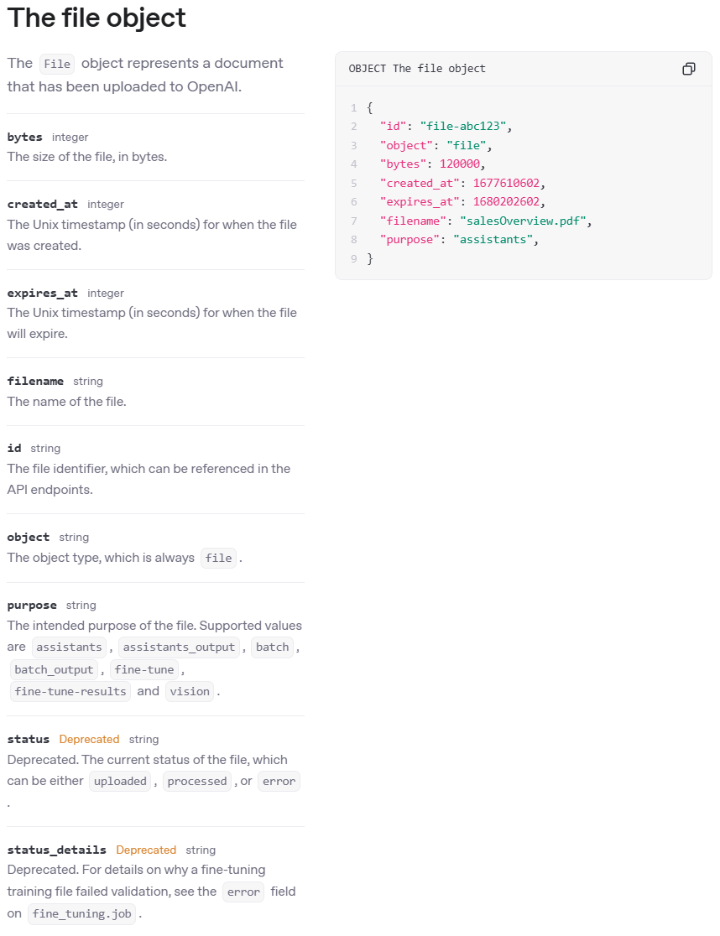
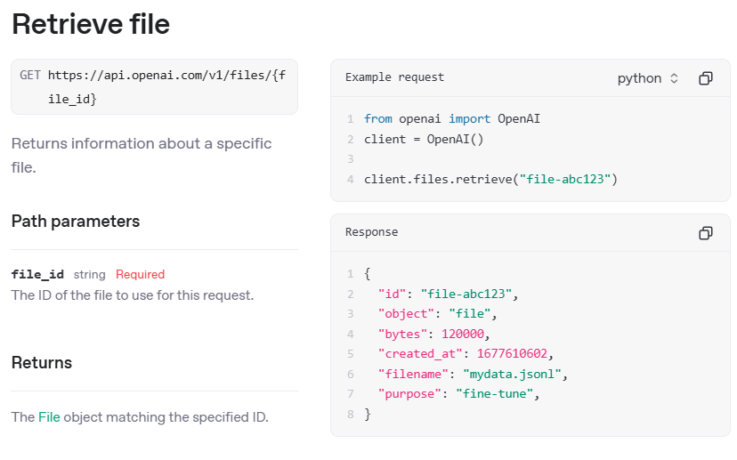
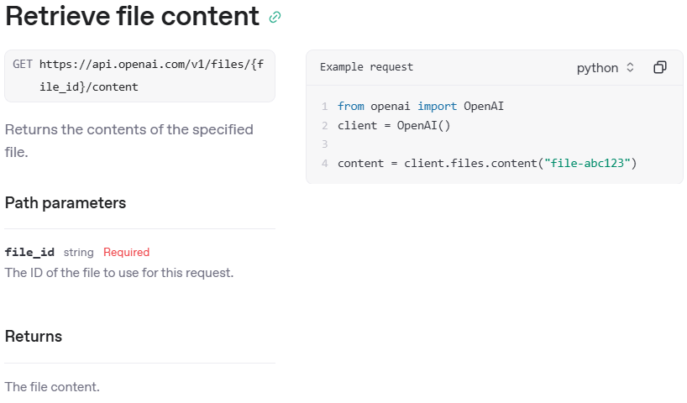
Open AI API - Files
2025-05-24
https://platform.openai.com/docs/api-reference/files

Slide 3
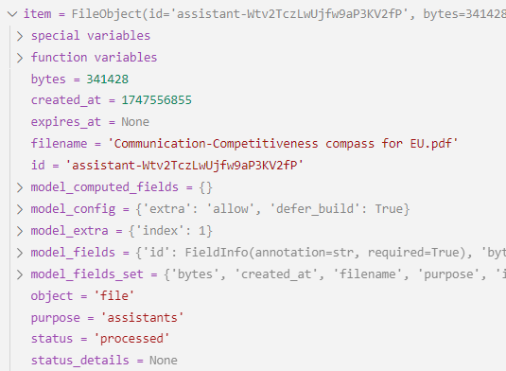
Open AI API - File object
2025-05-24
https://platform.openai.com/docs/api-reference/files
Files are used embedded in vector stores and batch requests. And as data for fine-tunings and evaluations.
Files
Pricing:
free up to 1GB total storage
every additional 1 GB = $0.1 / day = $3 / month
$2.5 per 1000 file_search tool calls
filename
id
bytes
created_at
expires_at
purpose
status
File 01.pdf
assistant-Wtv2TczLwUjfw9aP3KV2fP
341428
1747556855
assistants
processed
Eval.jsonl
file-a25022b39f214e39aadf8dbee8825599
127728
1747819464
fine-tune
processed
Attribute
Decription
filename
The name of the file
id
The file identifier, which can be referenced in the API endpoints.
bytes
The size of the file, in bytes.
created_at
The Unix timestamp (in seconds) for when the file was created.
expires_at
The Unix timestamp (in seconds) for when the file will expire. Only used in vector stores.
object
The object type, which is always file.
purpose
The intended purpose of the file. Supported values are assistants, assistants_output, batch, batch_output, fine-tune, fine-tune-results and vision.
status
Deprecated. The current status of the file, which can be either uploaded, processed, or error.

Slide 4
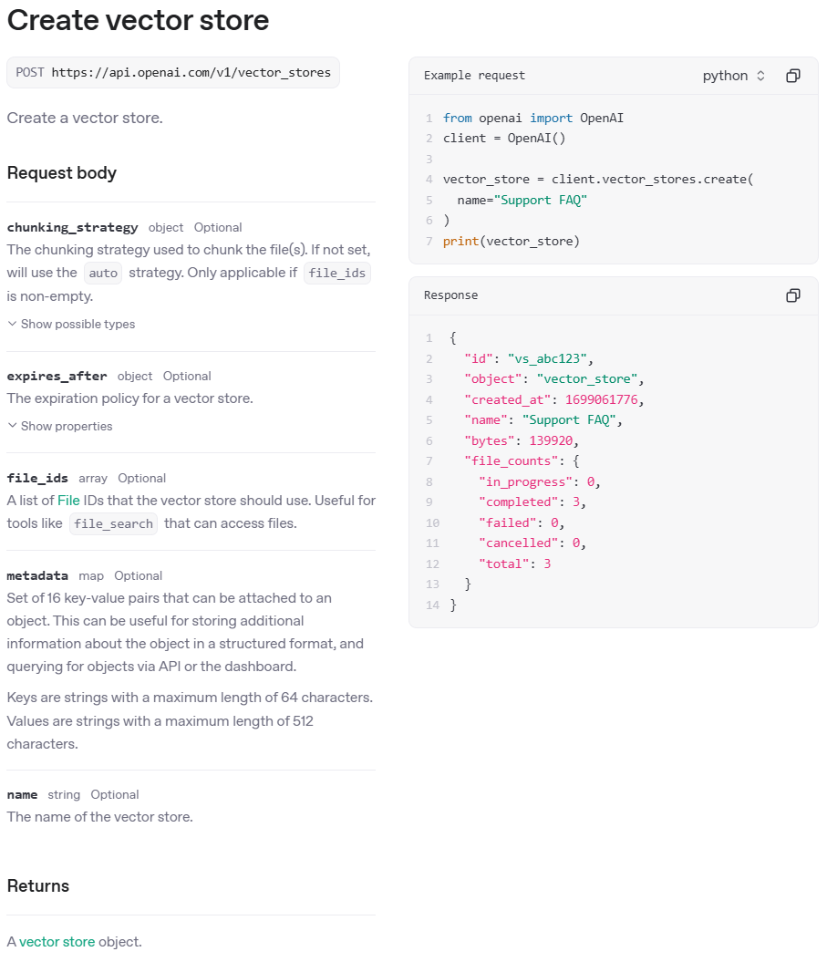
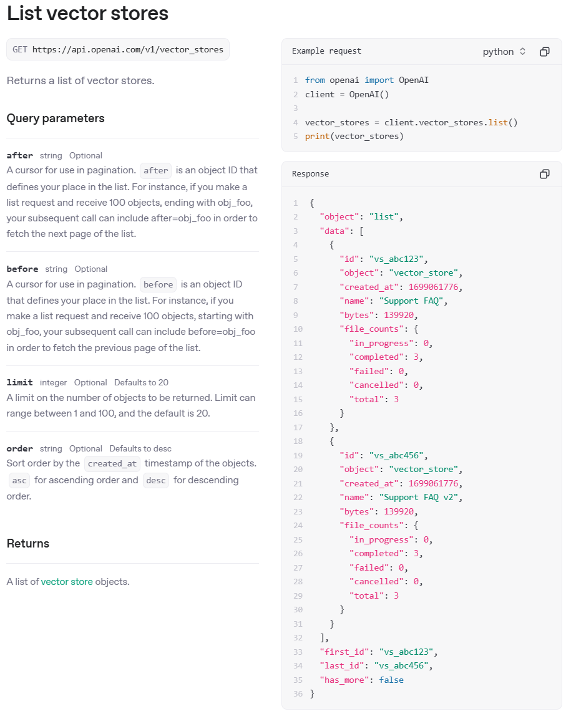
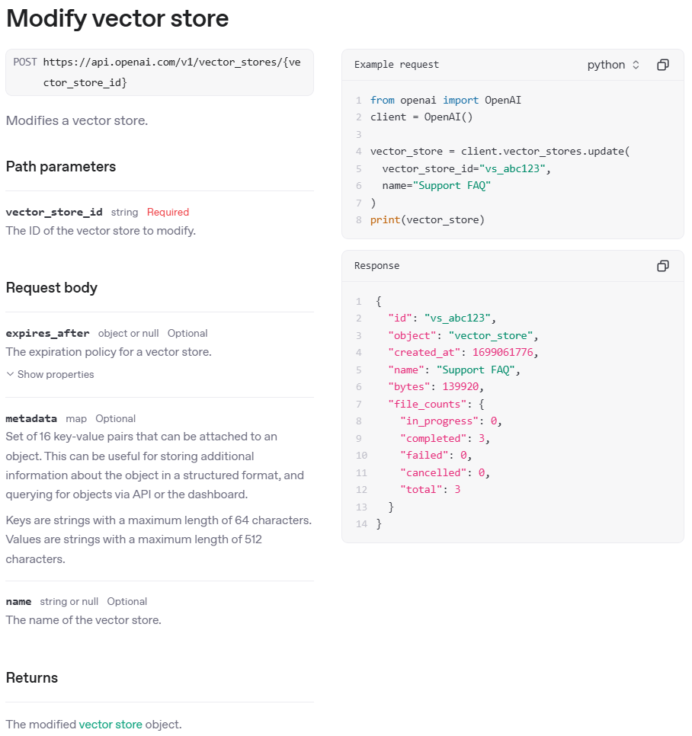
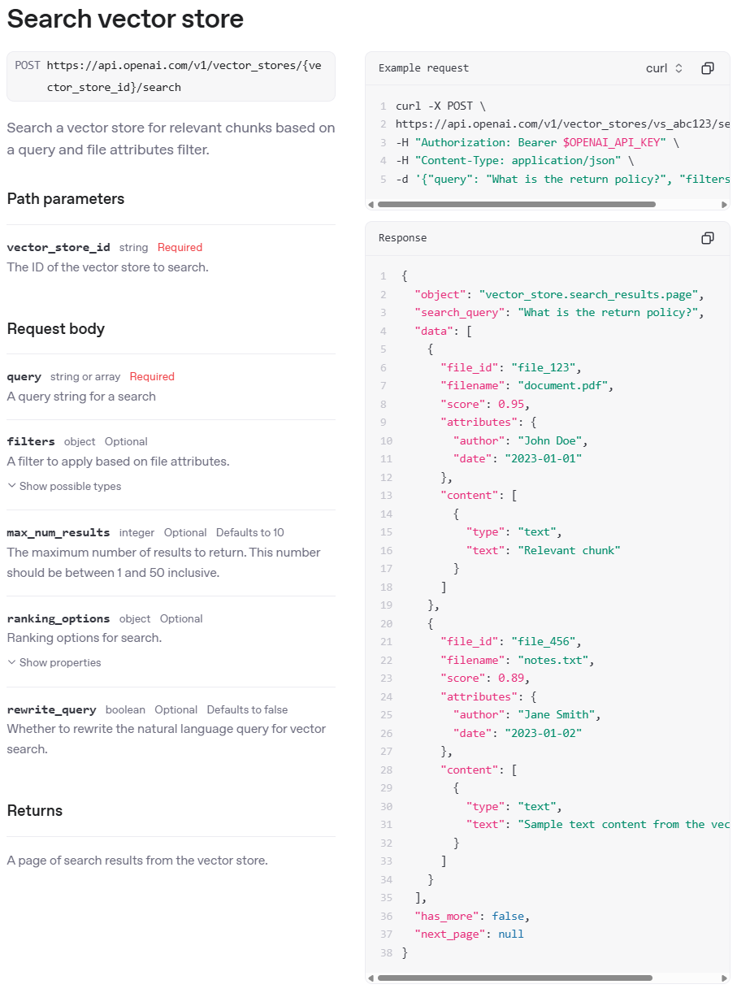
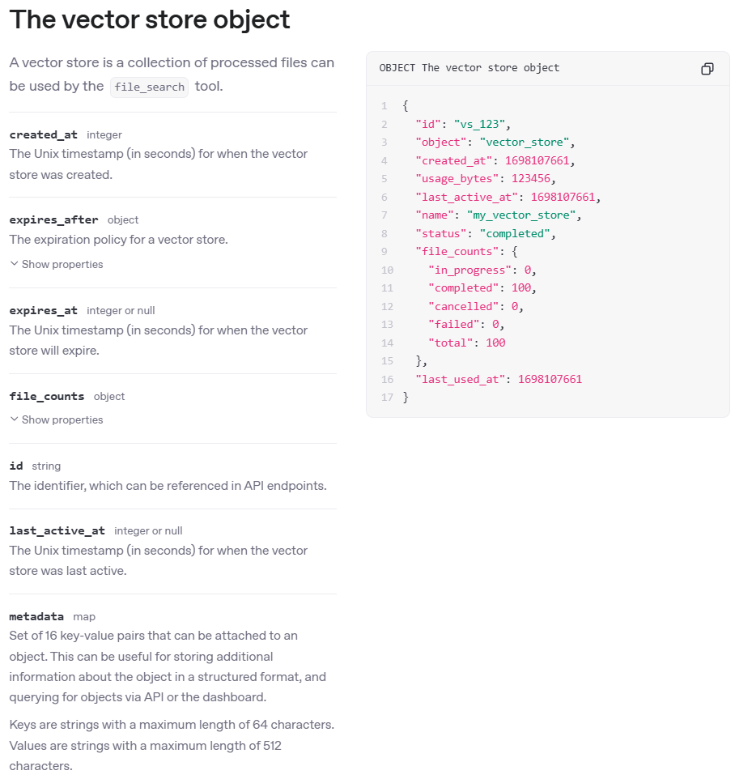
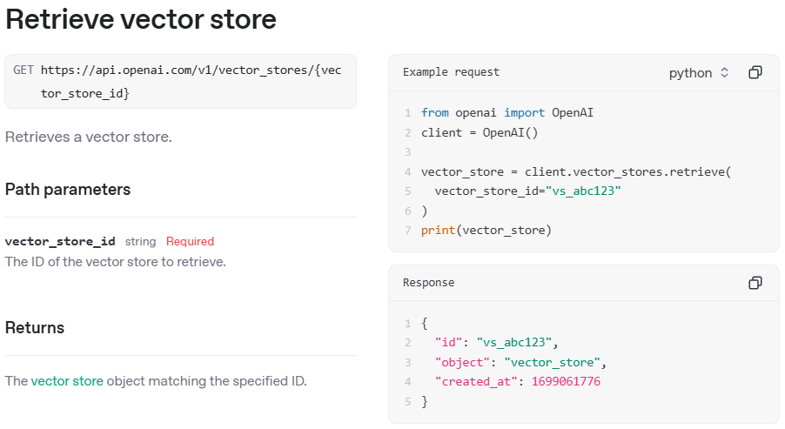
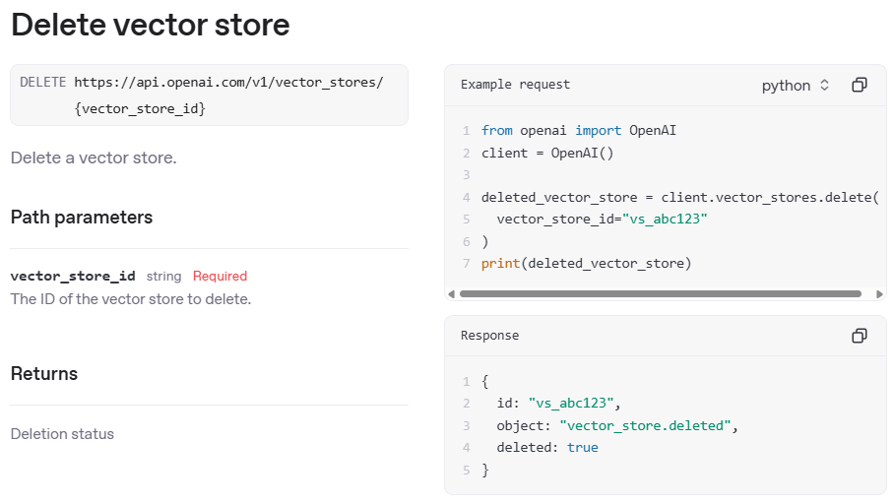
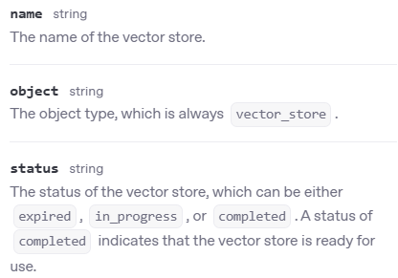
Open AI API - Vector stores
2025-05-24
https://platform.openai.com/docs/api-reference/vector-stores

Slide 5
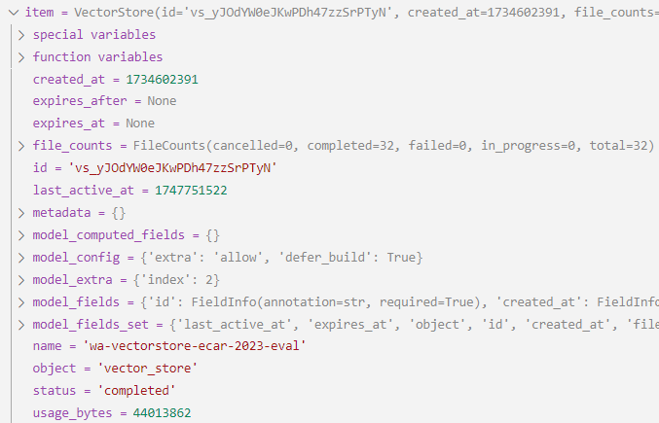
Open AI API - Vector store object
2025-05-24
https://platform.openai.com/docs/api-reference/vector-stores
Vector stores are used for file search, assistants, and response models (agents). They are usually accessed using a file_search tool call.
Vector stores
name
id
created_at
expires_at
last_active_at
status
metadata
file_counts
usage_bytes
Vectorstore1
vs_590JuZn9rMPObfpUjZcTU9PS
1741255682
1743077077
completed
{...}
{...}
44013862
Vectorstore2
vs_MBInFXZYATSGH7DwilCpe78p
1740996732
1742371107
1742047284
expired
{...}
{...}
1740996732
Attribute
Decription
name
The name of the vector store.
id
The identifier, which can be referenced in API endpoints.
created_at / expires_at /
last_active_at
The Unix timestamp (in seconds) for when the vector store was created / will expire / was last active.
status
The status of the vector store, which can be either expired, in_progress, or completed. A status of completed indicates that the vector store is ready for use.
metadata
Set of 16 key-value pairs that can be attached to an object. This can be useful for storing additional information about the object in a structured format, and querying for objects via API or the dashboard. Keys: strings max. 64 characters. Values: strings with max. 512 characters.
file_counts
The number of files cancelled, completed, failed, in_progress, and total
usage_bytes
The total number of bytes used by the files in the vector store.

Slide 6
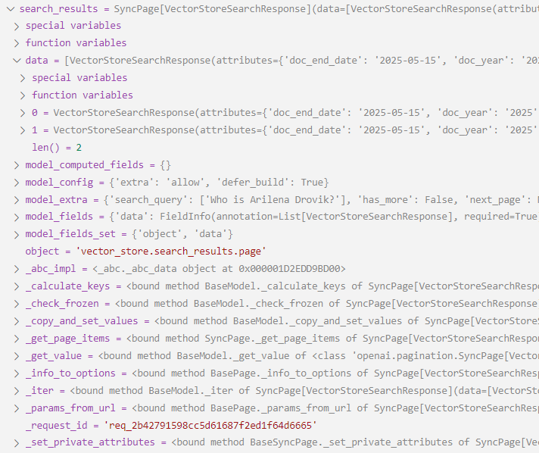
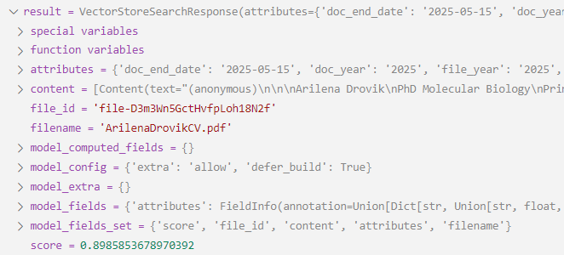
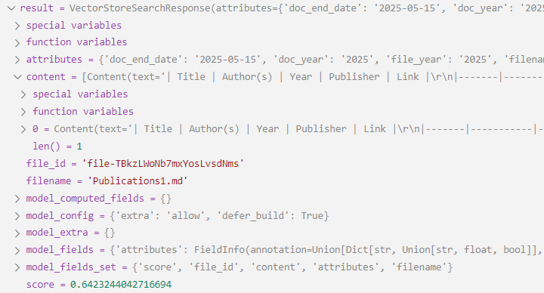
Search Results

Slide 7
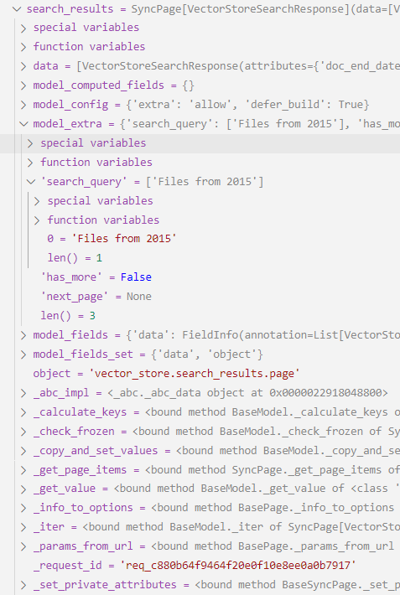
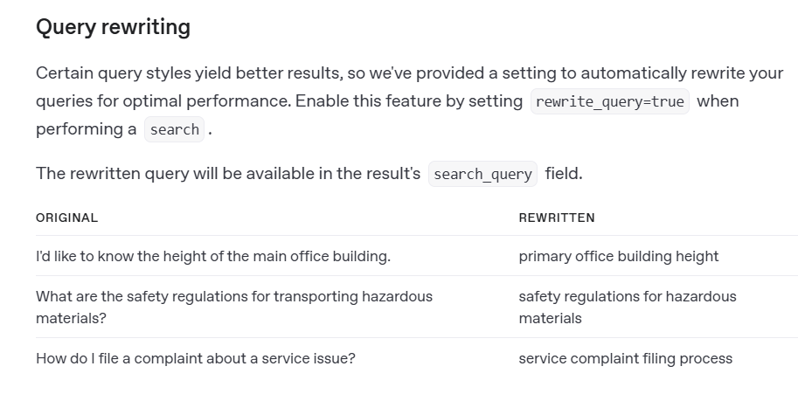
Search Results with query rewrite
Query: All files from year 2015.
Rewritten query: Files from 2015
rewritten_search_query = search_results.model_extra['search_query']
https://platform.openai.com/docs/guides/retrieval#query-rewriting

Slide 8
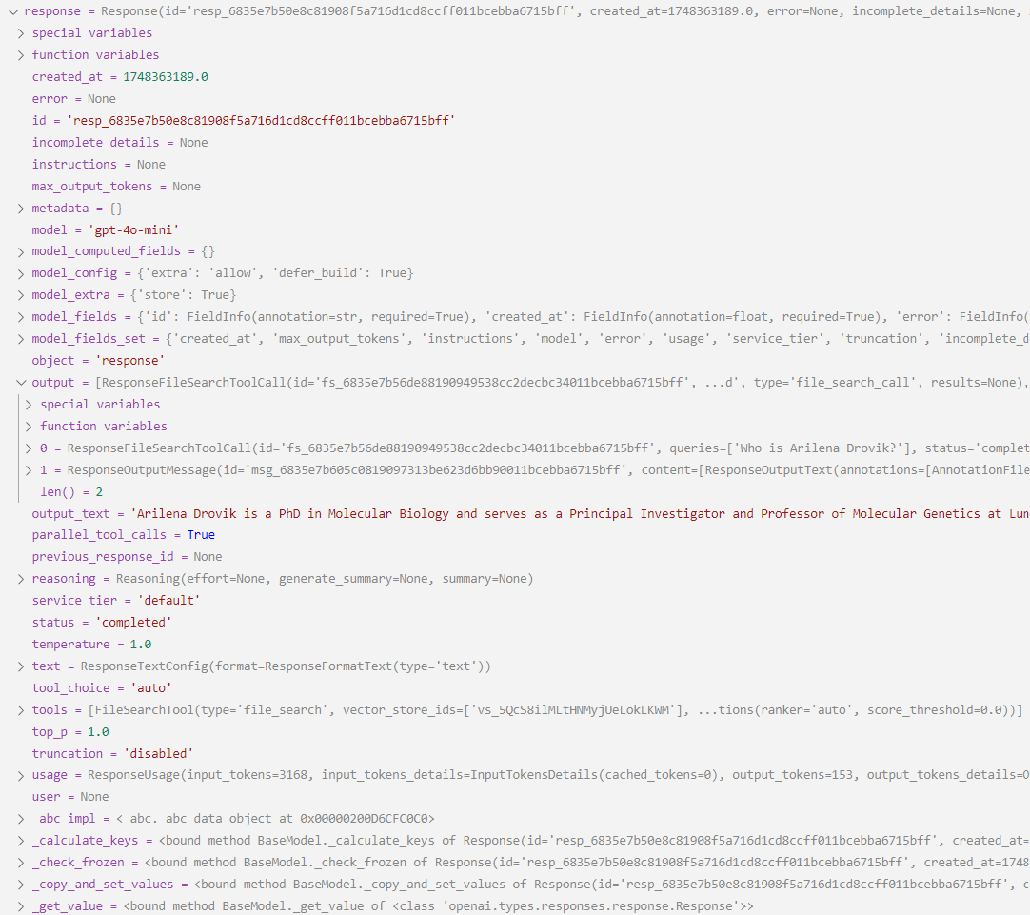
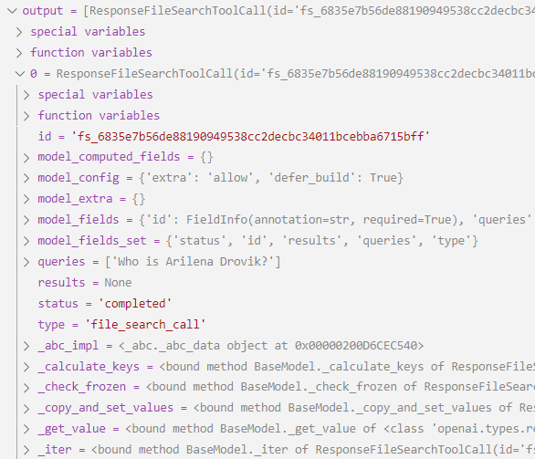
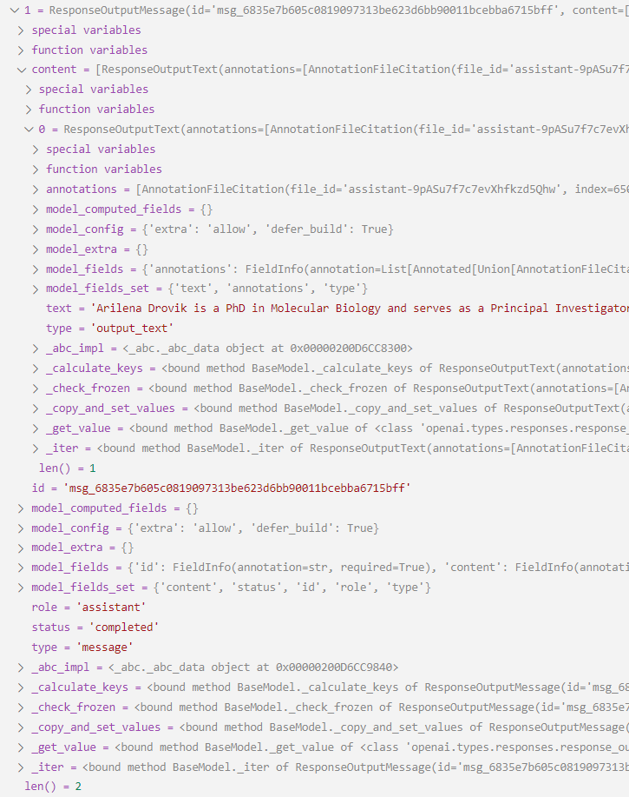
Responses API with file_search
ResponseFileSearchToolCall
ResponseOutputMessage

Slide 9
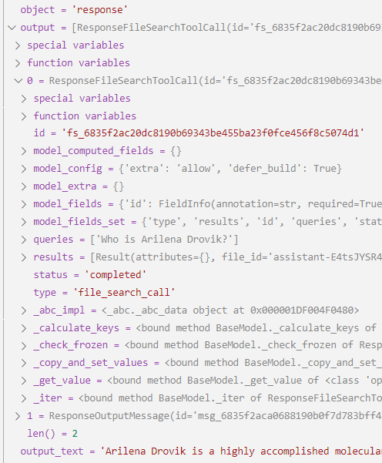
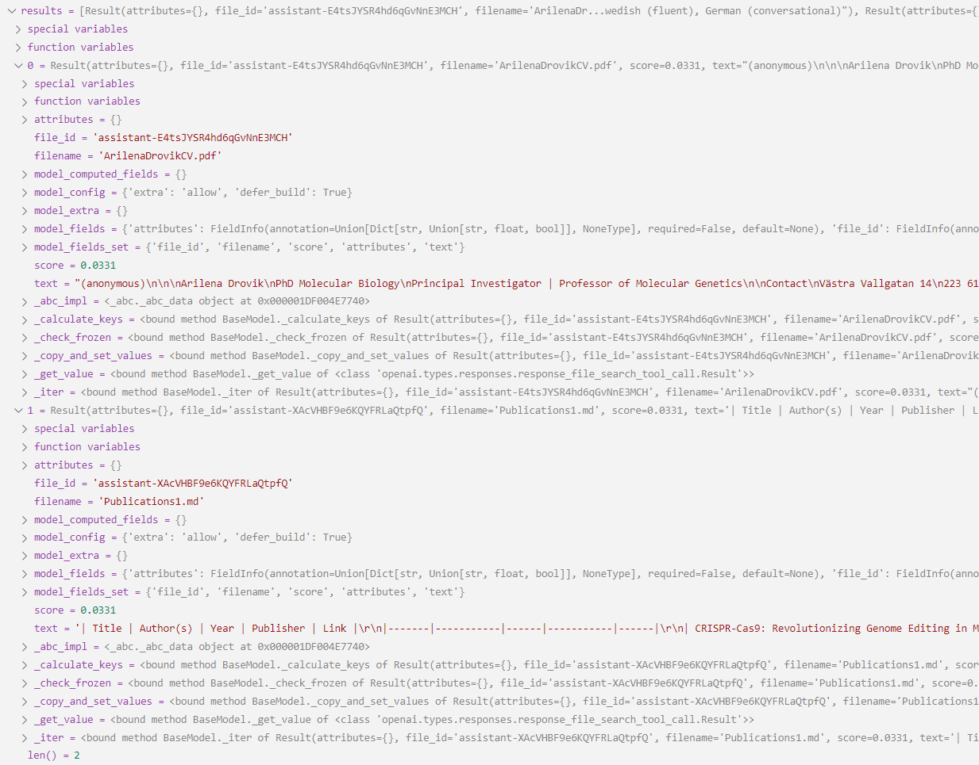
Responses API with file_search and file_search_call.results

