Slide 1
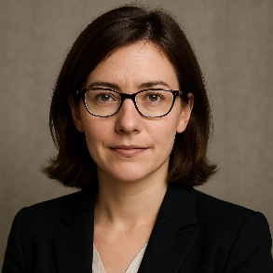

Arilena Drovik
Västra Vallgatan 14
223 61 Lund Sweden
Senior Scientist
Consultant
Scientific Writer
+46 72 555 4392
arilena.drovik@example.com
www.arilenadroviklab.com
linkedin.com/in/arilenadrovik
Personal Profile
Accomplished molecular biologist and scientific advisor with over a decade of experience in research and consultancy across academia, industry, and publishing. Senior scientist at Helixon Therapeutics leading molecular biology and genomics projects, combined with independent freelance work as a consultant and scientific writer. Expertise includes gene regulation, RNA biology, assay development, and translational research for early-stage biotech ventures.
Areas of expertise
Molecular Biology & Genetics
Epigenetics & Gene Regulation
CRISPR-Cas9 and Genome Editing
Single-cell Transcriptomics
RNA Biology and Non-Coding RNAs
Translational Research & Drug Target Validation
Scientific Leadership & Academic Mentoring
Research Grant Writing and Project Management
Career History
2009 – 2015
Senior Scientist – Genomics & Molecular Biology Division, Helixon Therapeutics Ltd., London, UK
Directed preclinical drug target validation projects in oncology and rare genetic diseases.
Led international collaborations between academia and pharma partners.
Co-inventor on patents related to RNA-based therapeutic strategies.
Provided consultancy for biotech startups on gene editing techniques.
Freelance scientific writer and editor for *Molecular Frontiers* magazine.
2012 – 2015
Independent Consultant – London, UK & Remote
Consulted for early-stage biotech firms on molecular assay design and RNA therapeutic development.
Provided strategic advice to two venture capital groups on life sciences investments.
Contributed scientific reviews and whitepapers for pharmaceutical clients.
Educational History
PhD in Molecular Biology
MSc in Molecular Biology
University of Cambridge, UK
Graduated: 2009
Dissertation: 'Epigenetic Modulators of Gene Expression in Early Development'
Charles University, Prague, Czech Republic
Graduated: 2004
BSc in Biology
Charles University, Prague, Czech Republic
Graduated: 2002
Professional Memberships
Languages
Member, European Molecular Biology Organization (EMBO)
Member, American Society for Cell Biology (ASCB)
Czech (native)
English (fluent)
German (basic)

