Slide 1
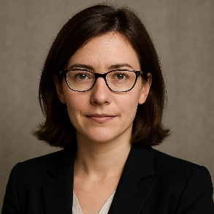

Arilena Drovik
Västra Vallgatan 14
223 61 Lund Sweden
PhD Molecular Biology Principal Investigator Professor of Molecular Genetics
+46 72 555 4392
arilena.drovik@example.com
www.arilenadroviklab.com
linkedin.com/in/arilenadrovik
Personal Profile
A highly accomplished molecular biologist and geneticist with over 20 years of experience in research, academic leadership, and translational science. Principal Investigator and Professor at Lund University, leading a research group focused on gene regulation and epigenetics in developmental biology and disease. International experience spanning industry and academia, with strong expertise in CRISPR-Cas9 gene editing, RNA biology, and single-cell sequencing technologies. Proven track record of securing competitive research grants, publishing in high-impact journals, and mentoring early-career scientists.
Areas of expertise
Molecular Biology & Genetics
Epigenetics & Gene Regulation
CRISPR-Cas9 and Genome Editing
Single-cell Transcriptomics
RNA Biology and Non-Coding RNAs
Translational Research & Drug Target Validation
Scientific Leadership & Academic Mentoring
Research Grant Writing and Project Management
Career History
2016 – Present
Professor and Principal Investigator – Department of Molecular Biology, Lund University, Sweden
Lead research program on gene regulation during early mammalian development.
Supervised 7 PhD students and 4 postdocs; over 30 peer-reviewed publications.
Partnered with biotech companies on translational gene therapy projects.
Developed core facility for single-cell RNA-sequencing technologies.
Successfully secured multiple grants from the Swedish Research Council and EU Horizon programs.
2009 – 2016
Senior Scientist – Genomics & Molecular Biology Division, Helixon Therapeutics Ltd., London, UK
Directed preclinical drug target validation projects in oncology and rare genetic diseases.
Led international collaborations between academia and pharma partners.
Co-inventor on 4 patents related to RNA-based therapeutic strategies.
Championed diversity and mentoring initiatives for early-career scientists.
Educational History
PhD in Molecular Biology
MSc in Molecular Biology
University of Cambridge, UK
Graduated: 2009
Dissertation: 'Epigenetic Modulators of Gene Expression in Early Development'
Charles University, Prague, Czech Republic
Graduated: 2004
BSc in Biology
Charles University, Prague, Czech Republic
Graduated: 2002
Professional Memberships
Languages
Member, European Molecular Biology Organization (EMBO)
Member, American Society for Cell Biology (ASCB)
Member, Swedish Society for Biochemistry and Molecular Biology (SFBBM)
Czech (native)
English (fluent)
Swedish (fluent)
German (conversational)

