Slide 1
Logistic Bifurcation Map
By Karsten Roberts

Slide 2
The logistic map is the graphical representation of the function x_{n+1}=rx_{n}(1-x_{n}) with the domain of [0,4] and range of [0,1]
As the value of r increases past ~3.56995, the function begins to exhibit chaotic behavior, with several small windows of stability, most notably at r = 3.82843
The number of times each initial value of x is recursed dramatically changes the accuracy of the graph, because if you recurse n times, the graph is capable of drawing up to an n period stable orbit

Slide 3
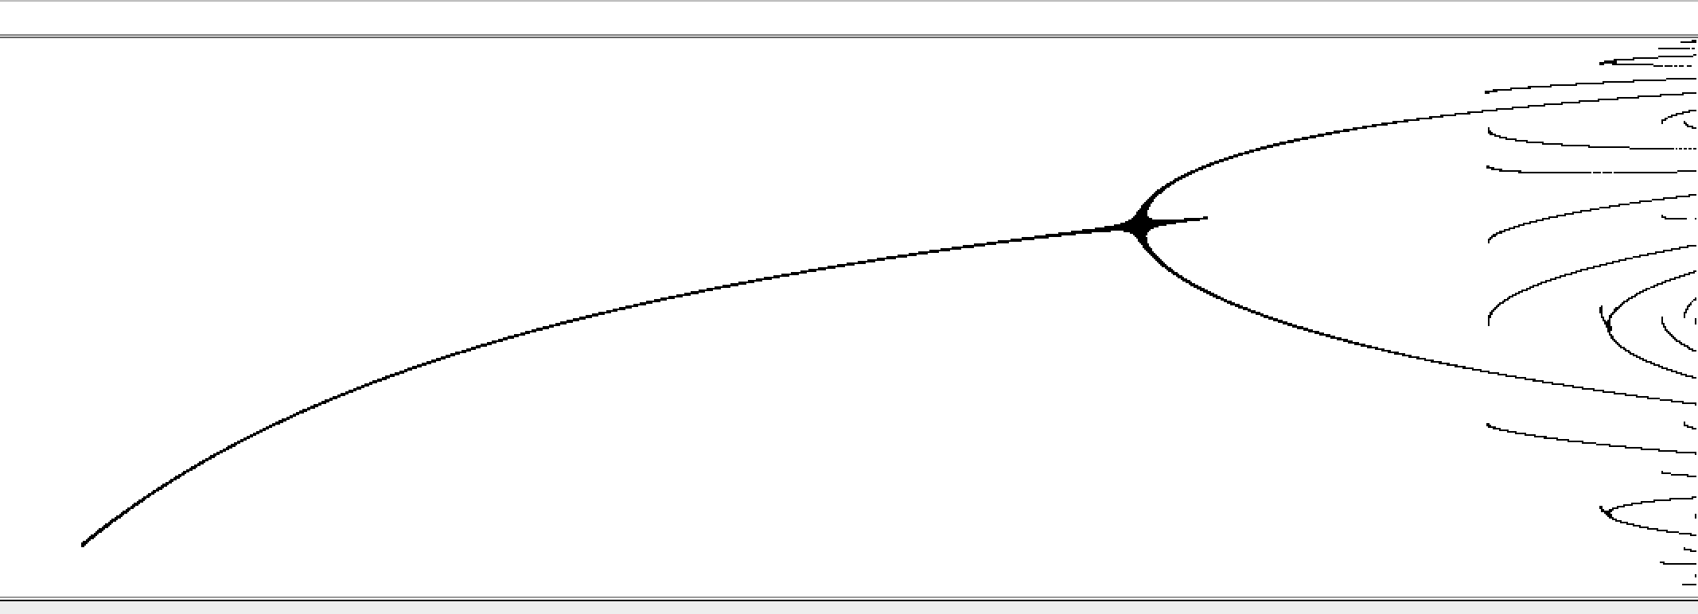
2 Recursive Iterations, results in only a stable orbit of period 2

Slide 4
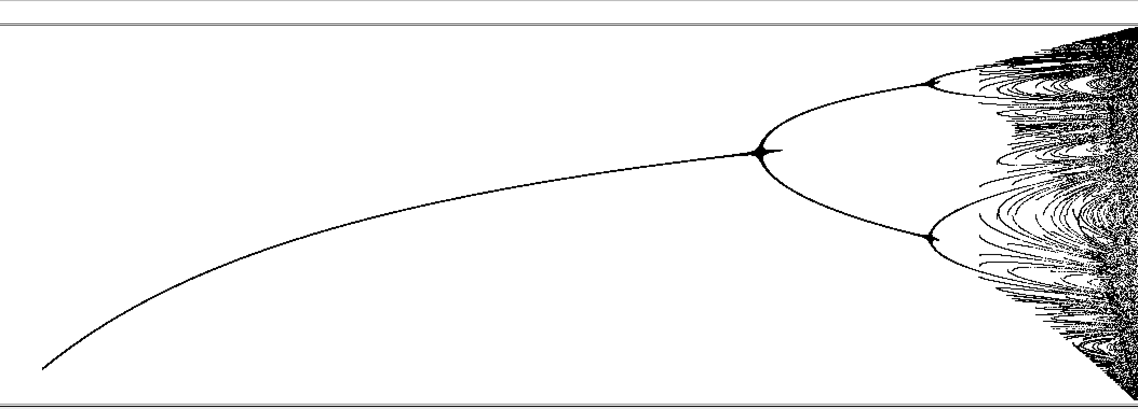
4 Recursive Iterations, results in a stable orbit of period 4

Slide 5
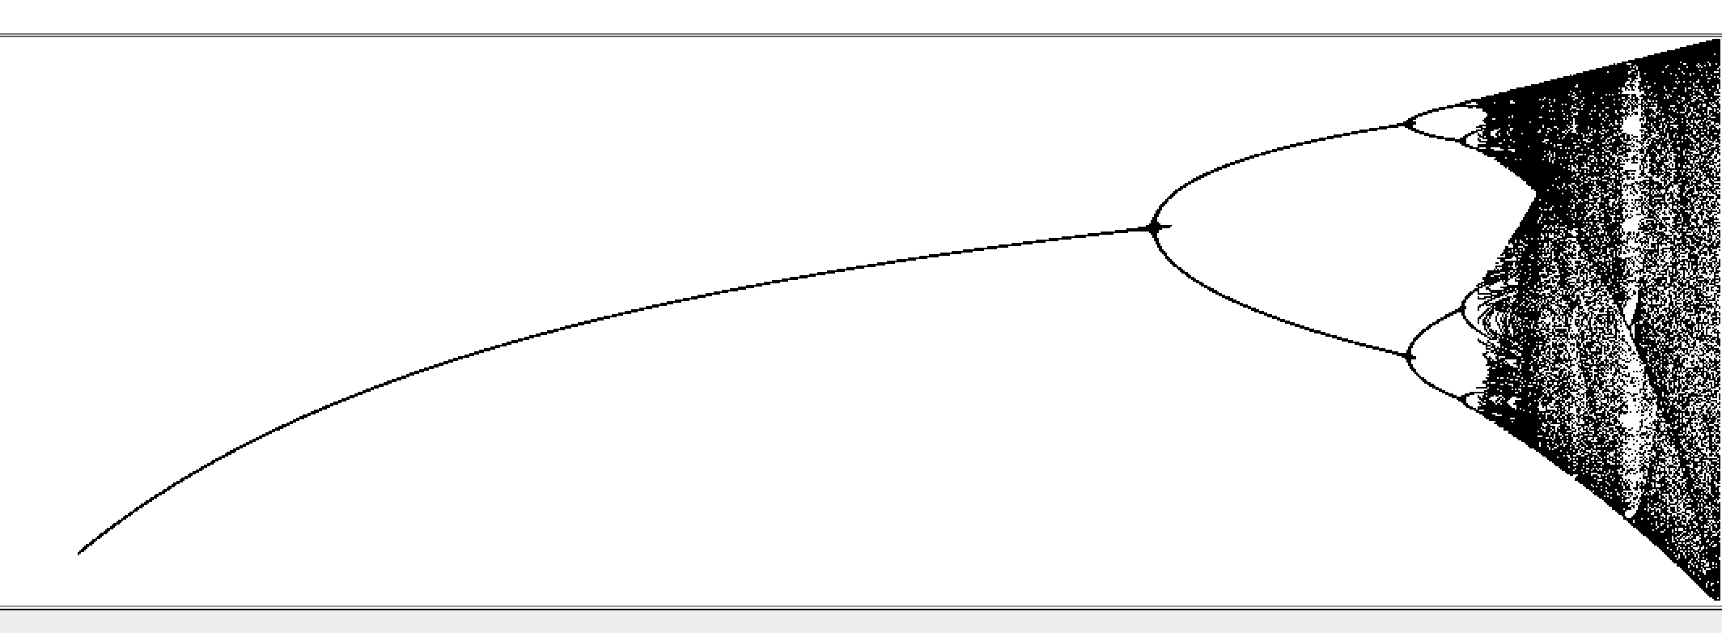
8 Recursive Iterations, results in a stable orbit of period 8

Slide 6
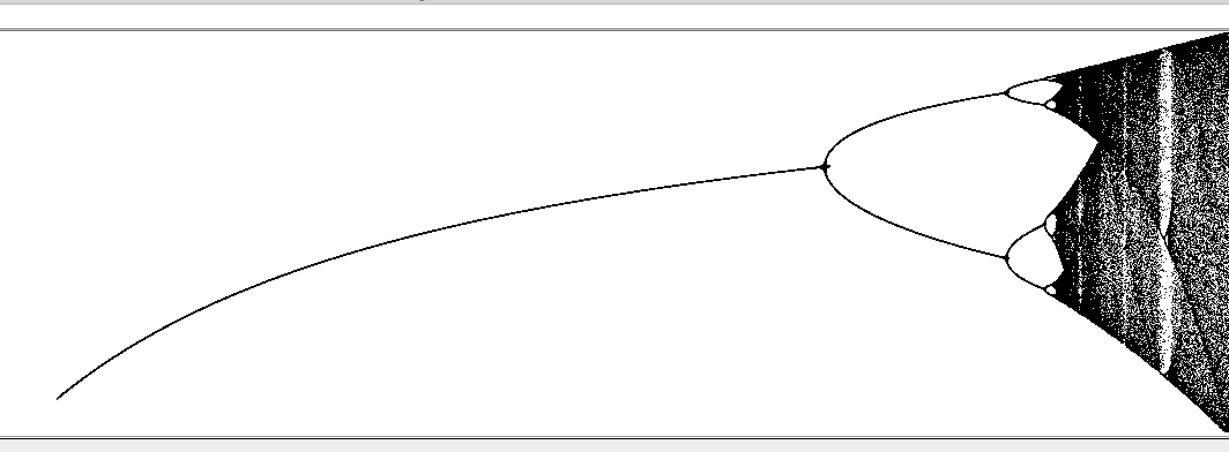
16 Recursive Iterations, results in a stable orbit of period 16

Slide 7

32 Recursive Iterations, results in a stable orbit of period 32

Slide 8
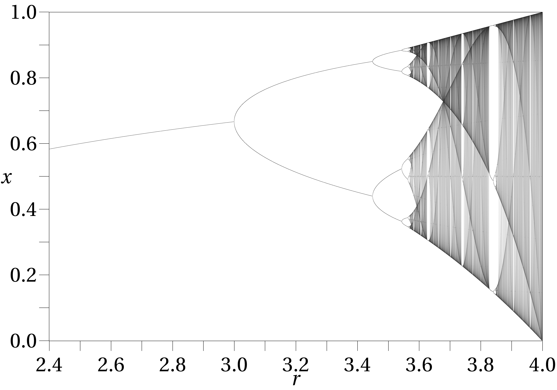
Actual Logistic Map (source: wikipedia.org)

Slide 9
Code
I programmed this using java. To execute the code, you will need to have installed a JDK, and to view it you will need an IDE. I used jGRASP. The java file in the .zip you want to execute is the BifurcationDiagram.java

Slide 10
Resources
http://en.wikipedia.org/wiki/Chaos_theory
Schroeder, Manfred R. Fractals, Chaos, Power Laws: Minutes from an Infinite Paradise. New York: W.H. Freeman, 1991. Print.

