Slide 1


Docker for web mapping
Examples
Carto (db) stack
MapServer + Mapbender + PostGIS
Karsten Vennemann

Slide 2
operating system virtualization software
that bundles programs in packages / containers
containers are isolated from each other
can communicate via defined channels
run on the same kernel
of the host machine
Karsten Vennemann

Slide 3
Docker engine
Background (daemon) process dockerd
Command line client docker
Docker compose
tool for defining and running
multi-container Docker applications
Command line utility docker-compose

Slide 4


git code GitHub
docker images dockerhub
Karsten Vennemann

Slide 5

How to use it
    Choose Server machine
    Install Docker engine
    Install docker-compose
    Start (download) existing docker image
    Comfigure and use
    web mapping software stack

Slide 6
Further Steps
    Build your own custom Docker image
    Push to Dockerhub
    Orchestrate multiple docker containers for an entire web mappping software stack with docker-compose
    Deploy with ease
terragisltd/webgis

Slide 7
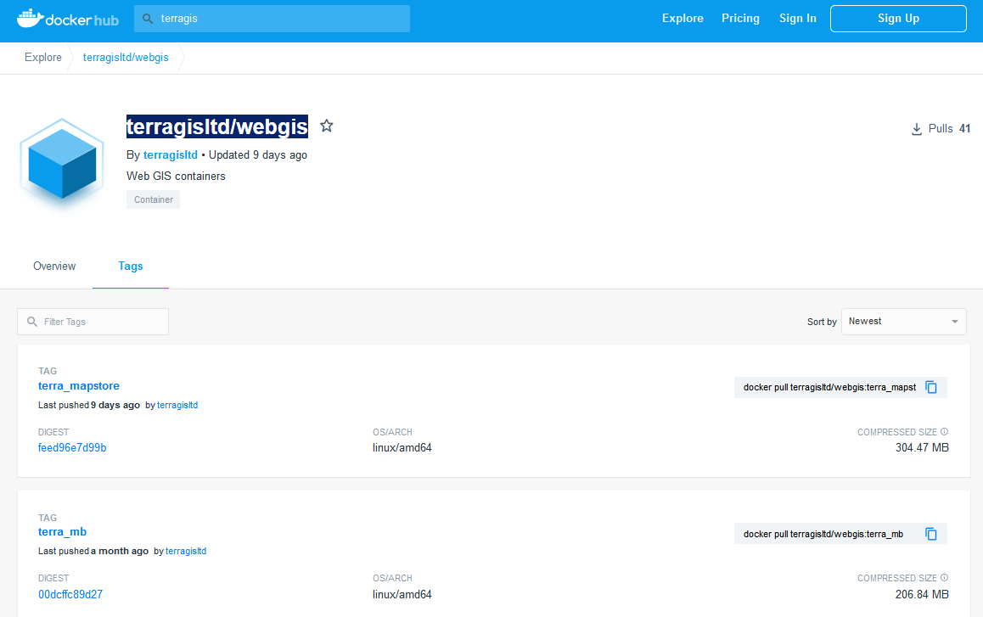
Examples terragis/webgis
MapStore
MapBender

Slide 8
Carto (db) stack
  dockerhub: : sverhoeven/cartodb
  https:/hub.docker.com/r/sverhoeven/cartodb/
  docker run -d -p 80:80 -h 111.222.11.222 sverhoeven/cartodb
  http:// 111.222.11.222 /login
  dev
  pass1234
  docker stop

Slide 9
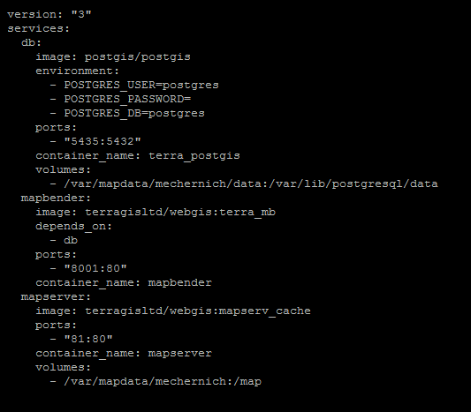
Custom web mapping stack
docker-compose.yml
to start:
docker-compose up -d

Slide 10
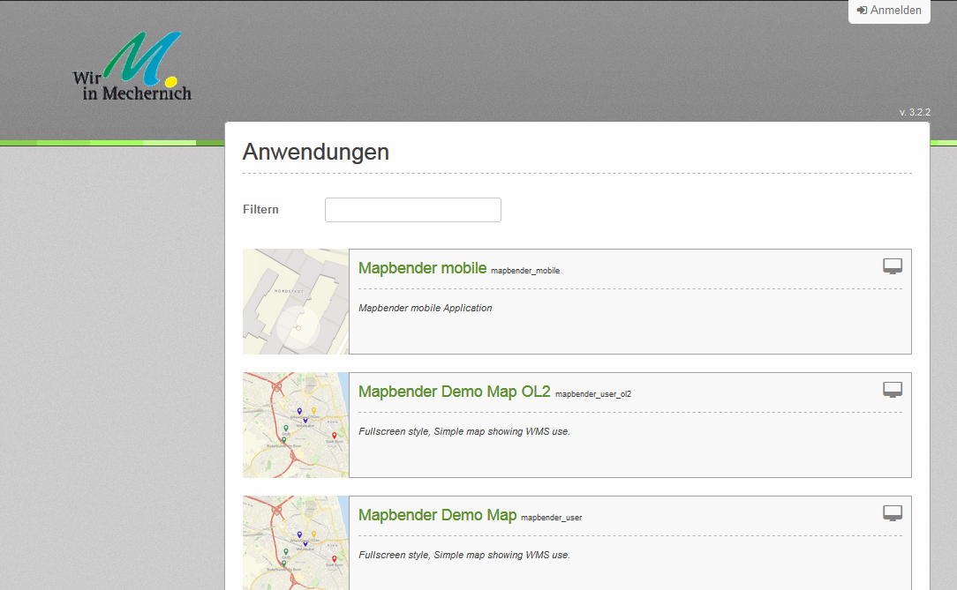
Custom web mapping stack
Mapbender – PostGIS - MapServer
http://terrax.terragis.net:8001/mapbender/

Slide 11
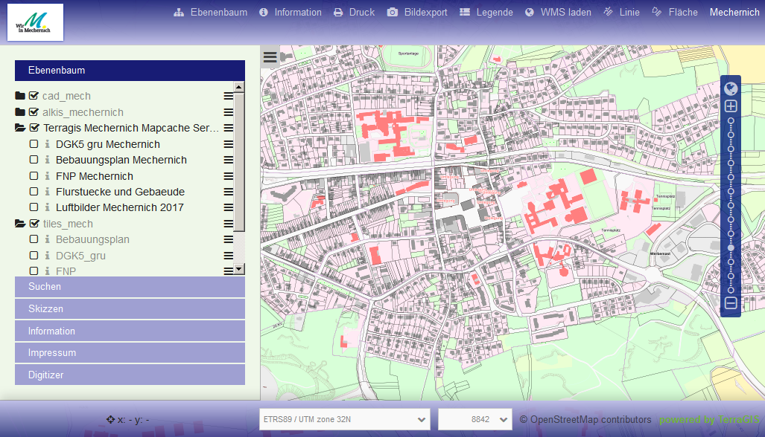
Custom web mapping stack
Mapbender – PostGIS - MapServer
http://terrax.terragis.net:8001/mapbender/

