Slide 1

A Peer-to-Peer Electronic Cash System
Name : Meng – Xian, Du
Student ID : CBB108047

Slide 2
Hash function

Slide 3
Introduction
Hash is an algorithm that can map data of arbitrary size to fixed value.
For example :
MD5(“Hello”)=8b1a9953c4611296a827abf8c47804d7
MD5(“Mr.Rise”)=2d4e8a16840a543747cd57ddf5fdebf3

Slide 4
Features
Output fixed length string
Irreversible
Fast to computing

Slide 5
Application
Data validation
Hash table
Protect data
Compress data

Slide 6
Merkle tree
It’s a data structure that can validate whether the data is completely by using hash function.

Slide 7
Principle
Splitting source data to several part and hash the part individually, and combine the hash value by a pair until there is no more hash value to combination.

Slide 8
Principle(cont.)
hABCD
hAB
hCD
hA
hB
hC
hD
A
B
C
D

Slide 9
Bitcoin

Slide 10
Trade
Satoshi Yamamoto this paper’s author defines a electronic coin as a chain of digital signatures. Each owner transfers the coin to the next by digitally signing a hash of the previous transaction and the public key of the next owner and adding these to the end of the coin. A payee can verify the signatures to verify the chain of ownership.

Slide 11
Trade(cont.)
Trade
Trade
Trade
Owner 1’ s
Public key
Owner 1’ s
Public key
Owner 1’ s
Public key
Hash
Verify
Hash
Verify
Hash
Owner 2’ s
Public key
Owner 2’ s
Public key
Owner 2’ s
Public key
Sign
Sign
Owner 1’s
Private Key
Owner 2’s
Private Key
Owner 3’s
Private Key

Slide 12
Timestamp Server
In this paper, they use timestamp server to verify each of trades. The server will stamp the timestamp on the block and widely publish the hash.

Slide 13
Timestamp Server(cont.)
Hash
Hash
Block
Block
Trade
Trade
Trade
Trade
Trade
Trade
Trade
Trade

Slide 14
Proof of Work
Block
Block
Prev Hash
Nonce
Prev Hash
Nonce
Trade
Trade
Trade
Trade
Trade
Trade

Slide 15
Network
The steps to run the network are as follows:
New transactions are broadcast to all nodes.
Each node collects new transactions into a block.
Each node works on finding a difficult proof-of-work for its block.
When a node finds a proof-of-work, it broadcasts the block to all nodes.
Nodes accept the block only if all transactions in it are valid and not already spent.
Nodes express their acceptance of the block by working on creating the next block in the chain, using the hash of the accepted block as the previous hash.

Slide 16
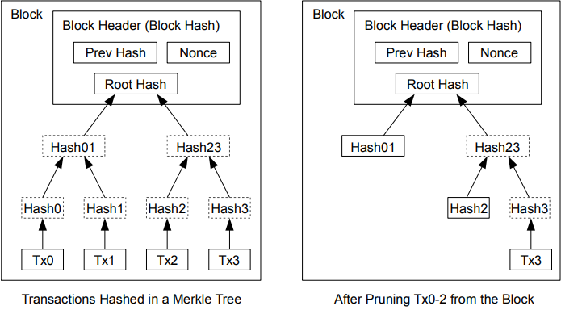
Reclaiming Disk Space

Slide 17
Simplified Payment Verification
Block Head
Block Head
Block Head
Prev Hash
Nonce
Prev Hash
Nonce
Prev Hash
Nonce
Merkle Root
Merkle Root
Merkle Root
Hash01
Hash23
Trade 2
Hash 2
Hash3
Trade 3

Slide 18
Simplified Payment Verification
Null content

Slide 19
Simplified Payment Verification
Null content

Slide 20
Simplified Payment Verification
Null content

Slide 21
Simplified Payment Verification
Null content

Slide 22
Reference
Satoshi yamamoto,”BitCoin: A Peer-to-Peer Electronic Cash System “,2008
https://ithelp.ithome.com.tw/articles/10215108
https://academy.binance.com/zt/articles/merkle-trees-and-merkle-roots-explained
https://bitcoin.org/files/bitcoin-paper/bitcoin_zh_cn.pdf
https://www.ussc.gov/sites/default/files/pdf/training/annual-national-training-seminar/2018/Emerging_Tech_Bitcoin_Crypto.pdf

