Slide 1

ESG and financial performance of European banks and division by geographical location
Author: Anton Kartaev, BAE’26, Faculty of Economic Sciences
Academic advisor: Karsten Sprenger, PhD

Slide 2
Overview
Theoretical framework
Methodology
Literature review
Data Analysis
Results
References
2/10
2

Slide 3
Theoretical framework
1. Subject / Object: relationship between Environmental Social Governance (ESG) performance indicators and the financial performance of European banks.
2. Hypothesis: the study hypothesizes significant differences in ESG performance and financial outcomes between banks categorized by developed versus emerging European countries, Eurozone versus non-Euro countries, and other classifications based on geographical regions and GDP/population clusters.
3. Goals: - To statistically compare ESG and financial performance across European banks using novel classifications. - To identify how ESG factors correlate with financial performance in developed and emerging European banks. - To provide insights for stakeholders on enhancing sustainability and financial results in the banking sector.
4. Scope - The research encompasses 108 European banks, utilizing data from Thomson Reuters, the World Bank, and EuroVoc for the year 2018. - It employs cluster analysis and ANOVA tests to examine the relationship between ESG scores and financial performance indicators, including variations across geographical regions, functional currency, and clusters related to GDP and population.
3

Slide 4
Methodology
Data Collection Process
Initial Screening: Identification of European countries with available ESG data in Thomson Reuters.
Cross-Check for Completeness: Inclusion of all relevant countries, with Cyprus and Malta classified in Emerging Europe despite their absence in Reuters' categories.
Final Sample Selection: Analysis of ESG scores in 108 banks (81 Developed, 27 Emerging Europe).
Variables and Definitions
Variables: ESG_combined, Environment, Social, Governance, and Controversies.
Source: Definitions aligned with the ESG scores methodology by Refinitiv.
Analytical Approach: ESG combined score integrates ESG pillars, discounted by controversies captured from global media sources.
Statistical Analysis
Cluster Analysis: Two groups based on GDP per capita and population, using IBM SPSS Statistics and TwoStep Cluster Analysis.
Group Tests and ANOVA: For analyzing differences across classifications and variables.
4

Slide 5
Literature Review
Introduction to ESG in Banking Sector — Scholtens & van’t Klooster (2019)
Banks' dual role in sustainability and financial stability
Impact of ESG Policies on Financial Performance — Nizam, E., et al. (2019), Buallay (2019)
The cost implications of establishing ESG frameworks and their potential for revenue stability and risk reduction.
ESG Performance, Corporate Scandals, and Market Reaction — Buallay, A., et al. (2020), Shakil, M. H., et al. (2019)
Significant improvements in the accounting and market-based performance of banks in developing countries post-2008 crisis
Ethical Values and ESG Controversies in European Banks — Ehrenhard, M. L., & Fiorito, T. S. (2018)
The ethical values of the 25 largest European banks
Disaggregated ESG Performance and Stakeholder Consideration — Jo, H., et al. (2015)
Customers respond positively to banks' environmental management
5

Slide 6
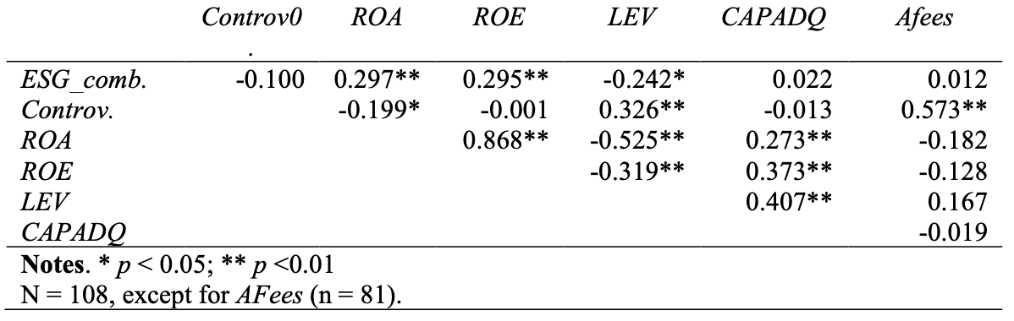
Data Analysis: correlation matrix
Table 1. Correlations between the main variables of the study
6

Slide 7
Data Analysis: correlation matrix
A correlation matrix is a table showing correlation coefficients between variables. Each cell in the table shows the correlation between two variables.
Table 1. Correlations between the main variables of the study

Slide 8
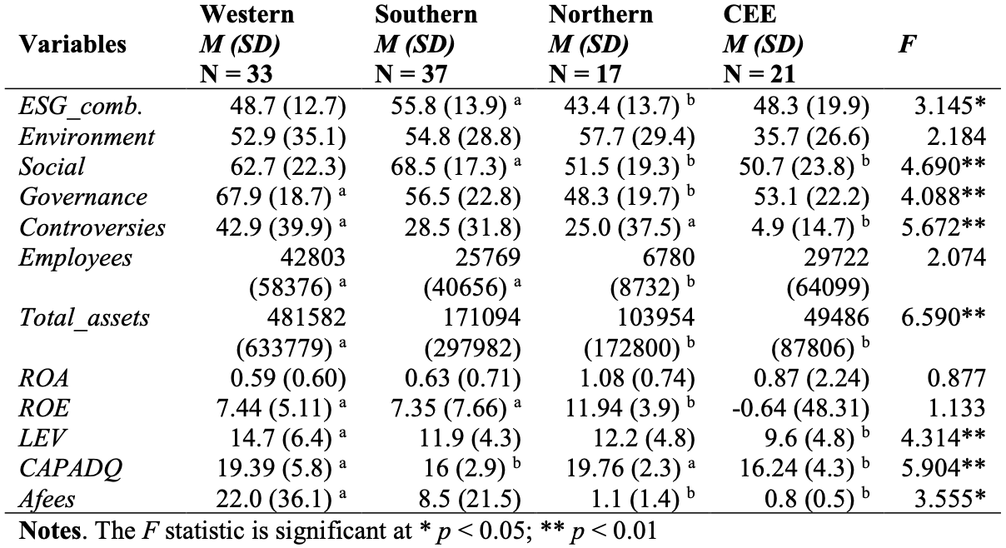
Data Analysis: one-way ANOVA
7
Table 2. Results of one-way ANOVA for geographical regions in Europe

Slide 9
Data Analysis: one-way ANOVA
An ANOVA test is a statistical test used to determine if there is a statistically significant difference between two or more categorical groups by testing for differences of means using a variance.
Table 2. Results of one-way ANOVA for geographical regions in Europe

Slide 10
Results
No significant difference in financial performance
Concentration of strong banks in Western Europe
The adoption of ESG policies may be driven by a desire other than firms' desire to improve their financial position.
8

Slide 11
References
Fiorito, T., & Ehrenhard, M. L. (2019). Understanding Organizational Integrity from an Institutional Perspective. Proceedings - Academy of Management, 2019(1), 16969. https://doi.org/10.5465/ambpp.2019.28
Buallay, A. (2019). Is sustainability reporting (ESG) associated with performance? Evidence from the European banking sector. Management of Environmental Quality: An International Journal, 30(1), 98–115. https://doi.org/10.1108/meq-12-2017-0149
Buallay, A., Fadel, S.M., Al-Ajmi, J.Y. & Saudagaran, S. (2020) “Sustainability reporting and performance of MENA banks: is there a trade-off?”, Measuring Business Excellence, vol. 24 no. 2: 197-221
Nizam, E., Ng, A., Dewandaru, G., Nagayev, R. & Nkoba, M.A. (2019) “The impact of social and environmental sustainability on financial performance: A global analysis of the banking sector”, Journal of Multinational Financial Management, Elsevier B.V., vol. 49: 35-53
Scholtens, B. & van’t Klooster, S. (2019) “Sustainability and bank risk”, Palgrave Communications, Springer US, vol. 5 no. 1: 1–8
9

Slide 12
Q&A
10

