Slide 1
Project Presentation of CO-OP Project at Industry (Module-2) (22CS421)
On
Impact of Social Media Algorithms on Adolescent Mental Health
Kartavya Tomar
2210990484
Supervised By
Dr. Darpan Anand
Department of Computer Science and Engineering,
Chitkara University, Punjab

Slide 2
Introduction
Rapid growth of AI-driven social media platforms.
Adolescents are primary users of algorithm-curated feeds.
Engagement optimisation drives content ranking.
Mental health concerns are rising globally.
Modern platforms such as Instagram, TikTok, and YouTube use machine learning algorithms to maximise engagement.
These systems continuously learn from user behaviour and personalise content feeds.
Adolescents, being in a sensitive developmental phase, are highly influenced by such algorithmic exposure.
‹#›

Slide 3
Problem Statement
Algorithms amplify emotionally intense content.
Reinforcement loops increase screen time.
High exposure linked to anxiety and depression.
Lack of algorithm transparency.
While traditional research focused on screen time, modern concerns centre around algorithmic amplification.
AI systems prioritise content that generates strong reactions, which may contribute to comparison behaviour, body dissatisfaction, and psychological distress.

Slide 4
Objective
To analyse algorithmic recommendation mechanisms.
To study correlation with mental health indicators.
To examine reinforcement learning feedback loops.
To propose human-centred AI design recommendations.

Slide 5
ML Implementation
Dataset: Survey dataset of 150 adolescents (age 13–19)
Features:
- ScreenTime
- EngagementFrequency
- AppearanceExposure
- RecommendationClicks
Target Variable: AnxietyScore
Model Used: Multiple Linear Regression.
Libraries: Python, Pandas, NumPy, Scikit‑learn, Matplotlib

Slide 6
ML Workflow
1. Data Collection (Survey Data)
2. Data Preprocessing
3. Train-Test Split
4. Model Training (Linear Regression)
5. Prediction
6. Model Evaluation
7. Interpretation of Feature Impact

Slide 7
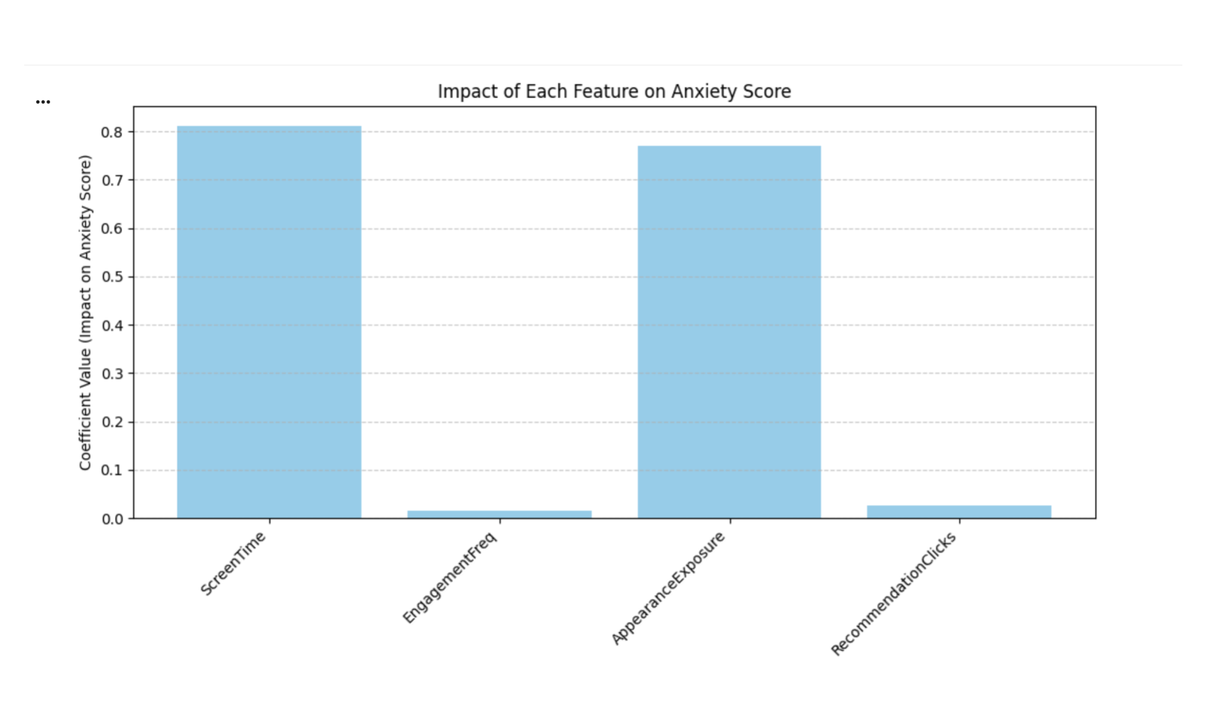
Analysis

Slide 8
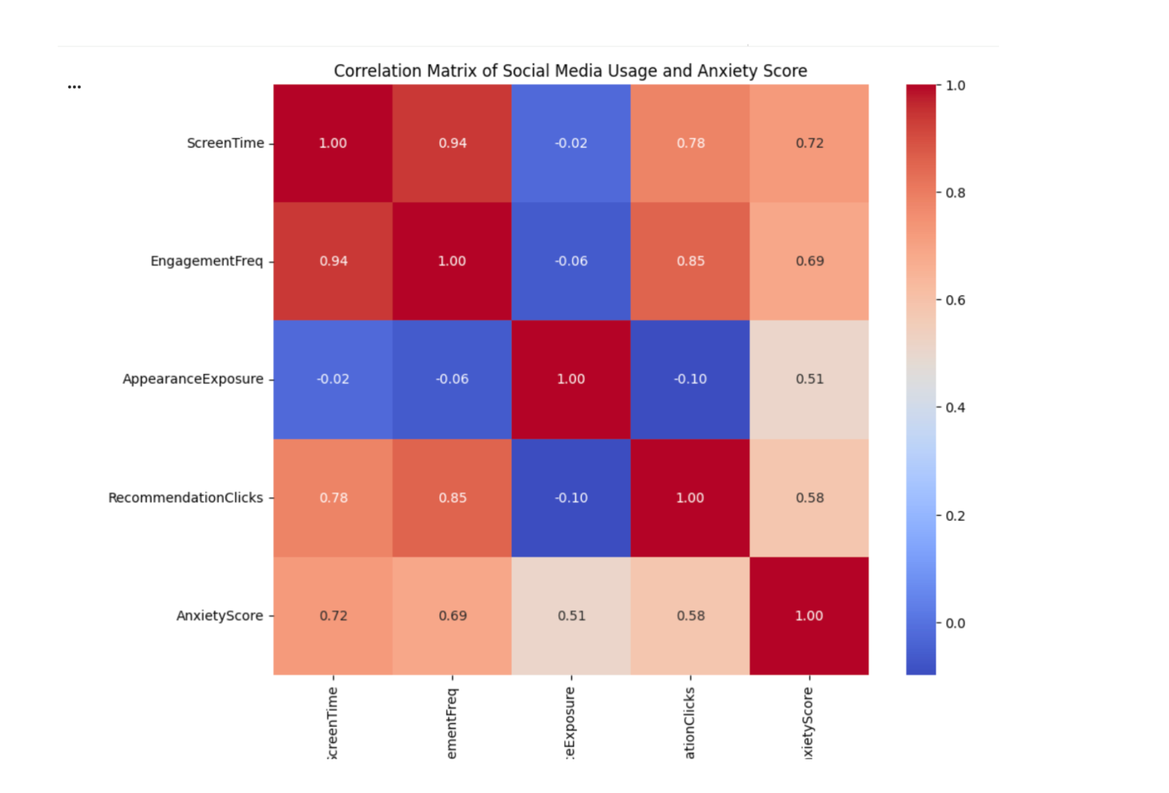
HeatMap

Slide 9
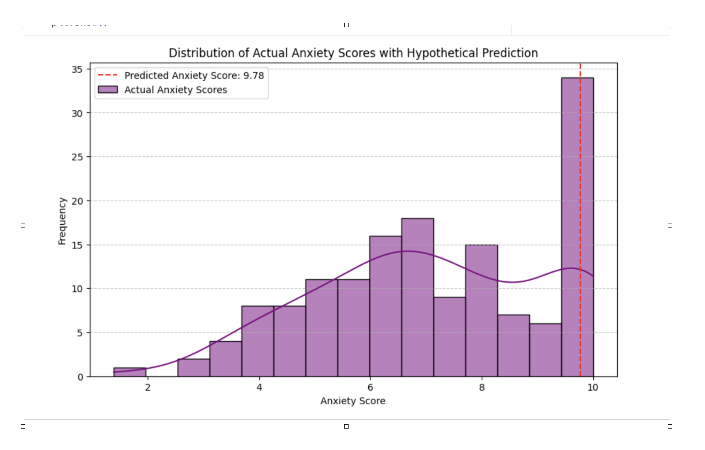
Visualisation

Slide 10
Evaluation Metrics
R² Score: Measures how well the model explains variance in the data.
Mean Squared Error (MSE): Measures prediction error between actual and predicted values.
Lower MSE and higher R² indicate better model performance

Slide 11
Technical Terms
test_size: percentage of data used for testing (e.g., 0.2 = 20%).
random_state: ensures reproducibility of train/test split.
model.fit(): trains the machine learning model.
model.predict(): generates predictions using the trained model.

Slide 12
Model Interpretation
Feature: input variable used to train the model.
Coefficient: weight assigned to each feature.
Impact: magnitude of influence of each feature on AnxietyScore.
Example: higher screen time may increase predicted anxiety level

Slide 13
Model Insights
Increased screen time correlates with higher anxiety scores.
Appearance-based content exposure strongly affects self-esteem.
Algorithmic recommendations reinforce engagement loops.
Behavioural engagement patterns help predict mental health indicators

Slide 14
Future Improvements
Use larger real-world datasets.
Apply advanced models like Random Forest or Neural Networks.
Perform sentiment analysis on social media content.
Develop AI systems that promote digital well-being

Slide 15
Limitations
Restricted access to proprietary algorithms.
Correlation does not imply causation.
Self-reported survey bias.
Rapid evolution of platforms.

Slide 16
Conclusion
Algorithms influence adolescent cognition, emotions, and behaviour.
Engagement-driven models may amplify harmful or intense content.
Ethical AI requires integrating psychological safeguards.
Long-term societal impact should matter as much as performance metrics.
Human-centred design must be the foundation of future AI systems.

Slide 17
Thank You
‹#›

