Slide 1
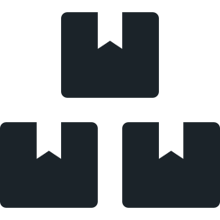
StockRoom
A stock control app, shipped through a full DevOps pipeline
Kartavya Panchal
Roll 24bcs10343 · DevOps Final Capstone
Notes:
Introduce yourself with name and roll number. One sentence: StockRoom is a stock control app, and the project is the DevOps chain around it.

Slide 2



What I built
A warehouse stock tracker. Small on purpose: the work is in how it is tested, packaged, secured, deployed and watched.
Track items
Flag low stock
See stock value
SKU, category, quantity, unit price and a reorder level for every item
Items at or below the reorder level are marked for a new order
Totals for items, units, value and categories from /api/items/stats
6
REST endpoints
12
pytest tests
3
containers
2
replicas per tier
Notes:
Show what the app does: add an item, change its quantity, see the low-stock flag. Mention the 6 item endpoints plus health, ready and metrics.

Slide 3
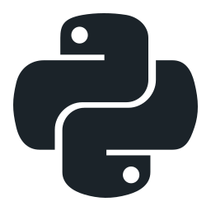





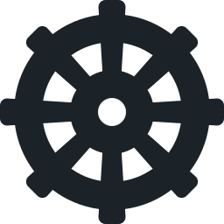

Tech stack
Application
FastAPI · SQLAlchemy · Alembic · PostgreSQL 16 · React 18 + Vite
Testing
pytest with an in-memory SQLite test database
Containers
Docker multi-stage builds, non-root users, Docker Compose
CI/CD
GitHub Actions · GitHub Container Registry · SHA tags
Security
Trivy 0.75 gate on fixable HIGH and CRITICAL CVEs
Infrastructure
Terraform · AWS VPC · Amazon EKS 1.36
Kubernetes
Helm · ingress-nginx · Argo CD (GitOps) · Minikube
Observability
kube-prometheus-stack: Prometheus + Grafana
Notes:
Walk through the layers top to bottom. Every tool has one job.

Slide 4
Architecture
Developer
git push
GitHub
main branch
GitHub Actions
test → scan → push
GHCR
image:SHA
Argo CD
watches Git
Kubernetes · namespace stockroom
Terraform
VPC + EKS on AWS
Ingress
/ and /api
Frontend
React · Nginx ×2
Prometheus
→ Grafana
Infrastructure is created from code, proven, then destroyed to stop the cost.
Backend
FastAPI ×2
PostgreSQL
PVC
Notes:
Follow one change from left to right: push, pipeline, image in GHCR, Argo CD sees the new tag, new Pods. Prometheus scrapes the backend. Terraform is a separate lane for AWS.

Slide 5
CI/CD pipeline
JOB 1
Test
JOB 2
Images
JOB 3
GitOps
pytest -v (12 tests)
npm ci + vite build
docker build ×2
Trivy scan ×2
push to GHCR
yq writes the SHA into values.yaml
commit with [skip ci]
Stops on a failing test
Stops on a fixable HIGH/CRITICAL CVE
One commit = one image tag. ghcr.io/kartavya37/stockroom-backend:<full SHA>
No "latest" tag. A rollback is a one-line revert in values.yaml.
Notes:
Two gates: tests and Trivy. Nothing reaches the registry without passing both. Job 3 makes Git the deployment trigger.

Slide 6
Security gate: what Trivy found
Backend image
Frontend image
CVE-2026-13221 · CRITICAL
perl-base 5.40.1-6 in the Debian base image
Perl mishandles very large regular expressions. StockRoom never runs Perl, so the API cannot reach it — but the package ships in the image, and Trivy reports what is present, not what is called.
Fix: apt-get upgrade → 5.40.1-6+deb13u1
20 → 0
43 → 0
fixable HIGH / CRITICAL CVEs
fixable HIGH / CRITICAL CVEs
The fixes
OS upgrades in both images
FastAPI 0.143.2 → Starlette 1.8.0
nginx 1.27 → 1.30 Alpine
Notes:
Our first scan failed both images. Explain CVE-2026-13221: present but not reachable, fixed anyway because Trivy blocks what is present. A clean scan means no known fixable CVE, not 'secure'.

Slide 7
Infrastructure as code on AWS
VPC 10.0.0.0/16 · ap-south-1
terraform plan
shows every resource before anything is created
Public subnet
10.0.1.0/24 · ap-south-1a
Public subnet
10.0.2.0/24 · ap-south-1b
EKS 1.36, not 1.31
1.31–1.33 are in extended support: 6× the control-plane price
Worker node
t3.medium
Worker node
t3.medium
No NAT gateway
nodes sit in the public subnets: cheaper and faster to create
EKS 1.36 control plane · managed node group
terraform destroy
right after the demo; no keys in the repo
Notes:
Point at the two public subnets the rubric asks for, the private subnets for the nodes, and the node group. Explain the EKS version choice and the destroy step.

Slide 8
Kubernetes, Helm and GitOps
One Helm chart
GitOps flow
Deployments
backend ×2 · frontend ×2 · postgres
Services
ClusterIP for each tier
1
git push
2
pipeline builds and scans
Ingress
/ → frontend, /api → backend
Secret + PVC
database URL and storage
3
job 3 commits the new SHA
4
Argo CD detects the change
ServiceMonitor
Prometheus scrape config
Dashboard ConfigMap
loaded by the Grafana sidecar
5
new Pods roll out
Auto sync, prune and self-heal. Git is the only way to change the cluster.
Notes:
The chart is the package; Argo CD is the operator. Mention that helm list is empty under Argo CD because Argo CD applies the rendered manifests itself.

Slide 9
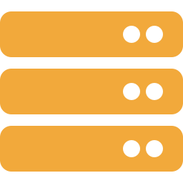

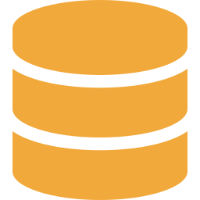

Observability
Backend
/metrics on every Pod
ServiceMonitor
tells Prometheus what to scrape
Prometheus
scrapes every 15 s
Grafana
StockRoom API dashboard
Dashboard panels — loaded automatically, no manual import
Requests / s by route
p95 latency
5xx error rate
Backend Pods up
CPU per Pod
Notes:
Show the Targets page with the backend UP, then the Grafana dashboard with live traffic. The dashboard ships inside the Helm chart as a ConfigMap.

Slide 10



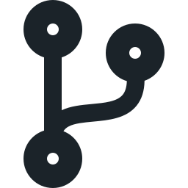
Key learnings
Gates catch problems early
Trivy blocked 63 fixable CVEs before a single image reached the registry.
Test the failure, not only the fix
Two Pods racing on the migration crashed one in 5 of 5 runs. An advisory lock: 0 of 5.
SHA tags give traceability
Every running Pod points to one commit. Rollback is a one-line revert.
Git is the source of truth
With Argo CD, a push is the deployment. Cost is a design input too: EKS 1.36, not 1.31.
Notes:
Close with the four learnings, then say: now I will show everything live.

