Slide 1
UMN Wireless Network: Maximum Network Coverage Problem
Vaibhav Sharma
Ying Liu
Ran Zhang

Slide 2
Problem Definition
Given the network coverage map (heat maps), we want to find the optimum number and positions of access points, which would maximize the network coverage in the specified region.
Non-linear optimization problem.
Variable length search problem.

Slide 3
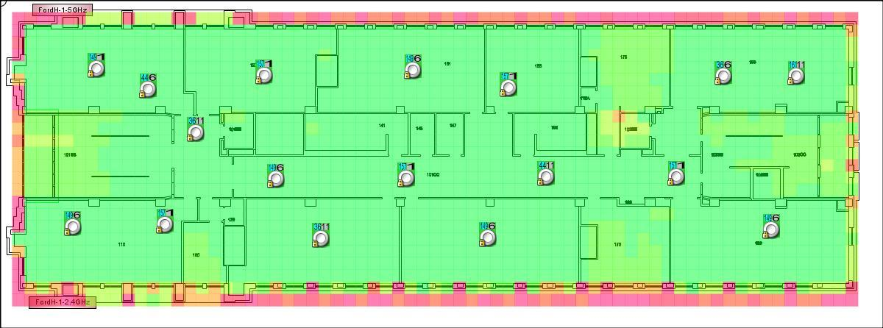
Ford Hall: Coverage Map

Slide 4
Genetic Algorithm
Is a search heuristic that mimics the process of natural selection.
Provides set of instructions and a fitness function to measure how well a computer has performed a task.
Starts from a high-level statement of ‘what needs to be done’ and automatically creates a computer program to solve the problem.
The heuristic is routinely used to generate useful solutions to optimization and search problems, using techniques inspired by natural evolution, such as inheritance, mutation, selection, and crossover.

Slide 5
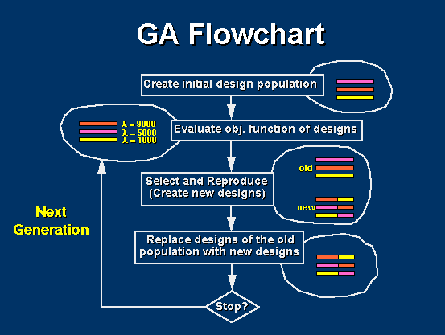
Genetic Algorithm

Slide 6
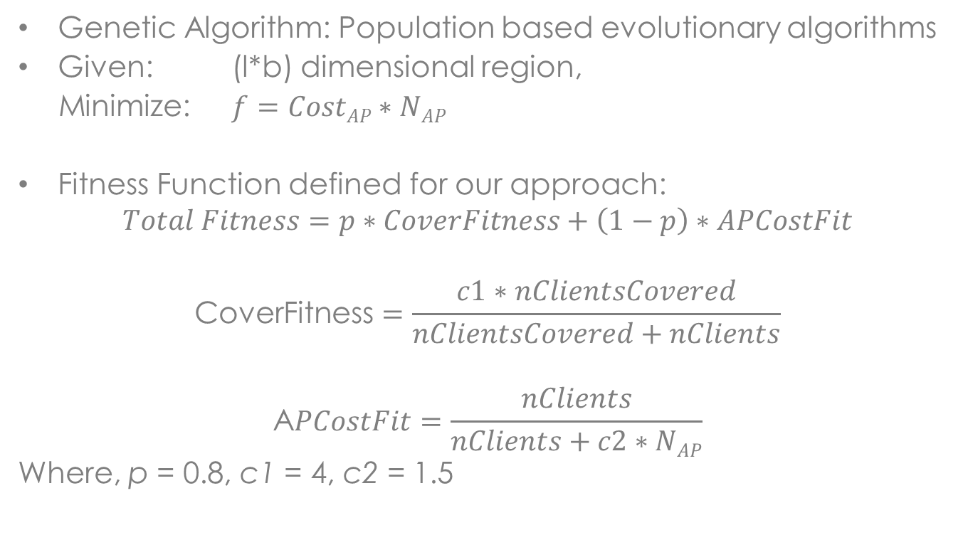
Method
Genetic Algorithm: Population based evolutionary algorithms
Given: (l*b) dimensional region,
Minimize: $f=CostAP∗NAP$
Fitness Function defined for our approach:
$$Total Fitness=p∗CoverFitness+\left(1−p\right)∗APCostFit$$
$$\text{CoverFitness}=\frac{c1∗nClientsCovered}{nClientsCovered+nClients}$$
$$\text{A}PCostFit=\frac{nClients}{nClients+c2∗NAP}$$
Where, p = 0.8, c1 = 4, c2 = 1.5

Slide 7
Explanation for choosing Genetic Algorithms
Provides approximate solutions to computationally expensive problems.
Population based evolutionary algorithms are more desirable if the cost saving from global optimality is important, as computing power is cheap today.
Have been employed successfully for Non-linear optimization problems and Variable length search problems.

Slide 8
Demo using LEDA software

Slide 9
Parameters
Parameter Name | Parameter Value
Building Dimensions | 477 * 176
Number of Clients | 150
Coverage Radius | 22 feet
Population Size | 100
Number of Generations | 100

Slide 10

Demo using first equation only
$$Total Fitness=CoverFitness$$

Slide 11
Parameters
Parameter Name | Real Building (Ford Hall) [in feet] | Image (Heat Map – Ford Hall) [in pixels]
Area | 84365 | 535200
Length | 477 | 1200
Breadth | 176 | 446
Coverage Radius | 22 | 56
Coverage Area | 1500 | 9852

Slide 12
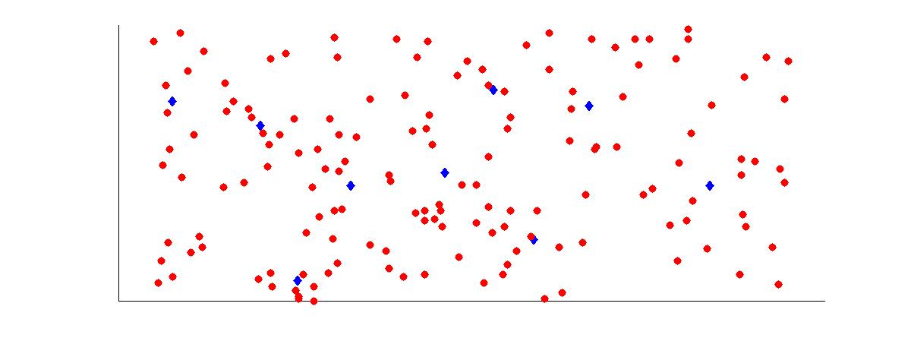
Access Point and Client Distribution

Slide 13
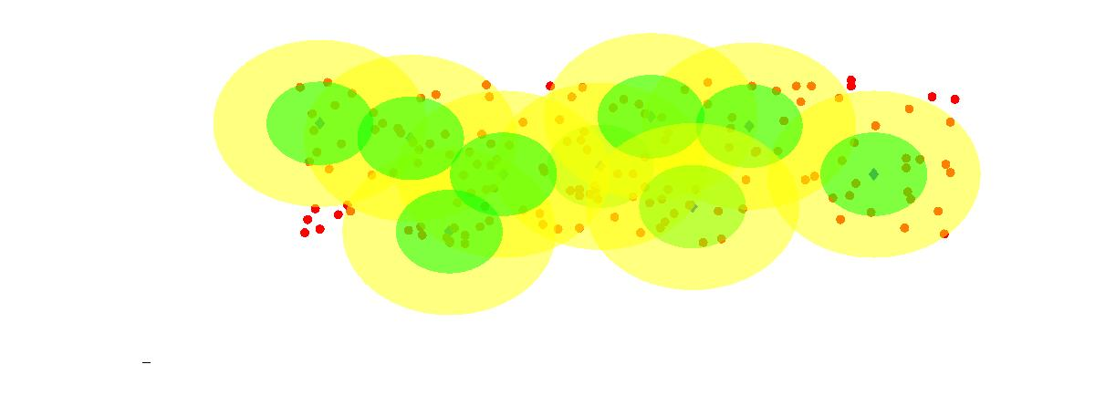
Coverage Map

Slide 14
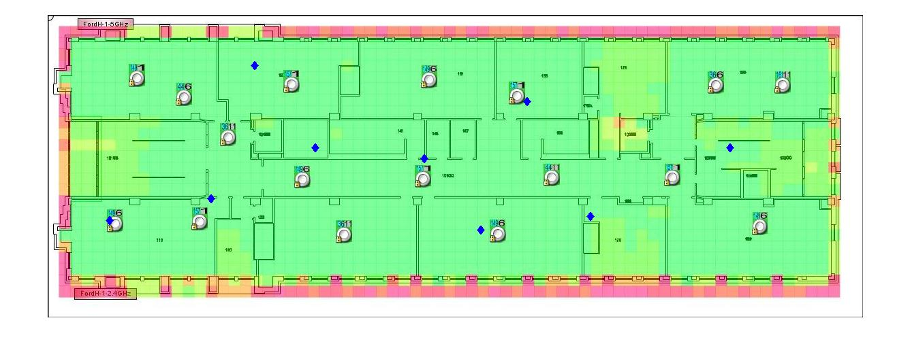
Access Points Distribution (Original v/s Proposed)

Slide 15
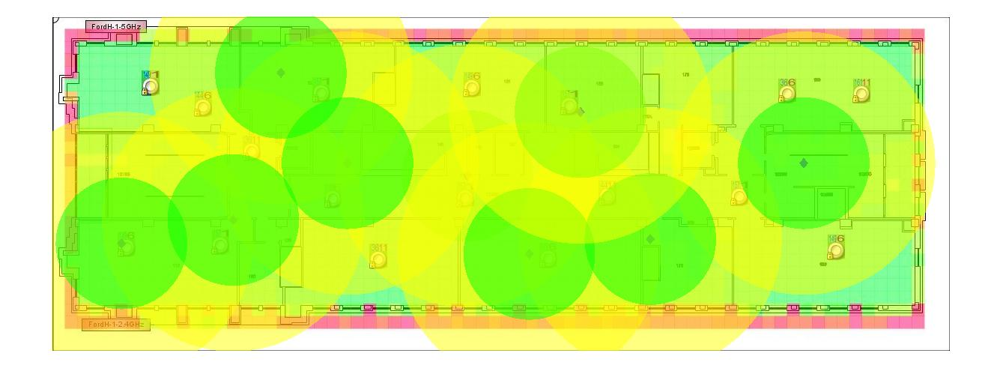
Heat Map Comparison

Slide 16
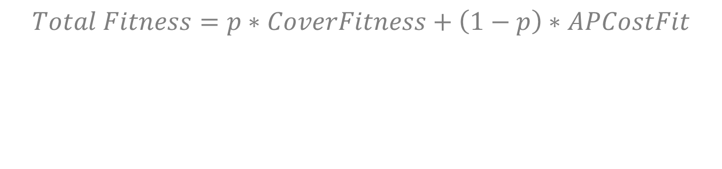
Demo using both equations
$$Total Fitness=p∗CoverFitness+\left(1−p\right)∗APCostFit$$

Slide 17
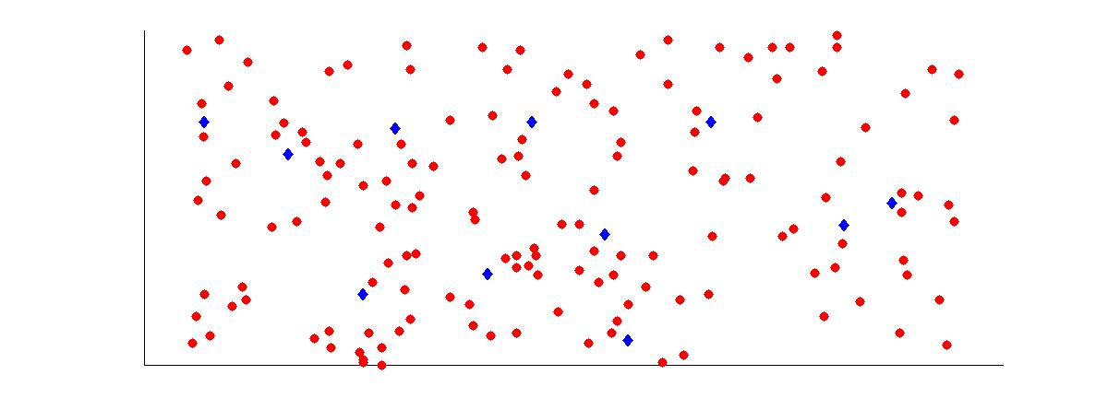

Slide 18
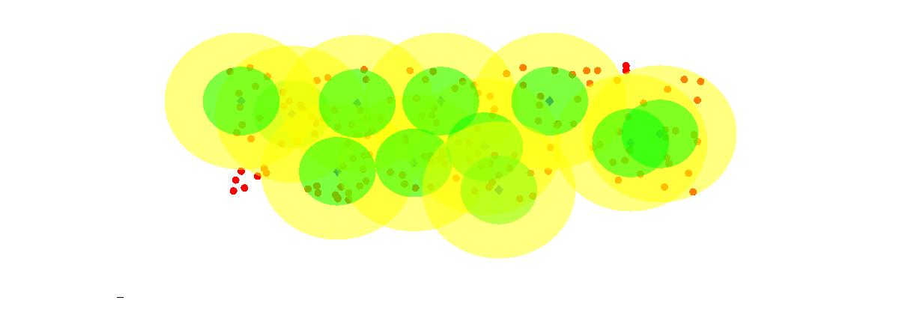

Slide 19
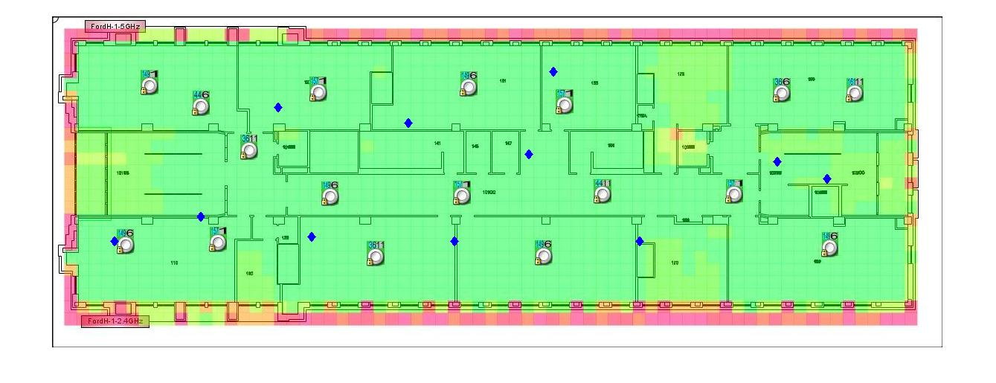

Slide 20
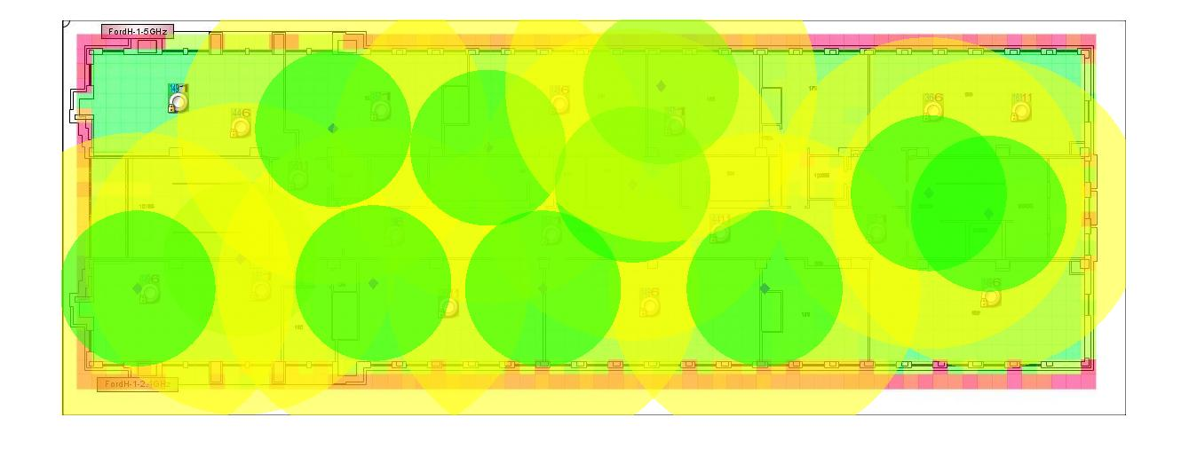

Slide 21
Results Comparison
 | Original | Using Equation1 | Using Both Equations
Dimension of Image | 446*1200 | 446*1200 | 446*1200
White region (%) | 14.34 | 14.34 | 14.34
Region Considered (%) | 85.66 | 85.66 | 85.66
Green region (%) | 68.50 | 24.91 | 27.17
Yellow region (%) | - | 38.45 | 36.14
Total region covered (%) | 68.50 | 63.36 | 63.31

Slide 22
Thank You
Any Questions?

